Slide 1

Leveraging Technology and AI to Drive Sales Outcomes
Noah Zandan, CEO and Co-Founder, Quantified.ai

Slide 2
The game has changed for sales reps. Shrinking HCP access, complex launches, and rising pressure demand new approaches.
Quote from the field: "We're launching faster, training faster—and the field's still not ready."

Slide 3

The Old Model is Broken
66%
35%
Launches Underperform
Sales Rep Turnover
Most product launches fail to meet expectations.
High turnover creates constant training needs.
36%
?
HCP Access Decline
Reach and Frequency
Access has dropped significantly since 2008.
Have been tapped out

Slide 4

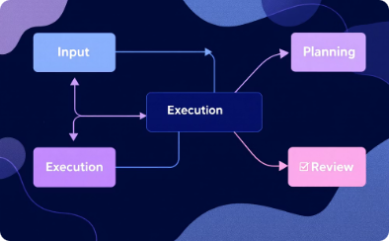
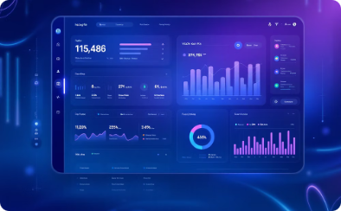

How do we fix it?
People
Process
Technology
AI
Empowering skilled individuals
Streamlining workflows for efficiency
Leveraging tools for innovation
Automating tasks and insights

Slide 5




Traditional Training Limitations
Classroom vs. Reality Mismatch
Slow Certification Process
Reps train in classrooms but sell in complex environments.
Traditional certification is resource-heavy and inefficient.
Inconsistent Coaching
Can't Scale Globally
Limited by manager bandwidth and availability.
Language barriers, cultural differences, time.

Slide 6






AI Role Play: The Field Readiness Accelerator
Messaging Mastery
Compliant, Perfect pitch delivery
Objection Handling
Confident responses under pressure
Value Communication
Clinical & patient outcomes articulation

Slide 7




From Knowledge to Fluency
Ongoing Practice
Reps get consistent simulation opportunities.
Instant Feedback
Real-time coaching after every session.
Muscle Memory
Building confidence through repetition.
Case Study: Novartis saw 25% improvement in selling skills. Reps who engaged with AI simulator were 26% more likely to make President's Club.

Slide 8




From Onboarding Bottlenecks to Competitive Advantage
Traditional: 5 Weeks
Slow, manager-dependent process.
AI Role Play: Less than 2 weeks
59% faster onboarding.
Results: 95% Pass Rate
It shouldn't be 100%
Case Study: Sanofi certified 80% of reps within 48 hours, saving 250+ hours of manager time.

Slide 9

From Guesswork to Precision Coaching
Skill Gap Mapping
Readiness Dashboards
AI identifies specific areas for improvement across teams.
Managers see real-time performance metrics.
Targeted Coaching
Focus on highest-impact development areas.
Case Study: Bayer understood across 500 reps, based on 5,000 simulations in 10 days, the 3 competency gaps for a key product launch.

Slide 10
Common Pitfalls & How to Avoid Them
Data Security
Overpromises
Always ask vendors if they train their AI models on your data. Many companies won't disclose this, but it's crucial for protecting sensitive information.
Don't get swayed by exaggerated claims. Request a trial period to test the AI tool's capabilities and ensure it aligns with your needs.
Lack of User Adoption
Overreliance on AI
Ensure the AI tool integrates seamlessly with your existing workflows to facilitate user adoption and avoid resistance.
Don't let AI replace the human element in sales. Continue building relationships, fostering trust, and offering personalized service.

Slide 11

Sales Outcomes
Organizations that use AI role play and institute a culture of practice and coaching see a 21% increase in good selling outcomes.
"This is the biggest no-brainer I've seen in my career." – Head of Sales Training, Global Pharma

Slide 12

Thank you
Open for questions about AI, challenges, or next steps.
Share your experiences and lessons learned.
Want to talk more? noah@quantified.ai
Further Research
  One Useful Thing by Ethan Mollick
  Co-Intelligence by Ethan Mollick
  Superagency by Reid Hoffman

