Slide 1
EXPIERIENCES WITH COLLECTING DB2 Z/OS SECURITY EVENTS
Gdansk 2-3 June 2026
How simple it is to accomplish with enterprise solutions
Oleg Dayneko
System DBA

Slide 2
Agenda
Agenda
  Introduction.
  About IBM zSecure Carla
      On how to collect and transfer events via batch task
      On how to collect and transfer events directly to SIEM
      z/OS, CARLa settings for SIEM
      DB2 settings for SIEM
      Result of output in LEEF format
  About self-developed methods to get security events
      General schema on how to extract security events
      On how to get and process z/OS,RACF,FTP,TN3270 security events
      On how to get and process DB2 security events
  Conclusion

Slide 3
Introduction: z/OS SECURITY PRODUCTS FOR SIEM.
IBM Security zSecure components:
BROADCOM Mainframe Security Suite:
Admin
Audit(RACF,ACD2,TopSecret)
Alert(RACF,ACF2)
Visual
Adapters for SIEM(RACF,ACF2,TopSecret)
READ FROM:
z/OS SMF STREAMS
TRANSFER TO:
SIEM
Multi-factor Authentication
Auditor for z/OS
Cleanup
Compliance Event Manager
Trusted Access Manager for Z
Mainframe Security Insights Platform
CorreLog:
BMC AMI:
SIEM Agent for IBM z/OS
Visualizer for IBM z/OS
SIEM Correlation Server
Datastream
Command Center for Security
Resident Security Server
This Enterprise security products(highlighted in red) collect z/OS,RACF,DB2 etc. security events from SMF logstreams, process and transmit data via standard protocols (such as TCP/UDP Syslog, HTTP, or MQTT) in a format the SIEM such as JSON,CEF or LEEF.

Slide 4
  About IBM zSecure Carla: on how to collect and transfer events via batch task
z/OS
The CKQLEEF procedure is launched every 5 minutes.
1
STEP1:CARLA
STEP2:USER_APPLICATION
SMF
SIEM
Specific vendor
ZOS.txt
DB2.txt
4
Protocol:FTP
Format:CSV
or other
OMVS
3
2
/audit
ZOS.zip
RACF.zip
DB2.zip
Every 5 minutes z/OS submits JCL batch job to get data from SMF stream(1) and processes them according to CARLA rules.
After which CARLA creates ZOS.zip, RACF.zip, DB2.zip in LEEF format(2) in USS.
In step 2 JCL executes a specific user application which processes data(3) according to certain rules and sends files to all SIEM systems via FTP(4).
Notes:
Monitoring has 2 modules: backend and frontend.
Frontend is developed as a web-based application.
Brief algorithm of monitoring operation: The source of information is SMF LOG STREAMS, which are fill up thanks to the work of activated STAT&ACCT traces and IFCIDs in DB2 (stream 1). Then IBM Omegamone for DB2 processes SMF LOG STREAMS (stream 2) and uploads to the PDB database (stream 3). Next night, the BACK-END application is launched, takes data from the PDB (stream 5) as well as additional data by executing STATEMENTS and DB2 COMMANDS (stream 4), aggregates them and writes to the archive database on Linux. Then the DB2 administrators enter the web-application (stream 8) and build various charts. The source of information for the web-application is the archive database (stream 7).
Information for the web application is available during the previous day. There are 297 charts in total.

Slide 5
  About IBM zSecure Carla: on how to collect and transfer events directly to SIEM
z/OS
SMF
JCL procedure works permanently
SIEM
Specific vendor
STEP1:CARLA
1
2
Protocol:SYSLOG
Format:LEEF
The best way is to read the SMF records from memory. In this case JCL procedure works permanently and reads SMF data from memory near real-time(1) and processes data according to CARLA language. In CARLA sends data via SYSLOG protocol(2) in format CEE/LEEF.
Notes:
Monitoring has 2 modules: backend and frontend.
Frontend is developed as a web-based application.
Brief algorithm of monitoring operation: The source of information is SMF LOG STREAMS, which are fill up thanks to the work of activated STAT&ACCT traces and IFCIDs in DB2 (stream 1). Then IBM Omegamone for DB2 processes SMF LOG STREAMS (stream 2) and uploads to the PDB database (stream 3). Next night, the BACK-END application is launched, takes data from the PDB (stream 5) as well as additional data by executing STATEMENTS and DB2 COMMANDS (stream 4), aggregates them and writes to the archive database on Linux. Then the DB2 administrators enter the web-application (stream 8) and build various charts. The source of information for the web-application is the archive database (stream 7).
Information for the web application is available during the previous day. There are 297 charts in total.

Slide 6
  About IBM zSecure Carla:z/OS,CARLA settings for SIEM.
Enabling General TCP/IP Connection Events:
Enabling RACF Activity Records:
For SMF119 **.TCPPARMS(PROFILE) :
...
SMFCONFIG
TYPE119 TCPINIT TCPTERM FTPCLIENT TN3270CLIENT TCPIPSTATISTICS IFSTATISTICS PORTSTATISTICS TCPSTACK UDPTERM IPSECURITY
...
//MYJOB1 JOB
//STEP1 EXEC PGM=IKJEFT01
//SYSPRINT DD SYSOUT=*
//SYSTSPRT DD SYSOUT=*
//SYSTSIN DD DATA,DLM=@@
SETROPTS AUDIT(USER GROUP DATASET DASDVOL)
SETROPTS SAUDIT
SETROPTS CMDVIOL
SETROPTS OPERAUDIT
SETROPTS LOGOPTIONS(ALWAYS(RACF_CLASS1 RACF_CLASS2))
SETROPTS LOGOPTIONS(FAILURES(RACF_CLASS1 RACF_CLASS2))
ALTDSD 'DATASET_NAMES' AUDIT(SUCCESSES(READ) FAILURES(ALTER))
ALTGROUP RACF_GROUP_NAME AUDIT(ALL)
RALTER APPL TSO* GLOBALAUDIT(ALL)
SETROPTS CLASSACT(APPL) RACLIST(APPL)
ALTUSER USER1 UAUDIT
@@
1
SMF
1
Enabling FTP Server Activity Records:
1
SYS1.PROCLIB(FTPD)
**.TCPPARMS(FTPSDATA,FTPWDATA):
...
SMF TYPE119
...
2
1
Enabling filters in CARLA to read SMF types-subtypes:
Enabling Telnet Client Activity Records:
SIEM
How to read DB2 type 102 with subtypes:
Correct **.SCKRCARL(CKQLEEF)
...
Define LEEF('LEEF:1.0!IBM!DB2!2.5!',hb,22) true
select likelist=SMFSEL type=102(4,5,6,7,8,9,10,22,23,24,25,55,83,87,
90,107,140,141,142,143,144,145,169,177,219,220,258,270,314,319)
...
The standard SMF records for SIEM described here:
https://www.ibm.com/docs/en/szs/2.5.0?topic=process-generating-smf-records
...
TelnetGlobals
SMFINIT TYPE119
SMFTERM TYPE119
EndTelnetGlobals
...
3
Notes:
Monitoring has 2 modules: backend and frontend.
Frontend is developed as a web-based application.
Brief algorithm of monitoring operation: The source of information is SMF LOG STREAMS, which are fill up thanks to the work of activated STAT&ACCT traces and IFCIDs in DB2 (stream 1). Then IBM Omegamone for DB2 processes SMF LOG STREAMS (stream 2) and uploads to the PDB database (stream 3). Next night, the BACK-END application is launched, takes data from the PDB (stream 5) as well as additional data by executing STATEMENTS and DB2 COMMANDS (stream 4), aggregates them and writes to the archive database on Linux. Then the DB2 administrators enter the web-application (stream 8) and build various charts. The source of information for the web-application is the archive database (stream 7).
Information for the web application is available during the previous day. There are 297 charts in total.

Slide 7
  About IBM zSecure Carla:DB2 settings for SIEM.
How to enable necessary DB2 TRACES,CLASSES,IFCIDS:
1.Find specific IFCIDS (usually from www.ibm.com)
which catch db2 security events such as GRANT,REVOKE,DDL,DML etc.
2.Create tables from DSNC10.SDSNIVPD(DSNWMSGS)
and load db2 traces information.
3.Find db2 specific traces types, classes, IFCIDS using query:
with SEL1(A_TYPE1,A_CLASS,A_IFCID,B_DESCRIPTION,B_SEQ) as (
SELECT DISTINCT A.TYPE AS A_TYPE1,A.CLASS as A_CLASS, A.IFCID AS A_IFCID,B.DESCRIPTION as B_DESCRIPTION,B.SEQ AS B_SEQ
FROM
DSNAC10.TRACE_TYPES A,
DSNAC10.TRACE_DESCRIPTIONS B
WHERE A.IFCID = B.IFCID AND
A.IFCID in
(
63,83,350,22,141,140,35
)
ORDER BY A.TYPE,A.CLASS)
select * from SEL1 order by A_IFCID,B_SEQ;
4.
Start db2 traces with specific trace types, classes & IFCIDS from query above:
-STA TRACE(A) C(1) IFCID(106) D(SMF) BUFSIZE(1024)
-STA TRACE(A) C(3) IFCID(6,7,8,9) D(SMF) BUFSIZE(1024)
-STA TRACE(A) C(8) IFCID(6,7,8,9) D(SMF) BUFSIZE(1024)
-STA TRACE(AU) C(1) IFCID(140) D(SMF) BUFSIZE(1024)
-STA TRACE(AU) C(5) IFCID(144) D(SMF) BUFSIZE(1024)
-STA TRACE(AU) C(6) IFCID(145) D(SMF) BUFSIZE(1024)
-STA TRACE(AU) C(7) IFCID(55,83,87,169,319) D(SMF) BUFSIZE(1024)
-STA TRACE(AU) C(8) IFCID(23,24,25,219,220) D(SMF) BUFSIZE(1024)
-STA TRACE(AU) C(10) IFCID(270) D(SMF) BUFSIZE(1024)
DB2
How to enable DB2 objects for audit:
1
Apply the Audit for specific table:
ALTER TABLE SCHEMA.MYTABLE1 AUDIT CHANGES;
Apply the Audit Policy to Specific Objects, AuthIDs, or Roles:
CREATE AUDIT POLICY POLICY_SENSITIVE_ACCESS CATEGORIES EXECUTE STATUS BOTH CHECKING STATUS BOTH SECMAINT STATUS BOTH;
AUDIT USER MGR_USER01 USING POLICY POLICY_SENSITIVE_ACCESS;
AUDIT ROLE AUDITOR_ROLE USING POLICY POLICY_SENSITIVE_ACCESS;
AUDIT TABLE HR_SALARY_DATA USING POLICY POLICY_SENSITIVE_ACCESS;
2
1
SMF
3
DB2 audit classes description:
CARLA
Class 1: Access attempts denied due to inadequate authorization.
Class 2: Explicit GRANT and REVOKE operations.
Class 3: CREATE, ALTER, and DROP operations.
Class 4: First change of audited object.
Class 5: First read of audited object.
Class 7: Bind time information for SQL involving audited objects.
Class 8: Authorization ID changes.
Class 9: Utilities.
Class 10: Installation-defined audit record.
Class 11: Trusted context information.
4
SIEM
Notes:
Monitoring has 2 modules: backend and frontend.
Frontend is developed as a web-based application.
Brief algorithm of monitoring operation: The source of information is SMF LOG STREAMS, which are fill up thanks to the work of activated STAT&ACCT traces and IFCIDs in DB2 (stream 1). Then IBM Omegamone for DB2 processes SMF LOG STREAMS (stream 2) and uploads to the PDB database (stream 3). Next night, the BACK-END application is launched, takes data from the PDB (stream 5) as well as additional data by executing STATEMENTS and DB2 COMMANDS (stream 4), aggregates them and writes to the archive database on Linux. Then the DB2 administrators enter the web-application (stream 8) and build various charts. The source of information for the web-application is the archive database (stream 7).
Information for the web application is available during the previous day. There are 297 charts in total.

Slide 8
  About IBM zSecure Carla:Result of output in LEEF format.
CARLA collects statistics about SMF type-subtype records:
ZOS: USER starts procedure /S SMFCLEAR:
Logon to z/OS:
LEEF:1.0!IBM!z/OS!2.5!119-20!devTimeFormat=yyyy-MM-dd'T'HH:mm:ss.SSSZ devTime=2026-03-02T11:09:32.010+0300 usrName=STCUSR name=STCUSR usrPriv=special operations usrGroups=SYS1 job= src=::FFFF:XX.XX.XX.XX srcPort=50206 dst=::FFFF:XX.XX.XX.XX dstPort=XX cmd= srcBytes= dstBytes= sum=Telnet server login appl A06TSO01 LU TCP00002 client у::FFFF:XX.XX.XX.XXЕ:50206 server у::FFFF:XX.XX.XX.XXЕ:XX
RACF successful for start procedure:
LEEF:1.0!IBM!RACF!1.13!80 2.3!devTimeFormat=yyyy-MM-dd'T'HH:mm:ss.SSSZ devTime=2026-03-02T11:15:28.780+0300 usrName=DSNUSER1 name=NONAME1 usrPriv= usrGroups= ICTXname= ICTXreg= job=EX10 2 Mar 2026 11:09:36.01 DSNUSER1 intent=UPDATE allow=NONE class=OPERCMDS prof=MVS.START.STC.** res=MVS.START.STC.SMFCLEAR vol= dsn= sens= own= box= terminal= poe= LU TCP00002 logstr=S SMFCLEAR auth=Normal desc=Warning appl= sum=RACF ACCESS warning for DSNUSER1: (UPDATE,NONE) on OPERCMDS MVS.START.STC.SMFCLEAR cmd=
z/OS start procedure:
LEEF:1.0!IBM!z/OS!1.13!30-1!devTimeFormat=yyyy-MM-dd'T'HH:mm:ss.SSSZ devTime=2026-03-02T11:16:15.120+0300 usrName=STCUSR name=STCUSR usrPriv=special operations usrGroups=SYS1 job=EX10 2 Mar 2026 11:16:15.04 SMFCLEAR jobid=STC04535 terminal= program= sum=Start of job SMFCLEAR (STC04535) for user STCUSR
Typ SubTp Count
102 89 ! 548
102 95 ! 185
102 96 ! 185
102 105 ! 8
102 106 ! 2
102 107 ! 3
102 112 ! 3
102 119 ! 4
102 120 ! 4
102 127 ! 98
102 128 ! 98
102 177 ! 1028
102 233 ! 1456
102 350 ! 1109
119 1 ! 25
2 ! 25
The most important security events for z/OS which are caught by CARLA:
1.start/stop z/OS.
2.start/stop procedures & jcls.
3.succesfull & unsuccessful authorizations.
4.All activity users from group:SYS1 and/or SPECIAL_OPERATIONS
5. Fail or cancel user jcls & procedures
6. Actions to manage TIMER TASKS.
7. Network anomalies and use new ports ,new ip
ZOS: TCP socket opened successfully:
LEEF:1.0!IBM!z/OS!2.5!119-1!devTimeFormat=yyyy-MM-dd'T'HH:mm:ss.SSSZ devTime=2026-03-07T12:40:48.490+0300 usrName=… name= usrPriv= usrGroups= job=EX10 src=::FFFF:XX.XX.XX.1 srcPort=XXXX1 dst=::FFFF: XX.XX.XX.2 dstPort= XXXX2 cipher= FIPS140= TLSproto= srcBytes= dstBytes= srcPackets= dstPackets= sum=TCP socket open MYAPPL1 remote у::FFFF:XX.XX.XX.1Е:XXX1 local у::FFFF:XX.XX.XX.2Е:XXX2
The most important security events for DB2 which caught by CARLA:
DB2: Connection from remote db2 client failed:
LEEF:1.0!IBM!DB2!2.5!102-83!devTimeFormat=yyyy-MM-dd'T'HH:mm:ss.SSSZ devTime=2026-03-09T10:30:39.550+0300 usrName= name= usrPriv= usrGroups= src= subsys=DSN1 dsn= plan= objtyp= obj= intent= SQLid= poe= submitby= job=EX10 DSN1 cmd= checkid= conn=DSN1 location DSN1 LU GAXXXXXX.CXXX connector DISCN-NC 028.DBAA 05 from ::XX.XX.XX.XX AED product SQL10053 sum=DB2 DSN1 from ::XX.XX.XX.XX AED Identify DIST failed by SAF RC=12 reason=00F30085x user , originator DSNUSER1
1.successful & unsuccessful authorizations.
2.DB2 SQL statements like: grand,revoke,select,create,alter,drop,truncate, rename,insert,update,delete,call,lock.
Notes:
Monitoring has 2 modules: backend and frontend.
Frontend is developed as a web-based application.
Brief algorithm of monitoring operation: The source of information is SMF LOG STREAMS, which are fill up thanks to the work of activated STAT&ACCT traces and IFCIDs in DB2 (stream 1). Then IBM Omegamone for DB2 processes SMF LOG STREAMS (stream 2) and uploads to the PDB database (stream 3). Next night, the BACK-END application is launched, takes data from the PDB (stream 5) as well as additional data by executing STATEMENTS and DB2 COMMANDS (stream 4), aggregates them and writes to the archive database on Linux. Then the DB2 administrators enter the web-application (stream 8) and build various charts. The source of information for the web-application is the archive database (stream 7).
Information for the web application is available during the previous day. There are 297 charts in total.

Slide 9
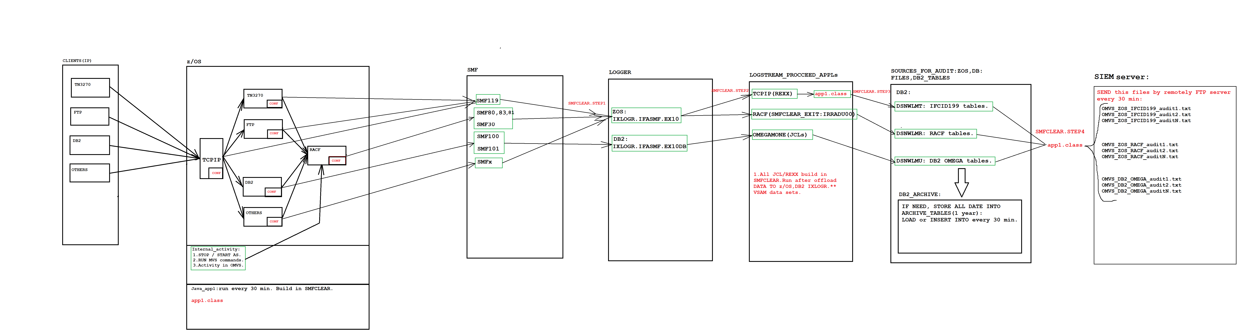
  About self-developed methods to get security events:
  General schema on how to extract security events.
This schema is overloaded, has multiple points of failure, requires more resources, and has limited functionality to process SMF records(119,80,83,81,30,100,101,102). Also it has been required DB2&OMEGAMON subsystem in the z/OS to be installed. Also, required IFASMF log streams must be available.
Notes:
Monitoring has 2 modules: backend and frontend.
Frontend is developed as a web-based application.
Brief algorithm of monitoring operation: The source of information is SMF LOG STREAMS, which are fill up thanks to the work of activated STAT&ACCT traces and IFCIDs in DB2 (stream 1). Then IBM Omegamone for DB2 processes SMF LOG STREAMS (stream 2) and uploads to the PDB database (stream 3). Next night, the BACK-END application is launched, takes data from the PDB (stream 5) as well as additional data by executing STATEMENTS and DB2 COMMANDS (stream 4), aggregates them and writes to the archive database on Linux. Then the DB2 administrators enter the web-application (stream 8) and build various charts. The source of information for the web-application is the archive database (stream 7).
Information for the web application is available during the previous day. There are 297 charts in total.

Slide 10
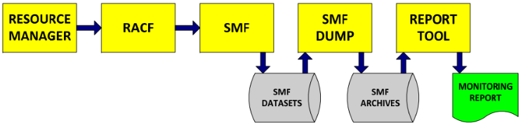
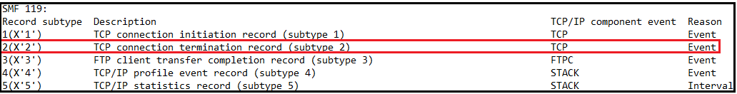
  About self-developed methods to get security events:
  On how to get and process z/OS,RACF,FTP,TN3270 security events
1.Like in CARLa, first you must setup needed parameters, settings in z/OS,RACF,FTP,TN3270. In addition, for RACF to include exits IRRADU00,IRRADU86.
2.Create DB2 tables for RACF security events.
3.Write applications,JCL,REXX scripts which read data from SMF Logstreams directly or via different datasets, which created after sorts like this:
Prepare SORTSMFX.DATA2.V1 for SMF 119 sub 2():
RACF SMF stream for monitoring:
//STEP1 EXEC PGM=ICETOOL
//DFSMSG DD SYSOUT=*
//RAWSMF DD DSN=SORTSMFX.DATA.G0121V00,DISP=SHR
//CONSMF DD DSN=SORTSMFX.DATA2.V1,DISP=(NEW,PASS),
// DCB=(RECFM=VB,LRECL=32756,BLKSIZE=0),UNIT=SYSDA,
// SPACE=(CYL,(10,10),RLSE)
//CON1CNTL DD *
OPTION DYNALLOC,VLSHRT,SPANINC=RC4
INCLUDE COND=(6,1,BI,EQ,119,AND,23,2,BI,EQ,2)
SORT FIELDS=(11,4,PD,A,7,4,BI,A)
/*
//TOOLMSG DD SYSOUT=*
//REPORT DD SYSOUT=*
//TOOLIN DD *
SORT FROM(RAWSMF) TO(CONSMF) USING(CON1)
/*
1.Only SORTSMFX.DATA2.V1 you could be able to use for further REXX processing
2.Need to create many JCL steps for different SMF types, subtypes.
SMF 119 subtype descriptions:
Notes:
Monitoring has 2 modules: backend and frontend.
Frontend is developed as a web-based application.
Brief algorithm of monitoring operation: The source of information is SMF LOG STREAMS, which are fill up thanks to the work of activated STAT&ACCT traces and IFCIDs in DB2 (stream 1). Then IBM Omegamone for DB2 processes SMF LOG STREAMS (stream 2) and uploads to the PDB database (stream 3). Next night, the BACK-END application is launched, takes data from the PDB (stream 5) as well as additional data by executing STATEMENTS and DB2 COMMANDS (stream 4), aggregates them and writes to the archive database on Linux. Then the DB2 administrators enter the web-application (stream 8) and build various charts. The source of information for the web-application is the archive database (stream 7).
Information for the web application is available during the previous day. There are 297 charts in total.

Slide 11
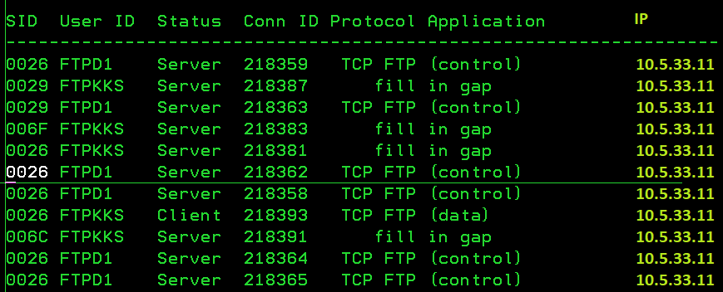
  About self-developed methods to get security events:
  On how to get and process z/OS,RACF,FTP,TN3270 security events(CONTINUE)
2.REXX1 is a part of code example:
1.Run REXX1 with input dataset SORTSMFX.DATA2.V1:
…
DO FOREVER
"EXECIO 1 DISKR SMFREC"
IF RC /= 0 THEN call End_of_file
else do
inrec = inrec + 1
PARSE PULL record
PARSE VAR record header 41 rest
SMF119HDType= c2d(substr(header,2,1)) /* Record type */
call SMFREC_header
end
End
…
PARSE var res1
off = s119S1Off -43
s119_TTRName = substr(res1,off,8) /* Socket resource name */
s119_TTConnID = c2d(substr(res1,off+8,4)) /* TCP connection id */
s119_TTTTLSCS = substr(res1,off+12,1) /* AT-TLS conn status */
s119_TTTTLSPS = substr(res1,off+13,1) /* AT-TLS policy status */
s119_TTTermCode = substr(res1,off+14,1) /* Conn Termination code */
s119_TTSMCStatus= substr(res1,off+15,1) /* SMC-R status */
s119_TTSubTask = c2d(substr(res1,off+16,4)) /* Subtask name: address */
s119_TTSTime = smf(c2d(substr(res1,off+20,4)))
s119_TTSDate = substr(c2x(substr(res1,off+24,4)),3,5) /* Connection start date */
s119_TTETime=smf(c2d(substr(res1,off+28,4))) /* Connection end time */
s119_TTEDate = , /* Connection end date */
substr(c2x(substr(res1,off+32,4)),3,5)
condate = left(Date('N',s119_TTSDate,'J'),11)
enddate = left(Date('N',s119_TTEDate,'J'),11)
start = c2d(substr(res1,off+20,4)) /* Connection start time */
endt = c2d(substr(res1,off+28,4)) /* Connection end time */
elap = cross(endt,start)
Tot_elap = Tot_elap + elap
elaps = smf(elap)
s119_TTRIP = substr(res1,off+36,16) /* Remote IPv6 */
…
//STEP1 EXEC PGM=IKJEFT01,REGION=0M,DYNAMNBR=50
//SYSEXEC DD DSN=MYLIB.JCL,DISP=SHR
//SMFREC DD DSN=SORTSMFX.DATA2.V1,DISP=(OLD,DELETE)
//SYSTSPRT DD SYSOUT=*
//SYSTSIN DD *
prof nopref
%REXX1
/*
3.Output dataset after parse SORTSMFX.DATA2.V1:
Notes:
Monitoring has 2 modules: backend and frontend.
Frontend is developed as a web-based application.
Brief algorithm of monitoring operation: The source of information is SMF LOG STREAMS, which are fill up thanks to the work of activated STAT&ACCT traces and IFCIDs in DB2 (stream 1). Then IBM Omegamone for DB2 processes SMF LOG STREAMS (stream 2) and uploads to the PDB database (stream 3). Next night, the BACK-END application is launched, takes data from the PDB (stream 5) as well as additional data by executing STATEMENTS and DB2 COMMANDS (stream 4), aggregates them and writes to the archive database on Linux. Then the DB2 administrators enter the web-application (stream 8) and build various charts. The source of information for the web-application is the archive database (stream 7).
Information for the web application is available during the previous day. There are 297 charts in total.

Slide 12
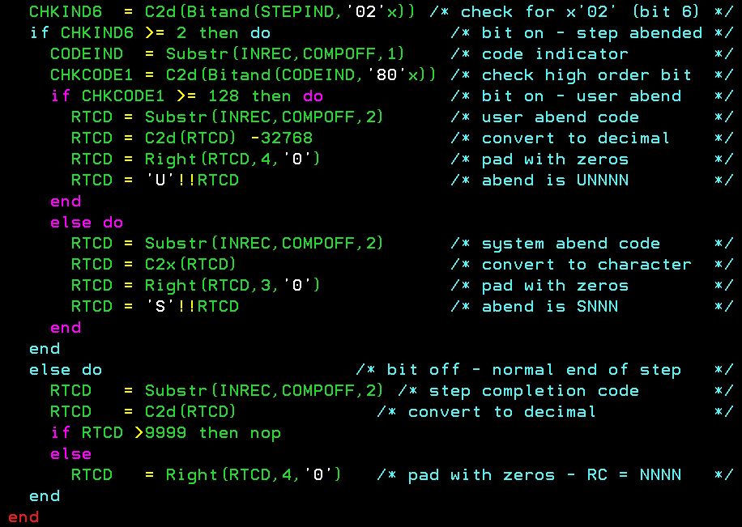
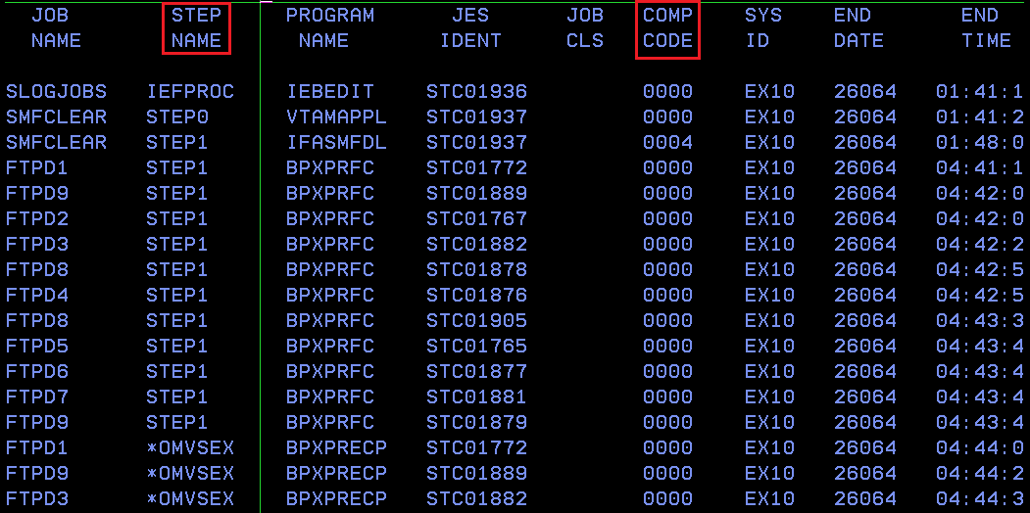
  About self-developed methods to get security events:
  On how to get and process z/OS,RACF,FTP,TN3270 security events(CONTINUE)
1.REXX2 is a part of code example(get return codes for each address space:
3.Output dataset after parse SMF DATASET:
2.Run REXX1 with input dataset SORTSMFX.SMF30.INPUT(SMF30 subtype 4 knows as Step Termination record):
//STEP1 EXEC PGM=IRXJCL,PARM=‘REXX2'
//SYSTSIN DD DUMMY
//SYSTSPRT DD SYSOUT=*
//SYSEXEC DD DSN=MYLIB.JCL,DISP=SHR
//SMF DD DSN=SORTSMFX.SMF30.INPUT,DISP=SHR
//RPT DD SYSOUT=*,
// DCB=(LRECL=133,BLKSIZE=3990,RECFM=FBA)/*
Notes:
Monitoring has 2 modules: backend and frontend.
Frontend is developed as a web-based application.
Brief algorithm of monitoring operation: The source of information is SMF LOG STREAMS, which are fill up thanks to the work of activated STAT&ACCT traces and IFCIDs in DB2 (stream 1). Then IBM Omegamone for DB2 processes SMF LOG STREAMS (stream 2) and uploads to the PDB database (stream 3). Next night, the BACK-END application is launched, takes data from the PDB (stream 5) as well as additional data by executing STATEMENTS and DB2 COMMANDS (stream 4), aggregates them and writes to the archive database on Linux. Then the DB2 administrators enter the web-application (stream 8) and build various charts. The source of information for the web-application is the archive database (stream 7).
Information for the web application is available during the previous day. There are 297 charts in total.

Slide 13
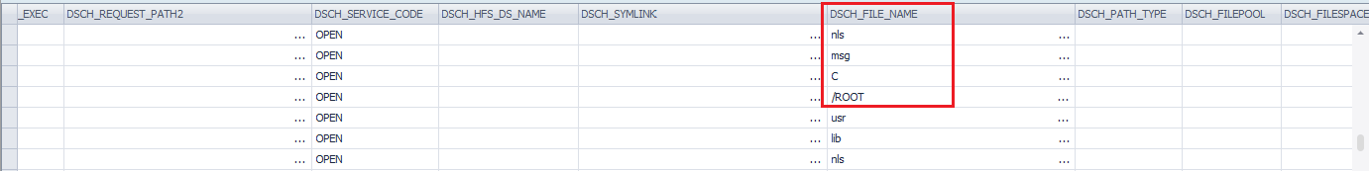
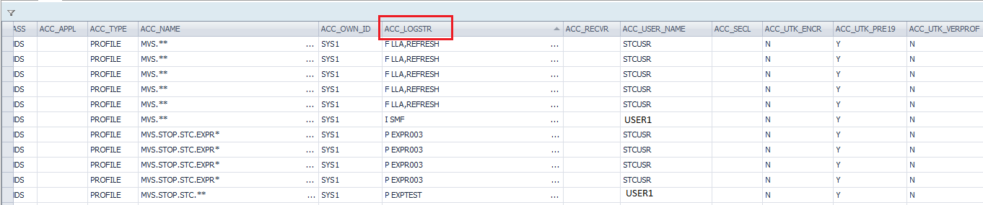
  About self-developed methods to get security events:
  On how to get and process z/OS,RACF,FTP,TN3270 security events(CONTINUE)
You are able to get data from RACF: turn on exits IRRADU00,IRRADU86, create necessary DB2 objects
from SYS1.SAMPLIB(RACDB*),create specific DB2 load job, turn on audit for specific RACF objects. In result RACF security events will be loaded in DB2 tables for further transfer into SIEM. Some examples from tables:
Who opens file/folder in USS:
Who runs F,I,P commands via MVS :
Notes:
Monitoring has 2 modules: backend and frontend.
Frontend is developed as a web-based application.
Brief algorithm of monitoring operation: The source of information is SMF LOG STREAMS, which are fill up thanks to the work of activated STAT&ACCT traces and IFCIDs in DB2 (stream 1). Then IBM Omegamone for DB2 processes SMF LOG STREAMS (stream 2) and uploads to the PDB database (stream 3). Next night, the BACK-END application is launched, takes data from the PDB (stream 5) as well as additional data by executing STATEMENTS and DB2 COMMANDS (stream 4), aggregates them and writes to the archive database on Linux. Then the DB2 administrators enter the web-application (stream 8) and build various charts. The source of information for the web-application is the archive database (stream 7).
Information for the web application is available during the previous day. There are 297 charts in total.

Slide 14
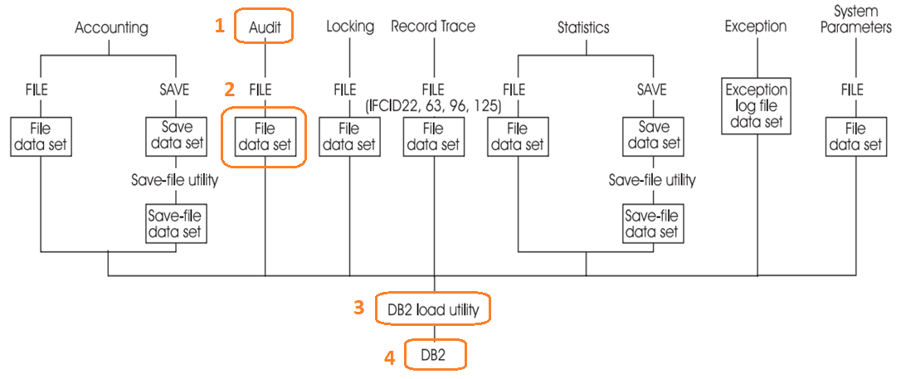
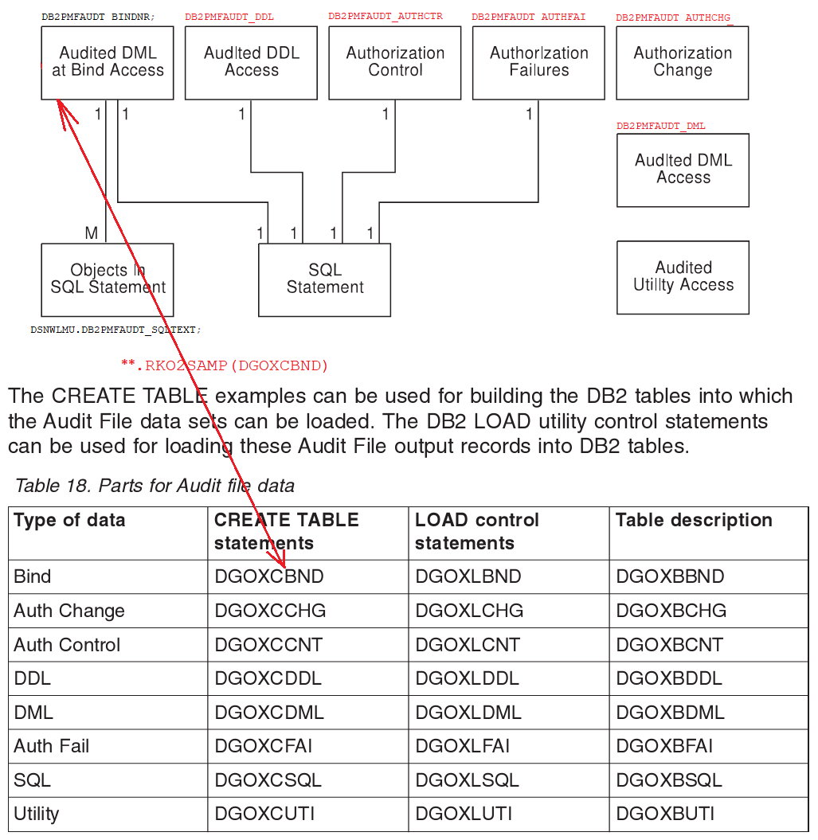
  About self-developed methods to get security events:
  On how to get and process DB2 security events
You are able to get data from DB2: such as CARLA. First, you must find and turn on specific traces types, classes, IFCIDS. Turn on audit traces for DB2 objects. Create JCL with OMEGAMONE commands to generate Audit File data set for further load into DB2 audit tables and transfer to SIEM.
1.Schema how to LOAD audit events into tables.
2.Descriptions of each audit tables.
3.How to get audit file data set:
//SYSIN DD *
…
AUDIT
TRACE
TYPE(ALL)
FILE
DDNAME(AUFILDD1)
…
Notes:
Monitoring has 2 modules: backend and frontend.
Frontend is developed as a web-based application.
Brief algorithm of monitoring operation: The source of information is SMF LOG STREAMS, which are fill up thanks to the work of activated STAT&ACCT traces and IFCIDs in DB2 (stream 1). Then IBM Omegamone for DB2 processes SMF LOG STREAMS (stream 2) and uploads to the PDB database (stream 3). Next night, the BACK-END application is launched, takes data from the PDB (stream 5) as well as additional data by executing STATEMENTS and DB2 COMMANDS (stream 4), aggregates them and writes to the archive database on Linux. Then the DB2 administrators enter the web-application (stream 8) and build various charts. The source of information for the web-application is the archive database (stream 7).
Information for the web application is available during the previous day. There are 297 charts in total.

Slide 15
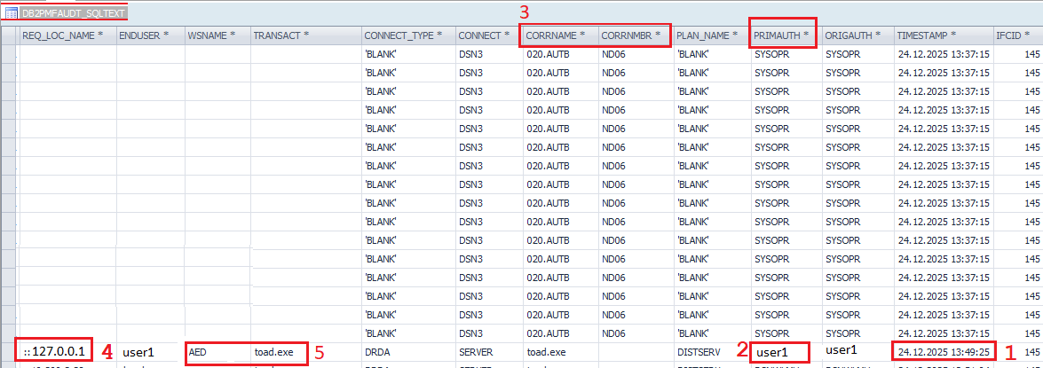
  About self-developed methods to get security events:
  On how to get and process DB2 security events(CONTINUE)
Some examples from db2 audit tables:
Notes:
Monitoring has 2 modules: backend and frontend.
Frontend is developed as a web-based application.
Brief algorithm of monitoring operation: The source of information is SMF LOG STREAMS, which are fill up thanks to the work of activated STAT&ACCT traces and IFCIDs in DB2 (stream 1). Then IBM Omegamone for DB2 processes SMF LOG STREAMS (stream 2) and uploads to the PDB database (stream 3). Next night, the BACK-END application is launched, takes data from the PDB (stream 5) as well as additional data by executing STATEMENTS and DB2 COMMANDS (stream 4), aggregates them and writes to the archive database on Linux. Then the DB2 administrators enter the web-application (stream 8) and build various charts. The source of information for the web-application is the archive database (stream 7).
Information for the web application is available during the previous day. There are 297 charts in total.

Slide 16
  Conclusion
The educational goal was to explore ways of obtaining security events using various settings in the z/OS and build JCL tasks.
As you've already realized, attempting to collect security events manually is infested with problems and unexpected surprises, requiring significant time for implementation. The end result can be a limited, poorly scalable, resource-intensive solution with numerous hidden bugs.
Tip: Choose enterprise software to transmit security events to SIEM.
Notes:
The db2mon back-end module to use STATISTICS & ACCOUNTING save-file data set & AUDIT file data set for further load into tables and data processing.

Slide 17
Thank you!
Any questions?
resumedb2zos@yahoo.com

