Slide 1
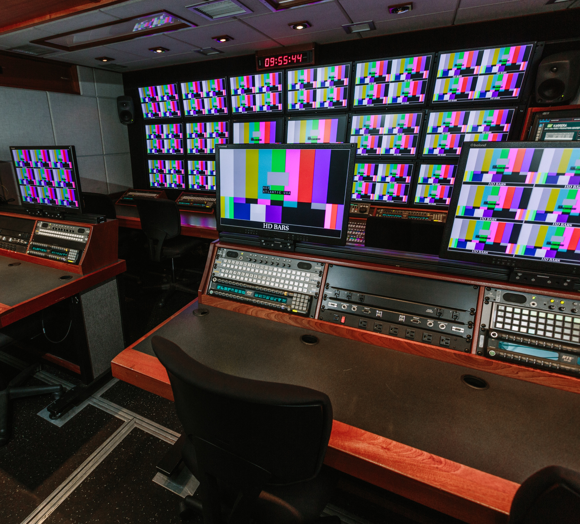

DENALI ATLANTIC
US MOBILE UNIT INFORMATION
Updated 06/01/2026
NEPGROUP.COM

Slide 2
ATLANTIC: TECHNICAL SPECIFICATIONS
1080p Capable | Single Trailer Unit
POWER REQUIREMENTS
POWER REQUIREMENTS: 208 VOLTS, 3 PHASE, 200 AMPS
PRODUCTION SWITCHER
KAYENNE K FRAME - 4 M/E
CAMERAS
10 SONY HDC2500 CAMERAS
4 SLEDS
4 HEAVY PANHEADS W/STICKS
6 LIGHTWEIGHT STICKS
1 SONY MSU-1500
LENSES
2 HARD LENSES
3 HANDHELD LENSES
8 WIDE ANGLE LENSES
RECORD/REPLAY
TRUCK IS WIRED FOR 4 EVS MACHINES
2 PRONOLOGY SCREENERS (4 CHANNELS OF H.264 RECORDS)
TRUCK WIRED FOR 12 EMBEDDED VT’S
AUDIO
CALREC ARTEMIS BEAM WITH 48 DUAL LAYER FADERS
COMMUNICATIONS
RTS ADAM INTERCOM SYSTEM – 112 PORTS
SUPPORT EQUIPMENT
Evertz EQX Router
HD video - 72 inputs x 72 outputs
MADI 19 inputs x 19 outputs
AES 192 inputs x 192 outputs
Analog audio 96 inputs x 96 outputs
3 HYDRA BOXES
20 UDX WITH COLOR CORRECTION
BASIC TRUCK COMPLIMENT OF CABLE, MICS, ETC.

Slide 3
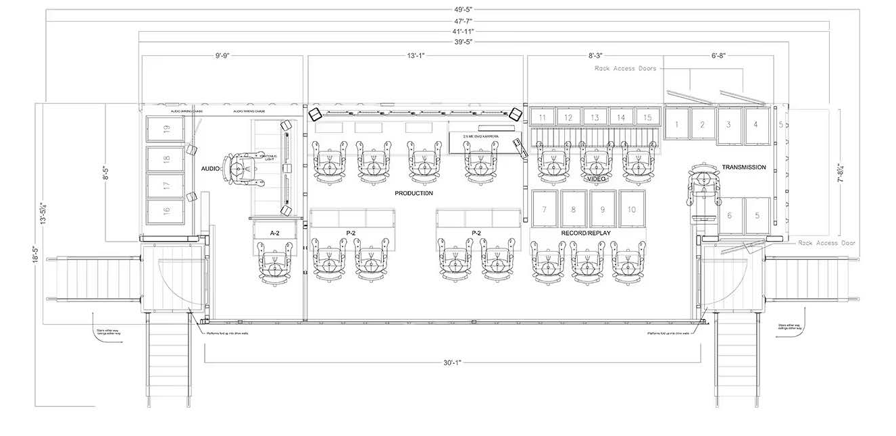
FLOORPLAN
ATLANTIC

Slide 4
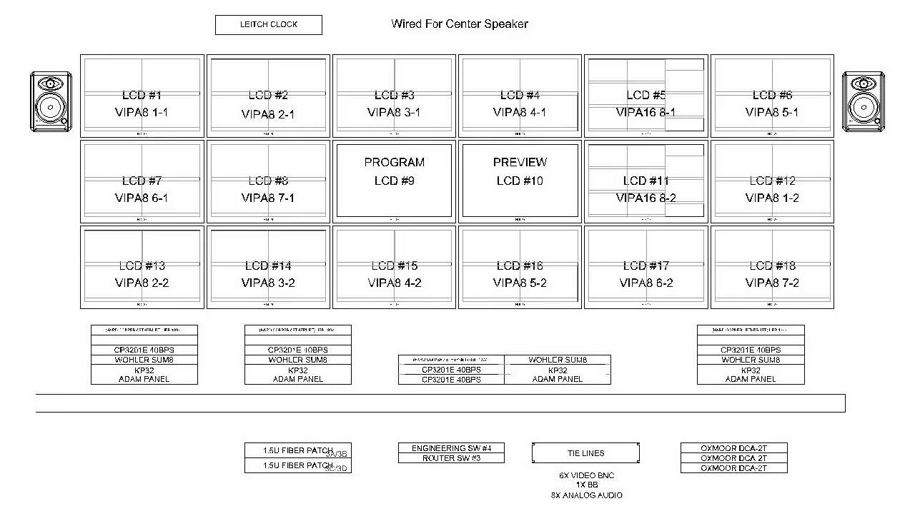
PRODUCTION MONITOR WALL
ATLANTIC

Slide 5
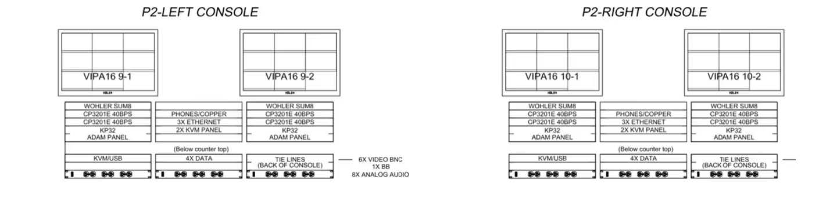
P2 MONITOR WALL
ATLANTIC

Slide 6
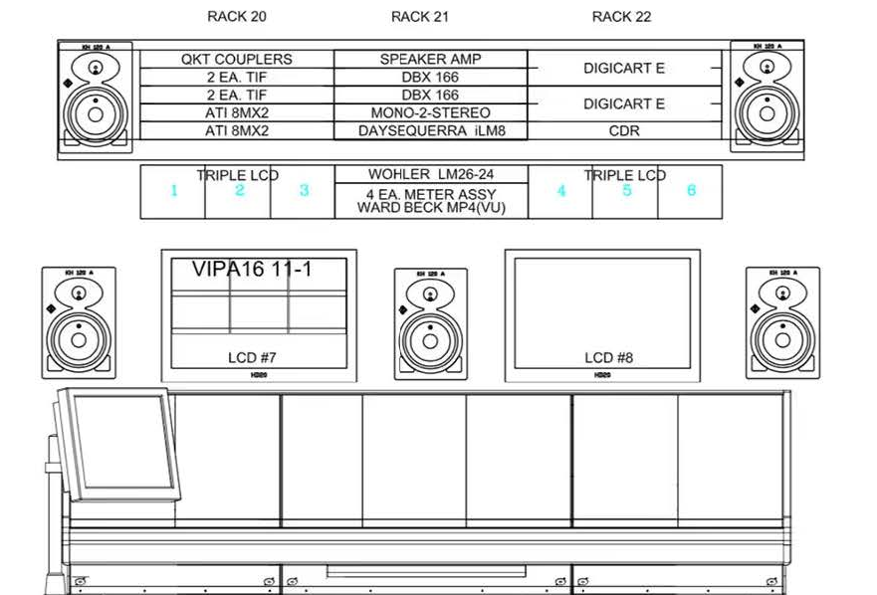
AUDIO MONITOR WALL
ATLANTIC

Slide 7
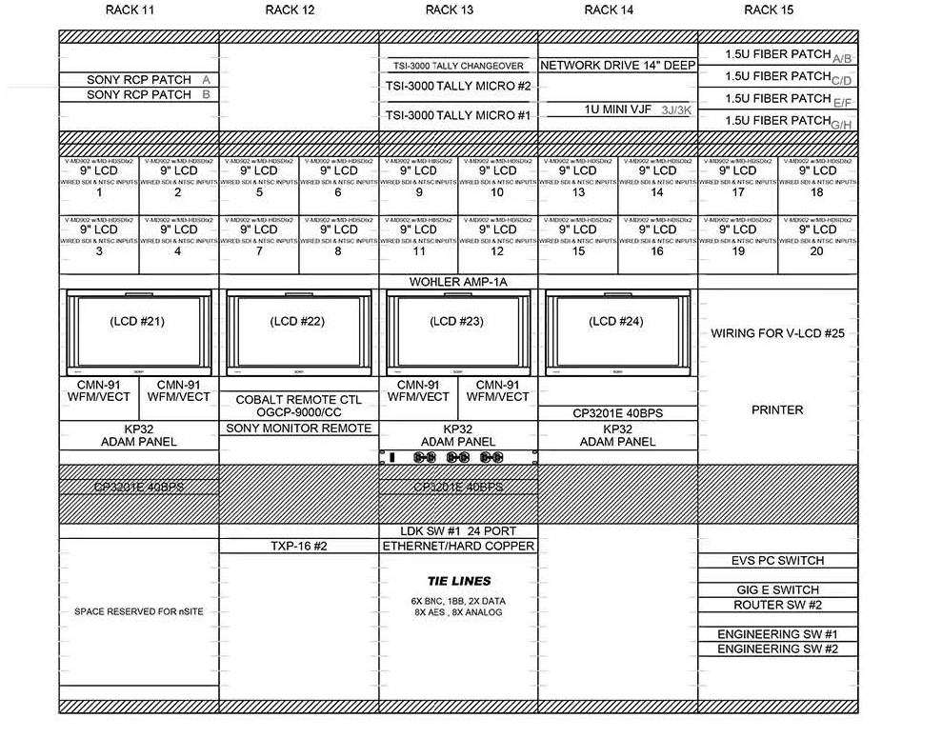
video MONITOR WALL
ATLANTIC

