Slide 1


www.getinvolved.io

Slide 2
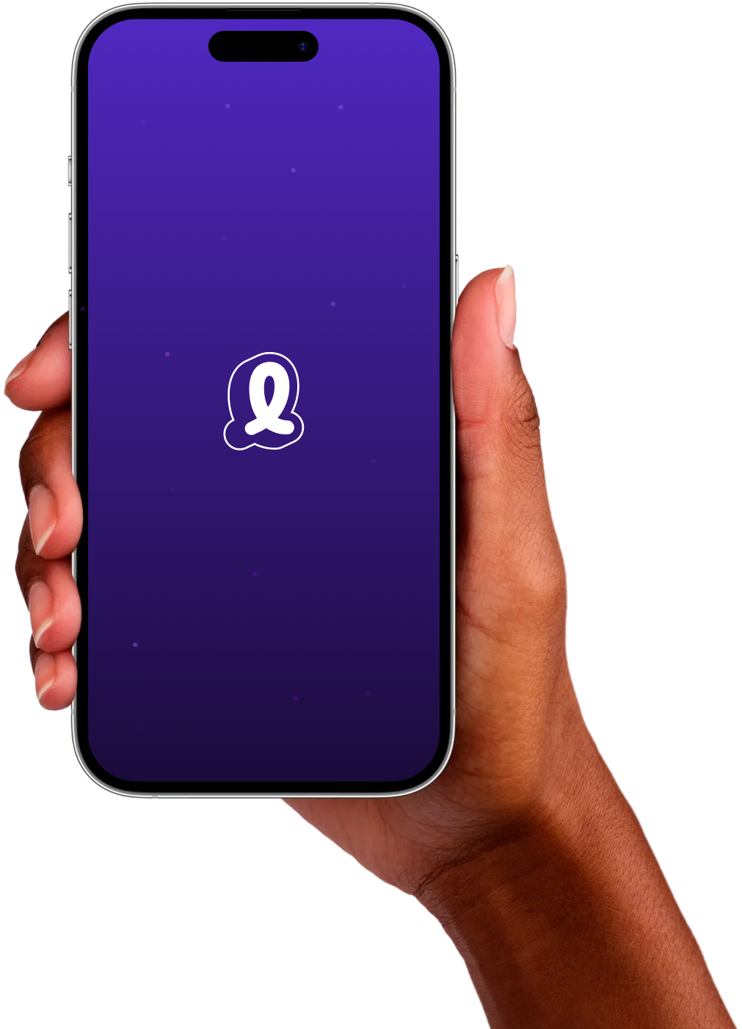

Involved
We believe in empowering every voice.
We believe there’s power in interacting and co-creating new perspectives.
With Involved it is easy for you to share your opinions, feelings, experiences, and ideas while interacting, inspiring, and identifying key insights together.
Together, we can transform ideas into impactful insights that drives positive outcomes.
That’s why you are here today!

Slide 3
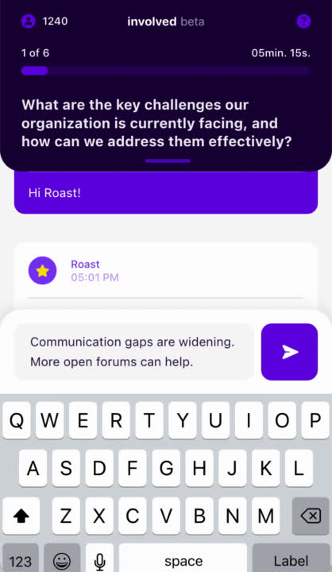

Step 1: Answer the question
Use the text box at the bottom to write your answer to the question.
Make sure you only write one point per answer.
You can write as many answers are you want.
Take your time to think.
There are no wrong or rigth answers.
Try to be as specific and detailed as you can.
www.getinvolved.io

Slide 4
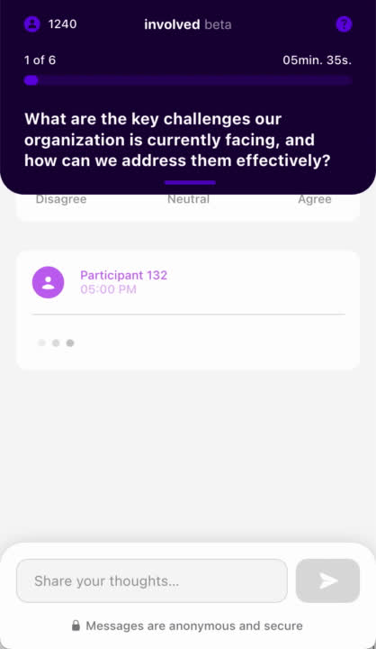
Step 2: Emoji time!
Score the messages from other participants by choosing the emoji that fits your view. The scale goes from Highly Disagree to Highly Agree.
You have to score a message to see a new message.
If you dont think the message is relevant to you, choose the neutral emoji in the middle.
It’s okay to disagree. Try to use the full scale.
www.getinvolved.io

Slide 5

How to get started on mobile or laptop:
Scan the QR code:
INSERT QR CODE TO YOUR SESSION HERE
...OR START YOUR SESSION DIRECTLY FROM THE INVOLVED PRESENTER MODE!
2. Go to the website: www.getinvolved.io
Click on the orange button that says “Join Session.”
Enter the 6-letter code you have been given!

Slide 6
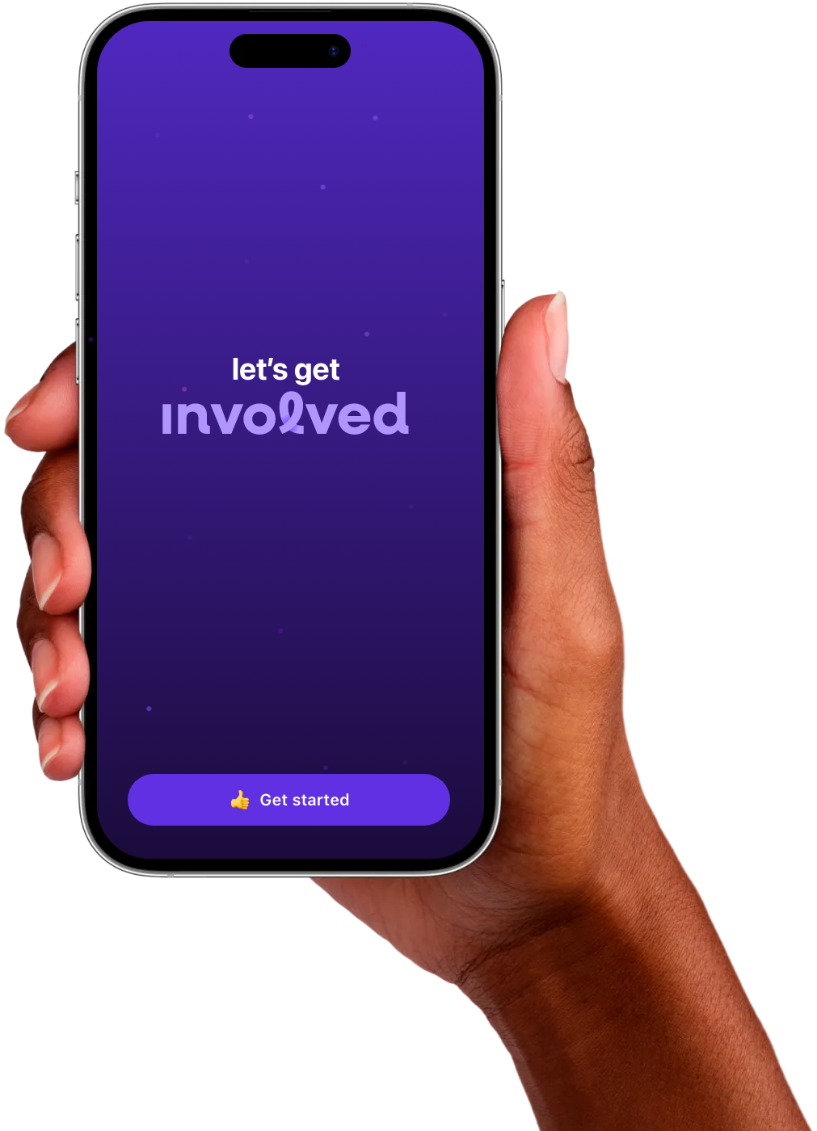
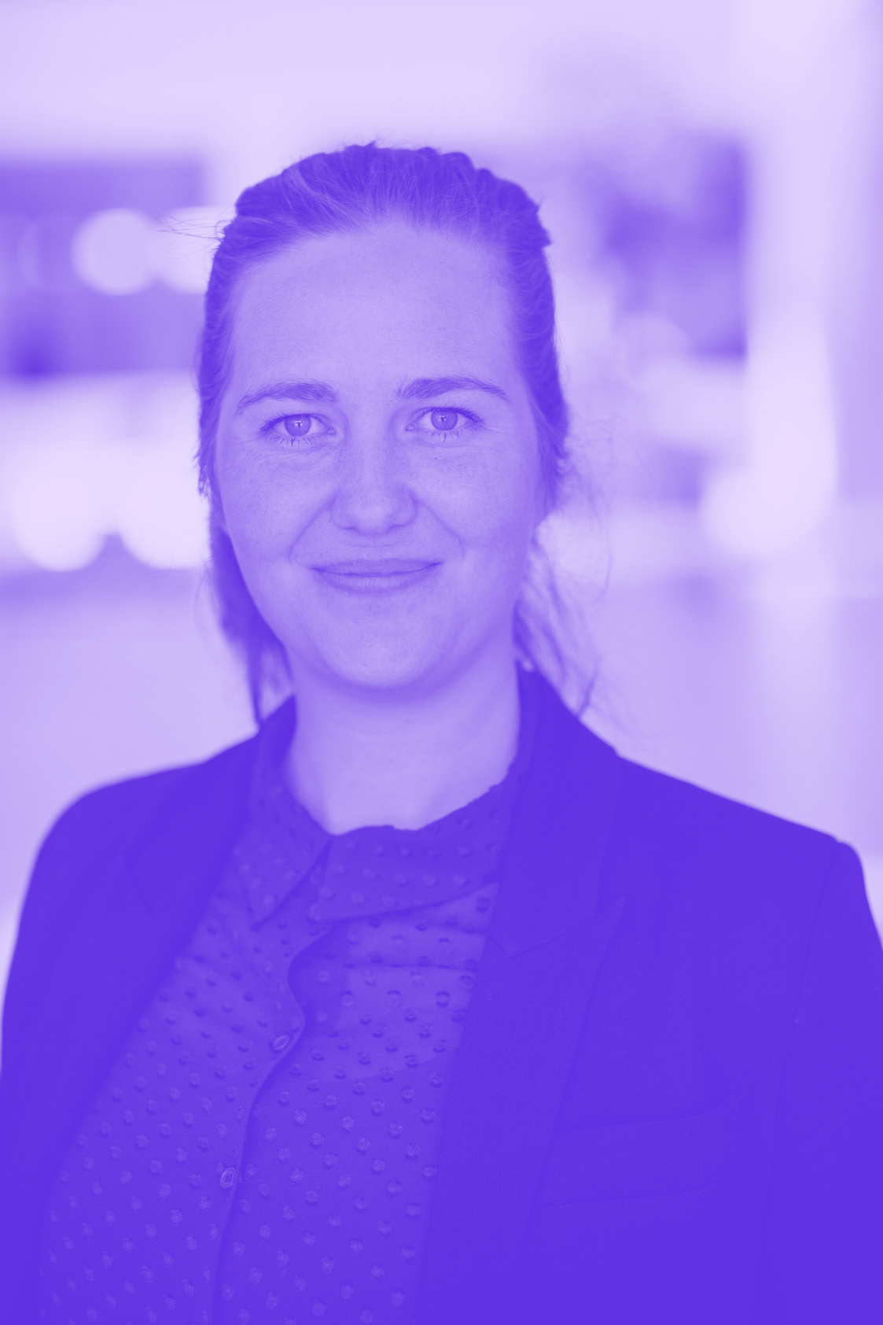
Get Involved!
Contact:
Sara Høyer Kragelund
Co-founder & CEO
sara@involved.live
+45 51578240
www.getinvolved.io

