Slide 1
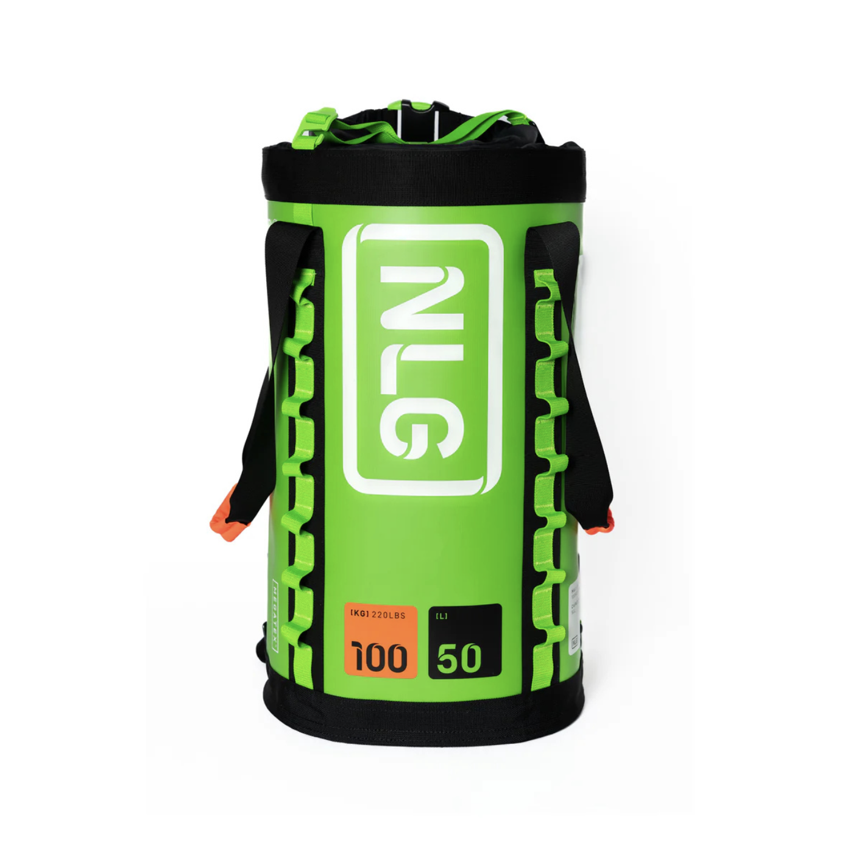
Product category: Bags
Usage: Rope Access + Rescue + Confined Spaces
Other tag: NEW
NLG
Ascent™ Carry
The NLG Ascent™ Carry solves a problem every rope access crew runs into: getting rope and tools up to height without two trips, or a dropped load along the way. Wear it as a backpack for the walk in, then tuck away the straps and waistbelt and haul it vertically using the load-rated lifting handles. Rated to carry up to 100kg, it’s built from Megatex™, a fabric up to seven times more abrasion-resistant than premium military-grade material, so it holds up against concrete, steel and rope friction shift after shift.
Main image: nlg-ascent-carry-bag-front.png
Features:
Two load-rated lifting handles turn the bag into a hoist for loads up to 100kg
Backpack straps tuck away and the waistbelt comes off entirely, leaving nothing to catch on rope or structure while you haul
Built from Megatex™, rated up to 7x more abrasion-resistant than premium military-grade fabric, so it shrugs off rock, steel and rope friction
Six internal anchor points keep tools tethered, while colour-coded loops at the base and top stop your main and backup rope getting mixed up
Roll-top closure keeps the bag water-resistant, and the compression straps hold contents in place no matter which way up the bag ends up
Pull the top ring and the bag packs down for easy storage between jobs
A full-length, load-rated daisy chain on the outside gives you extra points to clip on gear without opening the bag
Raised, reinforced base with a drainage hole stops water pooling inside, even after a wet job
Technical Information:
Max Load: 100 KG / 220 LBS
Internal Anchor Point / Daisy Chain Max Load: 5 KG / 11 LBS (each)
Capacity: 50 L
Load Tested and Third-party Certified: Dynamic (2:1 Safety Factor), Static (7:1 Safety Factor)
NLG ID™ Technology / Scannable Compatible
Unique Serial Number
Dimensions: 57cm (H) x 32cm (W) x 32cm (D)
Max Lanyard Length: 200 CM / 78 IN
Safety Standards: ANSI/ISEA 121-2023, CE / UKCA, NS 9611:2022+AC
Downloads:
NLG Ascent Carry Bag Datasheet
NLG Ascent Carry Bag User Manual

Slide 2
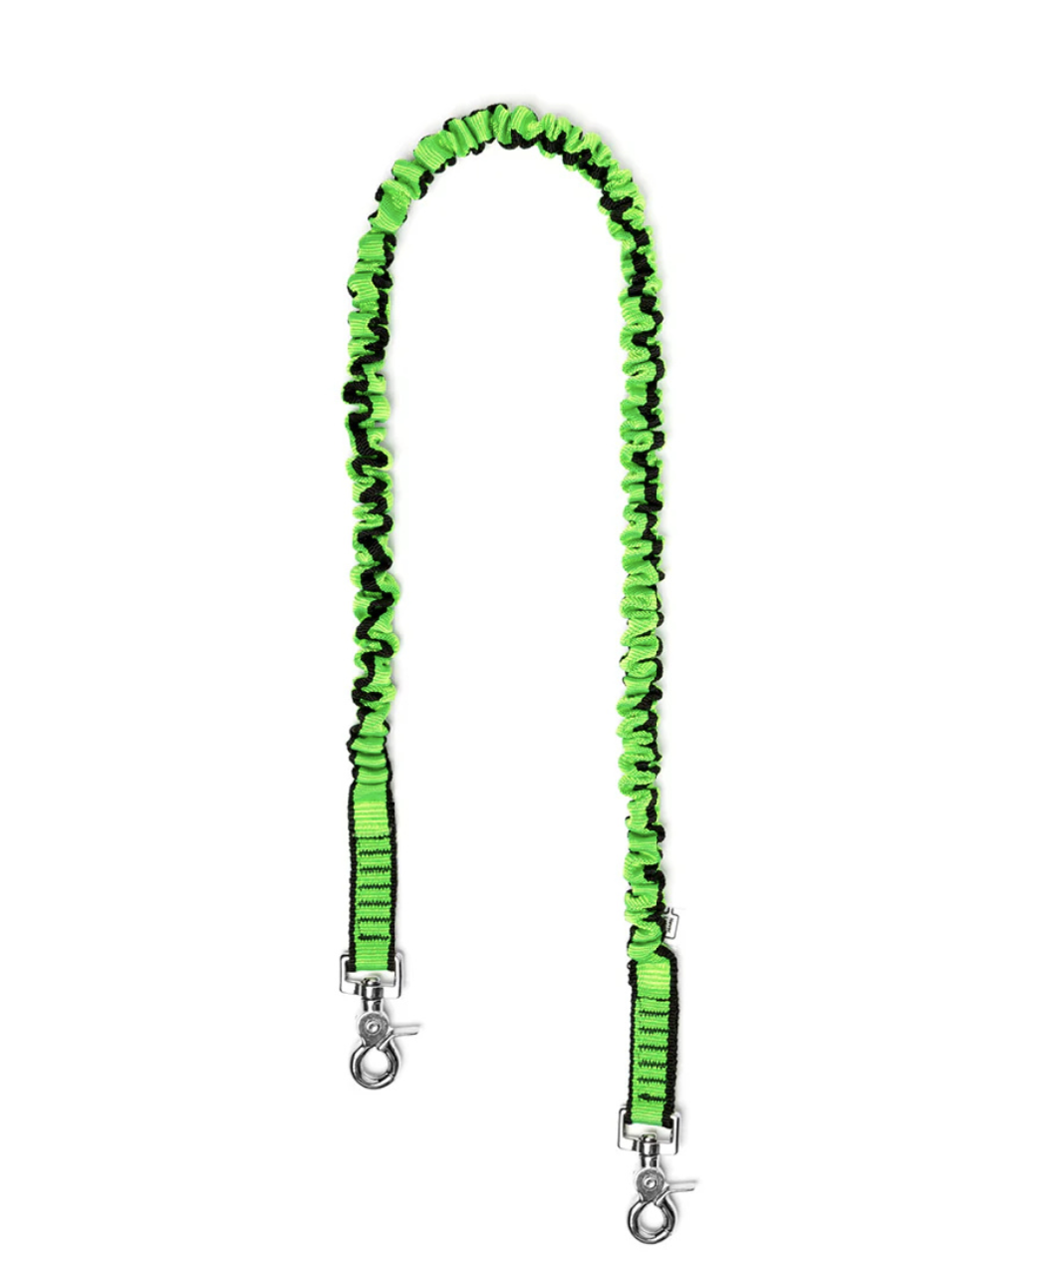
Product category: Slings and Lanyards
Usage: Rope Access + Rescue + Confined Spaces
Other tag: NEW
NLG
Extended Bungee Tool Lanyard
The NLG Extended Bungee Tool Lanyard stretches to 2 metres, giving you the reach to connect tools to anchor points on or off your body when working at height. Dual 360° Quick Clips at each end stay tangle-free even with tools that rotate freely, like screwdrivers and spanners. Each clip is shaped for a fast one-handed connection and release, with a trigger sized to work even through gloves.
Main image: nlg-extended-bungee-tool-lanyard-front.png
Features:
Lower bungee tension means precise control and comfortable handling
Dual Quick Clips give effortless, secure attachment at each end, with anti-tangle built in
High-strength, wear-resistant webbing for a lanyard that lasts
Contrast stitching makes wear and damage easier to spot during inspections
Clever built-in wear indicators change colour to flag any structural damage early
Technical Information:
Max Load: 5 KG / 11 LBS
Dimensions: Extends from 100cm to 210cm
Load Tested and Third-party Certified: Dynamic (2:1 Safety Factor)
NLG ID™ Technology / Scannable Compatible
Unique Serial Number
Safety Standards: CE / UKCA, NS 9611:2022+AC
Downloads:
NLG Extended Bungee Tool Lanyard Datasheet
NLG Extended Bungee Tool Lanyard User Manual

Slide 3
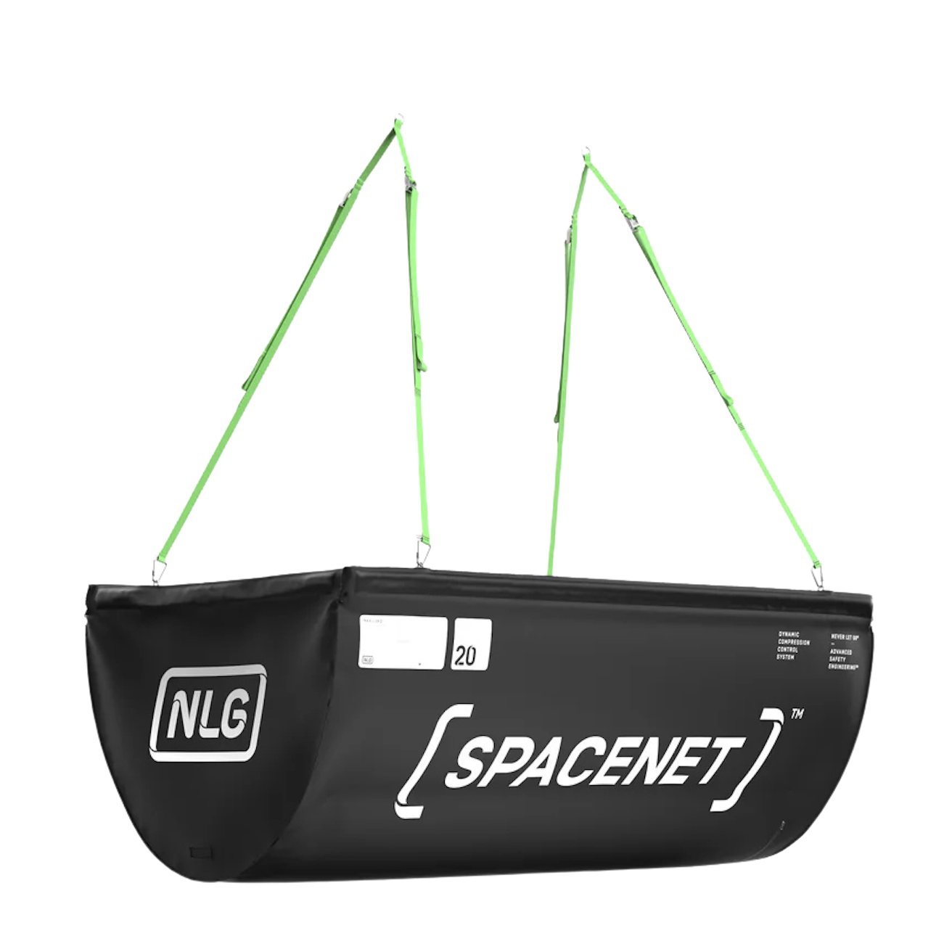
Product category: Accessories
Usage: Rope Access
Other tag: NEW
NLG
Spacenet™ 2.0
The NLG Spacenet™ 2.0 is a lightweight catch net that contains dropped tools and debris before they reach the ground below, eliminating cleanup of the work zone and reducing risk to anyone working or passing underneath. It deploys quickly, collapses and rolls for easy transport between sites, and fits a wide range of rigging configurations.
Main image: nlg-spacenet-rope-access.png
Features:
Fully removable, adjustable slings fit almost any rigging configuration on site
Fold-out aluminium frame holds the net rigid during use
Collapses and rolls for easy transport between sites
Zip on the base for fast, tool-free emptying after use
Built-in air vents allow airflow in windy conditions
Internal hook-and-loop fasteners for fitting the NLG Spacenet™ Impact Zone Mat (101673) for extra impact protection
Technical Information:
Max Load: 20 KG / 44 LBS
Dimensions: 1m (H) x 1m (W) x 2m (D)
Load Tested and Third-party Certified: Dynamic (2:1 Safety Factor)
NLG ID™ Technology / Scannable Compatible
Unique Serial Number
Downloads:
NLG Spacenet 2.0 Datasheet
NLG Spacenet 2.0 User Manual

Slide 4
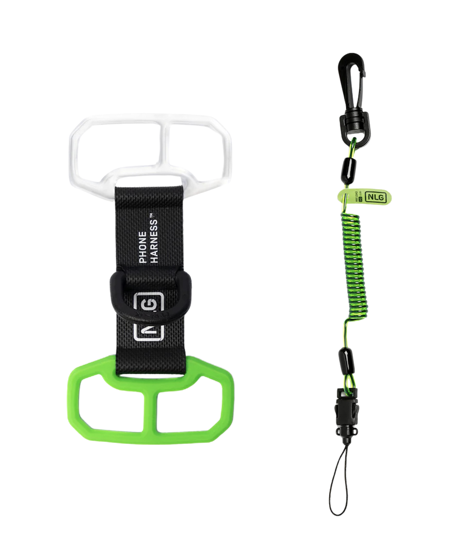
Product category: Accessories
Usage: Climbing + Rope Access + Rescue
Other tag: NEW
NLG
Phone Harness™ Kit
The NLG Phone Harness™ Kit gives you everything needed to keep one of the most frequently dropped tools secured while working at height. The patented Phone Harness fits any smartphone, and the included Mini Coil Tool Lanyard means you can start tethering straight away, without any additional setup.
Main image: nlg-phone-harness-kit.png
Features:
Patented design tightens the harness around the phone automatically in a drop, and the central attachment point eliminates the “catapult effect” common in bottom-mounted alternatives
Welded Rivertex and silicone construction for stability and durability in demanding environments
Offset design keeps the camera fully accessible; screen, fingerprint recognition, and ID functions all unobstructed
Fits most smartphones from 130x60mm to 200x110mm
Includes the NLG Mini Coil Tool Lanyard, no separate purchase needed
Technical Information:
Kit contains: 1 x NLG Phone Harness™ (101600), 1 x NLG Mini Coil Tool Lanyard (101371)
Max Load: 0.5 KG / 1.1 LBS
Phone Harness™ (101600):
Harness Dimensions: 115mm (L) x 60mm (W)
Phone Compatibility: 130x60mm to 200x110mm
Load Tested and Third-party Certified: Dynamic (2:1 Safety Factor)
Safety Standards: ANSI/ISEA 121-2023, CE / UKCA, NS 9611:2022+AC
Mini Coil Tool Lanyard (101371):
Lanyard Length: Extends from 30cm to 95cm
Load Tested and Third-party Certified: Dynamic (2:1 Safety Factor)
NLG ID™ Technology / Scannable Compatible
Unique Serial Number
Safety Standards: CE / UKCA, NS 9611:2022+AC
Downloads:
NLG Phone Harness™ Kit Datasheet
NLG Phone Harness™ Kit User Manual

Slide 5
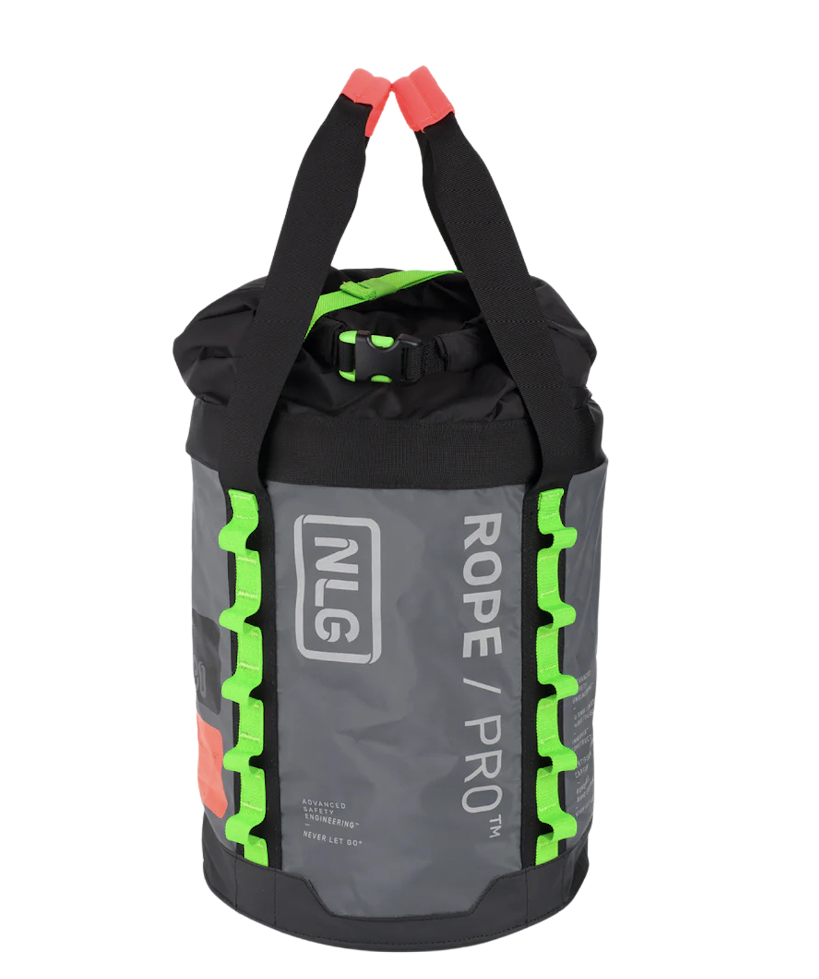
Product category: Bags
Usage: Rope Access
Other tag: NEW
NLG
Rope/Pro™ Bucket 30
The NLG Rope/Pro™ Bucket is a lightweight, durable 30-litre tool and rope bucket built for rope access crews working at height. Weather-resistant and tough enough for demanding environments, it comes with a load-rated handle and dual lifting slings for secure transport of loads up to 50kg.
Main image: nlg-rope-pro-bucket-front-view.png
Features:
Innervis™ material keeps the interior easy to see into, so locating tools in a loaded bucket is straightforward
Load-rated handle and dual integrated lifting slings rated to the full 50kg capacity
Weather-resistant roll-top closure combined with a compression strap keeps contents secure even when the bucket is inverted
Six internal load-rated anchor points for tethering tools inside the bucket
Load-rated external daisy chain loops for securing additional items up to 5kg (each) on the outside
Reinforced base with drainage holes
Technical Information:
Max Load: 50 KG / 110 LBS
Internal Anchor Point / Daisy Chain Max Load: 5 KG / 11 LBS (each)
Capacity: 30 L
Load Tested and Third-party Certified: Dynamic (2:1 Safety Factor)
NLG ID™ Technology / Scannable Compatible
Unique Serial Number
Dimensions: 40cm (H) x 32cm (W) x 32cm (D)
Max Lanyard Length: 200 CM / 78 IN
Safety Standards: ANSI/ISEA 121-2023, CE / UKCA, NS 9611:2022+AC, EN 1492-1
Downloads:
NLG Rope/Pro™ Bucket Datasheet
NLG Rope/Pro™ Bucket User Manual

Slide 6
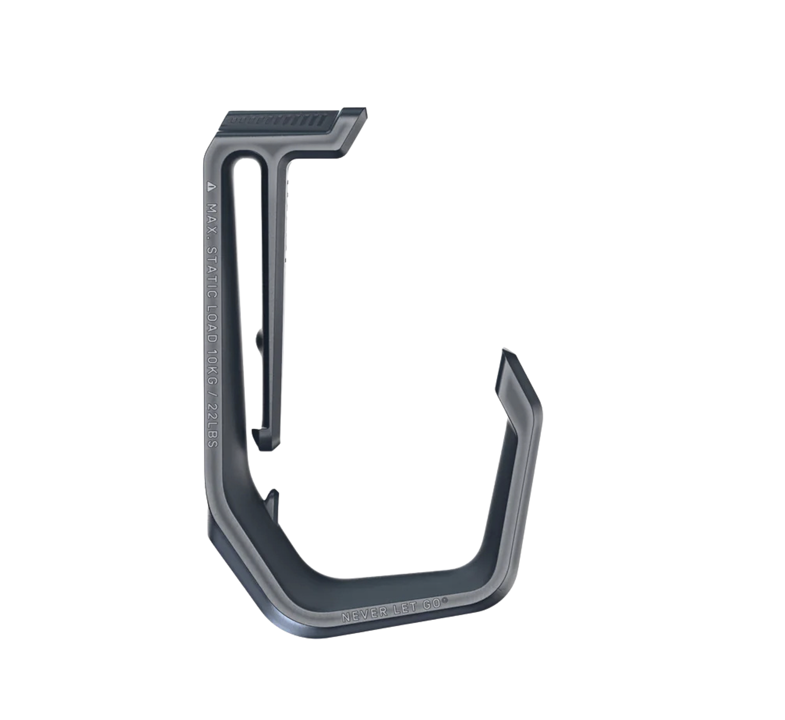
Product category: Accessories
Usage: [TBC]
Other tag: NEW
NLG
AirPark™, Grey
The NLG AirPark™ keeps your drill or chainsaw securely parked and easy to access on the job. Non-gated for fast docking and release, it clips onto any harness or tool belt up to 50mm wide and holds loads up to 10kg.
Main image: nlg-airpark-grey-tool-keeper.png
Features:
Open, non-gated design docks and releases tools in one motion, with no gate to fumble with when your hands are occupied
Hooked end keeps tools seated so they don’t slide off during movement
Sized to fit drills, chainsaws, and most similar power tools
Locking clip grips 45-50mm webbing and padded belts securely, so the AirPark™ stays in place even when loaded
Technical Information:
Max Load: 10 KG / 22 LBS
Dimensions: 10cm (H) x 6cm (W)
Downloads:
NLG AirPark™ Datasheet
NLG AirPark™ User Manual

