Slide 1


Why and how to fund your HSA
Discover the benefits of funding your Health Savings Account (HSA) and learn best practices for calculating contributions.
©2024 HSA Bank. HSA Bank is a division of Webster Bank, N.A., Member FDIC.
Plan Administrative Services and Benefit Services are administered by Webster Servicing LLC.
Notes:
Welcome! Today we’ll cover everything you need to know about how a Health Reimbursement Arrangement, or HRA, works – and how you can use it to offset out-of-pocket healthcare expenses.

Slide 2
Why should you contribute to your HSA?
Notes:
An HSA paired with your HSA-eligible high-deductible health plan can be a powerful savings tool to help you pay for current and future healthcare expenses, plus plan for retirement – but only if you put money into it! Let’s go over a few reasons why when it comes to contributing to your HSA, it pays to start early and stay consistent.

Slide 3
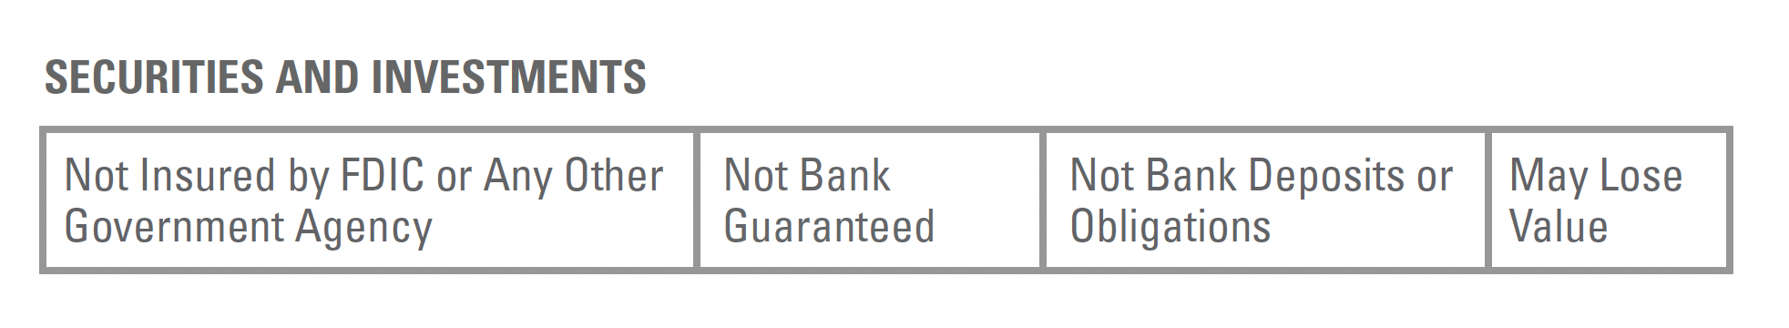
4 reasons to fund your HSA
1
2
3
4
Keep your HSA money for life.
Grow your financial safety net.
Gain unique tax savings.
Invest funds to potentially grow savings.
Notes:
Number one, the money in your HSA is yours – for life. The funds you put into your HSA never expire, meaning you always keep them even if you change jobs or retire.
Number two, your financial safety net grows. If you build your HSA balance, you can more easily manage both expected and unexpected healthcare costs – whether they be in the immediate or distant future.
Number three, there are unique tax savings gained by funding your HSA. Your HSA contributions reduce your taxable income. You can use your HSA funds to pay for IRS-qualified healthcare expenses tax free. Interest and investment earnings are also tax free.
Lastly, there are a variety of options for you to invest your HSA funds and help grow your savings. Plus, you can still access the HSA funds you’ve invested at any time, meaning your money is always there if you need it.

Slide 4
The more you contribute, the more you save
Tax savings from HSA contributions
Contribution amount | $500 | $1,000 | $2,000 | $3,000 | $4,000 | $5,000
Estimated tax savings* | $125 | $250 | $500 | $750 | $1,000 | $1,250
*The tax savings chart is for illustrative purposes only and uses 25% as an estimated tax rate. This is based on average tax rates for federal, FICA and state taxes. Your actual tax savings are based on your individual federal and state tax rate. Actual savings may vary.
Notes:
Here’s an example of the unique tax savings that can be realized from your HSA contributions. The more you contribute, the more you can save with reduced taxes.

Slide 5
The retirement savings gap
Retirement account
(401k, 403b)
HSA
Savings
Taxes
Amount available for
healthcare expenses
$50,000
-$12,500 (25%)
$37,500
$50,000
-$0
$50,000
*The tax savings chart is for illustrative purposes only and uses 25% as an estimated tax rate. This is based on average tax rates for federal, FICA and state taxes. Your actual tax savings are
based on your individual federal and state tax rate. Actual savings may vary.
Notes:
Beyond boosting your savings for immediate healthcare needs, contributing to your HSA can also help you build a stronger safety net for retirement. The retirement savings gap refers to the amount of money that people have saved for their retirement healthcare needs, versus the actual costs.
Studies show that most people believe they’ll be able to work for much longer than they’re able to, so it’s important to start saving as early as possible. It’s estimated that a 65-year-old couple retiring today will spend hundreds of thousands on healthcare costs in retirement.
Using a 401(k) for healthcare costs in retirement can increase your tax burden, so funding an HSA is a better option to maximize tax benefits. Plus, after age 65, the money in your HSA can be used for any kind of cost – whether that be your dream retirement vacation or the second property you’ve always wanted.

Slide 6
Ways to contribute to your HSA
HSA Bank provides multiple ways for you to make contributions to your account, to make boosting your savings easy and convenient. Let’s go over a few:
1
2
3
Payroll deductions: If your HSA was setup through your employer, you may be able to make pre-tax contributions to your HSA from your paycheck. Contact your employer for more information about this option.
Online transfers: Online, you can easily link your bank account and make direct contributions to your HSA.
Transfers or rollovers: IRS regulations permit the transfer or rollover of funds to an HSA from an existing HSA or MSA (short for a Medical Savings Account). For more details about consolidating your HSA balances or transferring funds, you can visit hsabank.com/transfer.
.
Notes:
HSA Bank provides multiple ways for you to make contributions to your account, to make boosting your savings easy and convenient. Let’s go over a few:
Payroll deductions: If your HSA was setup through your employer, you may be able to make pre-tax contributions to your HSA from your paycheck. Contact your employer for more information about this option.
Online transfers: Online, you can easily link your bank account and make direct contributions to your HSA.
Transfers or rollovers: IRS regulations permit the transfer or rollover of funds to an HSA from an existing HSA or MSA (short for a Medical Savings Account). For more details about consolidating your HSA balances or transferring funds, you can visit hsabank.com/transfer.

Slide 7
Best practices for contributing
Notes:
There are a few ways to make contributing to your HSA as easy as possible, plus potential incentives you can take advantage of to maximize your funds.
To start, setting up automatic contributions is the best way to easily fund your HSA without having to remind yourself to contribute. We already covered one of the best methods for automatic contributions: payroll deductions. Additionally, take note of healthcare expenses that you can expect in the years ahead. For example, if you anticipate the cost of braces for a child or know that you’ll need a medical procedure in the future, you may want to fund your HSA to cover these future expenses.

Slide 8
How much should you contribute?
hsabank.com/irs-guidelines
Notes:
Now you know why you should fund your HSA and how to do it, but how much should you be contributing?
A good way to start is to review your prior healthcare expenses. By looking at expenses from past years, you can determine a more precise estimate of the funds you will need to cover the year ahead. Additionally, take note of any anticipated healthcare expenses that you already expect to pay in the future.
It’s also important to pay attention to your deductible, so you know how much you’ll need to cover before your health insurance plans starts covering costs. Keep in mind that the IRS contribution limits change annually. Visit hsabank.com/irs-guidelines to view the annual HSA contribution limits.

Slide 9
55+ catch-up contribution:
$1,000
Notes:
Contributions made to your HSA cannot exceed the annual HSA limit set by the IRS – this includes all combined annual contributions made by you, your employer, or any third parties like parents and spouses.
However, you may meet certain qualifications that make you eligible to make an HSA catch-up contribution of $1,000.
You’re eligible to make this catch-up contribution if:
You’re an HSA accountholder
You’re age 55 or older, (regardless of when during the year you turn 55)
And, you’re not enrolled in Medicare. If you do enroll in Medicare mid-year, catch-up contributions should be prorated.
If you have a spouse who is also 55 or older and covered under your medical insurance, they can also make a catch-up contribution into a separate HSA under their own name.

Slide 10
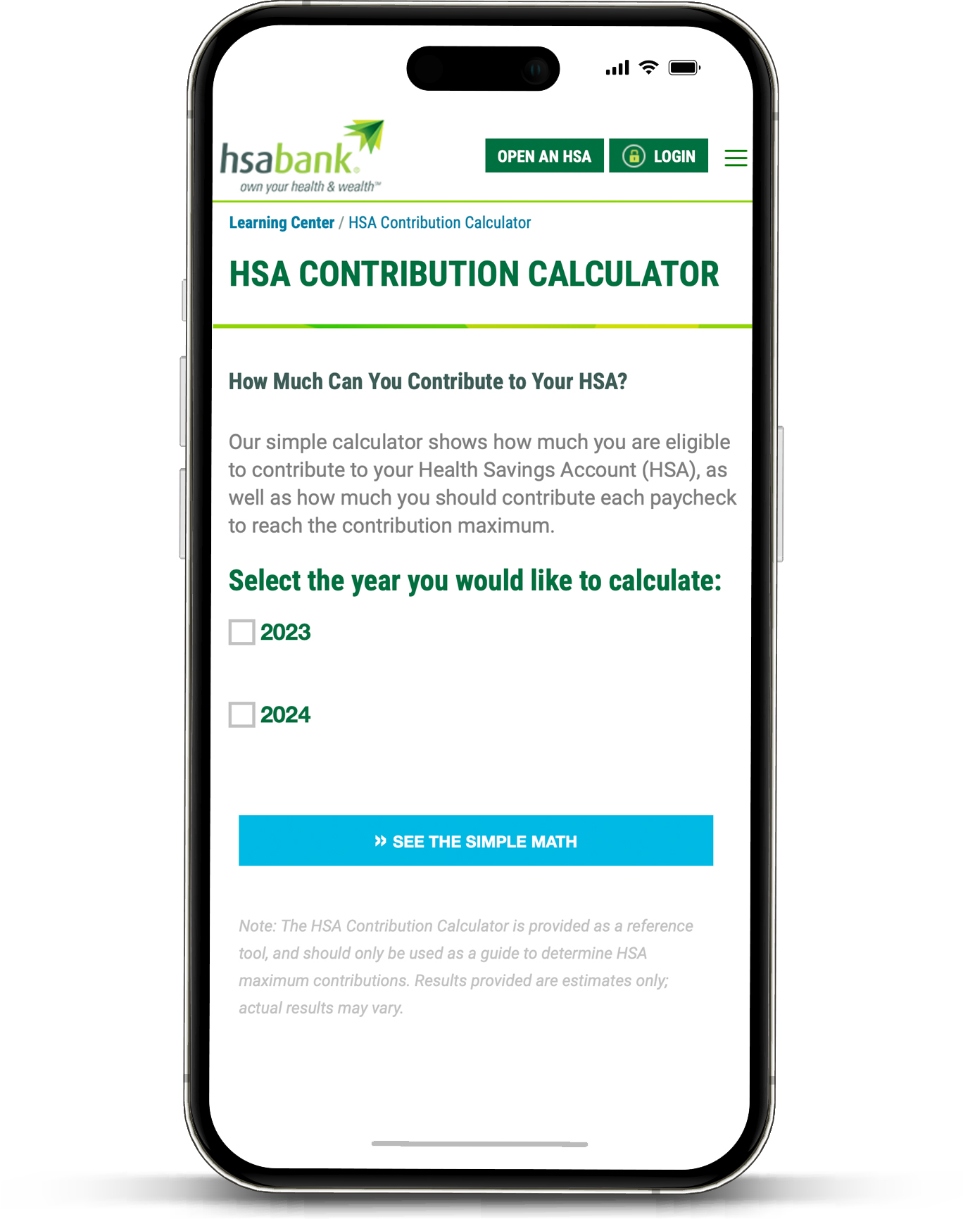
Get help planning
HSA Bank offers multiple tools that can help you determine how much you can and should save with your HSA.
Notes:
HSA Bank offers multiple tools that can help you determine how much you can and should save with your HSA.
The HSA Contribution Calculator shows you how much you’re eligible to contribute to your HSA, as well as how much you should contribute from each paycheck to reach the contribution maximum. You can pick which year you’d like to calculate for – the current year, or upcoming year.
The HSA Savings Calculator lets you discover how much money you could be saving with an HSA. By entering information like your plan type and average medical expenses, you can calculate hypothetical HSA tax savings and growth.

Slide 11
Thank you
Visit hsabank.com for more
information or to manage your account.

