Slide 1


Mass Timber building components, hardware and fasteners
By Mathieu Fraile-Tremblay

Slide 2
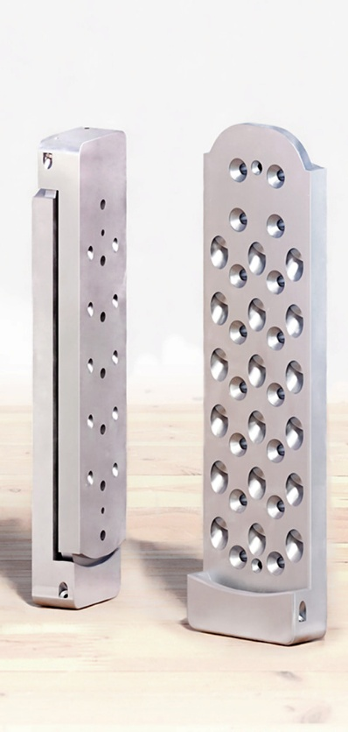
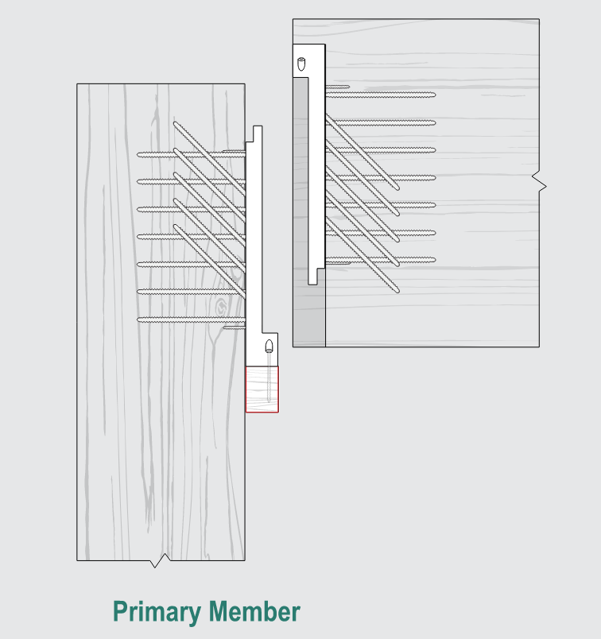
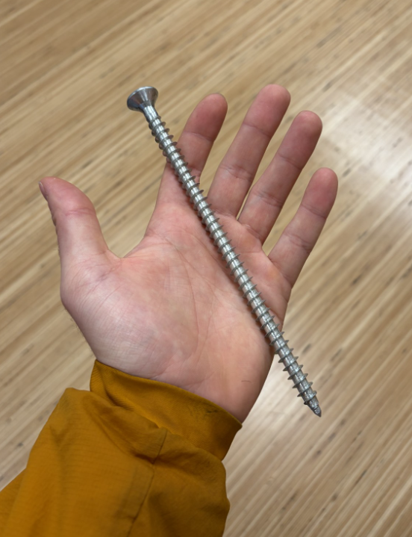
How much load can one of the largest standard concealed hanger support?
Apex L, MTC Solutions
443mm tall, 152mm wide
(24) 10x200mm fully threaded screws in each half
Did You Know?
227 kN = 23 140 kg
227 kN = 23 140 kg
Notes:
“What perspective are you bringing to this topic?”

Slide 3
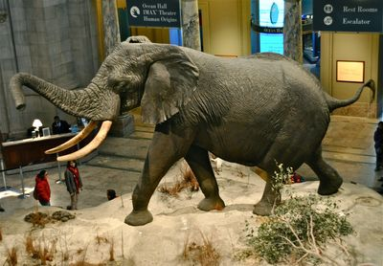
Henry
Did You Know?
227 kN = 23 140 kg
4m tall, 11 000 kg
Apex L : 23 140 kg
Notes:
“What perspective are you bringing to this topic?”

Slide 4
You'll Learn...
What will you learn in this video?
An overview of the different types for Mass Timber connectors
  Fasteners
  Beam connectors
  Post bases & caps
  Straps & Splines
  Miscellaneous hardware
Notes:
“What perspective are you bringing to this topic?”

Slide 5

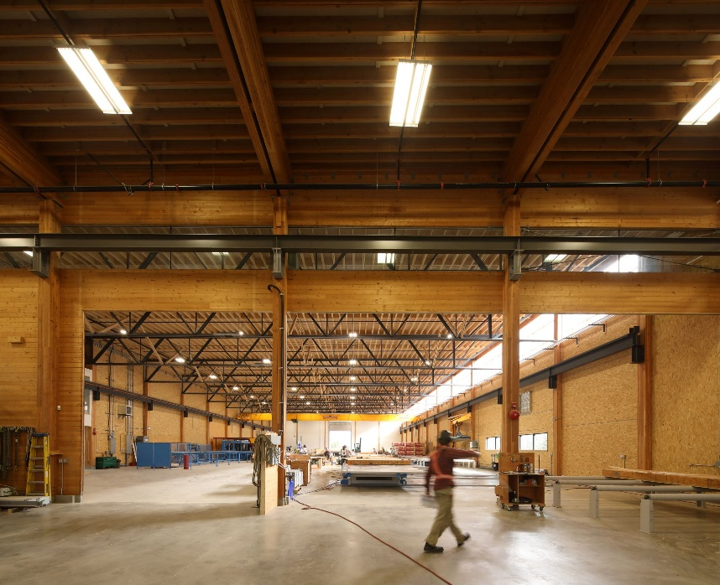
Mathieu Fraile-Tremblay M.Eng, P.Eng
Structural Engineer, specialization in wood light frame and mass timber structures
BC Passive House, Pemberton BC
Design, modelling and construction assist of prefabricated buildings
Experience in residential, commercial and institutional projects
BC Passive House

Slide 6
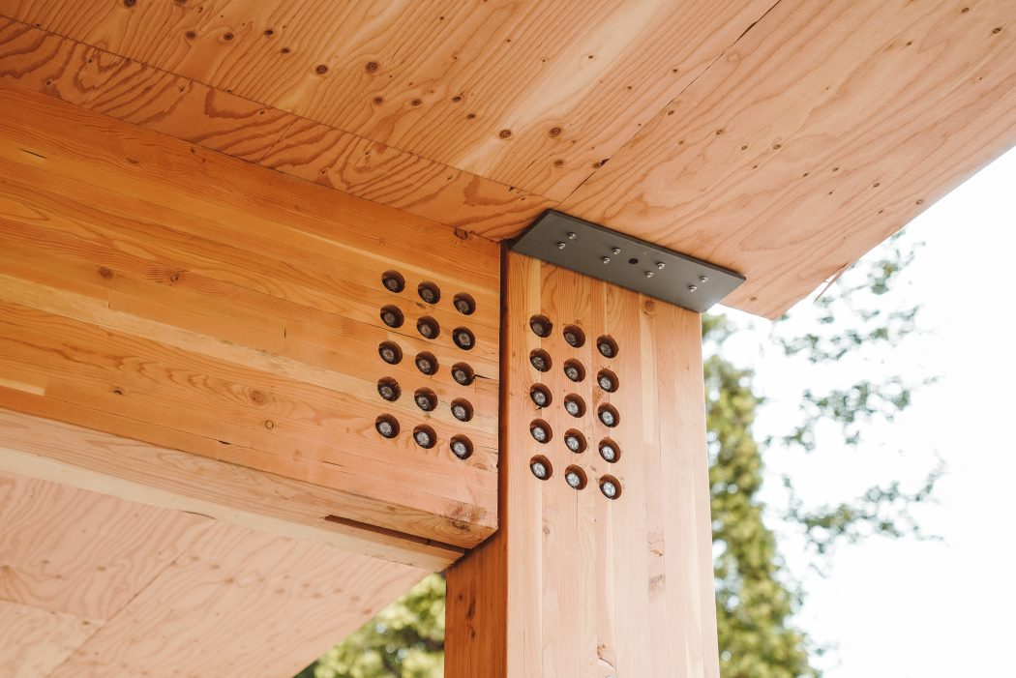
Mass Timber Fasteners
Bolts
Wood-Wood, Wood- Steel
Easy to install
Drilling tolerances:
  Wood : -1mm to +2mm
  Steel: +2mm to +3mm
Aesthetic impact
  Desirable or undesirable
Galvanized for exterior exposure
Notes:
“What perspective are you bringing to this topic?”

Slide 7
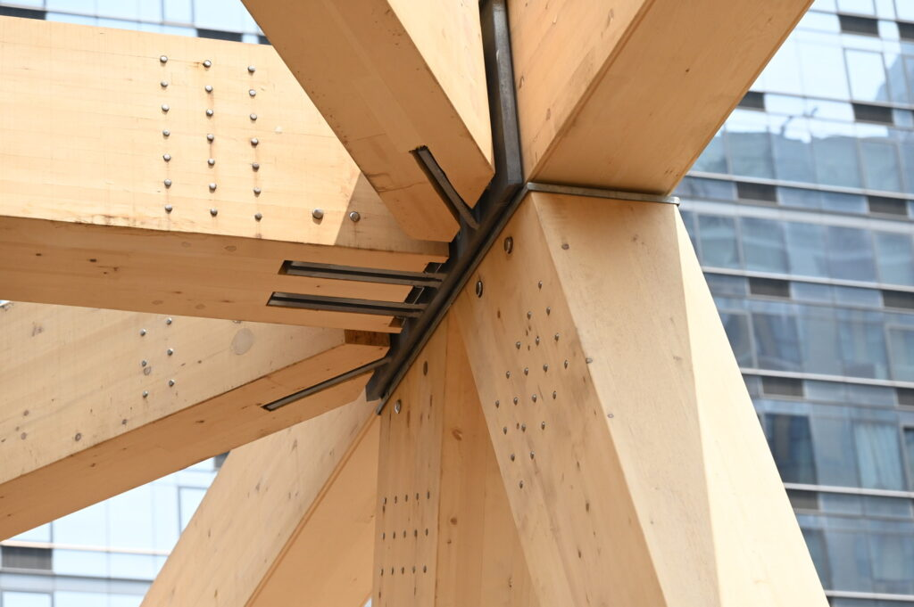
Mass Timber Fasteners
Tight Fit Pins
Wood-Wood, Wood- Steel
Harder to install
Drilling tolerances:
  Wood : 0mm
  Steel: 0mm to +1mm
Aesthetic impact
  Usually desirable
Typically Stainless Steet, good for exterior exposure
Notes:
“What perspective are you bringing to this topic?”

Slide 8
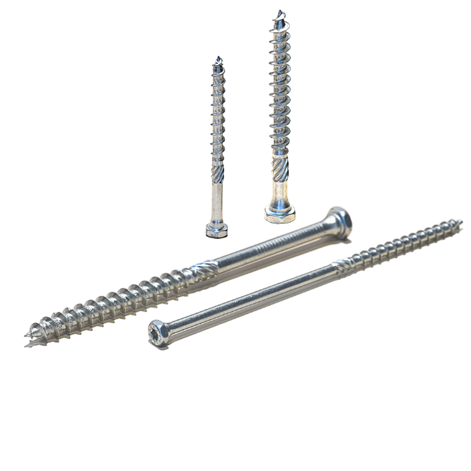
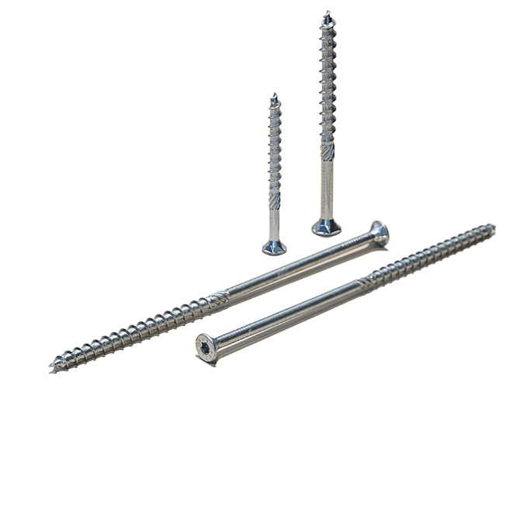
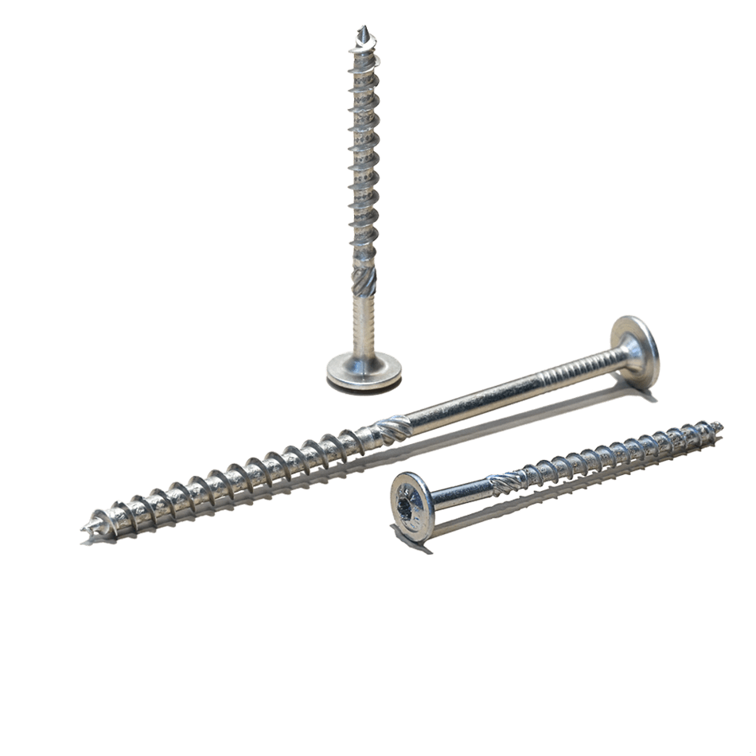
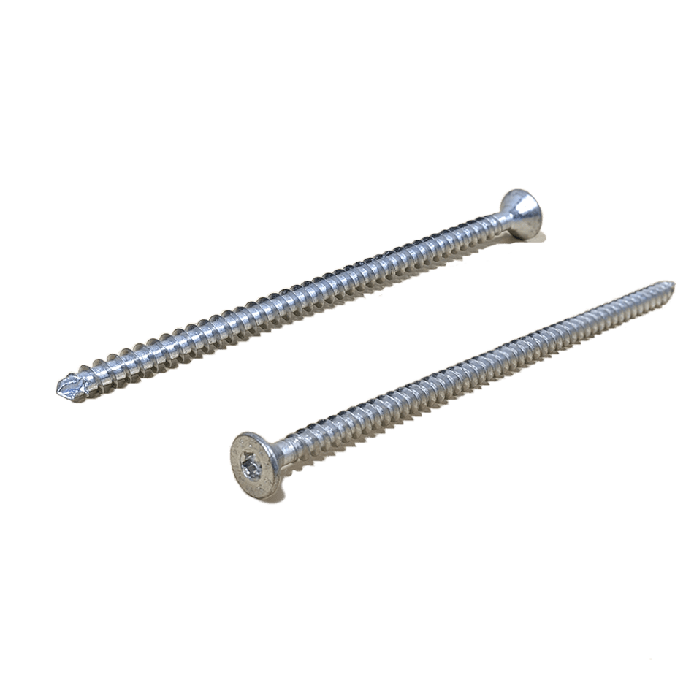
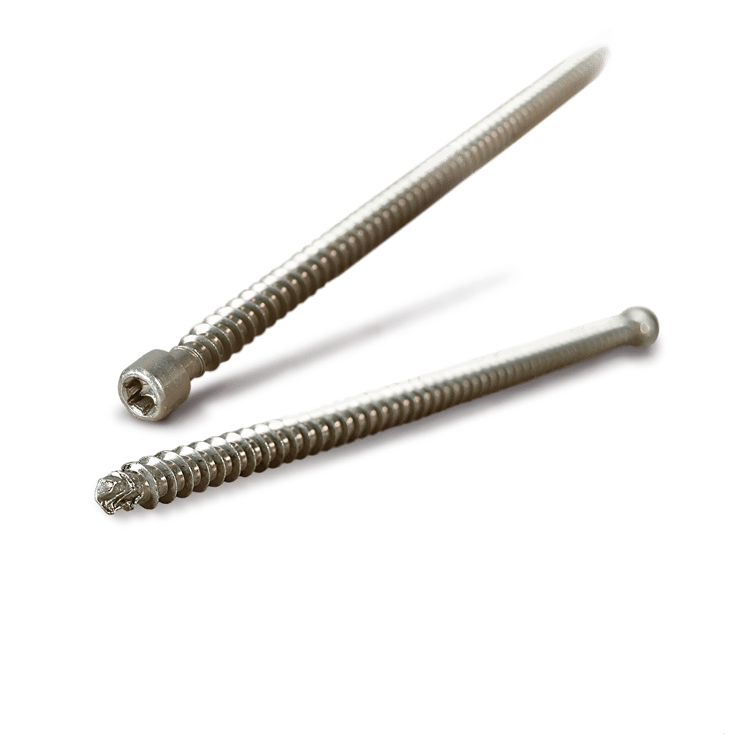
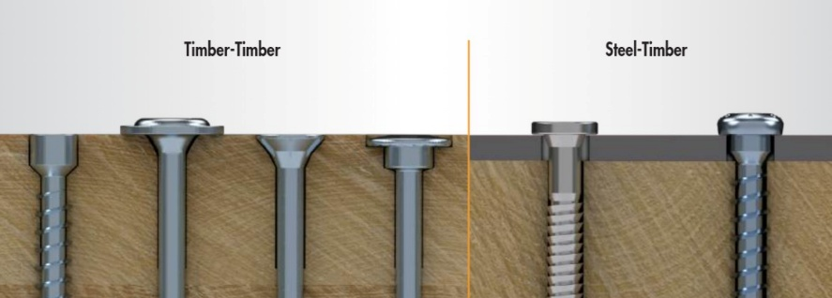
Mass Timber Fasteners
Self Tapping Screws
Hex Head
Partially Threaded
Wood-Wood, Steel-Wood
Variable ease of install
  Screws from 6x60mm to 14x1500mm long!
Pre-drilling sometimes necessary
Different head types
  Countersink, cylinder, washer, hex
Different thread types
  Partially & fully threaded
Countersink Head
Partially Threaded
Washer Head
Partially Threaded
Countersink Head
Fully Threaded
Cylinder Head
Fully Threaded
Notes:
“What perspective are you bringing to this topic?”

Slide 9
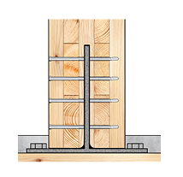
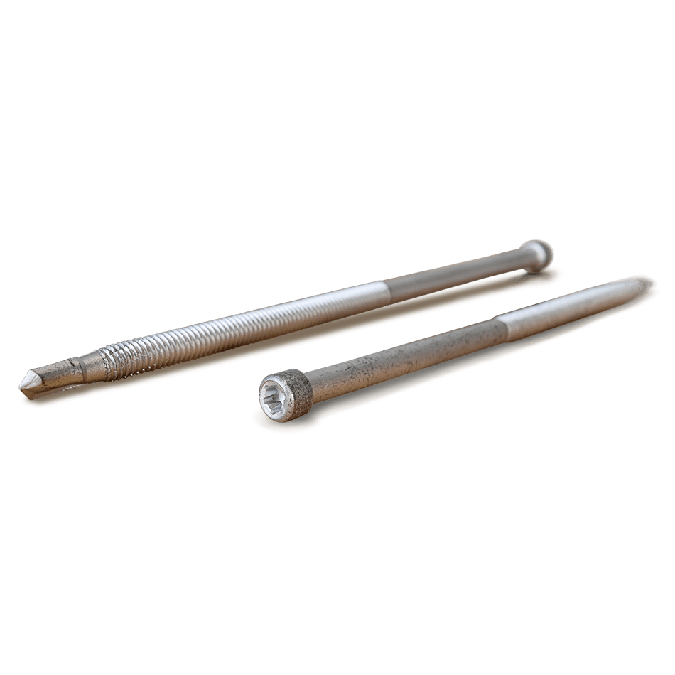
Mass Timber Fasteners
Self Drilling Dowels
Wood-Internal Steel/Aluminium plate
Physically demanding to install
No pre-drilling necessary in wood & metal
Aesthetic impact
  Usually desirable
Notes:
“What perspective are you bringing to this topic?”

Slide 10
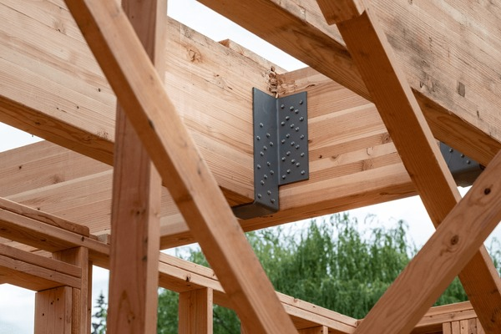
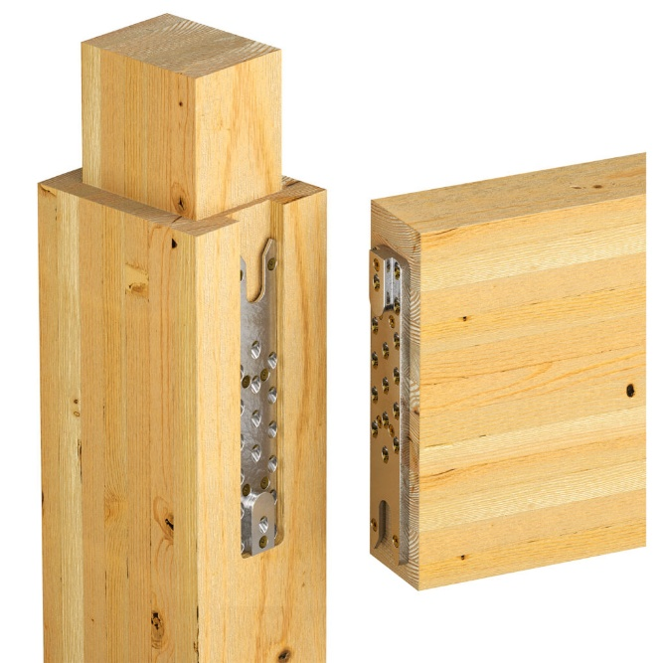
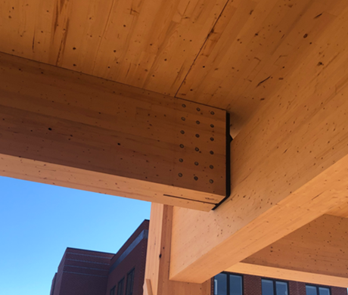
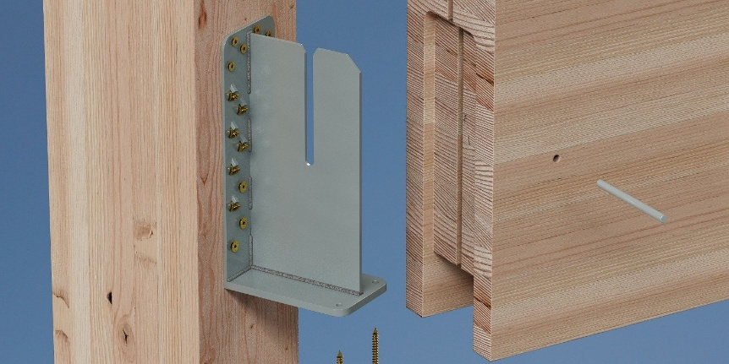
Mass Timber Beam Connectors
“Bucket” Connector
Wood-Wood, Wood Steel
Balance between different properties
  Capacity
  Tolerance
  Ease of install
  Exposure to fire
  Aesthetics
Standard and Custom options
Dovetail Connector
Knife Plate Connector
Bearing Plate Connector
Bearing Plate Connector
Notes:
“What perspective are you bringing to this topic?”

Slide 11
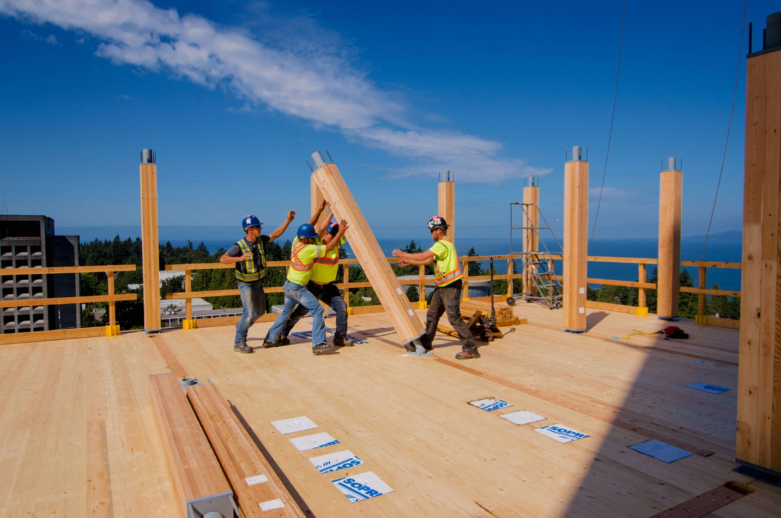
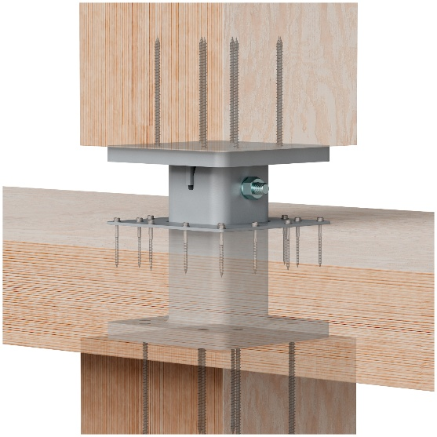
Mass Timber Post Bases & Caps
Post-Foundation, Post-Post
Balance between different properties
  Capacity
  Tolerance
  Ease of install
  Exposure to fire
  Aesthetics
Standard and Custom options
Notes:
“What perspective are you bringing to this topic?”

Slide 12
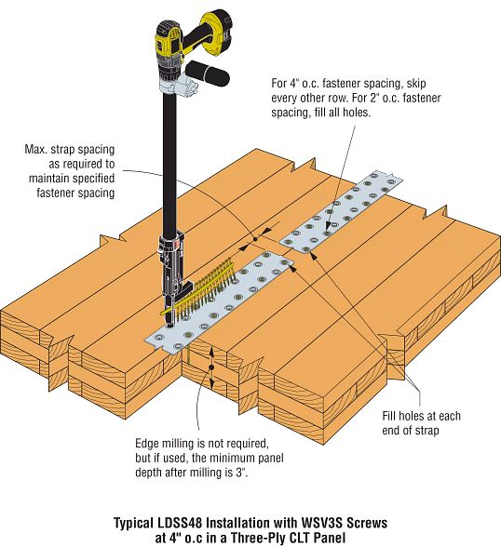
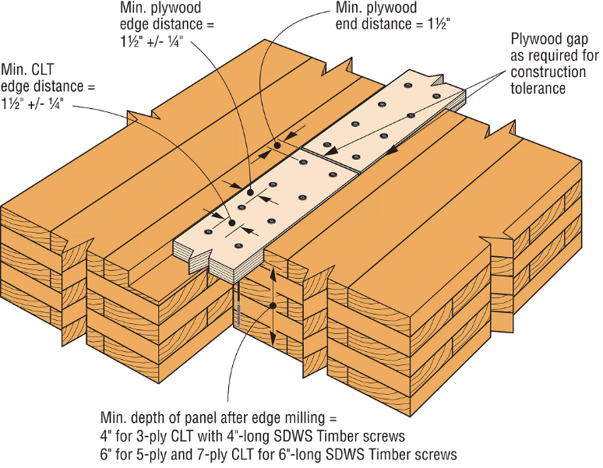
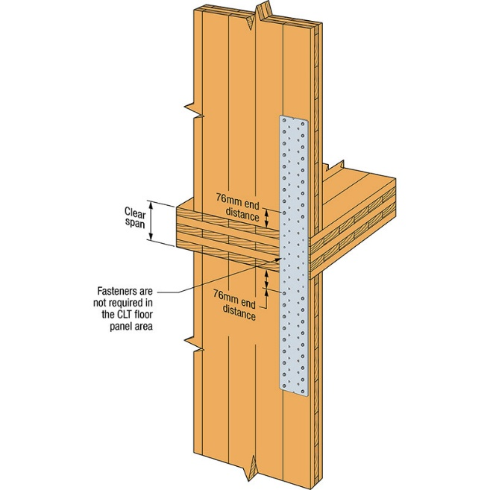
Mass Timber Straps & Splines
Usually used on MT Panels
Different styles
  Plywood
  Thin gauge steel
  Steel plate
Typically use nails or screws
Standard and Custom options
Notes:
“What perspective are you bringing to this topic?”

Slide 13
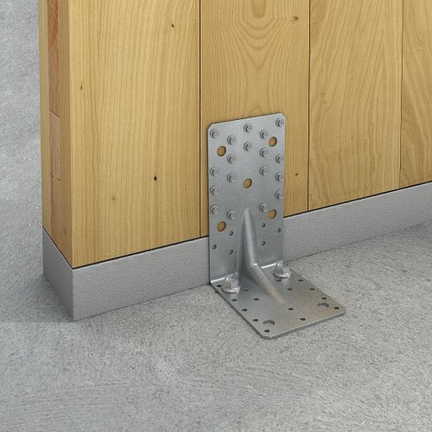
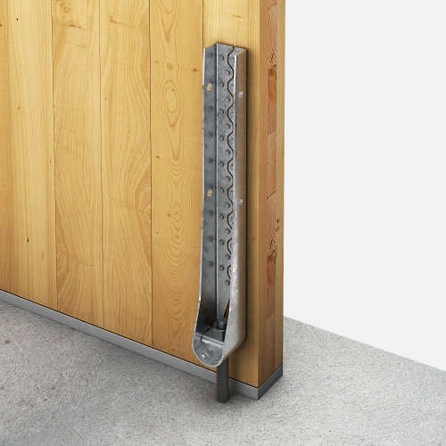
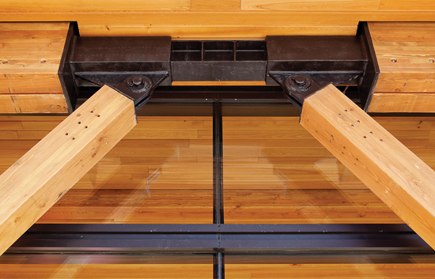
Mass Timber Misc, Hardware
Clips, holdowns, etc.
Stamped metal
  Standard catalogs
Fabricated steel connectors
  Almost always cutom
Notes:
“What perspective are you bringing to this topic?”

Slide 14
Summary
& Key Takeaways
Wide range of connectors for Mass Timber components:
  Fasteners
  Standard and Custom metal connectors
Constant balance between:
  Capacity (strength)
  Exposure to fire & weather
  Aesthetics
  Ease of install (tolerances, physicality & speed)
Notes:
“What perspective are you bringing to this topic?”

