Slide 1


Sustainability & Construction Performance of Mass Timber
By Mathieu Fraile-Tremblay

Slide 2
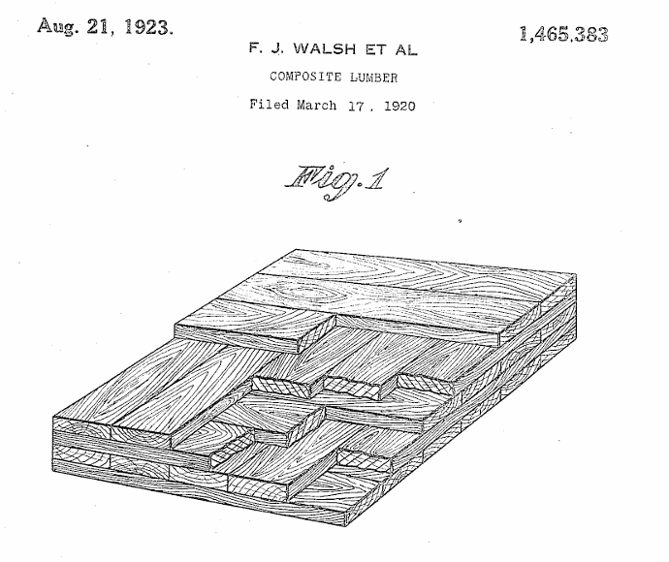
Did You Know?
Mass Timber is a relatively new concept, right?
First patent for glulam: 1901 in Germany
First patent for curved glulam: 1906 in Germany
First patent for CLT: 1920 in the US
Notes:
“What perspective are you bringing to this topic?”

Slide 3
You'll Learn...
What will you learn in this video?
Differentiate the various types of Mass Timber materials
Sustainable advantages of Mass Timber
Their structural advantages compared to lumber & timber
Construction advantages
Notes:
“What perspective are you bringing to this topic?”

Slide 4

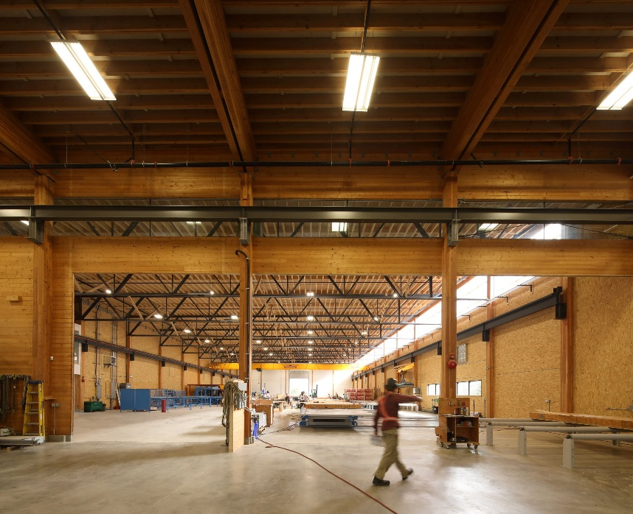
Mathieu Fraile-Tremblay M.Eng, P.Eng
Structural Engineer, specialization in wood light frame and mass timber structures
BC Passive House, Pemberton BC
Design, modelling and construction assist of prefabricated buildings
Experience in residential, commercial and institutional projects
BC Passive House

Slide 5
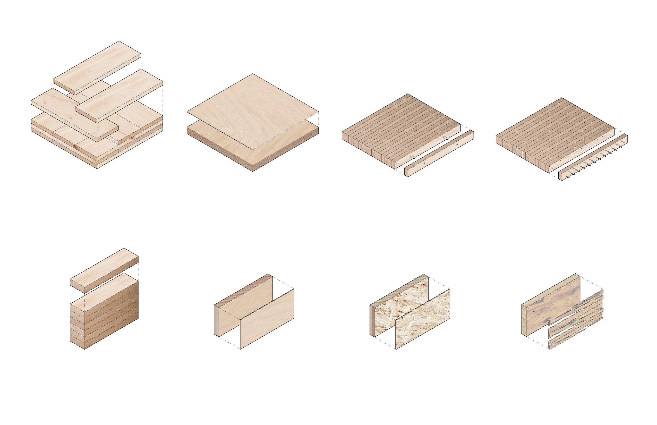
Range of Mass Timber materials
CLT
Cross Laminated Timber
MP
Mass Plywood
DLT
Dowel Laminated Timber
NLT
Nail Laminated Timber
GL
Glue Laminated Timber
LVL
Laminated Veneer Lumber
LSL
Laminated Strand Lumber
PSL
Parallel Strand Lumber
Notes:
“What perspective are you bringing to this topic?”

Slide 6
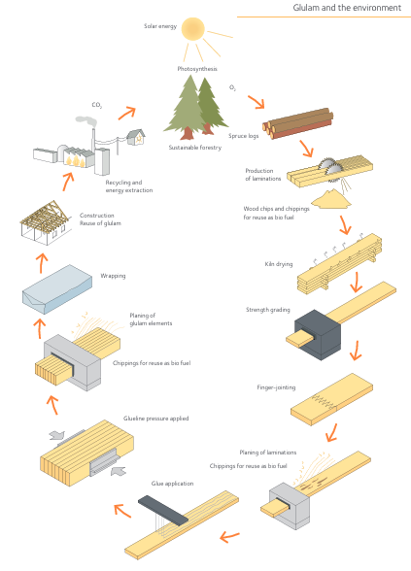
Sustainability Aspects
Carbon Storage (wood)
Trees absorb and store carbon from the atmosphere to grow
Only plants can breathe CO2!
Low Embodied Carbon
Low energy and greenhouse gas emissions to produce & install compared to Steel & Concrete
Forest Management & Renewability
Incentivizing the harvest of small-diameter trees
Faster cycles of regrowth and harvest
Only plants can regrow!
Notes:
“What perspective are you bringing to this topic?”

Slide 7
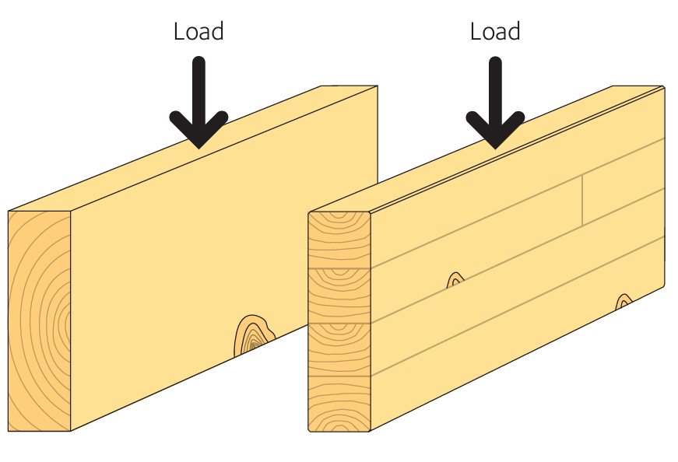
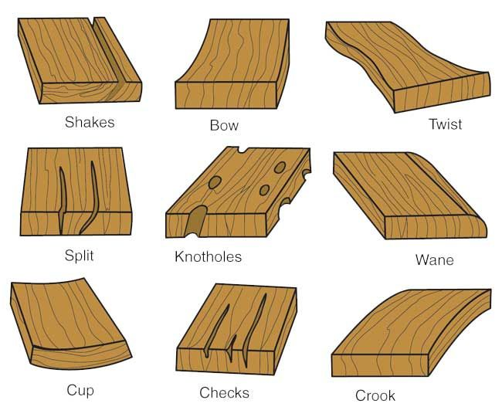
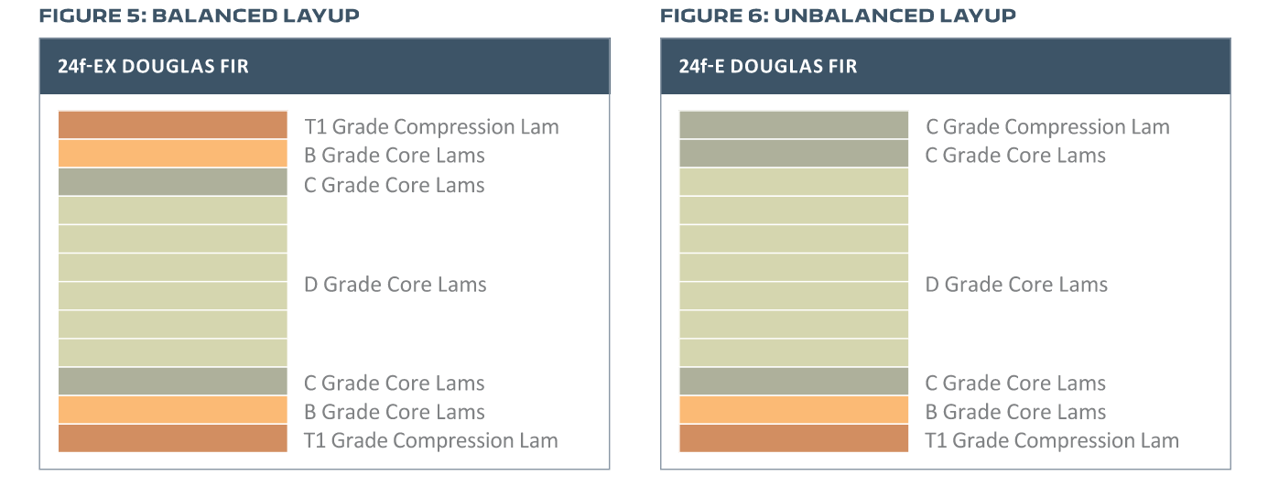
Structural Performance
Stronger than solid wood
Elimination of large defects
Use of stronger fiber where needed
More dimensionally stable
Less prone to checking (cracks), twisting, cupping, etc.
Notes:
“What perspective are you bringing to this topic?”

Slide 8
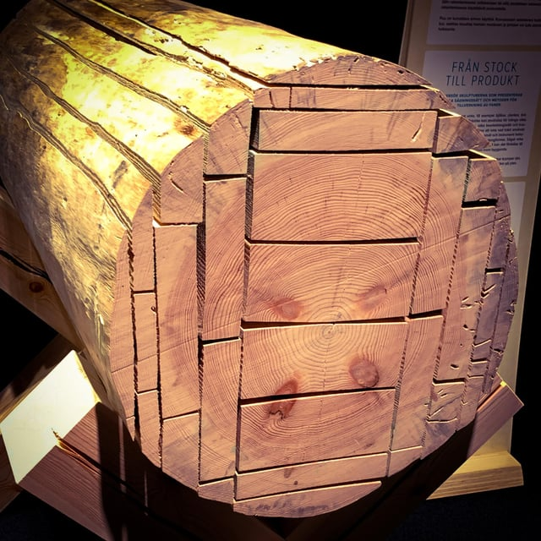
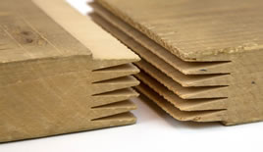
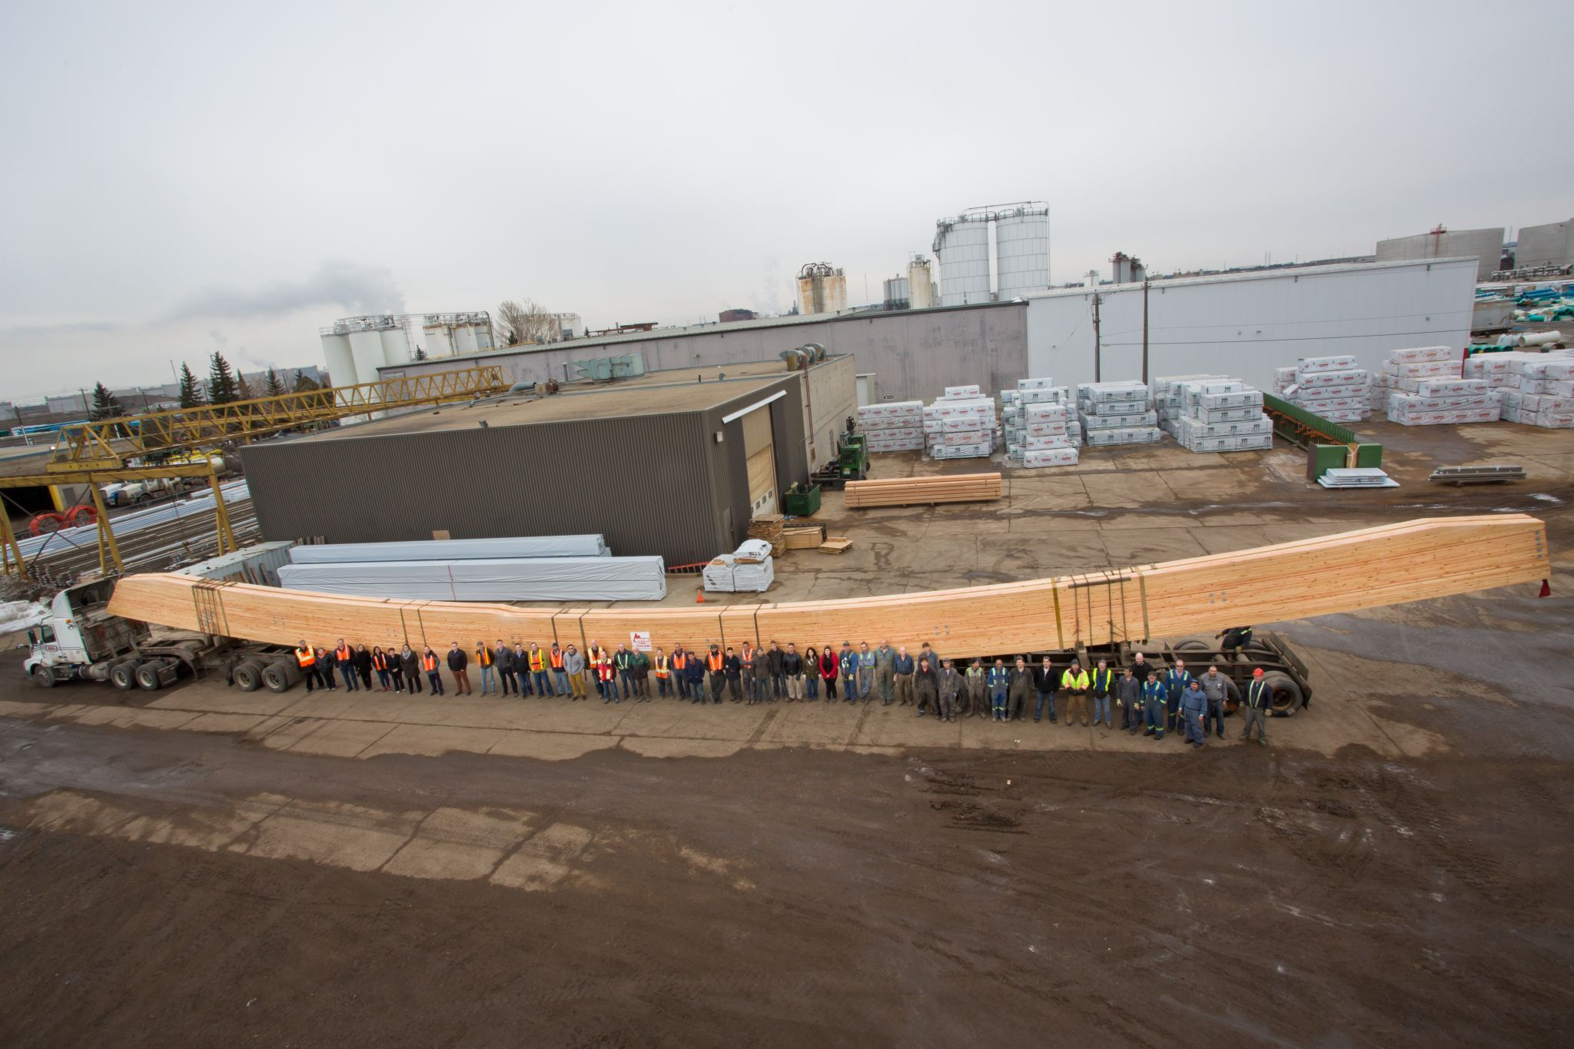
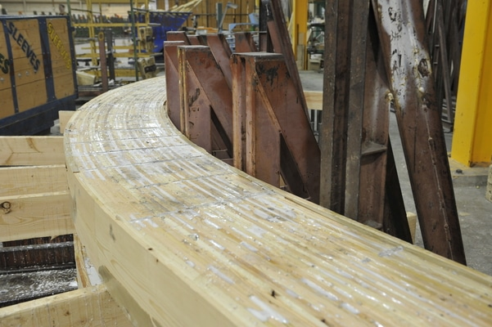
Dimensional Flexibility
Western Archrib
150ft (46m) curved glulam beam
Notes:
“What perspective are you bringing to this topic?”

Slide 9
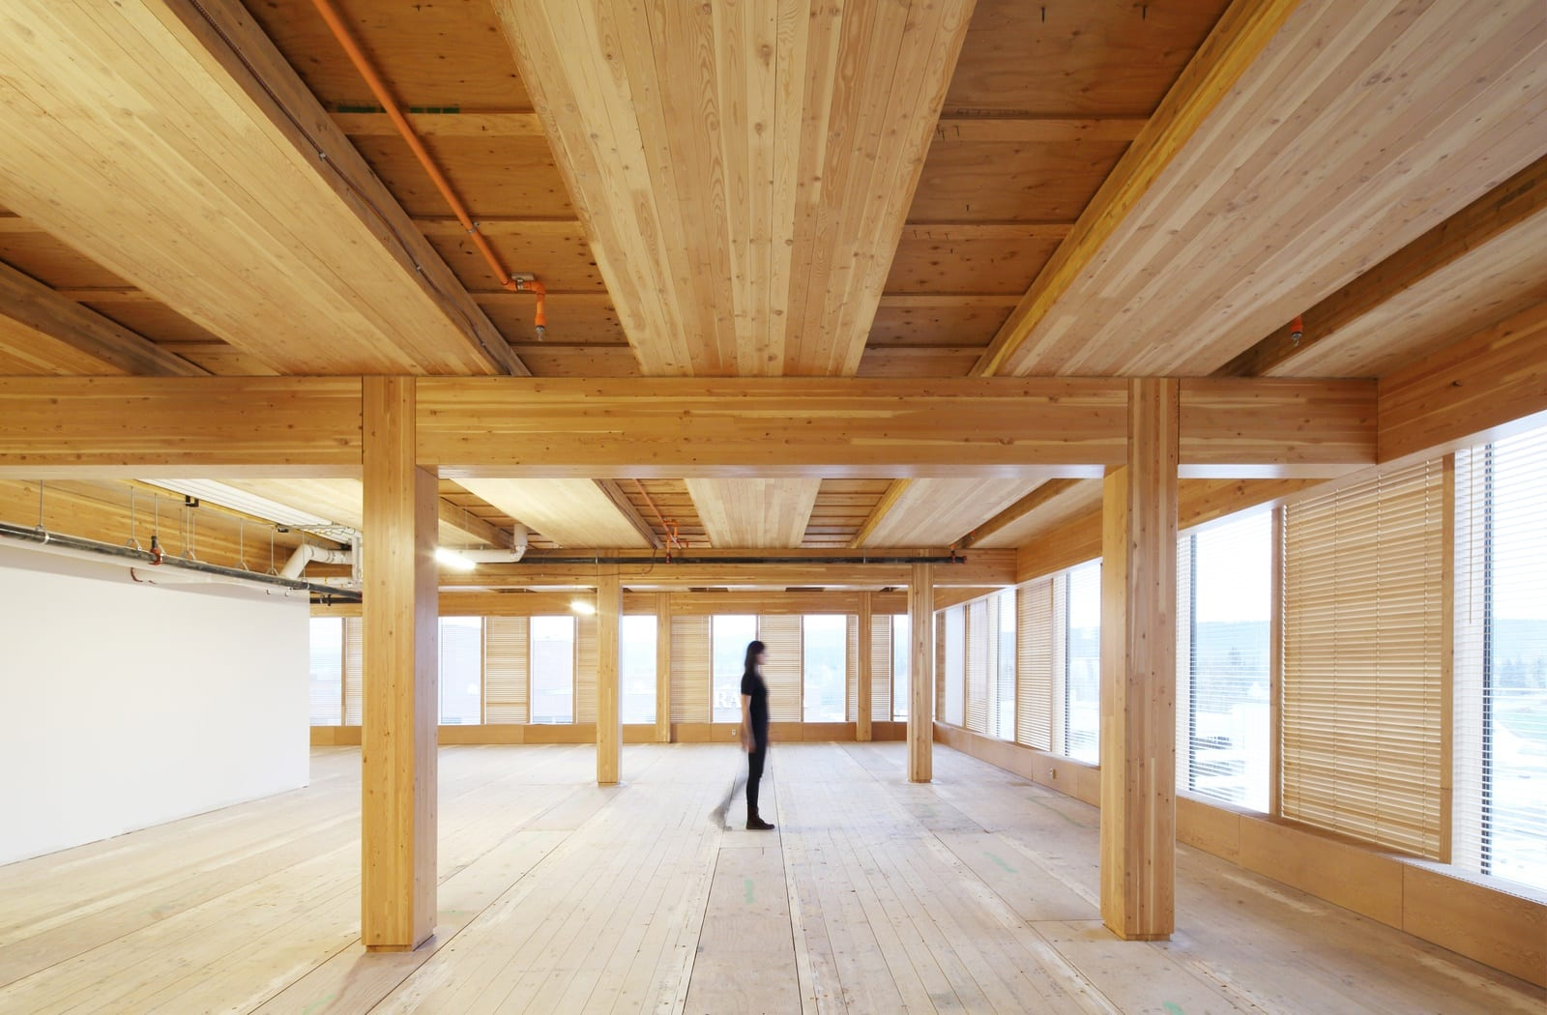
Wide Range of Application
Slabs
CLT, MP, DLT, NLT
Beams
GL, LVL, LSL, PSL
Walls
CLT
Columns
GL, PSL
Wood Innovation and Design Center
Prince George, BC
Notes:
“What perspective are you bringing to this topic?”

Slide 10
Summary
& Key Takeaways
Mass Timber (and wood) is a more sustainable alternative to traditional construction materials
It offers superior performance and flexibility compared to solid timber
Is manufactured in a wide range of materials, shapes and sizes to fit (almost) any need
Notes:
“What perspective are you bringing to this topic?”

