Slide 1
INCOMPASS
APEX CAPITAL PARTNERS · MERIDIAN INDUSTRIAL SERVICES · FY26 VALUE CREATION PLAN
VCP Progress Report
Q2 Progress · H2 Outlook
Confidential · Prepared by Incompass

Slide 2
APEX CAPITAL PARTNERS · MERIDIAN INDUSTRIAL SERVICES · FY26 VALUE CREATION PLAN
Context & Guide
THE SITUATION
After acquiring Meridian Industrial Services, Apex launched a Value Creation Plan across five strategic initiatives; each led by a VP-level Initiative Leader. These initiatives are the primary levers for generating returns in the first hold period.
WHAT'S IN THIS REPORT
Pre-Launch Baseline
01
Behavioral scores for every leader and team member pre-launch
THE BEHAVIORAL FRAMEWORK
Q2 Behavior Scores x Milestones
In partnership with Incompass, Apex defined five competencies necessary for VCP execution. All 29 VCP Leaders and Team Members were assessed at launch to set a baseline, and again at Q2 to track trajectory.
02
Progress mapped by individual on 2x2 grid for performance snapshot
Q2 Scorecard
03
Behavioral changes + milestone completion to show full picture for each team
MILESTONE TRACKING & OUTCOMES
04
Appendix
Using Incompass’ goal-setting platform, each initiative team defined quarterly milestones. Progress against milestone completion alongside behavioral scores, gives Apex a combined view of how teams are working and what they are delivering.
Overview initiatives, behavioral framework, milestone detail, and full individual scores

Slide 3
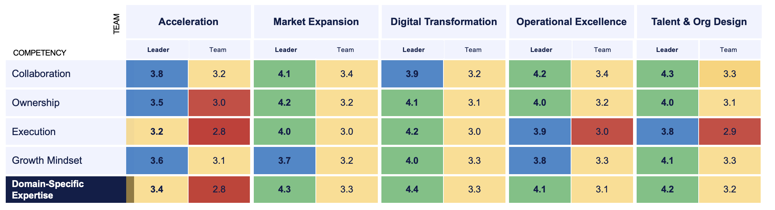
Pre-Launch Behavioral Baselines by Leader & Team
KEY INSIGHTS
Leaders are an asset. Leader scores run consistently higher than team scores across all five initiatives. Leadership quality is not a constraint.
Domain-Specific Expertise carries the most hidden risk. High leader scores (3.4–4.3) mask weak team scores (2.8–3.3) in four of five initiatives. Leaders may be carrying functional knowledge their teams don’t yet have — a succession and scalability risk.
Talent & Org Design team is a quiet standout. Highest Collaboration score in the portfolio (Leader 4.3), strong Growth Mindset (4.1/3.3), and no red zones except Execution team score (2.9). Strong behavioral foundation; execution cadence needs tightening.
Execution is the lowest-scoring behavior across the board. No leader scores above 4.2 on Execution, and team-level scores dip to 2.8–3.0 in three of five initiatives. Milestone delivery should be tracked proactively, not reactively.
Acceleration Team has the most potential flags. Lowest leader score on Execution (3.2) and the only team with two red-zone team scores (Ownership 3.0, Execution 2.8, Domain Expertise 2.8). Highest concentration of watch areas across the portfolio.
Scale: 1–5
4.0–5.0 Strong
3.5–3.9 Good
3.0–3.4 Developing
<3.0 At Risk

Slide 4
Q2 Behavior Scores x Milestone Progress
Low Behavior
High Progress
Team
Composite Beh. Score
YTD Milestone
Completion
Status
Porter
High Behavior
High Progress ✓
Reyes
Acceleration
Watch
Washington
3.52
72%
Foster
Higher Milestone Progress →
Taylor
Market Expansion
3.87
88%
On Track
Digital Transformation
3.78
58%
Watch
Operational Excellence
3.80
81%
On Track
← Lower Milestone Progress
Talent & Org Design
3.78
75%
Watch
Low Behavior
Low Progress ⚠
High Behavior
Low Progress
Each person = one dot.
■ Leader score
← Lower Competency Score Higher Competency Score →
□ Team member avg

Slide 5
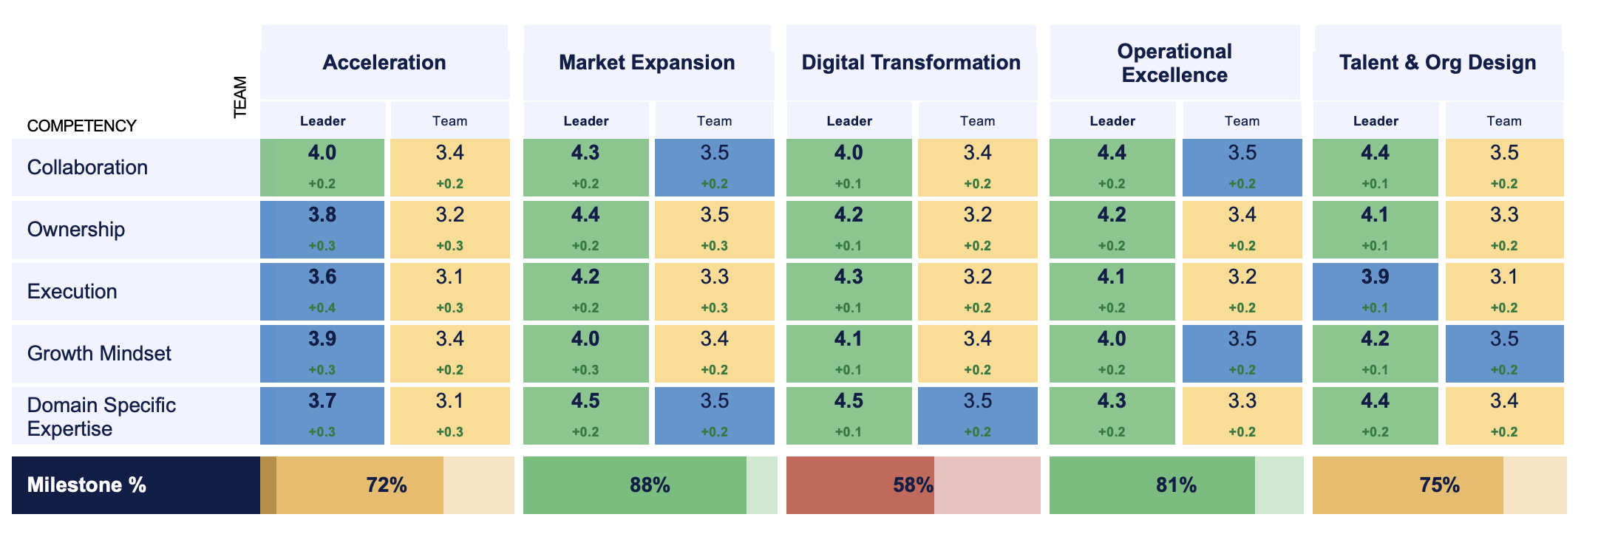
Q2 Scorecard: Behavioral Changes and Milestone Completion
KEY INSIGHTS
Execution is the biggest mover. Execution scores improved more than any other behavior across the portfolio (leader deltas +0.1 to +0.4). The Acceleration team led the way (+0.4 leader, +0.3 team). Given it was the lowest-scoring behavior last cycle, this trajectory is the right signal to watch.
Digital Transformation is the outlier that demands attention. 58% milestone attainment is significantly below the portfolio average (~75%). Smallest behavioral scores improvement in the portfolio (+0.1 on most competencies). Low behavioral improvement + low milestone attainment is the compound risk signal.
Market Expansion is the portfolio standout. 88% milestone attainment, highest behavioral scores across nearly every competency, and consistent gains cycle-over-cycle. This team is executing. Worth understanding operational and leadership best practices.
Acceleration made the most behavioral progress, but milestone attainment remains a watch area. Largest score improvements in the portfolio (+0.3–0.4 across multiple competencies), still only 72% milestone attainment. Behavioral momentum hasn’t fully converted to delivery yet — the next cycle will be the test.
The leader-team gap is narrowing, but teams are still trailing. Deltas are slightly higher on leader scores than team scores in most cases, but team scores are moving up consistently. The question is whether team-level execution catches up to leadership capability before it shows in the milestones.
Scale: 1–5
Q2 avg scores shown
Δ indicates change from Q1 baseline
4.0–5.0 Strong
3.5–3.9 Good
3.0–3.4 Developing
<3.0 At Risk

Slide 6
APEX CAPITAL PARTNERS · MERIDIAN INDUSTRIAL SERVICES · FY26 VALUE CREATION PLAN
Appendix
VCP Initiatives Overview
Summary of all VCP initiatives & associated Leaders.
Behavioral Framework
Definitions and scoring methodology for each of the five behavioral competencies assessed across VCP teams.
Full Individual Scores
Per-person behavioral scores for all 29 VCP Leaders and Team Members, by competency and by cycle.
Milestone Detail by Initiative
Complete milestone log for each initiative team, including status, owner, and target dates.
Additional slides can be added to this appendix as needed. Contact your Incompass account team for supplemental data exports.

Slide 7





APEX CAPITAL PARTNERS · MERIDIAN INDUSTRIAL SERVICES · FY26 VALUE CREATION PLAN
Value Creation Plan Initiatives
Acceleration
Emma Foster, VP of Revenue
Captures untapped customer segments and accelerates new product commercialization. Near-term EBITDA impact.
Market Expansion
Samuel Porter, VP of Global Markets
New geographic market entry and channel partnerships. Drives long-term enterprise value and exit multiple.
Digital Transformation
Malachi Taylor, VP of Digital Transformation
Core systems modernization and AI adoption across the business. Drives margin improvement and scalability.
Operational Excellence
Mateo Reyes, VP of Operations
Process improvement and vendor rationalization. Near-term margin expansion and operational leverage.
Talent & Org Design
Ellie Washington, VP of HR
Builds the org capability to execute the VCP and sustain performance beyond the initial hold period.

Slide 8
APEX CAPITAL PARTNERS · MERIDIAN INDUSTRIAL SERVICES · FY26 VALUE CREATION PLAN
Behavioral Framework
Five competencies assessed across all VCP Leaders and Team Members. Scale: 1–5.
Collaboration
Works effectively across teams and functions to advance shared goals. Includes active listening, transparent communication, and constructive conflict resolution. Strong collaboration is a prerequisite for cross-functional VCP execution.
Ownership
Takes personal accountability for outcomes, not just activities. Proactively identifies and resolves blockers without waiting for direction. Ownership signals whether individuals treat their initiative as their own or as an assignment.
Execution
Delivers against commitments on time and with quality. Translates plans into structured work with clear milestones. The most predictive competency for milestone attainment; low Execution scores are the earliest signal of delivery risk.
Growth Mindset
Seeks feedback, adapts to new information, and improves performance over time. Critical in high-change environments like post-acquisition transformation where the operating context shifts faster than experience can anticipate.
Domain-Specific Expertise
Functional knowledge required to make sound decisions within the initiative’s scope. Gaps at the team level signal succession risk and scalability constraints; the leader may be compensating through direct involvement rather than developing team capability.

Slide 9
APEX CAPITAL PARTNERS · MERIDIAN INDUSTRIAL SERVICES · FY26 VALUE CREATION PLAN
Milestone Detail by Initiative
YTD milestone log across all five VCP initiatives. Status as of end of Q2 FY26.
Initiative
Milestone
Owner
Target
Status
Acceleration
Launch two new customer segments with pilot offers
E. Foster
Q1 FY26
Watch
Complete product commercialization playbook
E. Foster
Q2 FY26
In Progress
Market Expansion
Sign two channel partnership agreements
S. Porter
Q1 FY26
Complete
Enter first target international market
S. Porter
Q2 FY26
Complete
Digital Transformation
Complete ERP migration Phase 1
M. Taylor
Q2 FY26
At Risk
Operational Excellence
Rationalize top 15 vendors; reduce spend 12%
M. Reyes
Q2 FY26
Complete
Talent & Org Design
Complete skills gap assessment across all functions
E. Washington
Q1 FY26
Watch
Status key: Complete (green) • In Progress / Watch (amber) • At Risk (red). Milestones shown are representative; full export available from your Incompass account team.

Slide 10
APEX CAPITAL PARTNERS · MERIDIAN INDUSTRIAL SERVICES · FY26 VALUE CREATION PLAN
Full Individual Scores
All 29 VCP Leaders and Team Members. Scores shown for Q2 FY26. Scale: 1–5.
Name
Role
Initiative
Collab.
Ownership
Execution
Growth
Domain Exp.
Emma Foster
Leader
Acceleration
4.0
3.8
3.6
3.9
3.7
Samuel Porter
Leader
Mkt. Expansion
4.3
4.4
4.2
4.0
4.5
Malachi Taylor
Leader
Digital Trans.
4.0
4.2
4.3
4.1
4.5
Mateo Reyes
Leader
Ops Excellence
4.4
4.2
4.1
4.0
4.3
Ellie Washington
Leader
Talent & Org
4.4
4.1
3.9
4.2
4.4
Team Members (avg. scores shown per initiative; full individual exports available)
Team avg.
Team
Acceleration
3.4
3.2
3.1
3.4
3.1
Team avg.
Team
Mkt. Expansion
3.5
3.2
3.3
3.4
3.5
Team avg.
Team
Digital Trans.
3.4
3.2
3.2
3.4
3.5
Team avg.
Team
Ops Excellence
3.5
3.4
3.2
3.4
3.3
Team avg.
Team
Talent & Org
3.5
3.3
3.1
3.5
3.4
4.0–5.0 Strong 3.5–3.9 Good 3.0–3.4 Developing <3.0 At Risk
Team member averages shown above. Full per-person data for all 24 team members is available as a supplemental export from your Incompass account team.

