Slide 1



Slide 2
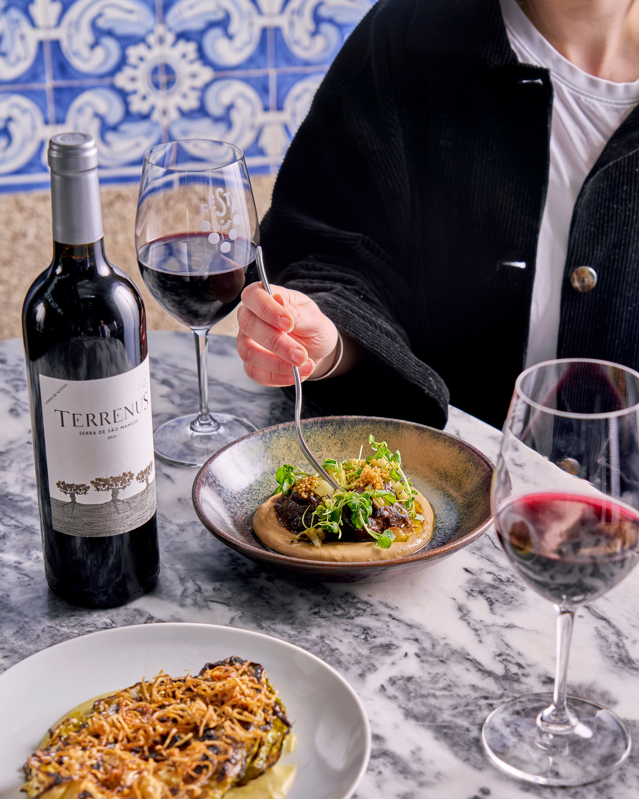

GROUP DINING AT BAR DOURO
At Bar Douro, we share the vibrant spirit of Portugal through honest food, characterful wines, and rich cultural stories.
Our group dining experiences are crafted to capture the essence of Portuguese culture; bringing people together to celebrate in true Portuguese style.
Experience Portugal, together.
For groups of 6 or more, we offer a sharing menu priced at £42.5 or £49.5 per person.
Enjoy a selection of small plates served for the table, allowing everyone to experience a diverse range of authentic
Portuguese flavours.

Slide 3
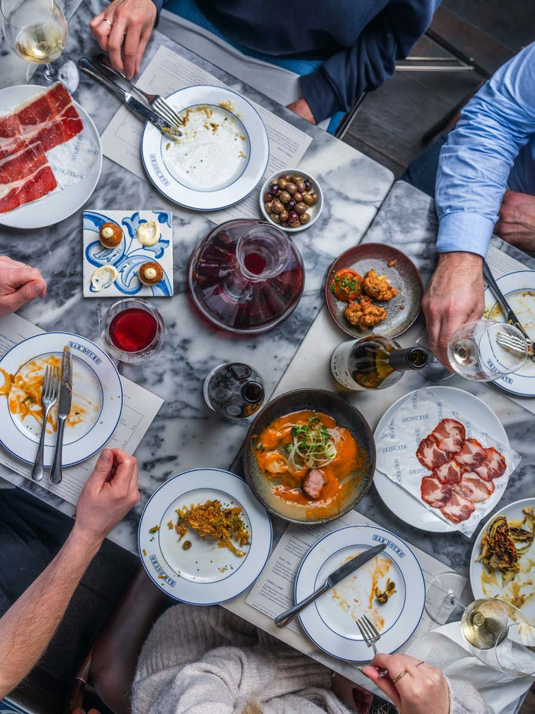

GROUP DINING MENUS
Our sharing style menu features iconic Portuguese dishes such as Bacalhau à Brás (salt cod hash), Cavala alimada com escabeche (marinated mackerel), and indulgent meat courses like Picanha com tutano (grilled picanha steak
& bone marrow sauce).
Pair your meal with our award winning wine list, the largest Portuguese selection in the UK, featuring indigenous grape varieties and pioneering winemakers. The wine selection perfectly complements our small plates, making every group dining experience truly special.

Slide 4




FESTIVE SHARING MENU
FESTIVE SHARING MENU
FESTIVE SHARING MENU
49.75
PP
42.75
PP
Group Sharing Menus are available for groups of 6+ guests. All dishes are served for the whole table to share.
Group Sharing Menus are available for groups of 6+ guests. All dishes are served for the whole table to share.
Croquetes de alheira Portuguese sausage croquetes
Pataniscas de bacalhau Salt cod fritters Salada de polvo Octopus salad
Croquetes de alheira Portuguese sausage croquetes
Pataniscas de bacalhau Salt cod fritters
Paio do Cachaço de Porco Preto Acorn fed black pig neck (3
Presunto Varanegra Hand cut acorn fed black pig ham (7.25
supplement pp
)
Paio do Cachaço de Porco Preto Acorn fed black pig neck (3
Presunto Varanegra Hand cut acorn fed black pig ham (7.25
supplement pp
)
supplement pp
)
supplement pp
)
-
-
Bacalhau à Brás Salt cod hash Cavala alimada com escabeche Marinated mackerel Gambas à Guilho Garlic prawns
-
Cachaço de porco com molho de Bifana Pork neck & Bifana sauce Bochechas de boi e couve-flor Beef cheeks & cauliflower
Bacalhau à Brás Salt cod hash
Gambas à Guilho Garlic prawns
Cherne com feijão e nabos Stone bass, beans, pork jowl & turnips
-
Bochechas de boi e couve-flor Beef cheeks & cauliflower
Presa de Porco Preto com açorda Acorn-fed black pig & bread porridge
Batatas a murro Garlic punched potatoes (ve) Couve grelhada Grilled cabbage & soubise (v)(ve)*
-
Batatas a murro Garlic punched potatoes (ve) Couve grelhada Grilled cabbage & soubise (v)(ve)*
-
Cheese selection, homemade jam & oat biscuits
(4.75
supplement pp)
Cheese selection, homemade jam & oat biscuits
(4.75
supplement pp)
-
-
Pastel de nata Custard tart & cinnamon ice cream (v)
Pastel de nata Custard tart & cinnamon ice cream (v)
(v) = vegetarian
|
(ve) = vegan
|
(v)* = vegetarian option available
|
(ve)* = vegan option available
(v) = vegetarian
|
(ve) = vegan
|
(v)* = vegetarian option available
|
(ve)* = vegan option available
Dishes are subject to change according to seasonality & availability. Supplements must be chosen for the whole group. Vegetarian/Vegan
menu available upon request. We handle all allergens in the kitchen. Please inform us of any allergies or dietary intolerances. Fish & meat
dishes may contain small bones. Our cheeses may be unpasteurised. Discretionary 13.5% service charge will be added to your bill.
VAT is included. We are a cashless restaurant. All payments must be made via credit or debit card.
Dishes are subject to change according to seasonality & availability. Supplements must be chosen for the whole group. Vegetarian/Vegan
menu available upon request. We handle all allergens in the kitchen. Please inform us of any allergies or dietary intolerances. Fish & meat
dishes may contain small bones. Our cheeses may be unpasteurised. Discretionary 13.5% service charge will be added to your bill.
VAT is included. We are a cashless restaurant. All payments must be made via credit or debit card.

Slide 5
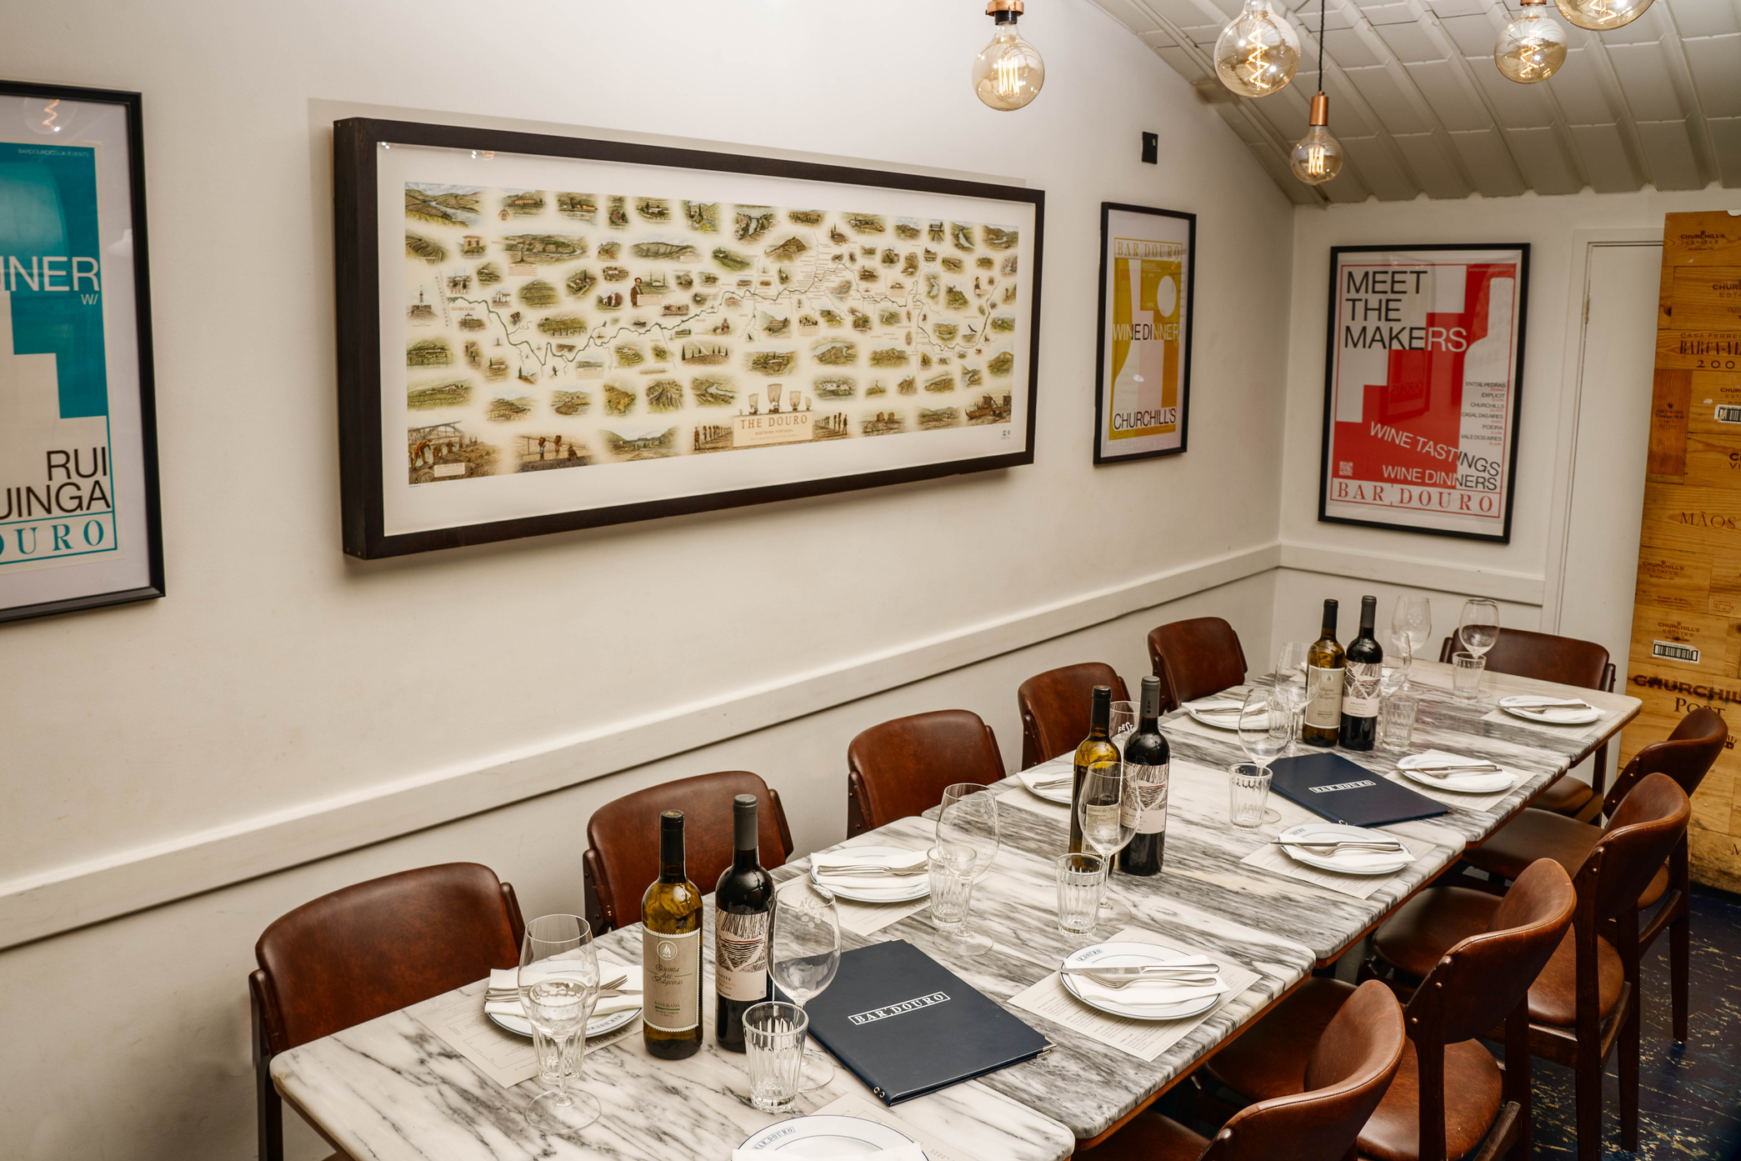
BAR DOURO LONDON BRIDGE
Occupying a railway arch in Southwark Quarter, Bar Douro was created to bring authentic Portuguese food and wine to London. Our wine cellar on the mezzanine seats groups of 6 to 12 people and is perfect for office parties, family dinners, friendly gatherings, or any other excuse to get together.
Reservations can be made online for up to 6 guests. Send us an email to enquire londonbridge@bardouro.co.uk

Slide 6
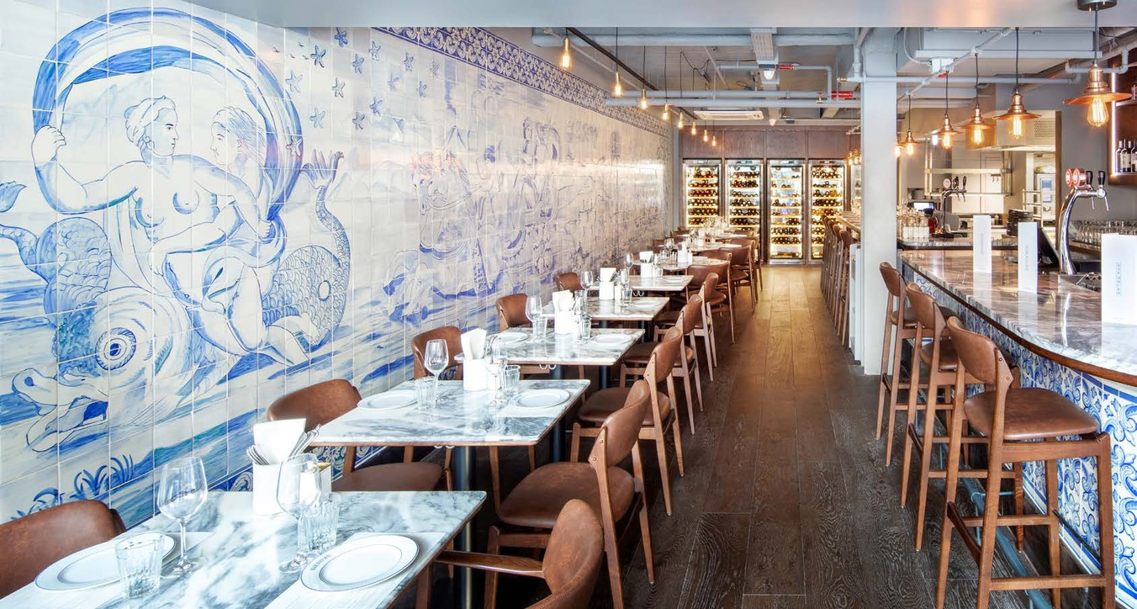
BAR DOURO CITY
Our elegant and comfortable dining space is adorned with blue and white azulejo tiles, a perfect backdrop for group bookings. Reservations can be made online for up to 8 guests. For larger groups up to 20 please enquire.
Please enquire via email for groups of 9 or more city@bardouro.co.uk
*Please note that for groups up to 8 you can book online, set menu is available but not compulsory. Book here.

Slide 7
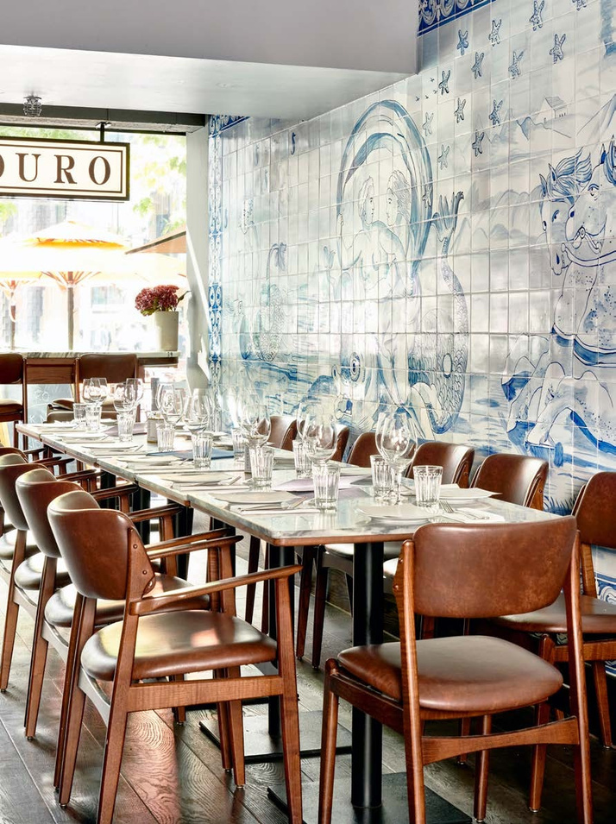

PRIVATE HIRE AT BAR DOURO CITY
For groups larger than 20 we can offer both seated and standing with a maximum capacity of 32 for seated parties and 45 for standing. Seated parties will be spread over 3 or 4 tables and our group dining
menu will be served.
For a standing reception, we offer our canape menu
at £30 per person.
Send us an email to enquire city@bardouro.co.uk
*Please note that private hireissubject to a minimum spend.

Slide 8


GROUP SHARING MENUS
GROUP SHARING MENU
GROUP SHARING MENU
£42.5 per person
£49.5 per person
Group Sharing Menus are available for groups of 6+guests. All dishes are servedfor the table to share.
Group Sharing Menus are available for groups of 6+guests. All dishes are servedfor the table to share.
Croquetes de alheira Portuguese sausage croquetes
Pataniscas de bacalhau Salt cod fritters
Croquetes de alheira Portuguese sausagecroquetes
Pataniscas de bacalhau Salt cod fritters Salada de polvo Octopus salad
Ostras Oysters & Quinta das Bageiras mignonette (£5supplementeach)*
Paio do Cachaço de Porco Preto Acorn fed black pig neck(£3supplementpp) Presunto de porco preto Acorn fed black pig ham (£5.5supplementpp)
~
Ostras Oysters & Quinta das Bageiras mignonette (£5supplementeach)*
Paio do Cachaço de Porco Preto Acorn fed black pig neck(£3supplementpp) Presunto de porco preto Acorn fed black pig ham (£5.5supplementpp)
~
Cavala alimada com escabeche Marinatedmackerel Bacalhau à Brás Salt cod hash Gambas à Guilho Garlic prawns
~
Espetada de porco Grilledporkskewer
Picanha com tutano Grilled picanhasteak&bonemarrowsauce
Or
Grilled sirloin steak & bone marrowsauce(7supplementpp)*
Bacalhau à Brás Salt cod hash
Gambas à Guilho Garlic prawns Tamboril com feijoada de chocos Monkfish & cuttlefish bean stew
~
Bochechas de Porco e abóbora assadaPigcheeks&roastsquash
Picanha com tutano Grilled picanhasteak&bonemarrowsauce
Or
Grilled sirloin steak & bone marrowsauce(7supplementpp)*
Batatas a murro Garlic punchedpotatoes
Couve grelhada Grilled cabbage&soubise
~
Batatas a murro Garlic punchedpotatoes
Couve grelhada Grilled cabbage&soubise
~
Cheese selection homemade jam & oat biscuits (£4.75 supplement pp)
~
Cheese selection, homemade jam & oat biscuits (£4.75 supplement pp)
~
Pastel de nata Custard tart & cinnamon ice cream
Pastel de nata Custard tart & cinnamon ice cream
Dishes are subject to change according to seasonality & availability.
Dishes are subject to change according to seasonality & availability.
Supplements must be chosen for the whole group. *Availble on preorder. Vegetarian/Vegan menu available upon request. We handle all allergens in the kitchen. Please inform us of any allergies or dietary intolerances. Fish & meat dishes may contain small bones. Our cheeses may be unpasteurised. Discretionary 12.5% service charge will be added to your bill. VAT is included. We are a cashless restaurant. All payments must be made via credit or debit card.
Supplements must be chosen for the whole group. *Availble on preorder. Vegetarian/Vegan menu available upon request. We handle all allergens in the kitchen. Please inform us of any allergies or dietary intolerances. Fish & meat dishes may contain small bones. Our cheeses may be unpasteurised. Discretionary 12.5% service charge will be added to your bill. VAT is included. We are a cashless restaurant. All payments must be made via credit or debit card.

Slide 9
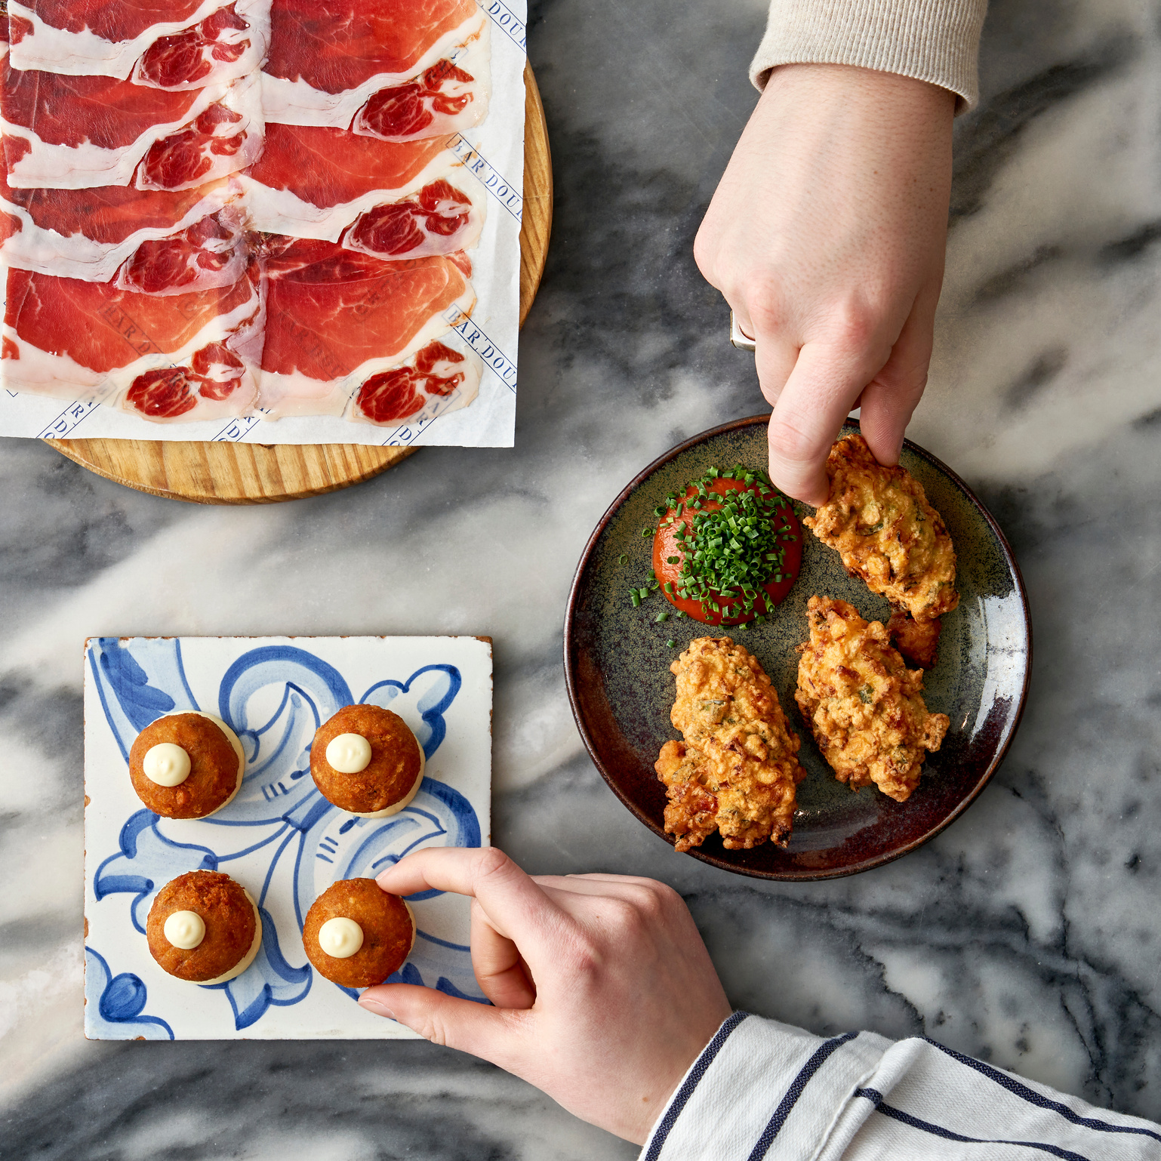

CANAPE MENU
CANAPE MENU
£30 per person
PETISCOS | SNACKS
Milho frito Crispy polenta & fermented redpeppersauce(ve)
Espetada de cogumelos Grilled mushroomskewers(ve)
Pataniscas de bacalhau Salt cod fritters Tiborna de cavala alimada Marinated mackerelontoast
Espetada de polvo Grilled octopus skewers
Croquetes de alheira Smoked Portuguese sausagecroquetes
Tiborna de pato confitado Confit duckontoast
Espetada de porco Grilled pork skewer
Preguinho Mini steak bun (£5 supplementeach)
Queijo & Enchidos Cheese & CuredMeats Selection(£8supplementeach)
TIGELAS | BOWLS
Arroz de cogumelos selvagens Wild mushroom rice (v)(ve)* (£6 supplement each) Bacalhau à Brás Salt cod hash (£5 supplement each) Bochechas de Porco e abóbora Pig cheeks & roast squash (£8 supplement each)
SOBREMESA | DESSERT
Pastel de nata Custard tart (v) (£3 supplement each)
Supplements must be chosen for the whole group.
(v) = vegetarian (ve) = vegan
(v)* = vegetarian option available (ve)* = vegan option available Extra Vegetarian/Vegan options available upon request. We handle all allergens in the kitchen. Please inform us of any allergies or dietary intolerances. Fish & meat dishes may contain small bones. Our cheeses may be unpasteurised. Discretionary 12.5% service charge will be added to your bill. VAT is included. We are a cashless restaurant. All payments must be made via credit or debit card.

Slide 10
FAQ
HOW DO THE SUPPLEMENTS WORK?
Supplements must be chosen for the whole group. Some supplements are only available on preorder.
DO YOU CATER FOR VEGETARIAN/VEGAN?
Vegetarian/Vegan menu available upon request.
DO YOU CATER FOR ALLERGIES AND OTHER DIETARY REQUIREMENTS?
Please inform us of any allergies or dietary requirements in advance so we can adjust the menu accordingly. Please note that our meat is not halal, and we can’t cater for kosher diet.
DO WE NEED TO PAY A DEPOSIT?
Deposits are only required for private hires, for smaller groups credit card details are required. Credit card will only be use if cancelation policy is not followed. Details will be stored on Stripe a secure system that works with our reservation system SevenRooms.
WHAT IS THE CANCELATION POLICY?
For private hires, deposit will not be refunded if you cancel within 7 days. For other group bookings our cancellation policy is 72 hours, with a charge of £20 per head. This includes late cancellations, no shows, or requests to move the date of the booking.
CAN I ORDER A LA CARTE?
Group menus are compulsory for groups of 7 or more at Bar Douro London Bridge & 9 or more at Bar Douro City. We can adapt the menus for dietary requirements.

Slide 11
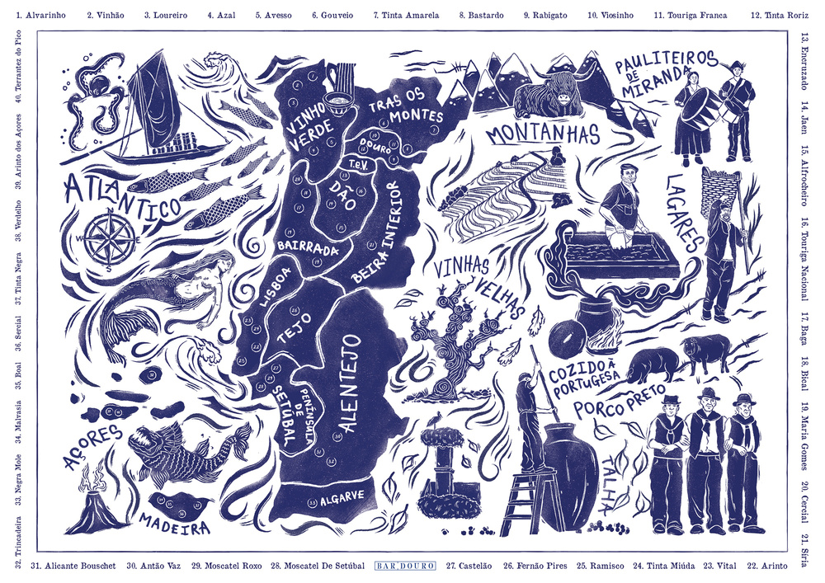
LONDON BRIDGE
CITY
Arch 35B 85B Southwark Bridge Rd
Finsbury Avenue Square
London, SE1 0NQ
Unit 3 1 Finsbury Avenue
02073780524 (option 1)
londonbridge@bardouro.co.uk
London, EC2M 2PF
02073780524 (option 2)
city@bardouro.co.uk
www.bardouro.co.uk
INSTAGRAM
FACEBOOK
@bardouro
@bardourouk

