Slide 1


January 2025 Awareness:
National Mental Wellness Month
TIPS FOR PRIORITIZING YOUR WELL-BEING:
Practice daily check-ins: Take a moment each day to ask yourself how you’re doing.
Set healthy boundaries: Protect your time and energy
Move your body: Regular movement can boost mood and reduce stress.
Stay connected: Community and conversation can help lighten emotional load.
Create moments of rest: Schedule time to unplug, breathe, and recharge without guilt.
Seek support when needed: Talking to a counselor or using available resources is a sign of strength

Slide 2

February 2025 Awareness:
American Heart Month
QUICK TIPS FOR A STRONGER HEART:
Eat Smart: Load up on fruits, veggies, whole grains, and lean proteins.
Move Daily: 150 minutes of activity per week keeps your heart pumping strong.
Quit Smoking: Every cigarette avoided is a win for your heart.
Manage Stress: Try deep breathing, meditation, or a mindful moment daily
Sleep Well: 7–9 hours of rest lets your heart recharge.

Slide 3
February 2025 Awareness:
American Heart Month
DID YOU KNOW....
Chronic stress, anxiety, and social isolation can strain your cardiovascular system.
Staying connected with loved ones, engaging in activities that bring joy, and practicing mindfulness are all essential components of heart health.

Slide 4

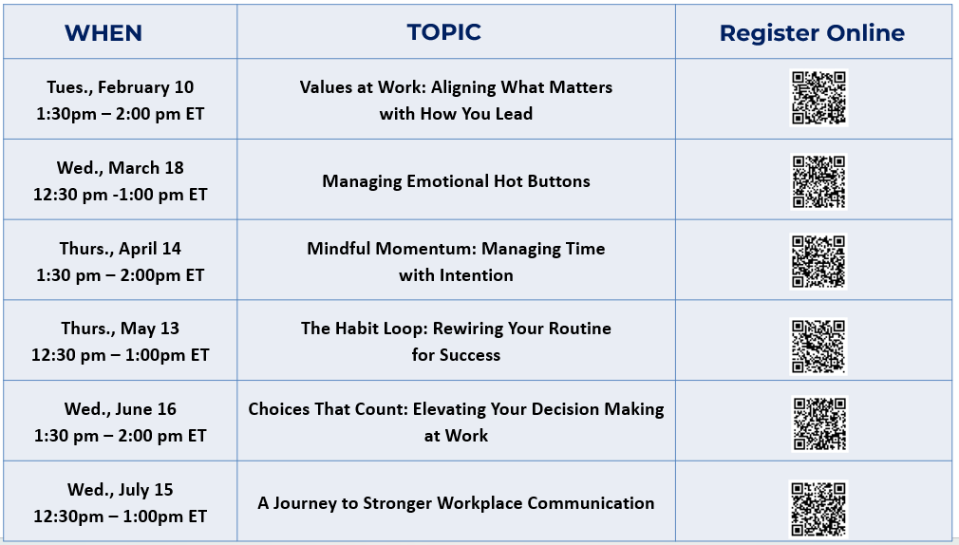
2026 THRIVE EDUCATIONAL WEBINARS

Slide 5
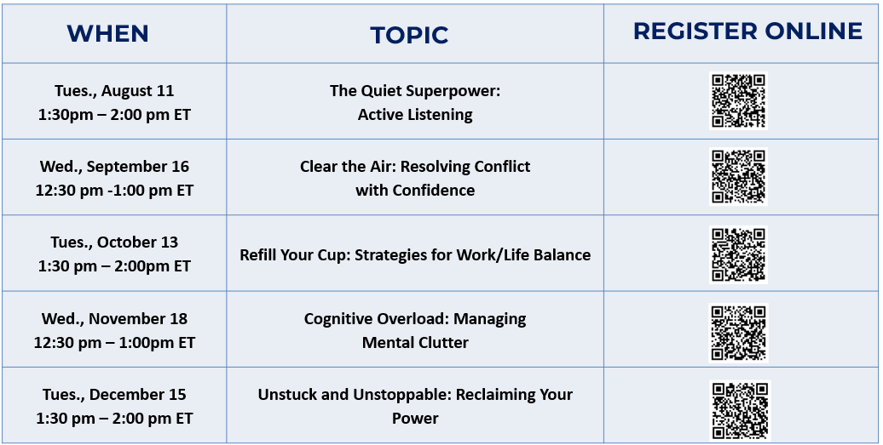
2026 THRIVE EDUCATIONAL WEBINARS

