Slide 1


July Awareness:
Disability Pride Month
Celebrating identity, visibility, and the contributions of people with disabilities.
Disability Pride Month commemorates the signing of the Americans with Disabilities Act (ADA) and recognizes disability as a natural and valuable part of human diversity.
WHY IT MATTERS IN THE WORKPLACE
HOW EMPLOYEES CAN SHOW SUPPORT
1 in 4 adults in the U.S. lives with a disability
Many disabilities are non-visible
Inclusion drives innovation, empathy, and stronger teams
Use respectful, person-centered language
Avoid assumptions about abilities or needs
Be mindful of accessibility in meetings, emails, and materials
Listen and learn from lived experiences
Support accommodations and inclusive practices
Amplify voices—don’t speak for others

Slide 2

August Awareness:
National Wellness Month
HOW YOU CAN PRIORITIZE WELLNESS
Take regular breaks to recharge throughout the day
Set boundaries to protect work-life balance
Stay active—even short walks can boost mood and energy
Practice mindfulness (deep breathing, meditation, gratitude)
Use available benefits (EAP, mental health resources, wellness programs)
Check in with yourself and others—connection matters
DID YOU KNOW....
Chronic workplace stress is linked to increased risk of anxiety, depression, heart disease, and burnout—making daily wellness habits more important than ever.

Slide 3

September Awareness:
Suicide Prevention Awareness Month
HOW YOU CAN SUPPORT YOURSELF & OTHERS
Check in with yourself and your colleagues regularly
Listen without judgment and take concerns seriously
Know the warning signs (withdrawal, mood changes, talking about hopelessness)
Encourage seeking help—professional support makes a difference
Use available resources (EAP, mental health benefits, crisis lines)
If you’re struggling, reach out—you don’t have to handle it alone
DID YOU KNOW....
In the U.S., suicide is a leading cause of death—and many people who are struggling show warning signs that, when recognized, create opportunities to help.

Slide 4
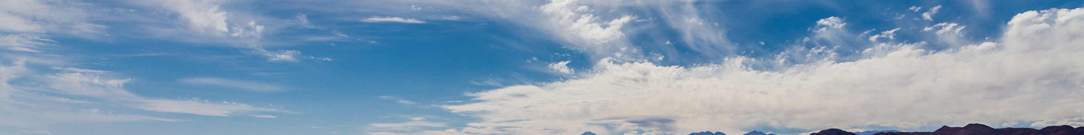
September Awareness:
Recovery Awareness Month
WHY NATIONAL RECOVERY MONTH MATTERS
It breaks silence. Talking about recovery reduces stigma around substance use and mental health challenges.
It honors strength. Every recovery journey is a story of courage, growth, and resilience.
It spreads hope. Recovery is not only possible — it happens every day, in every community.
It reminds us: No one is alone.
DID YOU KNOW....
Millions of Americans are living in recovery—proof that treatment, support, and community can make a lasting difference.

