Slide 1


November Awareness:
National Family Caregivers Month
WHY IT MATTERS IN THE WORKPLACE
WHY IT MATTERS IN THE WORKPLACE
  Many employees are “working caregivers” balancing dual responsibilities
  Caregiving demands can impact stress, attendance, and productivity
  Supportive workplaces improve retention and employee well-being
  Be flexible and understanding with colleagues who may have caregiving needs
  Avoid assumptions about availability or commitments outside of work
  Encourage use of benefits such as EAP, caregiving resources, or leave options
  Foster a culture of empathy and open communication
DID YOU KNOW....
Over 1 in 5 adults in the U.S. serves as a family caregiver, often balancing caregiving responsibilities with full-time work.

Slide 2

November Awareness:
National Alzheimer's Awareness Month
HOW YOU CAN SHOW SUPPORT
  Practice patience and empathy with colleagues who may be caregiving
  Respect privacy around personal or family health matters
  Offer flexibility, when possible, to support caregiving needs
  Learn about dementia to better understand its impact
  Share resources such as EAP or Alzheimer’s support organizations
DID YOU KNOW....
Alzheimer’s disease is the most common cause of dementia, and it affects not only individuals, but millions of family members and caregivers as well.

Slide 3
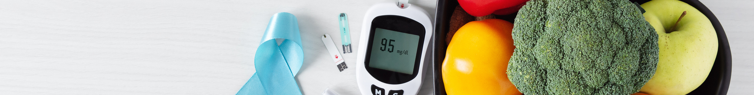
November Awareness:
National Diabetes Awareness Month
SMALL HABITS, BIG IMPACT
  Prioritize balanced meals and regular movement during the workday
  Encourage preventive care and routine screenings
  Be mindful of break needs for meals, medication, or monitoring
  Support a stigma-free environment around chronic health conditions
  Use available wellness resources (EAP, health plans, wellness programs)
DID YOU KNOW....
More than 1 in 10 adults in the U.S. has diabetes, and many more are at risk or unaware they have prediabetes.

Slide 4

December Awareness:
Seasonal Affective Disorder Awareness
HOW TO OVERCOME SAD:
  Maximize natural light during the day when possible
  Take movement and outdoor breaks to boost mood and energy
  Maintain consistent sleep and routine habits
  Check in with yourself and others about mental well-being
  Use available resources (EAP, therapy benefits, wellness programs)
  Speak up early if you’re struggling, support can help
DID YOU KNOW....
SAD affects millions of people in the U.S. each year, with symptoms often linked to reduced sunlight and changes in circadian rhythm.

