Slide 1





October Awareness:
Breast Cancer Awareness Month
HOW EMPLOYEES CAN TAKE ACTION
Schedule routine screenings (mammograms and clinical exams)
Know your risk factors and family history
Encourage open conversations about health and prevention
Support colleagues who may be impacted—with empathy and flexibility
Participate in awareness efforts (wear pink, join fundraisers, share resources)
EAP Services - Available 24/7
📞 Call NEAP at 800-624-2593
🌐www.nationaleap.com/my-eap
📋 Complete the Online EAP Intake Form
🌐 Member Portal
DID YOU KNOW....
When detected early, the 5-year survival rate for breast cancer is over 90%, highlighting the importance of regular screenings and awareness.

Slide 2
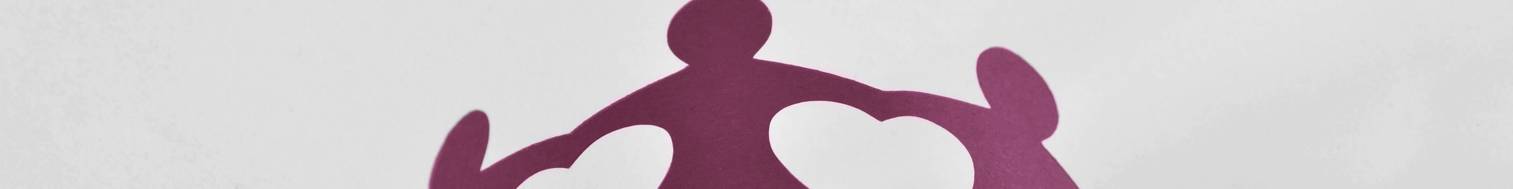
October Awareness:
Intimate Partner Violence Awareness
HOW EMPLOYEES CAN SUPPORT THEMSELVES & OTHERS
Learn the warning signs (unexplained absences, anxiety, isolation, changes in behavior)
Listen without judgment and believe disclosures
Respect privacy and avoid pressuring someone to share details
Share resources when appropriate (EAP, HR, local support services)
If you are experiencing IPV, know help is available, you are not alone
IF YOU NEED HELP
EAP Services - Available 24/7
📞 Call NEAP at 800-624-2593
🌐www.nationaleap.com/my-eap
📋 Complete the Online EAP Intake Form
🌐 Member Portal
In the US you can contact the National Domestic Violence Hotline:
Call 1-800-799-7233 or text START to 88788 for confidential support.
Also, NEAP (National EAP), your EAP provider is always here for you.

Slide 3

October Awareness:
World Mental Health Day
WHY IT MATTERS IN THE WORKPLACE
WHAT YOU CAN DO
Mental health directly impacts engagement, focus, and productivity
Stigma can prevent people from seeking help early
Supportive environments improve retention, morale, and well-being
Normalize conversations about mental health
Take breaks and set boundaries to prevent burnout
Use available resources (EAP, therapy benefits, wellness programs)
Listen without judgment if someone chooses to share
Encourage seeking help early, support makes a difference
DID YOU KNOW....
EAP Services - Available 24/7
📞 Call NEAP at 800-624-2593
🌐www.nationaleap.com/my-eap
📋 Complete the Online EAP Intake Form
🌐 Member Portal
1 in 5 adults experiences a mental health condition each year, but many do not receive the support or care they need.

Slide 4

October Awareness:
National Disability Employment Awareness
HOW EMPLOYEES CAN SUPPORT INCLUSION
Use inclusive, respectful language and person-first or identity-first preferences as appropriate
Design for accessibility in meetings, documents, and digital content
Avoid assumptions about what people can or cannot do
Respect confidentiality around accommodations
Listen to lived experiences and amplify disability voices
EAP Services - Available 24/7
📞 Call NEAP at 800-624-2593
🌐www.nationaleap.com/my-eap
📋 Complete the Online EAP Intake Form
🌐 Member Portal
DID YOU KNOW....
Over 1 in 4 adults in the U.S. lives with a disability, and many disabilities are non-visible—making inclusive design and awareness essential in every workplace.

