Slide 1

Your Employee Assistance Program (EAP)
National EAP (NEAP) Provides Confidential Support and Resources to Help You:
Navigate personal challenges
Professional stress
Manage mental health
Manage Work-Life Balance
Always Confidential
and Available.

Slide 2
Why USE YOUR EAP?
  Health and Nutrition Needs
  Domestic and Intimate Partner Violence
  Caregiving Stress
  Legal and Financial Concerns
  Workplace Issues
  Professional and Personal Development Goals
Personal Stress
Work Stress
Mental and Behavioral Health Concerns
Marital and Family Issues
Addiction Concerns
Grief and Bereavement

Slide 3
Your Employee Assistance Program (EAP)
What You Gain by
Using Your EAP
When Contacting
NEAP You Can Expect:
Personalized Consultations
Access to Multiple Expert Services
Support for Both Work and Personal Challenges
Practical Tools for Everyday Wellness
Confidentiality: Your privacy is fully protected.
Quick Response: Timely access to the right level of care.
Empathy & Compassion: Real humans who genuinely want to help.
Ongoing Support: Continued resources and follow-up,

Slide 4
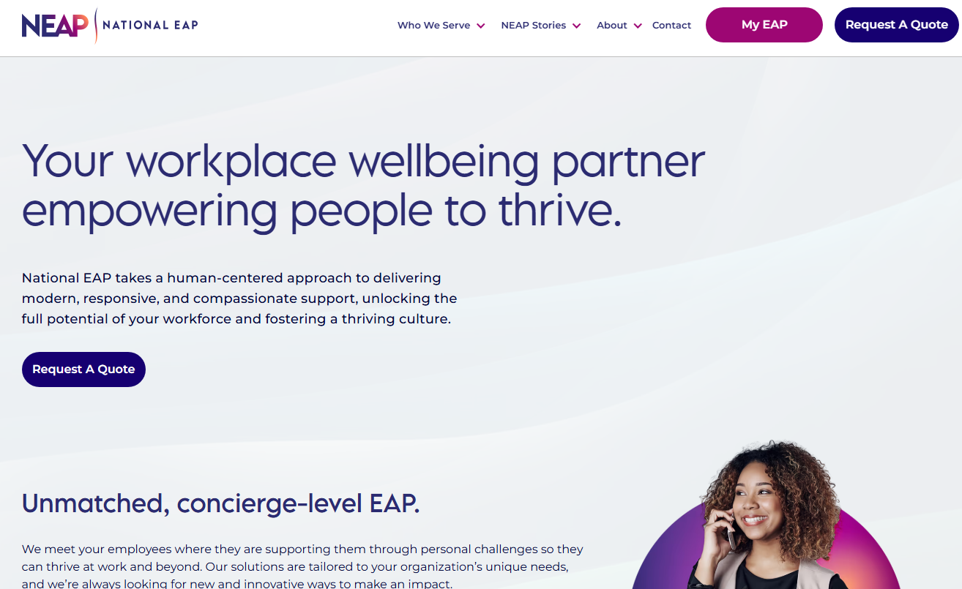
Accessing Your EAP
Visit www.nationaleap.com and click “MY EAP” to complete an online intake and connect to services
Contact Us Today:
Call 24/7: 1-800-624-2593
Email: info@nationaleap.com
Live Chat: www.nationaleap.com

Slide 5




EAP & Work-Life Services
Support is available 24/7 through National EAP.
If you or someone you know is struggling, call 800-624-2593 or Contact Us Online for a free, confidential support, counseling, and crisis intervention.
EAP Services Include:
  Confidential Support & 24/7 Crisis Counseling
  EAP Counseling Sessions, no cost to members
  Pre-Qualified Referrals to Therapists, Community Resources, and Treatment Providers.
Work-life Services:
  Legal, financial, ID theft consultation
  Child and elder care resources and referrals
  Housing resources and referrals
EAP Services - Available 24/7
📞 Call NEAP at 800-624-2593
🌐 www.nationaleap.com/my-eap
📋 Complete the Online
EAP Intake Form

Slide 6

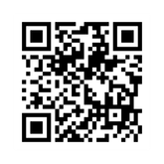
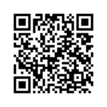
Wellness Services
WYSA
NUTRITION HEALTH
CBT-based mental resilience app that offers AI-powered chatbot, for personalized emotional support, and 150+ self-care tools.
Key Features:
  Easily accessible online
  Anonymous
  Confidential
EAP referrals to specialized nutrition counseling services include:
  Weight Management & Weight Loss Drug Support
  Diabetes & Blood Sugar Management
  Women’s Health & Hormonal Balance
  High Cholesterol & Cardiovascular Health
  Gut Health & Digestive Wellness
  Stress Management & Energy Optimization
Download Wysa
Learn More

Slide 7

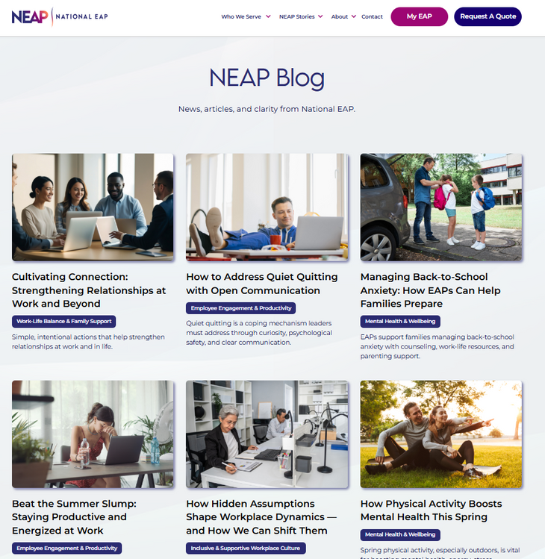
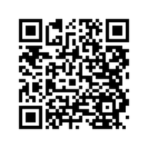
NEAP BLOG
CHECK OUT THE LATEST NEAP STORIES

Slide 8
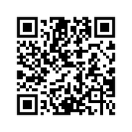
Contact Your EAP Provider
Don’t Hesitate to Reach Out to National EAP (NEAP) or
Visit Your Member Portal for Online Resources.
EAP Services - Available 24/7
📞 Call NEAP at 800-624-2593
🌐 www.nationaleap.com/my-eap
📋 Complete the Online
EAP Intake Form
Access Your Member Portal Online >>

