Slide 1

Top 5 Pricing Insights: Q3 Strategy Debrief
Masterclass Presented by James Wilton on September 26, 2024

Slide 2
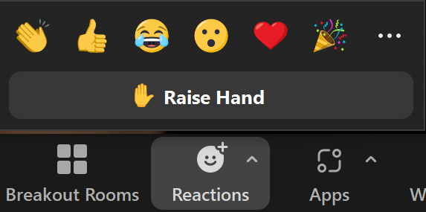

Brought to you by The Cube – our premiere pricing community
Masterclass Norms
Masterclasses are not intended to be “webinars” – they are content-facilitated discussion groups.
Please be “on camera” if you are able to be
Raise your hand to ask a question or raise a point
If you are not able to speak live, send questions in the Zoom chat
Today’s Topic
Pricing Strategy Q3 Roundup
Rough Agenda
Min. 5 – 45 – Review Core Principals & Cases
Min. 45 – 55 – Q&A
Min 55 – 60 – News + Wrap Up

Slide 3
We’ve covered a lot of ground over the past 13 weeks…
July 1, 2024
July 18, 2024
August 1, 2024
“Making Freemium Work in B2B”
“Price-setting Fact bases”
“Crafting Scalable Price Architectures
August 20, 2024
August 29, 2024
September 12, 2024
“B2B Product-Led Growth for Enhancing Customer Acquisition”
“Implementing B2B SaaS Pricing and Packaging”
“Discounting that Drives Growth
w/ guest Fynn Glover, Schematic

Slide 4
Top 5 Takeaways From Q3 Masterclasses
1
Freemium success depends on fine tuning of free & paid tiers
Optimized PLG looks different in B2B
There is no single "best" price setting data source or technique
It's not just which metric, but HOW that metric scales price
Discounting is not the enemy - unnecessary discounting is
2
3
4
5

Slide 5
Top 5 Takeaways From Q3 Masterclasses
1
Freemium success depends on fine tuning of free & paid tiers
Optimized PLG looks different in B2B
There is no single "best" price setting data source or technique
It's not just which metric, but HOW that metric scales price
Discounting is not the enemy - unnecessary discounting is
2
3
4
5

Slide 6










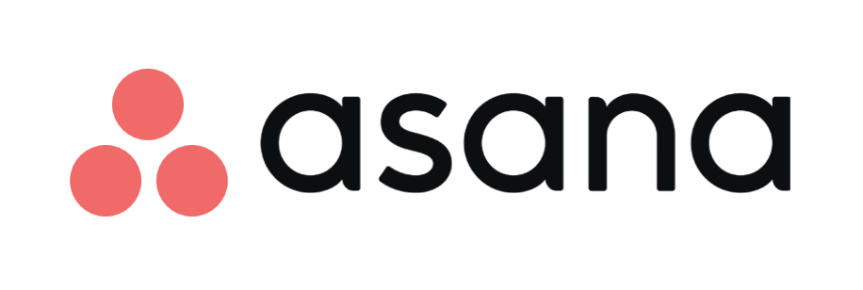
B2B Freemium Best Practices
Make the free version wonderful… for some customers
Create a marked leap in value to the first paid version
Set a
low barrier to paid
Be
clear
and transparent
Provoke the upgrade

Slide 7
The “fine-tuning” happens here
Make the free version wonderful… for some customers
Create a marked leap in value to the first paid version
Set a
low barrier to paid
Be
clear
and transparent
Provoke the upgrade

Slide 8
Design of the price:value relationship between the free and first paid tier is CRITICAL to your freemium model’s success
Paid Value jump must be…
High enough to make upgrading compelling
Low enough to provide option for additional tiers (assuming you want them…)
Price
Paid Value Jump
Paid
Paid Price Jump
Paid Price jump must be…
Low enough to overcome the psychological barrier of upgrading
High enough to cover the cost of free customers
Free Value must be…
High enough to delight some customers
Low enough that many customers will want/need to upgrade
Free Value
Free
Value

Slide 9
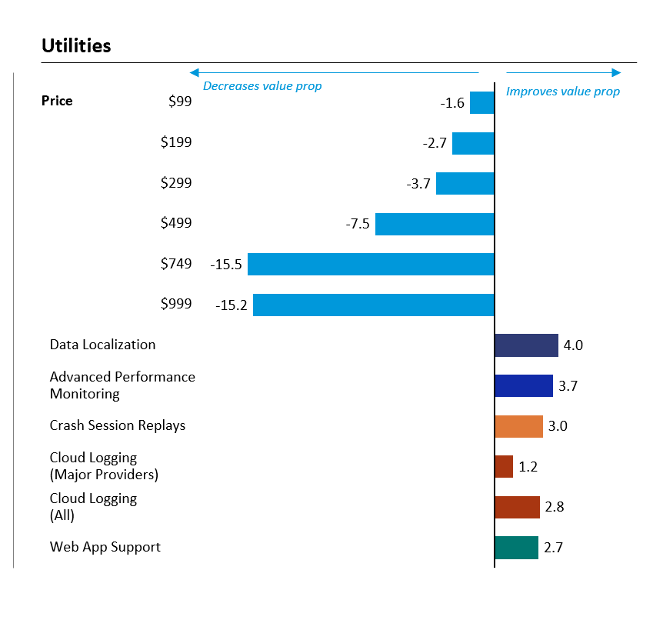
Conjoint is great for optimizing free-paid conversion
Option A
Option B
Feature A
Included
Included
Feature B
Not Included
Included
Feature C
None of the above
Not Included
Included
Feature D
Not Included
Included
Feature E
# Users
2
Unlimited
Revenue = $X.XM (Y% of max)
% Free Users = A%
% Paid Users = B%
% No purchase = C%
Annual Price¹
Free
$199

Slide 10
Top 5 Takeaways From Q3 Masterclasses
1
Freemium success depends on fine tuning of free & paid tiers
Optimized PLG looks different in B2B
There is no single "best" price setting data source or technique
It's not just which metric, but HOW that metric scales price
Discounting is not the enemy - unnecessary discounting is
2
3
4
5

Slide 11
The 7 commandments of B2B PLG Pricing
1.
2.
3.
4.
5.
6.
7.
Keep packaging sufficiently simple and clear
Gate packages appropriately
Prioritize freemium over free trial
Scale outside the packages
Choose a growth-oriented, value-based and acceptable metric
Invest in rigorous price optimization
Avoid over-discounting or over-promoting

Slide 12
2 commandments are truly different for B2B
1.
2.
3.
4.
5.
6.
7.
Keep packaging sufficiently simple and clear
Gate packages appropriately
Prioritize freemium over free trial
Scale outside the packages
Choose a growth-oriented, value-based and acceptable metric
Invest in rigorous price optimization
Avoid over-discounting or over-promoting

Slide 13

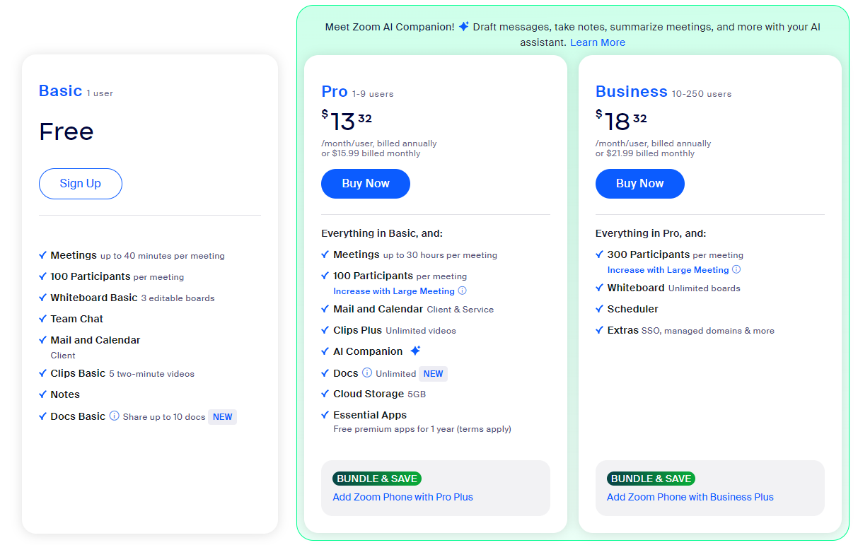
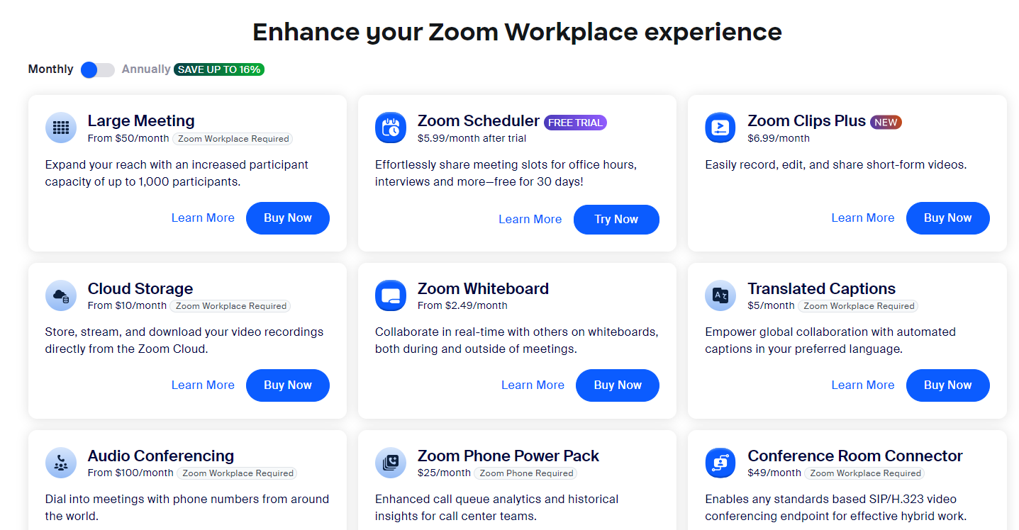

1. Keep packaging sufficiently simple and clear

Slide 14

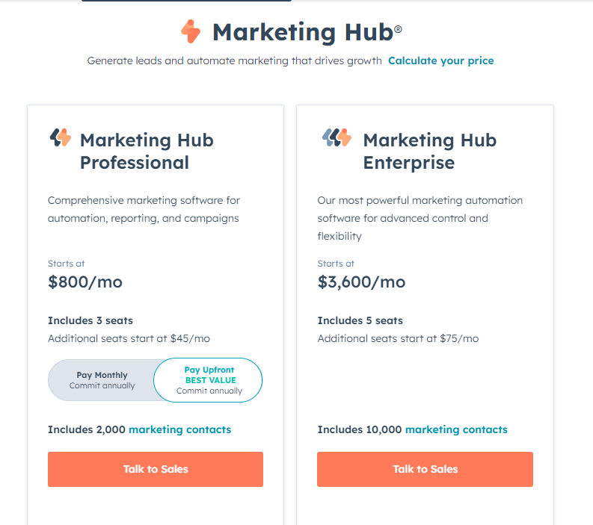

1. Keep packaging sufficiently simple and clear

Slide 15
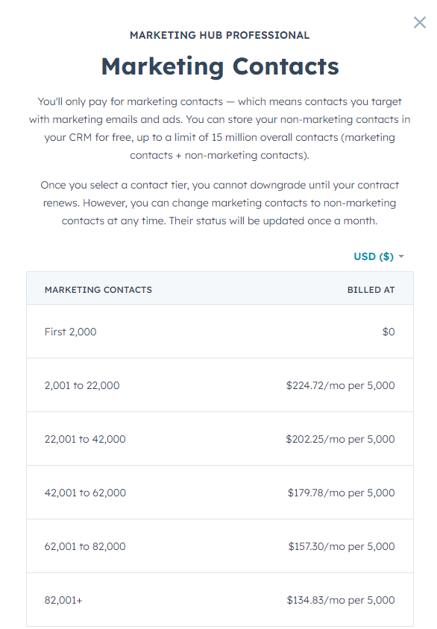
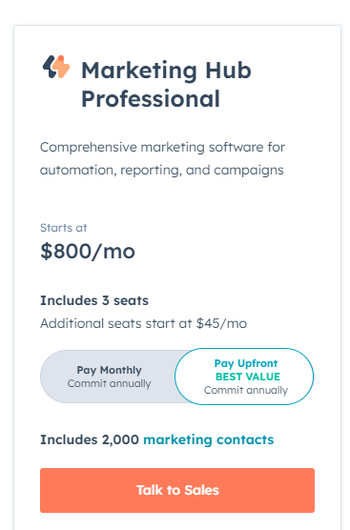

4. Scale outside the packages

Slide 16
Top 5 Takeaways From Q3 Masterclasses
1
Freemium success depends on fine tuning of free & paid tiers
Optimized PLG looks different in B2B
There is no single "best" price setting data source or technique
It's not just which metric, but HOW that metric scales price
Discounting is not the enemy - unnecessary discounting is
2
3
4
5

Slide 17
Key Takeaways for Price Setting Fact-bases
You shouldn’t be using just one technique – use multiple data sources to set prices
Price setting is based on costs and varying measures of willingness-to-pay
Willingness-to-pay can be estimated through multiple techniques, with varying levels of difficulty and accuracy and situational aptitude

Slide 18
7 Key Methodologies for Building a Price Setting Fact Base
 | Transaction-Based Methods: |  |  | Research-Based Methods: |  |  |  |  | Value-Based Methods:
 | Historical Transaction Data Analysis | Price testing |  | Van Westendorp | Gabor-granger | Conjoint | Value Profiling |  | Economic Value Estimation (EVE)
What It Does | Estimate WTP by identifying consistent net prices paid by specific customer segments | Understand the response to changing price levels |  | Determine viable price range for each customer | Find optimal price point for each customer | Optimize price and product configuration | Determine price premium you can command vs. competition |  | Determine how much you can charge based on value perception
How To Do It | 1. Examine the net prices after discounts in historical deals, and clustering customers based on similar profiles 2. Identify patterns such as increased win rates | 1. Alter prices 2. Observe changes in deal volume (vs. control) compare scenarios and control group to derive statistically significant results |  | Ask customers to define 4 price points: (1) Too expensive to consider, (2) Expensive, but still consider, (3) Inexpensive/ bargain, (4) Too cheap / questionable quality | Ask customers how likely they would be to purchase at a series of price points | 1. Define (small number of product attributes) and levels for those 2. Provide series of price & product config. Choices | 1. Determine ~10 product attributes 2. Rate importance of each attribute 3. Rate our product and competition on each attribute, and perceived price |  | Produce a value equation that quantifies the value that the product delivers Set an appropriate ROI
Best Use Cases | You have substantial past transaction data with varying discount levels, allowing you to identify trends and make informed estimates | • You need to finalize pricing decisions • You can gather large amounts of data quickly |  | You want a rough range of how different customers would expect to pay for a new product | You are trying to hone in on an optimal price point from an already tight range | You have already defined likely packages, and just need to optimize price | You are operating in a highly competitive market, with highly visible customers |  | Product adds significant, quantifiable value Product is a new concept
Limitations | Analysis is limited to what customers paid historically, as it does not account for what they might have paid under different strategies | • Cannot test a wide range of factors – only can tell which is best out of what you tested • Affects your customer base! |  | Works less well when: • Product is hard to describe / understand • Customer doesn’t have a reference point for what it “should” cost | Impractical when willingness-to-pay varies widely across a customer base | • Impractical when willingness-to-pay varies widely across a customer base • Requires large sample • Only viable for PLG | Only useful in competitive scenarios |  | Less compelling when product benefits are largely intangible

Slide 19
Van Westendorp is simple and adaptable
Sanitized client example
Methodology
Via Van Westendorp, prospects asked to define 4 price levels – prices that are:
Too expensive to even consider
Getting expensive, but still worth considering
Inexpensive – a “bargain”
So cheap that the value would have to be questions
Relative chance of purchase estimated for prices that fall into the ranges defined by the 4 price points
% of maximum
Profit
Revenue
Volume
0
50
100
150
200
250
300
350
400
450
500
550
600
Monthly
Price ($)
$150
$365
$490
Volume-maximizing price
Revenue-maximizing price
Profit-
maximizing price

Slide 20
Top 5 Takeaways From Q3 Masterclasses
1
Freemium success depends on fine tuning of free & paid tiers
Optimized PLG looks different in B2B
There is no single "best" price setting data source or technique
It's not just which metric, but HOW that metric scales price
Discounting is not the enemy - unnecessary discounting is
2
3
4
5

Slide 21
Price Architecture Challenges
People often think price scaling ends at the price metric, but the way you scale also has an impact on customer acceptability
Even if a metric is linked to value, it doesn’t mean rate of value increase is consistent as the metric units increase
Often, even value-aligned metrics can be unpredictable, which creates unpredictability in prices, and is a barrier to sales

Slide 22
There are several options for scaling price in accordance with your selected price metrics, including but not limited to these 7
Price Architecture Motif Types
Not exhaustive
Most variable, least predictable
Most predictable, least variable
2. Sliding scale
4. 2-part tariff
Pay a fixed recurring payment, with transactional rate on top
Increasing commitment decreases transactional rate
6. Capped
$
Per unit price decreases as metric crosses thresholds
$
$
Pay “per unit until you reach a max volume, where price is capped
Threshold
Option 2
Option 1
Upfront Commitment
Metric
Metric
Metric
1. Linear
3. Sawtooth
5. Overages
7. Banded
$
$
$
Price does not vary with Metric up until a capacity “limit”
is reached, at which point you pay per unit
$
Price “per unit” is discounted after threshold, and applies to entire volume
Total payment fixed within a “band” of the metric
Consistent per unit price
Threshold
Capacity Limit
Metric
Metric
Metric
Metric

Slide 23
Choosing the right curve is a matter of considering your Market Factors, Product Factors, and Objectives
Objectives
To what extent do you want to drive upsell vs retention (or satisfaction)?
How important is sales velocity vs. revenue maximization to you?
To what extent do you want to encourage increases in the metric volume?
Product
Factors
Market
Factors
To what extent can you control the metric volume?
Are there any constraints on metric volumes?
How do your costs scale with metric volumes?
To what extent do customers need/value predictability (e.g. for budgeting)?
How does the value to the customer increase as the metric increases?

Slide 24
Top 5 Takeaways From Q3 Masterclasses
1
Freemium success depends on fine tuning of free & paid tiers
Optimized PLG looks different in B2B
There is no single "best" price setting data source or technique
It's not just which metric, but HOW that metric scales price
Discounting is not the enemy - unnecessary discounting is
2
3
4
5

Slide 25
A key takeaway for today
Discounting is NOT the enemy!
The enemy is
UNNECESSARY discounting

Slide 26
Would a “no discounting EVER” policy work in practice?
What about these situations?
“You’re charging $11,000, but my budget is $10,000. I literally can’t sign off on anything above $10,000.”
“You literally can’t give me any discount at all? Can I speak to your manager?”
“I’d never get enough value to pay $11,000 because our use case is different. I might pay $8,000”
“You won’t give me anything off the price?? Seems like you don’t really want our business…”
Price differentiation / Flexibility
Rep autonomy / partnership

Slide 27
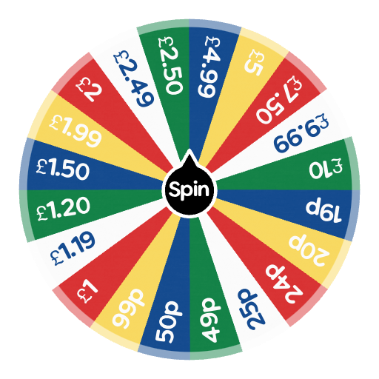
A reality to be considered
“I want a DEAL!
I don’t know what the quote will be, but whatever it is I’m going to ask for 20% off.”

Slide 28
You should plan for discounting through your price level setting
Typical price setting approach
Improved approach
List Price
$
Expected Discounting
Willingness-to-pay
Willingness-to-pay
List price
Target Price
Discounting
Sale price

Slide 29
Another key takeaway
Most reps in growing companies are paid a flat % commission. In that situation…
Sales Reps will always discount
AS MUCH AS THEY CAN

Slide 30
There are three tactics that should be implemented to ensure discounts are driving sales rather than leaking revenue
Tactic | Intent | Examples
Rules | Limit the freedom of the sales team to discount beyond acceptable levels, and/or for non-strategic reasons | Max discounting limits Situation-based discounts “Give-gets”
Incentives | Give sales reps “skin in the game” so that they want to price as high as they can | Price / Discount incentives “Kickers” Rankings tables …
Enablers | Make sales reps feel they have a higher chance of winning at higher price levels | Research data on willingness-to-pay Negotiation skills training Value messaging Playbooks.
Notes:
There will always be other reasons to discount – this is where rules (you can only discount X if Y), incentives (make sure salespeople do better if they discount less), and enablers (belief that you can win the higher price point) come in

Slide 31
Proposed structure for your price levels and discounting
$
List Price
Rep’s Discretionary Discounting
Expected Discounting
Willingness-to-pay
Strategic / Structural Discounting
Target Price
Situational Discounting
Walkaway price

Slide 32
Top 5 Takeaways From Q3 Masterclasses
1
Freemium success depends on fine tuning of free & paid tiers
Optimized PLG looks different in B2B
There is no single "best" price setting data source or technique
It's not just which metric, but HOW that metric scales price
Discounting is not the enemy - unnecessary discounting is
2
3
4
5

Slide 33
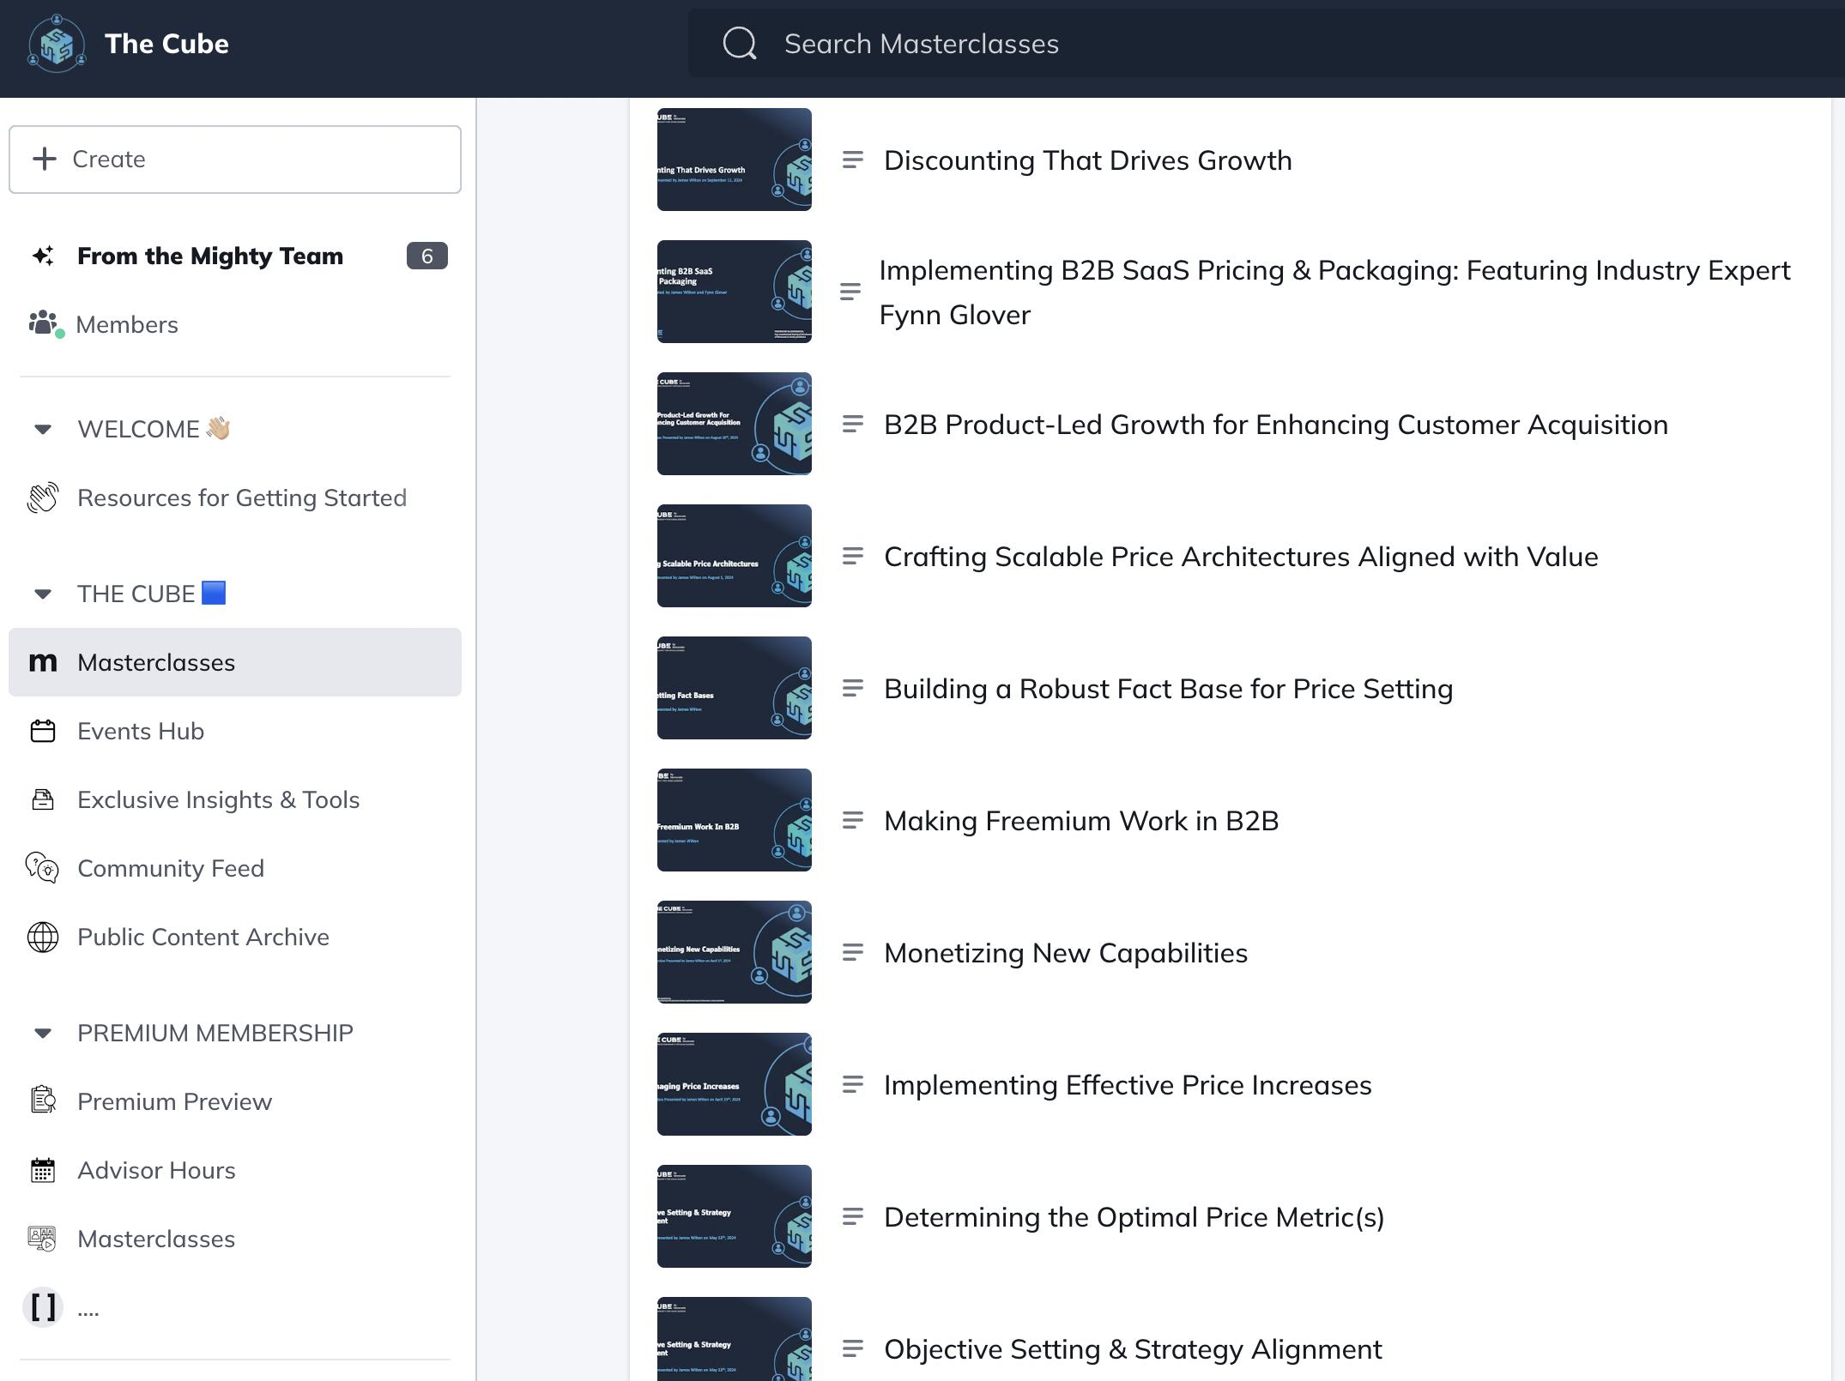
Open Q&A
Inside The Cube

Slide 34
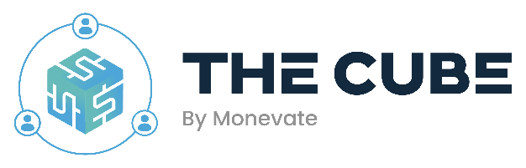
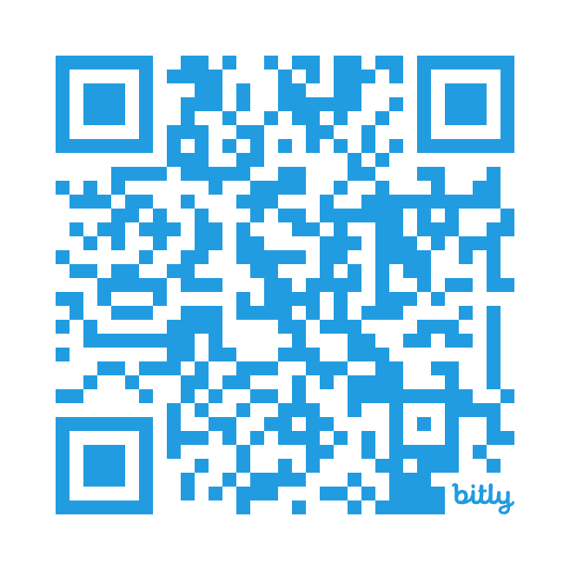


Upcoming Masterclass Topics:
October 10: Unlocking Growth With Usage Based Pricing In SaaS
Dive into the world of usage-based pricing and its potential as a powerful growth lever for SaaS businesses. Discover when and how to implement this strategy effectively, while understanding why it’s not the ideal solution for all SaaS companies.
Join The Cube
Access to:
All 12 previously recorded masterclasses + slides transcripts + guides & resources
Downloadable pricing tools
Expert written articles, guides, and playbooks
A supportive community of professional peers
dianna.lesage@monevate.com
October 24: Price Governance – Ensuring Successful Implementation of Pricing Strategies
Learn how even the best pricing strategies can falter without proper implementation and governance. Explore crucial elements such as sales incentives, deal desk operations, and key performance indicators for effective price monitoring to maximize the success of your pricing strategy.

