Slide 1
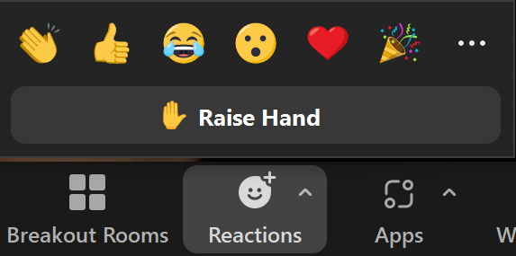

Overview of Masterclass
Masterclass Norms
Masterclasses are not intended to be “webinars” – they are content-facilitated discussion groups
Please be “on camera” if you are able to be
Raise your hand to ask a question or raise a point
If you are not able to speak live, send questions in the Zoom chat
Welcome to our bi-weekly Masterclass series on SaaS pricing and packaging!
Today’s Topic
Discounting That Drives SaaS Growth, NOT Revenue Leaks
Rough Agenda
Min. 5 – 35 – Review Core Principals & Cases
Min. 35 – 55 – Q&A
Min 55 – 60 – News + Wrap Up

Slide 2
Today we will cover
How to think about discounting as a concept. Good? Bad? Ugly?
How to plan for discounting within your price structure
How to keep discounting under control and avoid value leakage

Slide 3
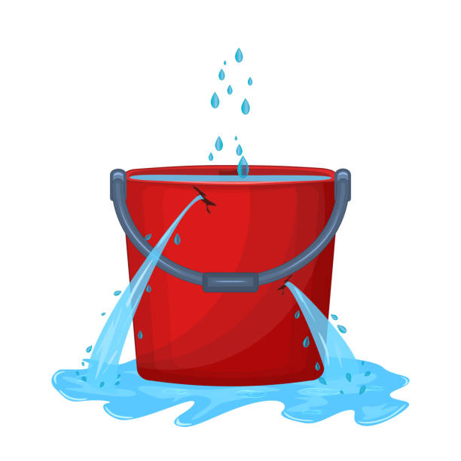
Pricing is capturing value. So discounting is value leakage... right?

Slide 4
A key takeaway for today
Discounting is NOT the enemy!
The enemy is
UNNECESSARY discounting

Slide 5
Would a “no discounting EVER” policy work in practice?
What about these situations?
“You’re charging $11,000, but my budget is $10,000. I literally can’t sign off on anything above $10,000.”
“You literally can’t give me any discount at all? Can I speak to your manager?”
“I’d never get enough value to pay $11,000 because our use case is different. I might pay $8,000”
“You won’t give me anything off the price?? Seems like you don’t really want our business…”
Price differentiation / Flexibility
Rep autonomy / partnership

Slide 6
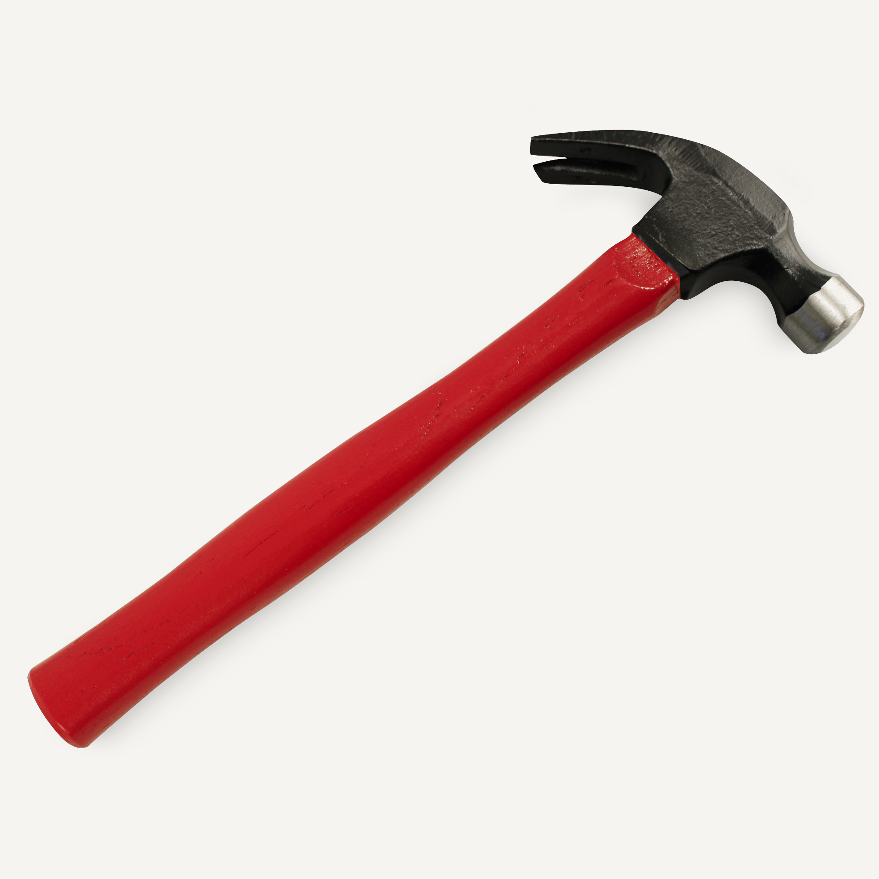
Think of discounting as a tool you can use

Slide 7
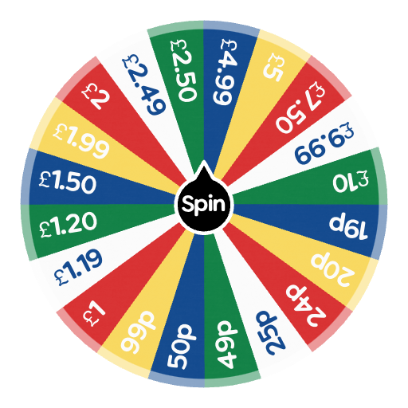
A reality to be considered
“I want a DEAL!
I don’t know what the quote will be, but whatever it is I’m going to ask for 20% off.”

Slide 8
You should plan for discounting through your price level setting
Typical price setting approach
Improved approach
List Price
$
Expected Discounting
Willingness-to-pay
Willingness-to-pay
List price
Target Price
Discounting
Sale price

Slide 9

Remember - misuse any tool and you can get hurt!
Making it easy to discount makes unnecessary discounting more likely

Slide 10
Another key takeaway
Most reps in growing companies are paid a flat % commission. In that situation…
Sales Reps will always discount
AS MUCH AS THEY CAN

Slide 11


Another reality: Sales people are coin-operated**
**Figuratively

Slide 12
Reps operate on expected payout
Perceived chance of winning deal (W)
Payout on successful deal (P)
Expected payout (E)
Payout on successful deal (P)
Perceived chance of winning deal (W)
=
x
Expected payout (E)
Price (R)
10% Discount
0% Discount

Slide 13
Typical discounting frequency distribution
Frequency
Sales rep discretionary discount
Sales manager approval required
Sales director approval required
% discount

Slide 14
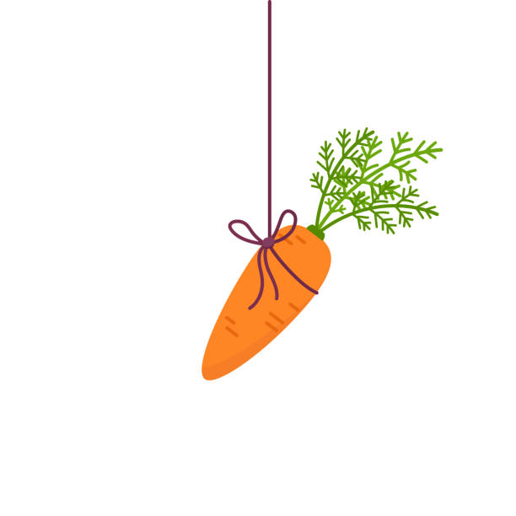



Price Execution
“Carrot”
“Stick”
Incentives
Rules
“Roller skates”
Enablers

Slide 15
There are three tactics that should be implemented to ensure discounts are driving sales rather than leaking revenue
Tactic | Intent | Examples
Rules | Limit the freedom of the sales team to discount beyond acceptable levels, and/or for non-strategic reasons | Max discounting limits Situation-based discounts “Give-gets”
Incentives | Give sales reps “skin in the game” so that they want to price as high as they can | Price / Discount incentives “Kickers” Rankings tables …
Enablers | Make sales reps feel they have a higher chance of winning at higher price levels | Research data on willingness-to-pay Negotiation skills training Value messaging Playbooks.
Notes:
There will always be other reasons to discount – this is where rules (you can only discount X if Y), incentives (make sure salespeople do better if they discount less), and enablers (belief that you can win the higher price point) come in

Slide 16
Proposed structure for your price levels and discounting
$
List Price
Rep’s Discretionary Discounting
Expected Discounting
Willingness-to-pay
Strategic / Structural Discounting
Target Price
Situational Discounting
Walkaway price

Slide 17
Key Takeaways
Discounting is not the enemy – it can be a valuable and necessary sales tool. The enemy is unnecessary discounting, which causes value leakage
You should always build your price list expecting a certain amount of discount
To avoid value leakage through discounting:
  Set target price based on willingness to pay, then back into list price based on expected discounting
  Use price execution (rules, incentives and enablers) to minimize unnecessary discounting

Slide 18
Discounting Types

Slide 19
Structured discounting guidelines can allow sales teams to adjust prices based on customer WTP while avoiding value leakage
Discounting Types & Ranges
Discount Type
Rationale
To ensure that several of these discounts do not move the net price too far from the value of the product customers receive, it’s important to set guardrails for total or maximum discounts
Volume-based
Customer expect volume-based discounts when purchasing more locations and transparency can incentivize large brands to add more locations
Multi-product
Customers are more likely to cross-sell when provided a discount for additional products and all-in-one functionality can increase retention
The size of the discount is based on the # of standalone modules purchased
Billing Frequency
Longer billing frequencies can make it more challenging for customers to churn during a billing frequency and can increase revenue predictability
Contract Length
Longer-term, multi-year contracts bring predictable revenue while reducing churn and discounting latitude should be set based on contract length
Discretionary
Gap month and early signatures to incentivize customers to commit to a deal
Low willingness-to-pay segments
Customers that can only use a limited set of functionality
Prospects are strongly considering competitors –
Cases where winning a particular customer can achieve a business objective
Referral discounts to encourage growth

Slide 20
Setting List and
Target Prices

Slide 21
There are a few basic components to how we think about setting price levels
Monevate Price Level Setting Fundamentals Approach
General
Prices are set based on three inputs: historical prices, survey findings, competitors, and client positioning (e.g. Client wants to be at a premium. Clients wants to win more deals, is concerned about churn, etc.
“Price levels” are a generic term. In reality, we’re setting three different prices
  List Price - Represents the price initially shown to customers and display how the client thinks about themselves compared to the market
  Target Price – The price the client ultimately wants to land at after expected discounts
  Minimum Price – Defined as the excepted price after the maximum discretionary discount.
Target & Minimum Price
We usually set target and minimum prices at the or just above 50th percentile
If there are few data points, we set prices towards the average price
During calibration, we set target prices first and apply an assumed discretionary discount to calculate list prices
Often we assume a discretionary discount of 20%
List Prices
We set list prices HIGH – usually at the 90th or 95th percentile of historical customer prices.
However, there are occasions when we use the 75th or lower percentiles, when there is too much spread between price levels for given segment.
If there are few data points, we may use a mark-up from average approach (e.g. 50% higher than the average)

Slide 22
There are a few basic components to how we think about setting price levels
Monevate Price Level Setting Fundamentals Approach
Determining Customer Future Prices
List & Minimum Approach (most common) – Customers above list price move down to list price, customers under the minimum move up to the minimum. Customers in between see no price change at all.
Full List Migration – All customers move to list prices.
We measure impact assuming many different scenarios:
Full Migration (Always do) – Measure the customer impact based on future prices (see above)
No Price Decreases + Capped Increases (very common) – Assume no customers receive a lower price + Price increases are limited (e.g. 50%)
No Price Decreases – Assume no customers receive a lower price than today
+ Churn Assumptions – To make estimates more realistic, we can create an estimated amount of churn and apply it to our modeling scenarios. To do this we need a baseline assumption for “% of price related churn” and we assume it goes higher due to our price increases (e.g. double)
Capturability Scenarios – Instead of assuming customer impact through increase/decrease caps, we take the full migration impact and assume the client can capture X% of it
Checking your calibration
Does the price per metric price change logically as volume discounts are applied
Do price make sense relative to competitors, survey data, and positioning?
Is the impact evenly spread among customers/segments (e.g. It should not be that one segment gets a HUGE increase and others get a HUGE decrease.)
Is the net ARR impact positive in a Full Migration scenario
Is the ARR impact positive assuming price caps?

Slide 23
We will design CLIENT’s price levels by triangulating across multiple analyses & references for greater confidence
10
Example Deliverable: Price List
Data-Driven Prices & Recommendation
Package C for Enterprise Customers
  Sanitized client example
Upper Range / List Price
Data-Driven Prices by Fact Base Source
Recommended Price Range
Mid-Range / Expected Price
Lower Range / Minimum Price
Based on observed prices, we recommend a $2,560 list price and $2,000 minimum price after negotiated discounts.
We expect the average price to be $2,240.
Segment
Current Prices
Van Westendorp
Price Range
Competitive Positioning
Price Range
Recommended Price Range

Slide 24
Future state pricing for CLIENT products will improve the alignment to overall volume discounting expectations
CLIENT Products
Current RPU by Segment Size – CLIENT Products
Standardized Price Curve – CLIENT Products
Tier | Min Users
Tiny | 1
XSmall | 10,000
Small | 25,000
Medium | 40,000
Large | 80,000
XLarge | 130,000
Jumbo | 200,000
Price
List Price
90th
Expected Price
Median
25th
Tiny
Xsmall
Small
Medium
Large
Xlarge
Jumbo
Tiny
Xsmall
Small
Medium
Large
XLarge
Jumbo
The Tiny Segment's 90th percentile is 771%

Slide 25
The future-state pricing curve for third-party products has a clear correlation to original price medians
Third-Party Products
Current RPU per Product by Segment Size– Third-Party Products
Standardized Price Curve – Third-Party Products
Tier | Min Users
Tiny | 1
XSmall | 10,000
Small | 25,000
Medium | 40,000
Large | 80,000
XLarge | 130,000
Jumbo | 200,000
Price
List Price
90th
Expected Price
Median
25th
Tiny
Xsmall
Small
Medium
Large
Xlarge
Jumbo
Tiny
Xsmall
Small
Medium
Large
XLarge
Jumbo
The Tiny Segment's 90th percentile is 622%, and Medium is 231%

Slide 26
The CLIENT Platform’s price curve shows consistent volume discounting with minimal variance across FI sizes
CLIENT Platform
Current RPU by Segment Size– CLIENT Platform
Standardized Price Curve – CLIENT Platform
Tier | Min Users
Tiny | 1
XSmall | 10,000
Small | 25,000
Medium | 40,000
Large | 80,000
XLarge | 130,000
Jumbo | 200,000
90th
Price
Median
List Price
25th
Expected Price
Tiny
Xsmall
Small
Medium
Large
Xlarge
Jumbo
Tiny
Xsmall
Small
Medium
Large
XLarge
Jumbo
The Tiny Segment's 90th percentile is 491%

Slide 27
Products with a unique historical pricing trend will be priced independently
PRODUCT
Current RPU per Product by Segment Size– PRODUCT
Standardized Price Curve – PRODUCT
Tier | Min Users
Tiny | 1
XSmall | 10,000
Small | 25,000
Medium | 40,000
Large | 80,000
XLarge | 130,000
Jumbo | 200,000
75th
Price
Median
List Price
25th
Expected Price
Tiny
Xsmall
Small
Medium
Large
Xlarge
Jumbo
Tiny
Xsmall
Small
Medium
Large
XLarge
Jumbo
The Tiny Segment's 90th percentile is 158%

Slide 28
Avoiding Revenue Leakage

Slide 29
There are three tactics that should be implemented to ensure discounts are driving sales rather than leaking revenue
Tactic | Definition | Example
Rules | Guidelines and constraints put in place to limit the freedom of the sales team, ensuring they adhere to specific pricing practices | Setting a maximum discount limit of 20% on all deals. This rule ensures that even if a salesperson feels the need to discount heavily, they cannot go beyond the set threshold without seeking higher approval.
Incentives | Rewards or benefits given to motivate salespeople to meet desired pricing levels and avoid unnecessary discounting | A price-based kicker is a financial incentive where salespeople receive a bonus or higher commission if they manage to close a deal at or above a certain price point, encouraging them to aim for higher prices.
Enablers | Tools, knowledge, or skills provided to help the sales team effectively achieve desired pricing outcomes | A negotiation playbook is an enabler that equips salespeople with strategies, objection-handling techniques, and value messaging, enabling them to confidently negotiate and maintain higher prices during sales discussions
Notes:
There will always be other reasons to discount – this is where rules (you can only discount X if Y), incentives (make sure salespeople do better if they discount less), and enablers (belief that you can win the higher price point) come in

Slide 30
Multi-Year Discount Calculator

Slide 31
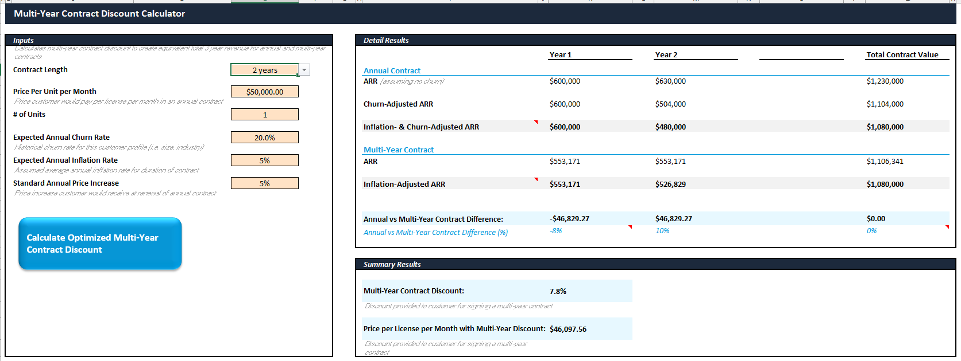
Download our multi-year contract calculator to minimize revenue leakage while incentivizing multi-year deals
The multi-year discount calculator is used to determine the optimized multi-year discount, which results in an equivalent contract value for annual and multi-year contracts, after considering inflation, typical price increases, and risk of churn.
Benefits:
Provides pricing that incentivizes multi-year contracts
Eliminates leaked revenue from multi-year contracts
Decreases churn risk
Adjusts for expected inflation
Join The Cube’s online platform to download today: https://the-cube-monevate.mn.co/posts/multi-year-contract-calculator

