Slide 1

CERF DRAFT
Regional Summary
Preparad vow

Slide 2
Resumen
Regional del CERF
Preparado por

Slide 3
Overview of the Regional Draft Summary
The following slide deck is a draft of the regional summary, which is part of the Regional Plan I.
The Regional Plan I is part of an entire regional plan for Kern County that includes the first part, due at the end of 2023, and the second part, due at the end of June 2024.
Stay tuned for more information on when the final version of the regional plan is completed at the Kern Coalition website.

Slide 4
Descripción del Resumen de Proyecto Regional
La siguiente diapositiva es un borrador del resumen regional, que forma parte del Plan Regional I.
El Plan Regional I es parte de un plan regional completo para el condado de Kern que incluye la primera parte, prevista para fines de 2023, y la segunda parte, prevista para fines de junio de 2024.
Manténgase atento para obtener más información sobre cuándo se complete la versión final del plan regional en el sitio web de Kern Coalition.

Slide 5
Outline
  Kern County Overview
  Economy
  Climate
  Health

Slide 6
Esquema
  Descripción General del Condado de Kern
Economía
Clima
Salud

Slide 7
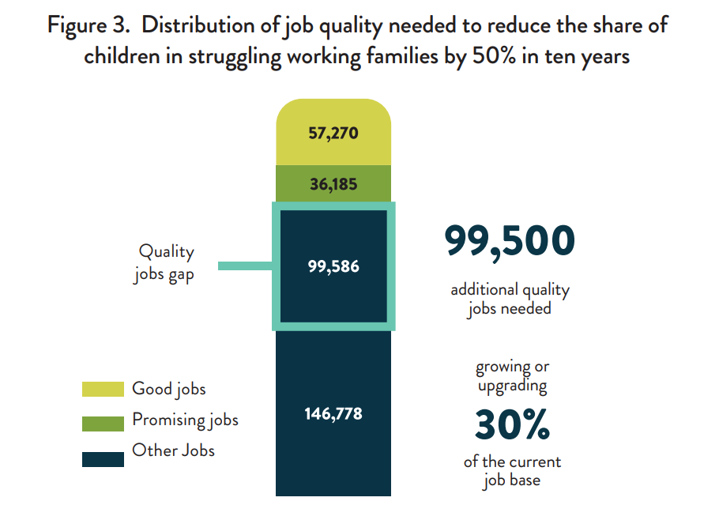
What is a good quality job?
A “Good jobs” meet three criteria :
Pays a sufficient annual wage that enables workers to meet their family’s market basket of expenses and savings, and (ii) be ineligible for California benefit transfers (i.e., SNAP, TANF, Medicaid)
Provides employer-sponsored health insurance, a proxy for other employment benefits.
Affords durable opportunity with stability in career options to continue holding an excellent job in the future. “Promising jobs” do not meet all the criteria of a good job but provide career pathways that will lead to an excellent job within ten years.
“Other jobs” do not qualify as good or promising.
1
Source:
1. Better Bakersfield and Boundless Kern (B3K). B3K-Market-Assessment-FINAL_031821-3.pdf (b3kprosperity.org)

Slide 8
¿Qué es un trabajo de buena calidad?
Un "buen empleo" cumple tres criterios :
Paga un salario anual suficiente que permite a los trabajadores cumplir con la canasta de gastos y ahorros de su familia, y (ii) no ser elegible para transferencias de beneficios de California (es decir, SNAP, TANF, Medicaid)
Proporciona seguro de salud patrocinado por el empleador, un sustituto de otros beneficios de empleo.
Ofrece una oportunidad duradera con estabilidad en las opciones de carrera para continuar manteniendo un excelente trabajo en el futuro. Los "trabajos prometedores" no cumplen con todos los criterios de un buen trabajo, pero proporcionan trayectorias profesionales que conducirán a un excelente trabajo dentro de diez años.
"Otros trabajos" no califican como buenos o prometedores.
1
Brechas de empleo de calidad
Cantidad de empleos adicionales de calidad que se necesitan
buenos trabajos
Aumento o actualización
Empleos prometedores
Otros trabajos
de la base de puestos de trabajo actual
Origen:
1. Better Bakersfield and Boundless Kern (B3K). B3K-Market-Assessment-FINAL_031821-3.pdf (b3kprosperity.org)

Slide 9
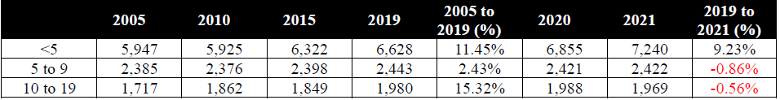
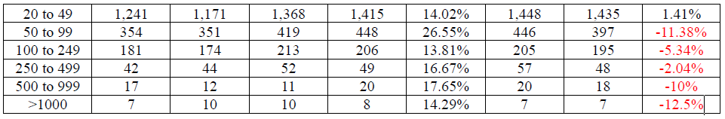
Kern County, Number of Businesses vow Number
Employees
2
Source:
2. The Impact of the COVID-19 pandemic on Businesses and Industries in Kern County pp. 10-11

Slide 10
Condado de Kern, Número de Empresas vs
Número de Empleados
2
Source:
2. The Impact of the COVID-19 pandemic on Businesses and Industries in Kern County pp. 10-11

Slide 11
North Kern Subregion (Delano) Employers Pt. 1
3
 | 2017 | 2019 | 2020 | 2021 | 2017 to 2019 (% Change) | 2019 to 2021 (% Change)
NAICS Code | Delano, CA (Zip Code 93215)
Total | 437 (6,423) | 439 (6,948) | 452 (7,191) | 473 (6,715) | 0.46 (8.17); 7.68 | 7.75 (-3.35); -10.30
11: Agriculture, Forestry, Fishing, and Hunting | 8 | 8 | 10 | 9 | 0.00 | 12.50
23: Construction | 13 | 14 | 11 | 14 | 7.69 | 0.00
31: Manufacturing | 14 | 11 | 11 | 12 | -21.43 | 9.09
44: Retail Trade | 97 | 90 | 89 | 93 | -7.22 | 3.33
441: Motor Vehicle and Parts Dealers | 9 | 11 | 9 | 9 | 22.22 | -18.18
442: Furniture and Home Furnishings Store | 3 | 3 | 3 | 3 | 0.00 | 0.00
445: Food and Beverage Stores | 22 | 19 | 21 | 22 | -13.64 | 15.79
446: Health and Personal Care Stores | 5 | 5 | 5 | 6 | 0.00 | 20.00
Source:
3. The Impact of the COVID-19 Pandemic on Businesses and Industries in Kern County pp. 17-18

Slide 12
Subregión de Kern Norte (Delano) Empleadores Pt. 1
3
 | 2017 | 2019 | 2020 | 2021 | 2017 to 2019 (% del cambio) | 2019 to 2021 (% del cambio)
NAICS Códigos | Delano, CA (Código Postal 93215)
Total | 437 (6,423) | 439 (6,948) | 452 (7,191) | 473 (6,715) | 0.46 (8.17); 7.68 | 7.75 (-3.35); -10.30
11: Agricultura, Silvicultura, Pesca y Caza | 8 | 8 | 10 | 9 | 0.00 | 12.50
23: Construcción | 13 | 14 | 11 | 14 | 7.69 | 0.00
31: Fabricación | 14 | 11 | 11 | 12 | -21.43 | 9.09
44: Comercio al por menor | 97 | 90 | 89 | 93 | -7.22 | 3.33
441: Distribuidores de Vehículos Motorizados y Repuestos | 9 | 11 | 9 | 9 | 22.22 | -18.18
442: Tienda de Muebles y Artículos para el Hogar | 3 | 3 | 3 | 3 | 0.00 | 0.00
445: Tiendas de Alimentos y Bebidas | 22 | 19 | 21 | 22 | -13.64 | 15.79
446: Tiendas de Salud y Cuidado personal | 5 | 5 | 5 | 6 | 0.00 | 20.00
Source:
3. The Impact of the COVID-19 Pandemic on Businesses and Industries in Kern County pp. 17-18

Slide 13
North Kern Subregion (Delano) Employers Pt.2
3
447: Gasoline Stations | 15 | 16 | 16 | 16 | 6.67 | 0.00
448: Clothing and Clothing Accessories Stores | 12 | 9 | 9 | 9 | -25.00 | 0.00
452: General Merchandise Stores | 10 | 9 | 7 | 8 | -10.00 | -11.11
48: Transportation and Warehousing | 31 | 35 | 40 | 46 | 12.90 | 31.43
51: Information | 6 | 8 | 8 | 10 | 33.33 | 25.00
52: Finance and Insurance | 30 | 29 | 27 | 26 | -3.33 | -10.34
531: Real Estate | 13 | 12 | 13 | 15 | -7.69 | 25.00
532: Rental and Leasing Services | 3 | 3 | 3 | 3 | 0.00 | 0.00
54: Professional, Scientific, and Technical Services | 19 | 16 | 19 | 16 | -15.79 | 0.00
Source:
3. The Impact of the COVID-19 Pandemic on Businesses and Industries in Kern County pp. 17-18

Slide 14
Subregión de Kern Norte (Delano) Empleadores Pt. 2
3
447: Estaciones de gasolina | 15 | 16 | 16 | 16 | 6.67 | 0.00
448: Ropa y Tiendas de Ropa y Accesorios | 12 | 9 | 9 | 9 | -25.00 | 0.00
452: Tiendas de mercancías generales | 10 | 9 | 7 | 8 | -10.00 | -11.11
48: Transporte y almacenamiento | 31 | 35 | 40 | 46 | 12.90 | 31.43
51: Información | 6 | 8 | 8 | 10 | 33.33 | 25.00
52: Finanzas y Seguros | 30 | 29 | 27 | 26 | -3.33 | -10.34
531: Bienes raíces | 13 | 12 | 13 | 15 | -7.69 | 25.00
532: Servicios de alquiler y arrendamiento | 3 | 3 | 3 | 3 | 0.00 | 0.00
54: Servicios Profesionales, Científicos y Técnicos | 19 | 16 | 19 | 16 | -15.79 | 0.00
Source:
3. The Impact of the COVID-19 Pandemic on Businesses and Industries in Kern County pp. 17-18

Slide 15
North Kern Subregion (Shafter) Employers
4
 | 2017 | 2019 | 2020 | 2021 | 2017 to 2019 (% Change) | 2019 to 2021 (% Change)
NAICS Code | Zip Code 93263, Shafter, CA
Total | 224 (4,281) | 220 (5,845) | 247 (6,282) | 248 (6,750) | -1.79 (36.53); 39.02 | 12.73 (15.48); 27.22
11: Agriculture, Forestry, Fishing, and Hunting | 8 | 6 | 6 | 5 | -25.00 | -16.67
21: Mining, Quarrying, and Oil and Gas Extraction | 7 | 6 | 8 | 8 | -14.29 | 33.33
23: Construction | 15 | 13 | 17 | 17 | -13.33 | 30.77
31: Manufacturing | 13 | 15 | 13 | 14 | 15.38 | -6.67
44: Retail Trade | 34 | 37 | 35 | 36 | 8.82 | -2.70
441: Motor Vehicle and Parts Dealers | 6 | 7 | 7 | 6 | 16.67 | -14.29
445: Food and Beverage Stores | 7 | 7 | 7 | 8 | 0.00 | 14.29
446: Health and Personal Care Stores | 3 | 3 | 3 | 3 | 0.00 | 0.00
447: Gasoline Stations | 6 | 8 | 7 | 8 | 33.33 | 0.00
452: General Merchandise Stores | 3 | 3 | 0 | 3 | 0.00 | 0.00
48: Transportation and Warehousing | 31 | 32 | 39 | 45 | 3.23 | 40.63
52: Finance and Insurance | 9 | 8 | 9 | 9 | -11.11 | 12.50
531: Real Estate | 4 | 0 | 3 | 4 | -100.00 | -
532: Rental and Leasing Services | 3 | 4 | 3 | 3 | 33.33 | -25.00
54: Professional, Scientific, and Technical Services | 9 | 10 | 13 | 12 | 11.11 | 20.00
621: Ambulatory Health Care Services | 10 | 11 | 13 | 11 | 10.00 | 0.00
623: Nursing and Residential Care Facilities | 0 | 0 | 3 | - | - | -
71: Arts, Entertainment, and Recreation | 3 | 3 | 5 | 3 | 0.00 | 0.00
722: Food Service and Drinking Places | 16 | 16 | 17 | 14 | 0.00 | -12.50
Source:
4. The Impact of the COVID-19 Pandemic on Businesses and Industries in Kern County pp. 22-23

Slide 16
Subregión de Kern Norte (Shafter) Empleadores
4
 | 2017 | 2019 | 2020 | 2021 | 2017 to 2019 (% del cambio) | 2019 to 2021 (% del cambio)
NAICS Códigos | Código Postal 93263Shafter, CA
Total | 224 (4,281) | 220 (5,845) | 247 (6,282) | 248 (6,750) | -1.79 (36.53); 39.02 | 12.73 (15.48); 27.22
11: Agricultura, Silvicultura, Pesca y Caza | 8 | 6 | 6 | 5 | -25.00 | -16.67
21: Minería, Canteras y extracción de petróleo y gas | 7 | 6 | 8 | 8 | -14.29 | 33.33
23: Construcción | 15 | 13 | 17 | 17 | -13.33 | 30.77
31: Fabricación | 13 | 15 | 13 | 14 | 15.38 | -6.67
44: Comercio al por menor | 34 | 37 | 35 | 36 | 8.82 | -2.70
441: Distribuidores de vehículos motorizados y repuestos | 6 | 7 | 7 | 6 | 16.67 | -14.29
445: Tiendas de alimentos y bebidas | 7 | 7 | 7 | 8 | 0.00 | 14.29
446: Tiendas de salud y cuidado personal | 3 | 3 | 3 | 3 | 0.00 | 0.00
447: Estaciones de gasolina | 6 | 8 | 7 | 8 | 33.33 | 0.00
452: Tiendas de mercancías generales | 3 | 3 | 0 | 3 | 0.00 | 0.00
48: Transporte y almacenamiento | 31 | 32 | 39 | 45 | 3.23 | 40.63
52: Finanzas y Seguros | 9 | 8 | 9 | 9 | -11.11 | 12.50
531: Bienes raíces | 4 | 0 | 3 | 4 | -100.00 | -
532: Servicios de alquiler y arrendamiento | 3 | 4 | 3 | 3 | 33.33 | -25.00
54: Servicios Profesionales, Científicos y Técnicos | 9 | 10 | 13 | 12 | 11.11 | 20.00
621: Servicios de atención médica ambulatoria | 10 | 11 | 13 | 11 | 10.00 | 0.00
623: Centros de atención residencial y de enfermería | 0 | 0 | 3 | - | - | -
71: Arte, entretenimiento y recreación | 3 | 3 | 5 | 3 | 0.00 | 0.00
722: Servicio de alimentos y lugares para beber | 16 | 16 | 17 | 14 | 0.00 | -12.50
Source:
4. The Impact of the COVID-19 Pandemic on Businesses and Industries in Kern County pp. 22-23

Slide 17
North Kern Subregion (Wasco) Employers Pt.1
 | 2017 | 2019 | 2020 | 2021 | 2017 to 2019 (% Change) | 2019 to 2021 (% Change)
NAICS Code | Zip Code 93280, Wasco, CA
Total | 194 (2,161) | 182 (2,223) | 191 (2,352) | 194 (2,657) | -6.19 (2.87); 9.65 | 6.59 (19.52); 12.13
11: Agriculture, Forestry, Fishing, and Hunting | 3 | 3 | 4 | 6 | 0.00 | 100.00
5
48: Transportation and Warehousing | 17 | 14 | 18 | 18 | -17.65 | 28.57
51: Information | 0 | 0 | 3 | 4 | - | -
52: Finance and Insurance | 7 | 7 | 8 | 7 | 0.00 | 0.00
531: Real Estate | 16 | 14 | 14 | 14 | -12.50 | 0.00
54: Professional, Scientific, and Technical Services | 6 | 6 | 8 | 6 | 0.00 | 0.00
621: Ambulatory Health Care Services | 12 | 13 | 12 | 11 | 8.33 | -15.38
623: Nursing and Residential Care Facilities | 4 | 4 | 4 | 3 | 0.00 | -25.00
624: Social Assistance | 0 | 3 | 0 | 3 | - | 0.00
722: Food Service and Drinking Places | 30 | 33 | 32 | 34 | 10.00 | 3.03
81: Other Services (Auto Repair, Appliance Repair, Barber, Nail, Dry Cleaner, …) | 17 | 14 | 14 | 15 | -17.65 | 7.14
Source:
5. The Impact of the COVID-19 Pandemic on Businesses and Industries in Kern County pp.24-25

Slide 18
Subregión de Kern Norte (Wasco) Empleadores Pt.1
5
 | 2017 | 2019 | 2020 | 2021 | 2017 to 2019 (% del cambio) | 2019 to 2021 (% del cambio)
NAICS Código | Código Postal 93280, Wasco, CA
Total | 194 (2,161) | 182 (2,223) | 191 (2,352) | 194 (2,657) | -6.19 (2.87); 9.65 | 6.59 (19.52); 12.13
11: Agricultura, silvicultura, pesca y caza | 3 | 3 | 4 | 6 | 0.00 | 100.00
48: Transporte y almacenamiento | 17 | 14 | 18 | 18 | -17.65 | 28.57
51: Información | 0 | 0 | 3 | 4 | - | -
52: Finanzas y Seguros | 7 | 7 | 8 | 7 | 0.00 | 0.00
531: Bienes raíces | 16 | 14 | 14 | 14 | -12.50 | 0.00
54: Servicios Profesionales, Científicos y Técnicos | 6 | 6 | 8 | 6 | 0.00 | 0.00
621: Servicios de atención médica ambulatoria | 12 | 13 | 12 | 11 | 8.33 | -15.38
623: Centros de atención residencial y de enfermería | 4 | 4 | 4 | 3 | 0.00 | -25.00
624: Asistencia social | 0 | 3 | 0 | 3 | - | 0.00
722: Servicio de alimentos y lugares para beber | 30 | 33 | 32 | 34 | 10.00 | 3.03
81: Otros servicios (reparación de automóviles, reparación de electrodomésticos, barbería, manicura, tintorería,…) | 17 | 14 | 14 | 15 | -17.65 | 7.14
Source:
5. The Impact of the COVID-19 Pandemic on Businesses and Industries in Kern County pp.24-25

Slide 19
North Kern Subregion (Wasco) Employers Pt. 2
23: Construction | 13 | 12 | 14 | 14 | -7.69 | 16.67
31: Manufacturing | 13 | 13 | 12 | 11 | 0.00 | -15.38
44: Retail Trade | 36 | 32 | 32 | 34 | -11.11 | 6.25
441: Motor Vehicle and Parts Dealers | 7 | 7 | 6 | 7 | 0.00 | 0.00
445: Food and Beverage Stores | 11 | 10 | 10 | 11 | -9.09 | 10.00
446: Health and Personal Care Stores | 0 | 3 | 3 | 3 | - | 0.00
447: Gasoline Stations | 4 | 5 | 5 | 5 | 25.00 | 0.00
452: General Merchandise Stores | 6 | 5 | 5 | 5 | -16.67 | 0.00
5
Source:
5. The Impact of the COVID-19 Pandemic on Businesses and Industries in Kern County pp.24-25

Slide 20
Subregión de Kern Norte (Wasco) Empleadores Pt. 2
5
23: Construcción | 13 | 12 | 14 | 14 | -7.69 | 16.67
31: Fabricación | 13 | 13 | 12 | 11 | 0.00 | -15.38
44: Comercio al por menor | 36 | 32 | 32 | 34 | -11.11 | 6.25
441: Distribuidores de vehículos motorizados y repuestos | 7 | 7 | 6 | 7 | 0.00 | 0.00
445: Tiendas de alimentos y bebidas | 11 | 10 | 10 | 11 | -9.09 | 10.00
446: Tiendas de salud y cuidado personal | 0 | 3 | 3 | 3 | - | 0.00
447: Estaciones de gasolina | 4 | 5 | 5 | 5 | 25.00 | 0.00
452: Tiendas de mercancías generales | 6 | 5 | 5 | 5 | -16.67 | 0.00
Source:
5. The Impact of the COVID-19 Pandemic on Businesses and Industries in Kern County pp.24-25

Slide 21
North Kern Subregion (Wasco) Employers Pt. 3
5
48: Transportation and Warehousing | 17 | 14 | 18 | 18 | -17.65 | 28.57
51: Information | 0 | 0 | 3 | 4 | - | -
52: Finance and Insurance | 7 | 7 | 8 | 7 | 0.00 | 0.00
531: Real Estate | 16 | 14 | 14 | 14 | -12.50 | 0.00
54: Professional, Scientific, and Technical Services | 6 | 6 | 8 | 6 | 0.00 | 0.00
621: Ambulatory Health Care Services | 12 | 13 | 12 | 11 | 8.33 | -15.38
623: Nursing and Residential Care Facilities | 4 | 4 | 4 | 3 | 0.00 | -25.00
624: Social Assistance | 0 | 3 | 0 | 3 | - | 0.00
722: Food Service and Drinking Places | 30 | 33 | 32 | 34 | 10.00 | 3.03
81: Other Services (Auto Repair, Appliance Repair, Barber, Nail, Dry Cleaner, …) | 17 | 14 | 14 | 15 | -17.65 | 7.14
Source:
5. The Impact of the COVID-19 Pandemic on Businesses and Industries in Kern County pp.24-25

Slide 22
Subregión de Kern Norte (Wasco) Empleadores Pt. 3
5
48: Transporte y almacenamiento | 17 | 14 | 18 | 18 | -17.65 | 28.57
51: Información | 0 | 0 | 3 | 4 | - | -
52: Finanzas y Seguros | 7 | 7 | 8 | 7 | 0.00 | 0.00
531: Bienes raíces | 16 | 14 | 14 | 14 | -12.50 | 0.00
54: Servicios Profesionales, Científicos y Técnicos | 6 | 6 | 8 | 6 | 0.00 | 0.00
621: Servicios de atención médica ambulatoria | 12 | 13 | 12 | 11 | 8.33 | -15.38
623:Centros de atención residencial y de enfermería | 4 | 4 | 4 | 3 | 0.00 | -25.00
624: Asistencia social | 0 | 3 | 0 | 3 | - | 0.00
722: Servicio de alimentos y lugares para beber | 30 | 33 | 32 | 34 | 10.00 | 3.03
81: Otros servicios (reparación de automóviles, reparación de electrodomésticos, barbería, manicura, tintorería,…) | 17 | 14 | 14 | 15 | -17.65 | 7.14
Source:
5. The Impact of the COVID-19 Pandemic on Businesses and Industries in Kern County pp.24-25

Slide 23
North Kern Subregion (Lost Hills) Employers
6
 | 2017 | 2019 | 2020 | 2021 | 2017 to 2019 (% of change) | 2019 to 2021 (% of change)
NAICS Code | Zip Code 93249, Lost Hills, CA
Total | 38 (1,706) | 36 (1,507) | 38 (1,297) | 38 (1,578) | -5.26 (-11.66); -6.76 | 5.56 (4.71); -0.80
31: Manufacturing | 3 | 3 | 3 | 3 | 0.00 | 0.00
44: Retail Trade | 11 | 10 | 10 | 10 | -9.09 | 0.00
447: Gasoline Stations | 8 | 7 | 7 | 7 | -12.50 | 0.00
531: Real Estate | 3 | 0 | 0 | 0 | -100.00 | -
621: Ambulatory Health Care Services | 0 | 0 | 3 | 3 | - | -
721: Accommodation | 0 | 0 | 0 | 3 | - | -
722: Food Service and Drinking Places | 7 | 7 | 7 | 7 | 0.00 | 0.00
81: Other Services (Auto Repair, Appliance Repair, Barber, Nail, Dry Cleaner, …) | 3 | 3 | 3 | 0 | 0.00 | -100.00
Source:
6. The Impact of the COVID-19 Pandemic on Businesses and Industries in Kern County pp. 21

Slide 24
Subregión de Kern Norte (Lost Hills) Empleadores
6
 | 2017 | 2019 | 2020 | 2021 | 2017 to 2019 (% del cambio) | 2019 to 2021 (% del cambio)
NAICS Código | Código Postal 93249, Lost Hills, CA
Total | 38 (1,706) | 36 (1,507) | 38 (1,297) | 38 (1,578) | -5.26 (-11.66); -6.76 | 5.56 (4.71); -0.80
31: Fabricación | 3 | 3 | 3 | 3 | 0.00 | 0.00
44: Comercio al por menor | 11 | 10 | 10 | 10 | -9.09 | 0.00
447: Estaciones de gasolina | 8 | 7 | 7 | 7 | -12.50 | 0.00
531: Bienes raíces | 3 | 0 | 0 | 0 | -100.00 | -
621: Servicios de atención médica ambulatoria | 0 | 0 | 3 | 3 | - | -
721: Alojamiento | 0 | 0 | 0 | 3 | - | -
722: Servicio de alimentos y lugares para beber | 7 | 7 | 7 | 7 | 0.00 | 0.00
81: Otros servicios (reparación de automóviles, electrodomésticos Reparación, Peluquería, Manicura, Tintorería, …) | 3 | 3 | 3 | 0 | 0.00 | -100.00
Source:
6. The Impact of the COVID-19 Pandemic on Businesses and Industries in Kern County pp. 21

Slide 25
East Kern Subregion (Lake Isabella) Employers
7
 | 2017 | 2019 | 2020 | 2021 | 2017 to 2019 (% Change) | 2019 to 2021 (% Change)
NAICS Code | Zip Code 93240, Lake Isabella, CA
Total | 120 (1,077) | 121 (1,095) | 121 (1,192) | 119 (1,249) | 0.83 (1.67); 9.76 | -1.65 (1.41); 6.54
22: Utilities | 3 | 3 | 3 | 3 | 0.00 | 0.00
23: Construction | 7 | 12 | 12 | 12 | 71.43 | 0.00
44: Retail Trade | 27 | 27 | 29 | 29 | 0.00 | 7.41
441: Motor Vehicle and Parts Dealers | 3 | 3 | 4 | 4 | 0.00 | 33.33
445: Food and Beverage Stores | 3 | 4 | 4 | 4 | 33.33 | 0.00
447: Gasoline Stations | 5 | 5 | 5 | 5 | 0.00 | 0.00
452: General Merchandise Stores | 0 | 3 | 3 | 3 | - | 0.00
48: Transportation and Warehousing | 0 | 3 | 3 | 3 | - | 0.00
51: Information | 4 | 4 | 4 | 3 | 0.00 | -25.00
52: Finance and Insurance | 11 | 9 | 8 | 7 | -18.18 | -22.22
531: Real Estate | 4 | 6 | 5 | 4 | 50.00 | -33.33
54: Professional, Scientific, and Technical Services | 7 | 6 | 6 | 6 | -14.29 | 0.00
621: Ambulatory Health Care Services | 15 | 13 | 15 | 15 | -13.33 | 15.38
722: Food Service and Drinking Places | 11 | 12 | 13 | 13 | 9.09 | 8.33
81: Other Services (Auto Repair, Appliance Repair, Barber, Nail, Dry Cleaner, …) | 14 | 14 | 14 | 13 | 0.00 | -7.14
Source:
7. The Impact of the COVID-19 Pandemic on Businesses and Industries in Kern County pp. 19

Slide 26
Subregión de Kern Este (Lake Isabella) Empleadores
7
 | 2017 | 2019 | 2020 | 2021 | 2017 to 2019 (% del cambio) | 2019 to 2021 (% del cambio)
NAICS Código | Código postal 93240, Lake Isabella, CA
Total | 120 (1,077) | 121 (1,095) | 121 (1,192) | 119 (1,249) | 0.83 (1.67); 9.76 | -1.65 (1.41); 6.54
22: Utilidades | 3 | 3 | 3 | 3 | 0.00 | 0.00
23: Construcción | 7 | 12 | 12 | 12 | 71.43 | 0.00
44: Comercio al por menor | 27 | 27 | 29 | 29 | 0.00 | 7.41
441: Distribuidores de vehículos motorizados y repuestos | 3 | 3 | 4 | 4 | 0.00 | 33.33
445: Tiendas de alimentos y bebidas | 3 | 4 | 4 | 4 | 33.33 | 0.00
447: Estaciones de gasolina | 5 | 5 | 5 | 5 | 0.00 | 0.00
452: Tiendas de mercancías generales | 0 | 3 | 3 | 3 | - | 0.00
48: Transporte y almacenamiento | 0 | 3 | 3 | 3 | - | 0.00
51: Información | 4 | 4 | 4 | 3 | 0.00 | -25.00
52: Finanzas y Seguros | 11 | 9 | 8 | 7 | -18.18 | -22.22
531: Bienes raíces | 4 | 6 | 5 | 4 | 50.00 | -33.33
54: Servicios Profesionales, Científicos y Técnicos | 7 | 6 | 6 | 6 | -14.29 | 0.00
621: Servicios de atención médica ambulatoria | 15 | 13 | 15 | 15 | -13.33 | 15.38
722: Servicio de alimentos y lugares para beber | 11 | 12 | 13 | 13 | 9.09 | 8.33
81: Otros servicios (reparación de automóviles, electrodomésticos Reparación, Peluquería, Manicura,Tintorería) | 14 | 14 | 14 | 13 | 0.00 | -7.14
Source:
7. The Impact of the COVID-19 Pandemic on Businesses and Industries in Kern County pp. 19

Slide 27
East Kern Subregion (Mojave) Employers
8
 | 2017 | 2019 | 2020 | 2021 | 2017 to 2019 (% change) | 2019 to 2021 (% change)
NAICS Code | Zip Code 93501, Mojave, CA
Total | 116 (3,047) | 118 (3,451) | 122 (3,379) | 120 (3,052) | 1.72 (13.26); 11.34 | 1.70 (-11.56); -13.04
21: Mining, Quarrying, and Oil and Gas Extraction | 3 | 0 | 0 | 0 | -100.00 | -
22: Utilities | 10 | 9 | 6 | 6 | -10.00 | -33.33
23: Construction | 6 | 8 | 8 | 7 | 33.33 | -12.50
31: Manufacturing | 14 | 14 | 15 | 15 | 0.00 | 7.14
44: Retail Trade | 16 | 19 | 21 | 19 | 18.75 | 0.00
445: Food and Beverage Stores | 0 | 4 | 4 | 4 | - | 0.00
447: Gasoline Stations | 5 | 6 | 6 | 6 | 20.00 | 0.00
48: Transportation and Warehousing | 9 | 6 | 9 | 11 | -33.33 | 83.33
51: Information | 3 | 3 | 0 | 0 | 0.00 | -100.00
52: Finance and Insurance | 3 | 3 | 3 | 3 | 0.00 | 0.00
531: Real Estate | 0 | 3 | 4 | 4 | - | 33.33
54: Professional, Scientific, and Technical Services | 9 | 9 | 9 | 9 | 0.00 | 0.00
621: Ambulatory Health Care Services | 4 | 4 | 4 | 3 | 0.00 | -25.00
624: Social Assistance | 0 | 0 | 0 | 3 | - | -
721: Accommodation | 7 | 8 | 8 | 10 | 14.29 | 25.00
722: Food Service and Drinking Places | 10 | 9 | 9 | 8 | -10.00 | -11.11
81: Other Services (Auto Repair, Appliance Repair, Barber, Nail, Dry Cleaner | 6 | 6 | 6 | 6 | 0.00 | 0.00
Source:
8. The Impact of the COVID-19 Pandemic on Businesses and Industries in Kern County pp. 31

Slide 28
Subregión de Kern Este (Mojave) Empleadores
8
 | 2017 | 2019 | 2020 | 2021 | 2017 to 2019 (% del cambio) | 2019 to 2021 (% del cambio)
NAICS Código | Código Postal 93501, Mojave, CA
Total | 116 (3,047) | 118 (3,451) | 122 (3,379) | 120 (3,052) | 1.72 (13.26); 11.34 | 1.70 (-11.56); -13.04
21: Minería, canteras y extracción de petróleo y gas | 3 | 0 | 0 | 0 | -100.00 | -
22: Utilidades | 10 | 9 | 6 | 6 | -10.00 | -33.33
23: Construcción | 6 | 8 | 8 | 7 | 33.33 | -12.50
31: Fabricación | 14 | 14 | 15 | 15 | 0.00 | 7.14
44: Comercio al por menor | 16 | 19 | 21 | 19 | 18.75 | 0.00
445: Tiendas de alimentos y bebidas | 0 | 4 | 4 | 4 | - | 0.00
447: Estaciones de gasolina | 5 | 6 | 6 | 6 | 20.00 | 0.00
48: Transporte y almacenamiento | 9 | 6 | 9 | 11 | -33.33 | 83.33
51: Información | 3 | 3 | 0 | 0 | 0.00 | -100.00
52: Finanzas y Seguros | 3 | 3 | 3 | 3 | 0.00 | 0.00
531: Bienes raíces | 0 | 3 | 4 | 4 | - | 33.33
54: Servicios Profesionales, Científicos y Técnicos | 9 | 9 | 9 | 9 | 0.00 | 0.00
621: Servicios de atención médica ambulatoria | 4 | 4 | 4 | 3 | 0.00 | -25.00
624: Asistencia social | 0 | 0 | 0 | 3 | - | -
721: Alojamiento | 7 | 8 | 8 | 10 | 14.29 | 25.00
722: Servicio de alimentos y lugares para beber | 10 | 9 | 9 | 8 | -10.00 | -11.11
81: Otros servicios (reparación de automóviles, reparación de electrodomésticos, barbería, manicura, tintorería | 6 | 6 | 6 | 6 | 0.00 | 0.00
Source:
8. The Impact of the COVID-19 Pandemic on Businesses and Industries in Kern County pp. 31

Slide 29
South Kern Subregion (Lamont) Employers
9
 | 2017 | 2019 | 2020 | 2021 | 2017 to 2019 (%Change) | 2019 to 2021 (%Change)
NAICS Code | Zip Code 93241, Lamont, CA
Total | 98 (1,068) | 93 (935) | 94 (1,083) | 97 (1,022) | -5.10 (-12.45); -7.75 | 4.30 (9.30); 4.80
23: Construction | 3 | 4 | 4 | 4 | 33.33 | 0.00
44: Retail Trade | 31 | 30 | 31 | 33 | -3.23 | 10.00
441: Motor Vehicle and Parts Dealers | 6 | 6 | 6 | 7 | 0.00 | 16.67
445: Food and Beverage Stores | 13 | 11 | 12 | 12 | -15.38 | 9.09
447: Gasoline Stations | 3 | 5 | 4 | 4 | 66.67 | -20.00
48: Transportation and Warehousing | 6 | 5 | 5 | 6 | -16.67 | 20.00
52: Finance and Insurance | 3 | 4 | 3 | 4 | 33.33 | 0.00
621: Ambulatory Health Care Services | 8 | 8 | 7 | 7 | 0.00 | -12.50
624: Social Assistance | 3 | 4 | 0 | 4 | 33.33 | 0.00
722: Food Service and Drinking Places | 18 | 17 | 19 | 17 | -5.56 | 0.00
81: Other Services (Auto Repair, Appliance Repair, Barber, Nail, Dry Cleaner, …) | 11 | 9 | 9 | 8 | -18.18 | -11.11
Source:
9. The Impact of the COVID-19 Pandemic on Businesses and Industries in Kern County pp. 20

Slide 30
Subregión de Kern Sur (Lamont) Empleadores
9
 | 2017 | 2019 | 2020 | 2021 | 2017 to 2019 (%del cambio) | 2019 to 2021 (%del cambio)
NAICS Código | Código postal 93241, Lamont, CA
Total | 98 (1,068) | 93 (935) | 94 (1,083) | 97 (1,022) | -5.10 (-12.45); -7.75 | 4.30 (9.30); 4.80
23: Construcción | 3 | 4 | 4 | 4 | 33.33 | 0.00
44: Comercio al por menor | 31 | 30 | 31 | 33 | -3.23 | 10.00
441: Distribuidores de vehículos motorizados y repuestos | 6 | 6 | 6 | 7 | 0.00 | 16.67
445: Tiendas de alimentos y bebidas | 13 | 11 | 12 | 12 | -15.38 | 9.09
447: Estaciones de gasolina | 3 | 5 | 4 | 4 | 66.67 | -20.00
48: Transporte y almacenamiento | 6 | 5 | 5 | 6 | -16.67 | 20.00
52: Finanzas y Seguros | 3 | 4 | 3 | 4 | 33.33 | 0.00
621: Servicios de atención médica ambulatoriaAmbulatory | 8 | 8 | 7 | 7 | 0.00 | -12.50
624: Asistencia social | 3 | 4 | 0 | 4 | 33.33 | 0.00
722: Servicio de alimentos y lugares para beber | 18 | 17 | 19 | 17 | -5.56 | 0.00
81: Otros servicios (reparación de automóviles, reparación de electrodomésticos, barbería, manicura, tintorería | 11 | 9 | 9 | 8 | -18.18 | -11.11
Source:
9. The Impact of the COVID-19 Pandemic on Businesses and Industries in Kern County pp. 20

Slide 31
West Kern Subregion (Taft) Employers Pt. 1
10
 | 2017 | 2019 | 2020 | 2021 | 2017 to 2019 (% Change) | 2019 to 2021 (% Change)
NAICS Code | Zip Code 93268, Taft, CA
Total | 203 (2,845) | 201 (2,978) | 200 (3,028) | 199 (2,363) | -0.99 (4.67); 5.72 | -1.00 (-20.65); -19.85
21: Mining, Quarrying, and Oil and Gas Extraction | 8 | 9 | 9 | 10 | 12.50 | 11.11
211: Oil and Gas Extraction | 4 | 4 | 3 | 3 | 0.00 | -25.00
22: Utilities | 3 | 3 | 3 | 3 | 0.00 | 0.00
23: Construction | 15 | 14 | 14 | 15 | -6.67 | 7.14
31: Manufacturing | 4 | 5 | 4 | 4 | 25.00 | -20.00
44: Retail Trade | 35 | 33 | 34 | 34 | -5.71 | 3.03
441: Motor Vehicle and Parts Dealers | 4 | 3 | 3 | 4 | -25.00 | 33.33
445: Food and Beverage Stores | 9 | 8 | 9 | 8 | -11.11 | 0.00
447: Gasoline Stations | 7 | 6 | 6 | 6 | -14.29 | 0.00
452: General Merchandise Stores | 3 | 4 | 5 | 5 | 33.33 | 25.00
Source:
10. The Impact of the COVID-19 Pandemic on Businesses and Industries in Kern County pp. 23-24

Slide 32
Subregión de Kern Oeste (Taft) Empleadores Pt. 1
10
 | 2017 | 2019 | 2020 | 2021 | 2017 to 2019 (% del Cambio) | 2019 to 2021 (% del Cambio)
NAICS Código | Código Postal 93268, Taft, CA
Total | 203 (2,845) | 201 (2,978) | 200 (3,028) | 199 (2,363) | -0.99 (4.67); 5.72 | -1.00 (-20.65); -19.85
21: Minería, canteras y extracción de petróleo y gas | 8 | 9 | 9 | 10 | 12.50 | 11.11
211: Extracción de petróleo y gas | 4 | 4 | 3 | 3 | 0.00 | -25.00
22: Utilidades | 3 | 3 | 3 | 3 | 0.00 | 0.00
23: Construcción | 15 | 14 | 14 | 15 | -6.67 | 7.14
31: Fabricación | 4 | 5 | 4 | 4 | 25.00 | -20.00
44: Comercio al por menor | 35 | 33 | 34 | 34 | -5.71 | 3.03
441: Distribuidores de vehículos motorizados y repuestos | 4 | 3 | 3 | 4 | -25.00 | 33.33
445: Tiendas de alimentos y bebidas | 9 | 8 | 9 | 8 | -11.11 | 0.00
447: Estaciones de gasolina | 7 | 6 | 6 | 6 | -14.29 | 0.00
452: Tiendas de mercancías generales | 3 | 4 | 5 | 5 | 33.33 | 25.00
Source:
10. The Impact of the COVID-19 Pandemic on Businesses and Industries in Kern County pp. 23-24

Slide 33
West Kern Subregion (Taft) Employers Pt. 2
10
48: Transportation and Warehousing | 7 | 7 | 8 | 9 | 0.00 | 28.57
51: Information | 4 | 5 | 5 | 4 | 25.00 | -20.00
52: Finance and Insurance | 10 | 11 | 10 | 9 | 10.00 | -18.18
531: Real Estate | 3 | 3 | 5 | 4 | 0.00 | 33.33
532: Rental and Leasing Services | 3 | 0 | 0 | 0 | -100.00 | -
54: Professional, Scientific, and Technical Services | 9 | 9 | 9 | 9 | 0.00 | 0.00
621: Ambulatory Health Care Services | 13 | 12 | 14 | 11 | -7.69 | -8.33
624: Social Assistance | 3 | 3 | 3 | 3 | 0.00 | 0.00
71: Arts, Entertainment, and Recreation | 3 | 3 | 3 | 3 | 0.00 | 0.00
722: Food Service and Drinking Places | 33 | 28 | 26 | 30 | -15.15 | 7.14
81: Other Services (Auto Repair, Appliance Repair, Barber, Nail, Dry Cleaner | 27 | 25 | 24 | 25 | -7.41 | 0.00
Source:
10. The Impact of the COVID-19 Pandemic on Businesses and Industries in Kern County pp. 23-24

Slide 34
Subregión de Kern Oeste (Taft) Empleadores Pt. 2
10
48: Transporte y almacenamiento | 7 | 7 | 8 | 9 | 0.00 | 28.57
51: Información | 4 | 5 | 5 | 4 | 25.00 | -20.00
52: Finanzas y Seguros | 10 | 11 | 10 | 9 | 10.00 | -18.18
531: Bienes raíces | 3 | 3 | 5 | 4 | 0.00 | 33.33
532: Rental and Leasing Services | 3 | 0 | 0 | 0 | -100.00 | -
54: Servicios de alquiler y arrendamiento | 9 | 9 | 9 | 9 | 0.00 | 0.00
621: Servicios de atención médica ambulatoria | 13 | 12 | 14 | 11 | -7.69 | -8.33
624: Asistencia social | 3 | 3 | 3 | 3 | 0.00 | 0.00
71: Arte, entretenimiento y recreación | 3 | 3 | 3 | 3 | 0.00 | 0.00
722: Servicio de alimentos y lugares para beber | 33 | 28 | 26 | 30 | -15.15 | 7.14
81: Otros servicios (reparación de automóviles, reparación de electrodomésticos, barbería, manicura, tintorería | 27 | 25 | 24 | 25 | -7.41 | 0.00
Source:
10. The Impact of the COVID-19 Pandemic on Businesses and Industries in Kern County pp. 23-24

Slide 35
Central Kern Subregion (South Bakersfield) Employers Pt.1
11
 | 2017 | 2019 | 2020 | 2021 | 2017 to 2019 (% Change) | 2019 to 2021 (% Change)
NAICS Code | Zip Code 93304, South Bakersfield, CA
Total | 668 (8,670) | 663 (8,252) | 643 (8,032) | 639 (7,648) | -4.10 (-4.82); -0.75 | -3.62 (-7.32); -3.84
23: Construction | 33 | 40 | 38 | 44 | 21.21 | 10.00
31: Manufacturing | 12 | 10 | 10 | 10 | -16.67 | 0.00
44: Retail Trade | 212 | 199 | 194 | 186 | -6.13 | -6.53
441: Motor Vehicle and Parts Dealers | 19 | 18 | 20 | 21 | -5.26 | 16.67
442: Furniture and Home Furnishings Store | 9 | 8 | 8 | 7 | -11.11 | -12.50
443: Electronics and Appliance Stores | 7 | 6 | 6 | 5 | -14.29 | -16.67
445: Food and Beverage Stores | 27 | 27 | 24 | 24 | 0.00 | -11.11
446: Health and Personal Care Stores | 26 | 25 | 25 | 23 | -3.85 | -8.00
447: Gasoline Stations | 14 | 15 | 14 | 17 | 7.14 | 13.33
448: Clothing and Clothing Accessories Stores | 75 | 67 | 65 | 56 | -10.67 | -16.42
452: General Merchandise Stores | 9 | 9 | 10 | 12 | 0.00 | 33.33
48: Transportation and Warehousing | 9 | 9 | 14 | 15 | 0.00 | 66.67
51: Information | 15 | 13 | 12 | 14 | -13.33 | 7.69
52: Finance and Insurance | 31 | 30 | 28 | 27 | -3.23 | -10.00
531: Real Estate | 27 | 21 | 22 | 23 | -22.22 | 9.52
Source:
11. The Impact of the COVID-19 Pandemic on Businesses and Industries in Kern County pp. 27-28

Slide 36
Subregión de Kern Central (Bakersfield Sur) Empleador Pt.1
11
 | 2017 | 2019 | 2020 | 2021 | 2017 to 2019 (% del cambio) | 2019 to 2021 (% del cambio)
NAICS Código | Código Postal 93304, South Bakersfield, CA
Total | 668 (8,670) | 663 (8,252) | 643 (8,032) | 639 (7,648) | -4.10 (-4.82); -0.75 | -3.62 (-7.32); -3.84
23: Construcción | 33 | 40 | 38 | 44 | 21.21 | 10.00
31: Fabricación | 12 | 10 | 10 | 10 | -16.67 | 0.00
44: Comercio al por menor | 212 | 199 | 194 | 186 | -6.13 | -6.53
441: Distribuidores de vehículos motorizados y repuestos | 19 | 18 | 20 | 21 | -5.26 | 16.67
442: Tienda de muebles y artículos para el hogar | 9 | 8 | 8 | 7 | -11.11 | -12.50
443: Tiendas de electrónica y electrodomésticos | 7 | 6 | 6 | 5 | -14.29 | -16.67
445: Tiendas de alimentos y bebidas | 27 | 27 | 24 | 24 | 0.00 | -11.11
446: Tiendas de salud y cuidado personal | 26 | 25 | 25 | 23 | -3.85 | -8.00
447: Estaciones de gasolina | 14 | 15 | 14 | 17 | 7.14 | 13.33
448: Tiendas de Ropa y Complementos de Vestir | 75 | 67 | 65 | 56 | -10.67 | -16.42
452: Tiendas de mercancías generales | 9 | 9 | 10 | 12 | 0.00 | 33.33
48: Transporte y almacenamiento | 9 | 9 | 14 | 15 | 0.00 | 66.67
51: Información | 15 | 13 | 12 | 14 | -13.33 | 7.69
52: Finanzas y Seguros | 31 | 30 | 28 | 27 | -3.23 | -10.00
531: Bienes raíces | 27 | 21 | 22 | 23 | -22.22 | 9.52
Source:
11. The Impact of the COVID-19 Pandemic on Businesses and Industries in Kern County pp. 27-28

Slide 37
Central Kern Subregion (South Bakersfield)
Employers Pt. 2
532: Rental and Leasing Services | 6 | 6 | 6 | 4 | 0.00 | -33.33
54: Professional, Scientific, and Technical Services | 44 | 45 | 40 | 42 | 2.27 | -6.67
55: Management of Companies and Enterprises | 4 | 3 | 3 | 3 | -25.00 | 0.00
621: Ambulatory Health Care Services | 31 | 32 | 32 | 34 | 3.23 | 6.25
623: Nursing and Residential Care Facilities | 7 | 7 | 6 | 6 | 0.00 | -14.29
624: Social Assistance | 13 | 15 | 13 | 11 | 15.38 | -26.67
71: Arts, Entertainment, and Recreation | 3 | 3 | 3 | 11 | 0.00 | 266.67
721: Accommodation | 11 | 14 | 11 | 11 | 27.27 | -21.43
722: Food Service and Drinking Places | 89 | 92 | 94 | 92 | 3.37 | 0.00
81: Other Services (Auto Repair, Appliance Repair, Barber, Nail, Dry Cleaner | 68 | 73 | 68 | 66 | 7.35 | -9.59
Source:
11. The Impact of the COVID-19 Pandemic on Businesses and Industries in Kern County pp. 27-28

Slide 38
Subregión de Kern Central (Bakersfield Sur)
Empleador Pt. 2
11
532: Servicios de alquiler y arrendamiento | 6 | 6 | 6 | 4 | 0.00 | -33.33
54: Servicios Profesionales, Científicos y Técnicos | 44 | 45 | 40 | 42 | 2.27 | -6.67
55: Gestión de Empresas y Emprendimientos | 4 | 3 | 3 | 3 | -25.00 | 0.00
621: Servicios de atención médica ambulatoria | 31 | 32 | 32 | 34 | 3.23 | 6.25
623: Centros de atención residencial y de enfermería | 7 | 7 | 6 | 6 | 0.00 | -14.29
624: Asistencia social | 13 | 15 | 13 | 11 | 15.38 | -26.67
71: Arte, entretenimiento y recreación | 3 | 3 | 3 | 11 | 0.00 | 266.67
721: Alojamiento | 11 | 14 | 11 | 11 | 27.27 | -21.43
722: Servicio de alimentos y lugares para beber | 89 | 92 | 94 | 92 | 3.37 | 0.00
81: Otros servicios (reparación de automóviles, Reparación de electrodomésticos, Peluquería, Manicura, Tintorería | 68 | 73 | 68 | 66 | 7.35 | -9.59
Source:
11. The Impact of the COVID-19 Pandemic on Businesses and Industries in Kern County pp. 27-28

Slide 39
Central Kern Subregion (East Bakersfield) Employers Pt.1
12
 | 2017 | 2019 | 2020 | 2021 | 2017 to 2019 (% change) | 2019 to 2021 (% change)
NAICS Code | Zip Code 93307, Southeast Bakersfield, CA
Total | 749 (12,095) | 764 (13,362) | 775 (12,989) | 793 (12,589) | 2.00 (10.48); 8.31 | 3.80 (-5.79); -9.23
11: Agriculture, Forestry, Fishing, and Hunting | 3 | 5 | 5 | 4 | 66.67 | -20.00
21: Mining, Quarrying, and Oil and Gas Extraction | 5 | 4 | 4 | 6 | -20.00 | 50.00
22: Utilities | 3 | 3 | 4 | 4 | 0.00 | 33.33
23: Construction | 90 | 99 | 99 | 104 | 10.00 | 5.05
31: Manufacturing | 42 | 40 | 41 | 40 | -4.76 | 0.00
44: Retail Trade | 143 | 142 | 144 | 142 | -0.70 | 0.00
441: Motor Vehicle and Parts Dealers | 35 | 33 | 35 | 37 | -5.71 | 12.12
445: Food and Beverage Stores | 41 | 37 | 36 | 34 | -9.76 | -8.11
446: Health and Personal Care Stores | 5 | 4 | 6 | 6 | -20.00 | 50.00
447: Gasoline Stations | 25 | 29 | 28 | 28 | 16.00 | -3.45
448: Clothing and Clothing Accessories Stores | 6 | 5 | 5 | 5 | -16.67 | 0.00
452: General Merchandise Stores | 5 | 5 | 5 | 5 | 0.00 | 0.00
48: Transportation and Warehousing | 74 | 80 | 93 | 113 | 8.11 | 41.25
51: Information | 3 | 0 | 3 | 3 | -100.00 | -
52: Finance and Insurance | 9 | 8 | 7 | 5 | -11.11 | -37.50
531: Real Estate | 16 | 16 | 18 | 21 | 0.00 | 31.25
532: Rental and Leasing Services | 10 | 10 | 12 | 10 | 0.00 | 0.00
54: Professional, Scientific, and Technical Services | 17 | 16 | 17 | 17 | -5.88 | 6.25
621: Ambulatory Health Care Services | 10 | 11 | 9 | 9 | 10.00 | -18.18
623: Nursing and Residential Care Facilities | 12 | 11 | 11 | 7 | -8.33 | -36.36
624: Social Assistance | 14 | 15 | 12 | 12 | 7.14 | -20.00
Source:
12. The Impact of the COVID-19 Pandemic on Businesses and Industries in Kern County pp. 29-30

Slide 40
Subregión de Kern Central (Este Bakersfield)
Empleador Pt.1
12
 | 2017 | 2019 | 2020 | 2021 | 2017 to 2019 (% del Cambio) | 2019 to 2021 (% del Cambio)
NAICS Código | Código Postal 93307, Southeast Bakersfield, CA
Total | 749 (12,095) | 764 (13,362) | 775 (12,989) | 793 (12,589) | 2.00 (10.48); 8.31 | 3.80 (-5.79); -9.23
11: Agricultura, silvicultura, pesca y caza | 3 | 5 | 5 | 4 | 66.67 | -20.00
21: Minería, canteras y extracción de petróleo y gas | 5 | 4 | 4 | 6 | -20.00 | 50.00
22: Utilidades | 3 | 3 | 4 | 4 | 0.00 | 33.33
23: Construcción | 90 | 99 | 99 | 104 | 10.00 | 5.05
31: Fabricación | 42 | 40 | 41 | 40 | -4.76 | 0.00
44: Comercio al por menor | 143 | 142 | 144 | 142 | -0.70 | 0.00
441: Distribuidores de vehículos motorizados y repuestos | 35 | 33 | 35 | 37 | -5.71 | 12.12
445: Tiendas de alimentos y bebidas | 41 | 37 | 36 | 34 | -9.76 | -8.11
446: Tiendas de salud y cuidado personal | 5 | 4 | 6 | 6 | -20.00 | 50.00
447: Estaciones de gasolina | 25 | 29 | 28 | 28 | 16.00 | -3.45
448: Tiendas de Ropa y Complementos de Vestir | 6 | 5 | 5 | 5 | -16.67 | 0.00
452: Tiendas de mercancías generales | 5 | 5 | 5 | 5 | 0.00 | 0.00
48: Transporte y almacenamiento | 74 | 80 | 93 | 113 | 8.11 | 41.25
51: Información | 3 | 0 | 3 | 3 | -100.00 | -
52: Finanzas y Seguros | 9 | 8 | 7 | 5 | -11.11 | -37.50
531: Bienes raíces | 16 | 16 | 18 | 21 | 0.00 | 31.25
532: Servicios de alquiler y arrendamiento | 10 | 10 | 12 | 10 | 0.00 | 0.00
54: Servicios Profesionales, Científicos y Técnicos | 17 | 16 | 17 | 17 | -5.88 | 6.25
621: Servicios de atención médica ambulatoria | 10 | 11 | 9 | 9 | 10.00 | -18.18
623: Centros de atención residencial y de enfermería | 12 | 11 | 11 | 7 | -8.33 | -36.36
624: Asistencia social | 14 | 15 | 12 | 12 | 7.14 | -20.00
Source:
12. The Impact of the COVID-19 Pandemic on Businesses and Industries in Kern County pp. 29-30

Slide 41
Central Kern Subregion (East Bakersfield) Employers Pt.2
12
71: Arts, Entertainment, and Recreation | 5 | 7 | 6 | 6 | 40.00 | -14.29
721: Accommodation | 16 | 19 | 18 | 14 | 18.75 | -26.32
722: Food Service and Drinking Places | 64 | 63 | 63 | 63 | -1.56 | 0.00
81: Other Services (Auto Repair, Appliance Repair, Barber, Nail, Dry Cleaner | 93 | 100 | 101 | 102 | 7.53 | 2.00
Source:
12. The Impact of the COVID-19 Pandemic on Businesses and Industries in Kern County pp. 29-30

Slide 42
Subregión de Kern Central (Este Bakersfield)
Empleador Pt.2
12
71: Arte, entretenimiento y recreación | 5 | 7 | 6 | 6 | 40.00 | -14.29
721: Alojamiento | 16 | 19 | 18 | 14 | 18.75 | -26.32
722: Servicio de alimentos y lugares para beber | 64 | 63 | 63 | 63 | -1.56 | 0.00
81: Otros servicios (reparación de automóviles, reparación de electrodomésticos, barbería, manicura, tintorería | 93 | 100 | 101 | 102 | 7.53 | 2.00
Source:
12. The Impact of the COVID-19 Pandemic on Businesses and Industries in Kern County pp. 29-30

Slide 43
Kern County Poverty vs Race & Sex
1
1
Race | Total | Poverty Rate
Black | 42,584 | 31.6%
Native Hawaiian/Pacific Islander | 1,103 | 23.1%
American Indian/Alaska Native alone | 8,439 | 23.0%
Some other race alone | 120,515 | 22.1%
Hispanic | 479,886 | 22.0%
Two or more races | 110,570 | 18.4%
Asian | 43,087 | 14.4%
White | 284,920 | 14.0%
Sex | Total | Poverty Rate
Male | 438,607 | 17.3%
Female | 436,219 | 21.4%
Sources:
1.US Census, Poverty Status in the Past 12 Months, Table S1701, 2021, 5-Year Estimates

Slide 44
Pobreza del condado de Kern vs Raza y Sexo
1
1
Raza | Total | Tasa de Pobreza
Negro | 42,584 | 31.6%
Nativo hawaiano/Isleño del Pacífico | 1,103 | 23.1%
Indio americano/nativo de Alaska solo | 8,439 | 23.0%
Alguna otra raza sola | 120,515 | 22.1%
Latino | 479,886 | 22.0%
Dos o mas razas | 110,570 | 18.4%
Asiático | 43,087 | 14.4%
White | 284,920 | 14.0%
Sexo | Total | Tasa de Pobreza
Masculino | 438,607 | 17.3%
Femenina | 436,219 | 21.4%
Sources:
1.US Census, Poverty Status in the Past 12 Months, Table S1701, 2021, 5-Year Estimates

Slide 45
Kern County Poverty vow Education Attainment
1
Educational Attainment Level | Poverty Rate
Less than high school graduate | 26.4%
High school graduate (includes equivalency) | 17.2%
Some college or associate’s degree | 13.5%
Bachelor’s degree or higher | 5.1%
Sources:
1.US Census, Educational Attainment, Table S1501, 2021, 5-Year Estimates

Slide 46
Pobreza del condado de Kern vs Nivel Educativo
Alcanzado
1
Nivel educativo alcanzado | Tasa de Pobreza
No graduado de la preparatoria | 26.4%
Graduado de preparatoria (incluye equivalencia) | 17.2%
Alguna educación superior o un título asociado | 13.5%
Título universitario o superior | 5.1%
Sources:
1.US Census, Educational Attainment, Table S1501, 2021, 5-Year Estimates

Slide 47
Kern County Poverty Median Earnings in Past 12 Months
1
Educational Attainment Level | Male Median Earnings | Female Median Earnings
Less than high school graduate | $29,044 | $17,036
High school graduate (includes equivalency) | $38,272 | $23,914
Some college or associate’s degree | $50,241 | $30,034
Bachelor’s degree or higher | $74,238 | $52,887
Sources:
1. US Census, Educational Attainment, Table S1501, 2021, 5-Year Estimates

Slide 48
Ingresos medios de pobreza del condado de Kern en los últimos 12 meses
1
Nivel educativo alcanzado | Ingresos Medios Masculinos | Ingresos Medios Femeninos
No graduado de la preparatoria | $29,044 | $17,036
Graduado de preparatoria (incluye equivalencia) | $38,272 | $23,914
Alguna educación superior o un título asociado | $50,241 | $30,034
Título universitario o superior | $74,238 | $52,887
Sources:
1. US Census, Educational Attainment, Table S1501, 2021, 5-Year Estimates

Slide 49
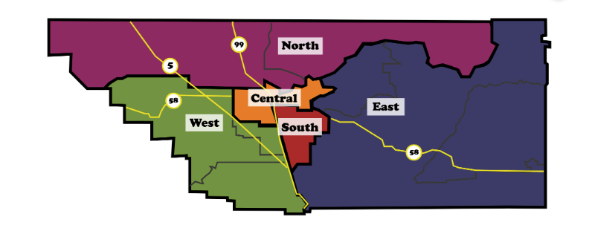
Kern County Subregions
1
Subregion | Cities and Zip-codes
South Subregion | Arvin: 93203, Lamont: 93241, Greenfield: 93307, Fuller Acres: 93307, Edmundson Acres: 93203, Weedpatch: 93241
North Subregion | Delano: 93215, 93216, Lost Hills: 93249, McFarland: 93250, Shafter: 93263, Wasco: 93280, Woody: 93287
East Subregion | Bodfish: 93205, California City: 93504, 93505, Kernville: 93238, Lake Isabella: 93240, Mojave: 93501, 93502, Edwards: 93523, 93524, Ridgecrest: 93555, 93556, Rosamond: 93560, Tehachapi: 93561, 93581
West Subregion | Taft: 93268, Buttonwillow: 93206, McKittrick: 93251, Derby Acres: 93224, Maricopa: 93252
Central Subregion | Bakersfield: 93301, 93302, 93303, 93304, 93305, 93306, 93307, 93308, 93309, 93310, 93311, 93312, 93313, 93314, 93380, 93383, 93384, 93385, 93386, 93387, 93388, 93389, 93390, Edison: 93220
^{Sources:}
1. Data from the Census Bureau ACS 5-year Estimate for subregional zip codes

Slide 50
Subregiones del condado de Kern
1
Subregión | Ciudades y Códigos Postales
Subregión Sur | Arvin: 93203, Lamont: 93241, Greenfield: 93307, Fuller Acres: 93307, Edmundson Acres: 93203, Weedpatch: 93241
Subregión Norte | Delano: 93215, 93216, Lost Hills: 93249, McFarland: 93250, Shafter: 93263, Wasco: 93280, Woody: 93287
Subregión Este | Bodfish: 93205, California City: 93504, 93505, Kernville: 93238, Lake Isabella: 93240, Mojave: 93501, 93502, Edwards: 93523, 93524, Ridgecrest: 93555, 93556, Rosamond: 93560, Tehachapi: 93561, 93581
Subregión Oeste | Taft: 93268, Buttonwillow: 93206, McKittrick: 93251, Derby Acres: 93224, Maricopa: 93252
Subregión Central | Bakersfield: 93301, 93302, 93303, 93304, 93305, 93306, 93307, 93308, 93309, 93310, 93311, 93312, 93313, 93314, 93380, 93383, 93384, 93385, 93386, 93387, 93388, 93389, 93390, Edison: 93220
Norte
Central
Este
Oeste
Sur
^{Sources:}
1. Data from the Census Bureau ACS 5-year Estimate for subregional zip codes

Slide 51
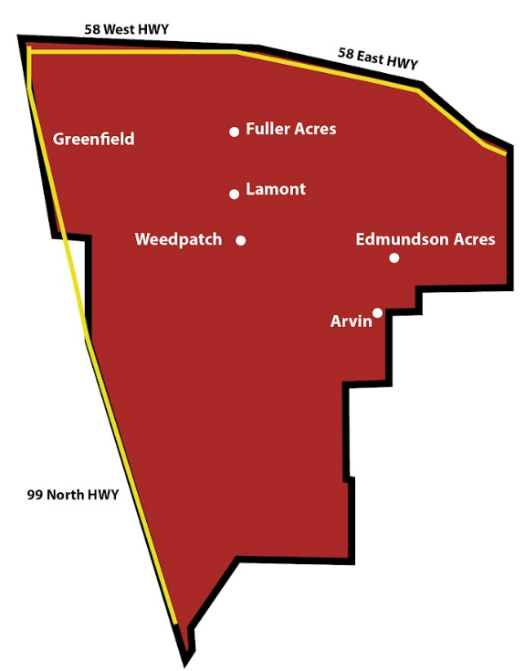
1
Total Pop. (2016-2020) | 133,157
Poverty = <100% of FPL (%, 2016-2020) | 28.77%
Low Income = <200% of FPL (%, 2016-2020) | 62.67%
Racial/Ethnic Minority (%, 2016-2020) | 87.90%
Hispanic/Latino (%, 2016-2020) | 80.32%
Black (%, 2016-2020) | 4.47%
Asian (%, 2016-2020) | 2.09%
Amer. Indian/Alaska Native (%, 2016-2020) | 0.92%
Native Hawaiian (%, 2016-2020) | 0.17%
Under 18 (%, 2016-2020) | 33.73%
65 and older (%, 2016-2020) | 7.23%
Less than High School Ed. (adults 25+, %, 2016-2020) | 45.00%
Adults Ever Told Have Diabetes (%, 2020) | 13.33%
Adults with No Dental Care in Past Year (%, 2020) | 56.53%
Adults with No Usual Source of Primary Care (%, 2018) | 25.44%
Adults Who Are Binge Drinkers (%, 2020) | 16.73%
Adults Who Smoke (%, 2020) | 18.57%
Adults Who Are Obese (%, 2020) | 38.92%
Adults with High Blood Pressure (%, 2020) | 27.84%
South Kern Subregion Demographics
^{Sources:}
1.Data from the Census Bureau ACS 5-year Estimate for subregional zip codes

Slide 52
1
Población total. (2016-2020) | 133,157
Pobreza = <100% of FPL (%, 2016-2020) | 28.77%
Bajos Ingresos= <200% of FPL (%, 2016-2020) | 62.67%
Minoría racial/étnica (%, 2016-2020) | 87.90%
Hispano / latino (%, 2016-2020) | 80.32%
Negro (%, 2016-2020) | 4.47%
Asiático (%, 2016-2020) | 2.09%
Indio americano/nativo de Alaska (%, 2016-2020) | 0.92%
Nativo hawaiano (%, 2016-2020) | 0.17%
Menores de 18 años (%, 2016-2020) | 33.73%
65 años y más(%, 2016-2020) | 7.23%
Menos que una educación secundaria (adults 25+, %, 2016-2020) | 45.00%
Adultos con diabetes (%, 2020) | 13.33%
Adultos sin atención dental en el último año (%, 2020) | 56.53%
Adultos sin fuente habitual de atención primaria(%, 2018) | 25.44%
Adultos que beben en exceso (%, 2020) | 16.73%
Adultos que fuman (%, 2020) | 18.57%
Adultos que son obesos(%, 2020) | 38.92%
Adultos con presión arterial alta(%, 2020) | 27.84%
Demografía de la subregión Kern Sur
^{Sources:}
1.Data from the Census Bureau ACS 5-year Estimate for subregional zip codes

Slide 53
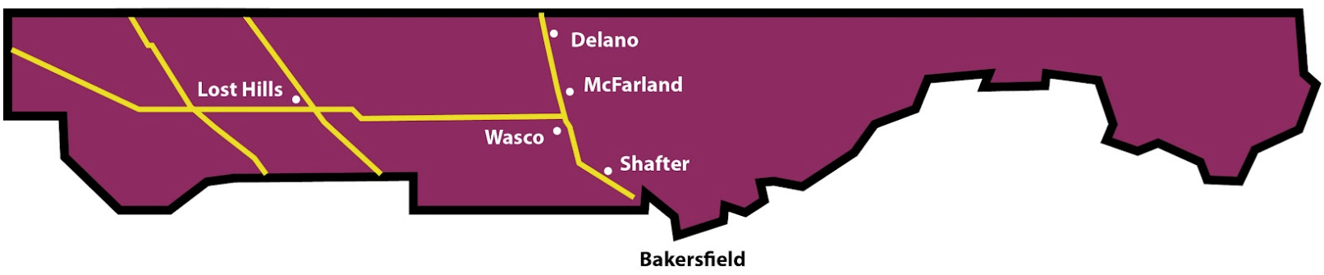
1
Total Pop. (2016-2020) | 134,211
Poverty = <100% of FPL (%, 2016-2020) | 21.90%
Low Income = <200% of FPL (%, 2016-2020) | 56.68%
Racial/Ethnic Minority (%, 2016-2020) | 86.60%
Hispanic/Latino (%, 2016-2020) | 76.37%
Black (%, 2016-2020) | 3.33%
Asian (%, 2016-2020) | 5.94%
Amer. Indian/Alaska Native (%, 2016-2020) | 0.64%
Native Hawaiian (%, 2016-2020) | 0.00%
Under 18 (%, 2016-2020) | 27.89%
65 and older (%, 2016-2020) | 9.22%
Less than High School Ed. (adults 25+, %, 2016-2020) | 38.50%
Adults Ever Told Have Diabetes (%, 2020) | 12.59%
Adults with No Dental Care in Past Year (%, 2020) | 54.63%
Adults with No Usual Source of Primary Care (%, 2018) | 30.57%
Adults Who Are Binge Drinkers (%, 2020) | 17.85%
Adults Who Smoke (%, 2020) | 17.96%
Adults Who Are Obese (%, 2020) | 37.13%
Adults with High Blood Pressure (%, 2020) | 27.66%
North Kern Subregion Demographics
^{Sources:}
1. Data from the Census Bureau ACS 5-year Estimate for subregional zip codes

Slide 54
1
Población total. (2016-2020) | 134,211
Pobreza = <100% of FPL (%, 2016-2020) | 21.90%
Bajos Ingresos = <200% of FPL (%, 2016-2020) | 56.68%
Minoría racial/étnica (%, 2016-2020) | 86.60%
Hispano / latino (%, 2016-2020) | 76.37%
Negro (%, 2016-2020) | 3.33%
Asiático (%, 2016-2020) | 5.94%
Indio americano/nativo de Alaska (%, 2016-2020) | 0.64%
Nativo hawaiano(%, 2016-2020) | 0.00%
Menores de 18 años (%, 2016-2020) | 27.89%
65 años y más(%, 2016-2020) | 9.22%
Menos que una educación secundaria . (adults 25+, %, 2016-2020) | 38.50%
Adultos con diabetes (%, 2020) | 12.59%
Adultos sin atención dental en el último año (%, 2020) | 54.63%
Adultos sin fuente habitual de atención primaria(%, 2018) | 30.57%
Adultos que beben en exceso (%, 2020) | 17.85%
Adultos que fuman (%, 2020) | 17.96%
Adultos que son obesos(%, 2020) | 37.13%
Adultos con presión arterial alta(%, 2020) | 27.66%
Demografía de la subregión Kern Norte
^{Sources:}
1. Data from the Census Bureau ACS 5-year Estimate for subregional zip codes

Slide 55
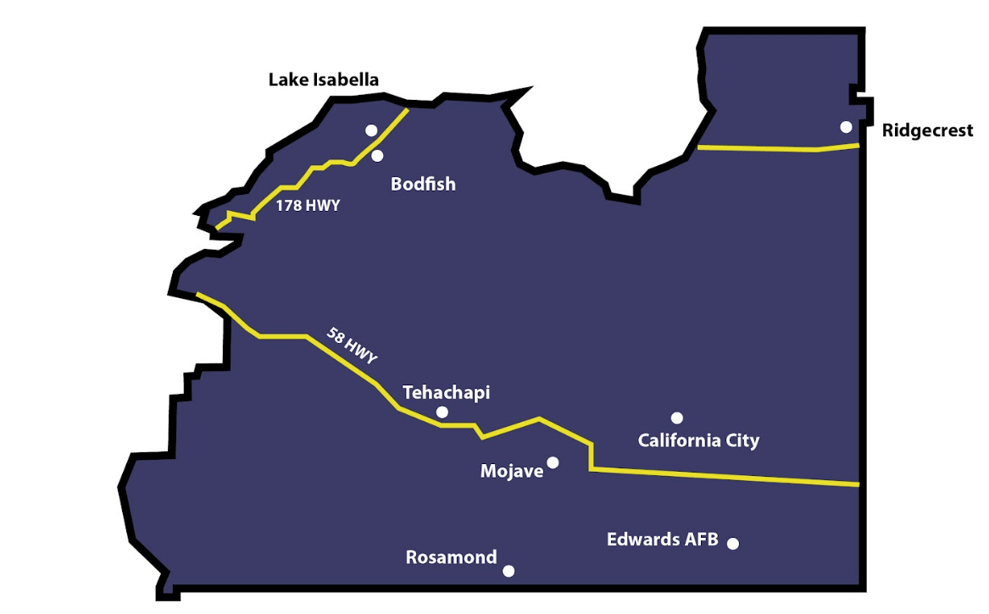
1
Total Pop. (2016-2020) | 120,284
Poverty = <100% of FPL (%, 2016-2020) | 15.97%
Low Income = <200% of FPL (%, 2016-2020) | 35.71%
Racial/Ethnic Minority (%, 2016-2020) | 42.76%
Hispanic/Latino (%, 2016-2020) | 27.67%
Black (%, 2016-2020) | 8.08%
Asian (%, 2016-2020) | 2.48%
Amer. Indian/Alaska Native (%, 2016-2020) | 1.29%
Native Hawaiian (%, 2016-2020) | 0.04%
Under 18 (%, 2016-2020) | 23.92%
65 and older (%, 2016-2020) | 15.68%
Less than High School Ed. (adults 25+, %, 2016-2020) | 14.11%
Adults Ever Told Have Diabetes (%, 2020) | 10.41%
Adults with No Dental Care in Past Year (%, 2020) | 39.50%
Adults with No Usual Source of Primary Care (%, 2018) | 23.45%
Adults Who Are Binge Drinkers (%, 2020) | 18.57%
Adults Who Smoke (%, 2020) | 15.35%
Adults Who Are Obese (%, 2020) | 32.77%
Adults with High Blood Pressure (%, 2020) | 29.34%
East Kern Subregion Demographics
^{Sources:}
1. Data from the Census Bureau ACS 5-year Estimate for subregional zip codes

Slide 56
1
Población total. (2016-2020) | 120,284
Pobreza = <100% of FPL (%, 2016-2020) | 15.97%
Bajos Ingresos = <200% of FPL (%, 2016-2020) | 35.71%
Minoría racial/étnica (%, 2016-2020) | 42.76%
Hispano / latino (%, 2016-2020) | 27.67%
Negro (%, 2016-2020) | 8.08%
Asiático (%, 2016-2020) | 2.48%
Indio americano/nativo de Alaska (%, 2016-2020) | 1.29%
Nativo hawaiano(%, 2016-2020) | 0.04%
Menores de 18 años (%, 2016-2020) | 23.92%
65 años y más(%, 2016-2020) | 15.68%
Menos que una educación secundaria (adults 25+, %, 2016-2020) | 14.11%
Adultos con diabetes (%, 2020) | 10.41%
Adultos sin atención dental en el último año (%, 2020) | 39.50%
Adultos sin fuente habitual de atención primaria(%, 2018) | 23.45%
Adultos que beben en exceso (%, 2020) | 18.57%
Adultos que fuman (%, 2020) | 15.35%
Adultos que son obesos(%, 2020) | 32.77%
Adultos con presión arterial alta(%, 2020) | 29.34%
Demografía de la subregión Kern Este
^{Sources:}
1. Data from the Census Bureau ACS 5-year Estimate for subregional zip codes

Slide 57
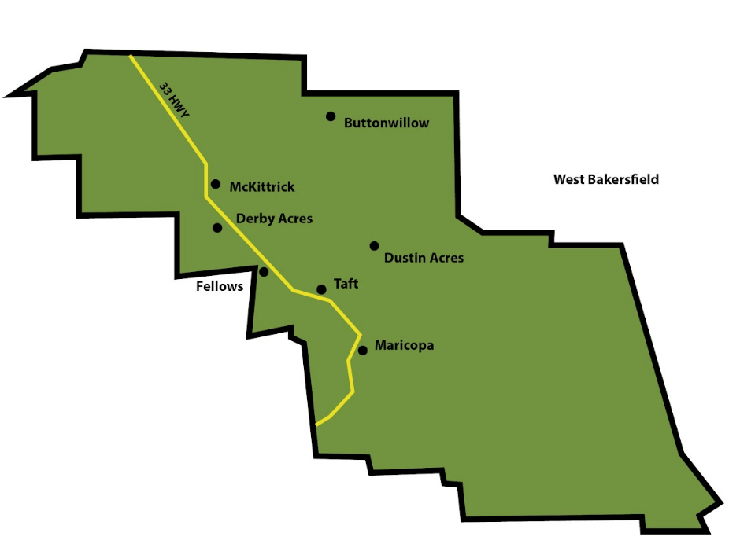
1
Total Pop. (2016-2020) | 15,767
Poverty = <100% of FPL (%, 2016-2020) | 15.14%
Low Income = <200% of FPL (%, 2016-2020) | 35.46%
Racial/Ethnic Minority (%, 2016-2020) | 67.99%
Hispanic/Latino (%, 2016-2020) | 51.66%
Black (%, 2016-2020) | 5.57%
Asian (%, 2016-2020) | 8.81%
Amer. Indian/Alaska Native (%, 2016-2020) | 0.35%
Native Hawaiian (%, 2016-2020) | 0.01%
Under 18 (%, 2016-2020) | 29.16%
65 and older (%, 2016-2020) | 9.54%
Less than High School Ed. (adults 25+, %, 2016-2020) | 21.57%
Adults Ever Told Have Diabetes (%, 2020) | 10.13%
Adults with No Dental Care in Past Year (%, 2020) | 44.98%
Adults with No Usual Source of Primary Care (%, 2018) | 34.90%
Adults Who Are Binge Drinkers (%, 2020) | 18.53%
Adults Who Smoke (%, 2020) | 16.35%
Adults Who Are Obese (%, 2020) | 33.68%
Adults with High Blood Pressure (%, 2020) | 25.99%
West Kern Subregion Demographics
^{Sources:}
1. Data from the Census Bureau ACS 5-year Estimate for subregional zip codes

Slide 58
1
Demografía de la subregión Kern Oeste
Población total. (2016-2020) | 15,767
Pobreza = <100% of FPL (%, 2016-2020) | 15.14%
Bajos Ingresos = <200% of FPL (%, 2016-2020) | 35.46%
Minoría racial/étnica (%, 2016-2020) | 67.99%
Hispano / latino (%, 2016-2020) | 51.66%
Negro (%, 2016-2020) | 5.57%
Asiático (%, 2016-2020) | 8.81%
Indio americano/nativo de Alaska (%, 2016-2020) | 0.35%
Nativo hawaiano(%, 2016-2020) | 0.01%
Menores de 18 años (%, 2016-2020) | 29.16%
65 años y más(%, 2016-2020) | 9.54%
Menos que una educación secundaria (adultos 25+, %, 2016-2020) | 21.57%
Adultos con diabetes (%, 2020) | 10.13%
Adultos sin atención dental en el último año (%, 2020) | 44.98%
Adultos sin fuente habitual de atención primaria (%, 2018) | 34.90%
Adultos que beben en exceso (%, 2020) | 18.53%
Adultos que fuman (%, 2020) | 16.35%
Adultos que son obesos(%, 2020) | 33.68%
Adultos con presión arterial alta(%, 2020) | 25.99%
^{Sources:}
1. Data from the Census Bureau ACS 5-year Estimate for subregional zip codes

Slide 59
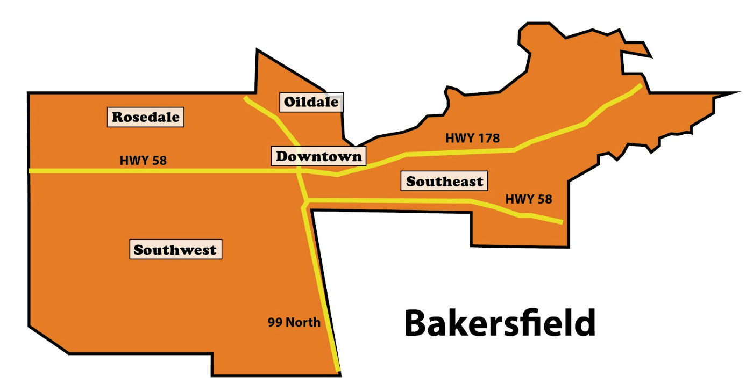
1
Total Pop. (2016-2020) | 583,873
Poverty = <100% of FPL (%, 2016-2020) | 20.24%
Low Income = <200% of FPL (%, 2016-2020) | 43.34%
Racial/Ethnic Minority (%, 2016-2020) | 67.55%
Hispanic/Latino (%, 2016-2020) | 53.75%
Black (%, 2016-2020) | 5.81%
Asian (%, 2016-2020) | 5.36%
Amer. Indian/Alaska Native (%, 2016-2020) | 0.95%
Native Hawaiian (%, 2016-2020) | 0.05%
Under 18 (%, 2016-2020) | 30.11%
65 and older (%, 2016-2020) | 10.33%
Less than High School Ed. (adults 25+, %, 2016-2020) | 23.04%
Adults Ever Told Have Diabetes (%, 2020) | 11.06%
Adults with No Dental Care in Past Year (%, 2020) | 45.04%
Adults with No Usual Source of Primary Care (%, 2018) | 29.03%
Adults Who Are Binge Drinkers (%, 2020) | 17.62%
Adults Who Smoke (%, 2020) | 15.91%
Adults Who Are Obese (%, 2020) | 34.04%
Adults with High Blood Pressure (%, 2020) | 26.70%
Central Kern Subregion Demographics
^{Sources:}
1. Data from the Census Bureau ACS 5-year Estimate for subregional zip codes

Slide 60
1
Población total (2016-2020) | 583,873
Pobreza = <100% of FPL (%, 2016-2020) | 20.24%
Bajos Ingresos = <200% of FPL (%, 2016-2020) | 43.34%
Minoría racial/étnica (%, 2016-2020) | 67.55%
Hispano / latino (%, 2016-2020) | 53.75%
Negro (%, 2016-2020) | 5.81%
Asiático (%, 2016-2020) | 5.36%
Indio americano/nativo de Alaska (%, 2016-2020) | 0.95%
Nativo hawaiano(%, 2016-2020) | 0.05%
Menores de 18 años (%, 2016-2020) | 30.11%
65 años y más(%, 2016-2020) | 10.33%
Menos que una educación secundaria (adultos 25+, %, 2016-2020) | 23.04%
Adultos con diabetes(%, 2020) | 11.06%
Adultos sin atención dental en el último año (%, 2020) | 45.04%
Adultos sin fuente habitual de atención primaria (%, 2018) | 29.03%
Adultos que beben en exceso (%, 2020) | 17.62%
Adultos que fuman (%, 2020) | 15.91%
Adultos que son obesos(%, 2020) | 34.04%
Adultos con presión arterial alta(%, 2020) | 26.70%
Demografía de la subregión Kern Central
^{Sources:}
1. Data from the Census Bureau ACS 5-year Estimate for subregional zip codes

Slide 61
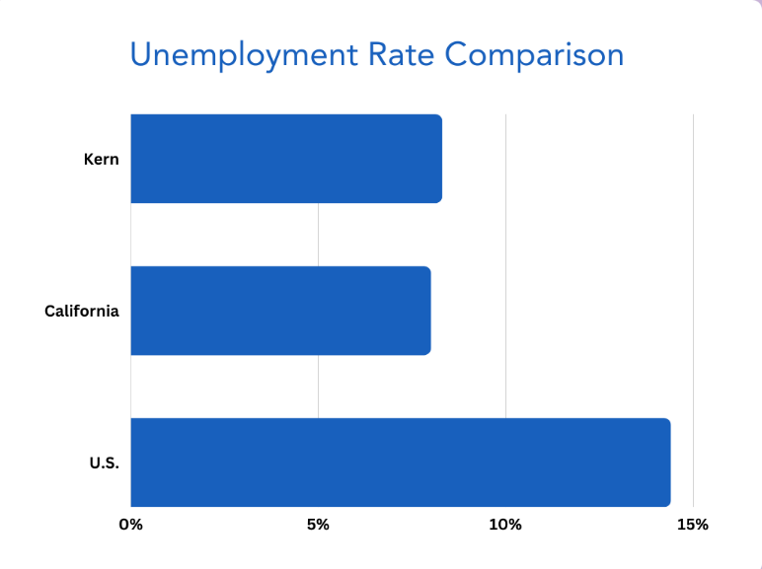
Kern County Economy
1
Key Job Groups
Office & Administrative Support Occupations: 36,017 people
Farming, Fishing, & Forestry Occupations: 30,911 people
Sales & Related Occupations: 30,359 people
Prominent Employment Sectors
Health Care & Social Assistance: 40,702 people
Agriculture, Forestry, Fishing & Hunting: 40,334 people
Retail Trade: 36,250 people
Unemployment Concerns
Kern's Unemployment Rate: 8.3%
Comparison to National (14.4%) and State (8%) Rates
Unemployment Tied to Education Levels
1
2, 3
Sources:
1.Data USA; Kern County; 2020; https://datausa.io/profile/geo/kern-county-ca#economy
2.State of California; Employment Development Department; Monthly Labor Force Data for Counties; July 2023
3.Comprehensive Economic Development Strategy (CEDS); County of Kern, CA; October 31, 2021
https://www.kerncounty.com/home/showpublisheddocument/7279/637913287179270000.

Slide 62
Economía del Condado de Kern
1
Grupos de Trabajo Clave
Ocupaciones de Oficina y Apoyo Administrativo: 36,017 personas
Ocupaciones Agrícolas, Pesqueras y Forestales: 30,911 personas
Ventas y Ocupaciones Relacionadas: 30,359 personas
Sectores de Empleo Destacados
Asistencia Sanitaria y Social: 40,702 personas
Agricultura, Silvicultura, Pesca y Caza: 40,334 personas
Comercio al por Menor: 36,250 personas
Preocupaciones de Desempleo
Tasa de Desempleo de Kern: 8.3%
Comparación con las Tasas Nacionales (14.4%) y Estatales (8%)
Desempleo Vinculado a los Niveles de Educación
Comparación del Porcentaje de Desempleo
1
2, 3
EE.UU.
Origen:
1.Data USA; Kern County; 2020; https://datausa.io/profile/geo/kern-county-ca#economy
2.State of California; Employment Development Department; Monthly Labor Force Data for Counties; July 2023
3.Comprehensive Economic Development Strategy (CEDS); County of Kern, CA; October 31, 2021
https://www.kerncounty.com/home/showpublisheddocument/7279/637913287179270000.

Slide 63
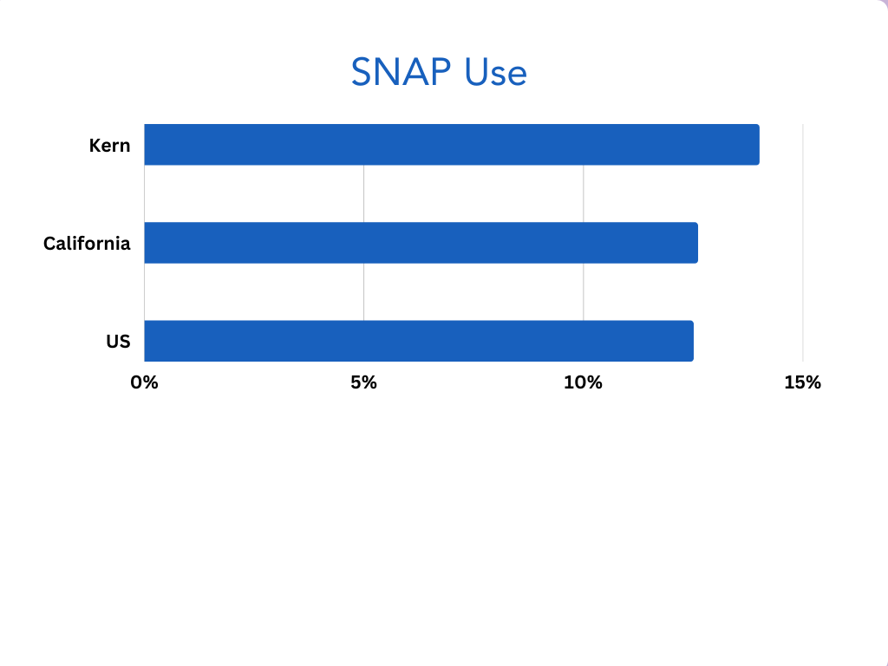
Kern County Economy
Economic Inequities
Concentration of Lower-Wage Jobs
Limited Upward Mobility and Opportunities
Economic Well-Being and Cost of Living
Diverse Economic Well-Being across Towns
Cost of Living Varies and Affordability
Towns with Economic Challenges
SNAP Utilization at a significant rate
1
2, 3
Sources:
1. U.S. Census Bureau; SNAP Benefits Recipients in Kern County, CA [CBR06029CAA647NCEN]; Retrieved from FRED, Federal Reserve Bank of St. Louis; https://fred.stlouisfed.org/series/CBR06029CAA647NCEN.
2.United Ways of California; "The Real Cost Measure in California 2023;" 2023; https://unitedwaysca.org/realcost/
3.California State University Bakersfield; Kern Economic Journal; 2022;
https://maindata.csub.edu/sites/maindata.csub.edu/files/2022%20Kern%20Economic%20Journal%20Second%20Quarter.pdf

Slide 64
Economía del Condado de Kern
Inequidades Económicas
Concentración de empleos con salarios más bajos
Movilidad ascendente y oportunidades limitadas
Bienestar Económico y Costo de Vida
Bienestar Económico Diverso en todas las Ciudades
El Costo de Vida Varía y la Asequibilidad
Ciudades con Desafíos Económicos
Utilización de SNAP a un ritmo significativo
Uso de SNAP
1
2, 3
EE.UU.
Origen:
1. U.S. Census Bureau; SNAP Benefits Recipients in Kern County, CA [CBR06029CAA647NCEN]; Retrieved from FRED, Federal Reserve Bank of St. Louis;
https://fred.stlouisfed.org/series/CBR06029CAA647NCEN.
2.United Ways of California; "The Real Cost Measure in California 2023;" 2023; https://unitedwaysca.org/realcost/
3.California State University Bakersfield; Kern Economic Journal; 2022;
https://maindata.csub.edu/sites/maindata.csub.edu/files/2022%20Kern%20Economic%20Journal%20Second%20Quarter.pdf

Slide 65
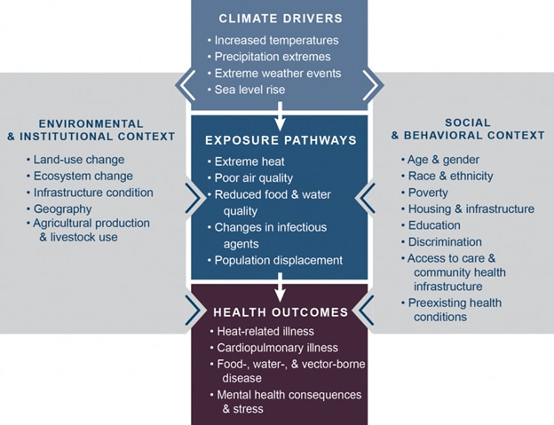
Kern County Climate & Environmental Impact
Kern experiences more frequent and intense extreme weather events
  Storms, Flash Floods, & Wildfires
    Property damage, infrastructure disruption, and human safety risks
  Influencing disease-carrying vectors, like mosquitos
    Disease like West Nile and Zika becoming more prevalent
  Pollen generation – rise in allergies and respiratory problems
  Air Quality concerns
    Asthma, allergies, chronic obstructive pulmonary disease (COPD), and other cardiovascular and respiratory diseases

Slide 66
Clima e Impacto Ambiental del Condado de Kern
Kern experimenta eventos climáticos extremos más frecuentes e intensos
  Tormentas, Inundaciones Repentinas e Incendios Forestales
    Daños a la Propiedad, Interrupción de la Infraestructura y Riesgos para la Seguridad Humana
  Influir en los Vectores Portadores de Enfermedades, como los Mosquitos
    Enfermedades como el del Nilo Occidental y el Zika cada vez más prevalentes
  Generación de Polen: Aumento de Alergias y Problemas Respiratorios
  Preocupaciones sobre la Calidad del Aire
    Asma, alergias, enfermedad pulmonar obstructiva crónica (EPOC) y otras enfermedades cardiovasculares y respiratorias
FACTORES CLIMÁTICOS
Aumento de las temperaturas
Precipitación extrema
Fenómenos meteorológicos extremos
Aumento del nivel del mar
CONTEXTO AMBIENTAL
E INSTITUCIONAL
Cambio de uso de la tierra
Los ecosistemas cambian
Estado de la infraestructura
Geografía
Producción agrícola y uso ganadero
CONTEXTO SOCIAL Y CONDUCTUAL
Edad y género
Raza y etnia
Pobreza
Vivienda e infraestructura
Educación
Discriminación
Acceso a la atención e infraestructura de salud comunitaria
Condiciones de salud preexistentes
VÍAS DE EXPOSICIÓN
Calor extremo
Mala calidad del aire
Reducción de la calidad de los alimentos y el agua
Cambio en los agentes infecciosos
Desplazamiento de población
RESULTADOS DE SALUD
Enfermedades relacionadas con el calor
Enfermedad cardiopulmonar
Alimentos, agua y enfermedades transmitidas por vectores
Consecuencias para la salud mental y estrés

Slide 67
Kern County Climate & Environmental Impact
1
Heat-Related Challenges
  48,620 outdoor farm workers listed in very same report being at risk of heat-related challenges
    62,238 agriculture jobs in Kern County
  Heatwaves have impacts on vulnerable populations as well as having an impact on energy demands
Short term impacts
  Property damage, unsafe conditions, transportation disruption
Long term impacts
  Ag degradation, loss of soil fertility leads to loss of crops
    Contributes population displacement or migration which in turn strains social services and increases pressures on housing resources
2
2
Sources:
1. Employment in the Kern County Oil and Agriculture Sectors, August 2019
https://www.kerncog.org/wp-content/uploads/2009/10/Oil-and-Agriculture-Report-Final-Nov-2019.pdf
2. Impacts on Climate Change Graphic, 2016, https://www.hhs.gov/climate-change-health-equity-environmental-justice/climate-change-health-equity/index.html?utm_source=news-releases-email&utm_medium=email&utm_campaign=august-21-2023

Slide 68
Clima e Impacto Ambiental del Cond ado de Kern
1
Desafíos Relacionados con el Calor
48,620 trabajadores agrícolas al aire libre enumerados en el mismo informe están en riesgo de desafíos relacionados con el calor
    62,238 empleos agrícolas en el condado de Kern
  Las olas de calor tienen impactos en las poblaciones vulnerables, además de tener un impacto en las demandas de energía
Impactos a corto plazo
  Daños a la propiedad, condiciones inseguras, interrupción del transporte
Impactos a largo plazo
  La degradación agrícola, la pérdida de fertilidad del suelo conduce a la pérdida de cultivos
    Contribuye al desplazamiento de la población o la migración, lo que a su vez ejerce presión sobre los servicios sociales y aumenta las presiones sobre los recursos de vivienda
2
2
Origen:
1. Employment in the Kern County Oil and Agriculture Sectors, August 2019, https://www.kerncog.org/wp-content/uploads/2009/10/Oil-and-Agriculture-Report-Final-Nov-2019.pdf
2. Impacts on Climate Change Graphic, 2016, https://www.hhs.gov/climate-change-health-equity-environmental-justice/climate-change-health-equity/index.html?utm_source=news-releases-email&utm_medium=email&utm_campaign=august-21-2023

Slide 69
Kern County Public Health Analysis
2
Climate Change Impact
  Higher Temperatures, Shifting Weather Patterns
  Heat-Related Illnesses, Respiratory & Cardiovascular Problems
  Vector-Borne Diseases, Allergies, Respiratory Issues
Air Pollution and Health Effects
  Asthma, Allergies, COPD, Cardiovascular Diseases
  Bakersfield: Worst Air Quality in the U.S.
  Wildfires, Vehicular Exhaust, Agriculture Burning
Access to Healthcare
  Limited Community Health Centers, No Hospitals
  Patient-to-Primary Care Provider Ratios
  Lack of Dentists and Mental Health Providers
Racial and Cultural Disparities
  Lack of Diversity in Healthcare Providers
  Communication and Language Barriers
1
Race | Total | Poverty Rate
Black | 42,584 | 31.6%
Native Hawaiian/Pacific Islander | 1,103 | 23.1%
American Indian/Alaska Native alone | 8,439 | 23.0%
Some other race alone | 120,515 | 22.1%
Hispanic | 479,886 | 22.0%
Two or more races | 110,570 | 18.4%
Asian | 43,087 | 14.4%
White | 284,920 | 14.0%
2
3
3
Sources:
1. US Census, Poverty Status in the Past 12 Months, Table S1701, 2021, 5-Year Estimates
2. Kern Department of Public Health Services, June 30, 2023, https://www.bakersfield.com/news/2-years-later-kern-releases-updated-covid-19-death-data/article_823d2158-42da-11ee-84da-7bf9da5cb61f.html
3. California Department of Public Health, Violence and Social Determinantes of Health, Report: Prevención Violence in California, Volumen 1: The Role of Public Health (PDF), 2017,https://www.cdph.ca.gov/Programs/CCDPHP/DCDIC/SACB/CDPH%20Document%20Library/Violence%20Prevention%20Initiative/VPI%20Volume%201%20Version%201%2024%2019%20ADA.pdf

Slide 70
Análisis de la Salad Pública del Cond ado de Kern
2
Impacto del Cambio Climático
  Temperaturas más altas, patrones climáticos cambiantes
  Enfermedades relacionadas con el calor, problemas respiratorios y cardiovasculares
  Enfermedades transmitidas por vectores, alergias, problemas respiratorios
Contaminación del Aire y Efectos en la Salad
  Asma, Alergias, EPOC, Enfermedades cardiovasculares
  Bakersfield: La peor calidad del aire en los EE.UU.
  Incendios forestales, Escape vehicular, Incendios agrícolas
Acceso a la Asistencia Sanitaria
  Centros de salud comunitarios limitados, sin hospitales
  Proporción de pacientes a proveedores de atención primaria
  Falta de dentistas y proveedores de salud mental
Disparidades Raciales y Culturales
  Falta de diversidad en los proveedores de atención médica
  Barreras de comunicación y lenguaje
1
Raza | Total | Tasa de Pobreza
Negro | 42,584 | 31.6%
Nativo hawaiano/Isleño del Pacífico | 1,103 | 23.1%
Indio americano/nativo de Alaska solo | 8,439 | 23.0%
Alguna otra raza sola | 120,515 | 22.1%
Latino | 479,886 | 22.0%
Dos o mas razas | 110,570 | 18.4%
Asiático | 43,087 | 14.4%
Blanco | 284,920 | 14.0%
2
3
3
Origen:
1. US Census, Poverty Status in the Past 12 Months, Table S1701, 2021, 5-Year Estimates
2. Kern Department of Public Health Services, June 30, 2023,
https://www.bakersfield.com/news/2-years-later-kern-releases-updated-covid-19-death-data/article_823d2158-42da-11ee-84da-7bf9da5cb61f.html
3. California Department of Public Health, Violence and Social Determinantes of Health, Report: Prevención Violence in California, Volumen 1: The Role of Public Health (PDF), 2017, https://www.cdph.ca.gov/Programs/CCDPHP/DCDIC/SACB/CDPH%20Document%20Library/Violence%20Prevention%20Initiative/VPI%20Volume%201%20Version%201%2024%2019%20ADA.pdf

Slide 71
Kern County Public Health Analysis
Chronic Illnesses
Leading Causes of Death: Cancer, Heart Disease, Diabetes, COPD
Risk Factors: Obesity, Smoking, Environmental Factors
Obesity and Smoking Link to Heart Disease and Diabetes
Food Insecurity
Poverty, Educational Inequalities
Racial Disparities in Food Insecurity
Rising Grocery Costs, Increased Food Bank Usage
Violence and Mental Health
Homicide, Suicide, Motor Vehicle Crash Rates
Limited Social, Economic Opportunities
Farmworker Health Challenges
Barrier to Access: Insurance, Citizenship, Language, Transportation

Slide 72
Análisis de la Salad Pública del Cond ado de Kern
Enfermedades Crónicas
Principales Causas de Muerte: Cáncer, Enfermedades Cardíacas, Diabetes, EPOC
Factores de Riesgo: Obesidad, Tabaquismo, Factores Ambientales
La Obesidad y el Tabaquismo se Relacionan con la Enfermedad Cardíaca y la Diabetes
Inseguridad Alimenticia
Pobreza, Desigualdades Educativas
Disparidades Raciales en la Inseguridad Alimenticia
Aumento de los Costos de los Comestibles, Aumento del Uso del Banco de Alimentos
Violencia y Salad Mental
Tasas de Homicidio, Suicidio y Accidentes Automovilísticos
Oportunidades Sociales y Económicas Limitadas
Desafíos de Salad de los Trabajadores Agrícolas
Barrera de Acceso: Seguro, Ciudadanía, Idioma, Transporte

