Slide 1
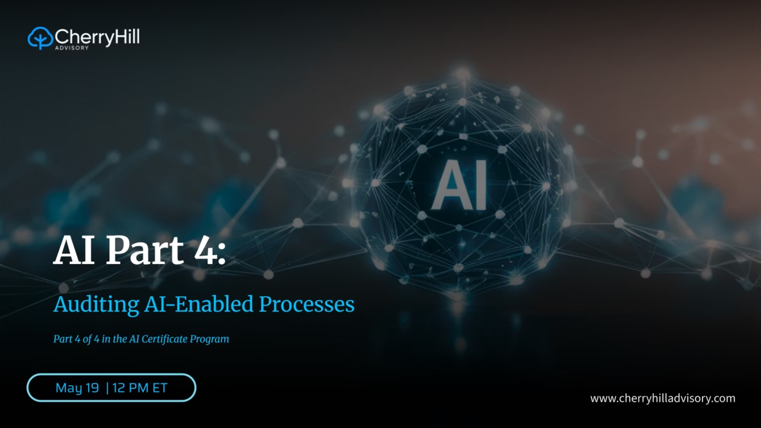


Notes:
Welcome to Part 4 of the AI Certificate Program, presented with MindBridge. This is where everything comes together — not governance theory, not framework alignment, but the actual mechanics of auditing a process where AI is doing part of the work.

Slide 2

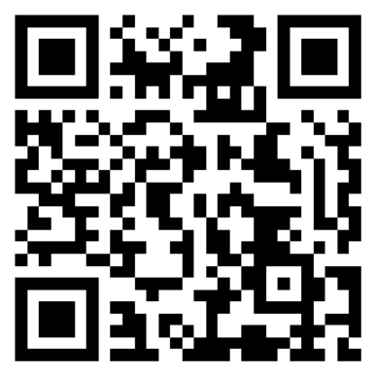
Connect with Mike on LinkedIn
Mike Levy
CIA, CRMA, CISA, CISSP, CDPSE, MBA
CEO & Managing Principal, Cherry Hill Advisory
20+ years of experience in Internal Audit, Cybersecurity, and Risk Management
Former Chief Audit Executive and Deloitte Consultant
IIA´s International Internal Audit Standards Board Member
Past Chair (2023-2024), IIA Northern American Board; Global Board Director
Expert in aligning audit functions with evolving cyber risk landscapes
Auditing AI-Enabled Processes
1
Notes:
Quick background: 20+ years in internal audit, cybersecurity, and risk management. Former Chief Audit Executive and Deloitte consultant.
Past Chair of the IIA North American Board 2023–2024, Global Board Director, and member of IIA's International Internal Audit Standards Board.
CEO of Cherry Hill Advisory. Connect with me on LinkedIn — the QR code on screen goes directly to my profile. Let's get into it.

Slide 3
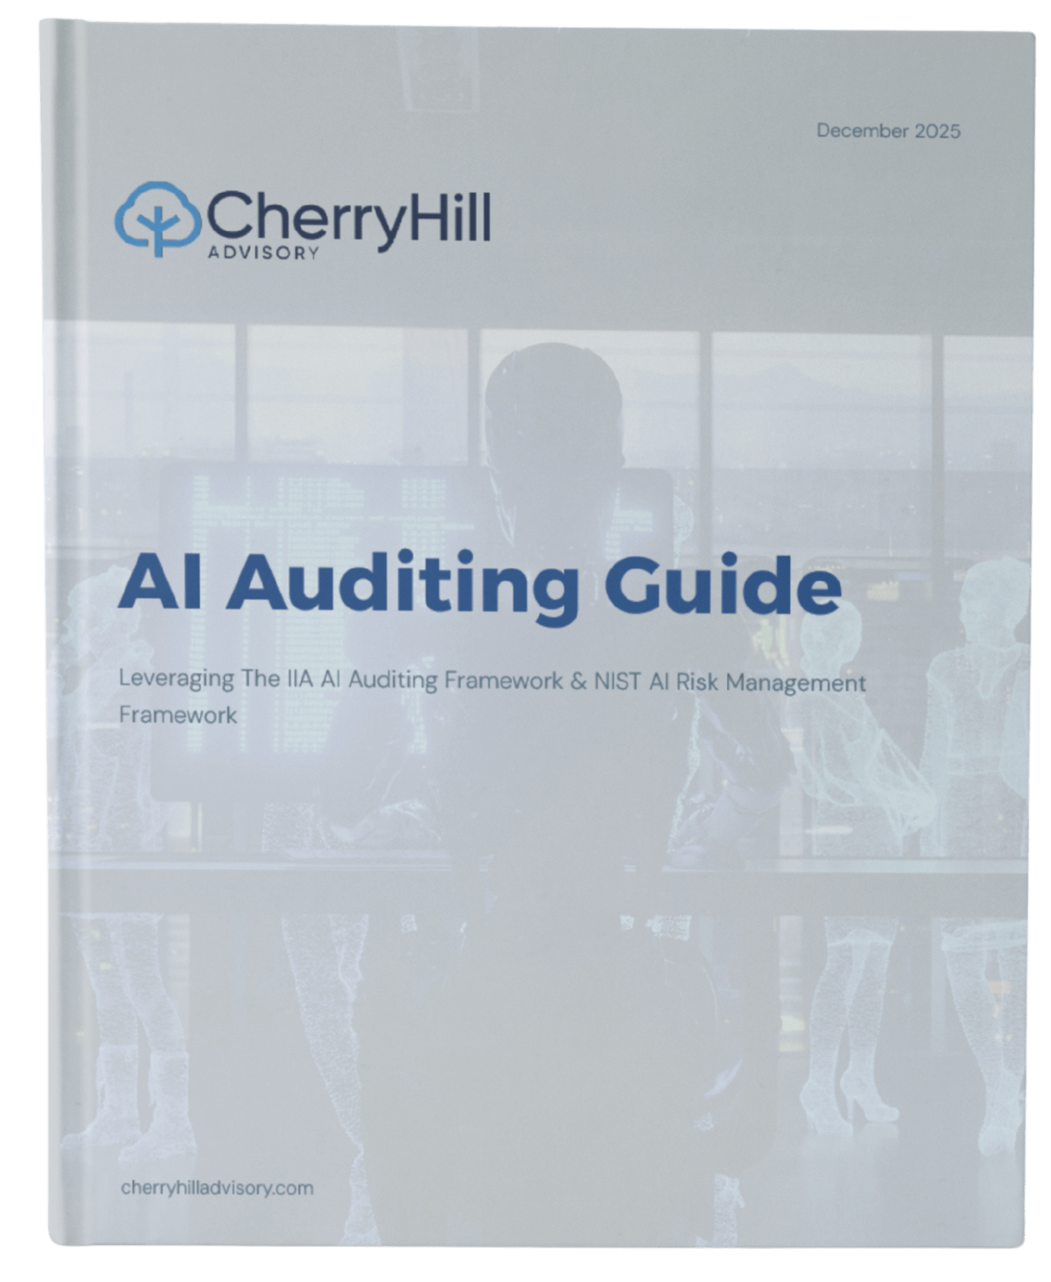
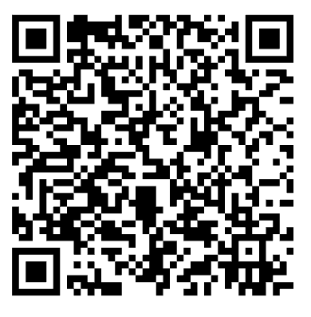
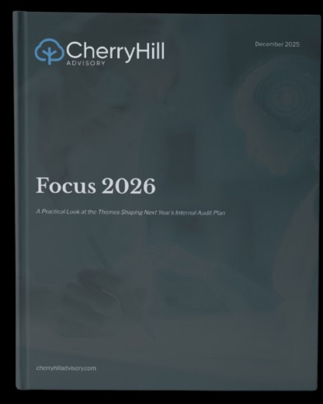
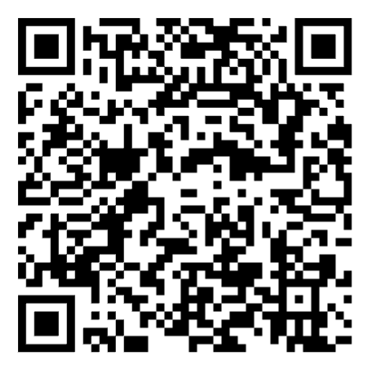
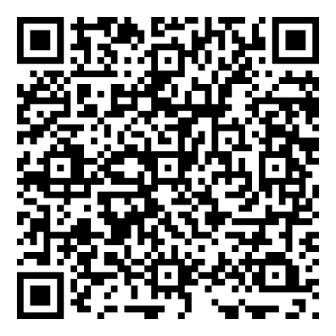
Resources for today
AI Auditing Guide
Focus 2026
IIA Global Internal Audit Standards
Auditing AI-Enabled Processes
2
Notes:
Three resources to grab before or after this session.
Cherry Hill Advisory AI Auditing Guide — the practical reference that anchors everything we cover today. QR code on screen.
Focus 2026 — Cherry Hill's annual publication on the priorities shaping internal audit this year, including AI.
IIA Global Internal Audit Standards

Slide 4


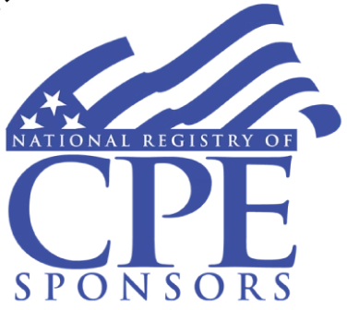
Auditing AI-Enabled Processes
CPE Credit Information
NASBA CPE Requirement: 50 minutes of attendance per hour, plus 3 poll questions.
Certificates will be distributed mid next week or earlier.
For any questions or concerns, please email cpe@cherryhilladvisory.com.
cherryhilladvisory.com
Notes:
CPE Requirements
CPE reminder - 50 minutes of attendance and three poll questions required for the credit.
Certificates - mid next week or earlier, email cpe@cherryhilladvisory.com with questions.

Slide 5
AGENDA
Today's Agenda
By the end of this session, you will be able to:
01
02
03
Plan and Scope an AI Audit From Start to Finish
Pick the Right Tests for AI-Enabled Processes
Tie AI Risks to Core Control Objectives
A four-step method applicable to both internal audit and financial statement engagements.
Three test categories and stratified sampling with worked examples for both audit types.
Map AI failure modes to the control objectives internal and external auditors already use.
04
Apply It: Template and Real-World Example
A workpaper template and finance control case study showing what complete documentation looks like, and where it breaks down.
Auditing AI-Enabled Processes
3
Notes:
Four things you will be able to do by the end of this session:
One — Plan and scope an AI audit from start to finish using a four-step method that works for both internal audit and financial statement engagements.
Two — Pick the right tests for AI-enabled processes using three test categories and stratified sampling, with worked examples for both audit types.
Three — Tie AI risks to core control objectives — map AI failure modes to the control objectives internal and external auditors already use.
Four — Apply it with a workpaper template and a real-world finance control case study showing what complete documentation looks like — and where it breaks down.

Slide 6
Why AI Now Lives Inside Your Audit Universe
AI is not a separate program. It is embedded in the finance, operations, and customer-facing workflows your audit work already touches, including the financial reporting processes covered by SAS 145 and ISA 315 (Revised). For finance teams running AI in financial reporting, this is what your auditors are now expected to test, and what your audit committee will ask about.
78%
65%
72%
Share of organizations reporting use of AI in at least one business function in 2024, up from 55% the prior year.
Share reporting regular use of generative AI in at least one business function in 2024, nearly double the prior year.
Share of companies globally already piloting or using AI in financial reporting, with near-universal adoption expected within three years.
Sources: Stanford HAI, AI Index Report 2025, Chapter 4; McKinsey & Company, "The State of AI in Early 2024," May 2024; KPMG, "AI in Financial Reporting and Audit: Navigating the New Era," May 2024.
Auditing AI-Enabled Processes
4
Notes:
The framing that matters most for this session: AI is not a separate program. It is already embedded in the finance, operations, and customer-facing workflows your audit work already touches.
Three numbers tell the story:
78% of organizations reported using AI in at least one business function in 2024 — up from 55% the prior year.
65% reported regular use of generative AI in at least one business function in 2024 — nearly double the prior year.
72% of companies globally are already piloting or using AI in financial reporting, with near-universal adoption expected within three years.
This is why SAS 145 and ISA 315 (Revised) now explicitly require auditors to consider automated and AI-assisted processes when assessing risk. If AI is in the process, it is in scope.

Slide 7
POLL 1 OF 4
When you scope an AI-enabled process today, what's your starting point?
AI Tool First
Business Process First
Data First
I start with the AI tool itself and work outward.
I start with the business process and locate the AI inside it.
I start with the data the AI uses.
Not Yet Scoped
I have not yet been asked to scope an AI-enabled audit.
Auditing AI-Enabled Processes
5
Notes:
Poll 1 of 4
[Launch poll] When you scope an AI-enabled process today, what's your starting point?
The four options are: AI Tool First, Business Process First, Data First, or Not Yet Scoped.

Slide 8
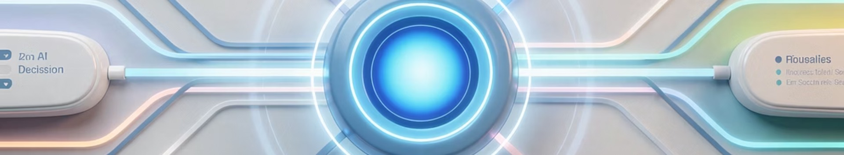
Plan and Scope
The first failure mode in AI audits is poor scoping. Auditors who start with the algorithm get lost. Auditors who start with the process get findings.
Auditing AI-Enabled Processes
6
Notes:
Section Break — Plan and Scope
The first failure mode in AI audits is poor scoping. Auditors who start with the algorithm get lost. Auditors who start with the process get findings.

Slide 9
The Four-Step Scoping Method
A repeatable structure you can apply to any AI-enabled audit, regardless of business unit or AI tool. The same four steps apply whether you are testing the control to provide assurance, or testing it to determine reliance for financial reporting purposes.
Map the Process
Locate the AI
Identify the end-to-end business process before identifying the AI. Document inputs, decision points, and outputs.
Pinpoint exactly which step or steps in the process the AI performs. Most AI lives in one of three places.
Define Risk + Control Objective + Procedure
Set the Documentation Bar
State the risk in business terms. Tie it to a core control objective. Specify a test procedure that produces evidence.
Would these workpapers hold up under an independent review against the audit standards your engagement is governed by?
Source: Cherry Hill Advisory AI Auditing Guide, "Practical Audit Steps and Tools," December 2025; aligned to IIA Global Internal Audit Standards (GIAS 2024) Domain IV and Domain V.
Auditing AI-Enabled Processes
7
Notes:
The Four-Step Scoping Method
This is the repeatable structure for any AI-enabled audit — internal audit providing assurance or external audit determining reliance. Same four steps either way.
Step 1 — Map the Process: identify the end-to-end business process before you identify the AI. Document inputs, decision points, outputs.
Step 2 — Locate the AI: pinpoint exactly which step in the process the AI performs. Most AI lives in one of three places — we cover those on the next slide.
Step 3 — Define Risk + Control Objective + Procedure: state the risk in business terms, tie it to a control objective, and specify a test procedure that produces evidence.
Step 4 — Set the Documentation Bar: before fieldwork begins, ask: would these workpapers hold up under an independent review against the standards governing this engagement?
This sequence is aligned to IIA Global Internal Audit Standards Domain IV and Domain V.

Slide 10
Step 01: Map the Process Before You Audit the AI
The process is the unit of audit. The AI is one component within that process.
An AI-enabled process is still a process. Apply the audit methodology you already know.
Document the end-to-end flow: inputs, decision points, outputs, downstream actions, and the people accountable at each step.
Identify what the process is supposed to do. That goal is the basis for every control objective downstream.
Walk the process with the process owner before scoping the AI itself. Ask: "What changes if the AI is wrong?"
Source: Cherry Hill Advisory AI Auditing Guide, "Mapping AI Use & Risk," December 2025.
Auditing AI-Enabled Processes
8
Notes:
Step 01 — Map the Process Before You Audit the AI
The most important reframe in this entire session: the process is the unit of audit. The AI is one component within that process.
Four things to do in Step 1:
Apply the audit methodology you already know. An AI-enabled process is still a process. The methodology does not change.
Document the end-to-end flow: inputs, decision points, outputs, downstream actions, and the people accountable at each step.
Identify what the process is supposed to do. That goal becomes the basis for every control objective downstream.
Walk the process with the process owner before scoping the AI itself. The question to ask: "What changes if the AI is wrong?" That answer tells you where the risk lives.

Slide 11
Step 02: Locate the AI - Three Places It Hides
AI rarely takes over an entire process. It usually performs one of three roles. Identify which one before you scope tests.
01 Decision Step
The AI makes or recommends a yes/no decision.
Examples: Vendor approval, credit decision, transaction flagging.
Risk: Unauthorized or biased decisions.
02 Monitoring Step
The AI watches a population and surfaces exceptions.
Examples: Fraud monitoring, journal-entry review, expense anomaly detection.
03 Automated Action Step
Risk: Missed exceptions or false positives at scale.
The AI takes an action without a human in the loop.
Examples: Customer messaging, document generation, automated remediation.
Risk: Unreviewed outputs reaching customers or regulators.
Source: Cherry Hill Advisory AI Auditing Guide, "Mapping AI Use & Risk," December 2025.
Auditing AI-Enabled Processes
9
Notes:
Step 02 — Locate the AI — Three Places It Hides
AI rarely takes over an entire process. It usually performs one of three roles. Identify which one before you scope tests — because the role determines the risk and the test.
01 — Decision Step: the AI makes or recommends a yes/no decision. Examples: vendor approval, credit decision, transaction flagging. Risk: unauthorized or biased decisions.
02 — Monitoring Step: the AI watches a population and surfaces exceptions. Examples: fraud monitoring, journal-entry review, expense anomaly detection. Risk: missed exceptions or false positives at scale.
03 — Automated Action Step: the AI takes an action without a human in the loop. Examples: customer messaging, document generation, automated remediation. Risk: unreviewed outputs reaching customers or regulators.
The automated action step carries the highest inherent risk because there is no human checkpoint between the AI output and the real-world consequence.

Slide 12

Step 03: Risk + Control Objective + Procedure
Connecting AI risk to practical audit work using the structure your team already uses for non-AI audits.
Risk
Audit Objective
The AI approves vendors without verifying sanctions screening, ownership, or conflict-of-interest disclosures. The AI classifies contract modifications as "no impact" without verifying revenue recognition criteria.
Confirm that vendors approved by the AI meet the same authorization criteria as vendors approved manually. Confirm that contract modifications classified by the AI meet ASC 606 modification criteria before being excluded from revenue restatement consideration.
Audit Procedure
Select a stratified sample of vendors approved in the last 12 months. Re-perform the authorization checks. Compare results to the AI's recorded decision. Select a stratified sample of AI-classified modifications. Re-perform the ASC 606 assessment. Compare to the AI's classification.
Internal auditors test whether the control worked. Financial statement auditors assess whether it can be relied upon. The structure, risk, objective, procedure, is the same either way.
Source: Cherry Hill Advisory AI Internal Audit Encyclopedia, "Audit Procedure Library," December 2025.
Auditing AI-Enabled Processes
10
Notes:
Step 03 — Risk + Control Objective + Procedure
This is how you connect AI risk to practical audit work using the structure your team already uses for non-AI audits.
Example one — vendor approvals:
Risk: the AI approves vendors without verifying sanctions screening, ownership, or conflict-of-interest disclosures.
Audit Objective: confirm that vendors approved by the AI meet the same authorization criteria as vendors approved manually.
Audit Procedure: select a stratified sample of vendors approved in the last 12 months, re-perform the authorization checks, and compare results to the AI's recorded decision.
Example two — contract modifications under ASC 606:
Risk: the AI classifies contract modifications as "no impact" without verifying revenue recognition criteria.
Audit Objective: confirm that AI-classified modifications meet ASC 606 criteria before being excluded from revenue restatement consideration.
The key point: internal auditors test whether the control worked. Financial statement auditors assess whether it can be relied upon. The structure — risk, objective, procedure — is the same either way.

Slide 13
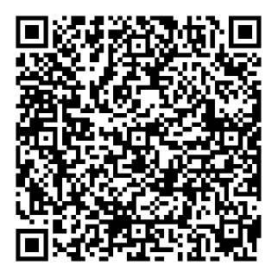
Step 04: Set Your Documentation Standard Before Fieldwork Begins
Before testing starts, agree on what the workpaper needs to contain. The same documentation discipline that applies to any audit applies here, AI doesn't change the standard.
CHERRY HILL ADVISORY TOOLS
What Your Audit Committee Needs to Hear Right Now
3 Required Workpaper Elements
Process Map
AI Inventory Reference
Risk → Objective → Procedure Matrix
Document the end-to-end process, showing where the AI sits, what it receives as input, and what it produces as output. This is the foundation every other workpaper element builds on.
Confirm the system being tested is catalogued, system ID, owner, risk tier, and approval status. If it isn't in the inventory, that finding comes first.
Each AI risk in scope must be linked to a stated control objective and a specific test procedure before fieldwork begins. Untethered testing produces untethered findings.
Source: Cherry Hill Advisory AI Auditing Guide, "Practical Audit Steps and Tools," December 2025; IIA Global Internal Audit Standards (GIAS 2024), Standard 13.4.
Auditing AI-Enabled Processes
11
Notes:
Step 04 — Set Your Documentation Standard Before Fieldwork Begins
Before testing starts, agree on what the workpaper needs to contain. AI doesn't change the documentation standard — it makes it harder to meet without discipline.
Three required workpaper elements:
Process Map: document the end-to-end process showing where the AI sits, what it receives as input, and what it produces as output. This is the foundation every other workpaper element builds on.
AI Inventory Reference: confirm the system being tested is catalogued — system ID, owner, risk tier, and approval status. If it isn't in the inventory, that finding comes first.
Risk → Objective → Procedure Matrix: each AI risk in scope must be linked to a stated control objective and a specific test procedure before fieldwork begins. Untethered testing produces untethered findings.
Aligned to IIA GIAS Standard 13.4.

Slide 14
POLL 2 OF 4
Which control objective do you most often miss when AI is in the process?
Authorization
Accuracy
Completeness
Who approved the AI's decision.
Whether the AI's output is correct.
Whether the AI processed every required record.
Validity
Whether the AI is the right tool for the population.
Auditing AI-Enabled Processes
12
Notes:
Poll 2 of 4
[Launch poll] Which control objective do you most often miss when AI is in the process?
The four options are: Authorization, Accuracy, Completeness, Validity.

Slide 15
Sampling for AI: Stratified by Decision Tier
AI populations are not uniform. Auditors who pull random samples miss the high-impact decisions. Stratify first.
Define the Population
Identify Decision Tiers
Stratify the Sample
Every AI decision in the audit period. Include rejected, approved, and overridden decisions.
High-impact (regulated, customer-affecting), medium-impact (internal-only), low-impact (informational).
Oversample high-impact tier. Include manual overrides and AI exceptions in every stratum.
Document the Sampling Rationale
Re-Perform on the Sample
Record why each tier was sized as it was. Any reviewer will ask
Test against the control objective, not against the AI's accuracy claim.
Source: Cherry Hill Advisory AI Auditing Guide, "Practical Audit Steps and Tools," December 2025; aligned to IIA GIAS Standard 13.3 "Engagement Procedures."
Auditing AI-Enabled Processes
13
Notes:
Sampling for AI — Stratified by Decision Tier
AI populations are not uniform. Auditors who pull random samples miss the high-impact decisions. You must stratify first.
Five-step sampling sequence:
Define the Population: every AI decision in the audit period — approved, rejected, and overridden. Overrides are critical — they tell you where humans disagreed with the AI.
Identify Decision Tiers: High-impact (regulated, customer-affecting), Medium-impact (internal-only), Low-impact (informational).
Stratify the Sample: oversample the high-impact tier. Include manual overrides and AI exceptions in every stratum — these are where problems hide.
Document the Sampling Rationale: record why each tier was sized as it was. Any reviewer will ask. This is your defense if a finding is challenged.
Re-Perform on the Sample: test against the control objective, not against the AI's accuracy claim. The AI saying it was right is not audit evidence.
Aligned to IIA GIAS Standard 13.3 — Engagement Procedures.

Slide 16
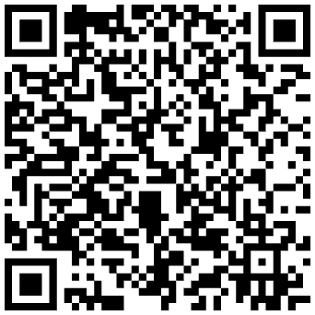
Example: Testing an AI-Enabled Journal Entry Review Control
This example uses journal entry review because it sits at the intersection of internal audit, financial statement audit, and the finance function. The same five-step structure applies to any AI-enabled control in revenue recognition, credit loss modeling, contract analysis, or vendor onboarding.
Control: AI flags journal entries above defined risk thresholds for human review before posting. All unflagged entries post automatically to the general ledger.
CHERRY HILL ADVISORY TOOLS
AI Auditing Guide
01
02
03
Scenario
Sample Design
Test Procedure
18,400 journal entries posted in Q1–Q2. 1,250 flagged by the AI for review. 17,150 auto-posted.
Stratified sample of 60 entries, 30 flagged-and- reviewed (test reviewer effectiveness) and 30 auto-posted (test what the AI said was safe). All flagged entries above $500K reviewed at summary level.
Re-perform the threshold logic against documented risk criteria. Identify any auto-posted entries that should have been flagged, and inspect reviewer documentation for those that were.
04
05
Auditor Validation Layer
Workpaper
For misses or false positives, determine root cause including threshold misconfiguration, training data drift, or post-deployment changes. Document.
Five elements per IIA GIAS 13.4 / PCAOB AS 1215: scope statement, sample selection rationale, test procedure, evidence (exception list with entry IDs and amounts), conclusion against the control objective.
Source: Cherry Hill Advisory AI Auditing Guide, December 2025; IIA GIAS 2024, Standard 13.4; PCAOB Auditing Standards (AS 1105 Audit Evidence; AS 1215 Audit Documentation).
Auditing AI-Enabled Processes
14
Notes:
Example — Testing an AI-Enabled Journal Entry Review Control
This worked example uses journal entry review because it sits at the intersection of internal audit, financial statement audit, and the finance function. The same five-step structure applies to any AI-enabled control — revenue recognition, credit loss modeling, contract analysis, or vendor onboarding.
The control: AI flags journal entries above defined risk thresholds for human review before posting. All unflagged entries post automatically to the general ledger.
Step 1 — Scenario: 18,400 journal entries posted in Q1–Q2. 1,250 flagged by the AI for review. 17,150 auto-posted. The risk isn't in the flagged pile — it's in the 17,150 the AI said were safe.
Step 2 — Sample Design: stratified sample of 60 entries — 30 flagged-and-reviewed (test reviewer effectiveness) and 30 auto-posted (test what the AI said was safe). All flagged entries above $500K reviewed at summary level.
Step 3 — Test Procedure: re-perform the threshold logic against documented risk criteria. Identify any auto-posted entries that should have been flagged. Inspect reviewer documentation for those that were.
Step 4 — Auditor Validation Layer: for misses or false positives, determine root cause — threshold misconfiguration, training data drift, or post-deployment changes. Document.
Step 5 — Workpaper: five elements per IIA GIAS 13.4 / PCAOB AS 1215: scope statement, sample selection rationale, test procedure, evidence (exception list with entry IDs and amounts), conclusion against the control objective.

Slide 17
POLL 3 OF 4
An AI fraud-detection model surfaces 1,500 alerts per month. You have one week to test. What do you test first?
Input Test
Logic Test
Output Test
Pull the underlying transaction data and look for completeness gaps.
Review the model approval and change-management documentation.
Re-perform on a stratified sample of alerts and compare to outcomes.
Re-Scope
Test the broader fraud monitoring process before the AI itself.
Auditing AI-Enabled Processes
15
Notes:
Poll 3 of 4
[Launch poll] An AI fraud-detection model surfaces 1,500 alerts per month. You have one week to test. What do you test first?
Options: Input Test, Logic Test, Output Test, Re-Scope.

Slide 18
What Makes AI Audit Evidence Hold Up
Five evidence quality standards that apply regardless of audit type. These are not AI-specific, they are the same standards that govern any audit engagement. AI-enabled processes don't lower the bar; they make it harder to clear without discipline.
Sufficiency
Reliability
Relevance
Enough evidence to support the conclusion. Not one record. Not the entire population. A sample that is sized and documented before testing begins.
Evidence sourced from a system of record, not from the AI's own self-reported metrics, and not from management's summary of the AI's performance.
Evidence tied to a specific control objective. Not "we tested the AI." Tested what, against which objective?
Usefulness
Traceability
Evidence that leads to a conclusion someone can act on. A finding without a recommended action or a clear effect statement does not meet this standard.
A reviewer unfamiliar with the engagement can follow the trail from objective → procedure → evidence → conclusion without asking the team for context.
Aligned to PCAOB AS 1105 (Audit Evidence) and AICPA AU-C 500 (Audit Evidence) for financial statement auditors.
Auditing AI-Enabled Processes
16
Notes:
What Makes AI Audit Evidence Hold Up
Five evidence quality standards — not AI-specific, the same standards that govern any audit engagement. AI-enabled processes don't lower the bar. They make it harder to clear without discipline.
Sufficiency: enough evidence to support the conclusion — a sample that is sized and documented before testing begins, not one record, not the entire population.
Reliability: evidence sourced from a system of record — not from the AI's own self-reported metrics, and not from management's summary of the AI's performance.
Relevance: evidence tied to a specific control objective. Not "we tested the AI." Tested what, against which objective?
Usefulness: evidence that leads to a conclusion someone can act on. A finding without a recommended action or a clear effect statement does not meet this standard.
Traceability: a reviewer unfamiliar with the engagement can follow the trail from objective → procedure → evidence → conclusion without asking the team for context.
Aligned to PCAOB AS 1105 and AICPA AU-C 500.

Slide 19

Tie AI Risks to Core Control Objectives
The most common reason an AI audit finding gets challenged is that it is written about the AI, not about a control failure. Whether you're an internal auditor providing assurance to management or an external auditor determining reliance, findings that hold up tie every AI risk to a control objective."
Auditing AI-Enabled Processes
17
Notes:
Section Break — Tie AI Risks to Core Control Objectives
The most common reason an AI audit finding gets challenged: it is written about the AI, not about a control failure.
Whether you're an internal auditor providing assurance or an external auditor determining reliance, findings that hold up tie every AI risk to a control objective. That's what this section delivers.

Slide 20
The Five Core Control Objectives
The same control objectives auditors have used for decades. The audit committee already understands them. Map every AI risk to one of these.
01 Authorization
02 Accuracy
03 Completeness
Did the right person or system approve this decision, with the right level of review?
Is the output correct against an independent benchmark?
Did the AI process every record it was supposed to process, with no gaps or dropouts?
04 Validity
05 Restricted Access
Is the AI being used for the population and purpose it was approved for?
Is access to the AI, its data, and its configuration limited to authorized personnel?
Source: Cherry Hill Advisory AI Internal Audit Encyclopedia, "Control Objective Mapping," December 2025; aligned to COSO Internal Control Integrated Framework (2013).
Auditing AI-Enabled Processes
18
Notes:
The Five Core Control Objectives
The same control objectives auditors have used for decades. The audit committee already understands them. Your job is to map every AI risk to one of these — and that translation is what makes AI findings actionable.
01 — Authorization: did the right person or system approve this decision, with the right level of review?
02 — Accuracy: is the output correct against an independent benchmark — not against the AI's own confidence score?
03 — Completeness: did the AI process every record it was supposed to process, with no gaps or dropouts?
04 — Validity: is the AI being used for the population and purpose it was approved for? An AI approved for one use case running on a different population is a validity failure.
05 — Restricted Access: is access to the AI, its data, and its configuration limited to authorized personnel? Configuration access is often overlooked — whoever can change thresholds can change outcomes.
Aligned to COSO Internal Control Integrated Framework (2013).

Slide 21
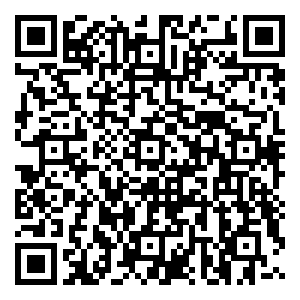
AI Failure Modes Map to Control Objectives
CHERRY HILL ADVISORY TOOLS
AI Ethics Integration Framework
Every AI failure mode maps to a control objective. Once mapped, it becomes a standard finding the audit committee already knows how to action.
AI Failure Mode
Control Objective
Test Procedure
Hallucination
Accuracy
Re-performance sampling on a representative sample
Bias
Validity
Stratified output review across population segments
Drift
Completeness
Time-series review of model performance over time
Each failure mode has a direct test procedure: re-performance sampling for hallucination, stratified output review for bias, and time-series model performance review for drift.
Sources: NIST AI Risk Management Framework (AI RMF 1.0), NIST, January 2023; NIST AI RMF Generative AI Profile (NIST-AI-600-1), July 2024; Cherry Hill Advisory AI Internal Audit Encyclopedia, December 2025.
Auditing AI-Enabled Processes
19
Notes:
AI Failure Modes Map to Control Objectives
This slide is the translation table. Every AI failure mode maps to a control objective. Once mapped, it becomes a standard finding the audit committee already knows how to action.
Three rows in the table — walk each one:
Hallucination → Accuracy → Re-performance sampling on a representative sample. The AI produced a confident but incorrect output. Test by re-performing the task independently and comparing results.
Bias → Validity → Stratified output review across population segments. The AI performs differently across demographic or category segments. Test by breaking the population into segments and comparing error rates.
Drift → Completeness → Time-series review of model performance over time. The AI was accurate at deployment but has degraded. Test by comparing performance metrics across time periods — not just the most recent.
The practical implication: you do not need to be an AI expert to audit these failure modes. You need to be a disciplined auditor who knows which test applies to which risk.

Slide 22
Real-World Case: When AI Disclosures Don't Match Reality
In January 2025, the U.S. Securities and Exchange Commission charged Presto Automation Inc., a Nasdaq-listed restaurant-technology company, with making materially false and misleading statements in its SEC filings about its flagship AI product, Presto Voice. The company described the AI as proprietary when the underlying technology was owned by a third party, and later claimed it "eliminated the need for human order-taking" when over 70% of orders still required human intervention. Presto consented to a cease-and-desist order for disclosure-controls and securities-law violations.
Audit Questions Through the Control-Objective Lens
Validity: Did the AI's actual capability match what was disclosed in SEC filings and to investors?
Authorization: Did disclosure controls catch the gap between AI performance and reported claims?
Accuracy: What independent evidence verified the automation rates before they reached the 10-K?
Sources: U.S. Securities and Exchange Commission, In the Matter of Presto Automation Inc., Securities Act Release No. 33-11352, Administrative Proceeding File No. 3-22390, January 14, 2025; SEC press release, "SEC Charges Restaurant-Technology Company Presto Automation for Misleading Statements About AI Product," sec.gov, January 14, 2025.
Auditing AI-Enabled Processes
20
Notes:
Real-World Case: When AI Disclosures Don't Match Reality
In January 2025, the SEC charged Presto Automation Inc., a Nasdaq-listed restaurant-technology company, with making materially false and misleading statements in its SEC filings about its flagship AI product, Presto Voice.
Two specific misrepresentations: the company described the AI as proprietary when the underlying technology was owned by a third party, and it claimed the AI "eliminated the need for human order-taking" when over 70% of orders still required human intervention.
Presto consented to a cease-and-desist order for disclosure-controls and securities-law violations.
Three audit questions this case generates — run through the control-objective lens:
Validity: did the AI's actual capability match what was disclosed in SEC filings and to investors?
Authorization: did disclosure controls catch the gap between AI performance and reported claims?
Accuracy: what independent evidence verified the automation rates before they reached the 10-K?
The lesson: AI disclosure risk is now a financial statement audit risk. If management's claims about AI capability can't be independently verified, that's a finding.

Slide 23
Reporting AI Findings Using Criteria / Condition / Cause / Effect
Standard finding structure. Translate AI risk into language the audit committee already actions.
01 Criteria
03 Cause
What was supposed to happen, anchored to a policy, standard, or control objective.
Why the gap exists.
Example: "Journal entries above a defined threshold must have documented human review before posting, per the entity's financial close policy."
Example: "The AI exception workflow routes flagged items to a shared queue with no assigned owner or deadline."
02 Condition
04 Effect
What actually happened, with population identifiers.
The business impact, quantified where possible.
Example: "Of 45 sampled entries flagged by the AI review tool, 6 had no documented reviewer sign-off before posting."
Example: "Potential for unsupported entries in the financial statements; elevated risk of material misstatement going undetected before period close."
Source: Cherry Hill Advisory AI Auditing Guide, "Reporting AI Findings," December 2025; IIA Global Internal Audit Standards (GIAS 2024), Standard 14.3 "Engagement Conclusions"
Auditing AI-Enabled Processes
21
Notes:
Reporting AI Findings Using Criteria / Condition / Cause / Effect
Standard finding structure. Translate AI risk into language the audit committee already actions. Nothing AI-specific about this — it's the same four elements you use for any finding.
01 — Criteria: what was supposed to happen, anchored to a policy, standard, or control objective.
Example: "Journal entries above a defined threshold must have documented human review before posting, per the entity's financial close policy."
02 — Condition: what actually happened, with population identifiers.
Example: "Of 45 sampled entries flagged by the AI review tool, 6 had no documented reviewer sign-off before posting."
03 — Cause: why the gap exists.
Example: "The AI exception workflow routes flagged items to a shared queue with no assigned owner or deadline."
04 — Effect: the business impact, quantified where possible.
Example: "Potential for unsupported entries in the financial statements; elevated risk of material misstatement going undetected before period close."
Aligned to IIA GIAS Standard 14.3 — Engagement Conclusions.

Slide 24
Real-World Example: What Good Documentation Looks Like
A finance team using AI to approve routine expense reports. Here is how the documentation holds up, and where it doesn't.
THE SCENARIO
Control:
A mid-size company deploys an AI tool that auto-approves expense reports under $500 with no policy violations flagged. Reports above $500 or with a flag route to a human reviewer. During the financial close, the external auditor asks: "Can we rely on this control?"
AI auto-approves low-risk expenses and routes exceptions for human review before the transaction posts to the general ledger.
WHAT THE AUDITOR FOUND
The Finding
Element
What Existed
Gap
Criteria: Per the entity's expense policy and AI governance standard, automated controls must be documented, risk-tiered, and subject to periodic revalidation.
Condition: The AI approval tool has been operating for 14 months with no formal risk tier, no documented control owner, and no revalidation since initial deployment.
Cause: The tool was implemented by IT without triggering the AI governance intake process.
Effect: The external auditor cannot place reliance on the control; manual substantive procedures are required, increasing audit cost and extending close timelines.
Process Map
Flowchart showing routing logic
No documentation of who owns the exception queue
AI Inventory Reference
Tool listed in vendor register
No risk tier, no approval date, no model version
Risk → Objective → Procedure
Informal walkthrough notes
No stated control objective; no evidence test was scoped before fieldwork
Sources: Cherry Hill Advisory AI Auditing Guide; IIA GIAS Standard 13.4; PCAOB AS 1105.
Auditing AI-Enabled Processes
22
Notes:
Real-World Example: What Good Documentation Looks Like
This is the case study that ties everything together. A mid-size company deploys an AI tool that auto-approves expense reports under $500 with no policy violations flagged. Reports above $500 or with a flag route to a human reviewer. The external auditor asks: can we rely on this control?
The control: AI auto-approves low-risk expenses and routes exceptions for human review before the transaction posts to the general ledger.
What the auditor found: three elements, three gaps:
Process Map: a flowchart existed showing routing logic, but no documentation of who owns the exception queue.
AI Inventory Reference: the tool was listed in the vendor register, but no risk tier, no approval date, no model version.
Risk → Objective → Procedure: informal walkthrough notes existed, but no stated control objective and no evidence the test was scoped before fieldwork.
The finding — written in criteria/condition/cause/effect:
Criteria: automated controls must be documented, risk-tiered, and subject to periodic revalidation.
Condition: the AI approval tool has been operating for 14 months with no formal risk tier, no documented control owner, and no revalidation since initial deployment.
Cause: the tool was implemented by IT without triggering the AI governance intake process.
Effect: the external auditor cannot place reliance on the control — manual substantive procedures are required, increasing audit cost and extending close timelines.

Slide 25
POLL 4 OF 4
When it comes to AI-enabled processes in your audit work, what is your biggest gap right now?
Inventory
Control Objectives
Sampling
I don't have a clear picture of where AI sits in the processes I audit.
I test AI-enabled processes but haven't consistently tied findings to a control objective.
I don't yet have a consistent approach for sampling AI decisions.
Documentation
All of the Above
I don't have a standard for what workpapers on AI-enabled processes need to contain.
Auditing AI-Enabled Processes
23
Notes:
Poll 4 of 4
[Launch poll] When it comes to AI-enabled processes in your audit work, what is your biggest gap right now?
Options: Inventory, Control Objectives, Sampling, Documentation, All of the Above.

Slide 26
AI Audit Workpaper Template
1
2
3
SECTION 1 — SCOPE STATEMENT
SECTION 2 — PROCESS MAP REFERENCE
SECTION 3 — AI INVENTORY REFERENCE
What process, what AI tool, what period, and what standard governs this engagement (IIA GIAS, PCAOB, AICPA).
Attach or cross-reference the process map showing where the AI sits, what it receives, and what it produces. If no map exists, document that as Finding 1.
System ID: ______
Owner: ______
Risk Tier: ☐ High ☐ Medium ☐ Low
Last Approved: ______
If not inventoried → Finding 1.
Auditing AI-Enabled Processes
24
Notes:
AI Audit Workpaper Template
This is the template. Three sections on this slide, two on the next. Together they produce a workpaper that meets IIA GIAS Standard 13.4, PCAOB AS 1215, and AICPA AU-C 230.
Section 1 — Scope Statement: what process, what AI tool, what period, and what standard governs this engagement (IIA GIAS, PCAOB, or AICPA). This is the first thing a reviewer reads. If it's vague, the workpaper is already at risk.
Section 2 — Process Map Reference: attach or cross-reference the process map showing where the AI sits, what it receives, and what it produces. If no process map exists, document that as Finding 1 — before any other testing.
Section 3 — AI Inventory Reference: four fields to complete: System ID, Owner, Risk Tier (High/Medium/Low), and Last Approved date. If the system is not in the inventory, that is Finding 1 — stop here and document it before proceeding.

Slide 27
SECTION 4 — RISK → OBJECTIVE → PROCEDURE MATRIX
AI Risk
Control Objective
Test Procedure
Sample Size
Result
Hallucination / inaccurate outputx
Accuracy
Re-performance on stratified sample
25–40
☐ No exceptions / ☐ Exceptions noted
Missed records / dropout
Completeness
Population reconciliation
100% or sample
☐ No exceptions / ☐ Exceptions noted
Unauthorized decisions
Authorization
Override log review + approver verification
All overrides
☐ No exceptions / ☐ Exceptions noted
Tool used outside approved scope
Validity
Compare deployment scope to approval docs
N/A – inspect
☐ Conforms / ☐ Gap identified
Unauthorized access to model/config
Restricted Access
Access log + role review
12-month period
☐ No exceptions / ☐ Exceptions noted
SECTION 5 — CONCLUSION
State the conclusion against each control objective, not against the AI's accuracy claim. Note any reliance limitation for financial statement auditors. Sign, date, and cross-reference to the engagement file.
Aligned to IIA GIAS Standard 13.4 / PCAOB AS 1215 / AICPA AU-C 230.
Auditing AI-Enabled Processes
25
Notes:
AI Audit Workpaper Template
Section 4 — Risk → Objective → Procedure Matrix. This is the core of the workpaper. Five rows — one for each AI failure mode mapped to a control objective and a specific test procedure:
Hallucination / Inaccurate Output → Accuracy → Re-performance on stratified sample (25–40).
Missed Records / Dropout → Completeness → Population reconciliation (100% or sample).
Unauthorized Decisions → Authorization → Override log review + approver verification (all overrides).
Tool Used Outside Approved Scope → Validity → Compare deployment scope to approval docs (inspect).
Unauthorized Access to Model/Config → Restricted Access → Access log + role review (12-month period).
Each row has a Result column: No Exceptions / Exceptions Noted for the first four, and Conforms / Gap Identified for Validity.
Section 5 — Conclusion: state the conclusion against each control objective — not against the AI's accuracy claim.
Note any reliance limitation for financial statement auditors. Sign, date, cross-reference to the engagement file.

Slide 28

What You Now Have: Three Monday-Morning Actions
Mirrors the empowerment promise from the opening. This slide stays on screen during Q&A.
01 Scope
02 Test
03 Report
Pick one AI tool in your audit universe. Write the four-step scoping memo: process map, AI location, risk-objective-procedure, documentation bar.
Pick one AI-enabled process. Identify which of the three test categories (input, logic, output) applies first. Draft a stratified sample.
Pick one AI risk on your team's radar. Write it up using criteria/condition /cause/effect. Map it to a core control objective.
Auditing AI-Enabled Processes
26
Notes:
What You Now Have: Three Monday-Morning Actions
You now have the full toolkit. Three concrete actions to take this week:
01 — Scope: pick one AI tool in your audit universe. Write the four-step scoping memo — process map, AI location, risk-objective-procedure, documentation bar. One tool. One memo. That's the start.
02 — Test: pick one AI-enabled process. Identify which of the three test categories — input, logic, or output — applies first. Draft a stratified sample using the tier structure from slide 14.
03 — Report: pick one AI risk on your team's radar. Write it up using criteria / condition / cause / effect. Map it to a core control objective from slide 19. That's a finding that will hold up.
This slide stays on screen during Q&A.

Slide 29
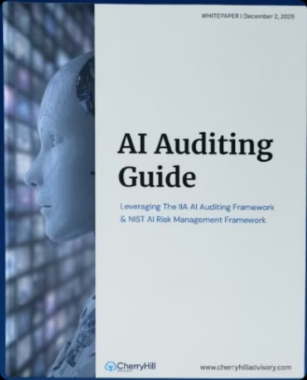
Resources for today
AI Auditing Guide
Focus 2026
IIA Global Internal Audit Standards
Auditing AI-Enabled Processes
27
Notes:
Resources for Today
Three resources — all available now via the QR codes on screen:
Cherry Hill Advisory AI Auditing Guide: the practical reference for everything covered today. Includes the workpaper template, procedure library, and governance documentation standards.
Focus 2026: Cherry Hill's annual publication covering the priorities shaping internal audit in 2026, including AI risk integration.
IIA Global Internal Audit Standards (2024): the professional standards framework referenced throughout — Standards 13.2, 13.3, 13.4, 14.3, and Domain IV and V.

Slide 30


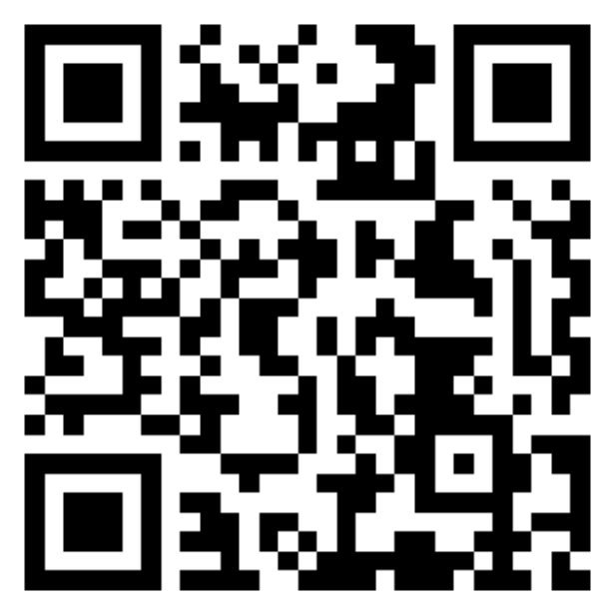
Thank you!
Connect with me on LinkedIn
Auditing AI-Enabled Processes
Notes:
Thank you. This was Part 4 of 4 in the AI Certificate Program.
Thank you all for joining us for Part 4 — and a special thank you to MindBridge for sponsoring today’s session. If you've found value in today's session, I'd encourage you to learn more about what they're building.
*Play Mindbridge Video*
connect with me on Linked In(QR code on screen) if you want to continue the conversation, have questions, or want to share how you're applying the framework in your work. I read every message.
Thank you again. Go audit something AI-enabled this week.

