Slide 1

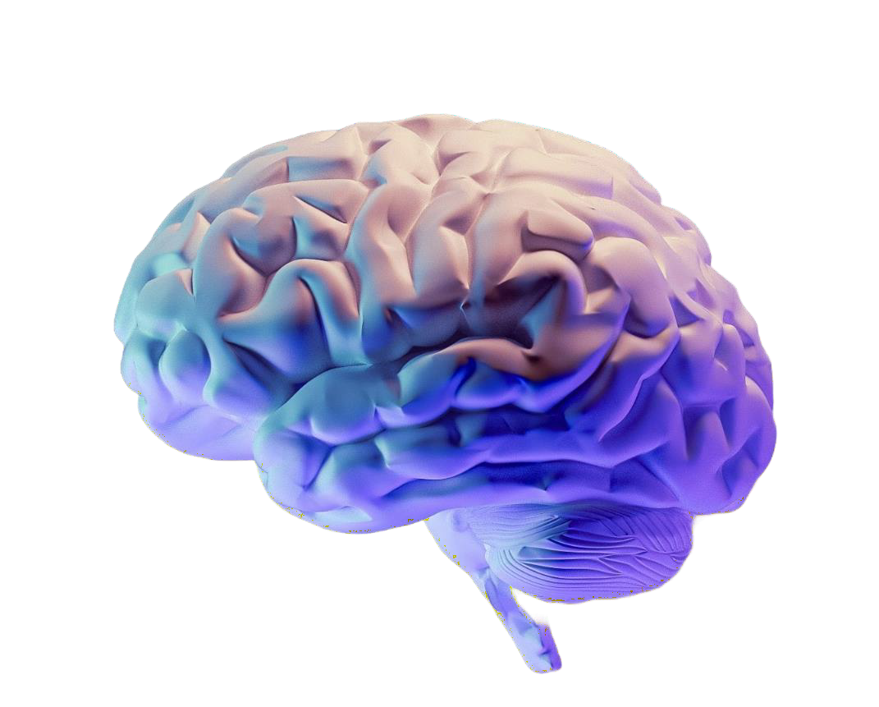
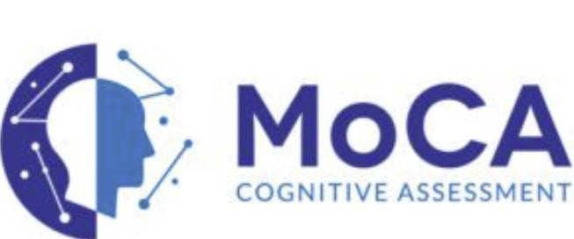
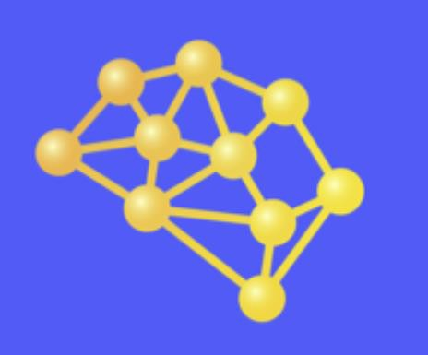
Data-Driven Medicine: How AI is Shaping the Future of Cognitive Health
Nardin Samuel, MD, PhD Resident Physician, Adult Neurology
CEO& Co-Founder, Cove Neuroscience Inc.
October 30, 2025

Slide 2
Objectives
Understand fundamentals of AI in the healthcare setting
Discuss current applications of AI tools in cognitive health
Review benefits and challenges
Future directions

Slide 3
Defining AI in Medicine
Artificial Intelligence (AI):
A broad field of computer science focused on creating systems that can perform tasks that typically require human intelligence including reasoning, learning, problem-solving, perception, and decision-making.
Machine Learning (ML):
A subset of AI that enables computers to learn from data and improve their performance over time without being explicitly programmed. It uses algorithms that identify patterns and make predictions or decisions.
Natural Language Processing (NLP):
A branch of AI that allows computers to understand, interpret, and generate human language. It powers applications such as chatbots, translation tools, and speech recognition systems.

Slide 4
AI Fundamentals for Clinicians
Supervised Learning
Model trained on labeled data (inputs with
known outputs)
Used for prediction and classification (e.g., stroke risk, image diagnosis)
Unsupervised Learning
Model finds hidden patterns or clusters in unlabeled data
Used for discovering subtypes, phenotypes, or anomalies
Neural Networks
Computational models inspired by brain structure
Learn complex, non-linear relationships between variables
Deep learning = multi-layered neural networks (e.g., CNNs, RNNs)
Computer Vision
AI field enabling image recognition and interpretation
Applications: MRI/CT segmentation, lesion
detection, retinal scan analysis

Slide 5
Clinical reasoning: Traditional statistics vs AI
1. Traditional Statistics
Model-driven: Begins with a predefined hypothesis or model (e.g., linear regression) based on prior clinical knowledge.
Focus: Tests associations or causal relationships between variables.
Data requirements: Typically smaller, structured datasets with clearly defined variables.
Interpretability: High—results (e.g., p-values, confidence intervals) are easily understood and explainable.
Example: Determining whether hypertension increases stroke risk using logistic regression.

Slide 6
Clinical reasoning: traditional statistics vs AI
Traditional Statistics
Model-driven: Begins with a predefined hypothesis or model (e.g., linear regression) based on prior clinical knowledge.
Focus: Tests associations or causal relationships between variables.
Data requirements: Typically smaller, structured datasets with clearly defined variables.
Interpretability: High—results (e.g., p-values, confidence intervals) are easily understood and explainable.
Example: Determining whether hypertension increases stroke risk using logistic regression.
Artificial Intelligence (AI) Approaches
Data-driven: Learns complex patterns directly from data without predefined hypotheses.
Focus: Prediction, pattern recognition, and classification rather than hypothesis testing.
Data requirements: Large, often unstructured datasets (e.g., imaging, EEG, free text). Interpretability: Often lower (black-box models), though explainable AI (XAI) methods are emerging. Example: Predicting stroke outcomes from multimodal MRI and clinical data using deep learning.

Slide 7
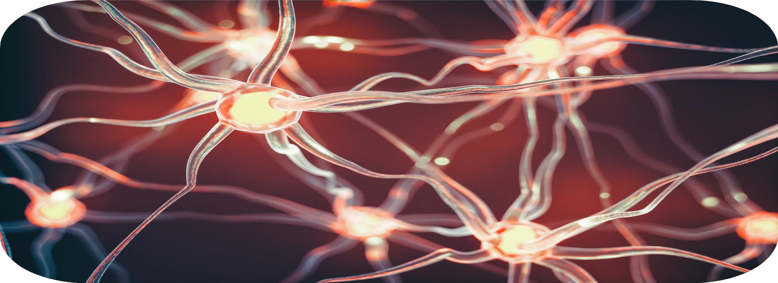
Clinical reasoning: traditional statistics vs AI
1. Traditional Statistics
Model-driven: Begins with a predefined hypothesis or model (e.g., linear regression) based on prior clinical knowledge.
Focus: Tests
associations or causal relationships between variables.
ments: Typically smaller, structured datasets with clearly defined variables.
ity: High—results (e.g., p-values, confidence intervals) are easily understood and exp etermining whether hypertension increases stroke risk using logistic regression.
ntelligence (AI) Approaches
Learns complex patterns directly from data without predefined hypotheses. tion, pattern recognition, and classification rather than hypothesis testing. ments: Large, often unstructured datasets (e.g., imaging, EEG, free text).
Data require Interpretabil Example: D
Traditional statistics emphasizes inference and causality: understanding why relationships exist, whereas AI emphasizes prediction and pattern recognition: understanding what is likely to happen
lainable.
2. Artificial I Data-driven: Focus: Predic Data require
Interpretability: Often lower (black-box models), though explainable AI (XAI) methods are emerging.
Example: Predicting stroke outcomes from multimodal MRI and clinical data using deep learning.

Slide 8
Evolution of Data-Driven Medicine
From Paper to Digital
Shift from paper charts → Electronic Health Records (EHRs)
Enabled large-scale data storage, interoperability, and real-time access
Foundation for analytics, AI, and precision medicine

Slide 9
Evolution of Data-Driven Medicine
From Paper to Digital
Shift from paper charts → Electronic Health Records (EHRs)
Enabled large-scale data storage, interoperability, and real-time access
Foundation for analytics, AI, and precision medicine
Impact on Evidence-Based Medicine (EBM)
Integration of real-world clinical data with research evidence
Continuous learning systems replace static guideline use
Facilitates outcome tracking and personalized recommendations

Slide 10
Evolution of Data-Driven Medicine
From Paper to Digital
Shift from paper charts → Electronic Health Records (EHRs)
Enabled large-scale data storage, interoperability, and real-time access
Foundation for analytics, AI, and precision medicine
Impact on Evidence-Based Medicine (EBM)
Integration of real-world clinical data with research evidence
Continuous learning systems replace static guideline use
Facilitates outcome tracking and personalized recommendations
Impact on Clinical Decision-Making
AI and decision-support tools enhance diagnostic accuracy and prediction
Enables individualized, data-driven treatment planning
Challenges: data quality, privacy, algorithm transparency, clinician trust

Slide 11

AI in Cognitive Health
11
Copyright © All rights Reserved

Slide 12
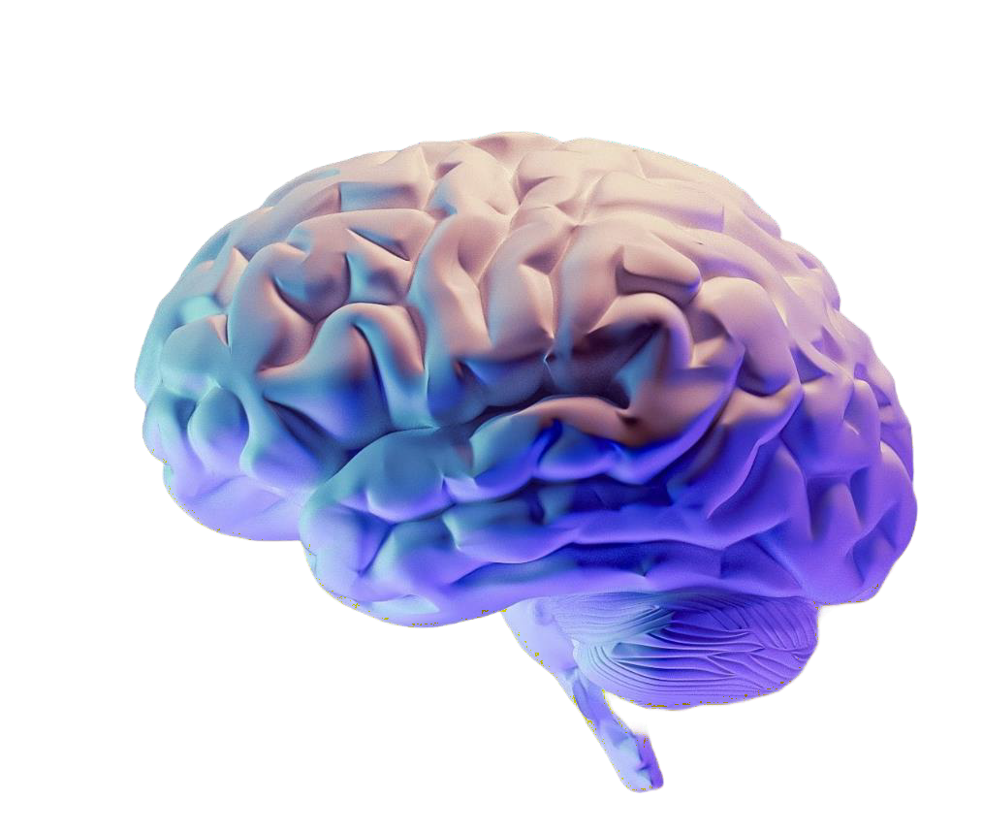
AI in Cognitive Health - Diagnostics
Cognitive Testing & Digital Biomarkers
AI-based cognitive platforms analyze speech, typing, or tablet- based task data to detect subtle deficits
Examples:
CogState, Linus Health, Altoida—use ML to predict MCI and
Alzheimer’s progression.
Speech AI tools identify early language changes in frontotemporal dementia and depression.

Slide 13
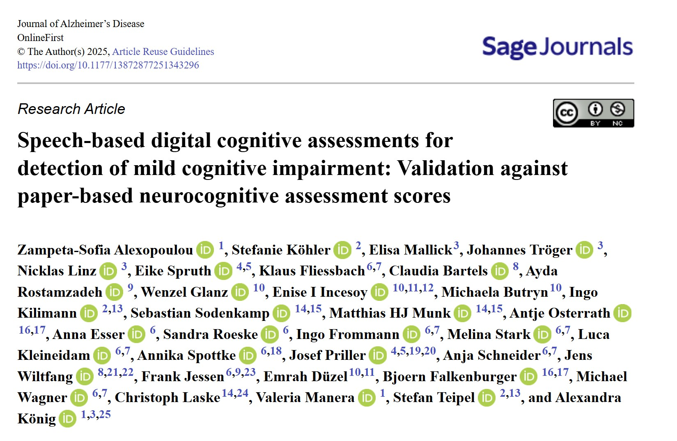
AI in Cognitive Health - Diagnostics

Slide 14
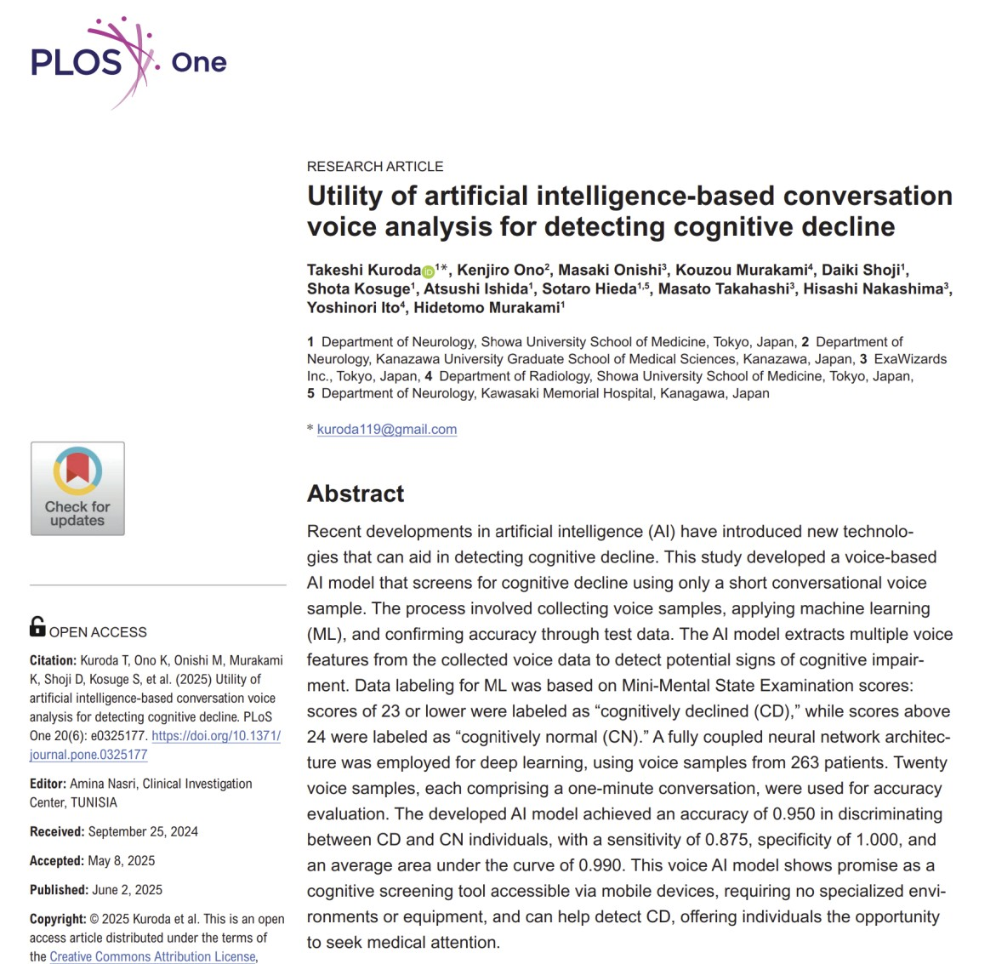
AI in Cognitive Health - Diagnostics

Slide 15
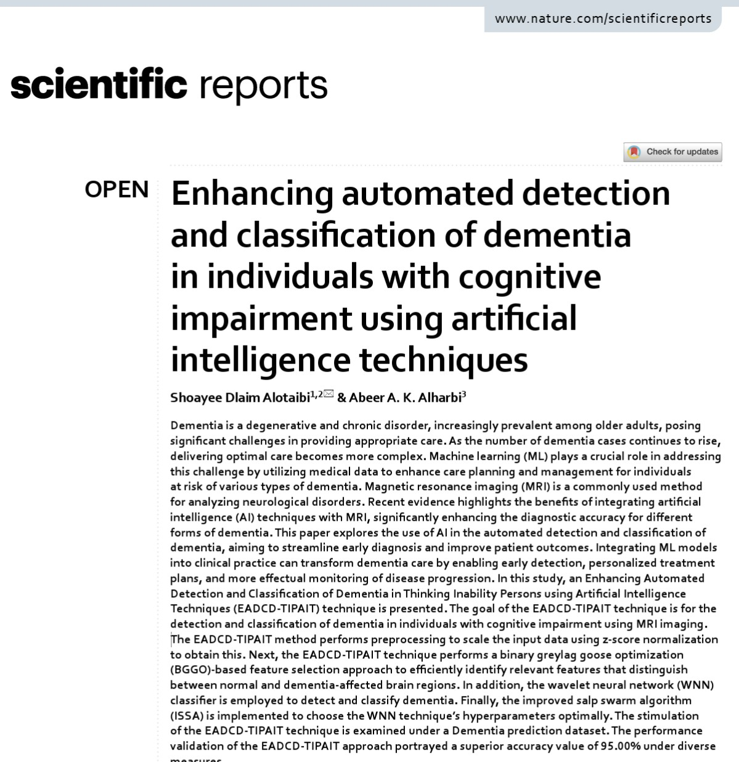
AI in Cognitive Health - Diagnostics

Slide 16
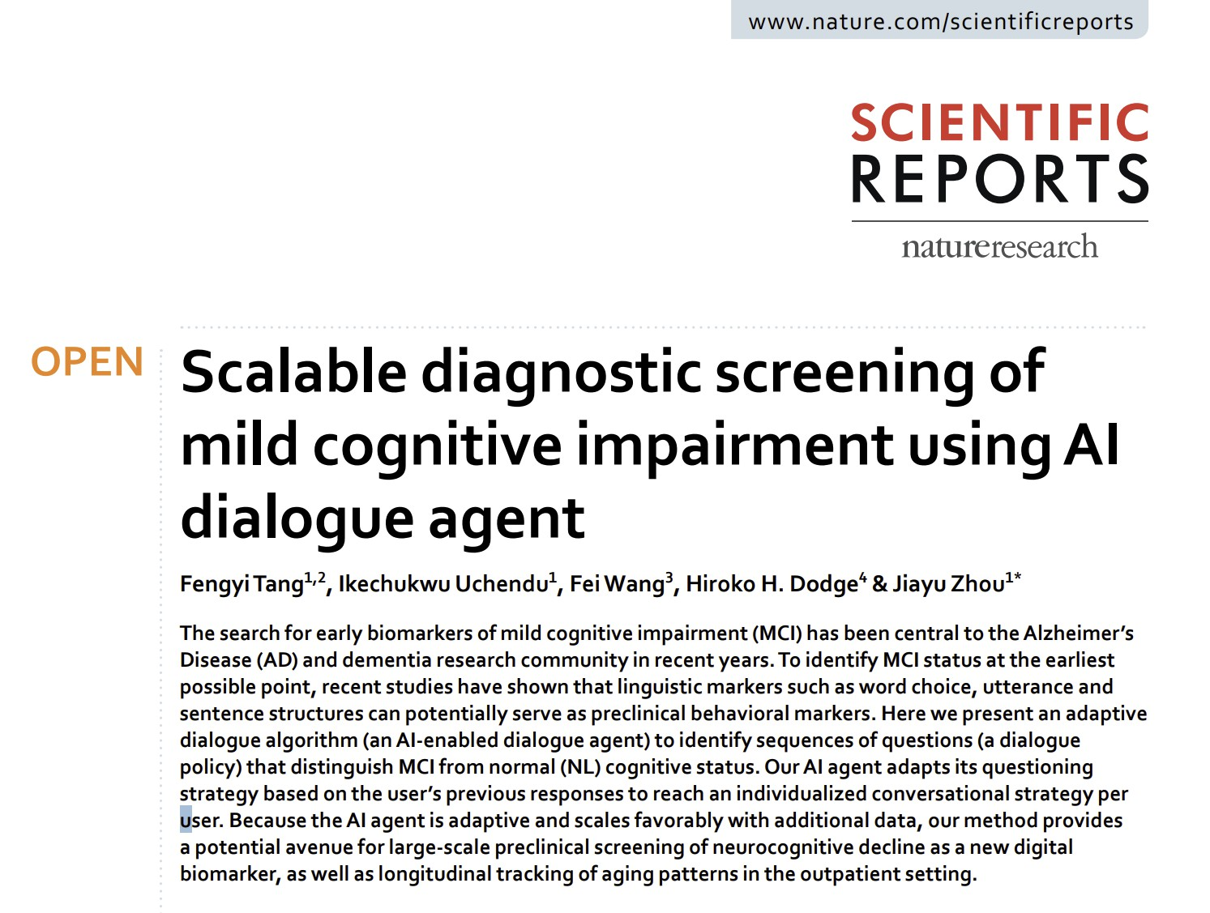
AI in Cognitive Health - Diagnostics

Slide 17
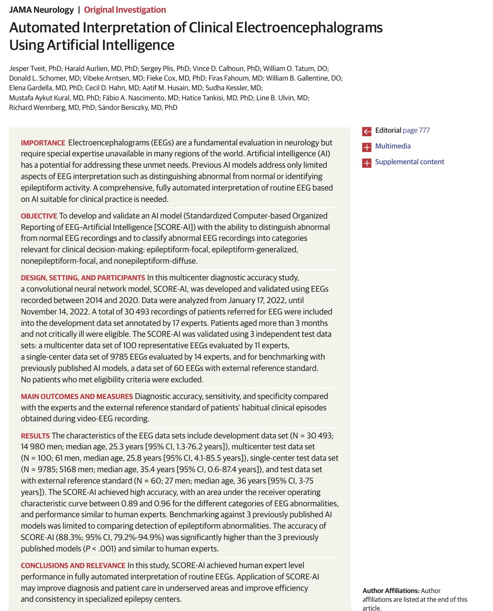
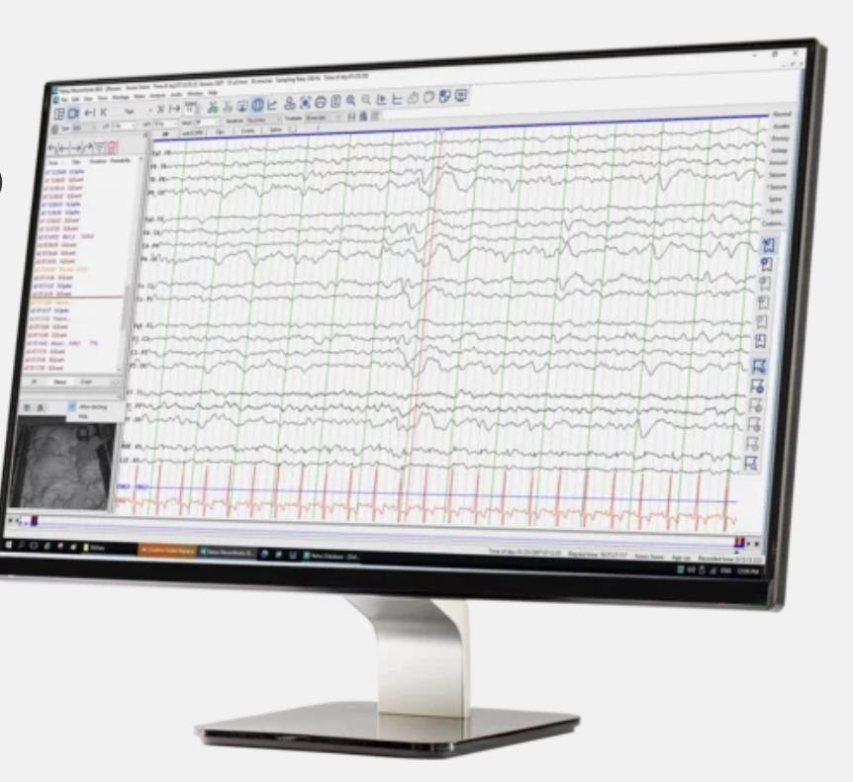
AI in Cognitive Health - Diagnostics

Slide 18
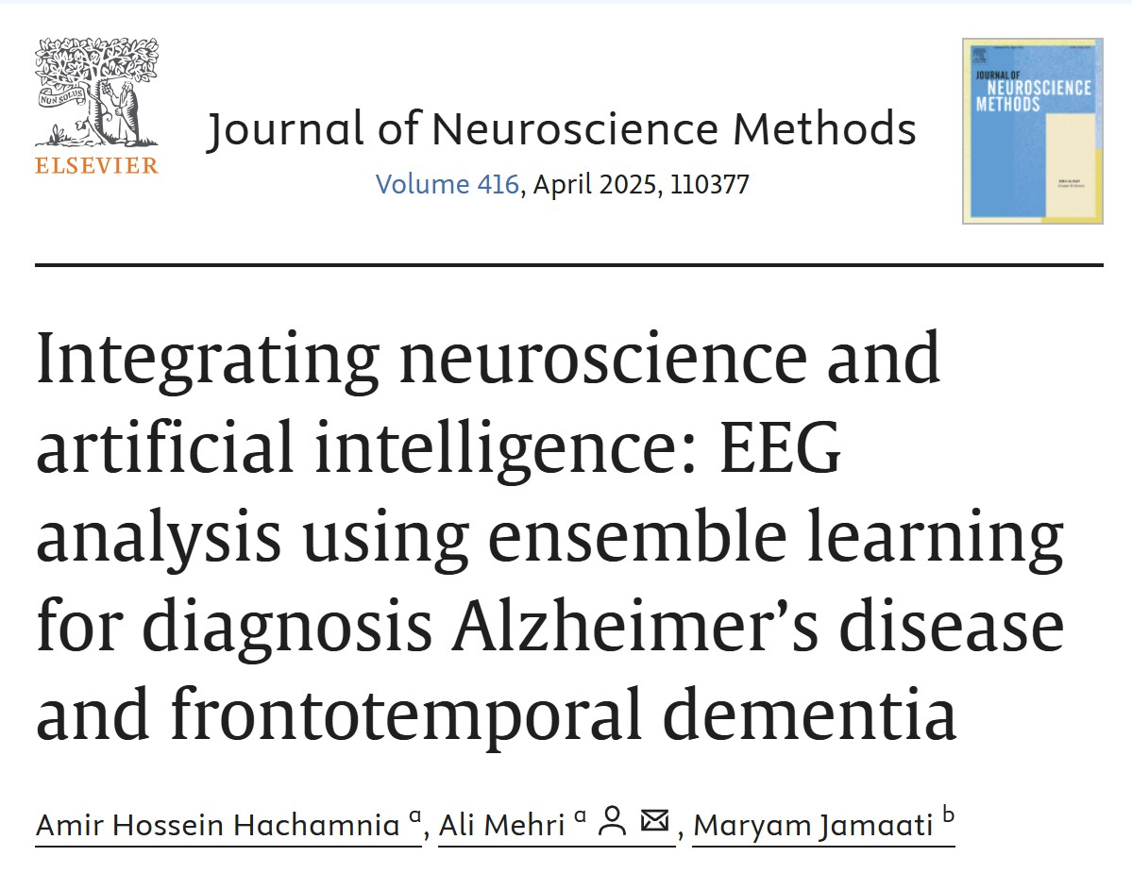
AI in Cognitive Health - Diagnostics

Slide 19
AI in Cognitive Health –
Personalized Care
Integration of multimodal data (clinical, neuroimaging, genetic, and digital biomarkers) enhances the accuracy of individualized risk assessment and enables dynamic adjustment of care plans based on predicted disease trajectories.

Slide 20
AI in Cognitive Health –
Personalized Care
Integration of multimodal data (clinical, neuroimaging, genetic, and digital biomarkers) enhances the accuracy of individualized risk assessment and enables dynamic adjustment of care plans based on predicted disease trajectories.
AI-driven staging and causal hypothesis models show high agreement with human experts and biomarker-based diagnoses, with reported sensitivity up to 89% and
specificity up to 82% for predicting progression to Alzheimer’s disease at 24 months.

Slide 21
AI in Cognitive Health –
Personalized Care
Integration of multimodal data (clinical, neuroimaging, genetic, and digital biomarkers) enhances the accuracy of individualized risk assessment and enables dynamic adjustment of care plans based on predicted disease trajectories.
AI-driven staging and causal hypothesis models show high agreement with human experts and biomarker-based diagnoses, with reported sensitivity up to 89% and
specificity up to 82% for predicting progression to Alzheimer’s disease at 24 months.
AI-based risk calculators and decision support tools facilitate early identification of high-risk individuals and support targeted intervention planning, with validated models showing robust performance in both internal and external cohorts, though generalizability and calibration remain ongoing challenges.

Slide 22
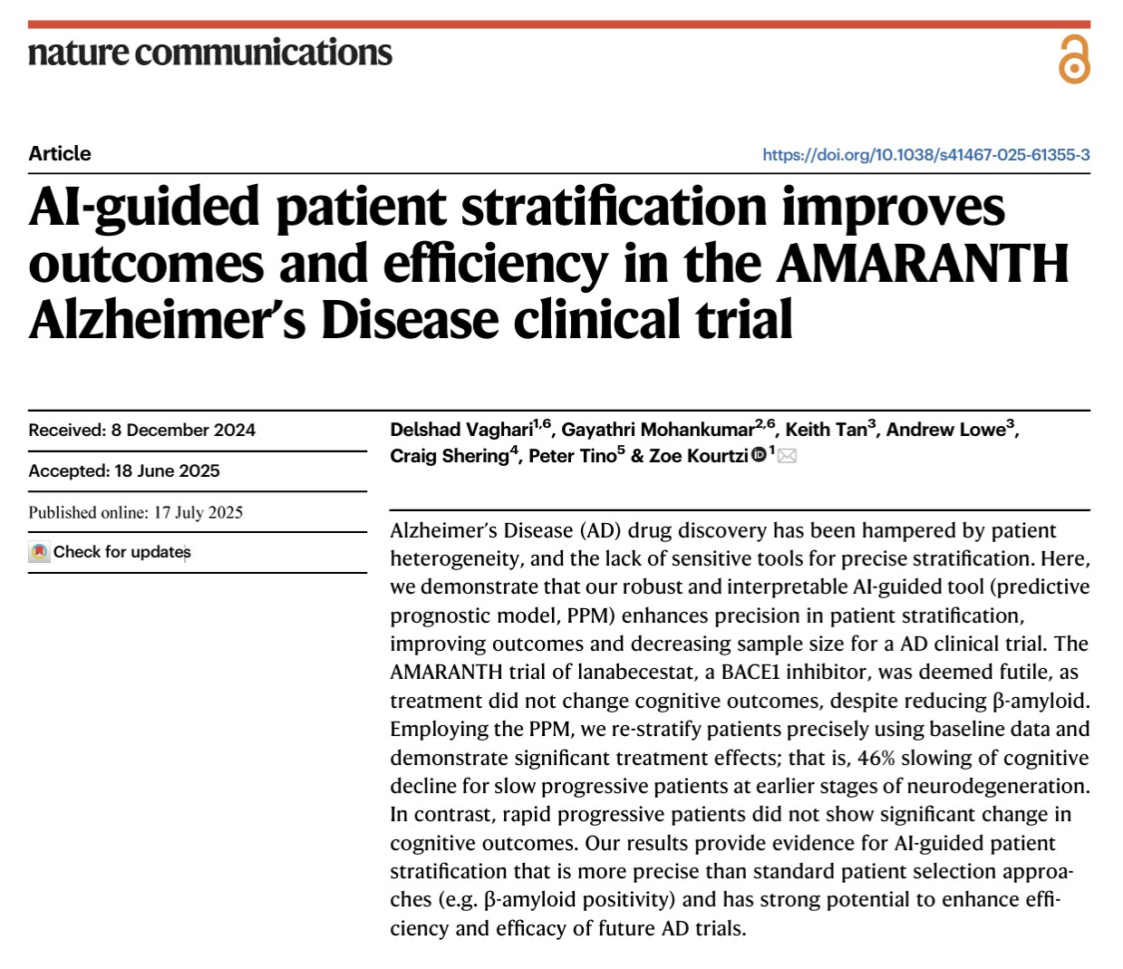
AI in Cognitive Health –
Personalized Care

Slide 23
Hybrid intelligence models, benefits and challenges of AI in cognitive health
23
Copyright © All rights Reserved

Slide 24
Hybrid intelligence models
Hybrid intelligence = collaboration between human expertise and AI algorithms.
Combines clinician intuition, contextual reasoning, and ethical judgment with AI’s data-driven precision and speed.
Goal: enhance, rather than not replace, clinical decision-making.

Slide 25
Joint cognitive systems
Radiology: AI highlights suspicious brain lesions → clinician
confirms and contextualizes findings.
EEG Analysis: Automated spike detection or network metrics
→ neurologist interprets patterns clinically.
Neuropsychiatry: AI-derived cognitive and linguistic
biomarkers → psychiatrist integrates with psychosocial
context.
Stroke Care: Decision-support tools predict outcomes and guide thrombectomy selection with clinician oversight.

Slide 26
Workflow integration
Embedded AI tools within EHRs, imaging viewers, and diagnostic dashboards.
Active learning loops: clinician feedback continuously refines AI model performance.
Multimodal systems: integrate imaging, EEG, clinical, and behavioral data into unified decision-support platforms.

Slide 27
Benefits of AI in cognitive health
Improved Patient Outcomes
Earlier diagnosis → earlier intervention and slower disease progression.
Personalized treatment recommendations informed by multimodal AI analysis.
Continuous monitoring via wearable sensors and digital cognitive tools.

Slide 28
Benefits of AI in cognitive health
Improved Patient Outcomes
Earlier diagnosis → earlier intervention and slower disease progression.
Personalized treatment recommendations informed by multimodal AI analysis.
Continuous monitoring via wearable sensors and digital cognitive tools.
Expansion of Clinical Expertise & Access to Care
Remote AI-assisted screening tools extend cognitive testing to rural and underserved areas.
Cloud-based neuroimaging platforms allow centralized expert review.
Supports general clinicians and allied health professionals in identifying at-risk patients.

Slide 29
Challenges – Statistical & Clinical
Generalizability
Models often trained on limited or homogeneous datasets.
Performance may drop when applied to new hospitals, scanners, or populations.
Need for external validation and diverse, multi-site data.
Interpretability
“Black box” models make it difficult for clinicians to understand decision logic.
Limits trust, accountability, and clinical adoption.
Growth of Explainable AI (XAI) aims to provide interpretable outputs.
Reproducibility
Variations in preprocessing, feature extraction, and code hinder reproducibility.
Lack of standardized reporting across studies.
Requires transparent pipelines and open datasets.
Population Inference vs. Prediction
Traditional studies emphasize inference — identifying causes and relationships.
AI emphasizes prediction — forecasting individual outcomes.
Integration of both is crucial for safe, clinically meaningful applications.

Slide 30
Alert fatigue and burnout
Risks of Over-Reliance on AI Decision Support
Excessive or low-value alerts → desensitization and missed critical warnings.
Overdependence on automated outputs can erode clinical judgment.
Cognitive overload and workflow interruptions contribute to clinician burnout.
Risk of liability confusion when human and AI decisions diverge.
Strategies to Mitigate Alert Fatigue
Prioritize relevance: Filter alerts by clinical urgency and context.
Adaptive systems: Use AI to learn user preferences and suppress redundant alerts.
Human-centered design: Integrate seamlessly into existing workflow (EHR, imaging).
Feedback loops: Allow clinicians to flag false or low-value alerts to improve the system.
Promote balanced use: Reinforce clinician oversight and continuous education on AI
tools.

Slide 31
The future of AI in cognitive health
31
Copyright © All rights Reserved

Slide 32
The future of AI in cognitive health
Federated Learning
Enables AI models to train across institutions without sharing patient data,
preserving privacy.
Example: Multi-site MRI and EEG data collaboration for early Alzheimer’s
detection (e.g., Federated ADNI networks).
Supports creation of generalizable, bias-resistant models across diverse populations.
Self-Supervised Learning
AI learns from unlabeled data, reducing dependence on expert annotation.
Example: Self-supervised models trained on raw brain MRI or EEG discover
latent biomarkers of neurodegeneration.
Facilitates continuous improvement from routine clinical data streams.

Slide 33
The future of AI in cognitive health
Integration with Large-Scale Datasets
Combining multimodal data — imaging, genomics, EEG, wearables, and EHRs —
to model disease trajectories.
Example: Integrative platforms like UK Biobank, ADNI, and Canadian Open Neuroscience Platform (CONP) used for predicting conversion from MCI to Alzheimer’s.
Enables precision neurology through personalized risk modeling and intervention
planning.
Policy Innovation & Interdisciplinary Collaboration
Development of regulatory frameworks for safe, ethical AI deployment (e.g., Health
Canada & FDA AI/ML guidelines).
Collaboration between clinicians, data scientists, ethicists, and policymakers to ensure transparency and trust.
Growth of AI literacy programs in medical education to empower clinician–AI partnerships.

Slide 34

Imagine a future where AI-powered platforms can:
Continuously monitor our brain health
Predict the onset of neurological conditions before symptoms even appear
Personalize treatment plans by decoding the unique neural signatures of each patient
Accelerate the discovery and development of targeted, effective therapies
34
Copyright © All rights Reserved

Slide 35
The future of neuroscience is AI-driven
Unlocking deeper brain insights and revolutionizing diagnosis and treatment

Slide 36
Thank You!

Slide 37
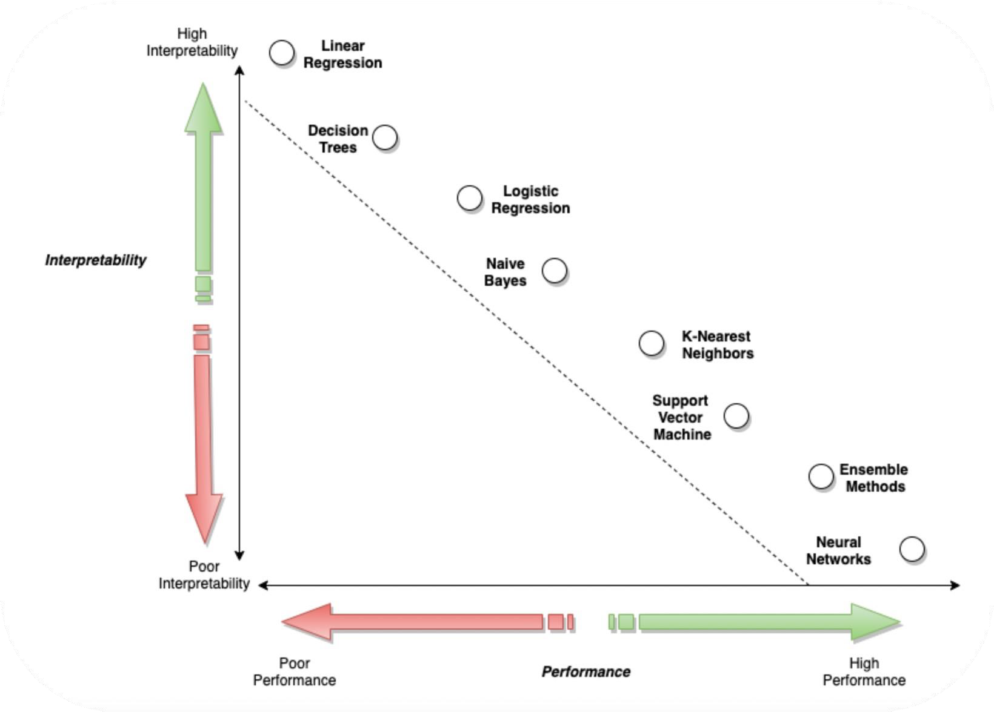
Interpretabilityof AI/MLmodels
37
Copyright © All rights Reserved

