Slide 1
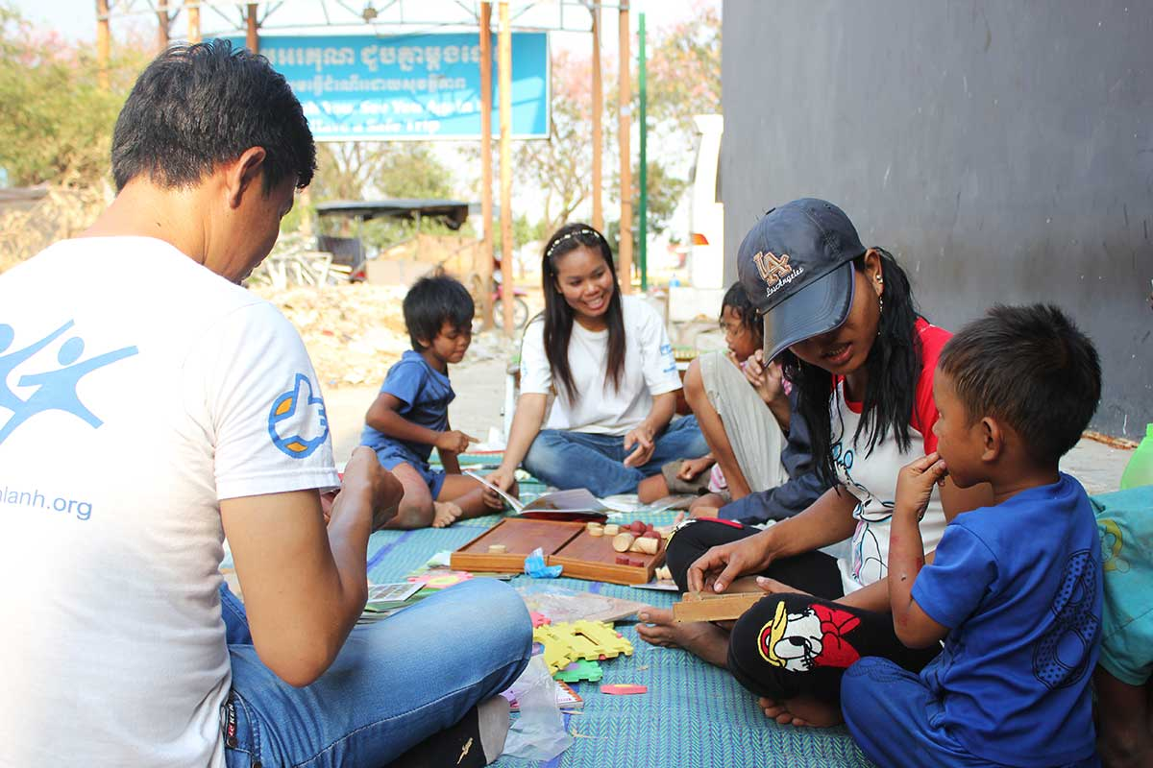
Ethical Implications of NGOs in Cambodia
Jack Hoye - Ethics

Slide 2
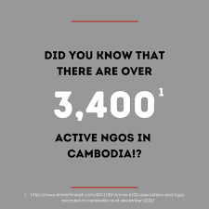

Introduction and Background
Overview of NGOs in Cambodia
-Non-governmental organizations (NGOs) in Cambodia are non-profit groups that focus on a range of topics, including poverty alleviation, healthcare, education, environmental protection, and economic empowerment.
-Due to the necessity for reconstruction following a conflict, Cambodia has become a popular target for foreign aid since the 1990s. The number of NGOs in the nation is among the greatest in the world per capita.
Importance of Ethical Analysis
-NGOs aim to do good but needs to be examined whether they create united cycles of dependency
-Are NGOs empowering people or inadvertently creating dependence? Are they imposing foreign ideals and practices, or are they strengthening local autonomy?
-Ethical analysis helps uncover true impacts and guide NGOs to create a more positive impact

Slide 3

Defining Key Concepts
Non-Governmental Organization (NGO)
-nonprofit groups that work to solve social, environmental, and economic problems without interference from governments. Stress that grants and contributions are frequently used by NGOs to finance their activities.
-ex. Habitat for Humanity, Oxfam, Halo Trust, Landmine Relief Fund, Room to Read, Friends International
Ethical Principles in Business and Humanitarian Work
Some key ethical principles that apply to NGOs are empowering justice in its distribution of resources, respecting the independence and autonomy of communities, acting in a way that promotes the well being of others and ensuring actions do not cause harm or dependency.
Framework for analysis
-Three main ethical theories will guide the analysis, Utilitarianism, Deontology, and Virtue Ethics

Slide 4
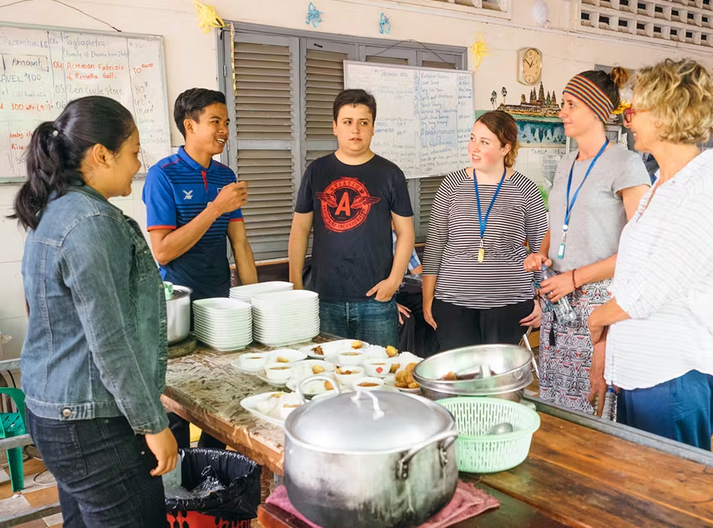
Overview of Ethical Questions
Significant ethical questions
-Do NGOs foster self-sufficiency or create dependency
-does the support enable communities to sustain themselves or does it lead to reliance
-Are NGO’s goals truly centered on empowering local people?
-potential for unintended consequences such as paternalism or undermining local governance
-How does the story of “doing good” fit in with moral business practices
-good intentions alone doesn't always justify NGO practices and the outcome decides what is true ethical business

Slide 5

Case Study NGOs in Cambodia
Examples of NGO activities
Education programs: Schools, scholarships, teacher training with Room to Read
Healthcare: child health, vaccinations and clinics with Doctors without Borders
Economic: Job placement, microloans and more with Friends-International
Observed Impacts
Positive impacts from these NGOs are of course -increased education and healthcare and economic improvement with skill building programs leading to higher income
Negative impacts: communities rely on NGO services and risk loss of care if NGOs leave. NGOs also reduce the local drive for long term government support as the NGOs fill the gaps. The NGOs also disrupt local markets and take market away from local organizations, while simultaneously conflicting with local culture and community values which is at risk of being lost

Slide 6
Framework for Analysis Dependency vs. Opportunity Creation
Defining dependency
-NGOs providing healthcare services reduce illness and improve quality of life but may provide dependency by not encouraging government-led solutions. Long term outcome leaves communities vulnerable when NGOs depart. A more autonomous approach may involve training local healthcare workers and collaborating with government to establish sustainable locally managed health services
Defining Opportunity Creation
-Instead of just providing fish, teach them how to fish. Programs that offer economic empowerment is more beneficial, offering training and microloans to create opportunities for individuals to gain self-serving skills and teach locals to work in the local community. Economic NGOs are a better example of beneficence allowing locals to support themselves independently
Key Concepts
NGOs focused on creating opportunity still face hurdles and have an ethical responsibility to implement their aid in an intelligent way that promote local self reliance and empowering a community rather than making them dependent

Slide 7
Ethical Issues in NGO operations
Autonomy
In rural cambodia, some NGOs such as room to read operate with limited government collaboration. While offering immediate access to education, they bypass local education priorities reducing the role of cambodian authorities in shaping school management and curriculum. By putting themselves in the role of government, NGOs take power away from local authority making it harder for them to take control when NGOs leave
Transparency and Accountability
Instead of pressure from local communities, NGOs rely on funding from international donors, which puts more focus on the organizations to report metrics such as number of schools built or people served instead of analyzing long term impacts. NGOs often distribute short term solutions for good numbers which does not create long term infrastructure for communities. NGOs do not meet or gather feedback from local communities and base their operations completely on their own priorities instead of local input
Cultural Sensitivity
-Especially in education pushing western values such as individualism and academic competition. NGOs with religious values also conflict with local Cambodian values.

Slide 8

Utilitarian Perspective
Utilitarian Analysis of NGOs
-On its surface, NGOs seem to focus solely on maximizing the welfare of the greatest number of people, addressing social issues that are often not addressed in rural Cambodia. Programs such as Cambodian League for Promotion and Defence of Human rights, work to protect vulnerable groups and provide legal aid which improved labor rights and protections for marginalized communities by and large, while other NGOs fall short in unintentionally causing non-sustainable support
-Other organizations such as Room to Read unintentionally undermine local government efforts and instead of building infrastructure for communities to become self-sustainable create an environment that is dependent on foreign support. Education programs also interfere with cultural values and introduce foreign curriculum to Cambodian locals

Slide 9
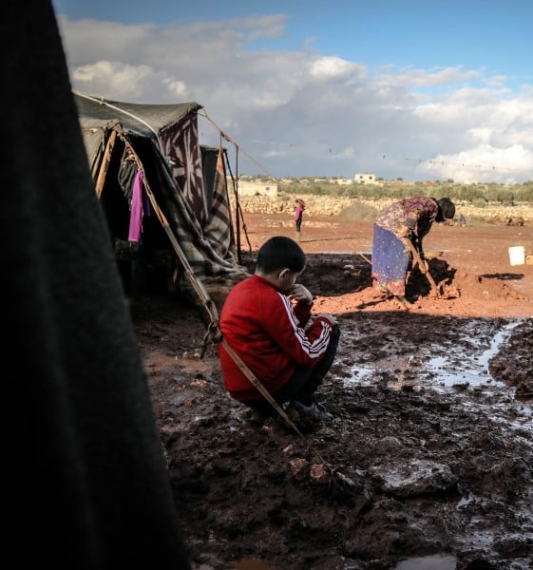
Deontological Perspective
Deontological analysis of NGO ethics
-Deontology focus on duty and moral obligation over outcomes
-NGOs on paper see it as their moral duty to address education, health and poverty issues. The agenda of some organizations however prompts us to question if these programs act from a true sense of duty or if other motives such as increasing funding and enhancing their image play a role. Some NGOs may promote agendas and focus solely on positive metrics to show to their donors that conflict with local autonomy and values.

Slide 10
Virtue Ethics
Virtue Ethics Analysis
Compassion and Alturism, NGOs by definition demonstrate compassion through their work, inspiring international support for those in need while balancing promoting local authorities to continue their pathway.
-While different depending on organization, a properly structured NGO focuses on empowering local communities through skill building, and education to encourage communities to become self-reliant
Shortcomings
Programs that do offer aid without training systems or education to local communities on how to operate without foreign support unintentionally create a system of dependence. While NGOs on paper promote valuable virtues a big emphasis should remain on empowering communities without compromising cultural identity and creating dependence.

Slide 11
Ethical Framework for Solutions
Transparency
-Clear reporting and transparent release of information on funding sources, spending and project outcomes is essential for keeping organizations accountable for their real impacts on community. An open line of communication should be created with government bodies and local communities to make sure their agenda is aligned with local goals and needs.
Community integration
-Working closely with community leaders and local structures fosters sustainable development that can create long-term good and uphold local customs and values.
Empowerment over blind support
-Programs that encourage skill development with locals rather than short term solutions will prove more sustainable over time. Structure aid to gradually reduce direct support and create self-reliance over time
EXIT Strategies and ethical intent
-Develop clear gradual exit strategies with an intent to pass responsibilities to local organizations. Ensure that organizations are providing aid with the right motivations and benefit the community rather than following their own agenda.

Slide 12
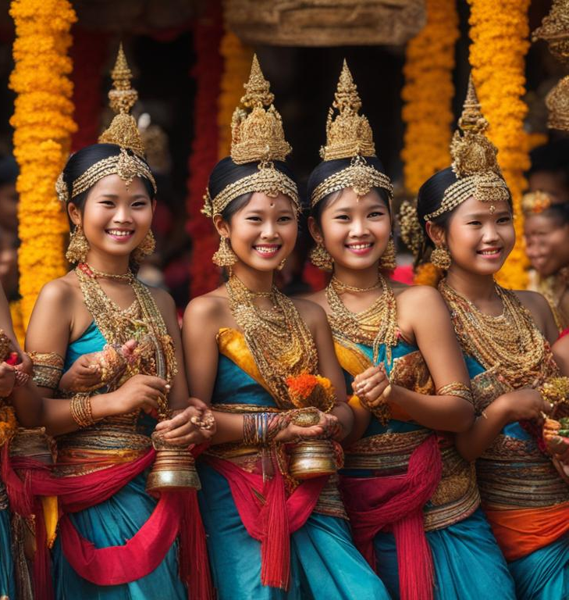
Promoting Human Values in NGO work
Dignity
-Respect independence and unique cultural identity of local populations,
-Engage in cultural sensitive practices that honor local customs
Equity
-Ensure equal access to resource and fair treatment particularly for marginalized groups and distribute aid without discrimination
Justice
-Support systems and structures that empower communities rather than control or undermine them and advocate for policies that protect rights and encourage self governance

Slide 13
Conclusion and Final Ethical Reflection
Summary of Ethical Implications
-NGOs must navigate a fine line between aid and dependency
Key Takeaways
-An ethically grounded approach require balancing local involvement, impact and intent
Future Considerations
-NGOs should evolve practices to enhance transparency, partnership and accountability

Slide 14
References
-Bentham, J. (1789). An Introduction to the Principles of Morals and Legislation. Oxford: Clarendon Press.
-CARE International in Cambodia. (2022). CARE in Cambodia: Programs and Impact. Retrieved from https://www.care-cambodia.org
-Jenkins, R. (2012). "The Cultural Politics of NGOs in Cambodia: Local Values and International Influence." International NGO Journal, 7(3), 55-66.
-Room to Read Cambodia. (2022). Literacy Program Overview. Retrieved from https://www.roomtoread.org
-Kiva. (2023). "Empowering Local Entrepreneurs in Cambodia." Kiva Annual Impact Report. Retrieved from https://www.kiva.org
-Singer, P. (1999). Practical Ethics. Cambridge: Cambridge University Press.

