Slide 1


Briefing slide (not for presentation)
For an understanding of how the issue of Israel-Palestine may be affecting your students, please refer to our teacher resources (available for download on the ‘Classroom Learning Resources’ page of our website).
This presentation is intended for a 30/40-minute school assembly at any time when the issue of the Israeli-Palestinian conflict hits our media headlines and students come into school with strong emotional responses to what they are seeing in the news. The following slides have a script in the slide notes for you to use, please do not deviate from the script when delivering our resources.
It is better to provide a space for students to learn about and express their views on this issue than to shut it down. That space should be both safe and brave. We can also provide a 2-hour training session for teachers on how to create and maintain that space in your school, please see our website for more details.
Under no circumstances should our resources be used to silence or disempower students who feel strongly about this issue. It is strongly recommended that you provide deeper learning opportunities for students who feel strongly about this at some point during the academic year. Please visit our website to book a session.
1
ASSEMBLY PACK

Slide 2



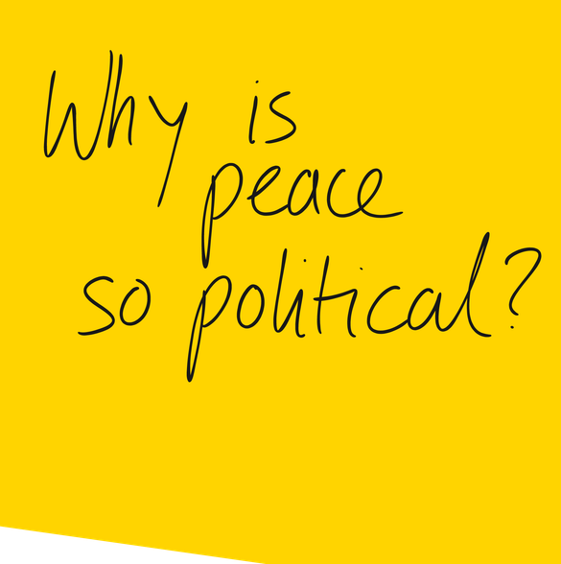
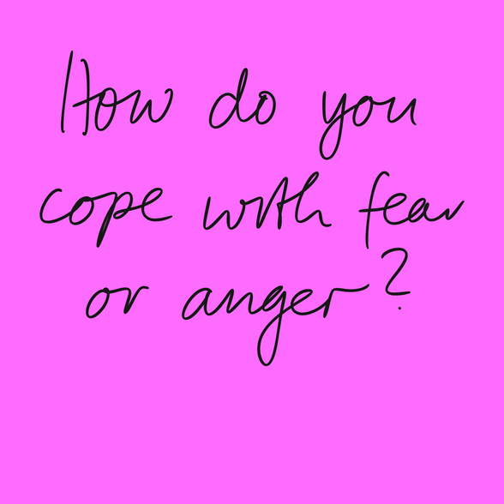
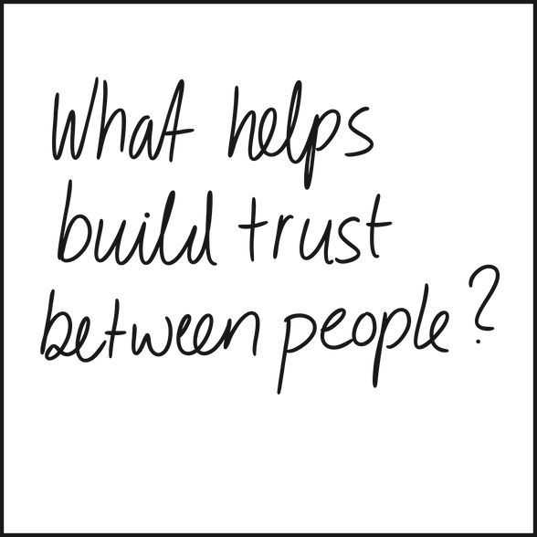
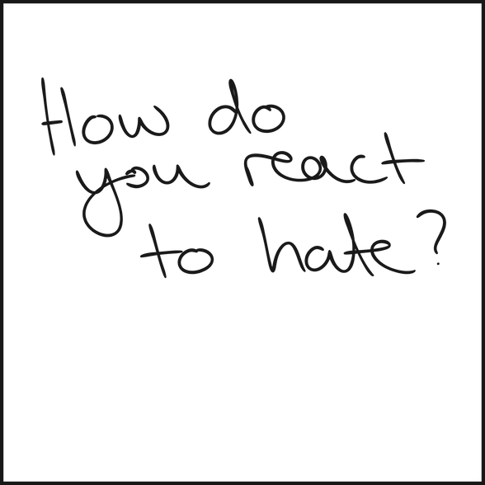
2025–2026
Listening to Palestinian and Israeli people when we see violence in the media
Notes:
“Good morning, everybody. As you may have seen, Israel-Palestine has become prominent in our news headlines again this week. As a school we care about the people there who have been suffering due to the violence, and about those in our own school community who may affected in any way.
It is important this morning to acknowledge that the conflict and the loss of life that we are seeing in the news is deeply upsetting, and it's okay to be angry, sad, confused, or any other emotion. Please be aware that staff are here to support you if you are struggling with this issue.”

Slide 3
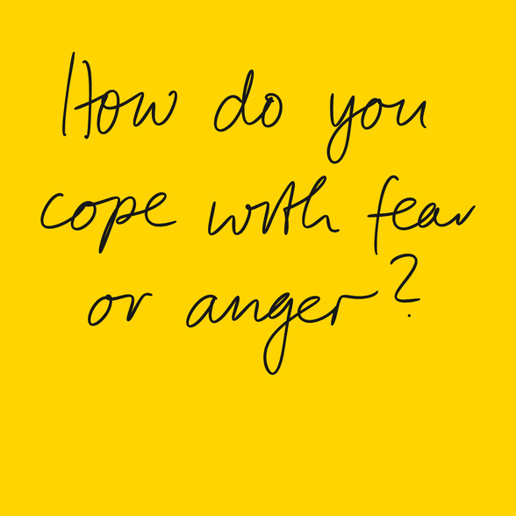
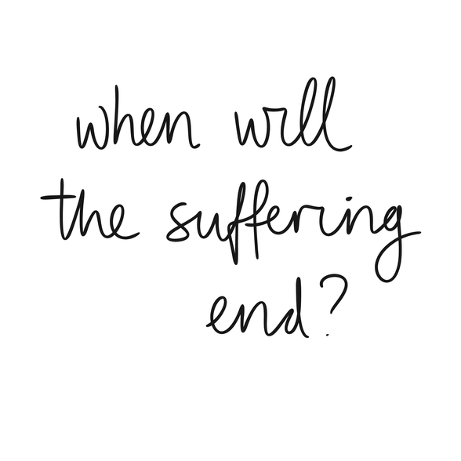
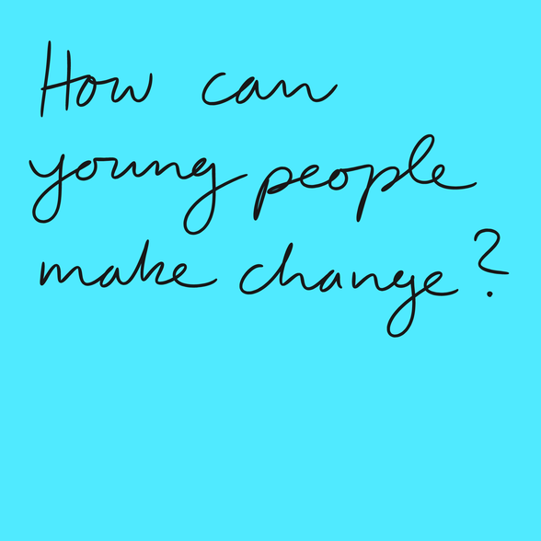
AS A SCHOOL, WE CARE
1. Learn, as a school, how to express concern about this issue in a way that is civil and respectful to all members of our community
2. Reflect on how ordinary people are affected by violence in the region
3. Consider an approach that is centred on finding solutions rather than supporting one side to win against the other
3
ASSEMBLY PACK
Notes:
“As part of that support, today, we are using these slides from an organisation called SNS to:
Learn, as a school, how to express concern about this issue in a way that is civil and respectful to all members of our community
Reflect on how ordinary people are affected by violence in the region
Consider an approach that is centred on finding solutions rather than supporting one side to win against the other
Let’s start with taking a moment to reflect on whether this issue is important to us personally, and if so, why we feel that it is important. (Allow 10 secs silence).”

Slide 4
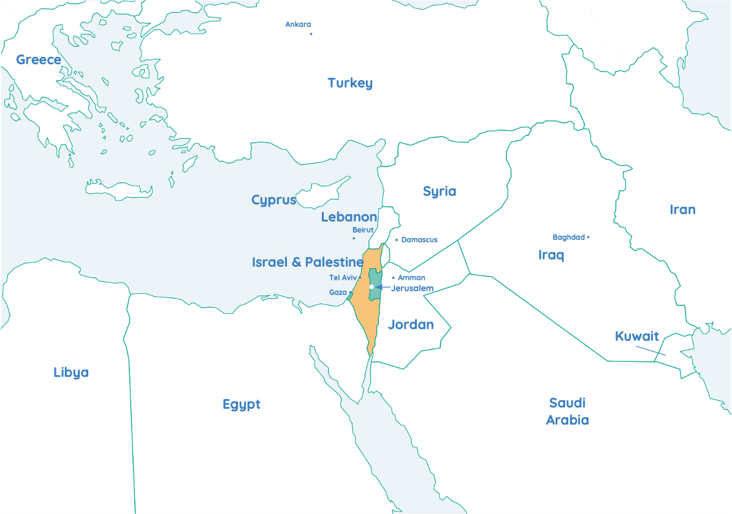

Where in the world?
4
ASSEMBLY PACK
Notes:
“The region we are seeing in the news at the moment is located here on the far eastern side of the Mediterranean Sea. The borders you see here for Israel and Palestine are outlined in International Law but have not been officially agreed upon or implemented by the Israeli and Palestinian leaders. They are disputed borders. The situation is complex, and as a school we will be providing opportunities for you to learn a lot more about it from both perspectives. But for today’s assembly, we will be reflecting on the people of the region who are just like us, and who are most affected by what is going on.”

Slide 5
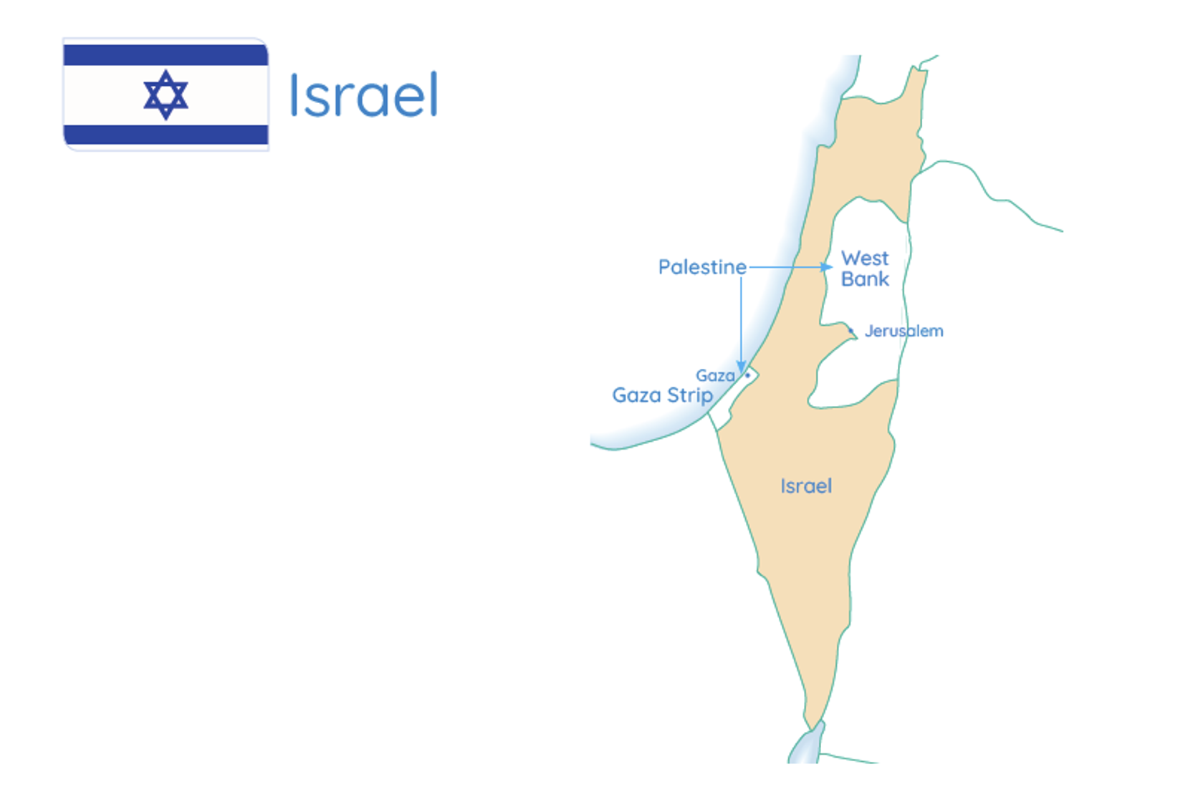

Map of Israel
The yellow shaded area is the area recognised as the State of Israel by the UN and the UK Government.
5
ASSEMBLY PACK
Notes:
The yellow shaded area is the area recognised as the State of Israel by the UN and the UK Government.

Slide 6
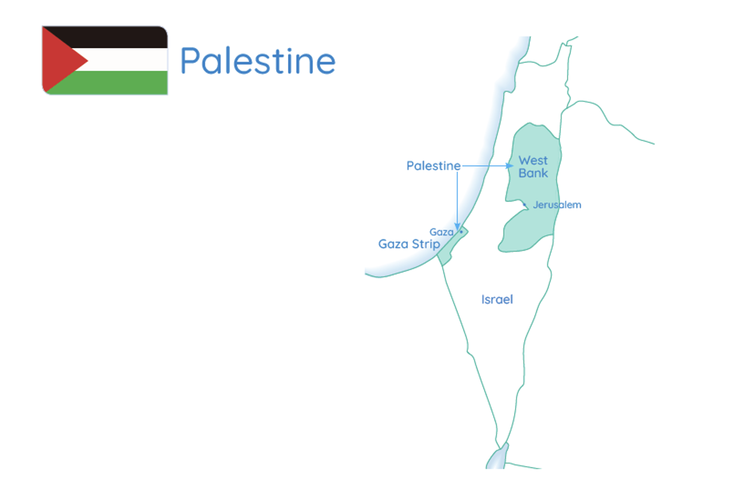
Map of Palestine
The green shaded area is the area recognised as the Occupied Palestinian Territories or Palestine by the UN and the UK Government.
6
ASSEMBLY PACK
Notes:
The green shaded area is the area recognised as the Occupied Palestinian Territories or Palestine by the UN and the UK Government.

Slide 7
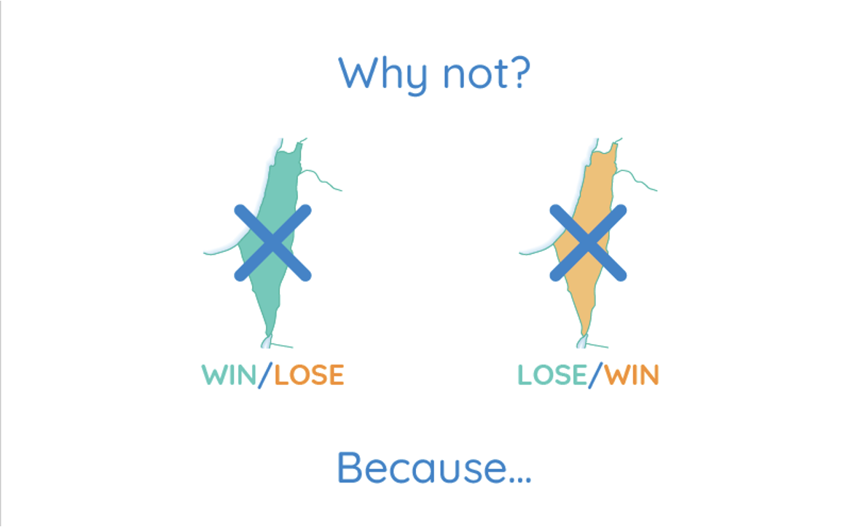


7
ASSEMBLY PACK
Notes:
“Because we care about the people of Palestine and Israel, we want to see a future in which there is a just and peaceful solution for them. If we support one side to win against the other (so all of the land for Israel or all of the land for Palestine) then the violence and pain will continue and so will the current situation of…”

Slide 8
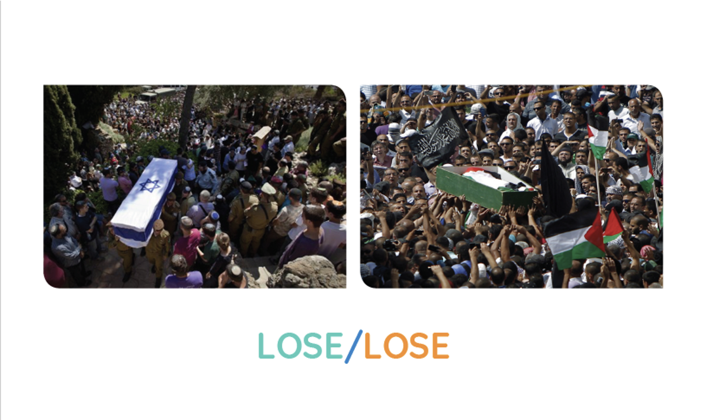
8
ASSEMBLY PACK
Notes:
“…lose-lose. That is why from a humanitarian perspective, the approach we are suggesting that we take as a school is to support an outcome that is…”

Slide 9
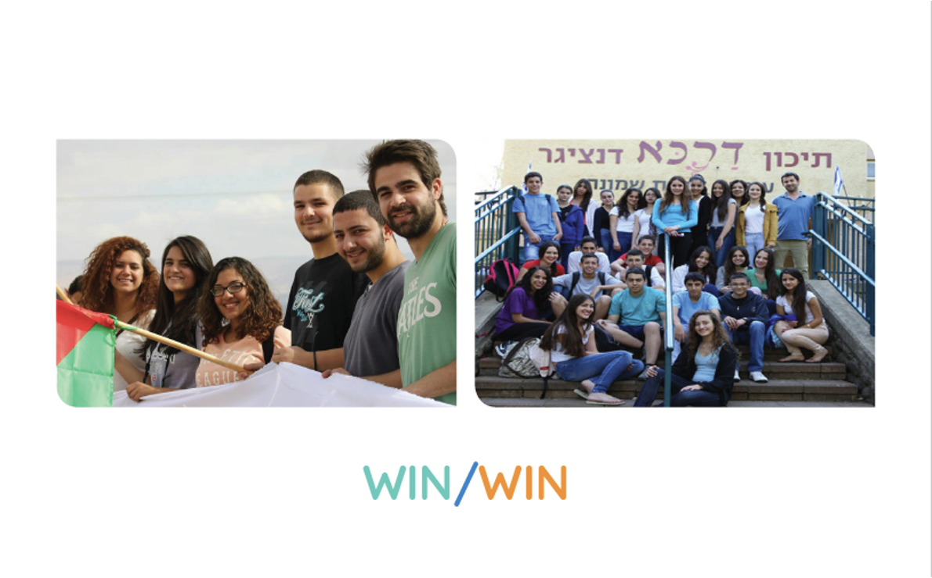

Watch the video: Rage, Revenge & Repair
9
ASSEMBLY PACK
Notes:
“…win-win, where the people on both sides get their human rights and security guaranteed and the land is shared. We are now going to watch a short film that illustrates for us the cost of lose-lose for the people living there, and why it is so important that we promote the values of non-violence, equality, and the rejection of hatred when we talk about and engage in activism on this issue. The film is called Rage, Revenge and Repair and includes the theme of bereavement. If for any reason you find watching this an emotional experience, please feel free to leave your seat during or after the film, and a member of staff will accompany you to another room and support you. We will have 20 seconds at the end of the film for reflection on the issues raised, and I would ask you to maintain silence for that time as we consider these people’s story.”

Slide 10
10
ASSEMBLY PACK
Notes:
“Thank you for watching and reflecting on this important issue that many of our students and staff care about. Hopefully, this film has helped all of us understand how people can be affected and as we now go about our day, we would ask everyone to bear in mind that this is a sensitive issue for some of our school community. As a school, we care about this issue, but also each other. Respectful discussion about the topic is encouraged, and if you would like a member of staff to help mediate a discussion on this, then please don’t hesitate to approach a teacher. Before we finish this assembly, we are now going to run through some guidelines that we would like you all to respect when having conversations about this.” (Read through following slides).

Slide 11


Where is the line?
Political speech: Criticises ideas, policies, actions or institutions
Opposing or supporting Israel, Palestine, or any state’s actions
“I strongly oppose the policies of the Israeli government” or “the actions of Hamas.”
Hate speech: Attacks people based on identity
Dehumanises
Demonises
Encourages hostility, discrimination, or violence
“People from that religion are evil and don’t belong here.”
“Am I criticising an idea—or attacking a group of people?”
11
ASSEMBLY PACK
Notes:
It’s important that we are able to discuss our views on this issue openly, but also avoiding hate speech, particularly against Jews, Muslims, Palestinians or Israelis.
Political speech: Criticises ideas, policies, actions or institutions. It could be opposing or supporting Israel, Palestine, or any state’s actions. For example:
“I strongly oppose the policies of the Israeli government” or “the actions of Hamas.”
Hate speech: Attacks people based on identity. It:
Dehumanises
Demonises
Encourages hostility, discrimination, or violence
For example:
“People from that religion are evil and don’t belong here.”
Before you voice your opinions, ask yourself: “Am I criticising an idea—or attacking a group of people?”

Slide 12
Clarify labels
Be clear about what you mean when using labels:
Jewish and Muslim
Palestinian or Israeli
Arab
Zionism
Islamism
12
ASSEMBLY PACK
Notes:
“Be clear about what you mean when using labels:
Jewish and Muslim refers to two minority groups in Europe and some other regions who experience racism, and this tends to get worse when violence in the Middle East hits our news headlines
Palestinian or Israeli are national identities
Arab is a grouping of people whose mother tongue is Arabic and there is great diversity across the Arab World (e.g. Jordan can’t simply become Palestine just because they are Arabs)
Zionism is the belief in the right of the Jewish people to self-determination (and not all people who call themselves Zionist share the same opinion about the exact territory, principles, etc. of the state of Israel). ‘Zionist’ or ‘Zio’ should not be used as a term of abuse
Islamism is an academic term with French origins that refers to a broad spectrum of political ideologies. Islamism is not a synonym for terrorism and should not be used as such”

Slide 13

Apply the 3 Ds
Demonisation
2. Delegitimisation
3. Double standards
13
ASSEMBLY PACK
Notes:
There are three Ds to think about when avoiding hateful speech:
1. Demonisation
2. Delegitimisation
3. Double standards

Slide 14


Demonisation
Palestine = Caliphate
Israel = long arm of USA
Palestine = Al Qaeda/ISIS
Israel = Nazi Germany
14
ASSEMBLY PACK
Notes:
Some examples of demonisation to avoid would be:
Israel is not a conspiracy to take over the Middle East or the World, and Palestine is not a conspiracy to enforce a Caliphate on Israel/Europe/the World. These are two national identities who both want to exist in the same piece of land.
Israel is not Nazi Germany. Palestine is not Daesh/ISIS.

Slide 15

Delegitimisation
Don't demand population transfer:
Palestinians to other Muslim countries
Israelis to 'wherever they came from' or another country
15
ASSEMBLY PACK
Notes:
Some examples of delegitimisation to avoid would be:
Do not state that Muslims should leave Palestine because they have the whole of the rest of the Middle East or that Israeli Jews should ‘go back to where they came from.

Slide 16

Double standards
Don't transfer accountability or put pressure:
Jewish or Muslim
Palestinian or Israeli
Anti-Zionism
Why?
Tropes
16
ASSEMBLY PACK
Notes:
Some examples of double standards would be:
Do not hold Jews responsible for the decisions of the Israeli leaders, or Muslims responsible for the decisions of the Palestinian leaders
Do not demand that Jews or Muslims must take a certain political position on the issue
Do not assume that all Palestinians or Israelis support the actions of their governments
Anti-Zionism is not always antisemitic (for example if someone is generally anti-nationalism and believes in abolishing nation-states), but it can be, for example if criticism of Israel goes beyond that of its government policies and uses antisemitic tropes (these include stereotypes about Jewish people being connected to wealth, power and global domination)

Slide 17
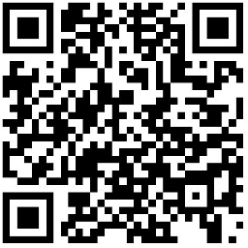




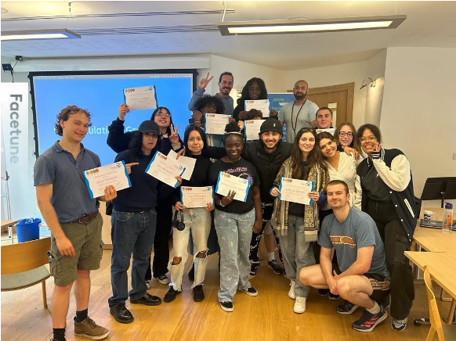
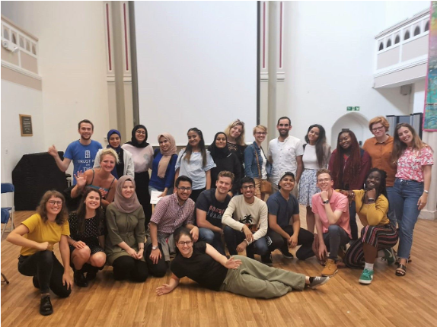

Follow up opportunities!
Follow us online!
Check out our website
Aged 16–19?
Apply to our Bridge Builders Programme!
Sign up for our weekly media literacy tool at www.sns.space
17
ASSEMBLY PACK
Notes:
Finally, remember that the media has many different voices on this issue and a lot are biased towards one side or the other. You can follow SNS online for more information and resources. Every week, they issue a news update on current events in Palestine-Israel that draws from diverse news sources so that you can get a broader picture of what is going on. They also have other opportunities for you to learn more and get involved on this issue, and we as a school can let you know about other organisations that provide multiple perspectives, as well. We are committed as a school to ensure that learning and discussion can take place on this issue and is not shut down, and that we ensure a safe and brave space for everyone in our school community.
Thank you for your attention this morning and let’s be mindful of those around us who feel strongly about this important international issue in the coming days.

Slide 18


Thank you
@sns
team@sns.space
sns.space
18
ASSEMBLY PACK

