Slide 1
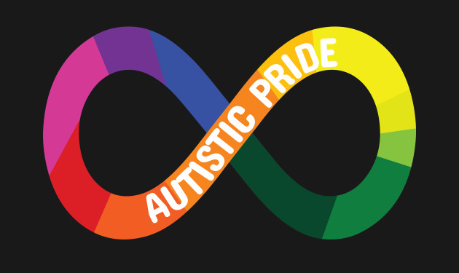
Some awesome stuff about autism
#Be YOu

Slide 2
First…
People on the autism spectrum are individuals. This means that there is no one kind of autistic person. Everyone is different and unique! ☺
Now that we are clear that there is no one way to be a person (or to be autistic, or to be an autistic person, or a person with autism, or a person on the autism spectrum…), here are 10 really cool things that lots of autistic people have in common:

Slide 3
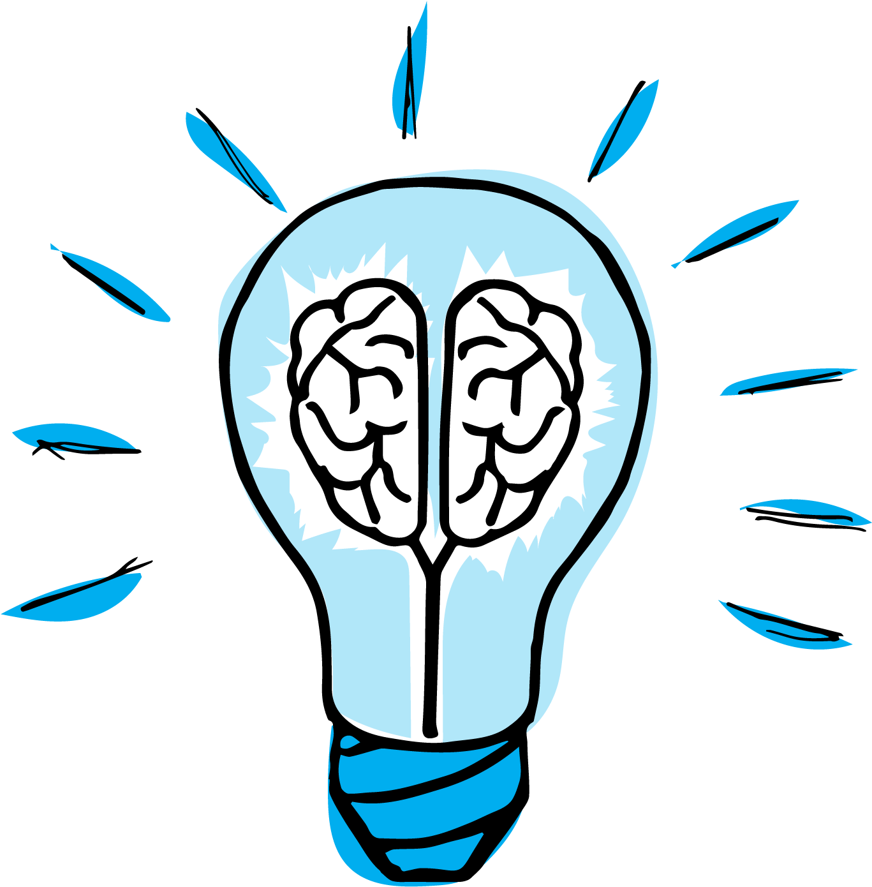
1. Autistic people are extremely passionate about what interests them.
This awesome quality leads to hyper-focusing and avidly researching those interests until they have a deep understanding of the subject matter.
Autistic people have great expertise in their areas of interest.
Does this sound like you? what topics are you very knowledgeable about?

Slide 4
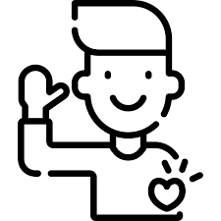
2. They are straightforward, direct and honest.
Autistic people rarely lie.
They mean what they say and will tell others what they truly think.
Does this sound like you? why or why not?

Slide 5
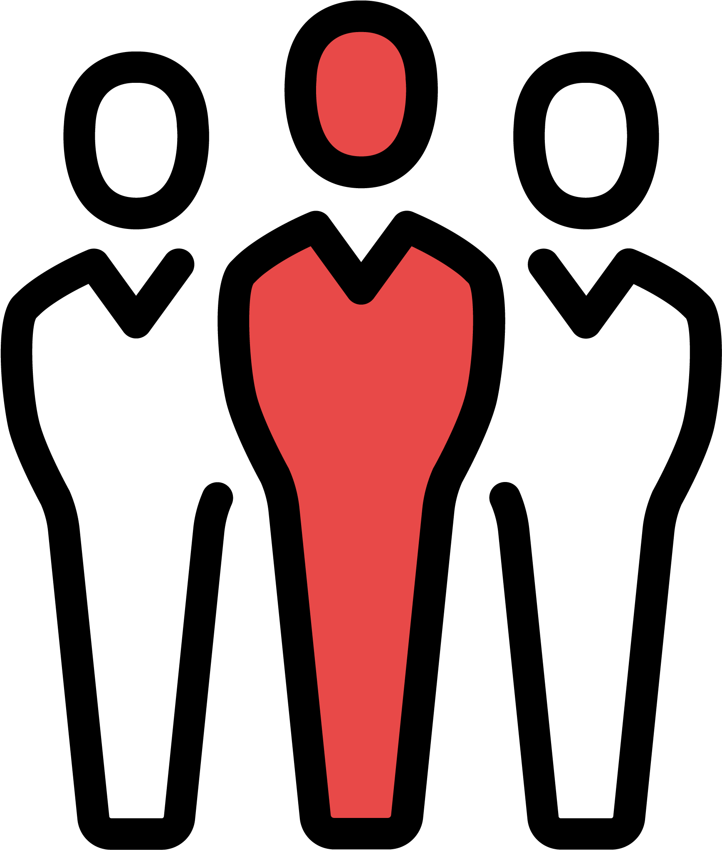
3. Autistic people perceive the world differently and process information in unique ways.
As a result, they are independent and creative thinkers.
Does this sound like you? How so?

Slide 6

4. They are detail-oriented and they pay attention to the finer details that others often miss.
Does this sound like you? What details do you tend to notice that others might miss?

Slide 7
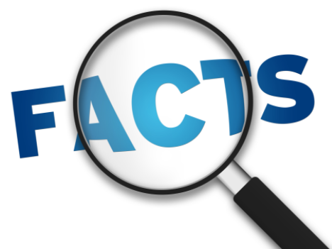
5. They have a strong memory and an amazing ability to recall facts.
Does this sound like you? do others tell you what an incredible memory you have? what are some facts that you are able to recall?

Slide 8
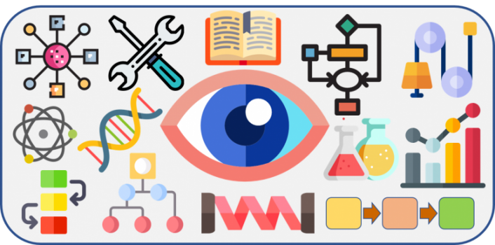
6. People on the Autism spectrum also tend to be visual thinkers.
As a result, they can visualize solutions to problems, as well as other things, better than most people can.
Does this sound like you?
why or why not?

Slide 9
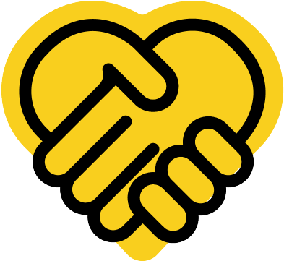
7. they are unlikely to bully people, judge others or get easily swayed by peer pressure.
Does this sound like you? which part or parts?

Slide 10
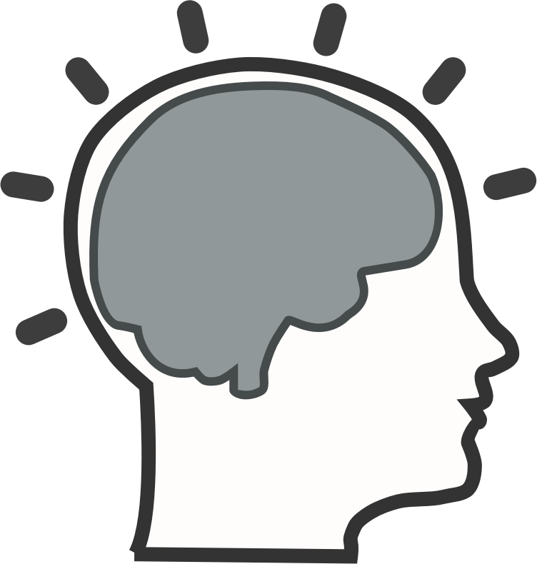
8. Autistic people are smart.
Many have above-average intelligence. This includes some non-verbal autistic people.
Non-verbal means that the person does not speak
Does this sound like you? How SO?

Slide 11
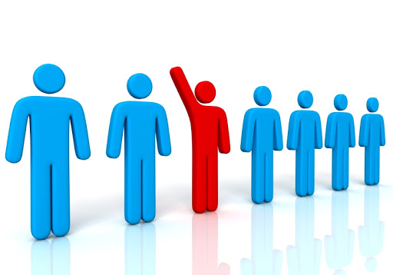
9. Autistic people aren't afraid to be themselves.
They're unique and “quirky,” and don't get as bothered by what other people think of them. They just continue to be their unique selves and share their passions with the world.
Does this sound like you?
In what ways?

Slide 12

10. Others benefit from having a relationship with an autistic person
They Open New “Doors” for Neuro-typical People!
For most neuro-typical people, having an autistic person in their life has had a profound positive impact on their perceptions, beliefs, and expectations. In other words, autistic people help neuro-typical people experience the world in unique and wonderful ways. ☺

Slide 13
Different ways of talking about autism

Slide 14
“Autistic person” or “person with autism”?
There are two common ways that people talk about autism. They either use “identity-first” language, “Person-First language,” or both.
Identity-first language: “Autistic person”/ “I’m autistic”
Person-first Language: “Person with autism”/ “I have autism”

Slide 15
Preference for identity-first language
A recent study found that the term “autistic” was preferred by the majority of autistic adults

Slide 16
Arguments for “autistic” rather than “Has autism”
Autistic
Has autism
autism is an inherent part of a person’s identity, just as being shy, outgoing, athletic, jewish/Christian/muslim, etc.
Autism is part of a person’s biological make-up which shapes a person’s way of understanding the world and how they interact with it.
The person cannot be separated from their autism, just like a person cannot be separated from their skin color. it is a part of them.
Diseases, unlike autism (which is not a disease or illness), are often labelled through the use of “with,” such as, “person with cancer”.
labelling autistic people in the same way you would someone with a disease makes autism seem unfortunate, just like a disease, which could not be fUrther from the truth.

Slide 17
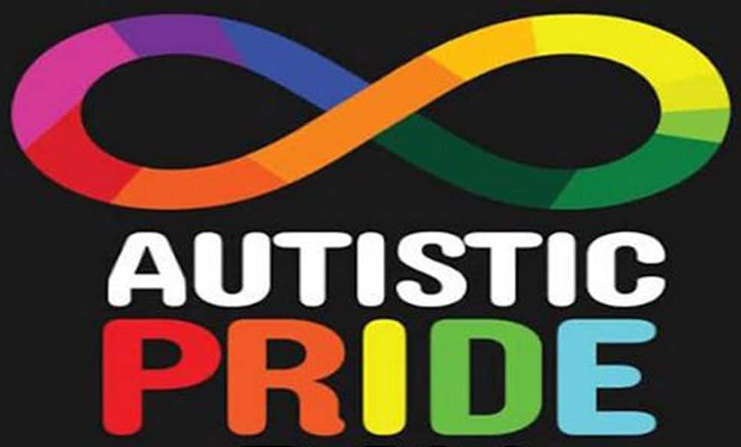
Arguments for “autistic” vs. “Has autism”
identity-first language is a choice for empowerment, culture and identity. It speaks to the fact that being autistic is nothing to be ashamed of and differences are to be respected and celebrated- not criticized.
IT is your choice!
Do you have a preference?

Slide 18
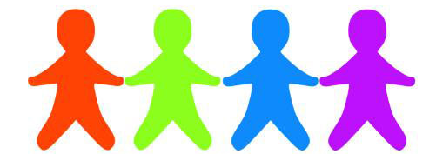
Oh wait!- and there’s a third way to talk about autism-
Some people prefer “ Person on the spectrum”/ “I’m on the spectrum”
like a “middle of the road” way to talk about autism. It’s technically person-first language (which is not the preference of most autistic adults), but it doesn’t use the word “with” or “has,” which are commonly used to talk about diseases or illnesses
ON THE SPECTRUM

Slide 19

Hey! Did you know that these famous people are autistic?

Slide 20
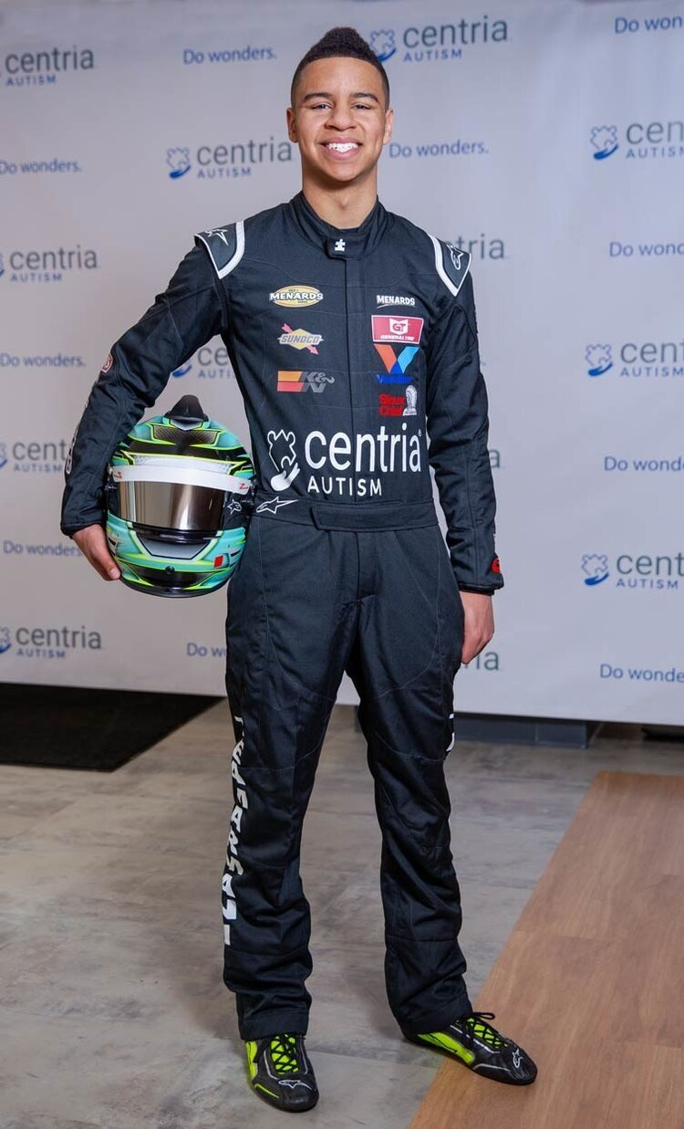
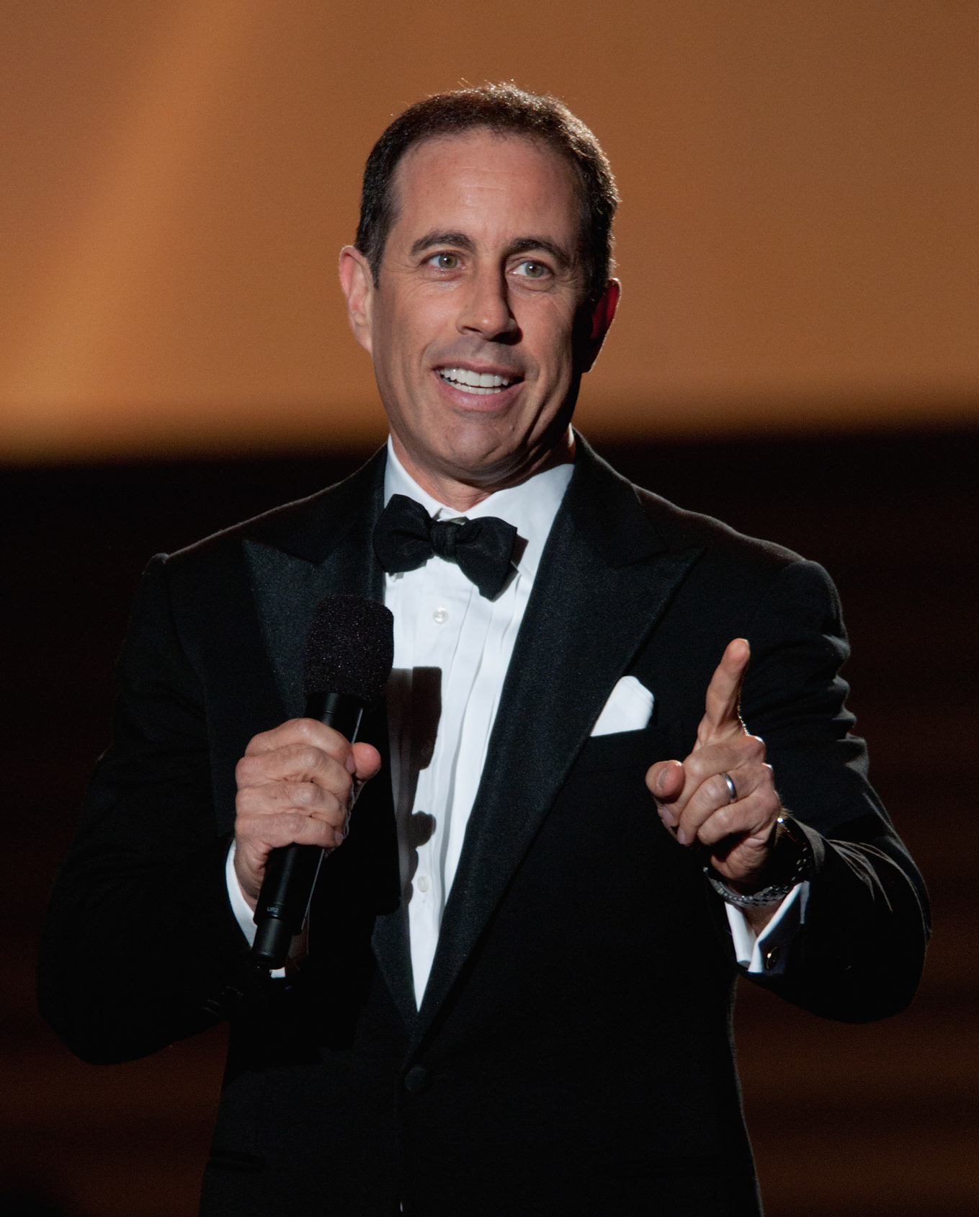

Armani Williams-NASCAR driver
Jerry seinfeld-comedian

Slide 21
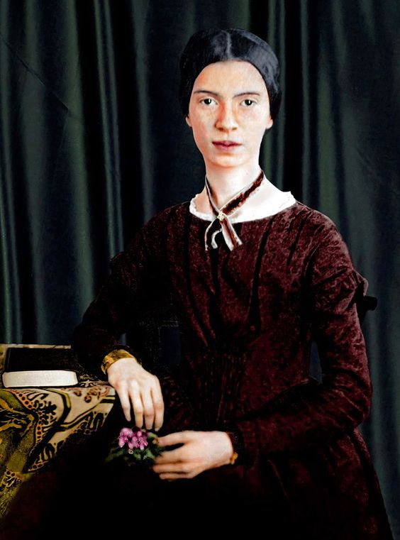
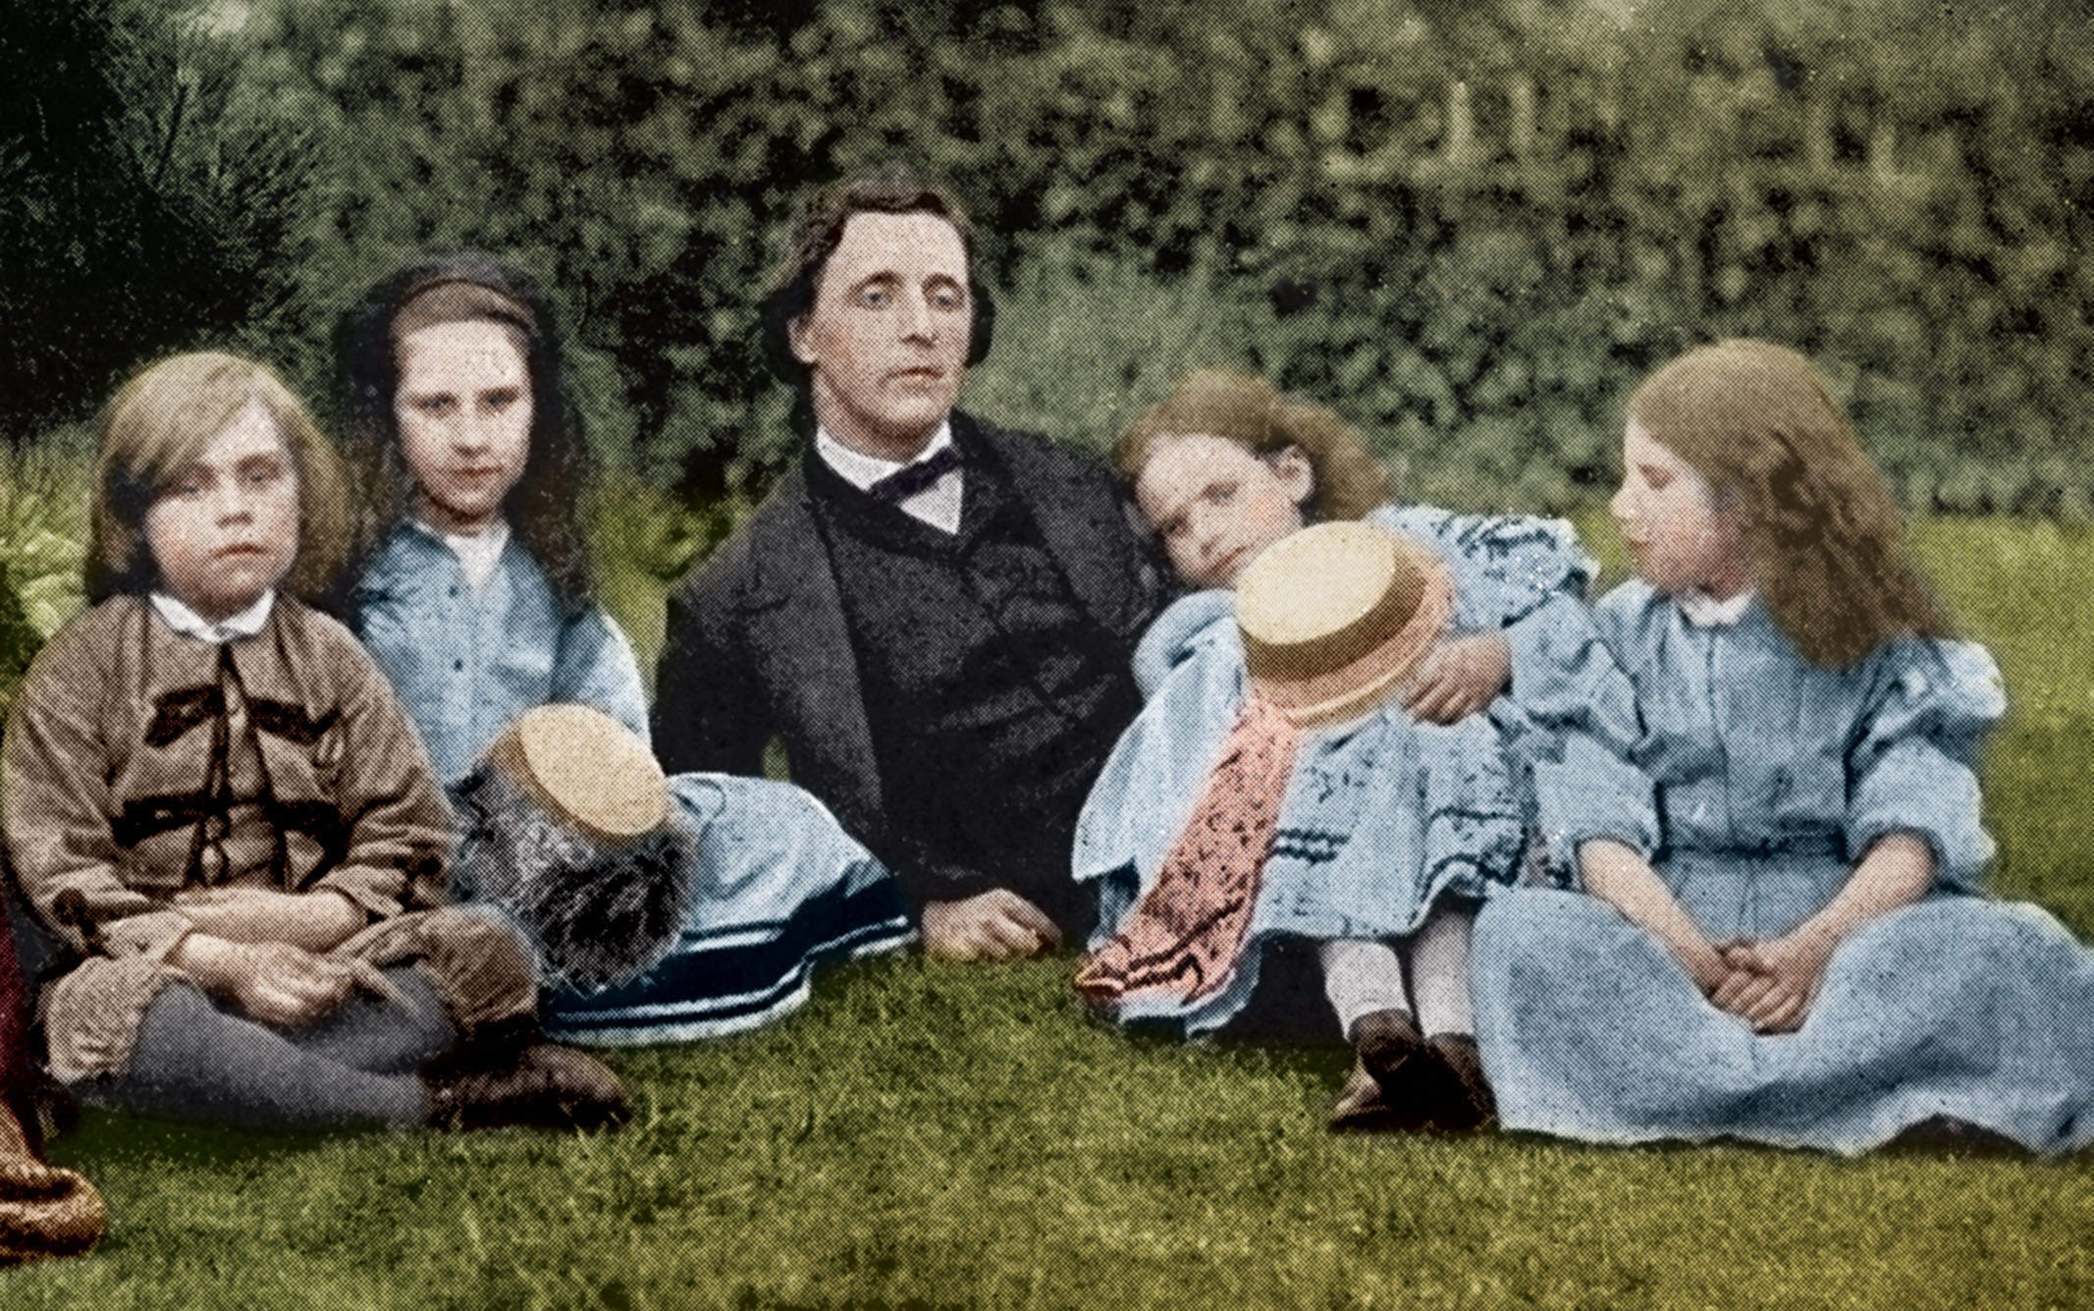
Lewis Carroll- Author of “Alice in Wonderland”
Emily dickinson-poet

Slide 22
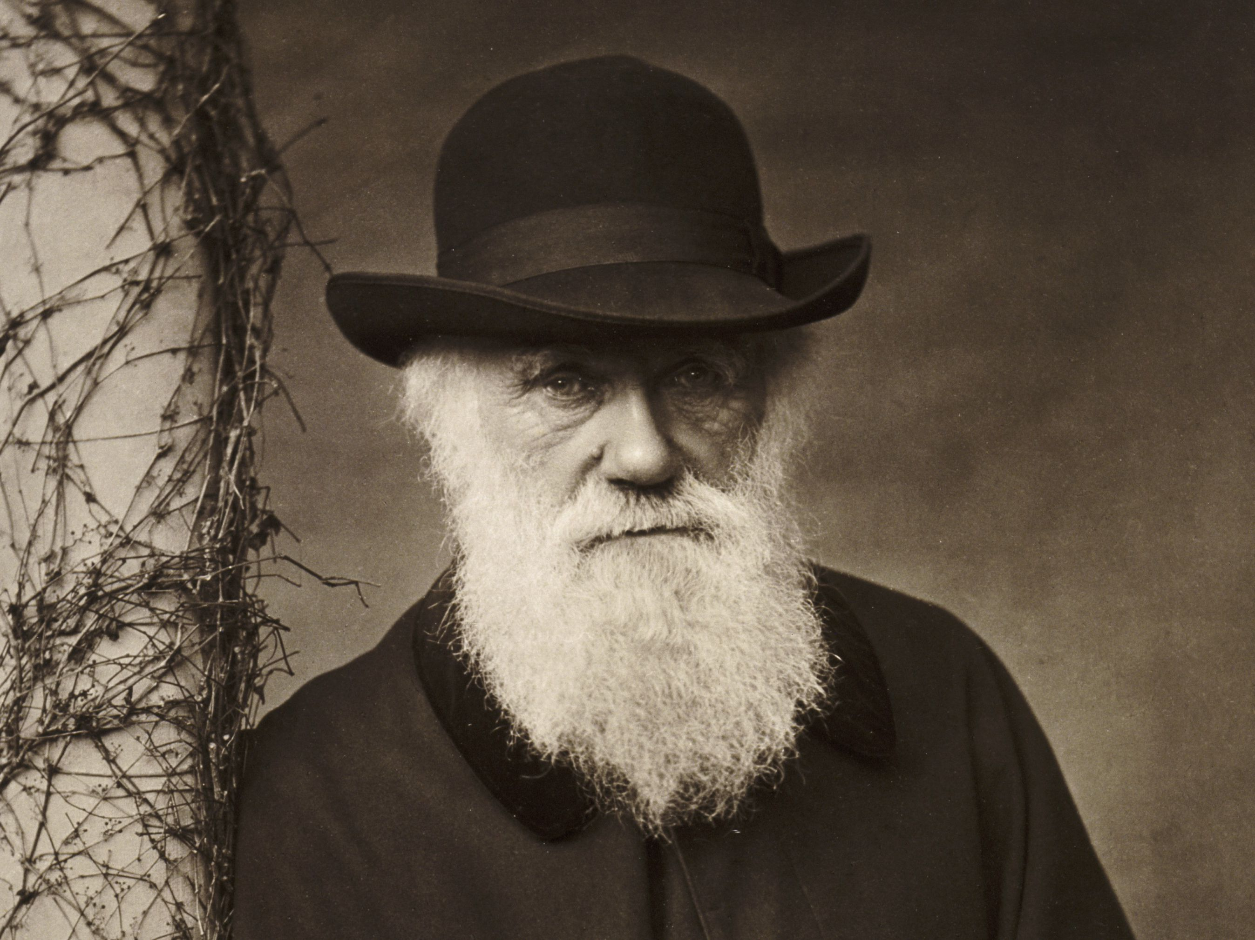
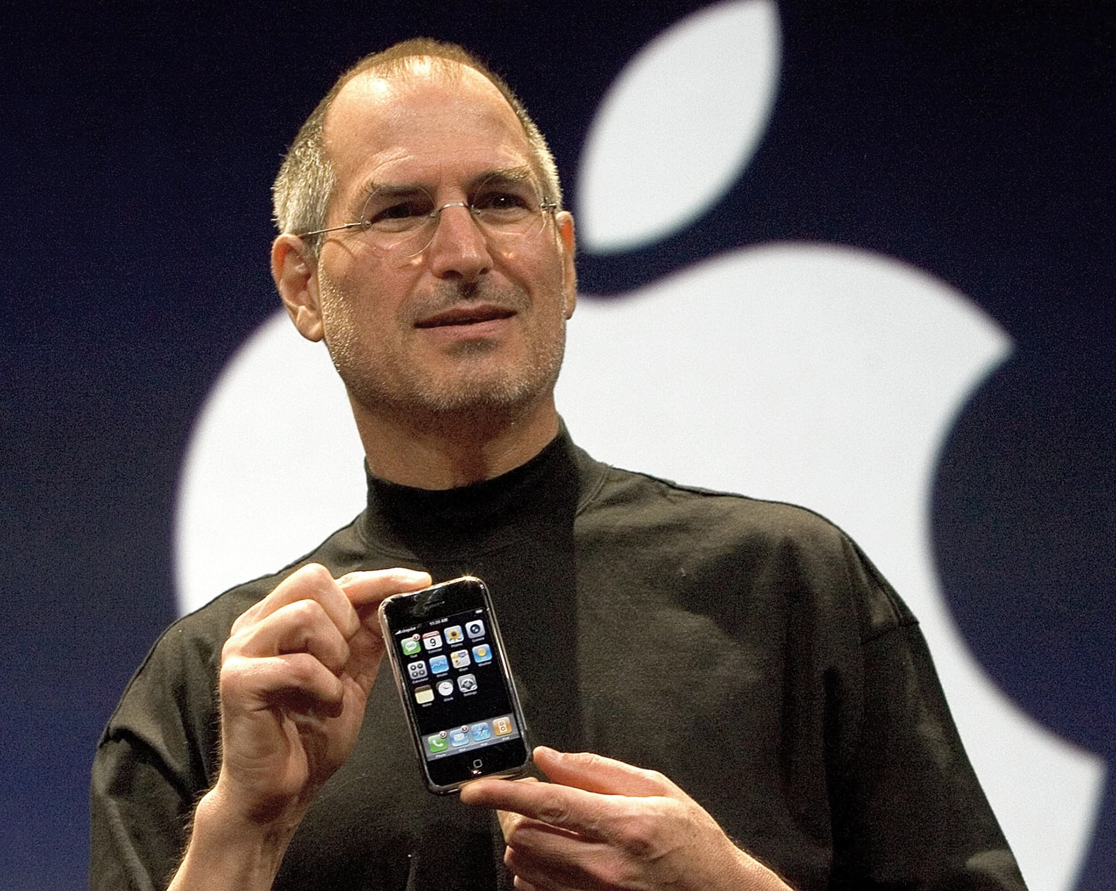

Charles Darwin- Naturalist, Geologist, and Biologist
Steve jobs- formal ceo of apple

Slide 23
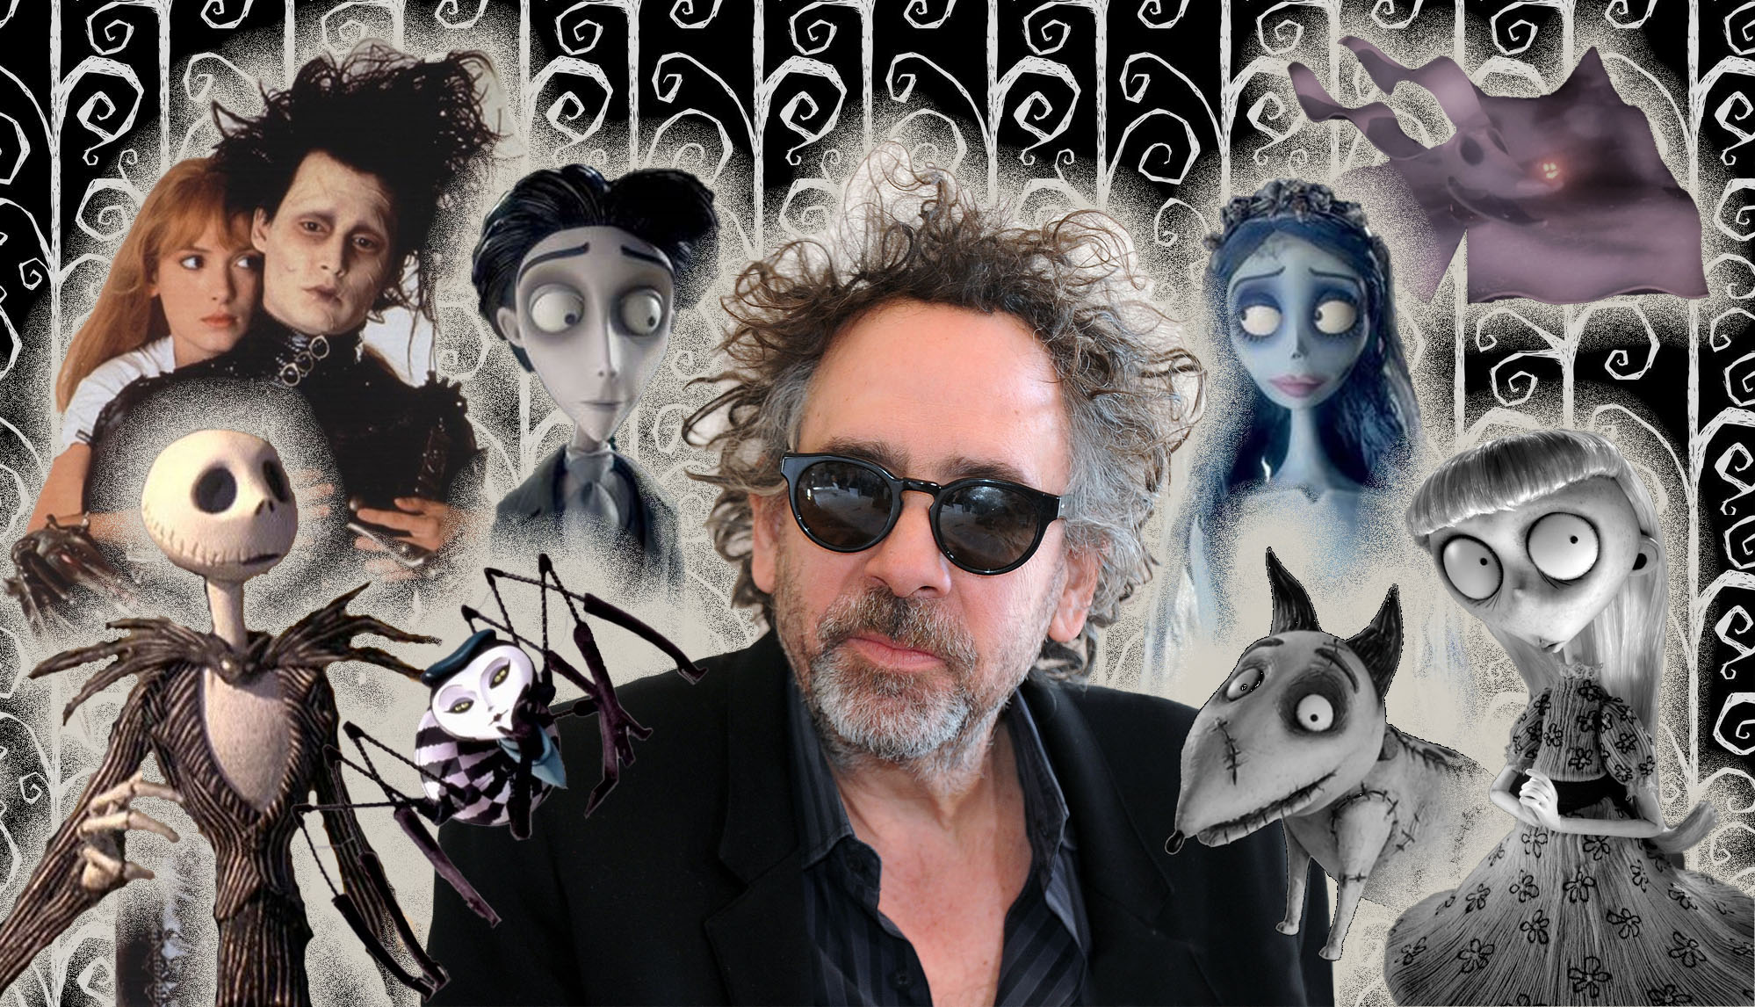
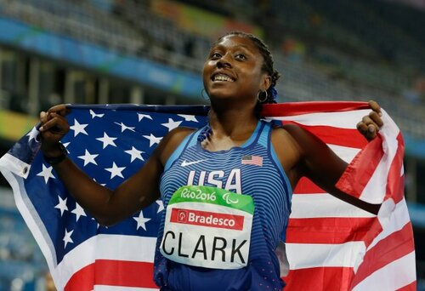
Tim Burton- Movie Director
Breanna clark-Olympic athlete

Slide 24
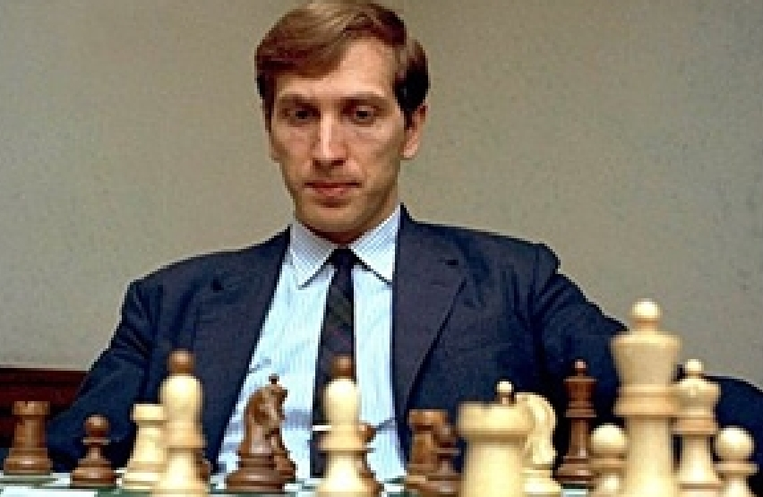
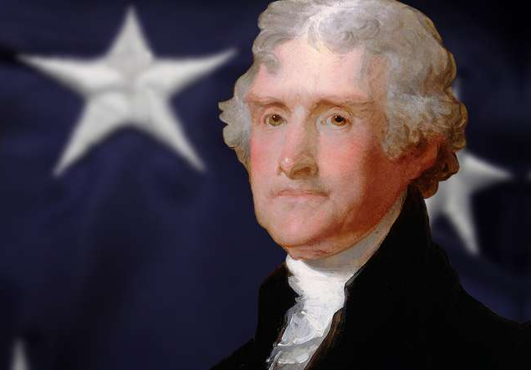
Bobby Fischer- Chess Grandmaster
Thomas Jefferson-American president

Slide 25
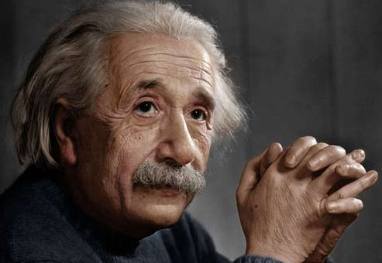
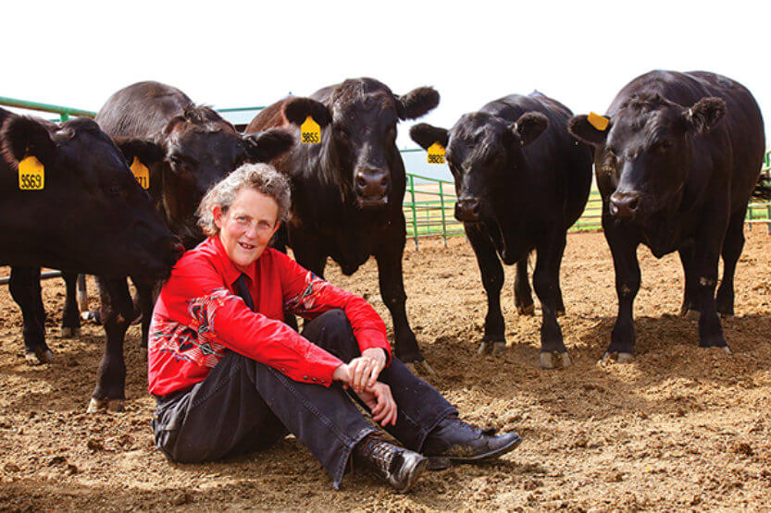
Albert Einstein- Scientist & Mathematician
Temple Grandin-animal scientist

Slide 26
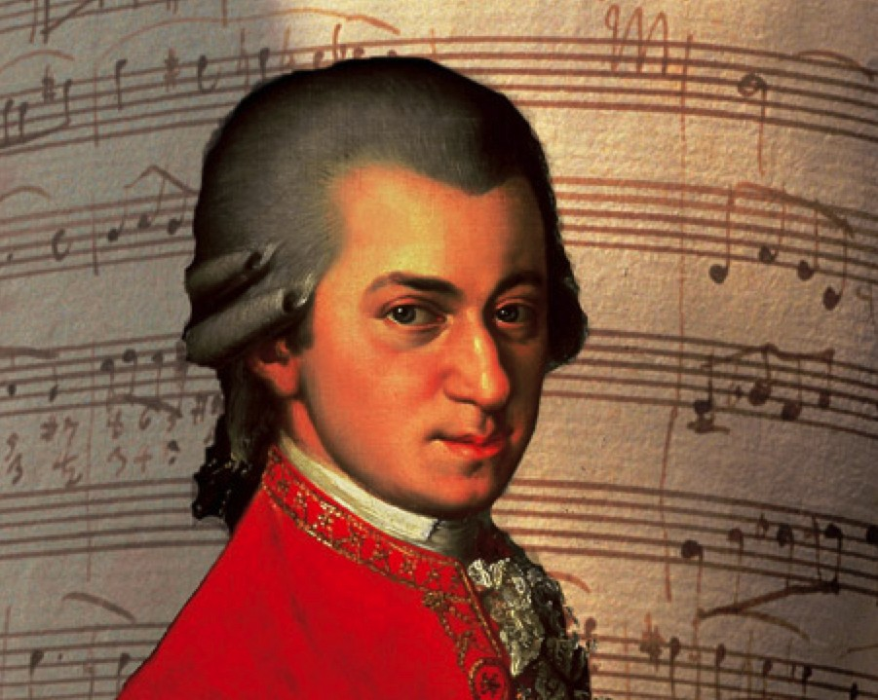
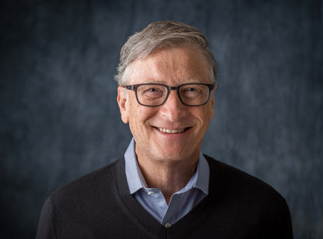

Bill Gates- Co-founder of the Microsoft Corporation
Wolfgang Amadeus Mozart – Classical Composer

Slide 27
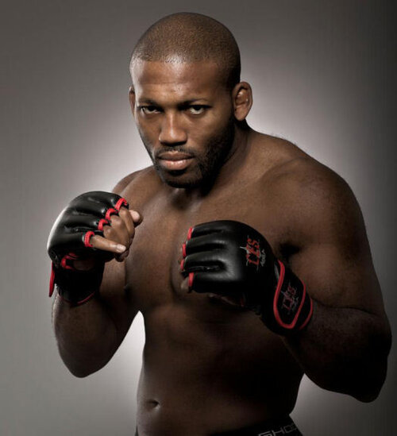
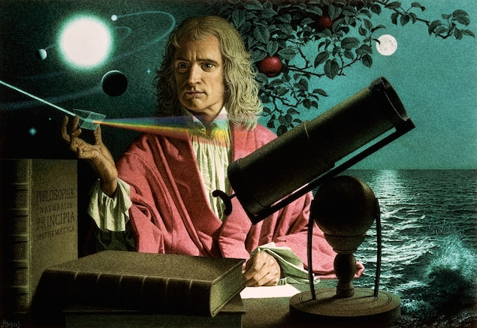
Sir Isaac Newton – Mathematician, Astronomer & Physicist
John howard-mixed martial arts competitor

Slide 28
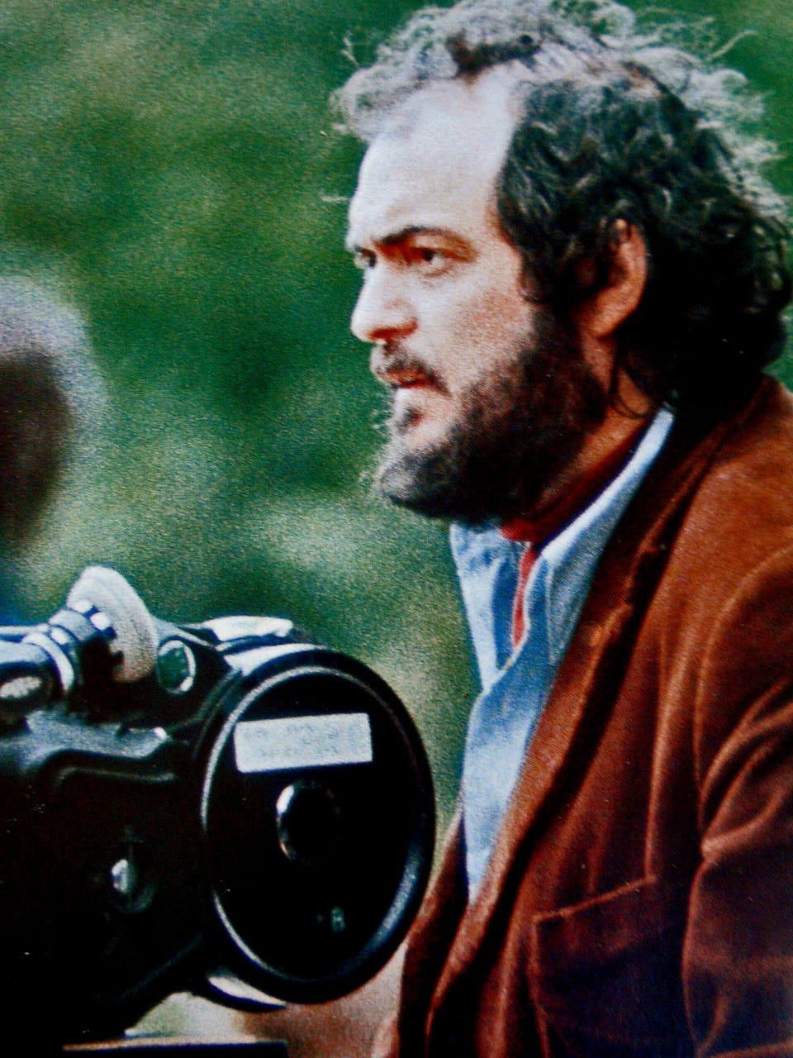
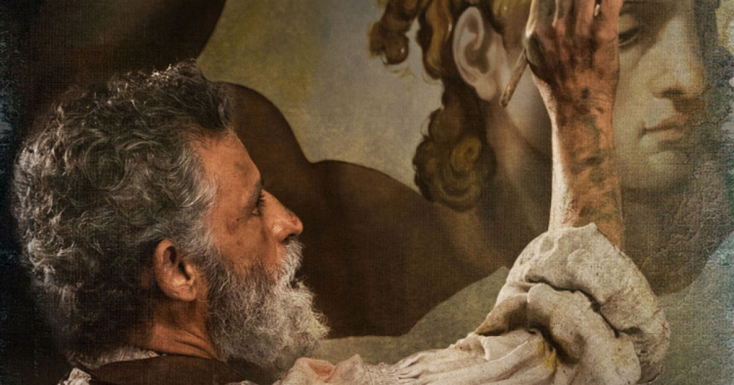
Michelangelo- Sculptor, Painter, Architect, Poet
Stanley Kubrick- Film Director

Slide 29
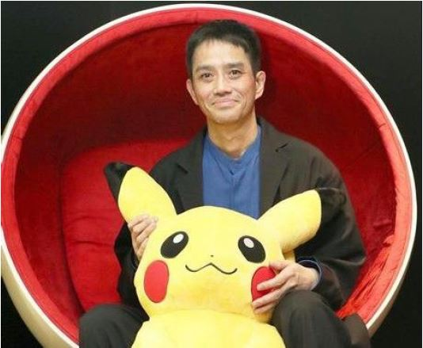

Satoshi Tajiri – Creator of Nintendo’s Pokémon

Slide 30
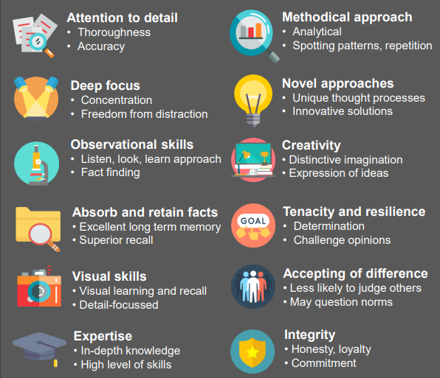
In summary: People on the autism spectrum are unique, important, capable, loved, and known to excel in many areas!

