Slide 1
Advocacy
Every parent or guardian has the right to advocate for their child, either by themselves or with the help of a parent advocate. All parents play an important role throughout their child's life.
The Advocacy Committee is here to help you

Slide 2
On a larger scale…..
If you genuinely care about your cause, you have the potential to be an effective advocate. Advocacy requires a great deal of patience, perseverance and persuasion. When you are passionate about your cause, this will be evident to your audience, and your message will come across more strongly and clearly. (Grand Canyon University)

Slide 3
Characteristics of a good advocate
Always listens and learns
Deliberate focus on long-term goals
Values support from others
Openness to different ways to share your message
Commitment to partner with different and like-minded individuals
Ability to look at and respond to positions and an issue
Tenacity to bounce back from negative responses
Engages the public and stakeholders
Collaboration
Persuade - Don’t Argue

Slide 4
Types of Advocacy
Self-advocacy refers to an individual’s ability to effectively communicate his or her own interests, desires, needs and rights.
Group advocacy involves people with shared experiences, positions or values coming together in groups to talk and listen to each other and speak up collectively about issues that are important to them. These groups aim to influence public opinion, policy and service provision.
Citizen advocacy aims to involve people in their local community by enabling them to have a voice and to make decisions about the things that affect their lives.
Peer advocacy refers to one-to-one support provided by advocates with a similar disability or experience to a person using services. Trained and supported volunteers often provide peer advocacy as part of a coordinated project.
Educational Advocacy - An educational advocate is someone with extensive knowledge about special education programs, 504 Plans, IEPs, and academic support that students can receive. This person educates parents, children and teens about the resources available to them and how to acquire each resource, as needed.
Parental advocacy is the single most important thing that can improve the quality of life for your child with special needs. Your everyday advocacy can impact every area of your child’s life— from his ability to function and progress in school, to his ability to experience great joy and contentment. Identifying and harnessing the wealth of experts and resources regarding your child’s special needs care will help you in becoming the most effective parent advocate possible.

Slide 5
It all depends on where you live
We want to make sure we say this at the beginning because it’s so true. There are federal laws, but there are also state laws.
The Individuals with Disabilities Education Act (IDEA) 60-day timeline applies only to the initial evaluation and does not include the time required to determine eligibility, to obtain parent consent for the initial provision of special education and related services, or to implement the individualized education program (IEP).
HOWEVER, an example of where states differ is as follows:
-In Connecticut, a school district has 45 school days from the first time a parent emails/calls/inquires about conducting an initial evaluation for their child to complete the evaluations and meet back as a team at a PPT (planning and placement team) meeting to determine whether or not the child qualifies for special education services
-In California, an SST (student study team meeting) must be held within 15 days, and assessment plan given then or letter as to refusal given by district at that date. Assessment has 60 days from day of signature to IEP. weekends are included in that 60 days, only vacations over 5 days are excluded in the 60 day count.
-In Maryland, the IEP team must complete the evaluation process, including the initial meeting, completion of the assessments, within 90 days of receiving the written request for an evaluation
-In Maine, an initial evaluation must be conducted within 60 calendar days of receiving parental consent for children in the Child Development Services system OR within 45 school days of receiving parental consent for children 5-20 under the responsibility of the public school system. Within the above timeframe the agency or SAU shall proceed to determine if the child is a child with a disability under 39 CFR 300.8.

Slide 6
But Every Family is Entitled to Child Find
Child Find: Schools Have a Legal Duty to Evaluate Children Impacted by Disability
A Brief Overview
School districts have an affirmative duty to locate, evaluate and potentially serve any infant, toddler or school-aged student impacted by disability under the Child Find Mandate — part of special education law.
The duty to evaluate is based on a known or suspected disability that may significantly impact access to learning. Data from evaluation then determines eligibility. PAVE recommends making referrals in writing and provides a sample letter.
Public school districts provide evaluations and special education services at no cost to the family.
Child Find is intact during the pandemic, as are all student rights and protections. For more information, PAVE provides a training video: Student Rights: Special Education During COVID-19 and Beyond.
The Child Find Mandate requires states to implement programs to locate children who might need more support, particularly those who might need services as infants or toddlers. Child Find is written into the IDEA in “Part C,” which protects children 0-3 with known or suspected disabilities in need of early intervention. However, Child Find applies to all children who might need services—through age 21 or until high-school graduation.The timeline requires the following occur within 45 days of a child's referral: (1) any screening offered by the State; (2) the initial evaluation; (3) the initial child and family assessment; and (4) the initial IFSP (Individual Family Service Plan) meeting.

Slide 7
Assessments
For a child ages 3-21, an evaluation determines whether a disability is significantly impacting access to school and whether specially designed instruction is necessary for the student to access learning at school.
It should be noted that the referral process and timeline for special education is state specific.
The Federal Law states: The Individuals with Disabilities Education Act (IDEA) 60-day timeline applies only to the initial evaluation and does not include the time required to determine eligibility, to obtain parent consent for the initial provision of special education and related services, or to implement the individualized education program (IEP).
If a school district refuses to evaluate, family caregivers can request an explanation in writing and have the right to dispute that decision by exercising Procedural Safeguards.
The type of assessments schools use to evaluate vary state to state, but ALL schools use data to determine whether a child is eligible for services.

Slide 8
A few examples of assessments: In Connecticut: school psychologist administers tests to determine student’s cognitive ability and possibly also uses rating scales to look at executive functioning, social/emotional needs, attentional issues, etc. Speech & Language Pathologist administers tests focusing on receptive language, expressive language, and pragmatic language. Special Education Teacher administered tests looking at student’s abilities in reading, writing, phonological awareness and math
Widely Used Academic Tests:
Woodcock-Johnson Tests of Achievement (general and extended batteries that include fluency measures)
Scholastic Abilities Test for Adults
Wechsler Individual Achievement Test, with reading rate measure
Kaufman Test of Educational Achievement
Nelson Denny Reading Test
Widely Used Intelligence Tests:
Wechsler Adult Intelligence Scale or Wechsler Intelligence Scale for Children
Woodcock-Johnson Tests of Cognitive Abilities
Stanford Binet Intelligence Scales (when individually administered)
Kaufman Assessment Battery for Children
Differential Ability Scales

Slide 9
Private Schools
The LEA (Local Education Agency) manages services and funding for schools in the local area it covers. (“Local” can mean different things in different areas. It could be state, regional or individual school districts.)
The Individuals with Disabilities Education Act (IDEA) requires that LEAs set aside funding for students with disabilities whose parents choose to send them to private school.
Because this money is limited, your child will receive “equitable services.” These services can be similar to the ones in an IEP, but these services may be fewer than if he went to public school.
It is also important to know that just because your child may end up at a private school, it is still the public school’s responsibility to conduct triennial reviews, review/revise the IEP, conduct annual reviews, etc.

Slide 10
Private Schools
You are entitled to services at Private Schools - but there are differences.
Private schools can offer special education, but they aren’t required to. This is also an area where decisions are made state by state, and even town by town.
Maryland: some private schools may offer an Instructional Services Plan or an Individual Service Plan, both known as ISPs. That happens when the private school works to provide specialized services within their own system. But it’s important to know that if your child chooses a private school, he most likely will get what’s called a service plan through your local education agency (LEA)—not through the private school itself.
Connecticut: if a child with an IEP goes to a private school that does not specialize in special education, the private school is not responsible for implementing any type of service for the child. If the private school is state approved as a special education school, then typically the IEP transfers over from the public school. The public school district does not HAVE to send the
California: if you attend a private school you are entitled to an IEP IF you bring your child to the public school for services. Otherwise you get up to two 1 hour sessions per IEP.
Maine: I don’t know of any special ed student who has ever attended a private school in northern Maine because there are so few. However, the regulations state that a student enrolled in a private school by the parents will be provided special ed and related services with the amount to be expended for those services by the SAU equal to a proportionate amount of Federal funds made available. State and local funds may supplement but in no case supplant the proportionate amount of Federal funds.

Slide 11
General “Good Practice” Guidelines for Parents
Request to see your child’s file – each state has a different title for this request
Start a journal to record dates and subject matter of all related phone calls, appointments, meetings and informal discussions.
Keep all records for your child in a binder or an online folder (i.e. IEPs, meeting invitations, evaluations, meeting notes, progress reports)
All communication with school personnel should be written down
If you hire an outside advocate, review the current IEP Plan and develop a list of questions/concerns. If you don’t hire an advocate, you should do this prior to an IEP meeting to discuss with the school team
Prior to an IEP meeting, prepare an opening statement to deliver verbally, reflecting your concerns and desires for your child.
Record your IEP meetings

Slide 12
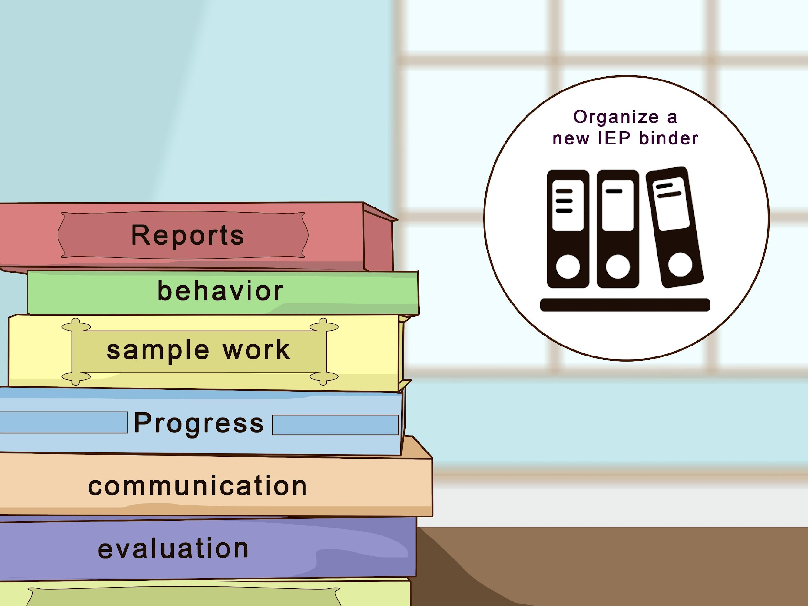
Up through age 21-are services are an ENTITLEMENT
Special education services, some good, some not as good.
Remember this: An IEP is a contract between you and the school, when the contract is not enforced, the student needs to be compensated.
A program is only as good as the teacher, and teachers change. Trust your instincts. Visit programs and see where you see other children like yours. Are they happy? Are they learning? Are they learning the skills they need?
Start keeping a notebook

Slide 13
After Entitlement Your Child is Eligibile
Age of eligibility | IDEA says educational services must be provided to students with disabilities who are in school until the age of 21. | States can choose to limit or extend eligibility for kids who are 18 or older. Most states provide services until the age of 21. But a few end services earlier or later.

Slide 14
Age of transition services | Federal law says schools must start transition planning for after high school at the age of 16. | Some states choose to start earlier. In Maryland, for instance, schools must provide transition services starting at age 14.

Slide 15
Educate yourself on your state’s services
Every state has an HCBS waiver - The Medicaid Home- and Community-Based Services (HCBS) waiver program was authorized under Section 1915(c) of the Social Security Act. Through this program, states can help provide different services that allow those who need care to receive services in their homes or communities.
Some states have Medicaid Autism Waivers
Most communities have local programs – recreation, respite, etc.

Slide 16
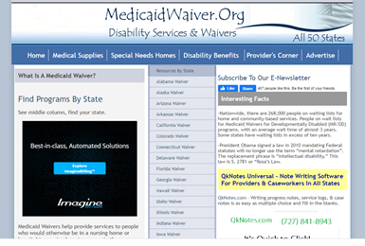
medicaidwaiver. org - state by state listing

Slide 17
Getting Services - Your Worst Day

Slide 18
Getting medical documentation - doctor letters
Doctor’s letters are extremely strong forms of documentation, but they are very busy people.
Suggest drafting a letter for your doctor’s signature and asking them to edit it, put it on their letterhead.

Slide 19
Emergency Scripts
Wandering 911 Script

Slide 20
Guardianship –– Surrogate Decision- Conservatorship - what is in your state?
Tough decisions, you need to make up your own mind about these. Understand you will need to hire a lawyer for you, and for your child if you choose guardianship
A surrogate decision maker, also known as a health care proxy agents, is an advocate for “incompetent patients”. If a patient is unable to make decisions for themselves about personal care, some agent must make decisions for them.

Slide 21
Get connected
Know who is making the laws and allocating funds where you live.

Slide 22
Know who makes your laws and spends your taxes
Find State Senators
Find Your Representatives
Find Your Legislators

Slide 23
Sample Letters
Peer Advocate
Citizen Letter
Medical Advocacy Letter
Medical Charges Appeal Letter
DDA Policy Letter
Letter to Government Officials

Slide 24
Citizen Advocacy - Top Ten List of things Parents Need to Know
Montgomery County

Slide 25
Contact Us:
Susan Hartung: thehartungs1@gmail.com 240-372-3106
Beth Woodbury: woodburymaine@roadrunner.com 207 723 3759. Home: 207 794 0268
Sue Carpenter: westburygrr@yahoo.com 408-896-7710 (West Coast)
Amy Young: amycyoung6@gmail.com 203-536-7428

