Slide 1
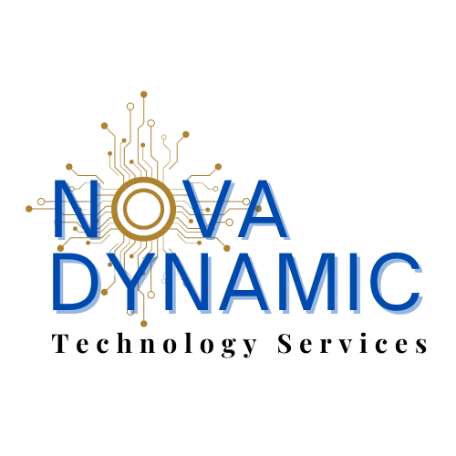
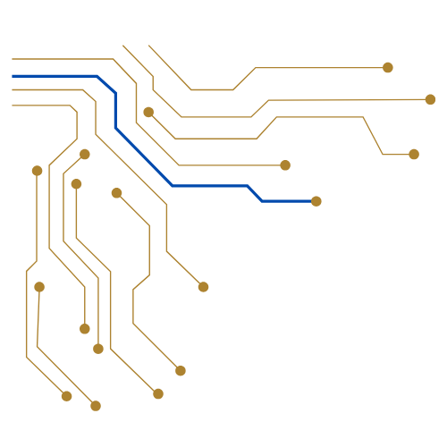
TECHNOLOGY SERVICES
TECHNOLOGY SOLUTION MAP
Core & Extended
Service Offerings
A Complete View of What NovaDynamic Delivers
508-203-1397
|
info@novadynamicit.com
|
www.novadynamicit.com
NOVADYNAMIC TECHNOLOGY SERVICES

Slide 2
CORE SERVICE OFFERINGS
9 Strategic Service Pillars — Tailored to Your Goals, Budget & Community.
Business IT Strategic Consulting
Cybersecurity & Risk Reduction
Managed IT Services
Align technology to your business goals with expert guidance.
Full-framework protection from identify to recovery.
24/7 proactive monitoring, helpdesk, and IT management.
Vendor & Technology Partnerships
IT Infrastructure & Hardware
AI & Emerging Technology
OEM-agnostic partner relationships for best-fit solutions.
Enterprise-grade hardware procurement and deployment.
Strategic AI advisory and responsible implementation.
Strategic IT Planning
Comprehensive IT Support
IT Professional Implementation
Long-term IT roadmaps aligned to growth objectives.
End-to-end support for users, systems and environments.
Expert-led rollout, integration and go-live execution.
✦ Every service is tailored — not templated. ✦

Slide 3
CORE SERVICE DEEP DIVE · CONSULTING & PLANNING
BUSINESS IT STRATEGIC CONSULTING
Your Technology Vision, Defined and Executed.
What We Do
Strategic IT Planning for Business Growth
▸Align IT Strategy with business operations and growth goals
Beyond consulting, NovaDynamic builds structured, long-term IT roadmaps that align every technology investment to your mission and bottom line.
▸Identify business technology gaps, risks, and opportunities
▸Build multi-year IT roadmaps with prioritized action plans
30-Day
60-Day
90-Day
Action Plans
▸Evaluate vendor relationships and technology stacks
▸Budget forecasting and lifecycle planning
▸Facilitate leadership and board-level IT conversations
▸Vendor & Contract optimization review
▸Deliver plain-language guidance with measurable outcomes
▸Quarterly strategic review sessions
▸Scalable frameworks that grow with you
SPEED
PRECISION
GROWTH
Rapid Deployment
Goal-Aligned IT
Scalable Results
"We don't just advise — we partner, plan, and deliver."

Slide 4
CYBERSECURITY & RISK REDUCTION
Full NIST-Aligned Framework — From Identification to AI-Powered Recovery.
IDENTIFY
NIST CSF
PROTECT
NIST CSF
DETECT
NIST CSF
Virtual CISO· Vulnerability Assessment· Penetration Testing· Government Risk & Compliance· Security Awareness Training
Managed Firewall· Web App Security· Email Security· Endpoint Protection· Managed Cloud FW· DLP· Zero-Trust· Patch Mgmt· IAM
SIEM / Log Management· Machine Learning· Intrusion Detection· Intrusion Prevention· SOC as a Service
RESPOND
NIST CSF
AI-POWERED
AI-ENHANCED
RECOVER
NIST CSF
Incident Response· Containment· Eradication & Restore
Attack Identification· Rapid Response· Social Engineering Detection· Biometric Authentication
Business Continuity· Disaster Recovery as a Service (DRaaS)· Backup as a Service (BUaaS)
Protecting organizations across every sector with enterprise-grade security frameworks.

Slide 5
MANAGED IT SERVICES & COMPREHENSIVE IT SUPPORT
One partner. All your IT. Zero surprises.
MANAGED IT SERVICES
COMPREHENSIVE IT SUPPORT
24/7 Proactive Monitoring & Alerting
End-User Device Support & Break/Fix
Helpdesk as a Service (HDaaS)
Staging, Kitting & Deployment
IT Outsourcing (ITO)
Remote & On-Site Support
Cloud Migration & Application Management
MDM (Mobile Device Management)
ERP / CRM Platform Management
RMA Processing & Lifecycle Management
Software License Management & Optimization
Plan Optimization & Cost Analysis
Vendor Management & Escalation
IT Professional Implementation Services
Your team, supported.
◆
Your systems, managed.
◆
Your operations, uninterrupted.

Slide 6
AI, EMERGING TECHNOLOGY & VENDOR PARTNERSHIPS
Innovation with Intention. Partnerships Built for Performance.
CORE SERVICE
CORE SERVICE
AI & EMERGING TECHNOLOGY CONSULTING
VENDOR & BUSINESS TECHNOLOGY PARTNERSHIPS
▸Identify and evaluate AI use cases aligned to operations
▸OEM- agnostic – solutions based on what’s best for you
▸Build AI governance and ethics frameworks
▸Strategic relationships with leading technology providers
▸Robotic Process Automation (RPA) implementations
▸AWS, Microsoft Azure, GCP, ADP, Dell Technologies, Cisco, VMware, QuickBooks partnerships
▸ Conversational AI, Chatbots & Virtual Assistants
▸Office Hardware procurement at scale – Copiers, Printers and Fax
▸Real-time agent assist and AI- powered analytics
▸Software license negotiation and optimization
▸Generative AI integration advisory
▸CPaaS, SaaS, and IaaS ecosystem management
▸AI Ops for network performance and billing optimization
▸Legally compliant partnership and governance frameworks
▸Computer Vision and IOT data analytics
“We design solutions for your business — not for vendor convenience.”

Slide 7
TECHNOLOGY SOLUTION MAP · EXTENDED
EXTENDED SERVICE OFFERINGS
Beyond Core IT — A Complete Technology Ecosystem Delivered by One Strategic Partner.
01
02
03
Customer Experience
Cloud & Managed Services
Advanced Networking
Contact Center · UCaaS · AI · RPA · BPO
Public · Private · Hybrid · DRaaS · BUaaS · IaaS
SASE · SD-WAN · Fiber · 5G · Managed WiFi
04
05
06
Mobility
Internet of Things (IoT)
Other Services
Devices · MDM · LTE/5G/Satellite · MDaaS
Sensors · Smart City · Physical Security · Energy
Marketing · Answering Svcs · Expense Mgmt · Physical Security
All extended offerings integrate seamlessly with your core IT strategy — delivered by one accountable partner.

Slide 8
EXTENDED OFFERING 01
EXTENDED OFFERING 01 — CUSTOMER EXPERIENCE
Connecting Your Organization to the People You Serve.
Contact Center
UCaaS
AI in CX
Robotic Process Automation
ACD · Branded Caller ID ·
Call Recording ·
Dialers (Preview/Power/Predictive) · Inbound/Outbound/Blended ·
IVR ·
Omnichannel ·
APIs & SDKs
Voice & Video Calling ·
Voicemail ·
Messaging & Chat ·
Conferencing ·
Collaboration Tools ·
Mobile Access ·
CRM Integrations · CPaaS
Conversational AI & Chatbots ·
Generative AI ·
Real-Time Agent Assist ·
Virtual Assistants
Workflow automation ·
CRM integration ·
Business process digitization
Analytics & BI
Employee Engagement
Compliance
Premises Systems
Reporting ·
Real-time dashboards ·
Workforce optimization ·
Quality Assurance & Monitoring
Gamification ·
Workforce Management ·
Performance Coaching ·
Knowledge Management
Compliance consulting & implementation ·
CRM Integrators & Licenses
Premises-as-a-Service ·
SIP Trunks ·
BPO ·
Legacy system migration
◆ UNIFIED CUSTOMER EXPERIENCES — POWERED BY PEOPLE, PROCESS & TECHNOLOGY ◆

Slide 9
EXTENDED OFFERING 02
CLOUD & MANAGED SERVICES
Scalable. Secure. Multi-Cloud. Fully Managed.
CLOUD CONNECTIVITY
INFRASTRUCTURE
MANAGED & PRO SERVICES
Data Fabrics
Data Center & Cloud
Helpdesk as a Service
Public Cloud Connections
AWS · Azure · GCP
ITO – IT Outsourcing
AWS Direct Connect
Oracle Fusion · SAP HANA
Cloud Migration
Azure ExpressRoute
Private Cloud
Application Mgmt (ERP, CRM)
Oracle FastConnect
Hybrid & Multi-Cloud
Software License Management
CDN
IaaS · PaaS · Bare Metal
Software License Optimization
SaaS Platforms
DRaaS · BUaaS · Colocation
Storage: Object, File, Block
From public cloud to bare metal — NovaDynamic manages the complexity so you don't have to.

Slide 10
EXTENDED OFFERING 03
Advanced Networking
Intelligent, Resilient, and Secure Network Infrastructure.
SASE
SD-WAN
MANAGED WIFI
▸ Network optimization and security
▸ Cloud Access Security Broker (CASB)
▸ Zero Trust integration
▸ Auto-Failover · Intelligent Routing
▸ Virtual Network Functions (VNF)
▸ Application-Aware Firewall
▸ Internal Network · Guest Network
▸ Network Security Assessment
▸ Monitoring & Management
CONNECTIVITY
NETWORK SECURITY
AI FOR NETWORKING
▸ Broadband/Coax · Dedicated Fiber
▸ WISP/Microwave · 4G/5G Internet
▸ Satellite Internet · Aggregation
▸ Firewall (Premises/Web)
▸ Endpoint Security · Net Security Assessment
▸ Zero Trust Architecture
▸ AI Ops · Performance Optimization
▸ Billing Optimization
▸ Automated threat response
Built for reliability, optimized for performance, secured by design.

Slide 11
EXTENDED OFFERINGS 04 & 05
EXTENDED OFFERINGS 04 & 05 — MOBILITY & IoT
Connected Devices. Smart Environments. Intelligent Operations.
MOBILITY
INTERNET OF THINGS (IOT)
CORE PRODUCTS
SENSORS
Handsets/Phones · Tablets · eSIM · MultiSIM
Temperature · Pressure · Soil Moisture/Content
WIRELESS NETWORK
PHYSICAL SECURITY
LTE/4G/5G Connectivity · Device Usage Mgmt · Application Filtering
Detailed Reporting · Distributed Antenna Service (DAS)
Satellite · Private LTE/4G/5G · POTS Replacement over Cellular
Cameras · Access Control · Video Analytics
ENERGY
Electric · Gas · Solar · EV Chargers
MANAGED MOBILITY
VERTICAL-SPECIFIC
MDaaS · Staging & Kitting · Helpdesk · Break/Fix
MDM · Plan Optimization · RMA
Smart City · Agriculture · Manufacturing · Logistics · Hospitality
AI
REPORTING
Geo-Fence · Detailed Use · Velocity/Acceleration
AI-Powered:
Performance & Billing Optimization
AI
Computer Vision
Telematics
IoT Data Analysis
Managed mobility and IoT — connected, intelligent, and always on.

Slide 12
EXTENDED OFFERING 06 — ADDITIONAL SERVICES
Supporting Every Layer of Your Business Operations.
ANSWERING SERVICES
MARKETING SERVICES
Ruby Receptionist ·Professional call answering ·After-hours coverage ·Call routing and message delivery ·First impression management for your organization
Email Drip Campaigns ·Website Design & Development ·Content Creation ·Digital presence strategy ·Brand consistency support
EXPENSE MANAGEMENT
PHYSICAL SECURITY
Wireline expense management ·Mobility expense management ·Invoice auditing ·Cost recovery & optimization ·Vendor billing reconciliation
Video Surveillance Systems ·Access Control Cards & Management ·Video Analytics ·Integrated physical-digital security posture
NovaDynamic is your single accountable partner — across IT, communications, security, and beyond.

Slide 13
ONE PARTNER. TOTAL TECHNOLOGY COVERAGE.
Core Services · Extended Offerings · Strategic Advisory · Nationwide Delivery
Cybersecurity
Managed IT
Cloud & Infrastructure
AI & Automation
Networking
Mobility & IoT
Customer Experience
Strategic Consulting
From a single service to a fully managed IT ecosystem — NovaDynamic Technology Services scales with your organization, respects your budget, and delivers results that matter.
PHONE
EMAIL
WEBSITE
508-203-1397
info@novadynamicit.com
www.novadynamicit.com
"Broad capability. Strategic alignment. The freedom to build what your business actually needs."

