Slide 1
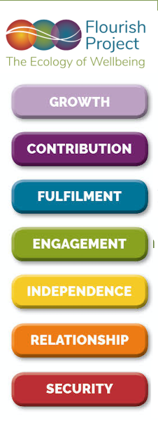
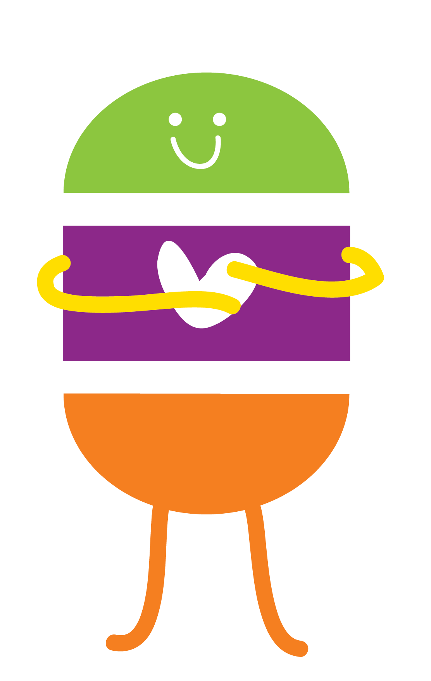
Flourish Project Seven Levels of Everything

Slide 2

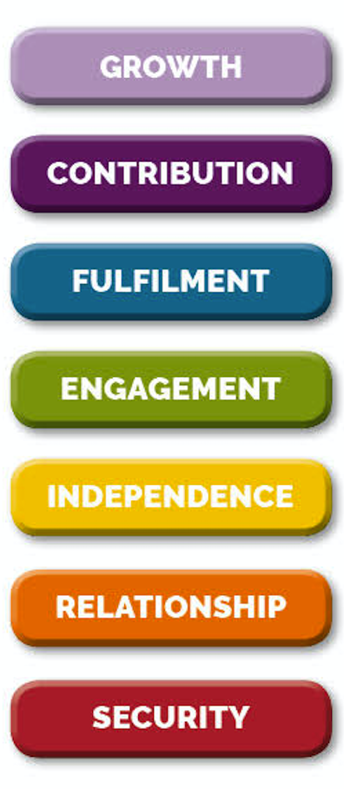
Flourish Model- Children’s Questions
Service
How are we protecting children’s human rights as young citizens? Are the best interests of the child at the heart of all decision-making? Are all children able to experience beauty, wonder and joy? Are we supporting all aspects of their flourishing?
Making a Difference
How are children’s voices being heard? How are they being actively involved as young citizens? In what ways are they able to contribute to the decision-making processes about things that affect them? How are we supporting them in experiencing themselves as members of a wider community?
Internal Cohesion
How are we ensuring that children are supported in being able to meaningfully express themselves? In what ways are we recognizing and supporting their unique backgrounds, mindsets and learning dispositions? How are we ensuring that every child feels a sense of value and worth? How are we preventing them from being exposed to developmentally damaging or inappropriate pressures?
Transformation
Are we giving children the time to be curious and explore the things in the environment that most interest them? Are we ensuring that they have lots of time and freedom for free play? Are we ensuring that they are getting the right environmental opportunities? Are we supporting them in achieving states of concentration and flow?
Self-Esteem
How are we maximizing early brain-building? How are we nurturing children’s ability to learn and do things for themselves? How are we nurturing their resilience and ensuring that they are not afraid to take risks and learn from failure? How can we ensure that they can follow their unique interests and aspirations? How can we identify if they have problems or need extra support?
Relationship
How do we ensure that every child feels loved and wanted? How do we provide every child with strong and consistent relationships/parenting? How are we nurturing children’s relationship with the natural world? How are we promoting children’s communicative abilities?
Survival
How do we ensure that every child feels safe and secure? How do we ensure that every child has shelter, clean water and enough food to eat? How do we ensure that every child has the best possible physical environment to grow up in? How are we ensuring thar every child has enough physical movement and exercise? How do we ensure that every child has a healthy balanced diet? What healthcare systems are available to support the needs of sick or physically disabled children?

Slide 3
Flourish Model- School Questions
Service
How are we protecting children’s human rights as young citizens? Are the best interests of the child at the heart of all our activities? Are all children being given the space and time to experience beauty, wonder and joy? Are we supporting all aspects of their flourishing?
Making a Difference
How are ensuring that children’s voices are being heard and responded to? How are they being actively involved as the citizens, leaders and decision-makers of the future? In what ways are they able to contribute to the decision-making processes about things that effect them?
Internal Cohesion
How are we ensuring that children are able to fully express themselves? In what ways are we recognizing and supporting their unique backgrounds, mindsets and learning dispositions? How are we ensuring that every child feels valued? How are we preventing them from being exposed to developmentally damaging or inappropriate pressures?
Transformation
Are we giving children the time to be curious and explore the things in the environment that most interest them? Are we ensuring that they have lots of time and freedom for free play? Are we ensuring that they are getting the right environmental opportunities? Are we supporting them in finding lots of ways that they can express themselves as unique individuals?
Self-Esteem
How are we nurturing children’s ability to learn and do things for themselves? How are we nurturing their resilience and ensuring that they are not afraid to take risks and learn from failure? How can we ensure that they can follow their unique interests and aspirations? How can we identify if they have problems or need extra support? How are we supporting the needs of seek or physically disabled children?
Relationship
How are we ensuring that every child feels valued and cared for? How are we helping to promote the importance of strong and consistent relationships/parenting? How are we promoting positive and supportive friendship groups? How are we responding to the impact of social media?
Survival
How are we ensuring that every child feels safe and secure? How are we ensuring that very child can get enough physical exercise? How are we ensuring that every child has appropriate nutrition and enough to eat? How are we ensuring that every child is provided with the best possible learning environments? How are we protecting children from abusive or bullying situations?

Slide 4
Flourish Model- Adult Questions
Service
In what ways am I currently supporting my own growth/inner development/spirituality? What am I currently doing to achieve a sense of inner /deeper connection or ‘high’? What is my own definition of a ‘Good Life’? What values would I like to see in society? What resources would I like to be able to access to support my own sense of meaning, connection and wellbeing?
Making a Difference
Do I currently feel that that my voice and opinions matter and that I am being listened to? What could need to change/ could I get involved in for me to achieve this? What would I do to create a better sense of community? What resources would we need?
Internal Cohesion
Do I currently have a sense of meaning and purpose in my life? What would need to change for me to achieve this? In what ways could I use my knowledge, skills and abilities? What needs to change for me to feel more happy and fulfilled? What steps can I take to help me get there? What resources would I need?
Transformation
In what ways am I able to access continual new learning opportunities? How can I ensure that I can spend more time doing things that I am most drawn to/ interested in and love? How can I express my individuality?
Self-Esteem
Am I getting the support I need to enable me to be as independent as possible? What changes would I make if I could improve my current situation? How can I learn the things I want so that I can do the things I am most interested in/want to do? How can I earn an income that supports my basic needs?
Relationship
How am I fulfilling my need to love and be loved? What can I do to more easily/better connect with others? How can I improve the nature and quality of my family relationships? How can I improve and develop my friendship groups? What additional resources would I need to feel more connected?
Survival
What can I do to ensure that I feel safe and secure? Do I have shelter, clean water and enough to eat? Do I live in a safe and healthy environment? And if not, what would I need to do to achieve this? Do I have enough income to support my basic needs? Am I getting enough exercise? Am I eating a healthy, balanced diet? Am I avoiding things that I know harm my system?

Slide 5
Flourish Model- Community Questions
Service
In what ways are we supporting everyone’s growth/inner development/spirituality? How are we promoting kindness, generosity and compassion as core qualities of our community? What values would we like to see in our community? How do they differ from our current reality and what steps could we take to correct this? How can we support everyone’s sense of meaning, connection and wellbeing? How can we ensure that we are contributing to a happier, healthier planet?
Making a Difference
How do we ensure that local people’s voices and opinions matter and that they are being listened to? How can we connect people up and help them feel part of a larger community? How can we promote a sense of community pride? How can we introduce fun and laughter into the process? What would need to happen to achieve this? What resources would we need? And how would we access them?
Internal Cohesion
How can we find out what local people feel would give them more meaning and purpose in their lives? What would we need to introduce/change to achieve this? In what ways could we tap into and use local knowledge, skills and abilities? What small steps could we take to help us get there? What resources would we need? and how would we access them?
Transformation
How do we ensure that everyone knows what is going on locally and can access new learning opportunities? How can we give people access to, and involvement in, the arts? How can we help people to spend more time doing and sharing the things that they are good at and love? How can we help everyone express their unique talents and individuality?
Self-Esteem
How can we ensure that we can support people in being as healthy and independent as possible? What changes would we like to make to the current system? How could we find out what people are interested in and give them more access to what they would most want to do? How could we tap into and develop new forms of community wealth?
Relationship
How are we ensuring that nobody needs to feel lonely? What are we doing to support healthy partnerships and child & family relationships? How can we help people to develop friendship groups? What additional resources would people need to feel more connected? How can we reach out to disadvantaged and minority groups?
Survival
What changes can we make to our streets so that we can feel safe and secure? Does everyone have shelter, clean water and enough to eat? Do we all live in safe and healthy environments? If not, what would we need to do to achieve this? Do people have enough income to support their basic needs? Are they able to get enough exercise? Are our transport systems supporting their real needs? Are we all being helped to eat healthy, balanced diets?

Slide 6
Flourish Model – Local authority Services
Service
FAITH CENTRES, SPIRITUAL/SELF-DEVELOPMENT SUPPORT, ACCESS TO NATURE (PARKS AND GREEN SPACES), WELLBEING SERVICES AND RESOURCES
Making a Difference
COMMUNITY INVOLVEMENT, CITIZENS PANELS, COMMUNITY CONSULTATIONS, VOLUNTARY SERVICES, SUPPORT GROUPS, COMMUNITY GROUPS AND NETWORKS
Internal Cohesion
THE ARTS, MUSIC AND DANCE, LEISURE AND ENTERTAINMENT, LIBRARIES, YOUTH CLUBS, ADULT EDUCATION, UNEMPLOYMENT SERVICES, APPRENTICESHIPS, BUSINESS SERVICES AND SUPPORT, MENTORING, COMMUNITY SUPPORT NETWORKS
Transformation
SCHOOLS, AFTER SCHOOL CARE, YOUTH SERVICES, UNEMPLOYMENT SERVICES, APPRENTICESHIPS, BUSINESS SERVICES AND SUPPORT, MENTORING, COMMUNITY SUPPORT NETWORKS
Self-Esteem
EARLY CHILDHOOD CARE AND EDUCATION, CHILDMINDERS, CHILDRENS CENTRES, NURSERIES,, URBAN PLANNING, PLAY AREAS, TRAVEL SERVICES, SOCIAL SERVICES, DISABLED AND SPECIAL NEEDS SUPPORT, CARE OF THE ELDERLY, MENTAL HEALTH SUPPORT, THERAPEUTIC SERVICES, PRISON SERVICES, DRUG REHABILITATION
Relationship
PREGNANCY SERVICES, MENTAL HEALTH SERVICES, SEXUAL HEALTH SERVICES, PARENTAL SUPPORT, COUPLES COUNSELLING
Survival
HOUSING DEPT, HOMELESS SUPPORT, HEALTH SERVICES, SPORT FACILITIES, URBAN PLANNING, ENVIRONMENTAL HEALTH, FOOD HYGIENE, WASTE MANAGEMENT, COMMUNITY POLICING, JUSTICE SYSTEM

Slide 7
Flourish Model- Community Resources
Service
Self Development Groups, Growth Circles, Mindfulness and Meditation initiatives, Yoga, Holistic health and care, Life and Death Cafes, Compassion initiatives, Happiness initiatives
Making a Difference
Participatory Urban Design, Art Exhibitions, Music Festivals, Community Cafes, Flourish Cafes, Youth Voice initiatives, Connect initiatives, Meet-Ups, Skill shares, Be-My-Eyes, Give-Back, Street-shares, Food-shares
Internal Cohesion
Learning and Working, Making, Fixing, Trading and Sharing, Art hubs, Creative cafes, Skill-shares, Food-Shares
Transformation
Learning and Working, Making, Fixing, Trading and Sharing Skill-shares, Craft Cafes, Local Hubs and Networks
Self-Esteem
Learning and working, Playing Out, Play Streets, Forest Schools, Making, Fixing, Trading and Sharing, Digital cafes, Community Bookshares
Relationship
Meetups, Meet your Neighbor, Coffee and Chat, Newbie Networks, Back-up Buddies, Laptop Fridays, Community Circles, Making, Fixing, Trading and Sharing, Pet shares, Adopt a neighbour initiatives
Survival
Participatory Urban Design, Living Streets, Walk your city, Place Standards Cooking and Eating Initiatives, Community making, Food Forests, Community planting, Garden Libraries, Public Compost boxes

Slide 8
Flourish Model- Public Health England Index of Wellbeing Measures
Service
Future Plans
Making a Difference
Internal Cohesion
Life Situation – Happiness/Positive Outlook - Time or Money Use
Transformation
Values and Attitudes
Self-Esteem
Social and Emotional Skills – Self Confidence – Self Esteem – Personal Agency – Coping and Control
Relationship
Family – Peers/Popularity – Social Skills – Self Image
Survival
Neighbourhood Environment – Home Environment – School Environment – Protective Factors – Service Support

Slide 9
Flourish Model- NEF 5 Core Wellbeing Measures
Service
Making a Difference
Overall, how often do you think the things you do in your life are worthwhile?
Internal Cohesion
I’ve been feeling optimistic about the future Overall, how satisfied are you with your life nowadays? Overall, how happy did you feel yesterday?
Transformation
I’ve been dealing with problems well, I’ve been thinking clearly
Self-Esteem
I’ve been feeling relaxed, I’ve been able to make my mind up about things Overall, how anxious did you feel about life yesterday?
Relationship
I’ve been feeling close to other people Generally speaking, would you say that most people can be trusted, or that you can’t be too careful in dealing with people? Please give a score of 0 to 10, where 0 means you can’t be too careful and 10 means that most people can be trusted.
Survival

Slide 10
Flourish Model- OECD 2019 Education Megatrends ‘Competence as a multi-dimensional capacity’
Service
Lifelong Learning – Intergenerational Contact and Learning – Modern Governance
Making a Difference
Democratic Citizenship – Global Competence – Inclusiveness
Internal Cohesion
Creativity and Entrepreneurship
Transformation
Values and Attitudes
Self-Esteem
Mobility – Equity – Digital Divides – Knowledge Economy
Relationship
Respecting Boundaries – Social and Emotional Wellbeing – Inequality – Diverse Families
Survival
Preserving the Environment – Physical Health and Lifestyles - Protecting Body and Mind – Securing Financial Wellbeing - Economic Literacy – Safeguarding Cyberspace

Slide 11
Flourish Model- OECD 2030 Curricula Design Principles ‘Balancing knowledge and skills with attitudes and values’
Service
Making a Difference
Transferability- knowledge, skills, attitudes and values that can be transferred to others
Internal Cohesion
Alignment – with teaching and assessment practices that value student outcomes and actions Authenticity and Purpose – linking learnt experience to the real world
Transformation
Focus – enhance the depth and quality of learning Coherence: reflect sequenced logic and enable progress thought stages Rigour - challenge that involves deep-thinking and reflection
Self-Esteem
Teacher Agency – empowering teachers to use their professional knowledge, skills and expertise Student Agency – designed around students interests and motivations and recognise prior knowledge, skills, attitudes and values Choice – diverse range of topic and project options
Relationship
Interdisciplinary and Collaborative Learning Inter-relation – linking topics across disciplines and to real life
Survival
Flexibility – adaptable and dynamic curricula that respond to evolving societal requirements as well as individual learning needs Stakeholder Engagement – teachers, students and other stakeholders should be involved in early curricula development, to ensure ownership

Slide 12
Flourish Model- New educational Curriculum in Finland - with educational competencies – “promoting students’ growth as human beings and as citizens”
Service
Sustainable future orientation
Building a sustainable future
Making a Difference
Participation and democratic action
Participation involvement
Internal Cohesion
Working life competence Entrepreneurship
Learning environment and methods
Transformation
Learning community Interaction and versatile learning approaches
Working life competence Multiliteracy
Self-Esteem
Cultural diversity and language awareness Subject lessons and multi-disciplinary learning modules
Digital competence Thinking and learning to learn
Relationship
Cultural competence, interaction and expression
Equity and equality School welfare activities, guidance and support
Survival
Structure of the schools days Assessment and feedback Environmental responsibility Wellbeing and safety in daily life.
Taking care of oneself Managing Daily Life

Slide 13
Flourish Model - Curriculum Content
Service
Lifelong Learning – Reflective Practices - Natural Systems – Peace - Spirituality – Faith – Religions – Wisdom – Empathy - Suffering - Love
Making a Difference
Culture – Society – Power – Politics – Ethics – The Media - Leadership - Intergenerational Learning - Global Citizenship – Empathy – Kindness - Inclusiveness – Generosity - Reaching and Sharing - Becoming a Change Agent
Internal Cohesion
Personal Meaning – Flow - Happiness – Optimism - Positivity – Pessimism – Boredom - Purpose – Success – Self Expression – The Arts – Celebrity - Entrepreneurship
Transformation
Meaning-Making – Challenge - Curiosity – Courage - Creativity - Concentration – Playfulness – Persistence – Innovation
Self-Esteem
Social and Emotional Skills - Self Confidence – Self Esteem – Personal Agency – Self-Regulation - Mastery – Resilience – Mobility - Digital Equity
Relationship
Belonging - Family – Identity – Diversity – Friends - Peers/Popularity – Respecting Boundaries - Social Skills – Adverse Childhood Experiences (ACES) - Self Image – Loneliness - Inequality - Bullying – Conflict Resolution – Tribes – Gangs – Social Media
Survival
Protecting the Environment – Pollution – Climate Change - Environmental Destruction - The Natural World - Food Systems – Waste - Nutrition – Physical Health and Lifestyles –Brain Development and Plasticity - Clothing - Homes and Habitats Homelessness – Neighbourhoods – Immigration – Refugees - Work - Money and Finances - Economic Literacy - Safeguarding Cyberspace

Slide 14
Flourish Model- ESKARET FOUNDATION Inner Development Goals
Service
Appreciation (spiritual), Complexity Awareness, Connectedness (Natural World), Compassion, Humility, Long-term Orientation and Visioning, Perspective Skills (Natural World), Presence, Self-Awareness
Making a Difference
Appreciation (relational), Co-creation skills, Empathy, Inclusive Mindset, Intercultural Competence,
Internal Cohesion
Creativity and Entrepreneurship
Transformation
Critical Thinking, Creativity, Inner Compass, Openness and Learning Mindset, Optimism ,
Self-Esteem
Courage, Integrity and Authenticity, Mobilization Skills, Perseverance
Relationship
Communication skills, Connectedness (Others) Perspective Skills (Others)
Survival
Sense-making Trust

Slide 15
Flourish Model- ESKARET FOUNDATION Inner Development Goals plus Flourish
Service
Appreciation (spiritual), Complexity Awareness, Connectedness (Natural World), Compassion, Humility, Long-term Orientation and Visioning, Perspective Skills (Natural World), Presence, Self-Awareness
Making a Difference
Appreciation (relational), Co-creation skills, Empathy, Inclusive Mindset, Intercultural Competence,
Internal Cohesion
Creativity and Entrepreneurship
Transformation
Critical Thinking, Creativity, Inner Compass, Openness and Learning Mindset, Optimism ,
Self-Esteem
Courage, Integrity and Authenticity, Mobilization Skills, Perseverance
Relationship
Communication skills, Connectedness (Others) Perspective Skills (Others) Trust (in others)
Survival
Sense-making Trust Trust (in the environment)

Slide 16
Flourish Model- UK OFSTED FOUNDATION STAGE Seven Levels of Learning and Development
Service
Making a Difference
Understanding the world Past and present, People, culture and communities The Natural World
Internal Cohesion
Expressive arts and design Creating with materials, Being imaginative and expressive
Transformation
,
Self-Esteem
Personal, social and emotional development Self regulation, Managing self Literacy Comprehension, Word-reading, Writing Maths Number, Numerical pattern
Relationship
Communication and language Listening, attention and understanding, Speaking Personal, social and emotional development Building relationships
Survival
Physical development Gross and Fine Motor Skills

Slide 17
Wellbeing apps
Headspace, Exhale, Mediitopia, Thrive, Calm, Mindful Powers, Be Mindful
Three good things, Cove
My Possible Self, The Worrinots, Powerme, Worrytime, WorryTree, Resilience Project, Wysa, Beat Panic,Catch-it, Chill Panda, TruConect
Wisdom, the World of Emotions
Clue, Flo (Menstrual health), Sleep Cycle, Smoke Free, Leso, Help Kids Cope

Slide 18
Inner Development Goals (IDGs)
Inner Compass/ Openness and Learning mindset/ Humility/ Compassion
Appreciation/Connectedness/ Perspectival Skills/ Co-creation skills / Long-term orientation and Visioning
Presence/Integrity and Authenticity
Sense-making/ Critical-thinking/ Complexity-awareness
Self-awareness/Mobilisation skills/ Perseverance/ Optimism
Empathy/Communication skills/Inclusive mindset/Inter-cultural competence
Trust/Courage

Slide 19
Six Senses Dementia Care
??
SIGNIFICANCE: To feel respected, values and included in care home decisions
ACHIEVEMENT: To be able to set realistic goals and realistically contribute to the family and community
PURPOSE: To ne meaningfully engages with the ability to make choices and have their preferences respected.
CONTINUITY: To feel valued and connected with the past, seamlessly inclusive of endeavours to maintain personal interests and hobbies
BELONGING: To feel connected and to be able to contribute within one’’s own home and community
SECURITY: To feel safe and secure physically and emotionally

Slide 20
Montessori Dementia/Person-Centred Care
Being supported in learning new things; Mindfulness, gratitude and spiritual deepening/development
Celebrating personal identity and uniqueness; Being supported in maintaining a sense of personal value and contribution; Caring for others and the community as a whole
Creativity and self-expression; Music and the Arts; Being supported in maintaining a sense of personal meaning and self-worth
Being supported in engaging with the environment in positive ways; Free choice; Purposeful activity
Being supported in feeling independent; Optimisation of movement; Self-Respect and Dignity, Recognition of skills and capacities
Being supported in being able to effectively communicate; Developing self-kindness and compassionate understanding towards self and others
Order and Predictability; Feeling safe within the environment; Personalised living areas; Familiar diets; Beauty; Tranquillity; Access to Nature

Slide 21
Flourish Model- The Relational Ecosystem
Service
Expansion, Evolutionary flow
Making a Difference
Internal Cohesion
Coherence
Transformation
Presence, Generative creativity
Self-Esteem
Relationship
Symbiosis, Harmony, Reciprocity, Ancestors, Rituals, Ceremony
Survival
Food Security, Water Security, Energy Security, Climate Security

