Slide 1

FREEDOM OF RELIGION SOUTH AFRICA
Stop State Regulation of Religion
Equipping the Church to engage the CRL's Section 22 hearings
Senior Religious Leaders Briefing Cape Town Castle · 6 August 2026
Michael Swain Freedom of Religion South Africa
Notes:
Three things in ten minutes: what the Section 22 Committee is proposing, what FOR SA has already built to answer it, and what I need from you. This is not a moment for anxiety. It is a moment for confident, orderly participation.

Slide 2
SECTION 22 CAMPAIGN
The moment we are in
The CRL Rights Commission's Section 22 Committee has proposed a "Legislative framework" that would fundamentally reshape the relationship between faith communities and the State.
Every province
Not yet law
Closing soon
Public hearings are already scheduled across the country
Public consultation gives a unique opportunity to influence outcomes
The window to be heard will not stay open
Notes:
The Section 22 Committee has been tasked with recommending a legislative framework for our sector, and hearings are now running in every province. Two things matter. It is still a proposal under consultation, so our voice genuinely counts. And in a public participation process, silence is read as consent.

Slide 3

SECTION 22 CAMPAIGN
The hearings, province by province
All dates and venues are in the Roadshow Pack and on the Section 22 Committee registration page.
WESTERN CAPE · AUGUST 2026
Tue 18 Aug
Scan now to register
Structured Institutional Engagements
Wed 19 Aug
Open Provincial Summit
SECTION22COMMITTEE.CO.ZA
Notes:
Here is what is in front of us. In the Western Cape: Tuesday the eighteenth of August, structured institutional engagements; Wednesday the nineteenth, the open provincial summit. Put the dates in your diary today. Scan the code on the right to register, and the hearings continue province by province.

Slide 4

SECTION 22 CAMPAIGN
Everything you need, in one place
01
The registration link for the hearing in your province
SCAN NOW
02
The Roadshow Pack, with a ready-to-use verbal submission and answers to the misleading claims made by the Committee
03
A template submission to hand in on the day
04
A presentation to equip and empower your church or network to participate
05
A short video to play in a Sunday service to encourage congregants to make individual submissions
forsa.org.za
06
The 2019 Code of Conduct and the CRL's own source documents
Notes:
Here is why you can act with confidence: the work is done. One website holds all of it. The registration link, the Roadshow Pack with a ready-made verbal submission and answers to the misleading claims, a template submission, a presentation, a video for your Sunday service, and the source documents. Scan the code, or simply go to forsa dot org dot za.

Slide 5
SECTION 22 CAMPAIGN
Three actions every leader can take
1
2
3
REGISTER
PREPARE
ENGAGE
Register for the hearing in your own province. Dates are in the Roadshow Pack.
Complete the template submission in advance and hand it in on the day. Everyone can do this.
Play the two-minute Sunday Service Video so your members make their own submissions online.
Notes:
If people remember nothing else, let them remember three words. Register for the hearing in your province. Prepare by completing the template submission beforehand and handing it in on the day, because that puts your position on the record. Engage your members with the video so they submit online. One leader doing all three becomes a hundred voices.

Slide 6
SECTION 22 CAMPAIGN
The Sunday Service Video
Most of your members will never reach a hearing. They do not need to — they can make their own submission online, in about two minutes.
FROM THE VIDEO
One submission may be a whisper. Tens of thousands become a voice that cannot be ignored.
A short video explains what is being proposed and why it matters.
It ends with a QR code that opens the Dear South Africa submission page directly.
On the campaign page under Equip your community to take part . Download it to play offline.
Michael Swain, Freedom of Religion South Africa
Notes:
Most of your members will never get to a hearing. They do not have to. FOR SA has produced a two minute Sunday Service Video, presented by Michael Swain, our Executive Director, which explains what is being proposed and points people straight to the online submission. It is on the campaign page, and it can be downloaded to play offline. Play it in one service. That is the whole ask.

Slide 7
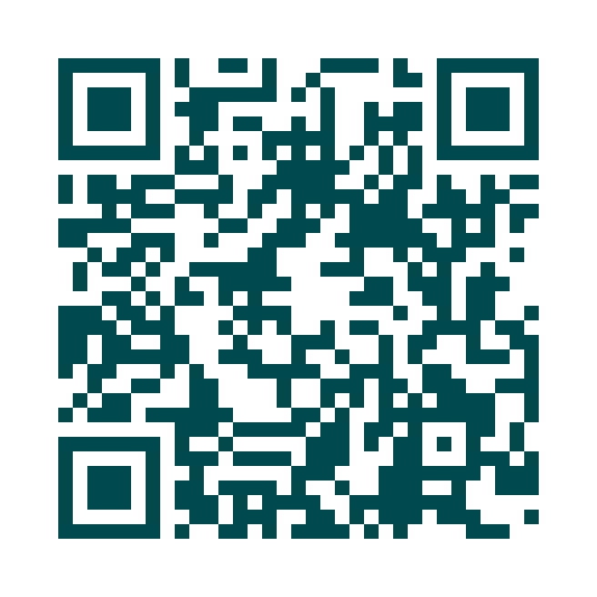
SECTION 22 CAMPAIGN
Play it, then share it
WATCH IT NOW
1
Play it in one service
Two minutes, before or after the notices. Stream it, or download it to play offline.
2
Share the link
Newsletter, WhatsApp groups, and your leadership.
3
Ask them to submit there and then
Or forsa.org.za/crl-regulation-of-religion — Equip your community to take part
On their phones, before they leave the building.
Notes:
Three things. Play it in one service this month. Put the link in your newsletter and your WhatsApp groups. Then ask people to submit there and then, on their phones, before they leave the building. Scan the code and the video is in your hand.

Slide 8
SECTION 22 CAMPAIGN
What we are asking of you
As senior leaders, your endorsement carries weight that ours alone cannot.
Endorse
Cascade
Publicly back the campaign so your networks know it matters
Send the resources through your denomination and networks
Submit
Adopt
Commit your body to a formal institutional submission
Endorse the Religious Freedom Charter and Code of Conduct
Notes:
My ask of you is four things. Endorse the campaign, because when you back it your networks pay attention in a way they never would from us alone. Cascade the resources through your denomination. Commit your body to a formal institutional submission, not only individual ones. And endorse the Charter and Code in your own governance.

Slide 9
SECTION 22 CAMPAIGN
Let us stand up and speak out while there is still time.
Register
·
Prepare
·
Engage
forsa.org.za/crl-regulation-of-religion
info@forsa.org.za
Notes:
Let me end where I began. This is not a moment for fear. It is a moment for courage and order. We have the arguments, the resources and the constitutional high ground. What we need is your voice and your networks. Register, prepare, engage. Let us stand up and speak out while there is still time. That is the briefing. If there is time, I will walk you through the pack itself.

Slide 10
SECTION 22 CAMPAIGN · PART TWO
The Roadshow Pack
A ready-to-use toolkit for anyone attending a hearing: what you will hear, what to say, and the evidence behind it.
One PDF · thirteen pages · free to print and forward
forsa.org.za
Notes:
Everything that follows is already written and free to download. I will take you through the six tools in the pack, and show you what each one looks like, so you know exactly what your people will be holding on the day.

Slide 11
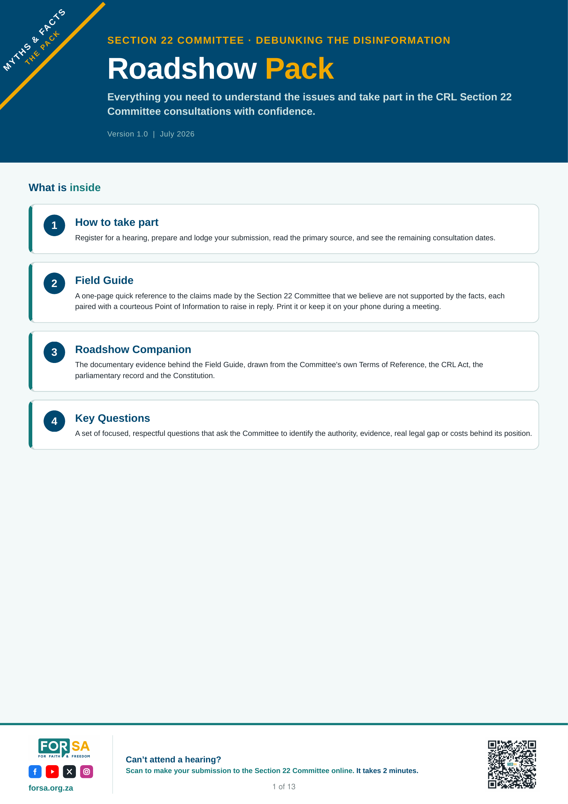
ROADSHOW PACK
What is in the pack
How to take part
Field Guide
Register, make your submission, and see the remaining consultation dates.
The claims you will hear, each with a Point of Information to raise in reply.
Roadshow Companion
Verbal Submission
The documentary evidence behind every point you raise.
Speaking notes for a three to four minute slot.
Key Questions
Submission template
Nineteen forensic questions across five themes.
Complete it in advance and hand it to the Committee.
LOOK FOR THIS COVER
Notes:
Six tools in one document, thirteen pages. How to take part, the Field Guide, the Companion, the verbal submission, the Key Questions, and a submission template to leave behind. Recognise this cover, so you know you have the right file.

Slide 12
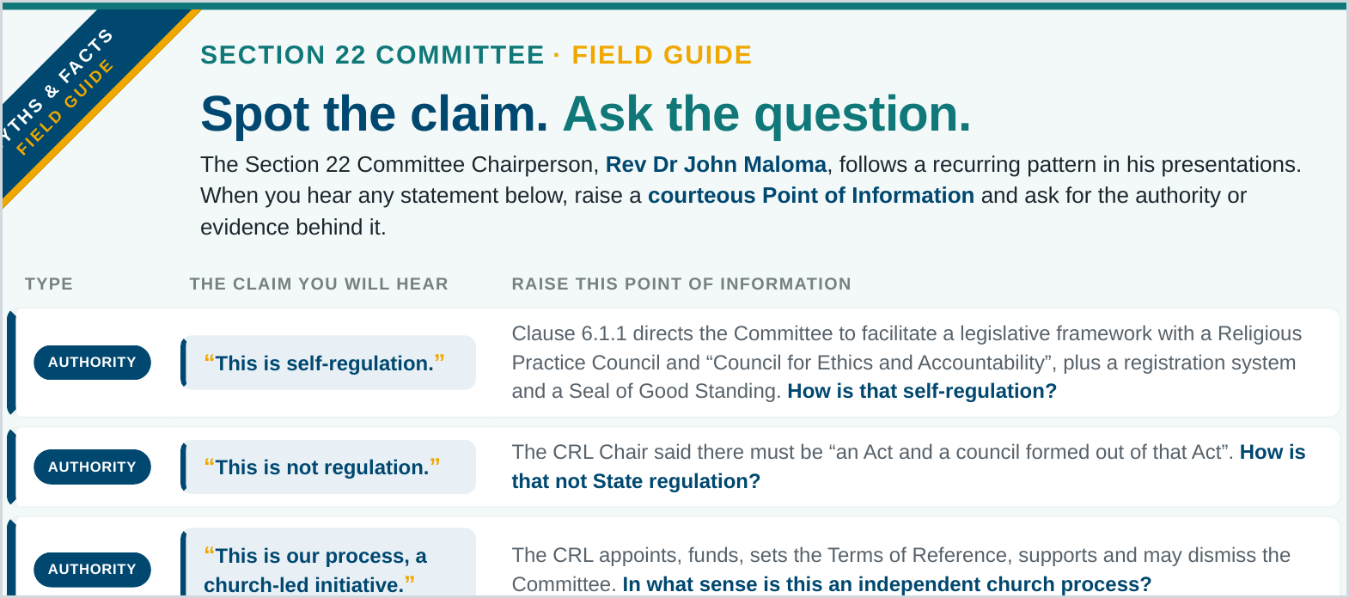
ROADSHOW PACK · TOOL 1
Spot the claim. Ask the question.
A one-page quick reference. Print it, or keep it on your phone during the meeting.
Type — what the reply rests on: Authority, Record, Evidence or Constitution.
The claim you will hear — the exact statement to listen out for.
Raise this Point of Information — the courteous reply to read out.
Notes:
The Field Guide is one page. Keep it in front of you. When you hear a claim in the room, find its row and read out the Point of Information beside it. One question at a time, and ask that it be minuted.

Slide 13
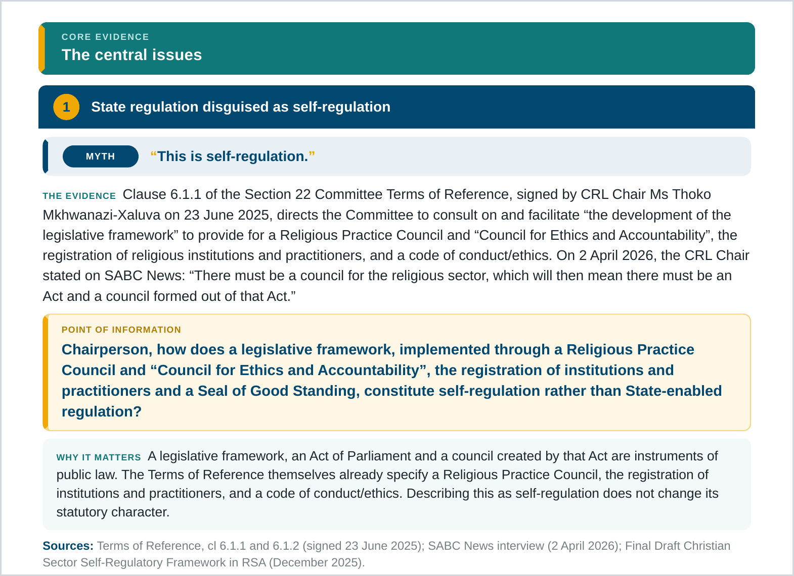
ROADSHOW PACK · TOOL 2
When you are challenged, here is the evidence
The Roadshow Companion carries the documents and the exact wording behind every Field Guide row.
Myth — the claim, echoing a Field Guide row.
The evidence — documents, dates and quotations that answer it.
Point of Information — the fully worded question to put.
Why it matters + sources — the significance, and where to check it.
Notes:
The Field Guide gives you speed. The Companion gives you depth. Every issue is built the same way: the myth, the evidence with dates and quotations, the fully worded Point of Information, why it matters, and the sources.

Slide 14
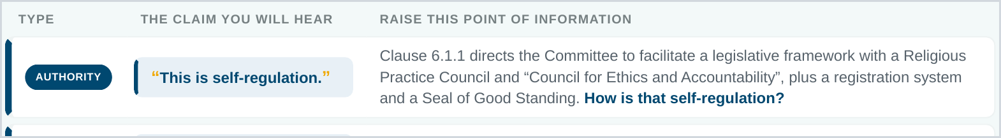
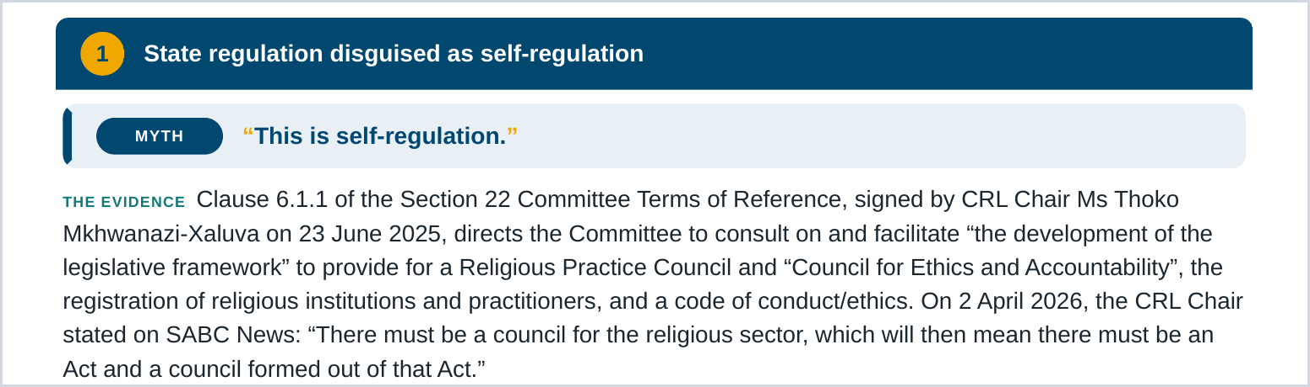
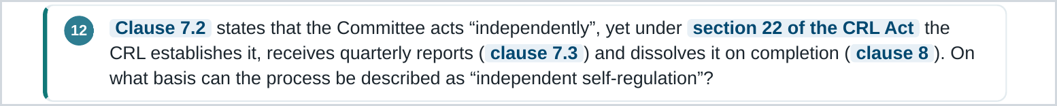
ROADSHOW PACK · WORKED EXAMPLE
“This is self-regulation.”
01 Hear it
02 Back it
03 Press it
Notes:
Here is how the tools work together on one claim. You hear it, you find it in the Field Guide, you back it up from the Companion, then you press it with Key Question twelve. Ask that both the question and the reply be minuted.

Slide 15
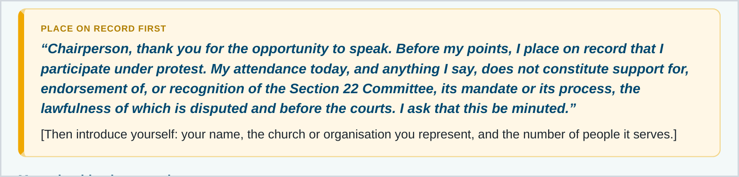
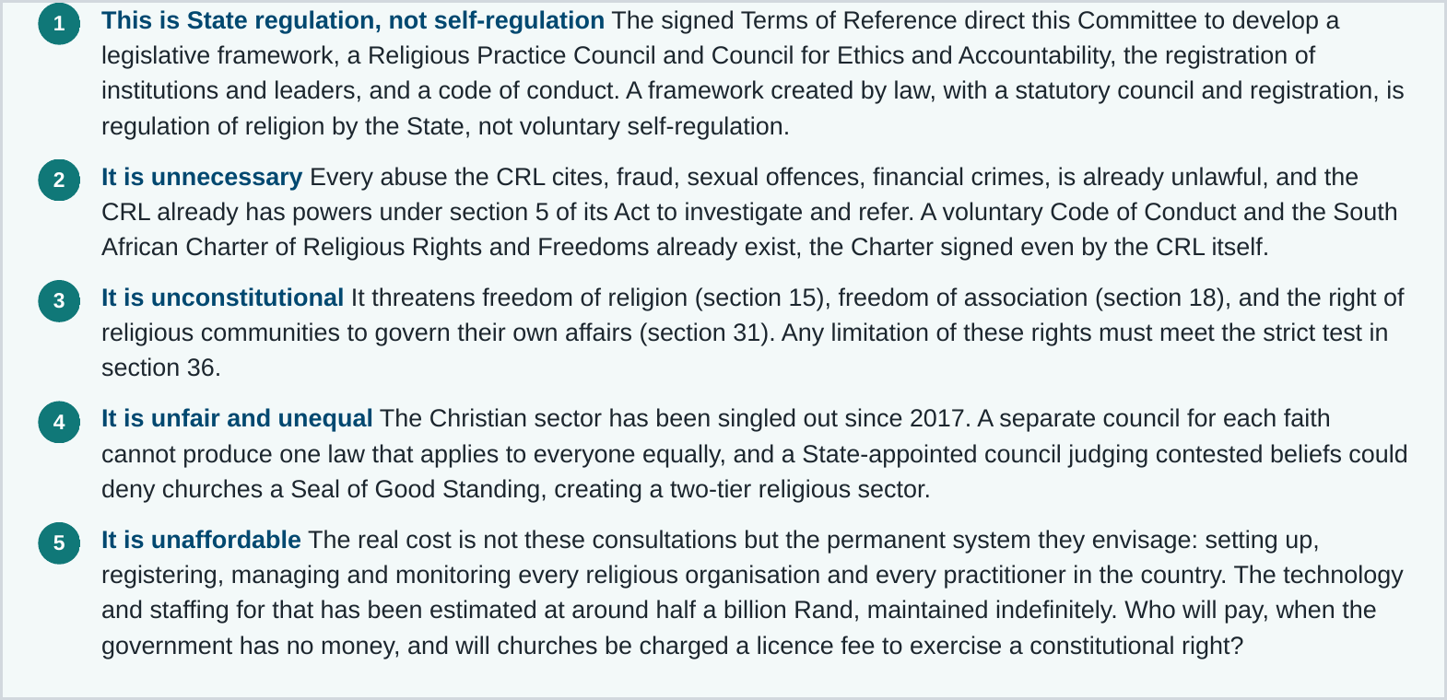
ROADSHOW PACK · TOOL 3
Your three to four minutes, written for you
1
Place your protest on record — open with the written statement.
2
Introduce yourself — your church or organisation, and who it serves.
3
Make your five objections — State regulation, not self-regulation.
4
Close and hand up your submission — ask that it be minuted.
5
Use any time left — on the Key Questions.
Notes:
If you get a speaking slot it will be short. Follow this order. Open under protest, introduce yourself, make the five objections, close by handing up your written submission, and use any time left on the Key Questions. Every word is written out for you.

Slide 16
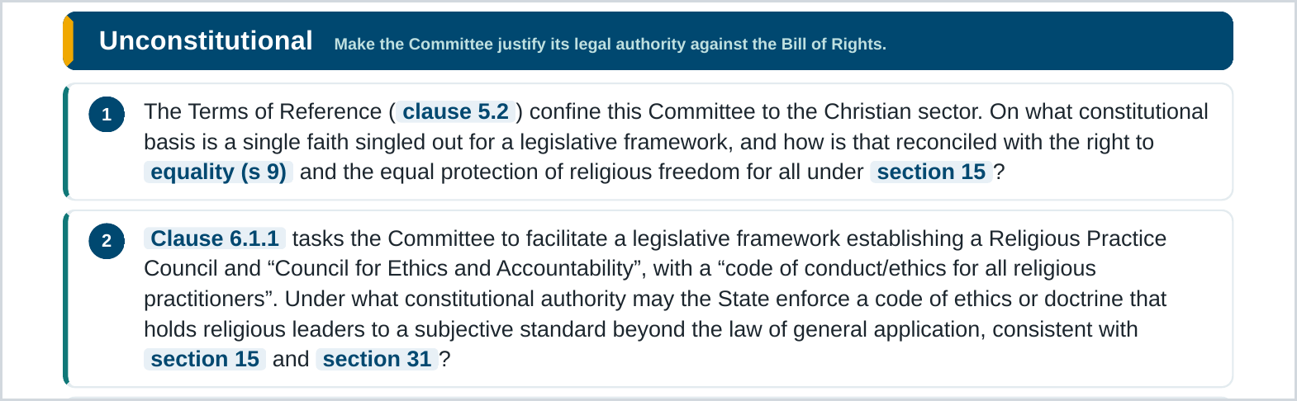
ROADSHOW PACK · TOOL 4
Nineteen questions they must answer
Grouped by theme: unconstitutional, unnecessary, unworkable, unaffordable, unfair. Pick the ones that fit the moment.
Choose a theme that fits the room.
Ask one question at a time, citing the clause.
Press politely for a direct answer.
Ask that the question and the reply be minuted.
Notes:
Nineteen forensic questions grouped by theme. You do not need them all. Choose a theme, cite the clause, ask one question at a time, press politely for a direct answer, and ask that both question and reply be minuted.

Slide 17
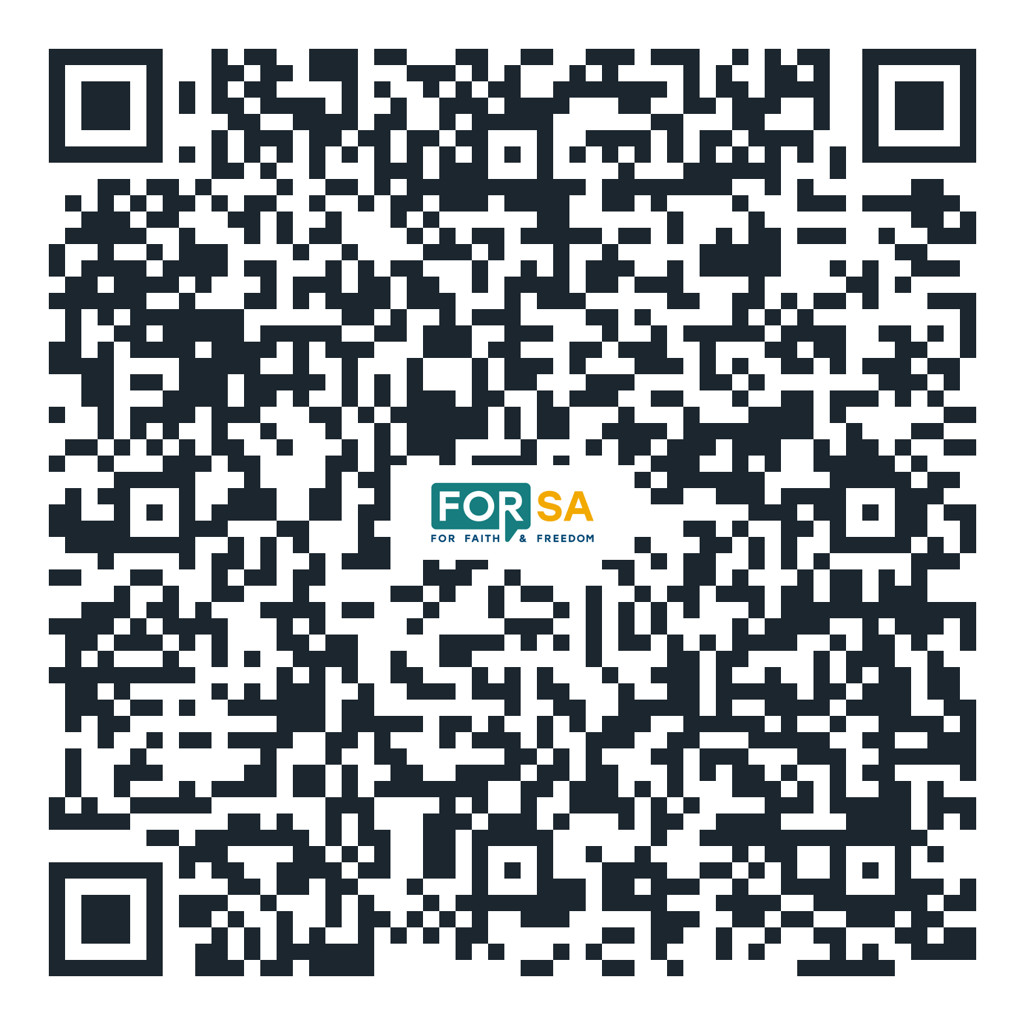
GET THE PACK
Download it, and pass it on
SCAN NOW
Point your camera at the code. Print it, forward it to your leaders and members, and take it with you to the hearing.
forsa.org.za
No participation, no voice.
forsa.org.za/crl-regulation-of-religion
info@forsa.org.za
Notes:
That is the whole pack. Scan the code, download it, print it, and forward it to your leaders and your members. Register, prepare, engage. No participation, no voice.

