Slide 1
Demand Gen Council
2024 planning: From chaos to clarity
December 8, 2023

Slide 2
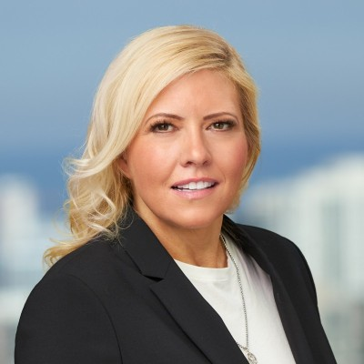

Today’s Product Marketing Council leaders
Maria Pergolino
CMO Executive-in-Residence
Scale Venture Partners
Lauren Vaccarello
CMO Executive-in-Residence
Scale Venture Partners

Slide 3
First some interactivity
Go to: https://www.menti.com and use code 7719 0298
IN 3 WORDS (or less)
Enter in your top GTM challenges

Slide 4
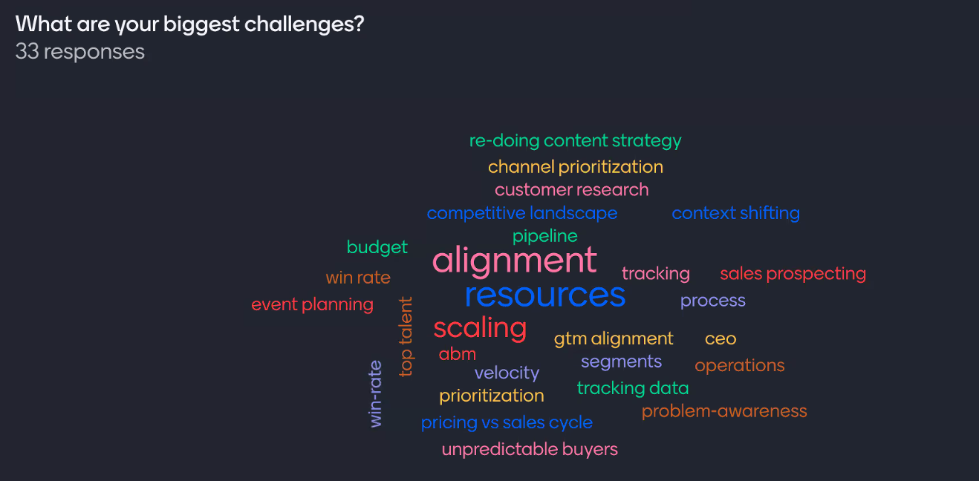

Slide 5

https://www.vendr.com/insights/saas-trends-report-q3-2023

Slide 6
Vendr: The SaaS Trends Report
ACV Down 17.7% YOY (three year low) - Larger like Amazon, SFDC raising prices. CAC at a three year high.
Security and Data companies are holding up the best.
Top products purchases net new in Q3: Gong, LinkedIn, Okta, 6Sense.
Topped the renewal list back-to-back in quarters: Linkedin, Zoom, Salesforce, NetSuite, Docusign, and Slack.
SaaS revenue: 81% renewals/19% new business vs. 70/30 a year ago.
Avg sales cycle 44 days versus previous 32 days.
Multi-year agreements are down from 38% to 31% (down 28% for renewals and 14% for net new business).
Typical EOY year lift from EOY spending will be reduced because of already cut budgets.

