Slide 1
5 Sales Tactics For Success in Today’s Tough Selling Market

Slide 2

We help our portfolio build and optimize hyper-growth GTM machines

Slide 3












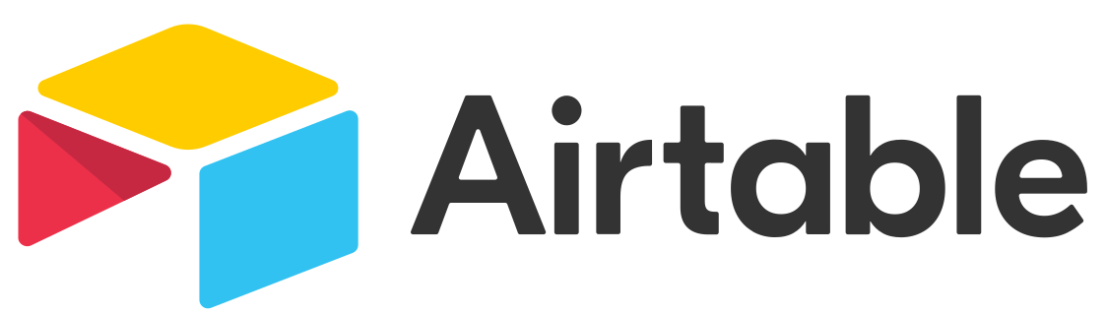

The Scale GTM platform leverages our expert network to provide a suite of offerings
Educational / Networking Events
Advisory
Content
GTM
Network
Experts in sales and marketing across the startup growth lifecycle

Slide 4

Today’s selling environment is combustible
Changing economic climate and buyer
Attention & engagement scarcity
Loss of sales fundamentals
Notes:
Not lost on anyone that it’s a tough environment these days
First you have Engagement Scacity- Gartner: amount of actual time that we get to spend with buyers during engagements is falling to less than 10%. Sellers have significantly fewer at bats
Attention Scarcity Disorder- When you do get buyer’s time, it’s extremely hard to get and maintain their attention in today’s age of information and communications overload, multitasking and everyone having to doing more with less
The economy is not only forcing companies and sales team to achieve the same results with fewer resources, it’s changing the way buyers behave- increasingly buyers are avoiding risk, kicking the can down the road and cloaking themselves in consensus.
Gone are the days of easy sales driven by gluts of money and product-market fit
What this means is that every buyer engagement, every meeting, every call has to capture their attention, provide value and be effective. And based on listening to well over a hundred calls in the last nine months, here’s the bad news…just at the time where we really need to thread the needle, be on the top of our craft and increasing our batting average in the fewer, tougher at bats that we get, there’s a staggering loss of sales fundamentals. By sales fundamentals, I mean doing research, personalizing messaging, asking timely questions, vetting whether we have a real champion, having more than one main contact, timely follow up and all those things. We’ve talked about sales fundamentals for decades and it’s not happening consistently in many places today and companies and sellers are paying the piper. Bravado reported in Q4 of last year that less than 25%, less than one in four sellers, hit quota, in 2022 the average company only hit 75% of quota and that missed revenue targets were the driving factor behind 40% of companies conducting layoffs
So, the good news is that there are some tools, frameworks and tactics that organizations can and Scale companies have adopted to make things less combustible. And I’m excited to share those with you today
Over the past 15-20 years, the technology boom has allowed sales teams and sellers to be successful without paying attention to some of the fundamentals. Companies could roll out an offering with good product-market fit that disrupted industries and sales, particularly early stage hunters, could reap the windfall. Today’s economic headwinds, glut of information and attention and engagement scarcity disorder, mean that we have to go back and study all those pesky fundamentals that we’ve been ignoring and not developing in sellers.
Increasingly companies are delaying purchase decisions by kicking the can down the road, porecting dwindling budgets, and being extra cautious due to FOMU, fear of messing up. They’re able to gather tons of information on the internet and the amount of time we get to spend with sellers is according to one research company, Gartner, falling to below 10%.
CR:
Split slide in half
We’re here for two reasons. It’s not lost on anyone here that the environment is tough and its a dynamic. And now attention scarcity is even work
Lack of fundamentals = not understanding the buyer, practicing and perfection questioning skills, etc., etc.

Slide 5

The Big 3 Selling Process
Identify a buyer’s three biggest challenges and run the rest of the sales process against those challenges
Notes:
To help revenue organizations combat the trends that makes today’s selling market tough, I want to introduce the Big 3 Selling process.
The idea is simple
can be used with any sales methodology or process from MEDDIC to MEDDPIC to Challenger that leverages the rule of three to simply and improve sales execution and thread buyer engagement together all the way from pre-meeting research to post-sales adoption.
It includes several tools which can be implemented individually or together. We’ll be reviewing four specific tools that are all aligned to the Big 3 selling process as well as an important component without which none of this will work

Slide 6


The Big 3 drives the transformation required to win
A series of disjointed sales actions
A series of disjointed sales actions
A unifying theme and thread throughout
Notes:
What I see: predominately in companies sales processes and buyer engagements is a series of ad hoc, disjointed sales actions that both sellers struggle to execute and buyers struggle to understand.
Ex: This looks like sales calls that don’t reference, tie to or build upon previous sales calls and new people from the seller’s organization that don’t understand the buyer’s business and
In today’s combustible, complex world the key to success is making things simpler- for buyers and sellers- Make it simple

Slide 7
The Big 3 transforms the entire sales cycle
Sales Step | From | To
Discovery | Ad Hoc | Intentional and Prescriptive
Discovery Outcome | Set up a demo | Focused on Id goal, top 3 challenges, impact and priorities
Demo | Feature-function dump | Aligned to buyer’s Big 3 challenges
Proposal | Present pricing | Aligning solution & value to the impact of the buyer’s top 3 challenges
Notes:
From ad hoc question, feature function dumping and premature, pricing presentations to
Guided discovery based on insights, demos, proposals and meetings aligned to the buyer’s main goal and big 3 barriers to success
The Big 3 ties together and transforms the entire sales cycle from discovery to demo to proposal. It moves us from ad hoc discovery, feature-function dumping and premature pricing presentations to intentional, guide discovery, demos, proposals and meetings aligned to the buyers main goal and top 3 barriers to success and
I’m going to dig into tools as part of the Big 3 sales process related to each of these areas

Slide 8
Deals die at the starting line: sellers aren’t capturing information they need to win deals
Sellers don’t understand the buyer’s business
Buyers are more discretionary and want immediate value
Companies and sellers miss the opportunity to differentiate
Ad hoc questions and questioning skills
Sales Step 1: Discovery
Notes:
Discovery is the most important sales stage in the sales process. It’s where we can drive the most alue and leverage
. What I’m seeing though is that a lot of deals are dying in discovery. Oh, they advance in the forecast beyond discovery, however
Don’t capture info b/c sellersaren’t framing the issues, asking good questions or questions that tie together or even more fundamentally understanding the buyer’s problem
We’re missing the critical information to make later meetings valuable and impactful,
Sellers aren’t using discovery to drive value
CR: Don’t try to break the table. Do it as a build.
“Over the course of listening to all these calls, this is what I sway. In the course of this I found the solution to be Prescriptive Discover. Here’s what I mean by Prescriptive Discovery
Discovery is the most important stage of the sales process. Done well, it’s where we build the most value and drive the most leverage to convert opportunities into closed-won deals. What we’ve found though is that discovery is still often missing and when performed, still limited to a handful of questions with little guiding purpose other than to pass time until the solution and all of our glorious features and functions can be presented.
Why? limited or poor understanding of the buyer’s business, no plan going into discovery, lack of questioning skills and emphasis on our comfort zone- our product, features and benefits- vs. our approach and insights to their business
This is rooted in poor understanding of the buyer’s business, the unique insights and perspectives we have to offer and lack of a plan of what to ask and how to ask it. The Big 3 Statements, a very distilled and simplified way of being closer to challengers, is how high performing sales teams are working to restore the power of discovery without wearing down the buyers.
What it is: Three statements providing your company’s perspective around the main business Sales Step you solve for your ideal buyers
Benefit: The modern executive doesn’t want to be asked what keeps them up at night. They want to know what others are doing and what should be keeping them up at night
How to Apply: Brainstorm a list of perspectives unique to your buyers, your company’s experience and the Sales Steps that you solve until you develop 1-3 statements that will enable your sellers to run more prescriptive, guided discovery.

Slide 9

The solution is prescriptive discovery: the perfect “give-and-take”
A process where sellers come armed with three hypotheses or perspectives about the buyer’s main business to drive the conversation
Sellers share a hypothesis, make a statement that offers insight and pivot to a pre-planned question
The statements differentiate the seller and company by showing how they think and act differently
Notes:
“Over the course of listening to all these calls, I found the solution to be Prescriptive Discover. Here’s what I mean by Prescriptive Discovery.
Armed with three hypotheses or perspectives
Make a statement that offers insight
Fast follow the statement with a pre-planned questions
Andy Paul: “They are not buying your product or solution. They’re buying you and your organization”
Discovery is the most important stage of the sales process. Done well, it’s where we build the most value and drive the most leverage to convert opportunities into closed-won deals. What we’ve found though is that discovery is still often missing and when performed, still limited to a handful of questions with little guiding purpose other than to pass time until the solution and all of our glorious features and functions can be presented.
Why? limited or poor understanding of the buyer’s business, no plan going into discovery, lack of questioning skills and emphasis on our comfort zone- our product, features and benefits- vs. our approach and insights to their business
This is rooted in poor understanding of the buyer’s business, the unique insights and perspectives we have to offer and lack of a plan of what to ask and how to ask it. The Big 3 Statements, a very distilled and simplified way of being closer to challengers, is how high performing sales teams are working to restore the power of discovery without wearing down the buyers.
What it is: Three statements providing your company’s perspective around the main business Sales Step you solve for your ideal buyers
Benefit: The modern executive doesn’t want to be asked what keeps them up at night. They want to know what others are doing and what should be keeping them up at night
How to Apply: Brainstorm a list of perspectives unique to your buyers, your company’s experience and the Sales Steps that you solve until you develop 1-3 statements that will enable your sellers to run more prescriptive, guided discovery.

Slide 10
Give the buyer value to get their 3 big pains
Example: A Third-Party Risk-Management Platform
Topic | Hypothesis | Statement | Pivot Discovery Question
Security Risk | 3rd party networks represent the biggest security risk | In their Voice of the Enterprise Survey, Forrester Research found that 82% of buyers believe their third-party networks pose the biggest security risk to their organization | How do you address third party network risk today?
Security Investment | Spending on network security is increasing yet network security is dropping | In the last couple of years, spending on security has increased by over 70%, yet 75% of organizations are dissatisfied with their current approach | What’s going well with your current approach and what opportunities do you have to improve overall security?
Monitoring & Alerts | Companies are focused on security assessments yet the continuous monitoring and alerts present the biggest risk | Many of our current buyers tell us that they relied on heavily manual processes, believing that what they needed was more assessment data integrated into their current workflows to improve security efficiency. What they found was that relying on monitoring and alerts from current data created more noise and greater vulnerability to changing threats unless the data was linked to specific areas of exposure | How are you conducting continuous monitoring and alerts today? How do you think about linking assessment data, monitoring and alerts?
Notes:
Discovery is the most important stage of the sales process. Done well, it’s where we build the most value and drive the most leverage to convert opportunities into closed-won deals. What we’ve found though is that discovery is still often missing and when performed, still limited to a handful of questions with little guiding purpose other than to pass time until the solution and all of our glorious features and functions can be presented. This is rooted in poor understanding of the buyer’s business, the unique insights and perspectives we have to offer and lack of a plan of what to ask and how to ask it. The Big 3 Statements, a very distilled and simplified way of being closer to challengers, is how high performing sales teams are working to restore the power of discovery without wearing down the buyers.
What it is: Three statements providing your company’s perspective around the main business Sales Step you solve for your ideal buyers
Benefit: The modern executive doesn’t want to be asked what keeps them up at night. They want to know what others are doing and what should be keeping them up at night
How to Apply: Brainstorm a list of perspectives unique to your buyers, your company’s experience and the Sales Steps that you solve until you develop 1-3 statements that will enable your sellers to run more prescriptive, guided discovery.

Slide 11
We forgot the goal of discovery
Seller’s act as if the goal of discovery is to get to a demo
The emphasis is on the product and solution
Organizations struggle to assess discovery effectiveness
Many companies are experiencing post-discovery and demo stalls
Sales Step 2: Discovery Outcomes
Notes:
What I hear. ‘I want to learn more about your business’, “i want to talk to you today about a,b,c and discuss our solution
Organizations struggle to assess disco effectiveness. The biggest issue I’m seeing today is post disco and demo opportunity stalls

Slide 12


The solution is The Big 3 Discovery Framework: capture essential data, win the deal
A tool for reorienting seller discovery that focuses on what’s most important to buyers: their goals, challenges, impacts on their business and priorities
Love the problem, not the solution
Notes:
What I’ve introduced and see work at several companies is the Big 3 Discovery Framework
Benefits: The Big 3 Discovery framework helps identify discovery gaps, derive additional discovery questions and give the organization and sellers an assessment and self-assessment tool

Slide 13
Goal - Big 3 - Impact: the key to unlocking buyer value
Example
Goal The business goal that the buyer is trying to solve | The Big 3 Challenges Buyer’s barriers to solving the pain or achieving the goal | Impact Consequence of not solving the challenge or seizing the opportunity | Impact Rating 1-10. 10= Critical Impact, 1= Low Priority | Potential Solution Solution to each challenge
Improve Marketing ROI by accelerating the content lifecycle | Everyone working on different systems | No central, searchable view of all assets and content | 6 | Central content management system
 | Approvals take too long | 4-6 week delays in final marketing materials | 8 | Automated approval system with daily alerts
 | No central tracking mechanism | No ability to see what’s behind schedule | 8 | Reporting to proactively identify potential delays and save money by eliminating unused assets

Slide 14
Demos are still feature-function dumps
They focus on the solution vs. how we solve the buyer’s challenge
They’re often given outside the context of the buyer’s business and what we have learned about their business
We show too much
The buyer isn’t engaged
Sales Step 3: Demo
Notes:
Fail to recap what we understand about the buyer’s business and priorities
Don’t use the opportunity to do additional discovery. It’s not ‘always be closing”, it’s always be doing - and validating- discovery
Not engaging
Ex: Demoed for 35 minutes before stopping to ask the buyer a question. Didn’t share a single story or example- it was entirely about how the sausage was made

Slide 15

The solution is The Big 3 Demo framework: align the demo to the buyer’s primary pains
An engagement where we recap and perform additional discovery before jumping into the demo, and tightly align what we show to the buyer’s Big 3 challenges
Confirm the Big 3 (“What We Understand”)
Share how we solve the buyer’s Big 3 challenges + tell a story
Micro and macro closes to engage the buyer throughout and gauge their response
Notes:
Proposal: The Sales Step (what I saw when I listened), introduction of the tool to address the challenge (Here’s my answer and the big definition) and the tool

Slide 16
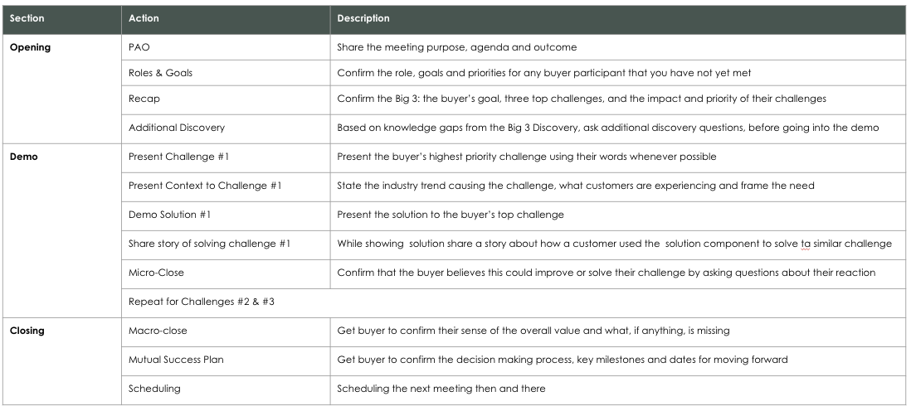
Walk the buyer through solutions to each Big 3 challenge
Example

Slide 17
Proposals are all SKUs and pricing
Glorified invoicing and pricing presentations
Enabling delays by reinforcing FOMO vs. FOMU
Creating vs. minimizing negotiation and objections
Sales Step 4: Proposal
Notes:
A proposal is nothing more than a summary of a well run sales process
$100K deal at a company achieving less than 55% quota and an overall win rate of less than 10% and the seller’s proposal call was 10 minutes, where they showed the price and asked three times if there were any questions that they can answer and closed by saying they would welcome the opportunity to get back on the phone to answer any questions

Slide 18

The solution is The Big 3 Proposal: deliver a value story
A proposal that begins with and anchors to the buyers goal, big 3 challenges, and quantifiable impact of those challenges
Notes:
Begin with recapping the goal, Big 3 Challenges and Impact
Review the buyer success plan and team
Leave solution and product detail to an appendix

Slide 19
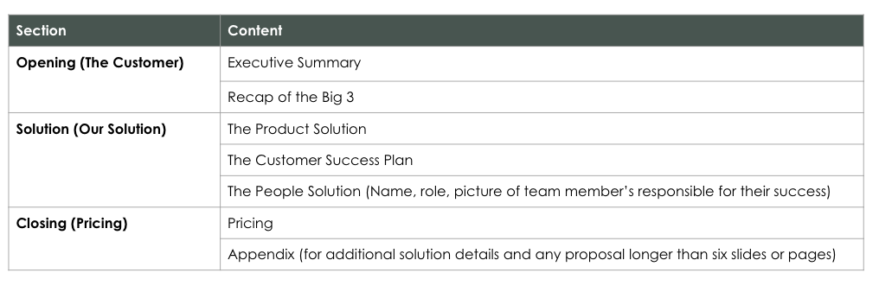
Give the big picture, not just pricing
Example

Slide 20
Meeting management is an unexciting and essential game changer for most sellers
How sellers introduce the meeting sets the trajectory for success or failure
If the introduction is off, the meeting is off
Sellers give meeting agendas and struggle defining the purpose and outcome of meetings
Ongoing: Meeting Management
Notes:
RK: The real outcome- meetings that end before we know what prospects think, speed talking, feature dumping to “cover all the material” and no next steps
CR: there’s one thing that I have to add because none of this works without a good meeting introduction. , and use the Sales Step, the answer and the example format. This is a simple methodology for managing every meeting. Here’s my main point- we’re not controlling the meetings. You have to thread the needle in the sales process- you can’t lose a meeting in today’s climate. What

Slide 21

The PAO is the glue that makes successful meetings
A written and verbal description of the purpose, agenda and outcome of a meeting that is
Preceded by icebreakers
Proceeded by questions to ensure buy-in and confirm timing
Notes:
CR: there’s one thing that I have to add because none of this works without a good meeting introduction. , and use the Sales Step, the answer and the example format. This is a simple methodology for managing every meeting. Here’s my main point- we’re not controlling the meetings. You have to thread the needle in the sales process- you can’t lose a meeting in today’s climate. What

Slide 22
Ensure meeting outcomes through a simple, effective introduction
PAO Example
Component | Definition | Description | Example
P | Purpose | One sentence declaring the main topic | “The purpose of today’s meeting is to discuss ______________”
A | Agenda | Short bullet points of areas to be covered | If you’re in agreement we’ll cover the following: A B C
O | Outcome | The ideal result of the meeting | The outcome of today’s meeting is to: Brainstorm… Develop… Agree Upon… Decide…

Slide 23
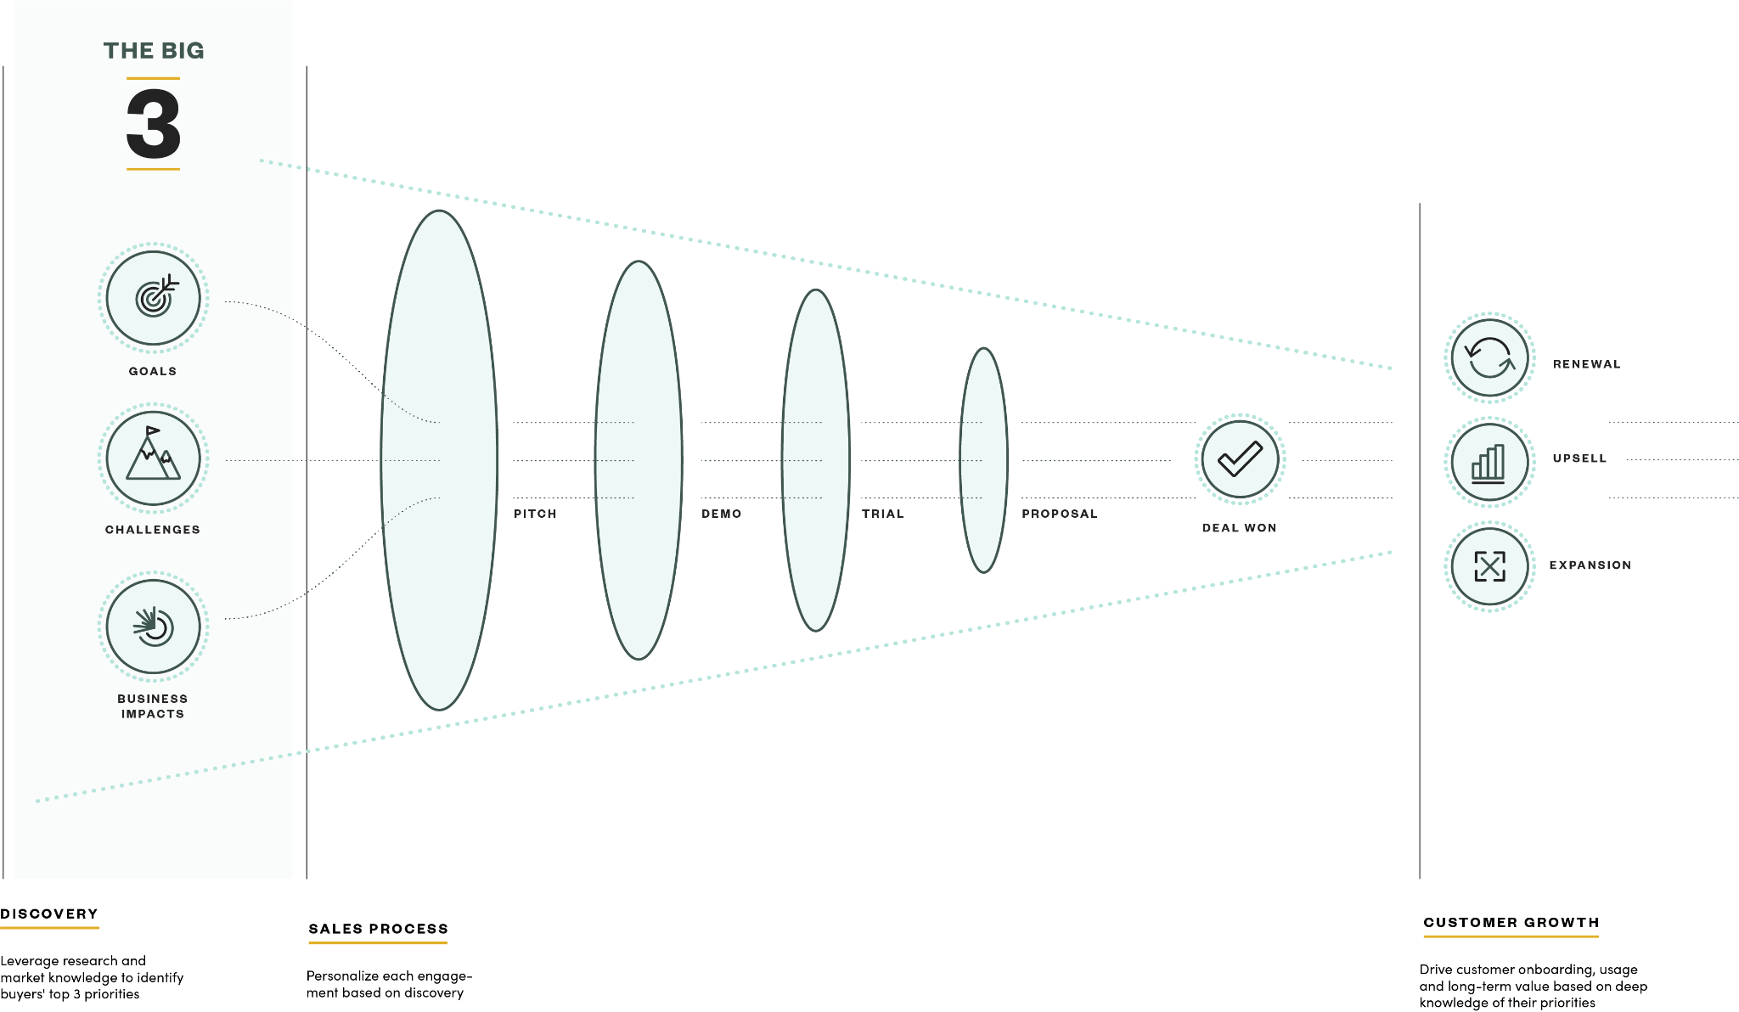
Summary: Sales Tactics for Success in Today’s Tough Selling Environment
Notes:
CR: We can workshop any of these for you. Email Anisha

Slide 24
Additional Resources & Information
If you would like more information on the tools and workshops related to The Big 3, please reach out to Anisha Agarwal (anisha@scalevp.com)

