Slide 1
Sample Board Slides

Slide 2
Board Deck Template Overview
Company Stage: $0-$1mm organization
This template provides guidance for the type of reporting that should go into a board deck for a bare minimum reporting package.
At a minimum, every board deck should have:
Agenda
CEO Overview
Financial update
Go-to-market update
1-2 strategic discussion topics
Closed board session
Resources:
Board deck template (ppt) – example slides and visuals
Scale Reporting Template (xls) – financial model, go-to-market funnel model
This deck is intended to:
Help you save time. These templates are a resource to help you get started, but each organization should determine the format that best suits their business.
Graphics provided are not required. We’ve provided examples of graphics that can be used, but only include them if that is your preference.
The deck will change as you grow. As the organization grows beyond $1mm, additional slides may be helpful to provide a complete picture on the health of your business. (see examples of optional slides).

Slide 3
Board Deck Template: Table of Contents
Basic Board Deck:
Agenda
CEO overview
Financial update
  Quarterly metrics
  GAAP data & cash flow analysis
Go-to-market update
1-2 strategic discussion topics
Closed board session
Appendix
Deep Dive Examples: Financial Reporting
Deep Dive: Go-to-market update
Sales examples
Marketing examples
Customer success examples
Product examples

Slide 4
Basic Board Deck

Slide 5
Agenda
SLIDES
CEO Q3 Overview | 15 min.
Financial Results | 15 min.
Go-to-Market Results | 30 min.
Strategic Discussion (1-2 big conceptual topics) | 45 min.
Board Business (Closed Session) | 30 min.
Appendix
Notes:
http://www.istockphoto.com/photo/blue-hourglass-gm510396701-46241116

Slide 6
CEO Overview: Highlights and Challenges
Highlights
Tracking broadly to plan, achieving 95% of Gross New ARR for Q3 and 100% of Ending ARR plan YTD.
Successful executive hires made including bringing on our VP Marketing and VP Customer Success.
Signed our biggest customer to date (Wells Fargo), which is nice validation for our moving up market strategy.
Challenges
Strong improvement in sales efficiency but still below the ScaleVP target benchmark of 0.8.
Ending quarterly headcount of 96 employees below target of 106. Driven by a lag in hiring for sales roles.
The space is getting noticeably more competitive. Need to tighten our competitive positioning against Acme Company.

Slide 7
Key Quarterly Metrics
Tips:
Editable version available in Scale Reporting Template (rows 9-33)
Consider adding bulleted comments or analysis OR 1-2 supporting slides if helpful

Slide 8
GAAP Analysis
Tips:
Editable version available in Scale Reporting Template (rows 55-73)
Consider adding bulleted comments or analysis OR 1-2 supporting slides if helpful

Slide 9
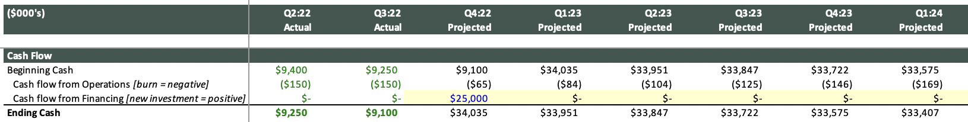
Cash Analysis
Tips:
It’s helpful to show recent past quarters, plus several forward quarters
Editable version available in Scale Reporting Template (rows 62-65)
Consider adding bulleted comments or analysis OR 1-2 supporting slides if helpful
Runway: 32 months
Next Fundraising Anticipated: 24 months

Slide 10
Key Quarterly GTM Metrics
Tips:
Editable version available in Scale Reporting Template (rows 37-53)
Consider adding bulleted comments or analysis OR 1-2 supporting slides if helpful

Slide 11
<Strategic Discussion of Big Conceptual Issue>
The “Big Conceptual Issue” is a place holder for strategic topics. We recommend limiting yourself to 1-2 key topics per meeting.
Examples:
Deep-dive on product roadmap
Analysis of competition
Update on team and organizational strategy
Feedback from customers

Slide 12
Board Business (Closed Session)
Review feedback, formalities, stock option grants, etc

Slide 13
Deep-Dive Examples:
Financial Reporting

Slide 14
Example: Key Quarterly Metrics
Metric | Status | Q317 (Act) | Q317 (Plan) | Variance (%) | Q316 (A) | YoY Growth (%) | YTD (Actual) | YTD (Plan) | Variance (%) | Comments
Gross New ARR* |  | $758 | $800 | 95% | $359 | 123% | $2,198 | $2,000 | 110% | Wells Fargo was biggest deal to date. Strong growth on last year.
Churned ARR* |  | ($86) | ($90) | 96% | 0 | n/a | ($198) | ($200) | 99% | Most of it due to Sephora churn
Revenue |  | $605 | $600 | 101% | $131 | 362% | $1,358 | $1,300 | 104% | Revenue ahead due to accelerated cust onboarding
Operating Income |  | ($995) | ($900) | 111% | ($993) | 0% | ($2,832) | ($2,600) | 109% | Hiring going well, opex higher as a result
Cash from Operations |  | ($895) | ($850) | 105% | ($893) | 0% | ($2,549) | ($2,500) | 102% | Tracking on cash, No change cash out date July 2018
Net Sales Efficiency |  | 0.79 | 0.79 | 100% | 0.78 | 1% | 0.97 | 1.00 | 97% | Sales Efficiency on plan, below last year as new reps ramp
Gross Monthly Churn |  | 1.2% | 1.5% | 80% | 0% | n/a | 1.3% | 1.6% | 81% | Higher than expected churn driven by SMB segment
Net New Customers |  | 57 | 60 | 95% | 22 | 159% | 134 | 130 | 103% | Broadly on plan
>= 100%
90% - 99%
< 90%
*Need to ensure consistency of accounting for reactivations, downgrades

Slide 15
Example: Trended Gross New ARR
884
758
556
359
227
250
154
Note: You could also build this slide with different subsegments including by segment or region if appropriate for the business

Slide 16
Example: Trended Gross Churn
Data on “Churn to Retention tab”, line 5
Note: You could also build this slide with different subsegments including by segment or region if appropriate for the business

Slide 17
Example: Trended Net New ARR, Ending ARR and Attainment to Plan
Corresponding graph on “Overall ARR tab”

Slide 18
Example: Quarterly ARR Analysis – Variance to Plan
ARR | Q317 (A) | Q317 (P) | Variance (%) |  | YTD (A) | YTD (P) | Variance (%) | Comments
New Business ARR | $700 | $750 | 93% |  | $2,064 | $2,100 | 98% | New reps ramping nicely
Expansion / Upsell ARR | $58 | $50 | 116% |  | $135 | $100 | 135% | Going deeper into the website increases ASP
Gross New ARR | $758 | $800 | 95% |  | $2,199 | $2,200 | 100%
Churn ARR | ($86) | ($90) | 96% |  | ($198) | ($200) | 100% | Getting better and on plan. Still room to improve
Net New ARR | $672 | $710 | 95% |  | $2,000 | $2,000 | 100%
Exit ARR | $3,092 | $3,131 | 99% |  | $3,092 | $3,093 | 100% | Tracking precisely to plan
Annualized Gross Quarterly Churn | 15.0% | 17.5% | 86% |  | 16.8% | 18.0% | 93%
Annualized Net Quarterly Churn | 4.8% | 5.0% | 96% |  | 7.8% | 5.0% | 156% | YTD still too high
Gross Sales Efficiency | 0.90 | 0.85 | 106% |  | 1.03 | 1.05 | 98% | On plan, room for improvement
Net Sales Efficiency | 0.79 | 0.79 | 100% |  | 0.97 | 1.00 | 97%

Slide 19
Example: Income Statement Variance to Plan
GAAP | Q117 (A) | Q117 (P) | Var (%) |  | YTD (A) | YTD (P) | Var (%) | Comments
Revenue | $273 | $270 | 101% |  | $273 | $270 | 101%
Cost of Service | $56 | $50 | 112% |  | $56 | $50 | 112% | Hoping new reserve instances can introduce efficiencies going forward
Gross Profit | $217 | $220 | 99% |  | $217 | $220 | 99%
S&M | $490 | $500 | 98% |  | $490 | $500 | 98% | Good job of staying on target. Need to watch recent hiring to make sure we don’t fall behind
R&D | $409 | $400 | 102% |  | $409 | $400 | 102%
G&A | $214 | $230 | 93% |  | $214 | $230 | 93%
Total OpEx | $1,114 | $1,130 | 99% |  | $1,114 | $1,130 | 99%
Operating Income | ($897) | ($900) | 99% |  | ($897) | ($900) | 99%
Ending Cash | $3,547 | $3,500 | 101% |  | $3,547 | $3,500 | 101%

Slide 20
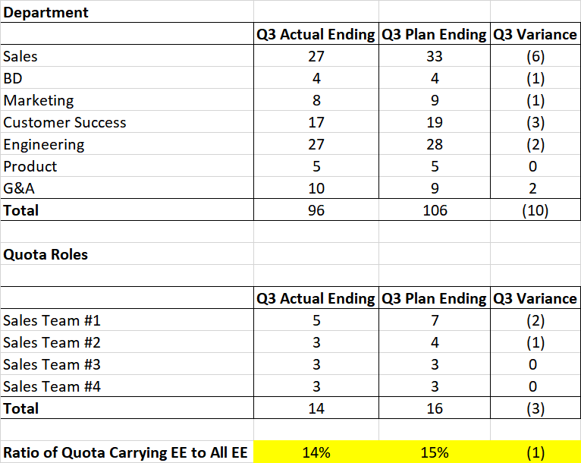
Headcount Variance to Plan
Corresponding data on “Headcount” tab

Slide 21
Deep-Dive Examples: Go-to-market

Slide 22
Sales Examples
In this section, we have included additional examples for providing updates on sales forecasts and pipeline progression.

Slide 23
Example: ARR and Customer Growth by Segment
ARR ABV | Q316
 | Actual | Budget | Variance
New | $40.00 | $45.00 | ($5.0)
Up / Cross Sell | $20.00 | $20.00 | $0
Gross New ARR | $60.00 | $65.00 | ($5.0)
Downsell / Churn | ($9.47) | ($10.00) | $0.53
Net New | $50.53 | $55.00 | ($4.47)
Customer ABV | Q316
 | Actual | Budget | Variance
New | 20 | 20 | 0
Churn | (4) | (2) | (2)
Net New | 16 | 18 | (2)

Slide 24
Key Wins
ARR: | ARR: | ARR: | ARR:
ARR: | ARR: | ARR: | ARR:
Logo
Logo
Logo
Logo
Logo
Logo
Logo
Logo

Slide 25
Example: Next Quarter Forecast
Pipeline Review
Enterprise Deals | Total Value | Status
Deal #1 | $500,000 | In procurement
Deal #2 | $340,000 | POC
Deal #3 | $325,000 | POC
Deal #4
Deal #5
Min
Mid
Max
Commercial Deals | Total Value | Status
Deal #1
Deal #2
Deal #3
Deal #4
Deal #5
Finance Forecast: $2.5M - $2.7M
Total Pipeline | Total Value | Forecasted Value
Enterprise
Commercial
Total

Slide 26
Sales Efficiency Over Time
Corresponding graph on “Sales Efficiency” tab

Slide 27
Example: Sales Performance by Region
All Company | Actual | Budget | Variance ($) | Variance (%) | YoY
Gross New ARR
Net New ARR
Exit ARR
Regional ARR | Actual | Budget | Variance ($) | Variance (%) | YoY
East
West
AMER
EMEA
APAC
Worldwide
New Logos | Actual | Budget | Variance ($) | Variance (%) | YoY
Commercial
Enterprise
Total
Comments:

Slide 28
Example: Trended Rep Ramp Assessment
Rep | Start Date | Quota | Months to 60% Quota | Month 1 | Month 2 | Month 3 | Month 4 | Month 5 | Month 6 | Month 7 | Month 8 | Month 9 | Month 10 | Month 11 | Month 12
Ramp Schedule |  | 1500 | Month 10 | $ - | $50 | $100 | $150 | $250 | $350 | $500 | $650 | $800 | $950 | $1,150 | $1,400
Rep 1 | Q118 | 1500 |  | $ - | $32 | $50 | $94 | $103 | $117 | $140 | $174 | $194 | $230 | $256 | $276
Rep 2 | Q119 | 1500 | Month 10 | $ - | $47 | $85 | $119 | $193 | $303 | $428 | $543 | $772 | $1,412 | $2,387 | $2,506
Rep 3 | Q120 | 1500 |  | $ - | $52 | $81 | $149 | $177 | $266 | $491 | $580
Rep 4 | Q120 | 1500 | Month 8 | $ - | $73 | $99 | $176 | $312 | $575 | $673 | $1,110
Rep 5 | Q220 | 1500 |  | $ - | $46 | $56 | $91 | $155 | $278 | $333
Rep 6 | Q220 | 1500 |  | $ - | $64 | $96 | $163 | $263 | $321 | $500
Rep 7 | Q220 | 1500 |  | $ - | $60 | $98 | $159 | $258 | $397
Rep 8 | Q320 | 1500 |  | $ - | $53 | $96 | $181

Slide 29
Example: Trended Rep Productivity and Attainment
Rep | Start Date | Tenure (Qtrs) | Lifetime ARR (000) | Q120 | Q220 | Q320 | Q420 | Q121 | Q221 | Q321
Joe Smith | 1/1/2020 | 7 | $3,058 | 102% | 103% | 98% | 54% | 106% | 108% | 101%
Jane Doe
Roger Miller
Jackie Chan
Total Attainment (A)
Total Quota (B)
Total Plan (C)
Over-assignment (B / C)
Quota Attainment (A / B)
Plan Attainment (A / C)
Participation Rate (% Reps >= 100% Quota)
100%+ of Quota
75% - 99% of Quota
< 75% of Quota

Slide 30
Example: Production Per Rep

Slide 31
Example: New Pipeline Overview

Slide 32
Example: Late-Stage Pipeline Overview

Slide 33
Example: Closed Won Overview

Slide 34
Example: Pipeline Coverage Analytics

Slide 35
Marketing Examples
In this section, we have included additional examples for providing updates on marketing programs and pipeline generation.

Slide 36
Example: Funnel Analysis over Time
 | Q121 | Q221 | Q321 | Q421 | 2021
In Quarter
Suspects
% to MQL
MQL
% to SAL
SAL
% to in Qtr SQL
SQL
% to Won
Won
Inherited
Carryover Opps
% to Won
Won
Total
Total Opps
% to Won
Won

Slide 37
Example: Program Costs
 | Q121 | Q221 | Q321 | Q421 | 2021
Leads
Suspects
MQL
SAL
SQL
Won
Program Costs
Marketing Programs ($)
Cost per Lead
Cost / Suspect
Cost / MQL
Cost / SAL
Cost / SQL
Cost / Won

Slide 38
Example: Pipeline Cohort Analysis
Running cohort analysis on leads is good practice to understand the velocity of pipe to close and can inform investment in new pipeline generation requirements.
 |  | Week of Close
 |  | Week 1 | Week 2 | Week 3 | Week 4 | Week 5 | Week 6 | Week 7 | Week 8 | Week 9 | Week 10 | Week 11 | Week 12 | Week 13 | Average | Median
Date Entering Pipeline | 1/1/2021
 | 1/8/2021
 | 1/15/2021
 | 1/22/2021
 | 1/29/2021
 | 2/5/2021
 | 2/12/2021
 | 2/19/2021
 | 2/26/2021
 | 3/5/2021
 | 3/12/2021
 | 3/19/2021
 | 3/26/2021
 | Average

Slide 39
Conservative Qualification w/ Best Rolling Total Pipe to Date ($35.3M)
9 Month Rolling Pipeline | Q121 | Q221 | Q321 | Q421 | Q122
Total Pipeline, Quarter Start | $xM | $xM | $xM | $xM | $xM
+ Added New | $xM | $xM | $xM | $xM | $xM
- Late Stage (Lost) | ($xK) | ($xK) | ($xK) | ($xK) | ($xK)
- Late Stage (Qualified Out) | ($xK) | ($xK) | ($xK) | ($xK) | ($xK)
- Early Stage (Lost) | ($xK) | ($xK) | ($xK) | ($xK) | ($xK)
- Early Stage (Qualified Out) | ($xK) | ($xK) | ($xK) | ($xK) | ($xK)
+/- Deal Value Change | ($xK) | ($xK) | ($xK) | ($xK) | ($xK)
9 Months Rolling Pipeline | $x +x% | $x +x% | $x +x% | $x +x% | $x +x%
- Won | $x +x% | $x +x% | $x +x% | $x +x% | $x +x%

Slide 40
Customer Success Examples
In this section, we have included additional examples for providing updates on customer usage and retention.

Slide 41
Example: ARR Churn by Segment
Outcomes of Top Q3 Entering Risks
Account | Q2 Entering Churn Forecast | Dollars Churned | Current TAV | Outcome | Competitor
xxx | $x.xM | $x.xM | $x.xM | FULL CHURN | xxx
Xxx | $x.xM | $x.xM | $x.xM | PARTIAL CHURN | Xxx
xxx | $x.xM | $x.xM | $x.xM | FULL CHURN
xxx | $x.xM | $x.xM | $x.xM | PARTIAL CHURN | xxx
xxx | $x.xM | $x.xM | $x.xM | PARTIAL CHURN | xxx
xxx | $x.xM | - | $x.xM | FULL RENEWAL | xxx
 | Q3 2017 | Q3 2017 | Q3 2017 | Comments
 | Actual | Plan | Variance
SMB
Commercial
Enterprise
Self-Service
Total
Total less Self-Service

Slide 42
Example: Renewal Analysis
Corresponding data on “Churn to Retention” tab
Bookings | Q116 (A) | Q216 (A) | Q316 (A) | Q416 (A) | Q117 (A) | Q217 (A) | Q317 (A) | Q417 (P) | 2016 (A) | 2017 (P)
Renewal Bookings (a) | $94 | $175 | $273 | $156 | $880 | $627 | $922 | $1,322 | $698 | $3,752
Downgraded ARR | -$36 | -$31 | -$52 | -$56 | -$59 | -$62 | -$65 | -$69 | -$175 | -$255
Cancelled ARR | -$24 | -$21 | -$34 | -$38 | -$39 | -$41 | -$44 | -$46 | -$117 | -$170
Total Churn | -60 | -52 | -86 | -94 | -$99 | -$104 | -$109 | -$114 | -$292 | -$425
Total Renewable Book (b) | $154 | $227 | $359 | $250 | $979 | $731 | $1,031 | $1,436 | $990 | $4,177
Gross Retention (a/b) | 61% | 77% | 76% | 62% | 90% | 86% | 89% | 92% | 71% | 90%
New Logo ARR | $884 | $480 | $700 | $1,179 | $1,474 | $1,842 | $2,303 | $2,878 | $3,243 | $8,497
Upsell ARR (c) | $1 | $76 | $58 | $101 | $116 | $134 | $154 | $177 | $236 | $580
Gross New ARR Bookings (d) | $885 | $556 | $758 | $1,280 | $1,590 | $1,976 | $2,456 | $3,055 | $3,479 | $9,077
Net Retention ((a+c)/b) | 62% | 111% | 92% | 103% | 102% | 104% | 104% | 104% | 94% | 104%
Assumes all single year contracts
Total renewable base calculated as gross new ARR bookings and renewal bookings from 1 year ago

Slide 43
Example: Retention Rates
Corresponding data on “Revenue Retention Graphs” tab

Slide 44
Example: Sample Slide: Churn Deep Dive
Enterprise
Enterprise
Account | ARR | Reason
Account A
Account B
Account C
Account D
Reason | ARR | Logos | % of ARR
Reason A
Reason B
Reason C
Reason D
SMB
SMB
Account | ARR | Reason
Account A
Account B
Account C
Account D
Reason | ARR | Logos | % of ARR
Reason A
Reason B
Reason C
Reason D
Web
Web
Account | ARR | Reason
Account A
Account B
Account C
Account D
Reason | ARR | Logos | % of ARR
Reason A
Reason B
Reason C
Reason D

Slide 45
Product Examples
In this section, we have included additional examples for providing updates on product roadmap updates and rollouts.

Slide 46
Example: Roadmap
 | Q3 2021 | Q4 2021 | Q1 2022
Product Area 1 | Feature 1 BETA | Feature 1 Prod | Feature 2 BETA
Product Area 2 | Maintenance | Efficiency | Gross Margin Impvt
Product Area 3 | Feature 3 Alpha | Feature 3 beta | Feature 3 Prod

Slide 47
Example: Product usage/feedback
TAKEAWAYS
App Launched | % Active users after App Launches
Cohort | Users | Day 0 | Day 1 |  | Day 2 | Day 3 | Day 4 | Day 5 | Day 6 | Day 7 | Day 8 |  | Day 9 | Day 10
Jan 25 | 1,098 | 100% | 33.9% |  | 23.5% | 18.7% | 15.9% | 16.3% | 14.2% | 14.5% | Retention over user lifetime |  |  | 12.1%
Jan 26 | 1,358 | 100% | 31.1% |  | 18.6% | 14.3% | 16.0% | 14.9% | 13.2% | 12.9%
Jan 27 | 1,257 | 100% | 27.2% |  | 19.6% | 14.5% | 12.9% | 13.4% | 13.0% | 10.8% | 11.4%
Jan 28 | 1,587 | 100% | 26.6% |  | 17.9% | 14.6% | 14.8% | 14.9% | 13.7% | 11.9%
Jan 29 | 1,758 | 100% | 26.2% |  | 20.4% | 16.9% | 14.3% | 12.7% | 12.5%
Jan 30 | 1,624 | 100% | 26.4% |  | 18.1% | 13.7% | 15.4% | 11.8%
Jan 31 | 1,541 | 100% | 23.9% |  | 19.6% | 15.0% | 14.8%
Feb 01 | 868 | 100% | 24.7% |  | 16.9% | 15.8%
Feb 02 | 1,143 | Retention over product lifetime |  |  | 18.5%
Feb 03 | 1,253
All Users | 13,487 | 100% |  | 27.0% | 19.2% | 15.4% | 14.9% | 14.0% | 13.3% | 12.5% | 13.1% | 12.2% |  | 12.1%
  This slide is a generic version of a product usage slide – could be a product usage cohort, retention cohort, or something else.
  And then this part of the slide is just narrative on top of what has changed/what to focus on/etc
  “Then I think it’s good to have 1-2 quotes from marquee customers that summarize what is going on.”
  – some cool customer

Slide 48
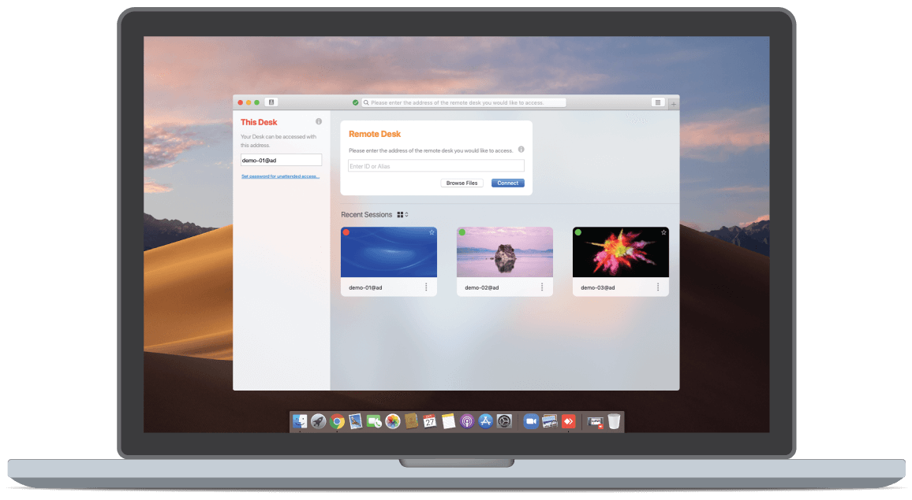
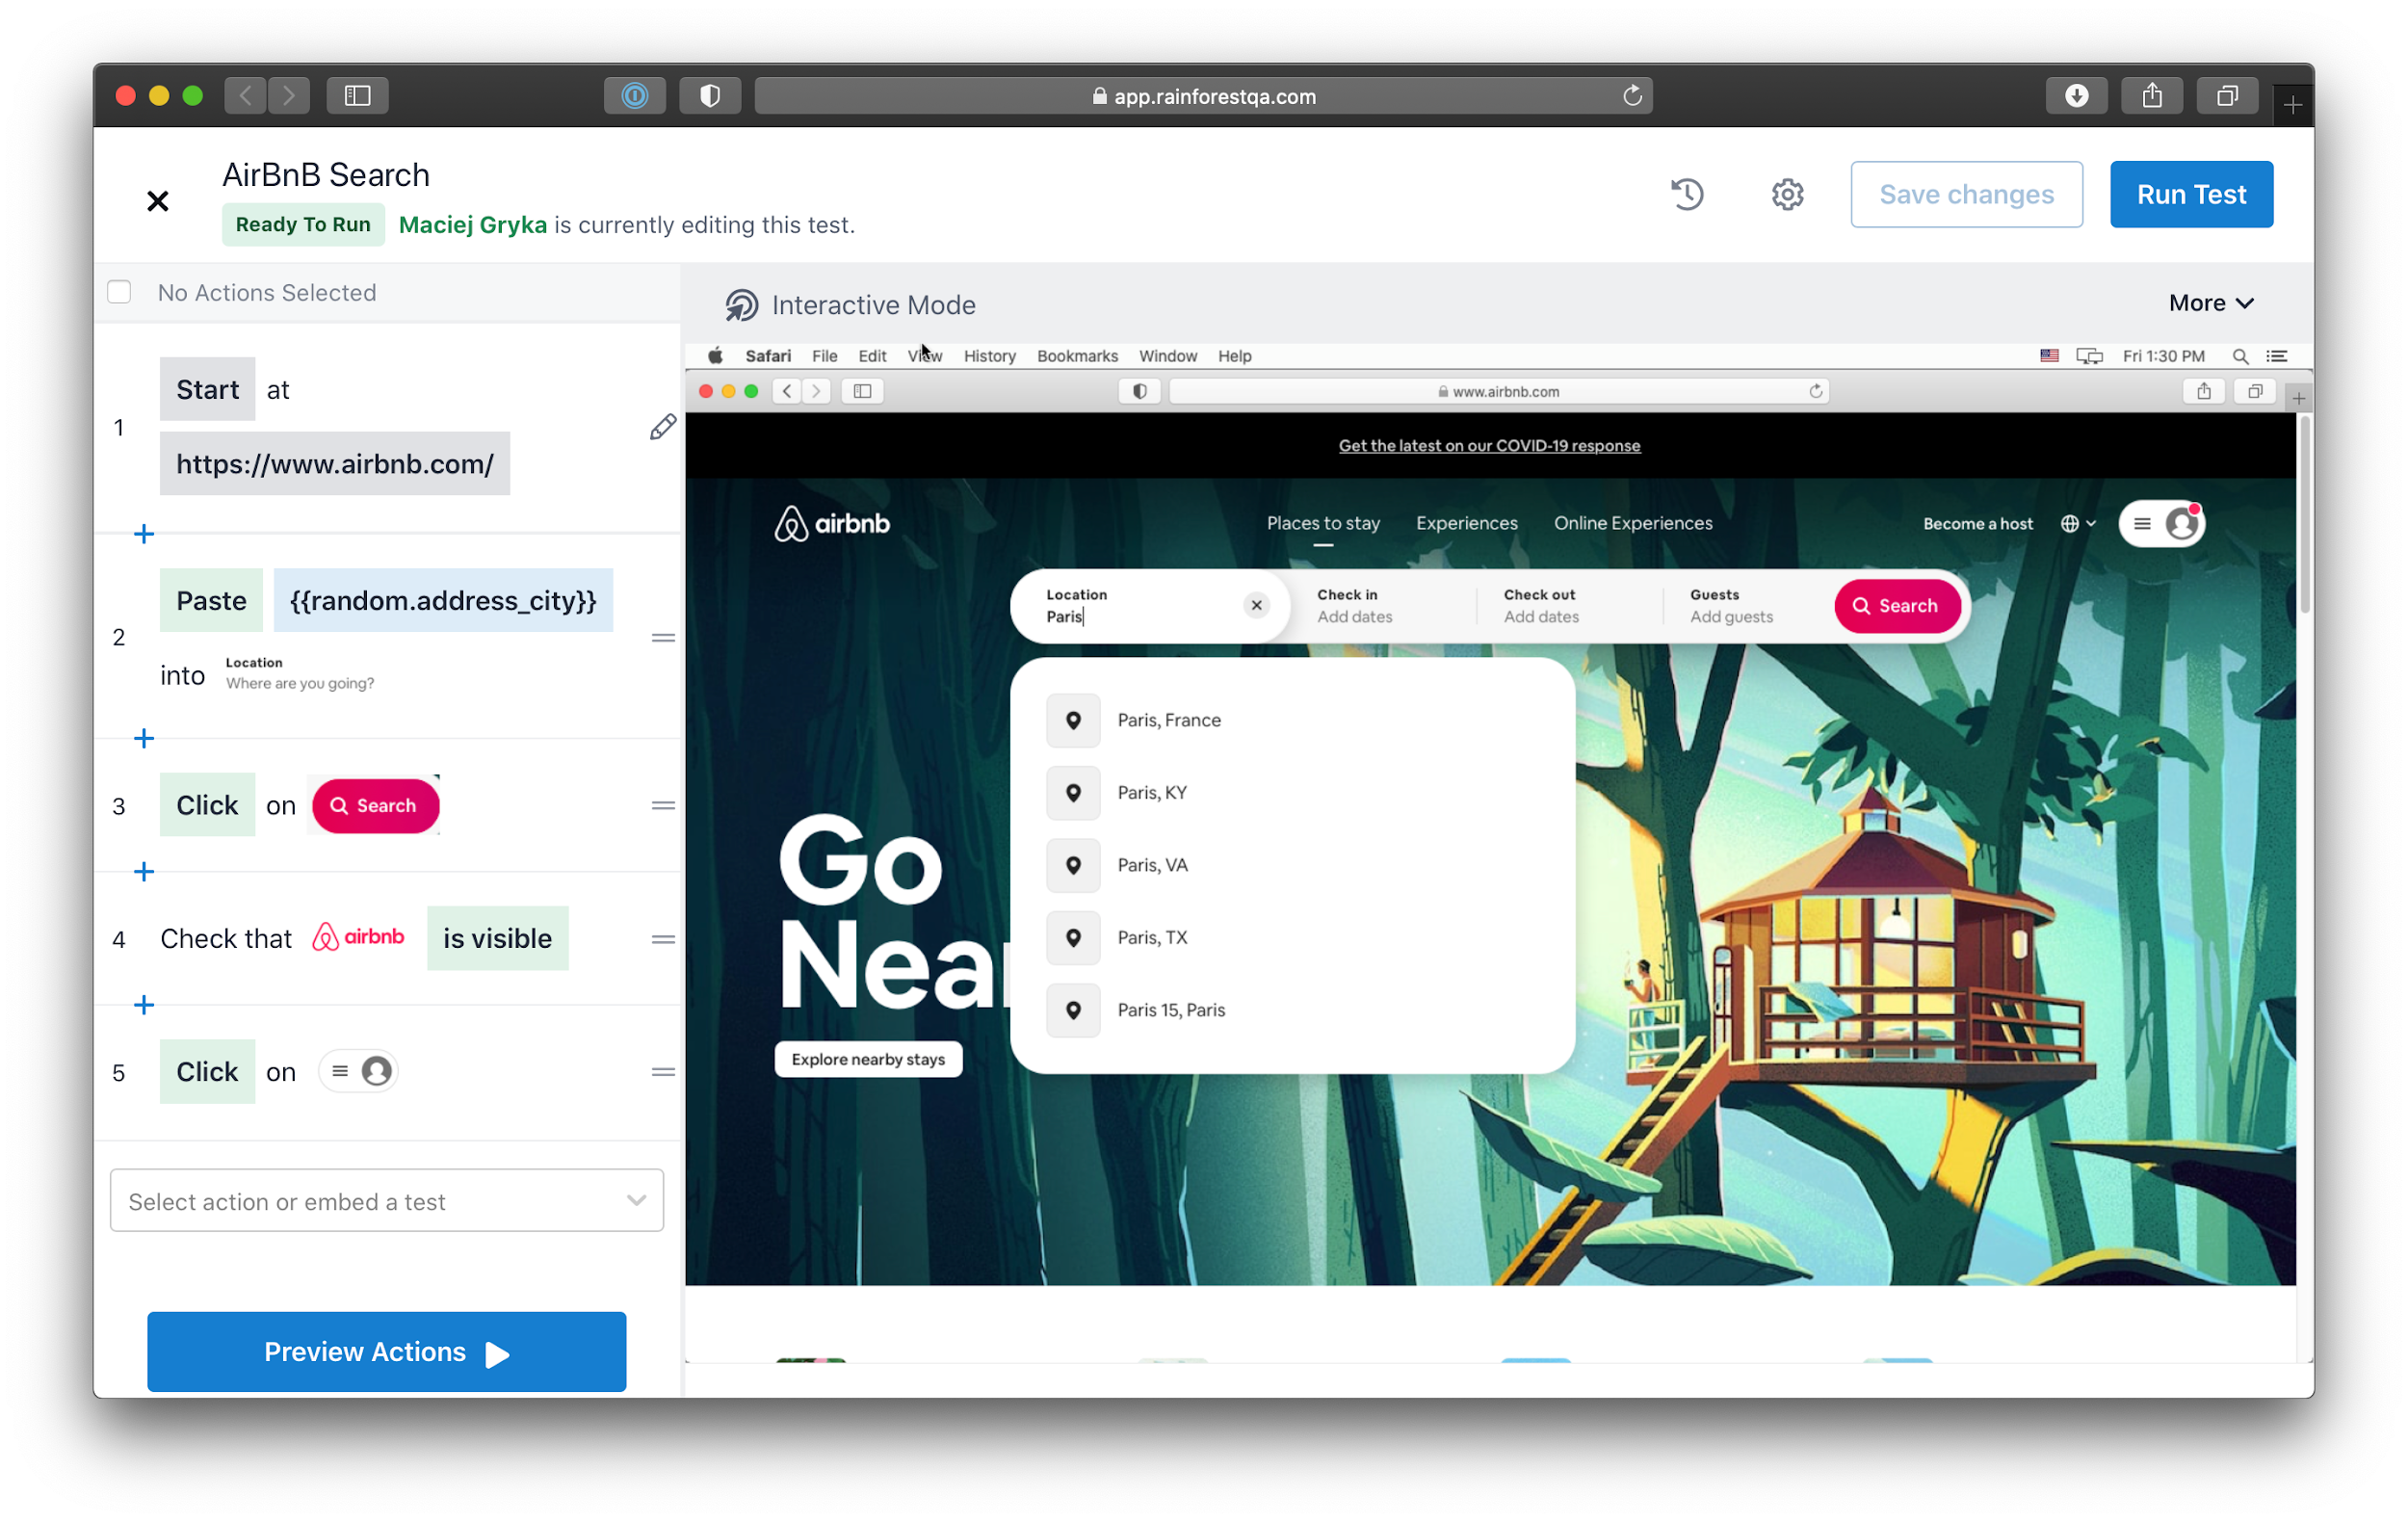
Example: Feature Spotlight - Automation
* Optional slide, but when there is a new exciting feature would be good to highlight it and talk it through with the team
Problem:
  Example: mature customers who are happy still churn (“graduate”) because of price
Hypothesis:
  By automating certain steps testers are doing we can reduce the cost of the service which should stem pricing churn
  In addition this will allow us to reduce pricing and may open up lower end self serve market
Timeline/Next Steps:
  V1 working well for churn save, unsure if it can scale though. Testing.
  Experimenting with self serve to see if market expansion opportunity is real.
Demo:

Slide 49
Example: Competitive Analysis
* Not necessarily a quarterly update, perhaps semi annual or annual checking in on where we are with competitors
 | Use Case 1 | Use Case 2 | Positioning | Pricing
Us |  |  | SMB | $$$
Competitor 1 |  |  | SMB | $$$
Competitor 2 |  |  | Enterprise | $
Competitor 3 |  |  | Enterprise | $
Competitor 4 |  |  | Everyone | $$
Competitor 1 commentary and some explanation
Competitor 2 commentary and some explanation (optional)
Competitor 3 commentary and some explanation (optional)

Slide 50
Example: Market sizing
Market Segment | Product Area | No. Customers | ARR ($K) | TAM ($M) | Market Share
SMB | Product 1 | 10000 | $20 | $200 | 20%
 | Product 2 | 12000 | $25 | $300 | 4%
 | Product 3 | 4000 | $40 | $160 | 0%
Enterprise | Product 1 | 1000 | $120 | $120 | 2%
 | Product 2 | 800 | $160 | $128 | <1%
 | Product 3 | 300 | $250 | $75 | 0%
 |  |  |  | $983

Slide 51
Appendix

Slide 52
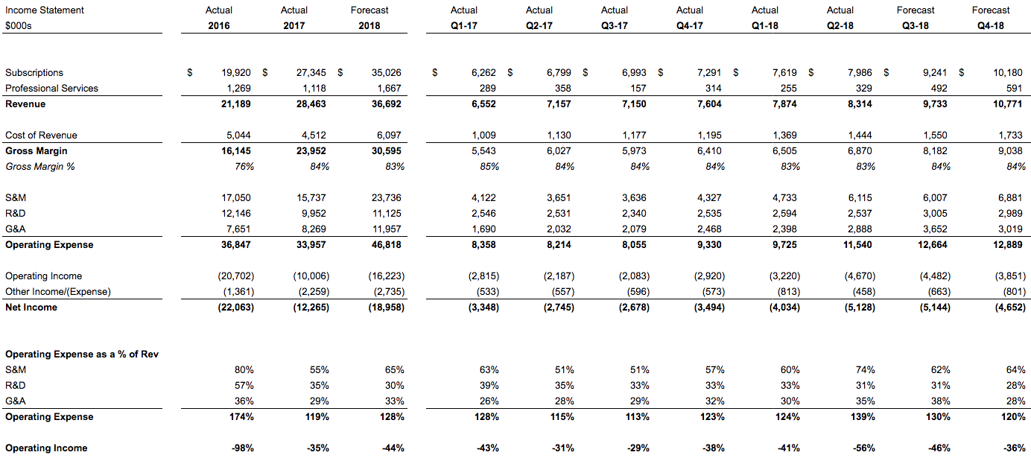
Income Statement
Notes:
Matt to cover this one.

Slide 53
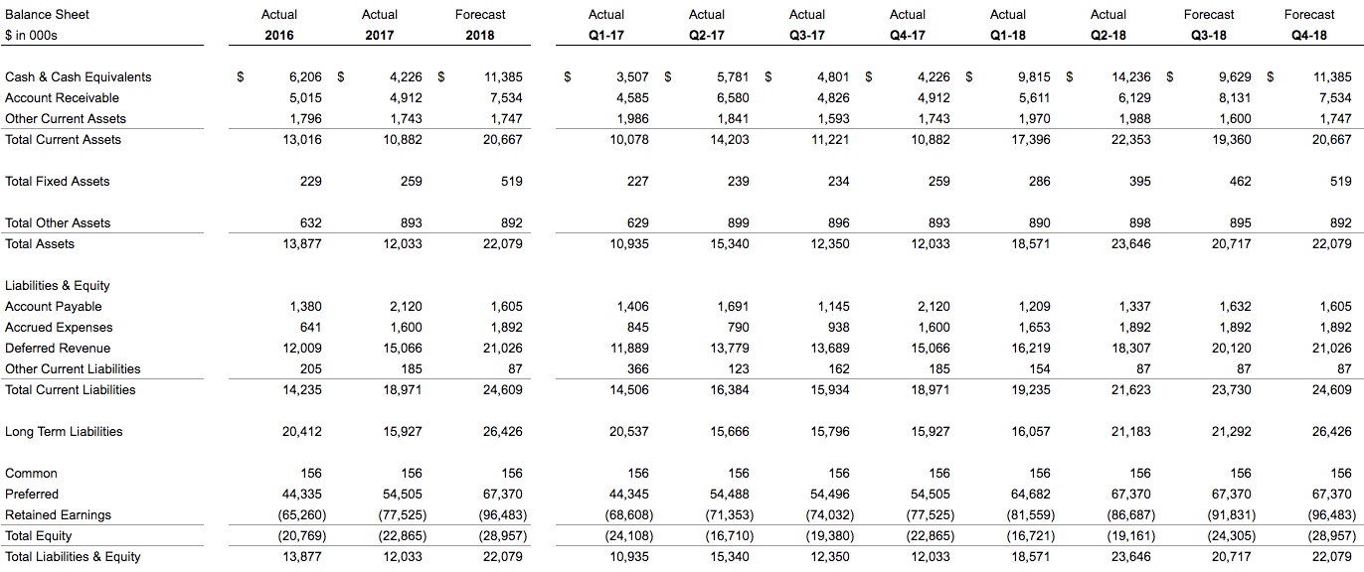
Balance Sheet

Slide 54
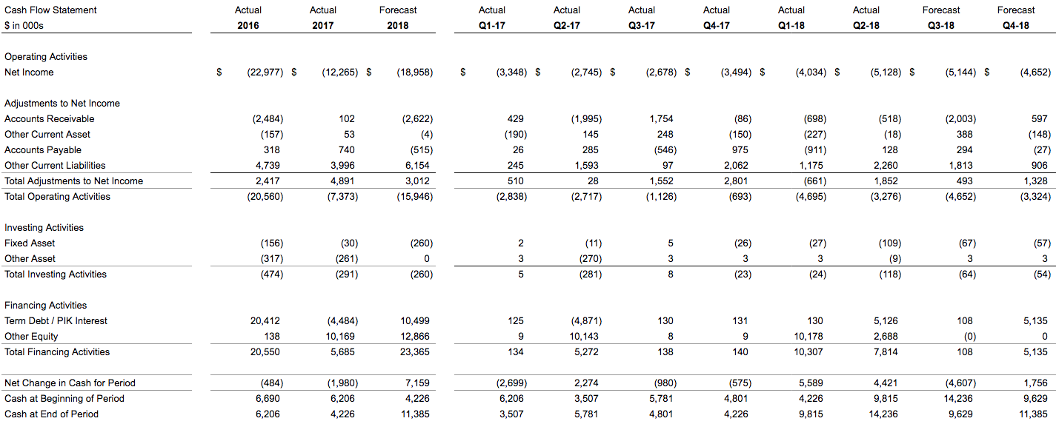
Cash Flow Statement

Slide 55
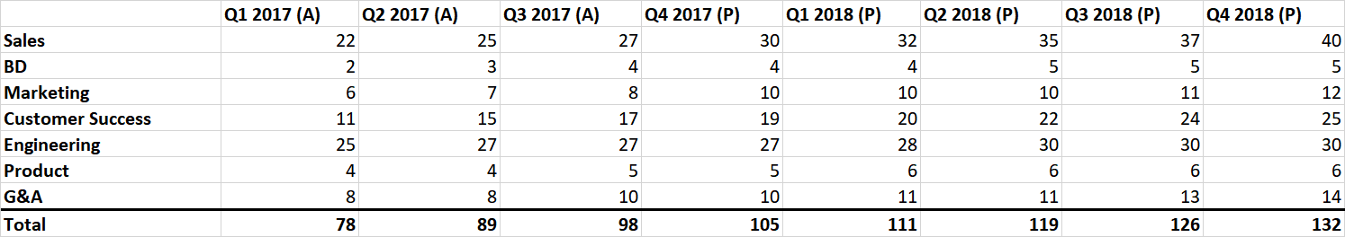
Trended Headcount by Department
The data is found on the “Trended Headcount” tab

Slide 56
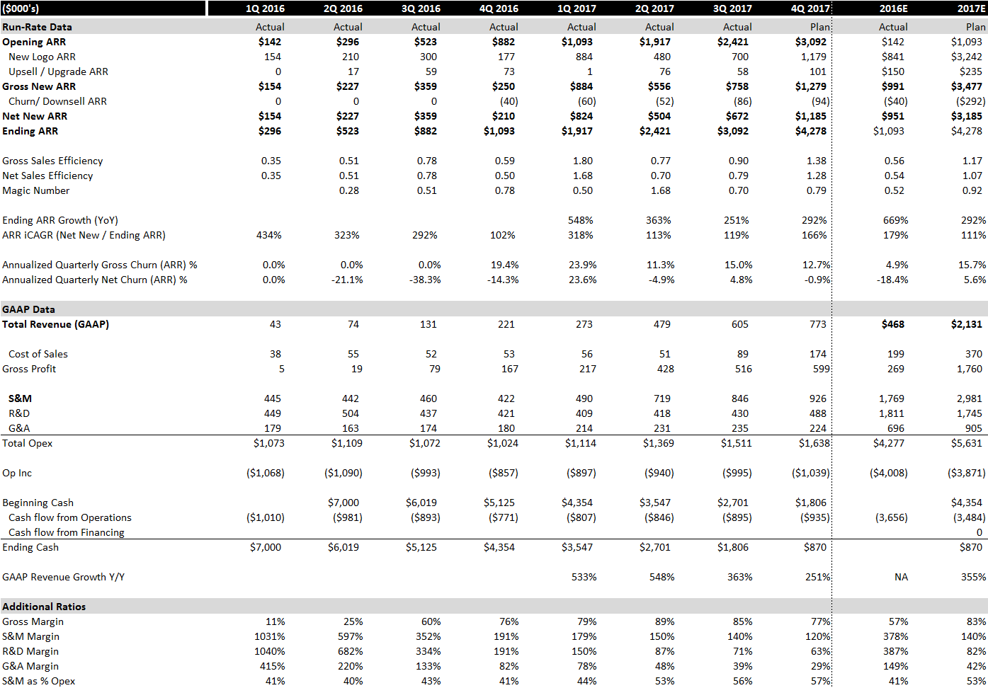
Trended Financial Analysis
The data is found on the “Model” tab

Slide 57
Other Slide Ideas

Slide 58
Example: Entering Pipe to New ARR Conversion Trends & Outlook
ARR Won / Entering Pipe
 | Q320(A) | Q420(A) | Q121(A) | Q221(A) | Q321(A) |  | Q421(E)
Entering Pipe | $6.0M | $5.5M | $7.0M | $6.5M | $7.5M | Entering Pipe | $6.5M
ARR Won | $2.0M | $2.2M | $2.5M | $2.3M | $2.5M | ARR Target | $3.0M
ARR Won / Entering Pipe | 33% | 40% | 36% | 35% | 33% | Required Close Rate | 46%
 |  |  |  | Conversion Rate Range | Min: 33% |  | $2.1M
 |  |  |  |  | Average: 35% |  | $2.3M
 |  |  |  |  | Max: 40% |  | $2.6M
Calculated conversion rate needed indicates high likelihood of ARR bookings shortfall
Likely ARR bookings based on historical conversion rates

Slide 59
Sample Slide: Churn Analysis

Slide 60
Sample Slide: Renewal Analysis

Slide 61




Categorizing Activity for Reporting
Growth: updates that improve customer acquisition and onboarding
Retention: updates that improve existing customer upsell opportunities
Expansion: new features and offerings targeted at entering new markets
Maintenance: improvements to existing features to retain customers
Four typical categories across markets:
*this slide is just a reference slide, not meant to be in the deck!

Slide 62
Current Quarter Stoplight Chart
* all comments below are examples
* not necessary to have all 4 categories, just showing as an example
ITEM | STATUS | NOTES
Growth |  | What is the high-level goal here?
Ship new enterprise features and get 5 beta/design partner customers to sign a beta contract |  | Closed 3/5 enterprise customers with new features
Retention |  | What is the high-level goal here?
Decrease customers who sign but never start using the product |  | Shipped new feature and reduced stuck customers from 25% (5/20) to ~10% (2/20)
Expansion |  | What is the high-level goal here?
Build new features that allow users to invite their coworkers |  | Shipped sharing feature to early alpha group, 2/15 customers used the feature and 25 referral signups but not charging yet
Maintenance |  | What is the high-level goal here?
Improve automation rate from 5% to 20% |  | Shipped feature, but only improved to 6%

Slide 63
Next Quarter Planning Chart
* all comments below are examples
* not necessary to have all 4 categories, just showing as an example
ITEM | STATUS | NOTES
Growth |  | What is the high-level goal here?
Get enterprise customers live & successful with the product to prove it works and get references | N/A | 100% of enterprise customers live in category 1 or 2 At least 1 public facing enterprise buyer quote that we can use
Retention |  | What is the high-level goal here?
Improve retention features from last quarter and roll out to 100% of clients with only 10% still in “stuck” | N/A | 100% new customers can use the feature No more than 10% of all customers in onboarding in the “stuck” category
Expansion |  | What is the high-level goal here?
Ship new feature to beta group to see if upsell potential | N/A | - Ship feature and have 3 engaged customers pay for product expansion
Maintenance |  | What is the high-level goal here?
Improve our product quality to reduce burden on the team | N/A | - Reduce product related support tickets by 25%

Slide 64
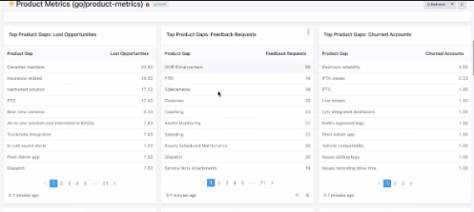
Product Metrics: Top Product Gaps
LOST OPPORTUNITIES |  | FEATURE REQUESTS |  | CHURNED ACCOUNTS
Product Gap | Lost Opportunities | Product Gap | Feature Requests | Product Gap | Churned Accounts
Feature name 1 | $33.00 | Feature name | $33.00 | Feature name 4 | 2
Feature name 2 | $45.00 | Feature name | $45.00 | Feature name 2 | 3
Feature name 3 | $23.00 | Feature name | $23.00 | Feature name 3 | 1
Feature name 4 | $33.00 | Feature name | $33.00 | Feature name 1 | 1
Feature name 5 | $45.00 | Feature name | $45.00 | Feature name 5 | 4
Feature name 6 | $23.00 | Feature name | $23.00 | Feature name 6 | 2

Slide 65
Team Allocation
* Meant to be more of a way to understand team allocation and focus rather than an exact counting of where people are spending time
 | Focus | Team Size | Feature Pts / % | Main Pts / % | Comments
Team 1 | Growth | 8 | 50 | 25 | -
Team 2 | Churn | 4 | 30 | 20 | -
Team 3 | Enterprise | 4 | 10 | 40 | -
Team 4 | Experimental | 2 | 10 | 0 | -
Total |  | 18 | 100% | 85%

Slide 66
Product Metrics: Lost Opps and Churn
Segment
Start Date
End Date
Product
All
04/01/21
06/01/21
Individual
>
>
>
>
LOST OPPORTUNITIES | PRODUCT LOSS RATE | CHURNED ACCOUNTS | PRODUCT CHURN
129 Lost due to product | 17% Product Loss Rate | 16 Churned due to product | 19% Product Churn

