Slide 1
Book of Funnels
A guide to the measuring the success of different GTM motions

Slide 2


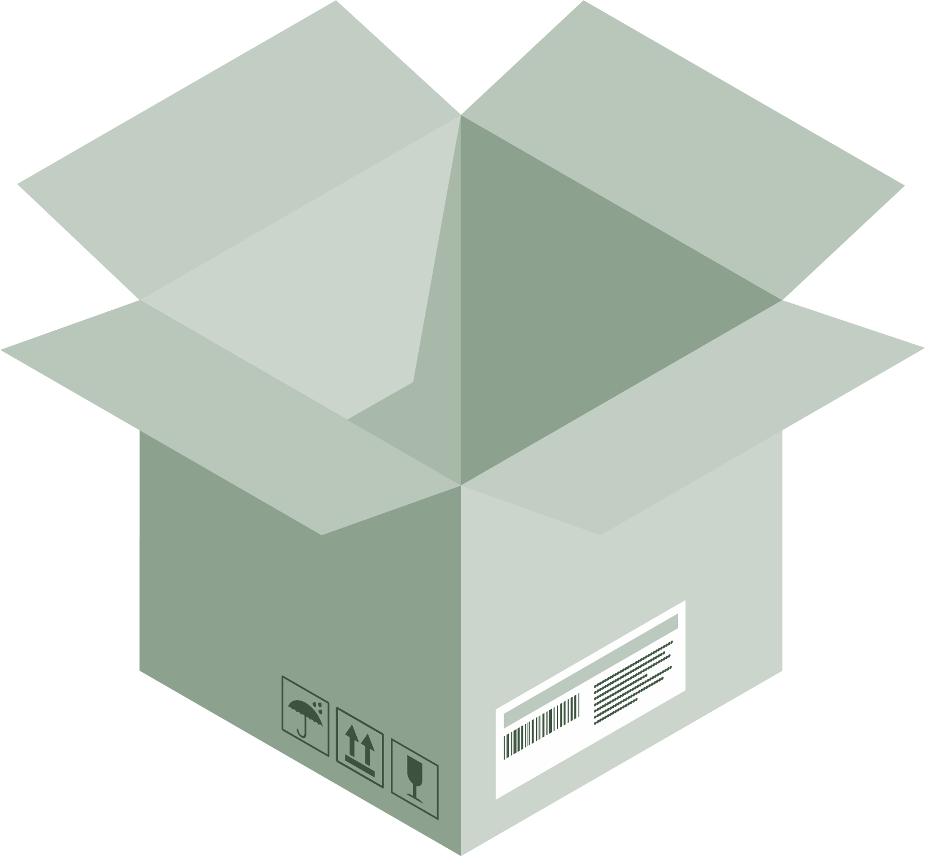
Scale GTM Provides Multiple Services
Scale GTM Advisors or Associates
Vetted 3rd Party Consultants
DIY
Members of the Scale team can advise you as you design, build, and optimize
Scale can recommend 3rd party consultants to help put “pen-to-paper”
The key elements required to do-it-yourself are there; tools/templates, build-out instructions, training, etc

Slide 3




Demand Generation Funnels
This collection of funnels is designed to help you manage and report on your demand generation efforts. The four funnels represent the most common demand gen models. You can choose the funnel(s) that make the most sense for your business and keep in mind, it’s common for organizations to use multiple funnels. For each funnel, we provide a recommended set of milestones that you can start using today or modify to best suit your business.
LEAD-CENTRIC
ACCOUNT-BASED
PRODUCT-LED
“GRASSROOTS” OUTBOUND
For programs focused on generating new lead registrations
Driven by marketing-led campaigns
High volume of leads
Inbound focused:
For programs focused on targeted accounts:
Narrow set of accounts
Complex sale
Multiple stakeholders
Often outbound
For programs driving prospects directly into the product:
Users can use product with little assistance
Driven by sign-ups and activations
For programs with little or no marketing support:
For early-stage GTM organizations
Driven by volume of activities
Focused on building contact database for future marketing campaign

Slide 4
LEAD-CENTRIC FUNNEL

Slide 5
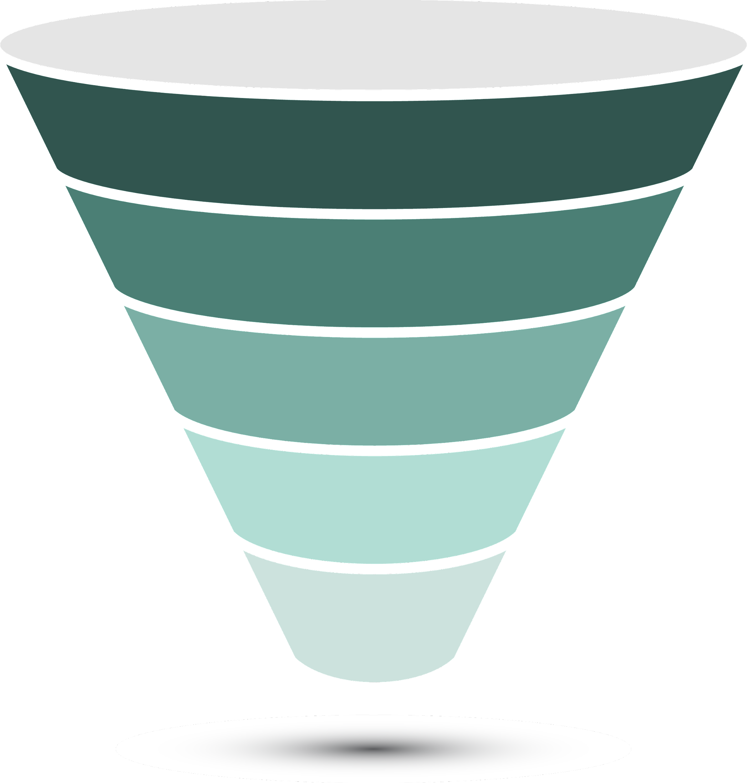
Lead-Centric Funnel
The lead-centric measurement model supports organizations generating a high volume of qualified leads.
LEADS: Names with contact information stored within your CRM.
LEADS
MQL: A lead that has engaged with your brand in a physical or digital space. (ex - filled out reg form for content)
MARKETING QUALIFIED LEADS
SQL: A prospective buyer that has been confirmed to meet the agreed-upon qualification definition and has agreed to a follow-up meeting with a sales rep.
SALES QUALIFIED LEADS
OPPORTUNITY: A potential sales deal, where a dedicated resource has been assigned to manage a sales cycle.
OPPORTUNITIES
CLOSED-WON
CLOSED-WON: A sales opportunity that has successfully closed.

Slide 6
Lead-Centric Funnel Dashboard
DESCRIPTION | EXAMPLE
Annual Contract Value | $50,000
Marketing Qualified Leads | 2,273
Conversion Rate | 23%
Sales Qualified Leads | 546
Conversion Rate | 24%
Opportunities | 175
Conversion Rate | 32%
Pipeline | $8,750,000
Closed-Won | 49
Conversion Rate | 28%
Revenue | $2,450,000
LEADS
MARKETING QUALIFIED LEADS
SALES QUALIFIED LEADS
OPPORTUNITIES
CLOSED-WON

Slide 7
ACCOUNT-BASED FUNNEL

Slide 8
Account-Based Funnel
An account-based funnel supports go-to-market programs focused on a specific set of target accounts (e.g ABM or enterprise).
TARGET ACCOUNTS: The list of accounts that match the ICP criteria and have been prioritized by the organization to pursue.
TARGET ACCOUNTS
ENGAGED ACCOUNTS: A target account that has reached a minimum threshold of measurable engagement. (e.g. Website visits, content downloads, intent signals, etc)
ENGAGED ACCOUNTS
SQL: A prospective buyer that has been qualified, meets the agreed-upon qualification definition, and has agreed to a follow-up meeting with a sales rep.
SALES QUALIFIED LEADS
OPPORTUNITIES
OPPORTUNITY: A potential sales deal in a target account.
CLOSED-WON
CLOSED-WON: A sales opportunity from a target account that has successfully closed.

Slide 9
Account-Based Dashboard
DESCRIPTION | EXAMPLE
Annual Contract Value | $50,000
Target Accounts | 1,000
Engaged Accounts | 419
Conversion Rate | 42%
SDR-Qualified Leads | 300
Conversion Rate | 72%
Opportunities | 208
Conversion Rate | 69%
Accounts | 139
Pipeline | $10,400,000
Closed-Won | 111
Conversion Rate | 53%
Revenue | $5,550,000
TARGET ACCOUNTS
ENGAGED ACCOUNTS
SALES QUALIFIED LEADS
OPPORTUNITIES
CLOSED-WON

Slide 10
PRODUCT-LED FUNNEL

Slide 11
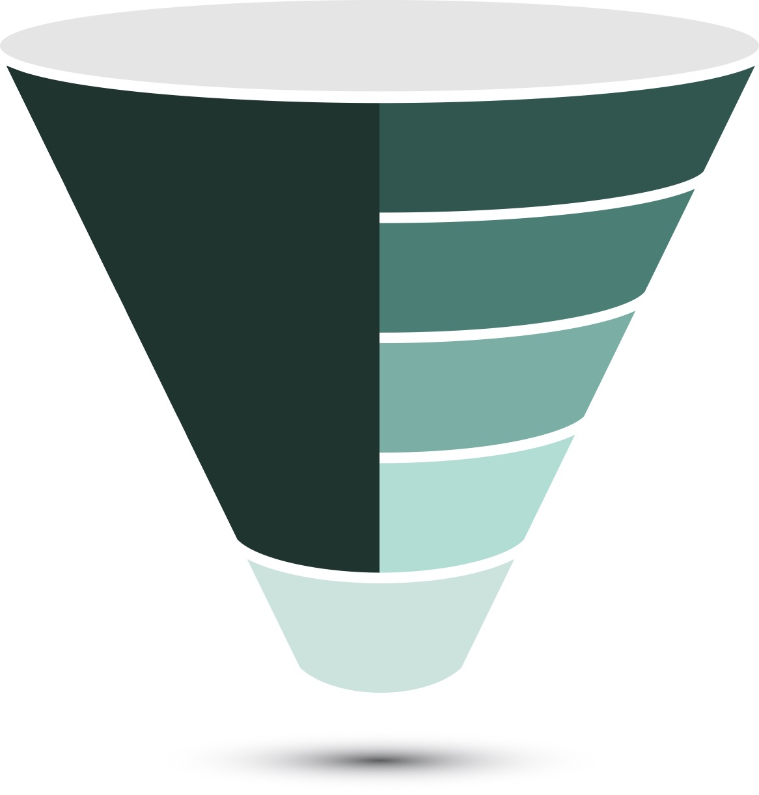
Product-Led Funnel
Product-Led Sales is a go-to-market strategy where the buyers interact with the product in the sales process
PRODUCT SIGN-UPS
ACTIVATIONS: Accounts that have at least one user within the application but have not yet hit a threshold or milestone in order for sales to take action
SELF-SERVE
SALES-ASSISTED
PQL: An individual who has used the product or specific features that are indicative of buyer value (e.g., experienced an “a-ha” moment)
PRODUCT QUALIFIED LEADS
SALES-QUALIFIED LEAD
SQL: A prospective buyer that has been qualified, meets the agreed-upon qualification definition, and has agreed to a follow-up meeting with a sales rep.
OPPORTUNITIES
OPPORTUNITY: A potential sales deal in a target account.
CLOSED-WON
CLOSED-WON: A sales opportunity from a target account that has successfully closed.

Slide 12
Product-Led Sales Dashboard
DESCRIPTION | EXAMPLE
Annual Contract Value | $50,000
Activations | 1,000
Product Qualified Lead | 419
Conversion Rate | 42%
Sales Qualified Lead | 300
Conversion Rate | 72%
Opportunities | 208
Conversion Rate | 66%
Accounts | 139
Pipeline | $695,000
Closed-Won | 111
Conversion Rate | 79%
Revenue | $5,550,000
PRODUCT SIGN-UPS
SELF-SERVE
SALES-ASSISTED
PRODUCT QUALIFIED LEADS
SALES-QUALIFIED LEAD
OPPORTUNITIES
CLOSED-WON
Notes:
Nobody goes from free to
50 seats on Figma
Free to paid to middle tier to enterprise plan
Signup — to the three bucket

Slide 13
“GRASSROOTS” OUTBOUND FUNNEL

Slide 14
“Grassroots” Outbound Funnel
The “grassroots” outbound model focuses on outbound activities to a broad set of accounts, with little or no marketing support.
CONTACTS
CONTACTS: Names with contact information stored within your CRM.
SDR ACTIVITIES
ACTIVITIES: Email, calls, and social touches by SDRs used to drive engagement with prospects.
CONNECTS: A phone call between the SDR and a prospect to deliver the value proposition, qualify the prospect against the SQL criteria and a set a meeting for the sales reps
CONNECTS
SQL: A prospective buyer that has been qualified, meet the agreed-upon qualification definition, and has agreed to a follow-up meeting with a sales rep.
SDR-QUALIFIED LEADS
OPPORTUNITIES
OPPORTUNITY: A potential sales deal in a target account.
CLOSED-WON
CLOSED-WON: A sales opportunity that has successfully closed.

Slide 15
“Grassroots” Outbound Funnel Dashboard
DESCRIPTION | EXAMPLE
Average Contract Value | $50,000
Contacts | 10,000+
Activities | 50 calls/emails per day
Connects | 6/per day
Connect Rate | 11%
Sales Qualified Leads | 132
Conversion Rate | 30%
Opportunities | 40
Conversion Rate | 85%
Closed-Won | 16
Conversion Rate | 40%
Revenue | $800,000
CONTACTS
SDR ACTIVITIES
CONNECTS
SDR-QUALIFIED LEADS
OPPORTUNITIES
CLOSED-WON

Slide 16
Book of Funnels
A guide to the measuring the success of different GTM motions

