Slide 1
Board deck template
2025

Slide 2
Intro to
board reporting

Slide 3
The 5 cardinal rules of board reporting
Translate complexity into clarity: Avoid the data dump. Strip out noise. Present metrics that matter to your business in context.
Highlight what matters most: Curate the 3-5 insights that shaped the quarter. Trends > snapshots. Direction > detail. Make liberal use of the appendix.
Lead with the “so what?”: Good reporting says what happened. Great reporting explains why—and what you’re doing next.
Tie everything back to strategy: Use the board deck to show how execution maps to company goals (growth, runway, product, etc.).
Make it easy to digest: Clean formatting. Clear headlines. Consistent charts. <5 slides per section. Appendix for depth.
CONFIDENTIAL
INSTRUCTIONS

Slide 4
The role of the board deck
Your job:
1
2
3
Translate complexity into clarity
Highlight what matters
Help the Board make better decisions
Early-stage companies run on instinct
Post-Series A, your Board expects operational rigor and data-backed storytelling
Board reporting is where leaders can build trust - and shape the strategic narrative
INSTRUCTIONS
Notes:
Early stage guys drive right up against the windshield - next 30 seconds
Want to be ale to look forward

Slide 5
Foundation needed for effective reporting
What you need | Description
Financial Foundation | ARR waterfall (growth, churn, expansion), accrual-based financials, cash & runway
GTM Foundation | Pipeline, quota capacity, sales efficiency, retention - the heartbeat of growth
Product & Customer Foundation | Product roadmap tied to strategy, adoption & usage metrics, customer advocacy
People & Operating Foundation | Headcount plan vs. actuals, attrition, critical hiring needs, organizational health
You don’t need perfection - just structure and consistency, with every function reporting in a way that ties back to company strategy
INSTRUCTIONS

Slide 6
A checklist for metric selection
Is it actionable? Can this metric inform a clear decision or next step?
Is it a trend? Does it show progress over time?
Does it map to a strategic priority? Is it directly tied to goals like growth, efficiency or runway?
Would the Board ask about it anyway? Does it preempt common investor questions or concerns?
Is it owned and understood internally? Is someone accountable and can you explain it clearly?
INSTRUCTIONS

Slide 7
The layer cake of strategic reporting
Numbers are just the start - add insight & action
3. Top layer: What do we do about it?
2. Middle layer: Why are they that way?
1. Bottom layer: What are the numbers?
INSTRUCTIONS

Slide 8
Example
3. What do we do: GTM is re-focusing on mid-market accounts with lower churn & higher expansion potential
2. Why: Churn in SMB segment ticked up X%
What happened: ARR dropped X% quarter over quarter
INSTRUCTIONS

Slide 9
TEMPLATE Sample board deck

Slide 10
CEO slides

Slide 11
For all companies
Slide 1: Highlights, lowlights, & focus areas
Highlights
Lowlights
Focus areas
3-5 bullets summarizing highlights for the quarter:
3-5 bullets summarizing lowlights for the quarter:
3-5 bullets summarizing focus areas for next quarter:
The CEO should kick off the meeting with a few slides on their observations of the business and a handful of metrics. Headline here (and throughout the deck) should be a bold takeaway from the quarter’s financial updates
CONFIDENTIAL

Slide 12
Slide 2: Key numbers
For all companies
ARR
Growth
# Months Runway
$XX
XX
XX
Choose the metrics that give the best insight into what’s happening with your business from a financial perspective
Commentary
What
Why
What next
CONFIDENTIAL

Slide 13
Sample finance slides

Slide 14
The finance section should come next. Headline should be a bold takeaway from the quarter’s financial updates
For all companies
Slide 1: Highlights, lowlights & focus areas
Highlights
Lowlights
Focus areas
Metric #1 performance
Metric #2 performance
Metric #3 performance
Metric #4 performance
Metric #5 performance
Focus area #1
Focus area #2
Focus area #3
The metrics highlighted here should be the top 3-5 metrics that truly drove your results. Not just ARR & Growth, but what had the biggest influence on the quarter. Pipeline? Sales productivity? Conversion rates? Be specific
CONFIDENTIAL

Slide 15
Slide 2: Financial highlights
For all companies
Gross Margin
Operating Burn
# Months Runway
XX%
$XX
XX
Choose the metrics that give the best insight into what’s happening with your business from a financial perspective
Commentary
What
Why
What next

Slide 16
Slide 3: Quarterly financial results
For all companies
Headline should be the key takeaway
Commentary
What
Why
What next
 | Quarterly |  |  |  | Year to date
 | Q2:25 | Q2:25 | Comparison |  | Q2:25 | Q2:25 | Comparison
 | Actual | Plan | % of budget |  | Actual | Plan | % of budget
Revenue | $401 | 300 | 134% |  | $687 | [manual] | NA
COGS | $100 | [manual] | NA |  | $172 | [manual] | NA
Gross profit | $301 | [manual] | NA |  | $515 | [manual] | NA
Gross margin % | 75% | NA | NA |  |  | NA | NA
S&M | $525 | [manual] | NA |  | $900 | [manual] | NA
R&D | $497 | [manual] | NA |  | $852 | [manual] | NA
G&A | $301 | [manual] | NA |  | $515 | [manual] | NA
Total | $1,323 | [manual] | NA |  | $2,267 | [manual] | NA
Operating income | ($1,023) | [manual] | NA |  | ($1,752) | [manual] | NA
Ending cash | $13,248 | [manual] | NA |  | $13,248 | [manual] | NA
Months runway | 35 | [manual] | NA |  | 35 | [manual] | NA
If you have an updated forecast for NQ or FY, include as an additional slide

Slide 17
Slide 4: Quarterly ARR results
For all companies
Headline should be the key takeaway
Commentary
What
Why
What next
 | Quarterly |  |  |  | Year to date
 | Q2:25 | Q2:25 | Comparison |  | Q2:25 | Q2:25 | Comparison
 | Actual | Plan | % of budget |  | Actual | Plan | % of budget
Starting ARR | $1,440 | [manual] | NA |  | $1,000 | [manual] | NA
New customer ARR | $356 | [manual] | NA |  | $694 | [manual] | NA
Upsell | $144 | [manual] | NA |  | $247 | [manual] | NA
Gross new ARR | $501 | [manual] | NA |  | $941 | [manual] | NA
Churn | ($30) | [manual] | NA |  | ($30) | [manual] | NA
Net new ARR | $471 | [manual] | NA |  | $911 | [manual] | NA
Ending ARR | $1,911 | [manual] | NA |  | $1,911 | [manual] | NA
Y/Y growth % | -% | [manual] |  |  | -% | [manual]
Gross retention | 92% | [manual] | NA |  | 89% | [manual] | NA
Net retention | 137% | [manual] | NA |  | 231% | [manual] | NA

Slide 18
Slide 5: Trended operating metrics (1 of 2)
For all companies
Commentary
What
Why
What next
 | Q1:24 | Q2:24 | Q3:24 | Q4:24 | Q1:25 | Q2:25 | Q3:25 | Q4:25
 | Actual | Actual | Actual | Actual | Actual | Actual | Budget | Budget
ARR & sales efficiency
S&M spend | $375 | $525 | $686 | $765 | $925 | $1,250 | $1,414 | $1,792
Total: Gross new ARR | $440 | $501 | $566 | $638 | $1,335 | $1,517 | $1,715 | $1,932
Total: Net new ARR | $440 | $471 | $566 | $578 | $1,335 | $1,492 | $1,675 | $1,842
Total: gross SE | 1.2x | 1.0x | 0.8x | 0.8x | 1.4x | 1.2x | 1.2x | 1.1x
Total: net SE | 1.2x | 0.9x | 0.8x | 0.8x | 1.4x | 1.2x | 1.2x | 1.0x
Total ending ARR | $1,440 | $1,911 | $2,477 | $3,056 | $4,390 | $5,882 | $7,557 | $9,399
Y/Y growth % |  |  |  |  | 205% | 208% | 205% | 208%
Cash position
Ending cash | $14,271 | $13,248 | $11,918 | $10,569 | $9,075 | $7,330 | $5,572 | $28,359
Operating income | ($729) | ($1,023) | ($1,330) | ($1,349) | ($1,494) | ($1,745) | ($1,758) | ($2,213)
Months of runway |  |  | 27 | 24 | 18 | 13 | 10 | 38
Burn multiple |  |  | 2.3x | 2.3x | 1.1x | 1.2x | 1.0x | 1.2x
This slide and the previous provide examples of metrics that could be used. Pick the top 5-10 and create one slide that capture the key numbers. The goal is one slide that captures the top metrics for your business
Add in trended metrics around churn or retention. Discuss how your key metrics compare to plan

Slide 19
Slide 5: Trended operating metrics (2 of 2)
For all companies
Commentary
What
Why
What next
 | Q1:24 | Q2:24 | Q3:24 | Q4:24 | Q1:25 | Q2:25 | Q3:25 | Q4:25
 | Actual | Actual | Actual | Actual | Actual | Actual | Budget | Budget
Funnel
Users to website | 5,625 | 5,938 | 6,250 | 6,563 | 16,875 | 17,813 | 18,750 | 19,688
Inbound demo requests | 281 | 297 | 313 | 328 | 844 | 891 | 938 | 984
Sales meetings booked | 56 | 59 | 63 | 66 | 169 | 178 | 188 | 197
Closed won deals | 11 | 12 | 13 | 13 | 34 | 36 | 38 | 39
Pipeline
Starting pipeline | $5,000 | $5,844 | $6,734 | $7,672 | $8,656 | $11,188 | $13,859 | $16,672
Gross added | $8,438 | $8,906 | $9,375 | $9,844 | $25,313 | $26,719 | $28,125 | $29,531
Closed won | ($338) | ($356) | ($375) | ($394) | ($1,013) | ($1,069) | ($1,125) | ($1,181)
Closed lost | ($7,256) | ($7,659) | ($8,063) | ($8,466) | ($21,769) | ($22,978) | ($24,188) | ($25,397)
Other adjustments | $- | $- | $- | $- | $- | $- | $- | $-
Ending pipeline ($) | $5,844 | $6,734 | $7,672 | $8,656 | $11,188 | $13,859 | $16,672 | $19,625
Closed won / start pipe | 7% | 6% | 6% | 5% | 12% | 10% | 8% | 7%
Quota attainment
Quota | $464 | $527 | $596 | $672 | $1,405 | $1,596 | $1,805 | $2,034
Bookings | $440 | $501 | $566 | $638 | $1,335 | $1,517 | $1,715 | $1,932
Bookings / quota | 95% | 95% | 95% | 95% | 95% | 95% | 95% | 95%
This slide and the previous provide examples of metrics that could be used. Pick the top 5-10 and create one slide that capture the key numbers. The goal is one slide that captures the top metrics for your business

Slide 20
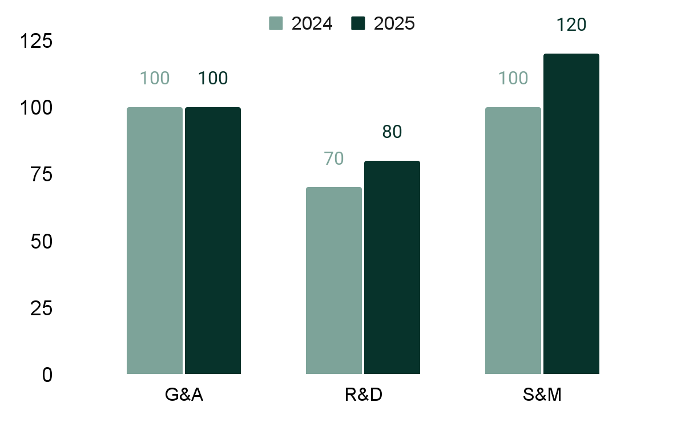
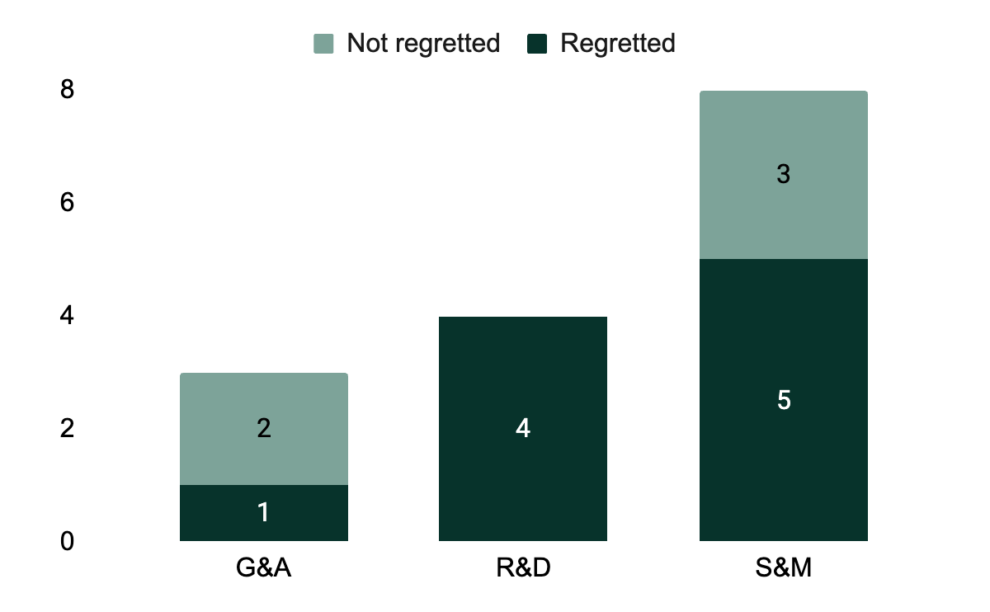
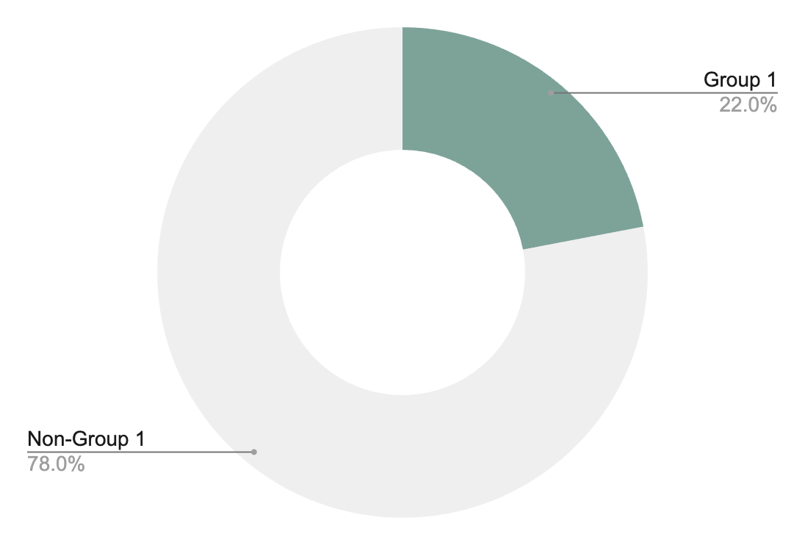
Slide 6: People update
For all companies
Global workforce
Employee diversity
Employee attrition
Total workforce: 300 FTEs
Average tenure: 3.4 years
 | Group #1 |  | Group #2
IC | 25% |  | 25%
Leader | 16% |  | 28%
Total | 22% |  | 26%
Retention YTD: 95%
Turnover YTD: 15 FTEs
Regrettable turnover YTD: 7 FTEs

Slide 21
Appendix: Trended ARR
Actuals + plan / projected
Appendix for all companies
 | Q1:24 | Q2:24 | Q3:24 | Q4:24 | Q1:25 | Q2:25 | Q3:25 | Q4:25 | Q1:26 | Q2:26 | Q3:26 | Q4:26
 | Actual | Actual | Actual | Actual | Actual | Actual | Budget | Budget | Projected | Projected | Projected | Projected
Starting ARR | $1,000 | $1,440 | $1,911 | $2,477 | $3,056 | $4,390 | $5,882 | $7,557 | $9,399 | $11,483 | $13,700 | $16,139
New customer ARR | $338 | $356 | $375 | $394 | $1,013 | $1,069 | $1,125 | $1,181 | $1,688 | $1,781 | $1,875 | $1,969
Upsell | $103 | $144 | $191 | $244 | $322 | $448 | $590 | $751 | $466 | $566 | $674 | $792
Gross new ARR | $440 | $501 | $566 | $638 | $1,335 | $1,517 | $1,715 | $1,932 | $2,153 | $2,347 | $2,549 | $2,761
Churn | $- | ($30) | $- | ($60) | $- | ($25) | ($40) | ($90) | ($70) | ($130) | ($110) | ($75)
Net new ARR | $440 | $471 | $566 | $578 | $1,335 | $1,492 | $1,675 | $1,842 | $2,083 | $2,217 | $2,439 | $2,686
Ending ARR | $1,440 | $1,911 | $2,477 | $3,056 | $4,390 | $5,882 | $7,557 | $9,399 | $11,483 | $13,700 | $16,139 | $18,825
Y/Y growth % |  |  |  |  | 205% | 208% | 205% | 208% | 162% | 133% | 114% | 100%
Trended ARR waterfalls, financials, and operating metrics: these are great views to put in the appendix as backup. They’re there if someone has questions, but you don’t need to walk through in detail

Slide 22
Appendix: Trended financials
Actuals + plan / projected
Appendix for all companies
 | Q1:24 | Q2:24 | Q3:24 | Q4:24 | Q1:25 | Q2:25 | Q3:25 | Q4:25 | Q1:26 | Q2:26 | Q3:26 | Q4:26
 | Actual | Actual | Actual | Actual | Actual | Actual | Budget | Budget | Projected | Projected | Projected | Projected
Revenue | $286 | $401 | $524 | $669 | $873 | $1,219 | $1,607 | $2,036 | $2,523 | $3,053 | $3,633 | $4,252
COGS | $71 | $100 | $131 | $167 | $218 | $305 | $402 | $509 | $631 | $763 | $908 | $1,063
Gross profit | $214 | $301 | $393 | $502 | $655 | $915 | $1,205 | $1,527 | $1,892 | $2,290 | $2,725 | $3,189
Gross margin % | 75% | 75% | 75% | 75% | 75% | 75% | 75% | 75% | 75% | 75% | 75% | 75%
S&M | $375 | $525 | $686 | $765 | $925 | $1,250 | $1,414 | $1,792 | $1,950 | $2,106 | $2,507 | $2,934
R&D | $355 | $497 | $644 | $665 | $762 | $900 | $970 | $1,215 | $1,290 | $1,352 | $1,598 | $1,871
G&A | $214 | $301 | $393 | $420 | $462 | $510 | $579 | $733 | $836 | $855 | $1,017 | $1,191
Total | $944 | $1,323 | $1,723 | $1,850 | $2,149 | $2,660 | $2,963 | $3,740 | $4,076 | $4,313 | $5,122 | $5,996
Operating income | ($729) | ($1,023) | ($1,330) | ($1,349) | ($1,494) | ($1,745) | ($1,758) | ($2,213) | ($2,184) | ($2,024) | ($2,398) | ($2,806)
Ending cash | $14,271 | $13,248 | $11,918 | $10,569 | $9,075 | $7,330 | $5,572 | $28,359 | $26,175 | $24,151 | $21,754 | $18,947
Months of cash | 52 | 35 | 25 | 25 | 16 | 13 | 9 | 36 | 40 | 34 | 26 | 19
You should also include a trended balance sheet (along with most recent quarterly BVA) in the appendix as well

Slide 23
Sample GTM slides All companies

Slide 24
Instructions for GTM slides
Pick what fits: The next slides show examples of metrics and views every company should consider, plus a few extras for businesses at ~$10M+ ARR. They are a menu, not a checklist.
Don’t build everything: You don’t need to replicate every chart. Choose the ones that best illuminate your business model and growth story.
Start where you are: Some metrics are messy - definitions evolve, data sources change, and early tracking can be incomplete. That’s normal. Track them anyway.
Why it matters: Consistently tracking key metrics lets you:
Understand performance drivers over time
Build a data-backed view of the future
CONFIDENTIAL
INSTRUCTIONS

Slide 25
Main deck for all companies
Slide 1: Highlights, lowlights, & focus areas
Highlights
Lowlights
Focus areas
3-5 bullets summarizing highlights for the quarter:
New logos
Gross new ARR
Expansion ARR
Sales efficiency
Segment-level performance
Etc.
3-5 bullets summarizing lowlights for the quarter:
New logos
Gross new ARR
Expansion ARR
Sales efficiency
Segment-level performance
Etc.
3-5 bullets summarizing focus areas for next quarter:
CONFIDENTIAL

Slide 26
For all companies
Slide 2: Key GTM highlights
Ending ARR
Net New ARR
Y/Y Growth %
NRR%
$XX
$XX
XX%
XX%
Choose the metrics that give the best insight into what’s happening with your business from a GTM perspective
Commentary
What
Why
What next

Slide 27
For all companies
 | Q1:24 | Q2:24 | Q3:24 | Q4:24 | Q1:25 | Q2:25 | Q3:25 | Q4:25
 | Actual | Actual | Actual | Actual | Actual | Actual | Budget | Budget
Funnel
Leads
MQLs / MQAs
Opportunities
Closed won deals
MQL / lead %
Opportunity / MQL %
Won / opportunity %
Pipeline
Starting pipeline
Gross added
Closed won
Closed lost
Ending pipeline
Gross new / start pipe %
Quota attainment
AE headcount
Quota
Gross new ARR / AE
Gross new ARR / quota
ARR
New logo ARR
Expansion ARR
Total gross new ARR
Churn / contraction
Net new ARR
Ending ARR
Y/Y growth %
Slide 3:
Trended funnel
Commentary
What
Why
What next
While some of these metrics may not apply to your business, the intent is to surface the core drivers and leading indicators of revenue, illustrate their trends over time, and provide a basis for forward projections
CONFIDENTIAL

Slide 28
For all companies
Slide 4: Top wins (new logo + expansion)
Customer | Segment | Starting ARR | Q2:25 expansion (if applicable) | Current ARR | Notes
Total
Commentary
What
Why
What next
CONFIDENTIAL

Slide 29
For all companies
Slide 5: High priority opportunities
Opportunity | Summary | ARR | Owner
Commentary
What
Why
What next
Show any key opportunities in the pipeline that the team is working. Use this slide to: a) demonstrate the type of customers you’re trying to win and b) secure deal assistance from your Board (through introductions, relationships, etc.)

Slide 30
For all companies
Slide 6: Notable churns & contractions
Customer | Segment | Q1:25 ARR (if applicable) | Q2:25 churn (if applicable) | Current ARR | Notes
Total
Commentary
What
Why
What next
CONFIDENTIAL

Slide 31
For all companies
Slide 7: Top ten customers
Customer | Segment | Initial ARR | Current ARR | Renewal | Notes
Total
Commentary
What
Why
What next
This is your opportunity to discuss customer health. Highlight your top logos, show how (if) they have grown over time and includes notes on the relationship. Color coding red / yellow / green is helpful.
CONFIDENTIAL

Slide 32
For all companies
Slide 8: NQ forecast
Commentary
What
Why
What next
 | Q1:25 | Q2:25 | Q3:25 | Q3:25 | Q3:25
 | Actual | Actual | Forecast | Plan | Forecast vs. Plan
Funnel
Leads
Opportunities
Closed won deals
Won / opportunity %
Pipeline
Starting pipeline
Gross new / start pipe %
Quota attainment
AE headcount
Quota
Gross new / quota
ARR
Gross new ARR
Churn / contraction
Net new ARR
Ending ARR
Y/Y growth %
“Can you smell it 3 ways?” Provide a forecast that shows that history is a reasonable predictor of the future - and that across pipeline and sales capacity expectations your projections make sense
CONFIDENTIAL

Slide 33
Sample product slide

Slide 34

For all companies
Product roadmap
 | 2025 |  |  |  | 2026 |  |  |  | 2027
 | Q1 | Q2 | Q3 | Q4 | Q1 | Q2 | Q3 | Q4 | Q1 | Q2 | Q3 | Q4
Product / feature #1
Product / feature #2
Product / feature #3
Product / feature #4
Product / feature #4
Product / feature #5
CONFIDENTIAL

Slide 35
Sample topic deep dive slide

Slide 36
For all companies
Deep dive on ____ initiative
Create bespoke slides to dig deeper on an important company initiative, a project requiring material investment, or a request from the Board from previous meetings / correspondence
CONFIDENTIAL

Slide 37
Sample GTM slides Considerations for companies with $10M+ in ARR

Slide 38
Repeating this slide so the message lands! The expectation is not that you will replicate every one of these slides for your next BOD meeting!
Instructions for GTM Slides
Pick what fits: The next slides show examples of metrics and views every company should consider, plus a few extras for businesses at ~$10M+ ARR. They are a menu, not a checklist.
Don’t build everything: You don’t need to replicate every chart. Choose the ones that best illuminate your business model and growth story.
Start where you are: Some metrics are messy - definitions evolve, data sources change, and early tracking can be incomplete. That’s normal. Track them anyway.
Why it matters: Consistently tracking key metrics lets you:
Understand performance drivers over time
Build a data-backed view of the future
CONFIDENTIAL
INSTRUCTIONS

Slide 39
Optional for companies with explicit plan targets for these metrics
Overall GTM: Performance vs. plan
Commentary
What
Why
What next
 | Q2:25 | Q2:25 | Comparison | Y/Y
 | Actual | Plan | % of budget | Change %
ARR
Gross new ARR | $XXX | $XXX | YY% | YY%
Net new ARR | $XXX | $XXX | YY% | YY%
Ending ARR | $XXX | $XXX | YY% | YY%
Pipeline
Starting pipeline | $XXX | $XXX | YY% | YY%
Gross new ARR / pipeline | YY% | YY% | YY% | YY%
Avg ASP | $XXX | $XXX | YY% | YY%
Quota attainment
AE headcount | XX | XX | YY% | YY%
Quota attainment | YY% | YY% | YY% | YY%
Gross new ARR / AE | $XXX | $XXX | YY% | YY%
Efficiency
Net sales efficiency | XX | XX | YY% | YY%
Gross sales efficiency
Net new ARR / operating burn | XX | XX | YY% | YY%
Retention
Gross retention | YY% | YY% | YY% | YY%
Net retention | YY% | YY% | YY% | YY%
Sample metrics. Adjust to suit your business
CONFIDENTIAL

Slide 40
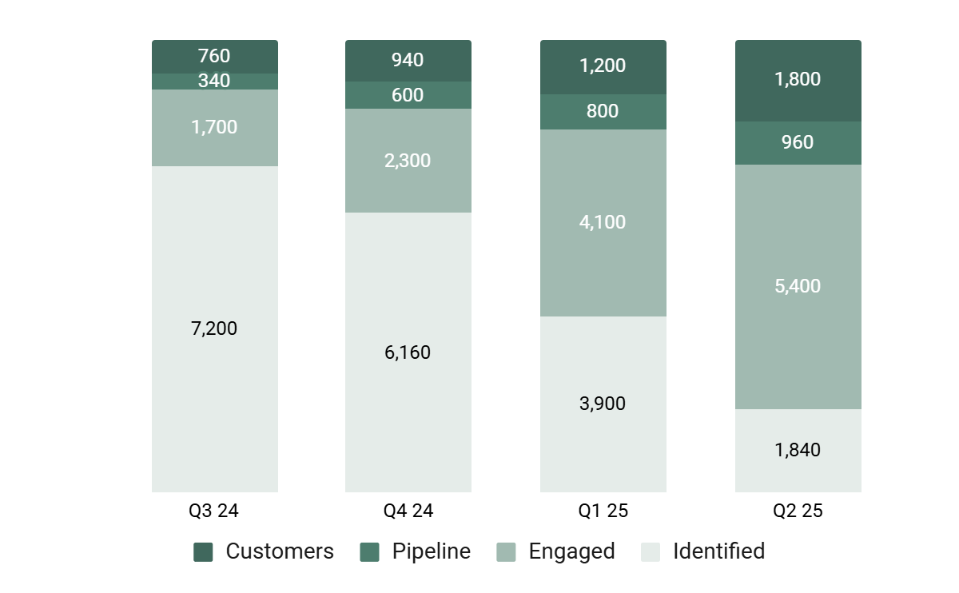
Optional for companies with $10M+ in ARR
Overall GTM: The market
Commentary
What
Why
What next
This view is helpful if you’re doing ABM

Slide 41
Optional for companies with $10M+ in ARR
Include if useful for your business. This can be an appendix slide
Overall GTM: Starting pipeline by segment
Commentary
What
Why
What next
 | Q1:24 | Q2:24 | Q3:24 | Q4:24 | Q1:25 | Q2:25 | Q3:25 | Q4:25
 | Actual | Actual | Actual | Actual | Actual | Actual | Budget | Budget
Starting pipeline
Segment #1
Segment #2
Segment #3
Segment #4
Conversion rate
Segment #1
Segment #2
Segment #3
Segment #4
Quota coverage
Segment #1
Segment #2
Segment #3
Segment #4
CONFIDENTIAL

Slide 42
Optional for companies with $10M+ in ARR
Overall GTM: Starting pipeline by type
Commentary
What
Why
What next
 | Q1:24 | Q2:24 | Q3:24 | Q4:24 | Q1:25 | Q2:25 | Q3:25 | Q4:25
 | Actual | Actual | Actual | Actual | Actual | Actual | Budget | Budget
Pipeline
New Logo
Expansion
Conversion rate
New Logo
Expansion
Quota coverage
New Logo
Expansion
Consider breaking down pipeline into target and non-target accounts if doing ABM
CONFIDENTIAL

Slide 43
For companies with $10M+ in ARR
Overall GTM: Performance by segment
Optional. Showing how your ARR breaks down by segment or industry is helpful to understand the composition of ARR and identify stronger or weaker segments of the business
 | Q2:24 | Q3:24 | Q4:24 | Q1:25 | Q2:25 |  | 2022 | 2023 | 2024
Segment #1
New
Upsell
Churn
Ending ARR
Y/Y growth
Gross retention
Net retention
ACV
Segment #2
New
Upsell
Churn
Ending ARR
Y/Y Growth
Gross Retention
Net Retention
ACV
Segment #3
New
Upsell
Churn
Ending ARR
Y/Y Growth
Gross Retention
Net Retention
ACV

Slide 44
This can be interesting to see how marketing spend connects to pipeline build, and how efficiency trends over time. Use if relevant / interesting
Optional for companies with $10M+ in ARR
Marketing: Efficiency
Commentary
What
Why
What next
 | Q1:24 | Q2:24 | Q3:24 | Q4:24 | Q1:25 | Q2:25 | Q3:25 | Q4:25
 | Actual | Actual | Actual | Actual | Actual | Actual | Budget | Budget
Pipeline added
Conversion %
Marketing spend
Headcount
Program spend
Total marketing spend
Efficiency
Pipeline added / marketing dollar
CONFIDENTIAL

Slide 45
Optional for companies with $10M+ in ARR
Marketing: Program efficiency
Program | Quarter | Type | # of accounts | # of opps | Pipeline | Closed: Won Opps | Closed: Won | Spend | Cost per opp | Cost per Closed:won
In-person events
Virtual events
Website
Paid advertising
ABM
Community
Commentary
What
Why
What Next
CONFIDENTIAL

Slide 46
Interesting for companies that are working on improving a given problem in the sales process
Optional for companies with $10M+ in ARR
Sales: Pipeline by stage
$ value
% of total
Close probability
Weighted $ value
Stage 1 Discovery |  | $1,000,000 | 53% |  | 10% | $100,000
Stage 2 POV |  | $500,000 | 26% |  | 20% | $100,000
Stage 3 Negotiation |  | $250,000 | 13% |  | 40% | $100,000
Stage 4 Procurement |  | $100,000 | 5% |  | 50% | $50,000
Stage 5 Closed |  | $50,000 | 3% |  | 50% | $25,000
 | Unweighted | Y/Y % |  | Weighted | Y/Y %
Total Pipeline | $1,900,000 | xx% |  | $375,000 | xx%
Pipeline / Bookings Ratio | 5.4 | x |  | 1.1 | x

Slide 47
Optional for companies with $10M+ in ARR
Sales: Leading indicators of AE performance
 | Ramped AEs |  |  |  |  | Ramping AEs |  |  |  |  | All
 | Rep 1 | Rep 2 | Rep 3 | Rep 4 | Total | Rep 5 | Rep 6 | Rep 7 | Rep 8 | Total | Total
Leads
Outbound activities (emails, calls, etc.)
Activities / lead conversion Rate %
Meetings scheduled
Meetings / lead conversion %
Meetings / activities conversion %
Opportunities created
Opportunities / lead conversion rate %
Opportunities / meetings conversion rate %
Wins
Wins / opportunity conversion rate %
Wins / lead conversion rate %
Gross bookings closed
Avg contract value ($ bookings / # wins)
Optional. This is helpful if Board members are interested in individual performance. An alternative view is to show in total and / or trended

Slide 48
Optional for companies with $10M+ in ARR
Sales: ARR results by sales team
 | Actual | Plan | Quota | Plan variance | Quota variance
Gross new ARR
Segment #1
Segment #2
Segment #3
Segment #4
Total gross new ARR
Churn
Net new ARR
Commentary
What
Why
What Next
CONFIDENTIAL

Slide 49
Optional for companies with $10M+ in ARR
Sales: NQ forecast by sales team
 | Forecast | Plan | Quota | Plan variance | Quota variance
Gross new ARR
Segment #1
Segment #2
Segment #3
Segment #4
Total gross new ARR
Churn
Net new ARR
Commentary
What
Why
What Next
CONFIDENTIAL

Slide 50
Optional for companies with $10M+ in ARR
Optional
Customer success: retention by segment
 | Q1:24 | Q2:24 | Q3:24 | Q4:24 | Q1:25 | Q2:25 | Q3:25 | Q4:25
 | Actual | Actual | Actual | Actual | Actual | Actual | Budget | Budget
Gross retention
Segment #1
Segment #2
Segment #3
Net retention
Segment #1
Segment #2
Segment #3
Commentary
What
Why
What Next
CONFIDENTIAL

Slide 51
Appendix: Sample KPI slides

Slide 52
Appendix for companies with $10M+ in ARR
Appendix: KPI dashboard
 |  | Q3:24 | Q4:24 | Q1:25 | Q2:25
 |  | Actual | Actual | Actual | Actual
Revenue % by GTM motion | Direct: Inside sales | X% | X% | X% | X%
 | Direct: Outside / field sales | X% | X% | X% | X%
 | Channel (all types) | X% | X% | X% | X%
 | Product-led growth (PLG) | X% | X% | X% | X%
Sales reps & attainment | ACV of new business deals | $XK | $XK | $XK | $XK
 | Avg. quota to comp ratio | X | X | X | X
 | Overall quota attainment (%) | X% | X% | X% | X%
 | % of all reps attaining quota | X% | X% | X% | X%
 | % of ramped reps attaining quota | X% | X% | X% | X%
 | Avg. new sales cycle length (months) | X | X | X | X
 | Win rate (%) | X% | X% | X% | X%
 | Avg. time for rep to ramp (months) | X | X | X | X
 | Sales rep turnover rate (%) | X% | X% | X% | X%
 | CAC payback period (months) | X | X | X | X
 | Blended CAC ratio | X | X | X | X
Marketing | % of pipeline from inbounds | X% | X% | X% | X%
 | Marketing CAC-to-pipeline ratio | X | X | X | X
 | Marketing CAC-to-new-ARR ratio | X | X | X | X
Pipeline | Pipeline coverage ratio | X | X | X | X
Pipeline contribution by source (%) | All marketing channels | X% | X% | X% | X%
 | Outbound SDRs | X% | X% | X% | X%
 | Sales reps | X% | X% | X% | X%
 | Partners and channel | X% | X% | X% | X%
CONFIDENTIAL

Slide 53
Next steps

Slide 54
How to make your board deck stand out
Key principles
~5 Slides for each section
One insight per slide
2-3 bullets per slide to explain “What, Why & Now What”
Lead with the headline - don’t bury the insight
Link charts / tables to Google sheets - provides easy updates
High-level views up front; details in the appendix
Show trends
Explain variances (don’t just show them)
Align to strategy–always tie back to priorities
INSTRUCTIONS

Slide 55
Polish is a signal of rigor
Format matters
Ensure your slides look professional and reflect the care you (obviously) put into them
Create a style guide and stick to it! Messy, inconsistent reporting distracts from the story
Make sure numbers are in 12pt+ font
Make liberal use of the appendix
Keep main deck tight - ~5 slides per section
Put detailed financials (BS, CF statement, GAAP financials) and any detailed GTM or product metrics in the appendix
If Board members have questions, they will ask!
INSTRUCTIONS

Slide 56
Example: Create a style guide
Board style guide
Real example from a portfolio company
Example table
Year | 2021 | 2022 | Y/Y %
Figures in $000s | Actual | Forecast | Forecast
Customers | 35 | 50 | 43%
Flights | 2,400 | 8,000 | 233%
Revenue | $2,731 | $3,600 | 32%
3rd Party COGs | ($2,048) | ($2,520) | 23%
Gross Margin | $683 | $1,080 | 58%
Gross Margin % | 25% | 30%
Style | Use the slide master template
Font | Hanken G 12p+ for notes. Urbanist 9pt+ in tables
Dollars | Represented as in $’000s (“$2,123”) or $’ms
Sig. figures | 0 decimal places (“DP”), unless $’ms
Percentages | 0 DP, unless <10% (e.g. 20% or 8.2%)
Negatives | Denoted with parentheses around in tables, “< >” in notes
Quarters | “QQ-YYYY” “Q1-2022” or “YYYY” “2022”
Table format | Consistent to graphic on right. Blue-bar at top, then 1 line space, then column headers. Copy pasted as a link from Google Sheets (or link to sheet & table in comments)
Table font | Select table > Font drop down menu > select “Hanken G” > input “14” into font size drop-down menu. This ensures table is in 1 font size. Then adjust font size down as needed to fit to space allotted (as noted above, no smaller than 9pt)
Table alignment | Text left-aligned & numbers right-aligned in tables (unless column label)
Table spacing | Format Options > Text Fitting > Top & Bottom at 0; “Squish” extra space out of table by pushing bottom edge of table up and top down
Table titles | Top left to include Year (or Quarter) Figures in $m (or Figures in $’000s or Units)
INSTRUCTIONS

Slide 57
Next steps
Access the reporting template here - make a copy & begin tailoring it for your company
Sign up for a session with M.G.! Email me at mg.thibaut@scalevp.com
Stay tuned for future CFO Council Sessions! Annual budgeting & forecasting coming soon
INSTRUCTIONS
Notes:
We’re happy to go through this with other members of your team, whether it’s the founder, your GTM execs, etc. We’re happy to do this exact same session with your team.
We don’t want this to be a systems conversation. Today, let’s focus on what should be in the deck. If you need help implementing the system, let us know.

Slide 58
Some real examples

Slide 59
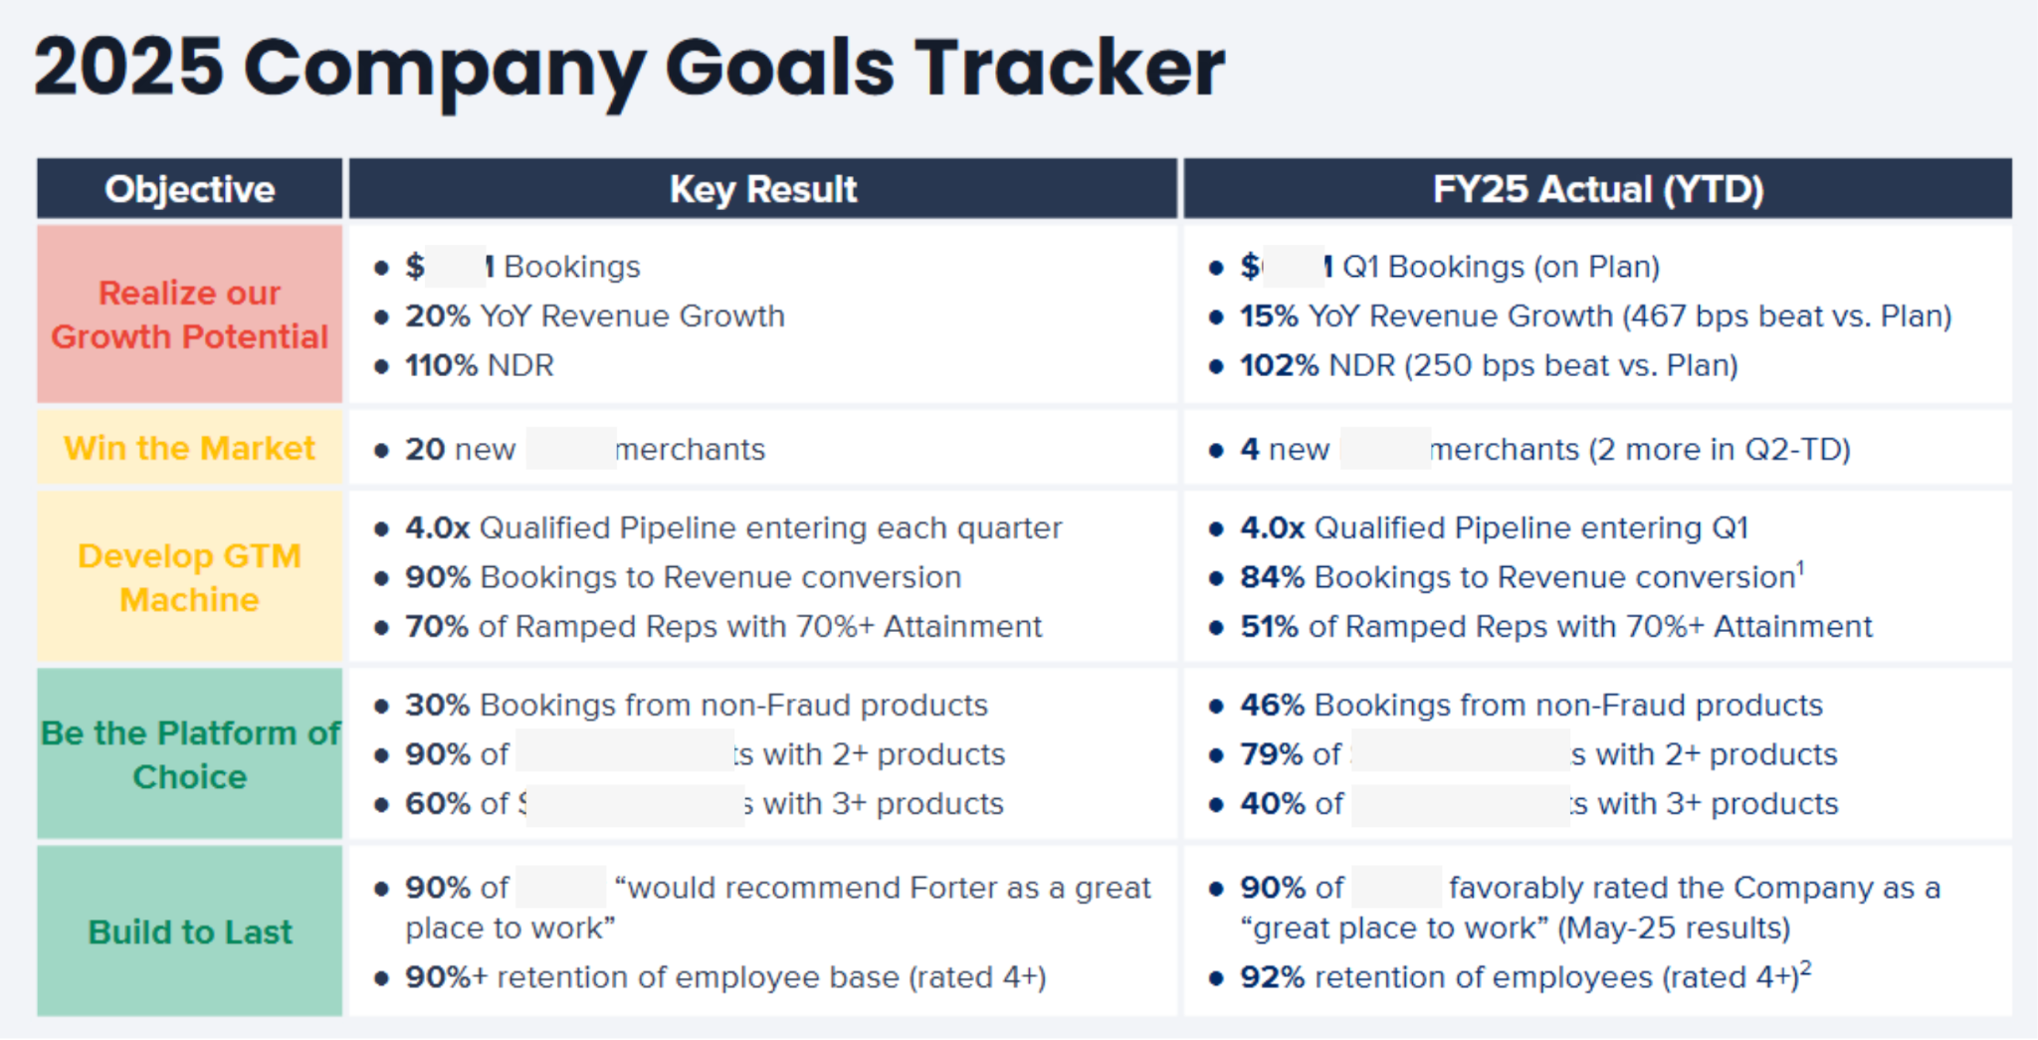

Slide 60
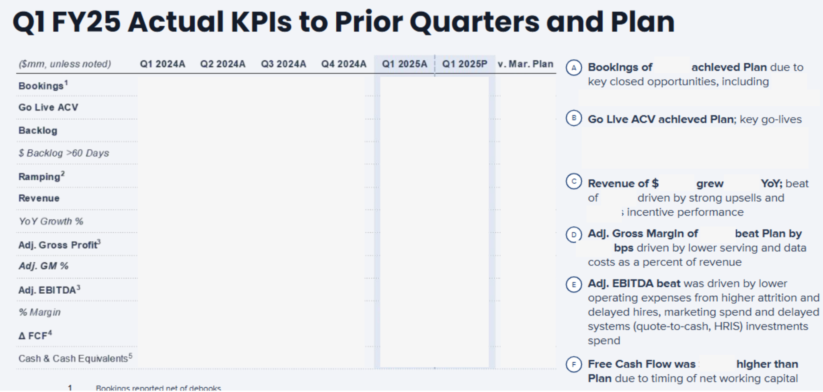

Slide 61
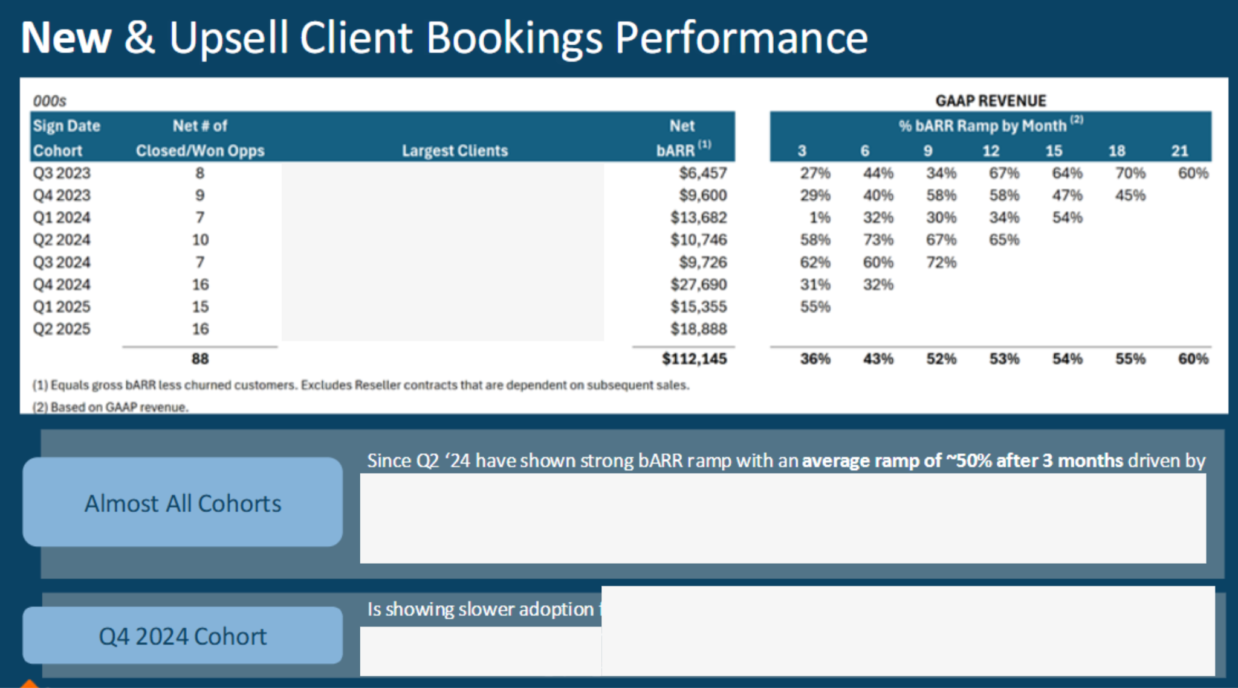

Slide 62
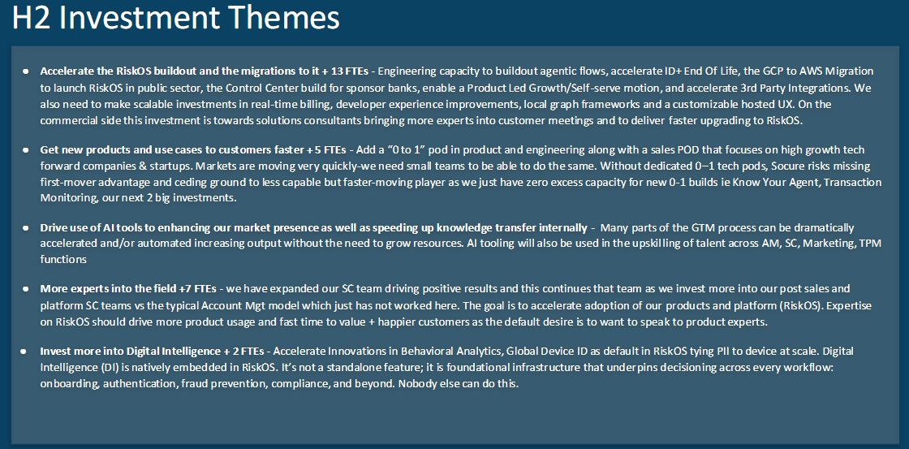

Slide 63
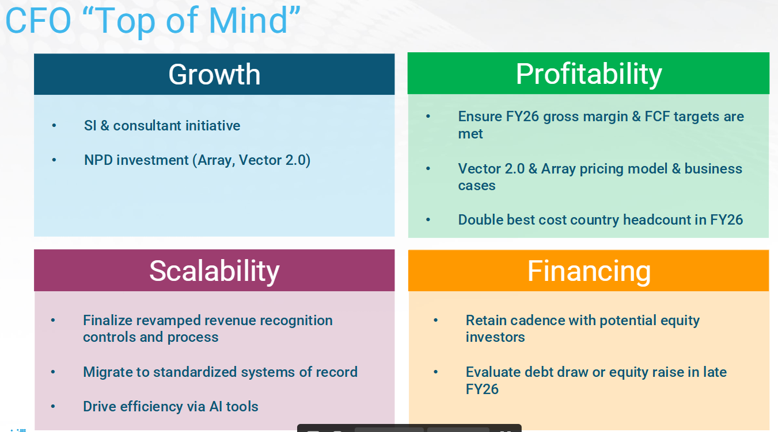

Slide 64
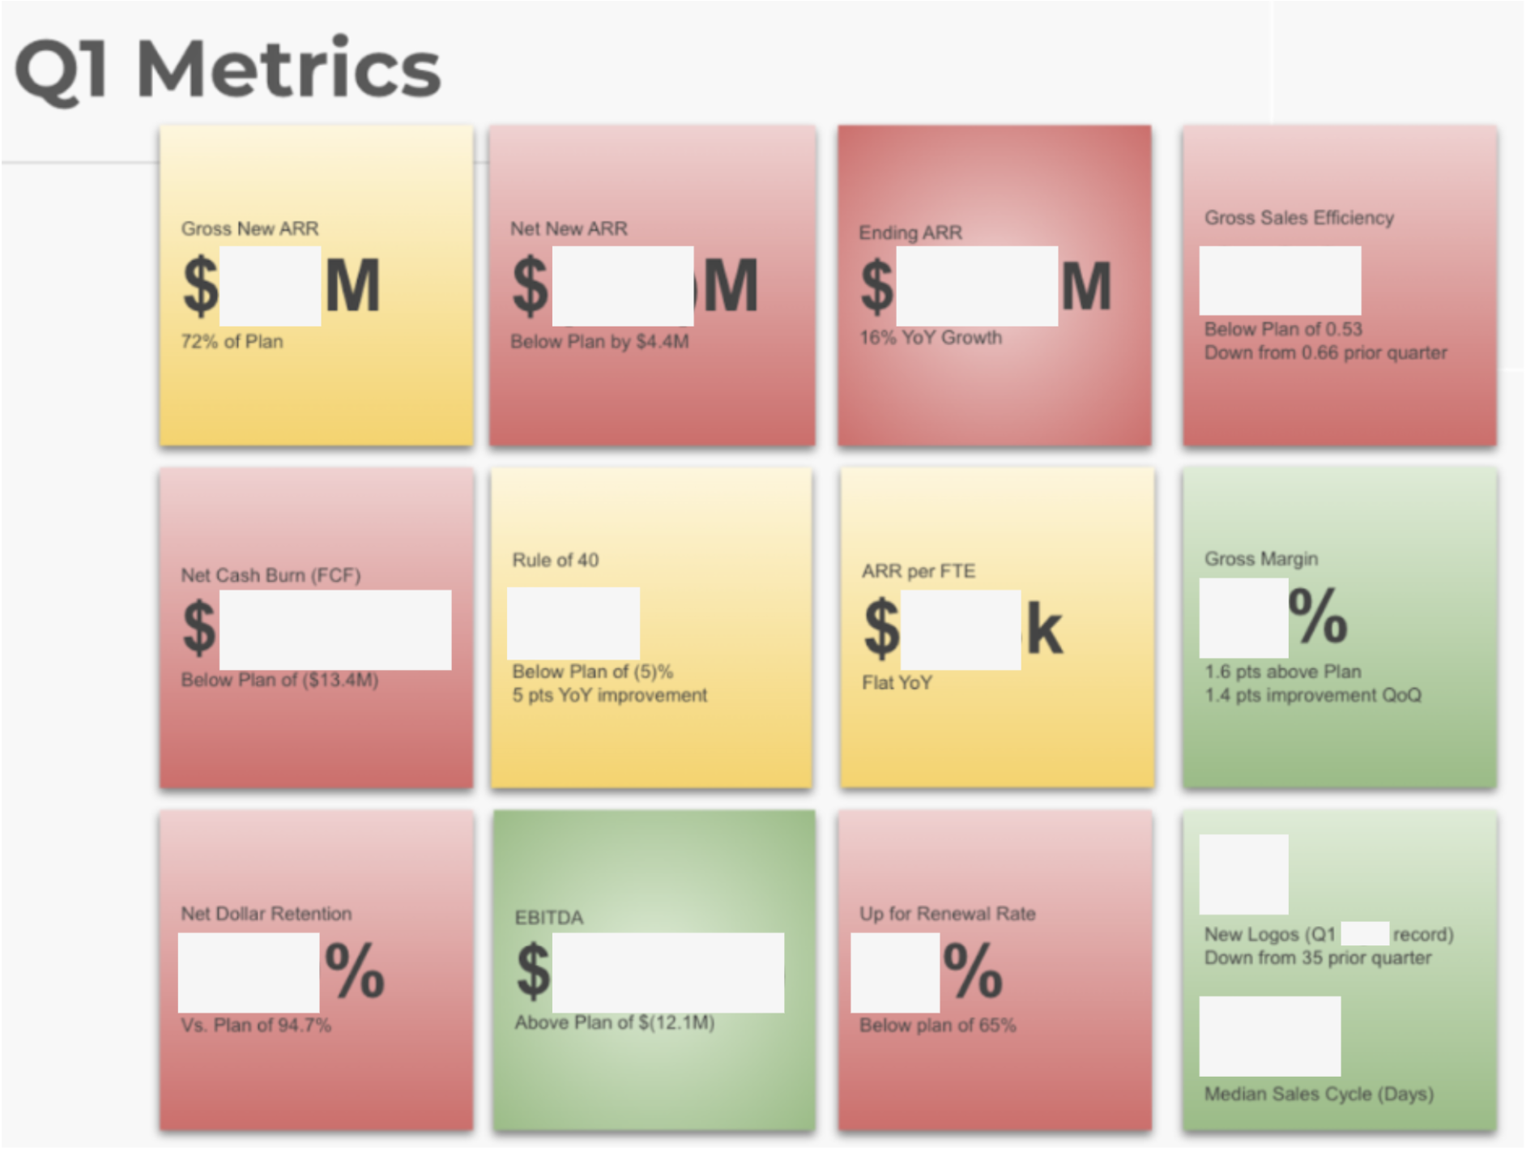

Slide 65
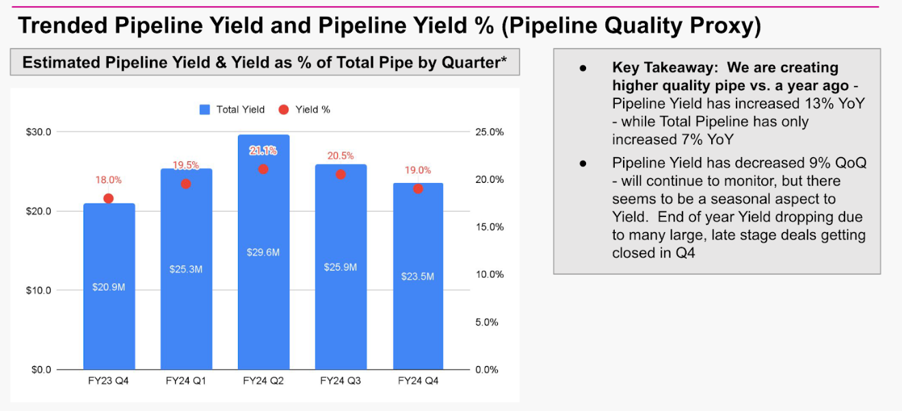

Slide 66
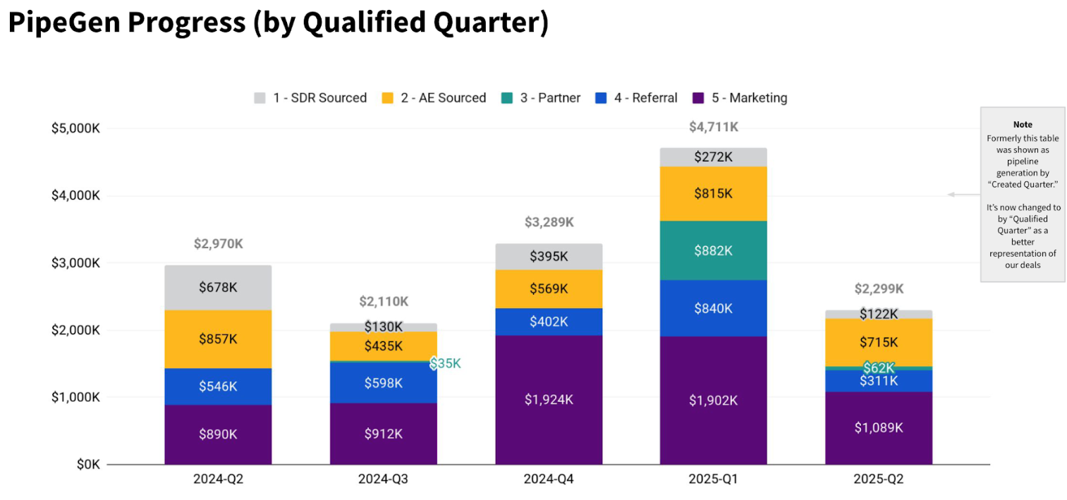

Slide 67
