Slide 1
5 Topics CMO Roundtable
Sydney Sloan, Mini Peiris, Matt Amundson
May 25th, 2023

Slide 2

We help our portfolio build and optimize hyper-growth GTM machines

Slide 3












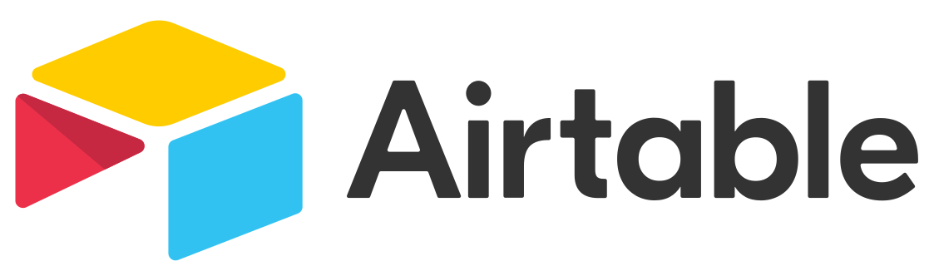

The GTM platform leverages our expert network to provide a suite of offerings
Educational / Networking Events
Advisory
Content
GTM
Network
Experts in sales and marketing across the startup growth lifecycle

Slide 4

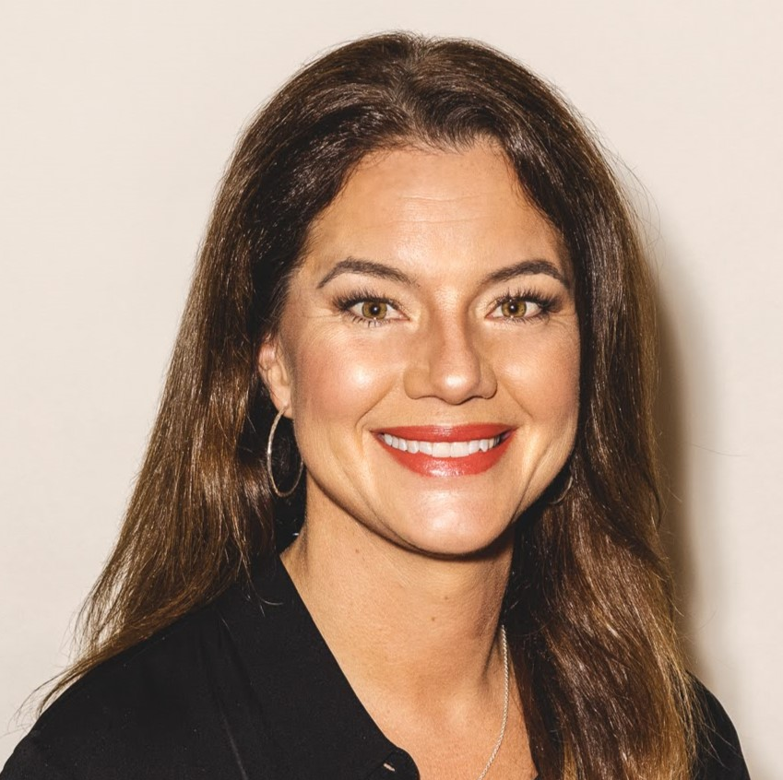

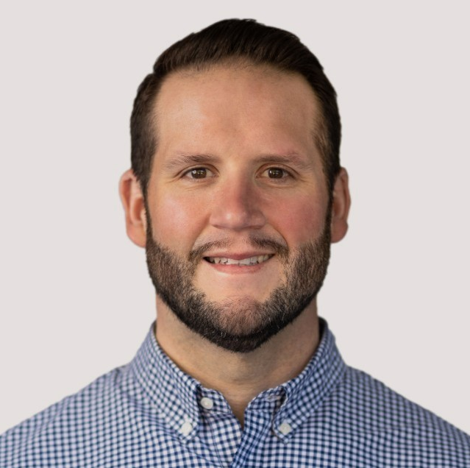
Today’s Speakers
Sydney Sloan
Executive in Residence
Scale Venture Partners
Mini Peiris
Executive in Residence
Scale Venture Partners
Matt Amundson
Executive in Residence
Scale Venture Partners

Slide 5

1. What is a marketing tactic you’re seeing work right now?
“In person events! PPC / SEO for branded terms and competitive campaigns.”

Slide 6
1. What is a marketing tactic you’re seeing work right now?
“In person events! PPC / SEO for branded terms and competitive campaigns.”

Slide 7
1. What is a marketing tactic you’re seeing work right now?
“In person events! PPC / SEO for branded terms and competitive campaigns.”
“Expansion into current customers via field events, community; large events work well as long as you set appointments ahead of time.”

Slide 8
1. What is a marketing tactic you’re seeing work right now?
“In person events! PPC / SEO for branded terms and competitive campaigns.”
“Expansion into current customers via field events, community; large events work well as long as you set appointments ahead of time.”
“Distinct motions for Demand Creation and Demand Capture.”

Slide 9

2. What’s the one piece of advice you would give to a marketing leader who is dealing with a smaller team and a flat or smaller budget?

Slide 10
2. What’s the one piece of advice you would give to a marketing leader who is dealing with a smaller team and a flat or smaller budget?
“Drive focus on your ICP with your G2M leadership team. Align with product on fewer more impactful product launches. Find trusted consultants or agency partners to give you more capacity.”

Slide 11
2. What’s the one piece of advice you would give to a marketing leader who is dealing with a smaller team and a flat or smaller budget?
“Drive focus on your ICP with your G2M leadership team. Align with product on fewer more impactful product launches. Find trusted consultants or agency partners to give you more capacity.”
“Pick 1-2 segments that have strong customer references already and go deep.”

Slide 12
2. What’s the one piece of advice you would give to a marketing leader who is dealing with a smaller team and a flat or smaller budget?
“Drive focus on your ICP with your G2M leadership team. Align with product on fewer more impactful product launches. Find trusted consultants or agency partners to give you more capacity.”
“Pick 1-2 segments that have strong customer references already and go deep.”
“Optimize for SEO, it’s inexpensive and pays for itself. Zero click content.”

Slide 13

3. What emerging GTM trend has the most staying power?
“Using AI tools to create your content strategy and content (sales & marketing teams!).”

Slide 14
3. What emerging GTM trend has the most staying power?
“Using AI tools to create your content strategy and content (sales & marketing teams!).”
“PLG won’t work for everyone… community – meaning leveraging your customers to tell your story – has staying power because people buy technology and they always check with their friends first.”

Slide 15
3. What emerging GTM trend has the most staying power?
“Using AI tools to create your content strategy and content (sales & marketing teams!).”
“PLG won’t work for everyone… community – meaning leveraging your customers to tell your story – has staying power because people buy technology and they always check with their friends first.”
“The B2Cification of B2B. PLG, interactive, prospect-driven demos where PLG is not applicable.”

Slide 16

4. What is the most common issue you see marketing departments getting wrong?

Slide 17
4. What is the most common issue you see marketing departments getting wrong?
“Doing more with less. You have to make trade offs when your budgets and teams get cut. Working with sales and product to make decisions together on where to cut.”

Slide 18
4. What is the most common issue you see marketing departments getting wrong?
“Doing more with less. You have to make trade offs when your budgets and teams get cut. Working with sales and product to make decisions together on where to cut.”
“Not having a strong foundation in the 3 pillars of PMM, brand strategy, demand gen.”

Slide 19
4. What is the most common issue you see marketing departments getting wrong?
“Doing more with less. You have to make trade offs when your budgets and teams get cut. Working with sales and product to make decisions together on where to cut.”
“Not having a strong foundation in the 3 pillars of PMM, brand strategy, and demand gen.”
“Lack of alignment with Sales. You need a shared vision of ICP, personas and an integration of messaging at all stages of the funnel.”

Slide 20

5. What is the one thing every marketing department should do right now to have the biggest impact on overall GTM success?

Slide 21
5. What is the one thing every marketing department should do right now to have the biggest impact on overall GTM success?
“Partner with Customer Success to help them address any churn challenges. Work with Sales to build plays for existing customers (cross sell / upsell motions.)”

Slide 22
5. What is the one thing every marketing department should do right now to have the biggest impact on overall GTM success?
“Partner with Customer Success to help them address any churn challenges. Work with Sales to build plays for existing customers (cross sell / upsell motions.)”
“Help drive a good disco/ consultative sales approach with insights to offer… or you’ll waste the lead and never get a 2nd meeting.”

Slide 23
5. What is the one thing every marketing department should do right now to have the biggest impact on overall GTM success?
“Partner with Customer Success to help them address any churn challenges. Work with Sales to build plays for existing customers (cross sell / upsell motions.)”
“Help drive a good disco/ consultative sales approach with insights to offer… or you’ll waste the lead and never get a 2nd meeting.”
“Getting closer to customers and thus shifting your overall motion to be more customer-centric. Bring customer stories into everything you do, enable sales to do the same.”

Slide 24
Thank You!
Sydney Sloan
sydney@scalevp.com
Mini Peiris
mini@scalevp.com
Matt Amundson
matt@scalevp.com

