Slide 1
Unlock Success: Mastering Pipeline Planning and Budget Alignment
Sydney Sloan, Mini Peiris
June 15th, 2023
Notes:
SYDNEY TO DO WELCOME TO INTRODUCTIONS

Slide 2

We help our portfolio build and optimize hyper-growth GTM machines

Slide 3














The GTM platform leverages our expert network to provide a suite of offerings
Educational / Networking Events
Advisory
Content
GTM
Network
Experts in sales and marketing across the startup growth lifecycle

Slide 4



Today’s Speakers
Sydney Sloan
Executive in Residence
Scale Venture Partners
Mini Peiris
Executive in Residence
Scale Venture Partners

Slide 5



Before you can build a plan…
…get strategic alignment using best practices
Align on Revenue Targets & Key Metrics
Equal Collaboration (Finance, Mktg, Sales)
ONE Set of Conversations
Notes:
Revenue target alignment + key metrics like ACV, Funnel Conversion, Marketing Contribution to Pipe
Make sure Finance doesn’t dictate budget prematurely
Joint collaboration: Finance, Sales, Marketing
Finance tells you what budget should be w/o bottom up plan
All parties need to operate as one and off the same numbers– can’t have separate convos between rev ops, finance, marketing etc.

Slide 6
Poll Question (Answer via Chat)
What do you think the ownership % should be of pipeline contribution across sales, marketing and partners?
Specify in your answer if its for B2B Enterprise, SMB or PLG-led.

Slide 7
Building a “bottom up” plan : data you’ll need
Traditional Funnel
ACV
Marketing Pipe Contribution
Sales Pipe Contribution
CPL
Inquiry → MQL Conv
MQL → SQL Conv
SQL → Stage 1 Conv
Stage 1 → Stage 4 (Proposal)
Stage 4 (Proposal) → Closed Won
Account Based Funnel
ACV
Marketing Pipe Contribution
Sales Pipe Contribution
CPC (Cost per Contact @ Target Account)
Target Account → Engaged Account Conv
Engaged Account → SQA Conv
SQA → Stage 1 Conv
Stage 1 → Stage 4 (Proposal)
Stage 4 (Proposal) → Closed Won
Need data for each segment– for ex:
SMB vs. Ent
Verticals
Regions– Americas, EMEA, APAC
Notes:
ACV / LTV / ASP - explain differences as it relates to land and expand motion and cost to acquire.
– if you have a fast expand, use LTV or ASP → open up for discussion

Slide 8

Template Tour : Practical Application
Pipeline Plan & Budget Template
Notes:
Adjust revenue # and show flow thru
Show how optimizing top of funnel conv can impact rest of the plan

Slide 9
Template Tour : Practical Application
Add columns / sections as needed for each segment in your GTM strategy
Adjust formulas for longer sales cycle, spanning across quarters
Add rows & update formulas to factor in partner contribution as needed

Slide 10
Poll Question (Answer via Chat)
How do you plan today?
Start Bottom Up
Start Top Down
Finance Tells Us
No Time to Plan / Targets Change Rapidly

Slide 11
Category Maturity. How much natural demand can you capture? 1st mover advantage?
Market & Competitive Landscape. Can you solve for things better than anyone else?
Market & Deal Size. High volume + small deals vs. large named accounts
Distribution Channels. B2B direct sales, B2C, PLG, channel - all of the above
S&M Investment Level - for SaaS. CAC Payback, CAC:LTV, % S&M
Many things cause your marketing mix to be specific in sourcing the pipe:

Slide 12
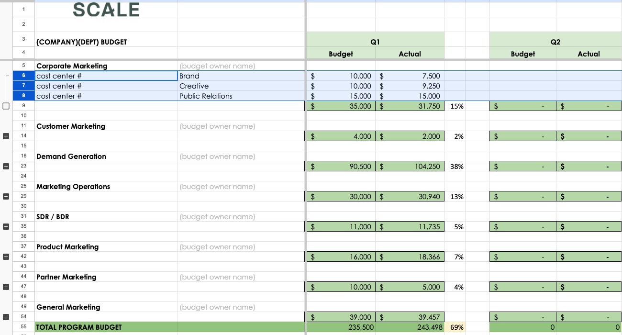
Budget Structure
Structure the budget to match ownership and accountability
Growth contribution determines budget (align w/ finance)
Budget structure and cost centers by owner
Set departmental targets by % drafting off previous year budgets
Budget owners draft budget based on goals
Notes:
Once you get your contribution and growth targets aligned with finance it’s time to start the tops down approach for each department. I want to give my budget owners their goals and a directional budget to work within.
It of course depends what the blend is of your growth engine. If you have a higher percentage coming from partners then your partner budget will be a higher portion of your mix. There are certain investments too (like analysts) that are needed so place those in first.

Slide 13
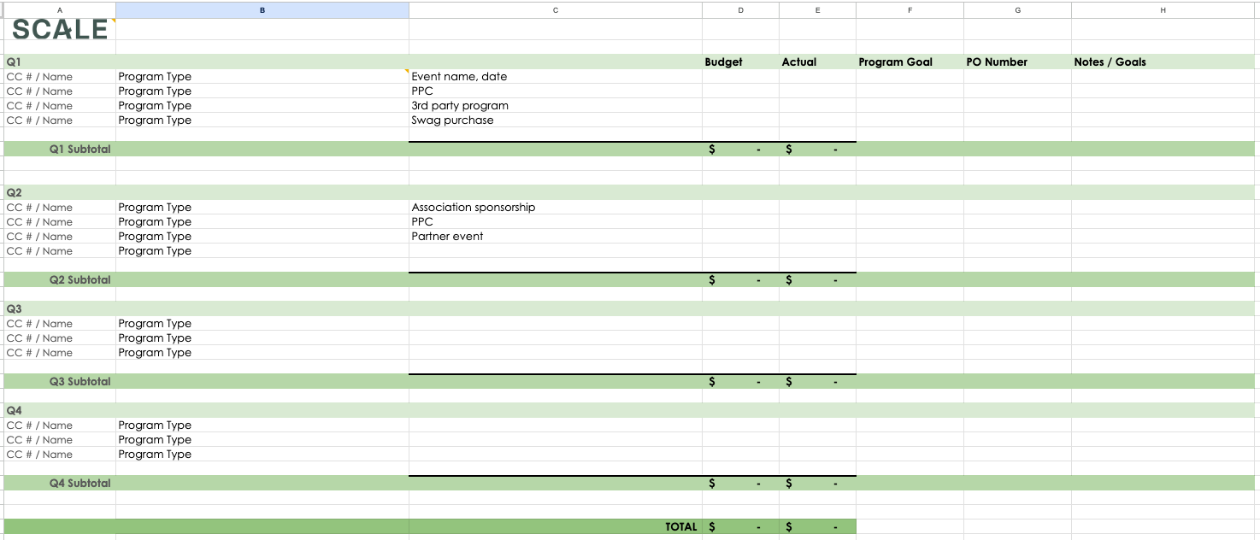
Departmental Budgets
Program Orientation
For: start up, field marketing, events, product marketing, customer, community, partner marketing

Slide 14
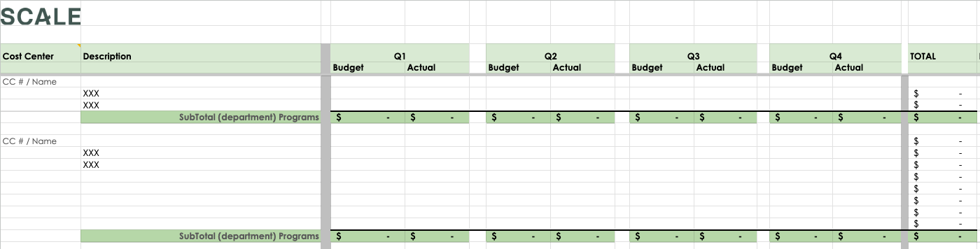
Departmental Budgets
Recurring Orientation
For: communications, PR / AR, tech spend, advertising,

Slide 15
Things you need to know about GAAP
Channeling your inner accountant.
What is amortization, and how do I budget for it?
  Subscriptions, tech spend…
What are Capital expenses and why is that an advantage to my budget?
  brand strategy, website development…
How do I plan and budget for Events
  Deposit schedules, event agencies, what about company travel and hotels?

Slide 16
Quarterly Orchestration Calendar
Week 1
Week 2
Week 3
Week 4
Week 5
Week 6
Week 7
Week 8
Week 9
Week 10
Week 11
Week 12
MONTH 1
MONTH 2
MONTH 3
Marketing Leads Budget Lock, 2Qs
Marketing Leads mid Q roll up & forecast
FINANCE
Finance Previous Q Close / Actuals
Finance Interlock, Accounting
Finance Interlock, Accounting
ENT Pipeline Council - Forecast
ENT Pipeline Orchestration
ENT Pipeline Council - Forecast
ENT Pipeline Orchestration
ENT Pipeline Council - Forecast
ENT Pipeline Orchestration
PIPELINE
SMB Pipeline Council - Forecast
SMB Pipeline Orchestration
SMB Pipeline Council - Forecast
SMB Pipeline Orchestration
SMB Pipeline Council - Forecast
SMB Pipeline Orchestration

Slide 17

Monthly Orchestration Crew
MONTH 1
MONTH 2
MONTH 3
MO OF
QTR
Per Segment
Per Segment
Per Segment
- Review Pipeline Council learnings & Action Items - 90-Day Demand Plan (BDRs, Sales, Marketing) - Upcoming Launches or Big Events - ABM Strategies - Top accounts - Enablement Updates - Action item review & capture | - Review Pipeline Council learnings & Action Items - BDRs, Sales, Marketing Top of Mind - Upcoming Launches or Big Events - BDR & Sales On the Ground Reporting - Enablement Updates - Action item review & capture Next Quarter Plan Review - Review next quarter plan for input / priority alignment - Review Sales enablement usage + request prioritization | - Review Pipeline Council learnings & Action Items - Upcoming Launches or Big Events - ABM Strategies - Top 5 Accounts - Enablement Updates - Action item review & capture
AGENDA
Marketing
- ABM Manager
- Segment PMMs
- Segment Mktg Mgr
- Marketing Analyst
Sales & BDRs
- Sales Leader
- Sales Reps
- BDR Leader
Sales Enablement & Ops
- Sales Analyst
- Sales Productivity & Enablement Mgr
ATTENDEES

Slide 18

Additional Resources
Pipeline Plan & Budget Template
Principles of Budget Management
Segmentation & Prioritization
The Art of Pipeline

Slide 19
Thank You!
Sydney Sloan
sydney@scalevp.com
Mini Peiris
mini@scalevp.com

