Slide 1
The Mutual Action Plan (MAP)
January 19, 2024

Slide 2
Mutual Action Plan (MAP) Tool
What it is
Why it’s important
A one-page plan (sometimes called a ‘MAP’, ‘Mutual Success Plan’ or a ‘Close Plan’) built collaboratively by sellers and buyers that outlines the key steps required to move forward with a deal or project
Mutual action plans:
Accelerate deal cycles and and prevent lengthy times-to-close
Deals often get delayed when they go to Legal and InfoSec. Setting timelines early using a MAP can help to the process
Qualify buyer intent and urgency
A buyer’s willingness to build and execute a MAP shows strong intent. Conversely, a lack of willingness is an early warning sign
Highlight the need to meet with senior executives / decision makers
Increase conversion rates
Who it’s for
Sellers, sales leaders, and buyers

Slide 3

Best Practices: Mutual Action Plans that convert leverage the following
Collaborative approach
Build the MAP with a buyer, particularly to address Legal, InfoSec, and Procurement requirements
Early sales stage introduction
Introduce the MAP after an initial demo instead of waiting until the proposal stage
Work backwards
Start with the buyer’s go-live date and work backwards
Timeline with limited steps
Keep it simple and focus on no more than 5 key steps. For larger clients, leverage a visual map on a single slide. For smaller clients or single-threaded buying processes, a simple list in an email will suffice
Verbal and written buyer confirmation
Getting the buyer’s verbal or written confirmation on Final MAPs can increase conversion rates by as much as 50%

Slide 4
MAP Example #1
Use case
Business Impact
Total timeline
Data warehouse to process 50K BI queries per day
Lower annual BI query costs by $1M; increase visibility into sales performance
2 months (including implementation)
9/30
10/13
10/23
11/3
11/10
Proposal Agreement
Signed Legal & InfoSec Docs
Signed Contract
Go Live Date
First Customer Success Meeting
Final proposal revisions are agreed to by both parties
Legal review and InfoSec testing / diligence is completed
Final contract is approved and signed by procurement
Software licenses are activated and first 20 users are provisioned
Current usage and product issues are discussed and resolved
IT: Mark Cooper Finance: Greg Schwarz
Legal: Robert Jones InfoSec: Lesley Arwald Procurement: Adam Xi
Procurement: Adam Xi, Carol Babson
Site Admin: John Lewis
CSM: Vicky Kang Site Admin: John Lewis

Slide 5
MAP Blank Example #1
Use case
Business Impact
Total timeline
Description
Description
Description
Due Date
Due Date
Due Date
Due Date
Due Date
Milestone Name
Milestone Name
Milestone Name
Milestone Name
Milestone Name
Description
Description
Description
Description
Description
Owner Department: Owner Name
Owner Department: Owner Name
Owner Department: Owner Name
Owner Department: Owner Name
Owner Department: Owner Name

Slide 6
MAP Blank Example #2
Project Overview
Proposal Summary | Proposed Solution | Description
 | Project Scope | Description
Benefits Summary | Critical Business Objective | Description
 | Key Benefits | Description
Path Forward / Next Steps
Due Date | Milestone | Owner | Status | Notes
Date | Milestone | Owner | Status | Note
Date | Milestone | Owner | Status | Note
Date | Milestone | Owner | Status | Note
Date | Milestone | Owner | Status | Note
Date | Milestone | Owner | Status | Note

Slide 7
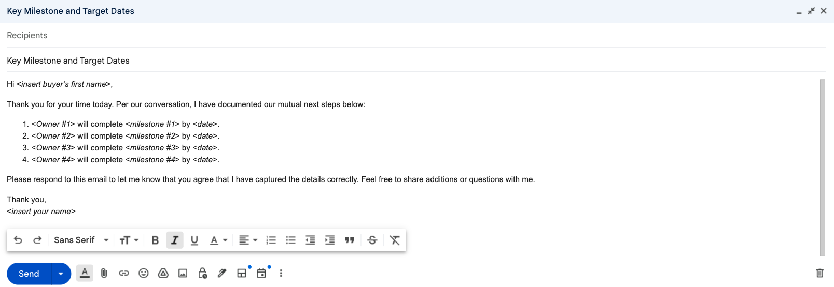
MAP Blank Example #3
For single-threaded buying processes (i.e., a 1- or 2-person buying committee) with smaller ACVs (less than $50,000), it is standard to just send the key elements of the MAP in an email

