Slide 1
GTM Planning Workshop
October 2023

Slide 2
Before We Start…
Do’s | Don'ts
Get started early (NOW!) Make a timeline/roadmap and hold people to it Get EVERYONE involved - this is not a GTM only initiative Ask for help - plenty of folks out there (and Vendors) that want to help here 80-10-10 - 80% is easy, 10% is difficult, the last 10% is very difficult; Get your 80% knocked out, identify your consensus team/escalation path early to work through trade offs/consensus on this last 20%. | Over-engineer - if you’re going down something that seems like a rabbit hole, it definitely is Rely solely on templates Set up planning meetings last minute. Q4 calendars are BUSY Short change communication - aim for perfection here! Fall for “the savior” planning tool - they can actually hinder planning progress

Slide 3
Agenda
High-Level Financial Plans (Tops-Down)
“Bottoms-Up” from GTM Leadership
Sales Capacity & Cost Planning
The Great Cage Match™ - Sales vs. Finance (kind of kidding)
Account Scoring & Territory Design
Pipeline Planning
GTM Compensation Planning
Communication & Roll-Out
Overall Timeline - Bringing It All Together

Slide 4
High-Level Financial Plan (Tops-Down)

Slide 5
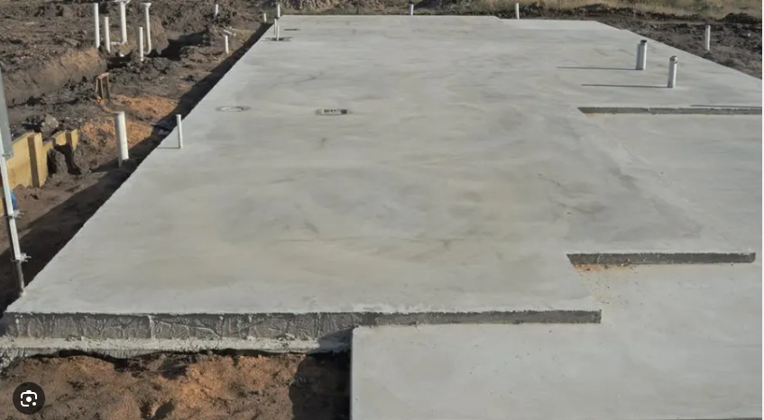
Tops-Down Plan - Overview
Objective:
Putting expectations from Execs and Board into hard numbers. Aka, aligning on “foundation” of plan.
Metrics to Be Provided:
ARR/Rev Growth Rates
NDR Target
New Biz/Upsell ARR/Rev Split
Product-Level ARR/Rev Splits
Overall Cost Envelope / Efficiency
Magic Number
Rule of 40

Slide 6
Tops-Down Plan - Hacks & Pitfalls
Hacks | Pitfalls
Build 2-3 year plan - 1 year plan doesn’t set up for following years and may miss needed costs Leverage benchmarks (Scale has these) Know where to stop - if you’re starting to do Geo/BU-based planning at this point, you’ve gone too far! | Iterate down a rabbit hole too early - start with high-level, almost “swag” numbers. Iterate once you get more feedback Start conflicts with finance at this stage - get data to back why something may not work (more on this needed healthy tension later…)

Slide 7
2. Bottoms-Up From GTM Leadership

Slide 8
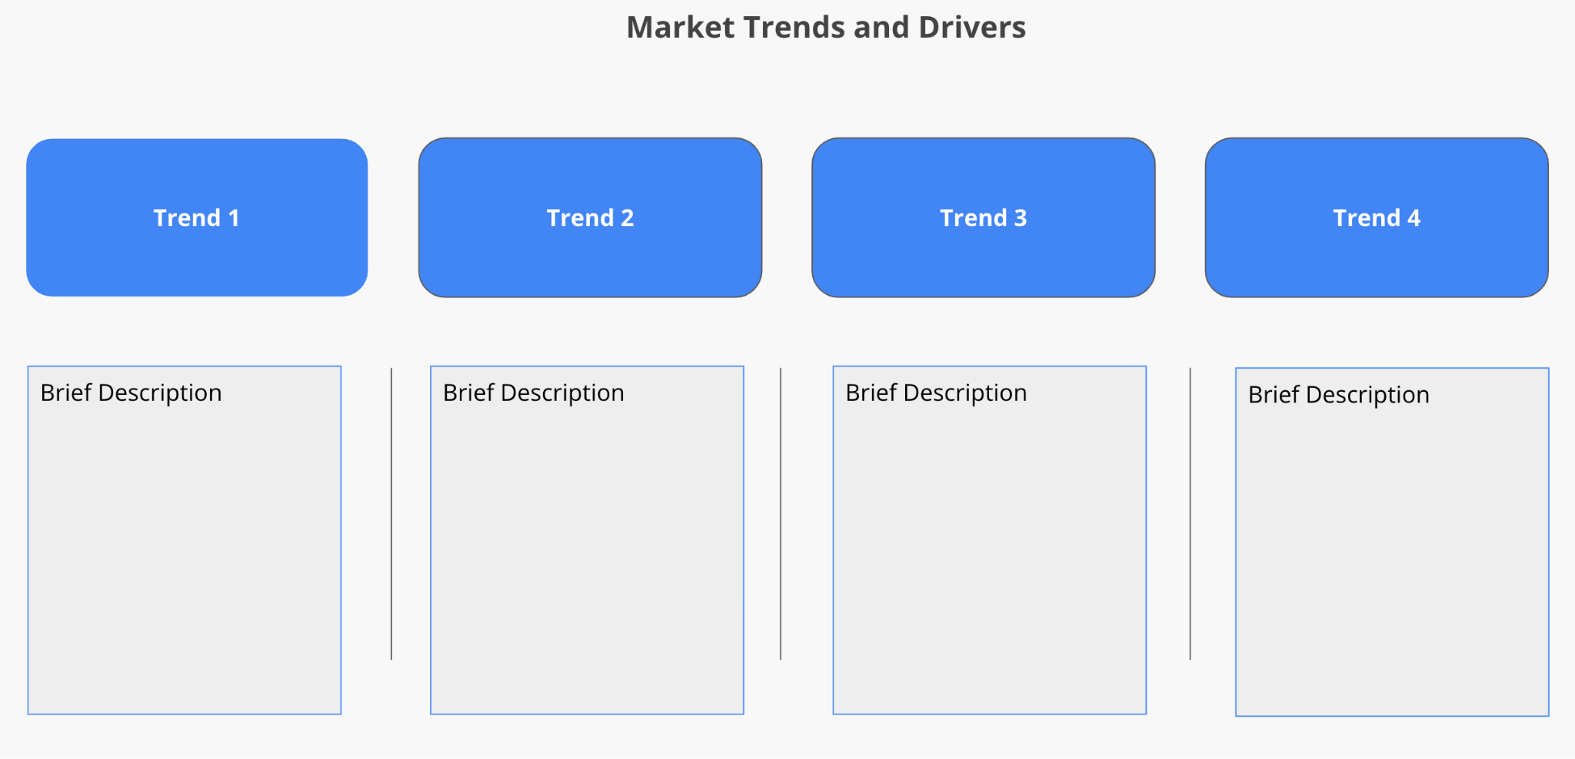
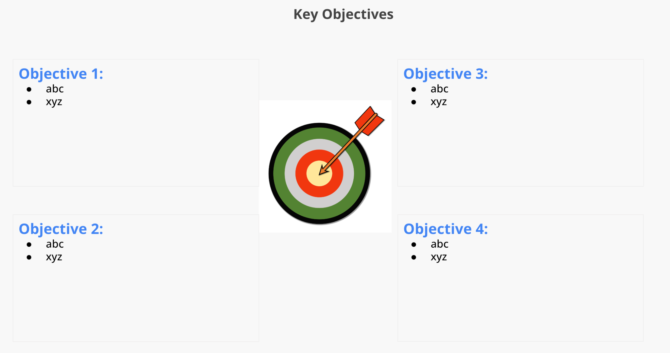
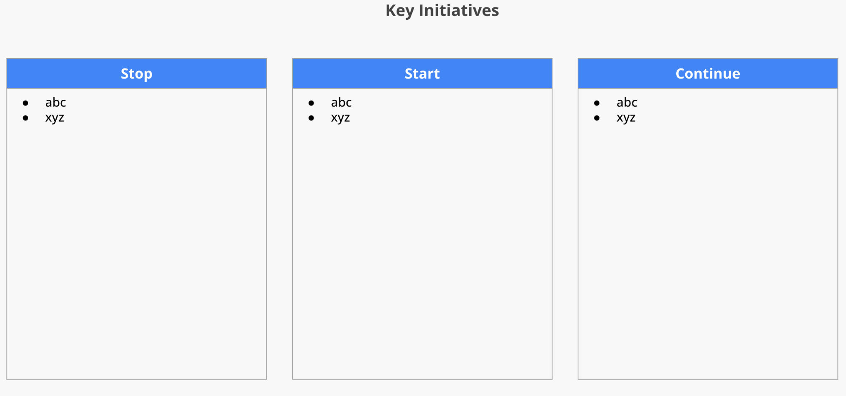
2. Bottoms-Up Plan - Overview
Objective:
Gather feedback from folks closest to the customer
Structure:
Market Trends → Key Objectives (from Tops-Down) → Key Initiatives (to achieve Objectives) → Detailed Proposed Investments (HC, Locations, etc.) → Rev/ARR Expected with Investments → Dependencies/Needs from Other Functions
Review Timing & Attendees:
3-4 weeks for leaders to complete plans
Schedule a 0.5-1.0 day session to review all plans at once, all GTM leaders attend all sessions (power here!)
Include key stakeholders - Finance, Marketing, Ops, Product, Services, etc.
Template to be provided!

Slide 9
2. Bottoms-Up Plan - Hacks & Pitfalls
Hacks | Pitfalls
As best as possible, align with tops down guidance (Growth Rates, NDR, etc.) Get cross-functional partners involved Identify timeline for delivery and then shave off a week - constraints help stopping over thinking here | Skipping this step (so many do…) Asking for too much detail (territory/account specifics, etc.) Not having all GTM leaders attend all sessions - cross pollination across teams is incredible!

Slide 10
3. Sales Capacity & Cost Planning

Slide 11
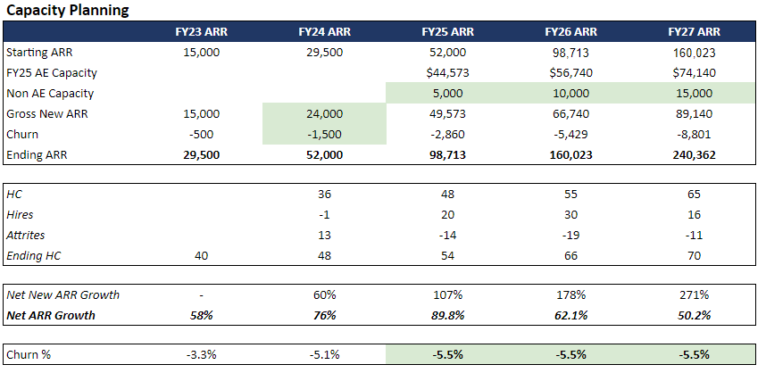
3. Sales Capacity & Cost Planning - Overview
Objective:
Building out detailed capacity model to ensure achievement of objectives
Key Outputs:
All GTM resources needed to achieve plan
Timing of hiring/deploying resources
Other Cost Items To Capture:
Tools
Ops
Outside help
Add’l T&E for One Time Events - SKO, etc.
Template to be provided!

Slide 12
3. Sales Capacity & Cost Planning - Key Drivers
Metrics | Description | Rules of Thumb
Starting Rep HC | # of Reps at start of plan timeframe | Depends on business
Ramp Time | Time it takes for a rep to reach full productivity | Ent: 6-9 months
Productivity | Annual Rev/ARR a rep can produce | Ent: $1.0-1.3M annually
YoY Productivity Increases | Expected annual increase in productivity | 5-7% organic
Rep Attrition | % of reps who leave | 15-25%
Churn | Amount of ARR base lost annually | Ent: 5-10%
Non-Rep Sources of ARR | ARR from contractual upsells, OEM deals, channel, etc. | 5-10% of ARR?
Seasonality | Monthly/quarterly variance in sales driven by market | Prob more driven by rep ramp
Other Spend | Non-standard costs - consultants, add’l tools, SKO, etc. | Depends on business; over-estimate
Expected Revenue / ARR | Overall amount of Sales expected and growth YoY | Depends on business
Add’l Rep HC Needed | Add’l rep HC needed to achieve Sales | Depends on business; should be monthly #
Support HC Needed | Add’l GTM support HC needed to support add’l Reps | 3:1 SDR; 2:1 SE; 5-30:1 CSM (Accounts) ; Ops
Sales Mgmt HC Needed | Add’l Sales Mgmt HC needed to support Add’l Reps | 6-8:1
Inputs
Outputs
Leverage data to determine and/or validate inputs/assumptions.

Slide 13
3. Sales Capacity & Cost Planning - Hacks & Pitfalls
Hacks | Pitfalls
Have your assumptions documented - and understand their limitations (it is a model) Create a summary that is easily digestable Create a very very malleable/dynamic model - tweaks will be constant | Making an inflexible model - this will create much more work for you, and add more meetings to the calendar Not validating assumptions Incomplete buy-in Not using this work to help build and monitor budgets throughout the year

Slide 14
4. The Great Cage-Match™ - Sales vs. Finance

Slide 15
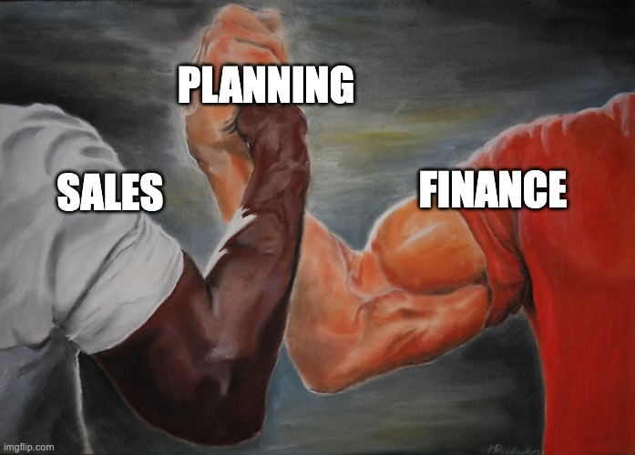
4. The Great Cage-Match™ - Overview
Objective:
Hash out all points of contention in the plan
Rules:
Lock yourself in a room (Zoom) and don’t come out until all points of contention are locked.
Tactical Steps:
Inventory all points of contention ahead of time
Have separate Finance and GTM review of points to identify compromise guardrails
Literally do the frikkin’ cage match
Note: I know I’m not using this meme like most people use it. However, if you know the movie Predator, you know this is actually more a moment of tension, and not of true alignment.

Slide 16
4. The Great Cage-Match™ - Hacks & Pitfalls
Hacks | Pitfalls
Use data and logic as your guide (and for your arguments) 80-10-10 - this should be the last 10! Build the Finance/Sales relationship and trust all year long in preparation for this moment Do this in-person - it’s worth the travel and cost | Finance or Sales dominating planning Emotional decision making Being too nice and not landing decisions - that’s why you need to call this a Cage Match! Skipping this step and letting hard decisions up to someone else (CEO, board, consultant, etc.) - always less optimal outcome

Slide 17





4. The Great Cage-Match™ - Predator Aside / Allegory
Grunt; always gets the job done; only performs rescue missions; taking care of his team is #1 priority; self-righteous
Dutch - Sales
Friendly, but cautious. Once Dutch is aware of being co-opted, self-righteousness and tension takes hold:
“So you cooked up a story and dropped us in a meat grinder.”
Aligned; common enemy identified; bad blood pushed aside; working together to finish “Predator”
Pre-Predator/Planning
Predator/Planning Arrives
Former grunt; now a beaurocrat for CIA; co-opts Dutch and team to help with “off the books” intelligence operation
Dylan - Finance
Planning collateral damage
Finance loses an arm
Sales wades in the mud
Hunter; only out for one thing - blood; only stops when dead
Predator - Planning

Slide 18
5. Account Scoring & Territory Design

Slide 19
5. Account Scoring & Territory Design - Overview
Objective:
Systematic, data-driven approach to building territories to maximize chances of rep and company success.
Possible Inputs:
Firmographic Data (Annual Rev, EEs, Industry, etc.)
Spend Data (from data providers)
Pipeline
Previous ARR / Renewals
Activity
Intent Data
Bespoke items - # of folks in a specific dept. (seat proxy)
Calculation Rules of Thumb:
Use ARR correlations to determine input weights
Use percentiles to create a relative weighting and to make it easier to “blend” inputs
FY24 Owner | # of Accounts | # of Customers | Total Account Score | # of Open Opps | Pipeline Value | Previous Yr ARR | Renewals Due
Commercial | 294 | 2 | 3,821 | 17 | $1,480,925 | $146,857 | $84,000
Rep 1 | 107 | 3 | 3,343 | 19 | $4,284,950 | $1,248,710 | $ -
Rep 2 | 57 | 0 | 2,271 | 8 | $2,700,200 | $489,864 | $ -
Rep 3 | 134 | 3 | 4,654 | 8 | $1,852,000 | $955,709 | $562,662
Rep 4 | 45 | 2 | 4,300 | 12 | $2,563,000 | $178,425 | $70,400
Rep 5 | 20 | 7 | 1,008 | 10 | $3,588,125 | $1,112,915 | $1,354,568
RVP | 307 | 0 | 8,043 | 3 | $1,127,000 | $ - | $ -
Grand Total | 1131 | 17 | 27,440 | 77 | $17,596,200 | $4,132,480 | $2,071,630
Template to be provided!

Slide 20
5. Account Scoring & Territory Design - Hacks & Pitfalls
Hacks | Pitfalls
Don’t overthink it - football cities to start Use 3rd party vendors to supplement your CRM data for account scoring Use heuristics around a good territory size - X account score, Y # of customers Account activity data is very useful when territories are shrinking in size - which accounts haven’t been touched in 90 days? Maps help leadership digest the data You can update territories more than once a year (as long as you’re not making a material difference to folks ability to earn) | Trying to get your data 100% perfect - very quickly diminishing returns Not reviewing early and often with Sales Managers - you need their buy-in to get the reps on board (reps don’t look at scores, they look at accounts) Creating territories that are misaligned with comp structure Not effectively communicating what accounts are changing hands (and what is being taken away) Do you really need verticals right now? Buying a tool too soon - spreadsheets work surprisingly well

Slide 21
6. Pipeline Planning

Slide 22
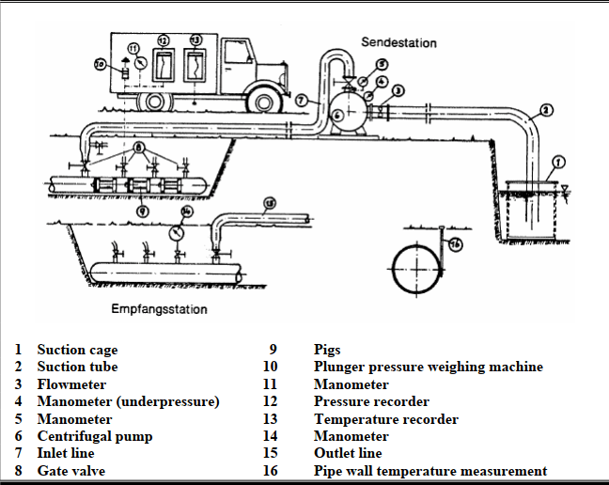
6. Pipeline Planning - Overview
Objective:
Set pipeline targets that align with revenue objectives
Recommended Approach:
Use HC, Quota and Win Rate to determine pipe gen target.
Allocate target based on expected contribution of pipe sources.
Alt. Approaches:
Pipeline waterfall - good luck!
Leads → Pipeline - Logically makes a ton of sense, but I advise to start “in the middle”

Slide 23
6. Pipeline Planning - A Simple Model
Step 1: Overall Target
# Reps x Quarterly Quota x Needed Coverage = Overall Pipe Create Target
Mid Atlantic | 2024-Q1 | 2024-Q2 | 2024-Q3 | 2024-Q4
Regional Sales Manager | 2 | 4 | 6 | 8
Enterprise Quarter Quota | 300 | 300 | 300 | 300
Desired Coverage | 4.0 | 4.0 | 4.0 | 4.0
Total Pipe Create Target | $ 2,400 | $ 4,800 | $ 7,200 | $ 9,600
Step 2: Assigning Sources
Historical Attribution x Strategic Adjustments (e.g., we’re making an investment in partners and want them to produce more pipe) = Pipe by Source
Department | Allocation | 2024-Q1 | 2024-Q2 | 2024-Q3 | 2024-Q4
Marketing | 20% | $480 | $960 | $1,440 | $1,920
SDR Outbound | 20% | $480 | $960 | $1,440 | $1,920
Sales | 30% | $480 | $960 | $1,440 | $1,920
Partner | 20% | $480 | $960 | $1,440 | $1,920
CSM | 10% | $480 | $960 | $1,440 | $1,920
Total | 100% | $2,400 | $4,800 | $7,200 | $9,600
Template to be provided!

Slide 24
6. Pipeline Planning - Hacks & Pitfalls
Hacks | Pitfalls
Simple is beautiful Align expectations across pipe generating function leaders Use inverse of your Win Rate to determine coverage needs (e.g., 25% win rate = 4x Coverage) | Do Not Over Complicate - this is very easy to do with pipeline Not monitoring target progression throughout the year - should be right up their with quota performance measuring Thinking Ramping Reps need less pipe - they need more!!

Slide 25
7. GTM Compensation Planning

Slide 26

7. GTM Compensation Planning - Overview
Objective:
Align efforts of your sales team with business objectives. Unless absolutely needed…should be evolution not revolution.
Approach:
A comp steering committee is essential to driving the process forward in an efficient fashion. Ensure Finance provided a tops down comp target. Start with key “Focus Areas” - don’t evaluate things you know are working.
Key Trends:
Utilizing NDR metrics for CS AND Sales
Pipe progression for key pipe gen roles (SDRs, Partners)
Spend ROI for Marketing

Slide 27
7. GTM Compensation Planning - Hacks & Pitfalls
Hacks | Pitfalls
Start early and roll-out on time Comp estimators are #1 tool for reps - if you don’t provide, they will waste time creating on their own (and it will be wrong) Keep it so darn simple - do you really need individual commission rates (ICRs)? Attend Scale’s comp seminars - incredibly experienced comp folks on the Scale team | Not getting field sales input - they will spot any gaps quickly Thinking comp fixes everything (set it and forget it) - process, manager oversight, enablement are just as important, if not more Staying in spreadsheets too long - too many great (cheap) tools out there now Not sharing Quotas, Territories with comp roll-out - will just lead to more and more questions

Slide 28
8. Communication & Roll-Out

Slide 29


8. Communication & Roll-Out - Overview
Objective:
Roll out the GTM plan with minimal friction, allowing the field to focus on the job at hand.
Order of Operations:
Exec Team review of changes (all leadership should know what is changing)
GTM Leadership Review (do not surprise them)
Field Advocate review (controlled leak)
Practice, practice, practice
Full Field roll-out at SKO

Slide 30
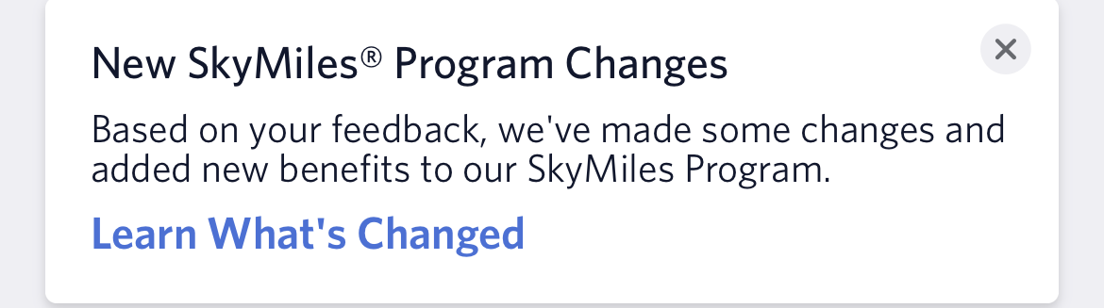
8. Communication & Roll-Out - Hacks & Pitfalls
Hacks | Pitfalls
Leverage SKO Roll out as early as possible - silence void gets filled with worry and rumors Actively identify your risks (individual or teams) and get ahead of these Seed the field with advocates - get your most tenured/influential reps on board early and use them to influence the rest Dry run the heck out of it - this is the step to get perfect; tell a story, use humor | Uncontrolled leaks - have NDA level trust in your inner circle) Not publish a FAQ Surprise your leaders Not take feedback if you got something REALLY wrong (e.g., Delta’s 2024 SkyMiles program)

Slide 31
9. Overall Timeline - Bringing It All Together

Slide 32
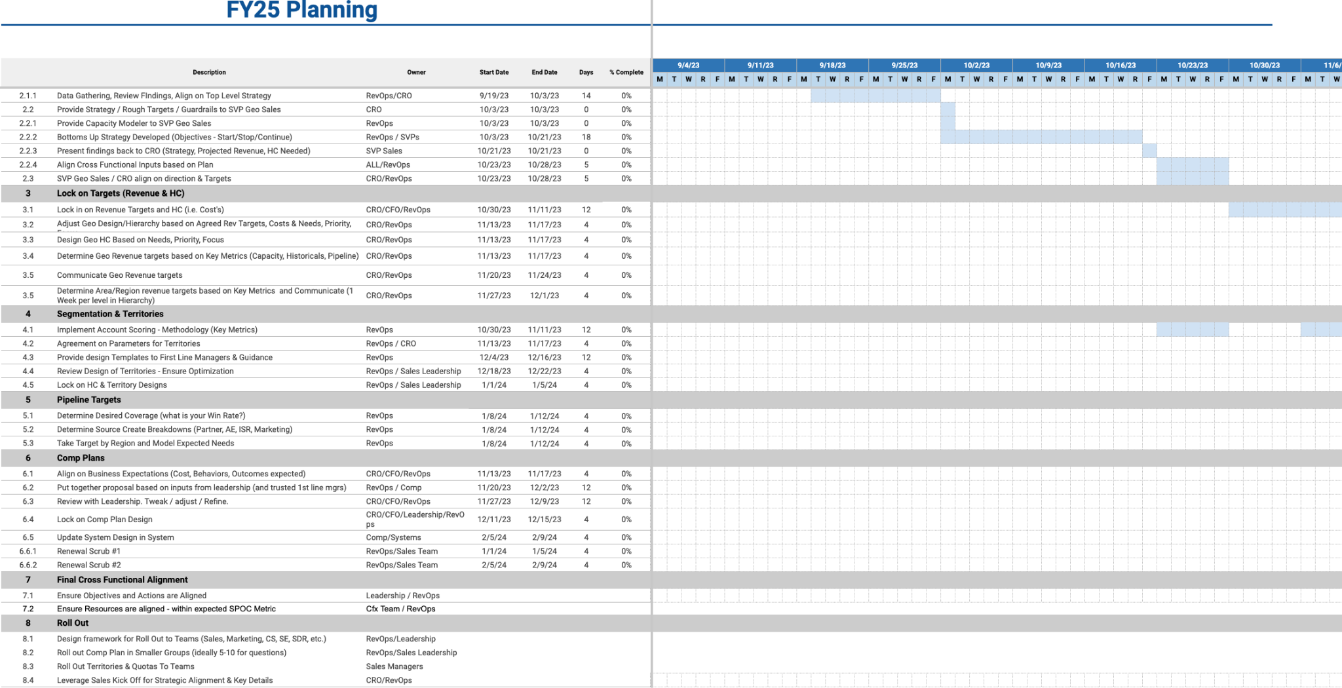
9. Overall Timeline
Objective:
Clearly communicate planning steps, timeline, dependencies, deadlines, etc. to all stakeholders
Key Dates:
Start planning at least 4 months before start of year
Board approval should be well before beginning of year
Roll-out should be closest to start of year as humanly possible
Critical Items:
Have all stakeholders sign off
Must have singular PM - Ops?
Think more parallel, less serial
Never be afraid to finish early
Template to be provided!

Slide 33
End

