Slide 1
Sales comp clinic: Answering your toughest questions
2025

Slide 2
Today’s agenda
Welcome & introduction
Foundations of a successful comp plan
Dozen common questions we hear
Q&A

Slide 3
We help our portfolio build and optimize hyper-growth GTM machines

Slide 4
What is the GTM Advisory?
Advisory
Content
Events
Been-to-market expertise
Step-by-step guides
The power of community
Advising over 70% of the portfolio with bespoke GTM consulting
Distilling decades of experience into 80+ practical tools and frameworks
Connecting EIRs, advisors, and portcos at 40+ events per year
Notes:
https://community.scalevp.com/c/static/content?recKNsqqn51MRz9pX

Slide 5
Upcoming events!
10am-11am Friday, December 12
Marketing council: The best data on how marketers are using AI Bill Crowley (creator of AI Advantage Assessment)

Slide 6
We want to hear your voice!
We’ll invite questions and/or anecdotes from the audience throughout the session
No need to raise hands–just come off mute
Remember to share your name, company, and title!

Slide 7


Today’s speakers
Ryan Azus
CRO EIR at Scale
M.G. Thibaut
CFO EIR at Scale

Slide 8
Foundations of a successful comp plan

Slide 9
A dozen common questions

Slide 10
When should I start my annual sales comp planning, and who should be involved?
QUESTION 1

Slide 11
When to start and who to involve
Tools & resources
QUESTION 1
📆 When to start
👤 Who’s involved
Start early, ideally in early Q3
Finance will typically set the schedule, often based on upcoming board meetings

Slide 12
When to start and who to involve
Tools & resources
QUESTION 1
📆 When to start
👤 Who’s involved
Start early, ideally in early Q3
Finance will typically set the schedule, often based on upcoming board meetings
Finance and the Head of Sales work together to craft the plan
Finance typically owns comp modeling
Sales typically owns GTM strategy & quota setting by rep segment
RevOps and People Ops provide input
CEO provides oversight and sets the tone for the company’s comp culture

Slide 13
What does a realistic quota-to- OTE ratio look like for a startup of my size?
QUESTION 2

Slide 14
Realistic quota-to-OTE ratios
QUESTION 2
Rule of thumb
Commentary
3x
4x
5x
Ratio
Heuristic
Okay 😐
Great 😀
Excellent 🥳
Takeaway
Work on boosting productivity before increasing comp or hiring more reps
Hire more reps and try to maintain their productivity
Accelerate sales org expansion as quickly as possible

Slide 15
Realistic quota-to-OTE ratios
QUESTION 2
Rule of thumb
Commentary
Ratios differ by segment; higher for SMB reps and lower for enterprise reps
Ratios correlate to marketing spend; high marketing spend requires a high ratio
Early-stage startups typically have to pay reps higher bases and commission rates to compensate for risk
3x
4x
5x
Ratio
Heuristic
Okay 😐
Great 😀
Excellent 🥳
Takeaway
Work on boosting productivity before increasing comp or hiring more reps
Hire more reps and try to maintain their productivity
Accelerate sales org expansion as quickly as possible

Slide 16
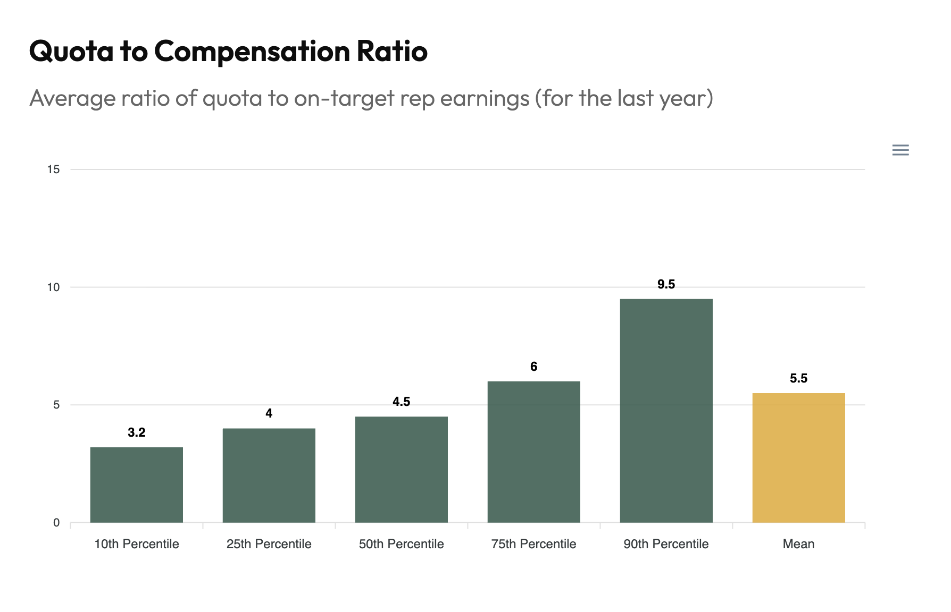
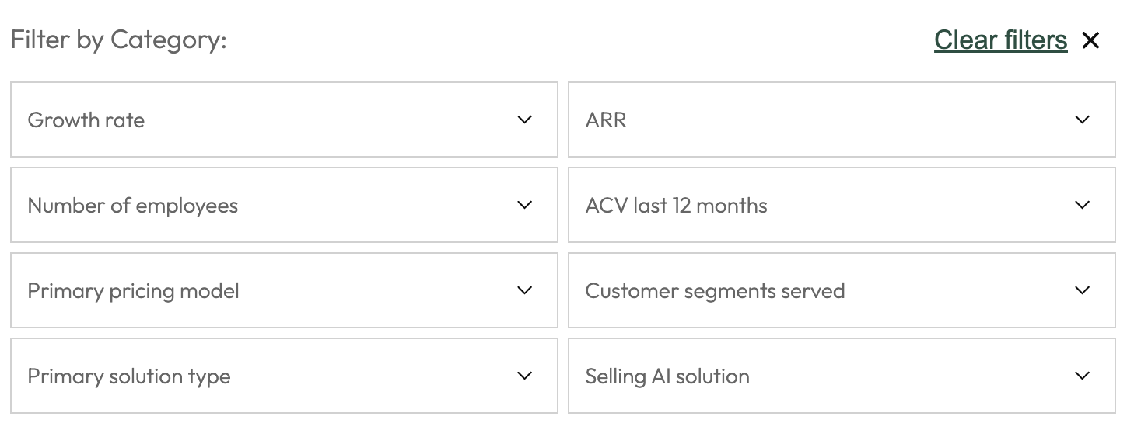
Realistic quota-to-OTE ratios
QUESTION 2
Benchmark tool (here)

Slide 17
How long should my quota and compensation periods be?
QUESTION 3

Slide 18
Choosing a quota and compensation period
QUESTION 3
Quota periods
Quota period | Ideal motion
Monthly | High-velocity / sales-assisted PLG
Quarterly | Transactional / SMB & Mid-Market
Semi-annually | Strategic / Mid-Market+ & Enterprise sales
Annually | Complex / Enterprise sales

Slide 19
Choosing a quota and compensation period
QUESTION 3
Quota periods
Quota period | Ideal motion
Monthly | High-velocity / sales-assisted PLG
Quarterly | Transactional / SMB & Mid-Market
Semi-annually | Strategic / Mid-Market+ & Enterprise sales
Annually | Complex / Enterprise sales
Semi-annual quotas give enterprise-focused startups flexibility as you scale
You can always lengthen quota periods, but it’s very hard to tighten them

Slide 20
Choosing a quota and compensation period
QUESTION 3
Quota periods
Quota period | Ideal motion
Monthly | High-velocity / sales-assisted PLG
Quarterly | Transactional / SMB & Mid-Market
Semi-annually | Strategic / Mid-Market+ & Enterprise sales
Annually | Complex / Enterprise sales
Semi-annual quotas give enterprise-focused startups flexibility as you scale
You can always lengthen quota periods, but it’s very hard to tighten them
⚠️ Overly short quota periods can cause sandbagging

Slide 21
Should my comp plan differ for my AEs vs. SDRs vs. CSMs?
QUESTION 4

Slide 22
Tailoring comp plans to AEs, SDRs, and CSMs
QUESTION 4
General rule: Each role’s compensation structure should match its primary influence on revenue

Slide 23
Tailoring comp plans to AEs, SDRs, and CSMs
QUESTION 4
General rule: Each role’s compensation structure should match its primary influence on revenue
Role | % variable comp | Performance drivers
SDR | 30% | SQLs, pipeline created
AE | 50% | Closed:won deals for territory
SE | 20-30% | Closed:won deals for alignment
CSM | 10-20% | Retention, adoption, NDR, renewals, referrals

Slide 24
How should I compensate reps for renewals, expansion, and multi-year deals?
QUESTION 5

Slide 25
Compensating renewals, expansion, & multi-year deals
QUESTION 5
Scenario | Compensation structure
Easy renewals | No commission (sometimes CSMs for retention)

Slide 26
Compensating renewals, expansion, & multi-year deals
QUESTION 5
Scenario | Compensation structure
Easy renewals | No commission (sometimes CSMs for retention)
Hard renewals | Hire a dedicated renewal team or pay AEs a small commission (e.g., <5% commission rate)

Slide 27
Compensating renewals, expansion, & multi-year deals
QUESTION 5
Scenario | Compensation structure
Easy renewals | No commission (sometimes CSMs for retention)
Hard renewals | Hire a dedicated renewal team or pay AEs a small commission (e.g., <5% commission rate)
Expansion | Compensate the same as new bookings (net new $s)

Slide 28
Compensating renewals, expansion, & multi-year deals
QUESTION 5
Scenario | Compensation structure
Easy renewals | No commission (sometimes CSMs for retention)
Hard renewals | Hire a dedicated renewal team or pay AEs a small commission (e.g., <5% commission rate)
Expansion | Compensate the same as new bookings (net new $s)
Multi-year deals | Calculate commissions based on Year 1 values rather than TCVs, but use SPIFFs or multi-year kickers (e.g., 0.2-0.5x commission multiplier for each additional year) to incentivize longer deals

Slide 29
How can I design accelerators / upside plans that actually motivate reps?
QUESTION 6

Slide 30
Designing accelerators to motivate reps
QUESTION 6
Four key considerations
Company culture: Who are you trying to hire? How do you want your compensation to compare to market averages?
1

Slide 31
Designing accelerators to motivate reps
QUESTION 6
Four key considerations
Company culture: Who are you trying to hire? How do you want your compensation to compare to market averages?
Sales culture: Are you most interested in rewarding a few big hitters, or a wider group of successful reps?
Leverage: Desired ratio of top-decile performers’ comp to reps who merely make quota (typically around 3x)
1
2

Slide 32
Designing accelerators to motivate reps
QUESTION 6
Four key considerations
Company culture: Who are you trying to hire? How do you want your compensation to compare to market averages?
Sales culture: Are you most interested in rewarding a few big hitters, or a wider group of successful reps?
Leverage: Desired ratio of top-decile performers’ comp to reps who merely make quota (typically around 3x)
Quota feasibility: Are your quotas easy or hard to meet?
1
2
3

Slide 33
Designing accelerators to motivate reps
QUESTION 6
Four key considerations
Company culture: Who are you trying to hire? How do you want your compensation to compare to market averages?
Sales culture: Are you most interested in rewarding a few big hitters, or a wider group of successful reps?
Leverage: Desired ratio of top-decile performers’ comp to reps who merely make quota (typically around 3x)
Quota feasibility: Are your quotas easy or hard to meet?
Budget: How aggressively can you afford to incentivize over-performance?
1
2
3
4

Slide 34
Designing accelerators to motivate reps
QUESTION 6
With deceleration below 100%
Linear to 100%
Quota attainment | Multiplier
0% to <50% | 0.8
50% to <100% | 1.2
100% to <140% | 1.5
140%+ | 2.0
Quota attainment | Multiplier
0% to <100% | 1
100% to <140% | 1.5
140%+ | 2.0
These multipliers, much like income tax rates, are marginal. For the table on the
right, the first ~100% is paid at 1x, then the next ~40% at 50% etc.

Slide 35
Designing accelerators to motivate reps
QUESTION 6
With deceleration below 100%
Linear to 100%
Quota attainment | Multiplier
0% to <50% | 0.8
50% to <100% | 1.2
100% to <140% | 1.5
140%+ | 2.0
Quota attainment | Multiplier
0% to <100% | 1
100% to <140% | 1.5
140%+ | 2.0
Recommendation: Don’t put caps on earnings. For extreme performance (300-400% etc), bring the accelerators back down, but keep them above the 100% multiplier to prevent sandbagging.

Slide 36
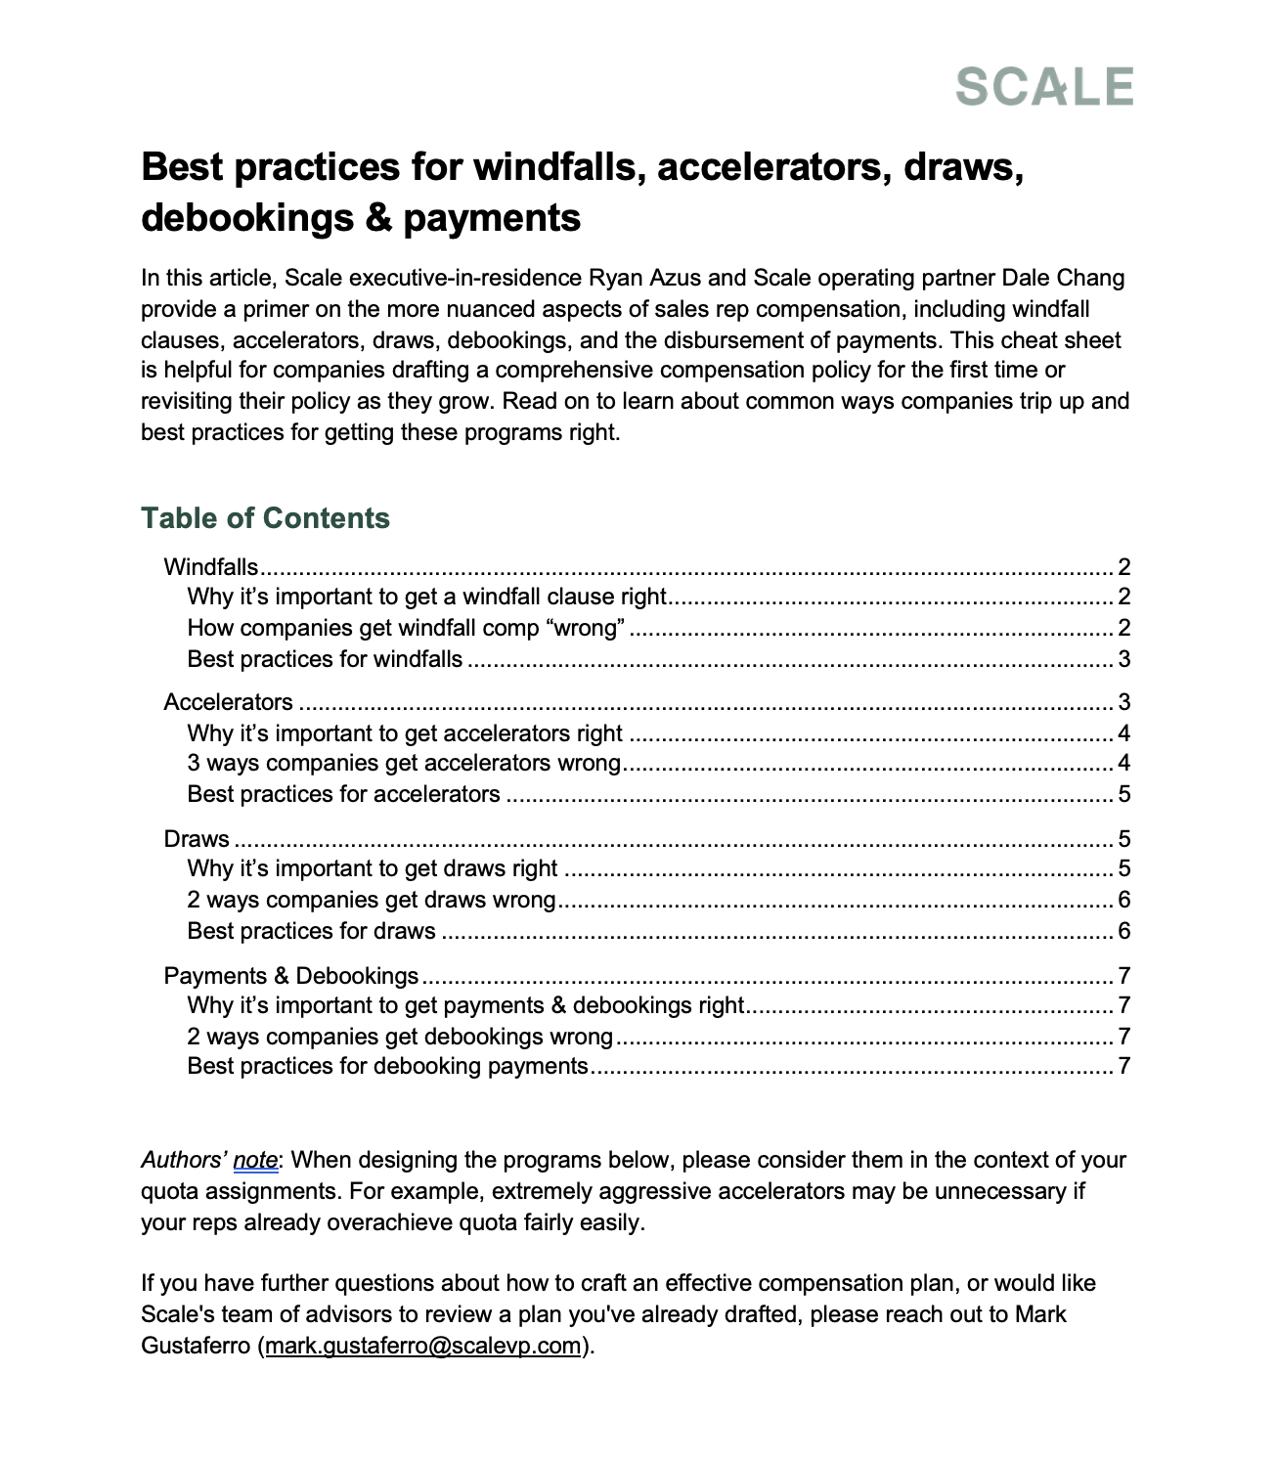
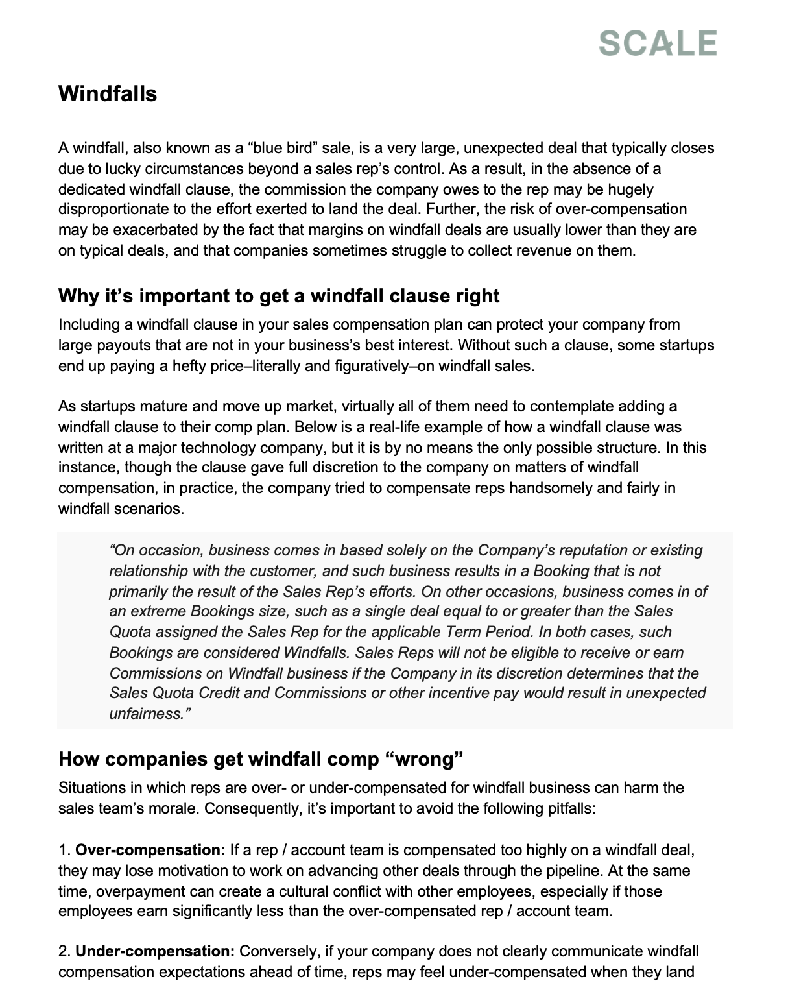
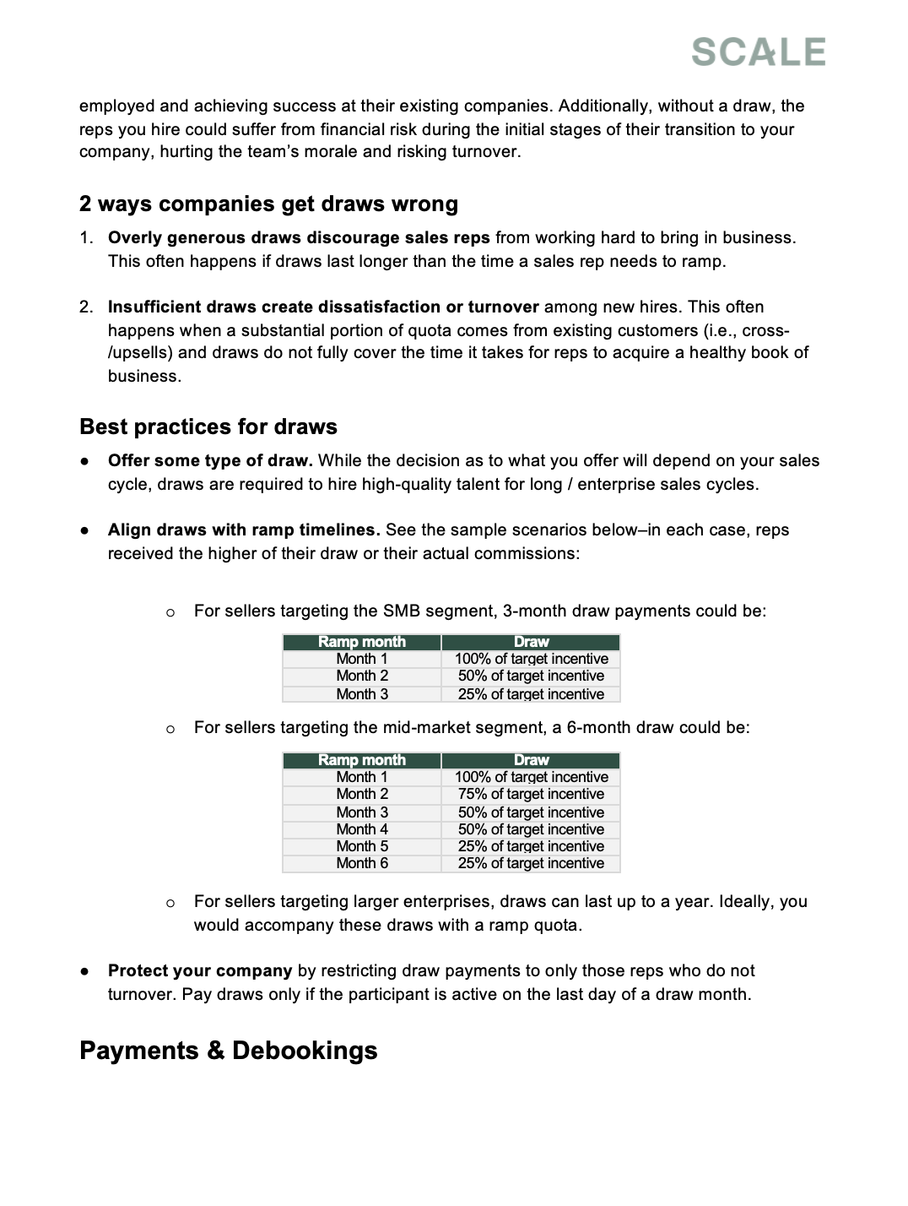
Designing accelerators to motivate reps
QUESTION 6
Detailed playbook (here)

Slide 37
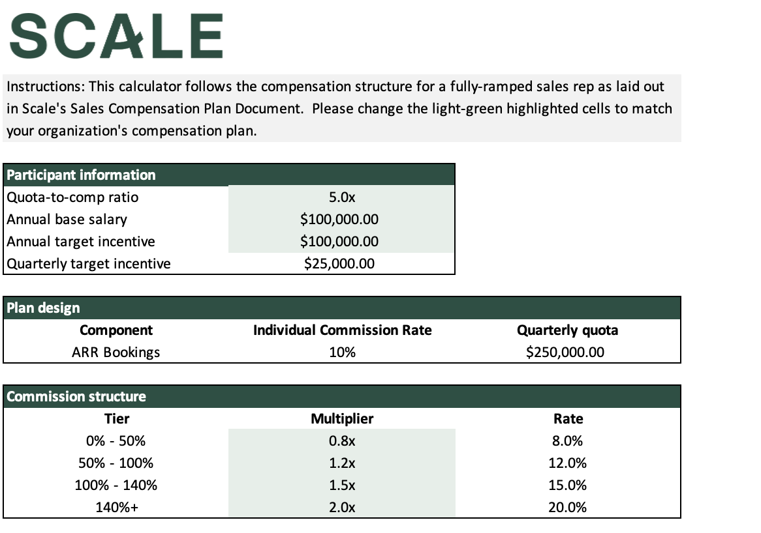
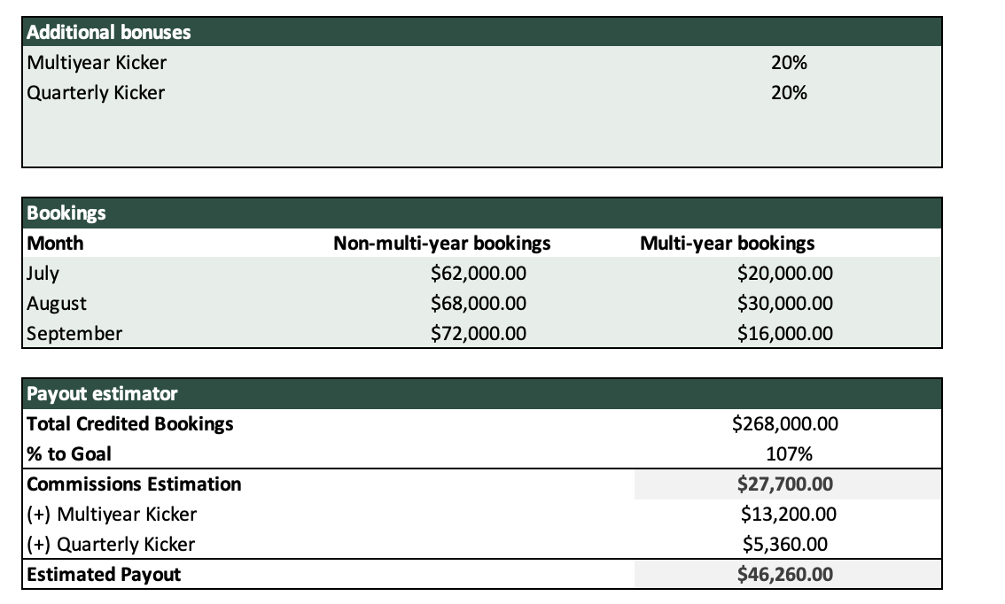
Designing accelerators to motivate reps
QUESTION 6
Payout calculator (here)

Slide 38
How should I compensate reps for windfalls or unusually large one-off deals?
QUESTION 7

Slide 39
Setting up windfall clauses
QUESTION 7
📖 Definition
Windfall clauses protect you from paying exorbitant commissions on very large, often unexpected deals

Slide 40
Setting up windfall clauses
QUESTION 7
📖 Definition
Windfall clauses protect you from paying exorbitant commissions on very large, often unexpected deals
🛠️ When to use
Commission is hugely disproportionate to rep’s effort
Deal margin is much lower than normal

Slide 41
Setting up windfall clauses
QUESTION 7
📖 Definition
Windfall clauses protect you from paying exorbitant commissions on very large, often unexpected deals
🛠️ When to use
Commission is hugely disproportionate to rep’s effort
Deal margin is much lower than normal
⚠️ Risks
Overcompensating reps can lower their motivation to advance other deals and harm team morale
Undercompensating can disincentivize chasing big deals

Slide 42
Setting up windfall clauses
QUESTION 7
✅ Best practices
Strike a balance: Generously compensate reps for large deals while also protecting the company
Set clear expectations: Keep reps informed when deals are still in pipeline, rather than after they’ve closed
Do not cap commissions: If you do, you’ll struggle to hire and retain talent, and reps may hold deals
Apply your clause consistently: Don’t risk a discrimination lawsuit

Slide 43
Setting up windfall clauses
QUESTION 7
Detailed playbook (here)

Slide 44
How should I design comp plans for usage-based or hybrid pricing models (vs. seat-based SaaS)?
QUESTION 8

Slide 45


Designing comp plans for usage-based or hybrid pricing
QUESTION 8
Consider a two-step scheme:
Time of booking: Compensate based on minimum commitment or prepaid credits
End of each quarter: Compensate based on usage (backward-looking)

Slide 46
How should I structure draws / guarantees for my new hires, and how long should they last?
QUESTION 9

Slide 47
Structuring draws for new hires
QUESTION 9
Key considerations
Implications
What caliber of rep are you looking to hire?
Successful, highly-compensated reps at other companies require larger draws

Slide 48
Structuring draws for new hires
QUESTION 9
Key considerations
Implications
What caliber of rep are you looking to hire?
Successful, highly-compensated reps at other companies require larger draws
What are your ramp timelines?
Draws should align with ramp quotas: shorter for SMB reps, longer for enterprise

Slide 49
Structuring draws for new hires
QUESTION 9
Key considerations
Implications
What caliber of rep are you looking to hire?
Successful, highly-compensated reps at other companies require larger draws
What are your ramp timelines?
Draws should align with ramp quotas: shorter for SMB reps, longer for enterprise
What % of quota comes from existing customers?
Draws need to last longer if a large portion of quota comes from cross-/upsells

Slide 50
Structuring draws for new hires
QUESTION 9
SMB rep example
Mid-market rep example
Ramp month | Draw
Month 1 | 100% of target incentive
Month 2 | 50% of target incentive
Month 3 | 25% of target incentive

Slide 51
Structuring draws for new hires
QUESTION 9
SMB rep example
Mid-market rep example
Ramp month | Draw
Month 1 | 100% of target incentive
Month 2 | 50% of target incentive
Month 3 | 25% of target incentive
Ramp month | Draw
Month 1 | 100% of target incentive
Month 2 | 75% of target incentive
Month 3 | 50% of target incentive
Month 4 | 50% of target incentive
Month 5 | 25% of target incentive
Month 6 | 25% of target incentive

Slide 52
Structuring draws for new hires
QUESTION 9
SMB rep example
Mid-market rep example
Ramp month | Draw
Month 1 | 100% of target incentive
Month 2 | 50% of target incentive
Month 3 | 25% of target incentive
Ramp month | Draw
Month 1 | 100% of target incentive
Month 2 | 75% of target incentive
Month 3 | 50% of target incentive
Month 4 | 50% of target incentive
Month 5 | 25% of target incentive
Month 6 | 25% of target incentive
Draws for enterprise reps can be even longer.

Slide 53
Structuring draws for new hires
QUESTION 9
Detailed playbook (here)

Slide 54
When should my reps get debooked?
QUESTION 10

Slide 55
Managing debookings
QUESTION 10
📖 Definition: Debookings occur when a closed:won customer churns or contracts partway through the contract, or fails to make payment entirely
✅ Best practices
Establish a debooking period: Withhold commissions on deals cancelled or downsold within a set time (e.g., 6 months)

Slide 56
Managing debookings
QUESTION 10
📖 Definition: Debookings occur when a closed:won customer churns or contracts partway through the contract, or fails to make payment entirely
✅ Best practices
Establish a debooking period: Withhold commissions on deals cancelled or downsold within a set time (e.g., 6 months)
Don’t penalize shorter deals: Create a carve-out for deals intended to last shorter than the debooking period but also adjust credit appropriately

Slide 57
Managing debookings
QUESTION 10
📖 Definition: Debookings occur when a closed:won customer churns or contracts partway through the contract, or fails to make payment entirely
✅ Best practices
Establish a debooking period: Withhold commissions on deals cancelled or downsold within a set time (e.g., 6 months)
Don’t penalize shorter deals: Create a carve-out for deals intended to last shorter than the debooking period but also adjust credit appropriately
Treat within-period payments as advances: Clearly communicate that all commissions paid within a quota period are really just advances to be finalized at the end of the period

Slide 58
Managing debookings
QUESTION 10
📖 Definition: Debookings occur when a closed:won customer churns or contracts partway through the contract, or fails to make payment entirely
✅ Best practices
Establish a debooking period: Withhold commissions on deals cancelled or downsold within a set time (e.g., 6 months)
Don’t penalize shorter deals: Create a carve-out for deals intended to last shorter than the debooking period but also adjust credit appropriately
Treat within-period payments as advances: Clearly communicate that all commissions paid within a quota period are really just advances to be finalized at the end of the period
Pay out advances carefully: Ensure that reps rarely owe money at the end of the period

Slide 59
Managing debookings
QUESTION 10
Detailed playbook (here)

Slide 60
How should I communicate plan changes to my team?
QUESTION 11

Slide 61
Communicating plan changes
QUESTION 11
📋 Rules to remember
🚦How to roll out a new plan
Reps can only handle so much change at a time, so prioritize the few key fixes that really matter
Any change will be viewed negatively at first
Clearly communicate why each decision matters for the company and how it will impact the reps
Preview the plan with senior leadership team to set the tone and collect feedback
1

Slide 62
Communicating plan changes
QUESTION 11
📋 Rules to remember
🚦How to roll out a new plan
Reps can only handle so much change at a time, so prioritize the few key fixes that really matter
Any change will be viewed negatively at first
Clearly communicate why each decision matters for the company and how it will impact the reps
Preview the plan with senior leadership team to set the tone and collect feedback
Meet with front-line sales managers to arm them with the rationale and key talking points
1
2

Slide 63
Communicating plan changes
QUESTION 11
📋 Rules to remember
🚦How to roll out a new plan
Reps can only handle so much change at a time, so prioritize the few key fixes that really matter
Any change will be viewed negatively at first
Clearly communicate why each decision matters for the company and how it will impact the reps
Preview the plan with senior leadership team to set the tone and collect feedback
Meet with front-line sales managers to arm them with the rationale and key talking points
Hold open session with reps to present the plan and answer questions
Head of Sales and Finance should attend and participate actively
1
2
3

Slide 64
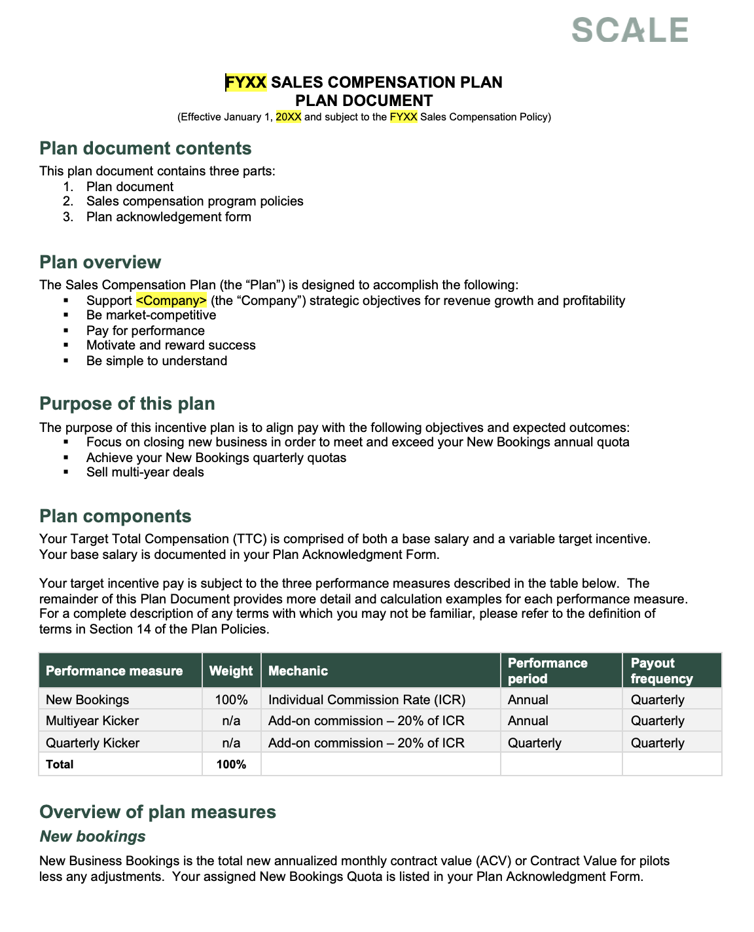
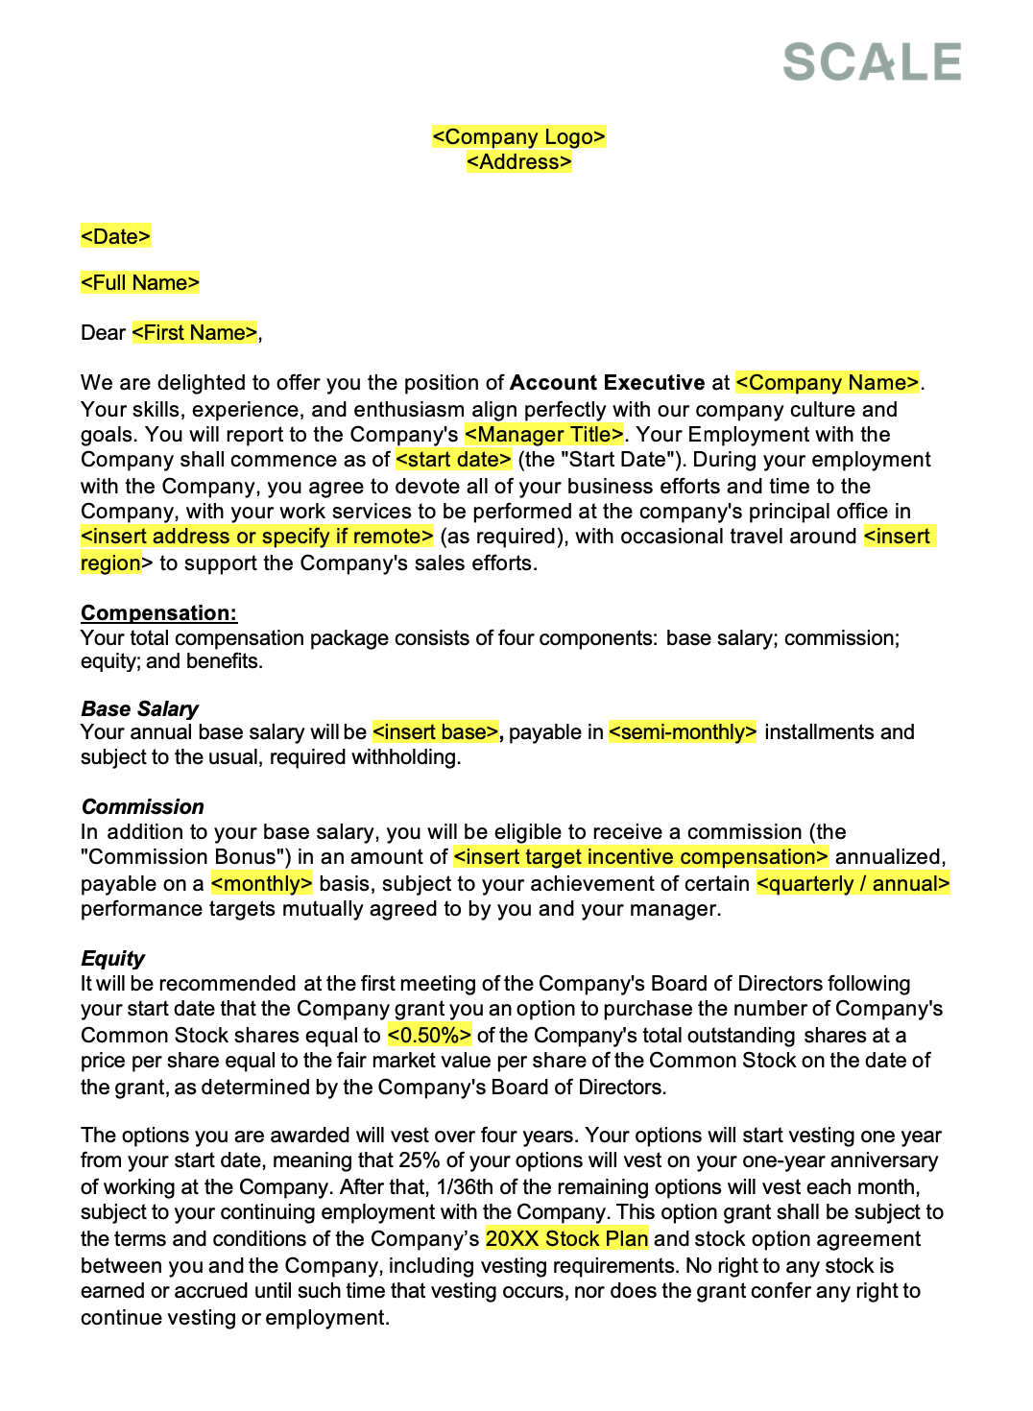
Communicating plan changes
QUESTION 11
Full plan template (here)
Offer letter template (here)

Slide 65
What are the most common sales comp pitfalls for early-stage companies?
QUESTION 12

Slide 66

Common design pitfalls
QUESTION 12
Two most common pitfalls
Underestimating resourcing cost
Budget for the true cost of a rep, including mgt, enablement, SEs, BDRs, & marketing

Slide 67

Common design pitfalls
QUESTION 12
Two most common pitfalls
Underestimating resourcing cost
Under-focusing on segmentation
Budget for the true cost of a rep, including mgt, enablement, SEs, BDRs, & marketing
Hire reps at different comp levels according to the skills needed to sell to their segment

Slide 68
Bonus (baker’s dozen) question

Slide 69
Where can I get benchmark data and 1:1 guidance?
QUESTION 13

Slide 70




Getting help
QUESTION 13
📊 Benchmark data
🔎 Comp plan reviews
Ryan Azus Scale CRO EIR
Tyler Harnish Scale CRO EIR
scalevp.com/gtm-resources
Email Mark at mark.gustaferro@scalevp.com

Slide 71
Bonus resource

Slide 72
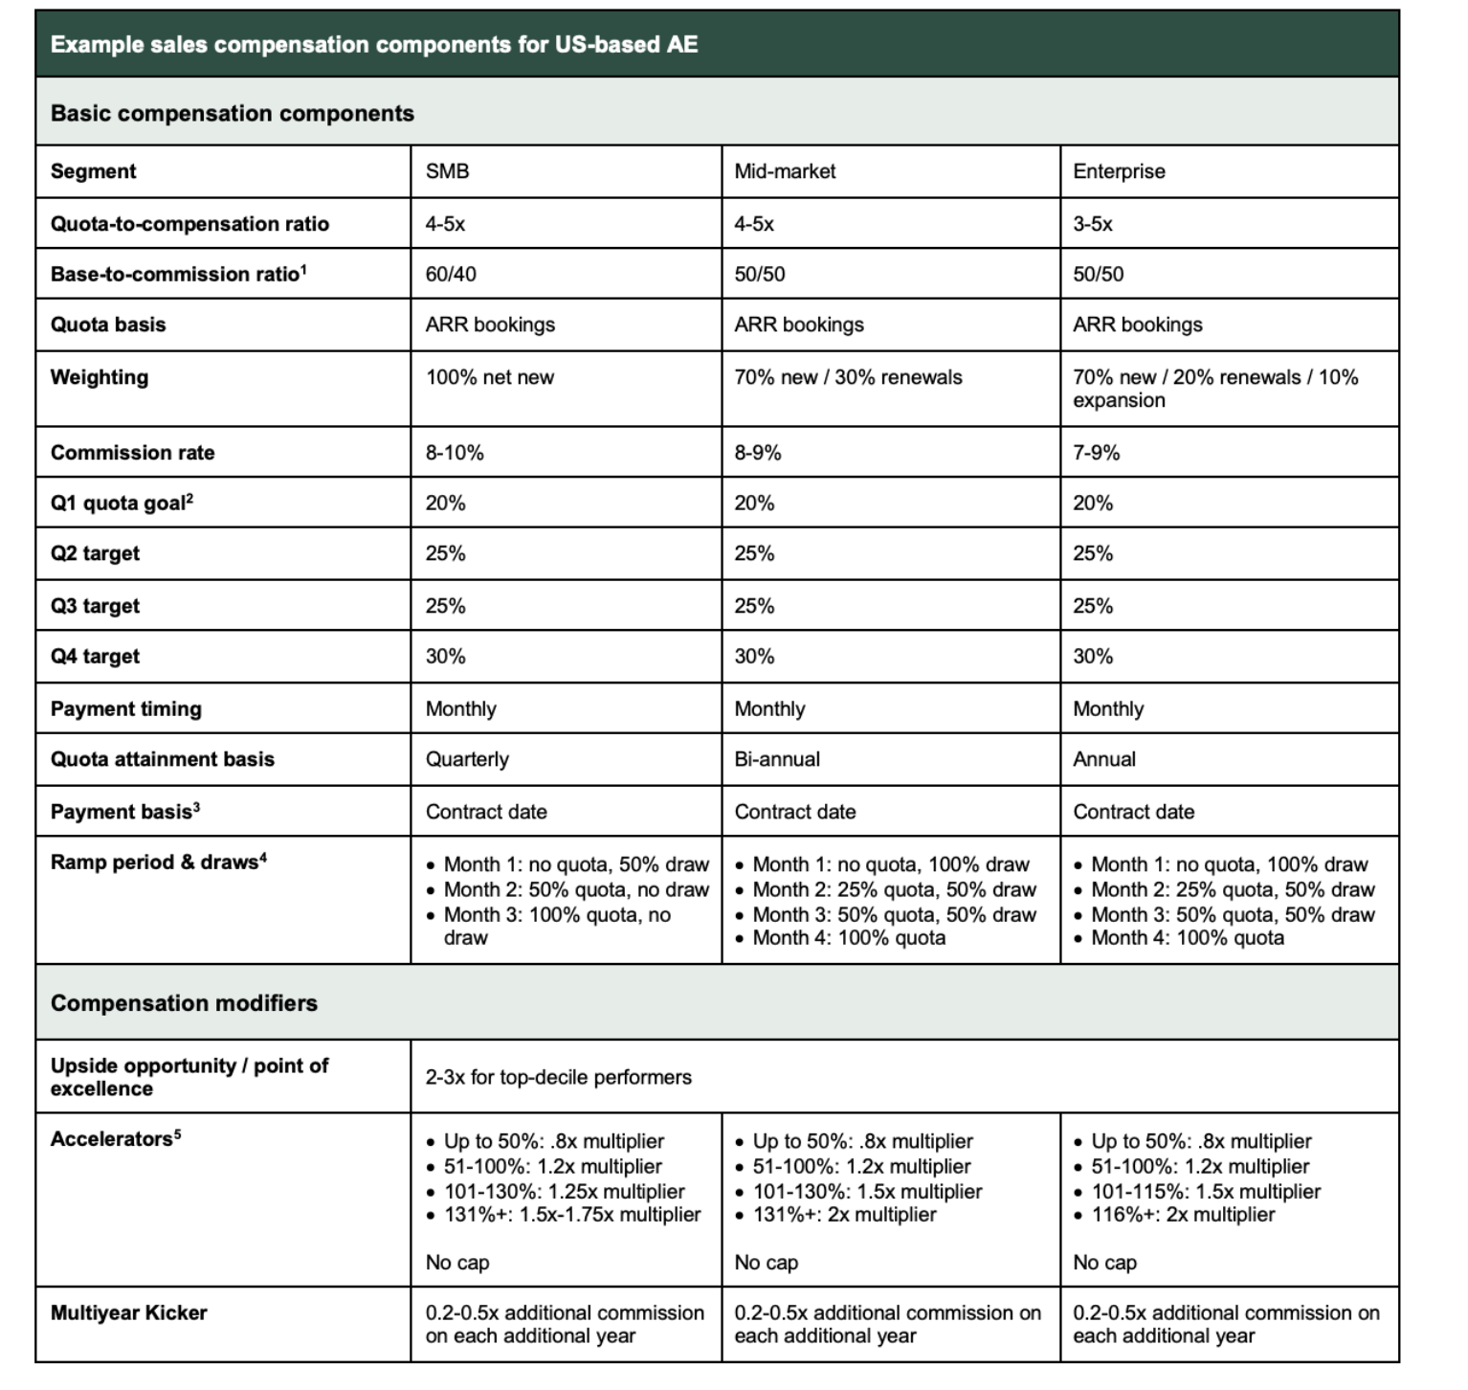
Cheat sheet recapping much of what we discussed
Cheat sheet (here)

Slide 73
Q&A

Slide 74
Thank you

Slide 75
Appendix

Slide 76
Realistic a quota-to-OTE ratio
QUESTION 2
Rule of thumb
3x
4x
5x
Ratio
Heuristic
Okay 🙂
Great 😀
Excellent 🥳
Takeaway
Work on increasing productivity before increasing comp or hiring more reps
Hire more reps and try to maintain their productivity
Accelerate sales org expansion as quickly as possible

