Slide 1
Scaling the
Demand Engine
March 10, 2023
Prioritizing Investments Across the Customer Journey
Lena Waters
Group Vice President, Global Demand & Digital Business

Slide 2

Hello!
Lena Waters
Group Vice President,
Global Demand & Digital Business
DocuSign
Notes:
Intro
Company
Size
Role

Slide 3
1
High-growth companies typically focus on maximizing momentum of their flywheel.
But priority can skew towards demand investments that are
most directly attributable.
2
Other stages of the customer journey – category awareness, brand favorability, and propensity to buy – can be neglected, under-resourced, and stall out, which ultimately slows growth.
3
Today, we'll discuss why staying focused on the entire customer journey is essential to drive momentum and growth.

Slide 4
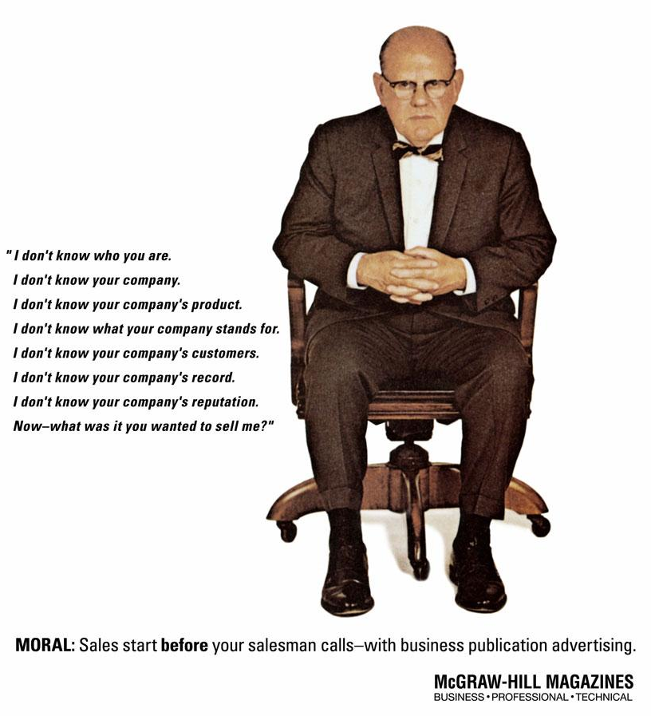
In 1958,
“Top of the funnel”
was already
a thing.
Nothing has really changed.
Notes:
We’re going to start out today getting back to basics :)
And yet the point is the same today – “Sales is asking me to make a buying decision, and I don’t have context for the problem, the solutions, your solution, and why I should care about any of this”.

Slide 5
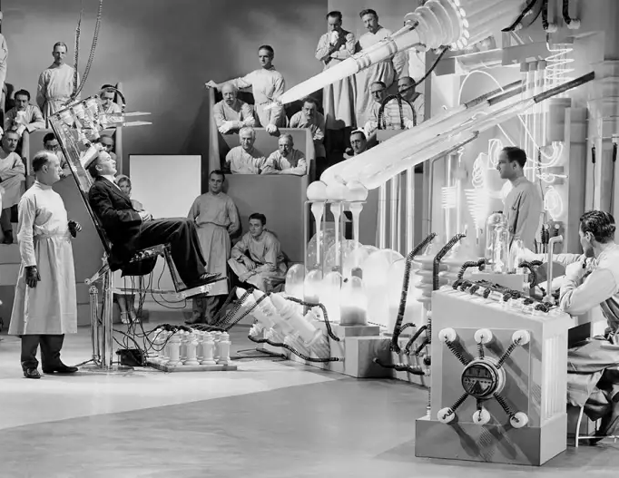
Why is it so hard to pay attention?
A person’s processing speed is 120 bits per second
Understanding one person talking takes 60 bits per second
During our leisure time, we process 100,000 words every day
And yet…
Notes:
Consider how much information was available to a buyer in 1958, when that ad was published.
Let’s talk about “Mental Availability”
Here’s the science behind the overload we all face every day.
https://www.fastcompany.com/3051417/why-its-so-hard-to-pay-attention-explained-by-science

Slide 6
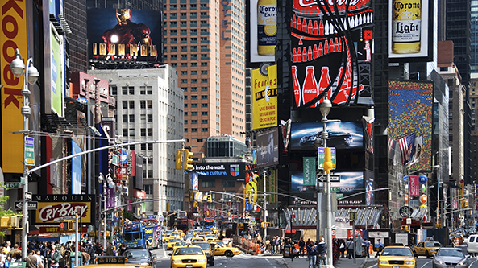
Notes:
In 2015 the estimate was that we are all exposed to 4000-10,000 ad impressions per day
Everything you hear, see, read, wear, eat, drink, ride in, travel past, have in your home, use at work, talk about with other people…. and then, there’s the internet
Source: https://www.redcrowmarketing.com/2015/09/10/many-ads-see-one-day/

Slide 7
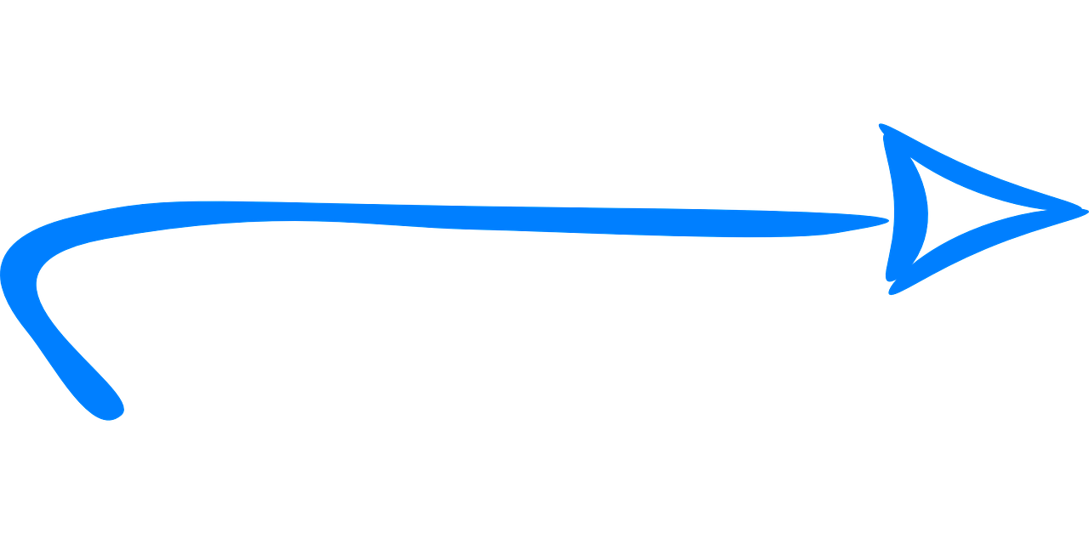
Earning mental availability is critical
Yet we feel most secure focusing on one
We focus a lot on and excel at this
1
2
3
Mental Availability
Emotional Resonance
Digital & Physical Availability
While we want people to have positive associations with our brand, a bigger challenge is to get them to think of us at all.
This is why we need to drive and sustain Awareness.
A great product proposition is not enough.
Emotions and associations play a big role in driving resonance, especially amongst prospects who are not yet in market, whom we simply want to prime.
Once prospects are interested in us, we need to be ready to meet them by maximizing our presence in digital & physical spaces.
This drives immediate revenue.
Notes:
A leading Marketing think tank, the Ehrenberg-Bass Institute, posits that effective marketing is based on a model of mental and physical availability. We are really, really good at the third trigger – capturing demand in the digital space via mid- and lower-funnel marketing – but can likely agree we have not focused enough on the first two. When you’re thinking about overall marketing effectiveness, physical/digital availability is of course, really important.
Even if a growing company isn’t in the position to materially invest in brand building, earning mental availability with bold creativity, consistent and distinct assets, is achievable for any company. Wide reach, and high frequency of exposure can come over time.
If you consider that people spend a matter of seconds or minutes scanning your XDRs emails, your demand team’s webinar invite, or your content team’s white paper/infographic/blog…. Are you using each one of those opportunities to earn mental availability & distinguish your brand, or are you just adding to the noise, and then buying your customers down-funnel?

Slide 8



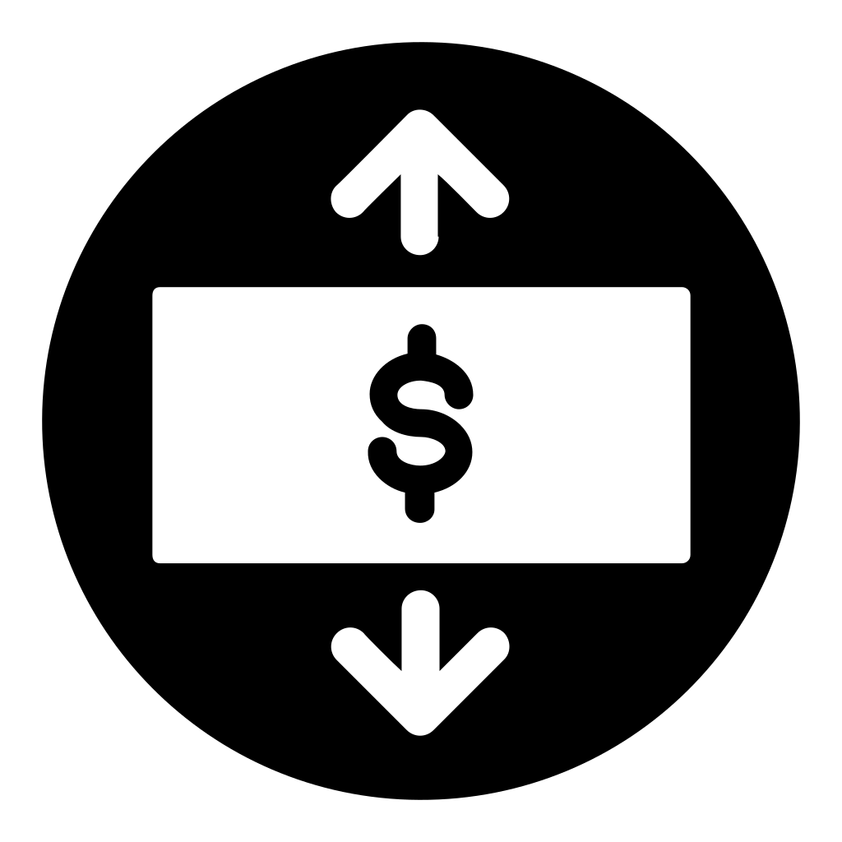



Full-funnel marketing creates broad value beyond sales
Forward-looking pipeline coverage doesn’t all come from “Demand Gen”
Short-term Sales
Demand Gen
(Or, “Lower Funnel,
High-Intent
Demand Capture”)
Mid-term Sales
Long-term Sales
Pricing Power
Category Optionality
Talent Attraction
Economic Moat
Full Funnel Marketing
Notes:
In addition to brand building in having a positive effect on future sales from future buyers who aren’t in market yet but there are other benefits, too.
Reducing pricing sensitivity is probably one of the most valuable things that marketing does. Research shows that “famous” brands can charge higher prices for their products and services (e.g., Apple).
Categories are mortal; brands are immortal. Every category shrinks eventually and when that happens, your brand can help you escape to a new category. Brands mitigate risk by giving you a beachhead in future categories. (Examples: Microsoft, which pivoted from Windows and then using the same brand trusted by IT departments all over the world, moved into the cloud. Virgin, from cheeky record store to commercial space travel and everything in between.)
Talent acquisition - especially critical today
Lastly, a brand can provide what Warren Buffet calls an economic moat, which is a distinct advantage a company has over its competitors that allows it to protect its market share and profitability. It’s generally difficult to mimic because it’s comprised of things like brand equity so it creates an effective barrier against competition from other companies.

Slide 9
Upper & lower funnel balanced for long-term growth
Lower funnel stages do not manifest on their own
Performance KPIs
Operational KPIs
Messaging
1
Awareness
Increase awareness of problem and our solution
Impressions/ Views/Reach
Frequency
Brand / ad recall
Brand differentiation
Share of Search
Memorable, branded storytelling
Awareness
Strangers
Familiarity
2
Favorability
Heighten positive perceptions of us and our products
Prospects
Brand Marketing builds mental availability
3
Consideration
Nudge toward trial/ purchase process
Preference in category
Consideration
Customer stories
Leads
Engagement (CTRs/site visits, time spent on site, downloads, subscriptions, contact me, etc.)
Demand Marketing converts via digital & physical availability
4
Intent
Increase likelihood of trial
MQL
SQO
Evaluation
Product messaging, category entry points, direct response
Purchase
Customers
5
Net Promoter Score
Likelihood to evangelize and opt for brand if re-evaluating
Cross- and up-sell
Notes:
Measurement is always imperfect but we need to strive for a credible barometer so that we can benchmark and anticipate outcomes. The messaging at the top of the funnel is all about being memorable and establishing our brand through the use of distinctive assets. As we start to move down to mid-funnel, customer stories and partner endorsements become important and then in the active evaluation phase, we need product messaging with strong calls to action.
NOTE that these stages are sequential. You need to have sufficient levels of Awareness, for instance, before you can achieve Favorability and a prospect needs to have a positive perception of us before they’ll consider doing a trial.

Slide 10
If nothing else:
Messaging
Content
Creative
are different at the top funnel and earns mental availability
Upper Funnel Marketing
Direct Response Marketing
Long-term brand building
Rational approach does NOT work well for brand building, which entails talking to prospects before they are in market.
They are not interested in product information right now, so they will screen it out.
Short-term sales activation
Rational persuasion works well, because people who are actively buying find product messages interesting and useful.
Focus should be on
eliciting a response
Emotional priming is more effective
Doesn’t require active interest
in the product or category
Creating physical/digital availability
Seeks to be memorable through branded and highly engaging content
Calls to action and subsequent user journey are critical
Notes:
A material difference between upper and lower-funnel programs is in the messaging. Serving time-consuming product messages to people who aren’t actively buying would be unlikely to ever achieve such a result. Upper-funnel messaging needs to focus on well-branded, memorable storytelling. This is precisely why the big auto insurance companies in the US do memorable, character-driven brand ads for their upper funnel campaigns and reserve their rates-focused, policy-feature ads for the lower funnel. (Think Jake from State Farm, the Aflac Duck, the Geico Gecko, Flo from Progressive and Allstate’s Mayhem.)

Slide 11
Notes:
At this point in the presentation, you are likely all thinking…. Easy for you to say, spend time & money on upper funnel marketing.
You’re at a $2.6B company, you can spend what you like on ad campaigns.
No… no we can’t.
No one is immune to the lure of huge amounts of inbound, high-intent, high-converting down funnel leads.
<note: general paid search approach, funding of brand campaigns, reallocation of lower to upper funnel funding>

Slide 12
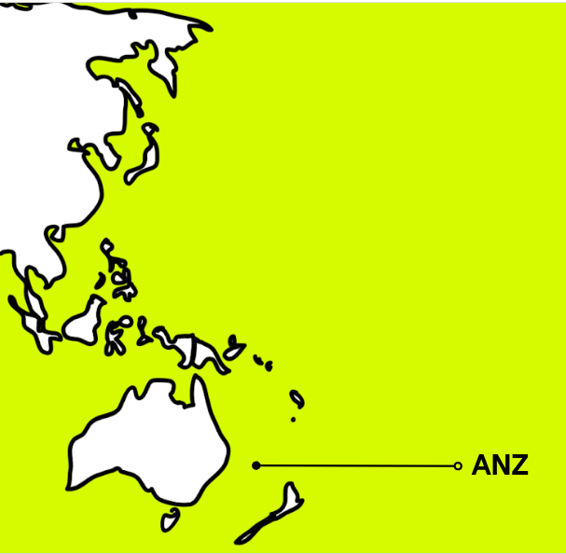
The Situation
DocuSign’s category & brand awareness is not an issue in the US.
“DocuSign” is the verb for esignature.
Not so in Australia.
So the goal was:
‘Grow awareness and interest in DocuSign in the local market.’
Notes:
Our brief appeared relatively simple; ‘Grow awareness and interest in DocuSign in the local market.’
The obvious approach was to sell DocuSign’s innumerable benefits: legally binding, super fast and effective, all the while saving the environment.
When we looked at the motives of organisational leaders and considering the evidence from behavioural science studies, we came to an important realisation: avoiding risk is the number one factor driving most B2B decisions, which is what makes B2B selling so tough.
The reason is, psychologically, we all fall victim to a cognitive bias known as Status Quo bias

Slide 13
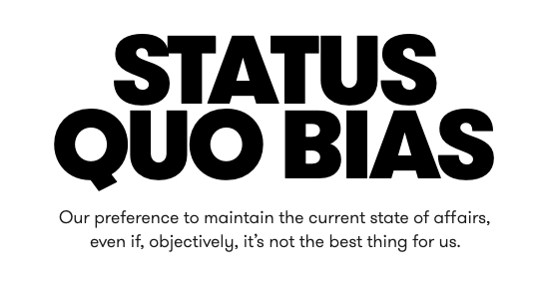
AKA “Lost to No Decision”
Notes:
Status Quo bias is heightened in a risk averse business environment. And you can see why.when you consider the asymmetrical relationship between risk and reward in the business world.
If a business leader makes a brilliantly executed decision to take a risk and switch over to a new product or system, the personal benefits are scant. However, if things go badly, reputations and livelihoods are at stake. Bob from finance stopped us being able to send an invoice out for 6 weeks. Now there’s no more Bob.
In a multi-decision-maker world, this problem just exacerbates.
With this in mind, the strategy became clear - convince paper-contract-signing business leaders that doing nothing was the riskiest choice of all.

Slide 14
Why influencer marketing?
2.
Raise brand awareness and campaign reach by leveraging the influencers social following
3.
3rd party endorsement from real people, with real stories, who act as brand ambassadors for DocuSign
1.
Align our brand with known and loved local personalities
Notes:
But firstly, why influencer marketing?
It’s relatively new to DocuSign
and the idea was - rather than spending paid media budget in the same ways we’ve always done, with the same rational messaging that was more suitable for lower funnel…. could we take that budget and put it towards an influencer campaign designed at growing awareness of DocuSign.
We could align our brand with known and loved personalities, raise awareness of DocuSign using their social reach, and gain 3rd party endorsement and ambassadorship for DocuSign

Slide 15
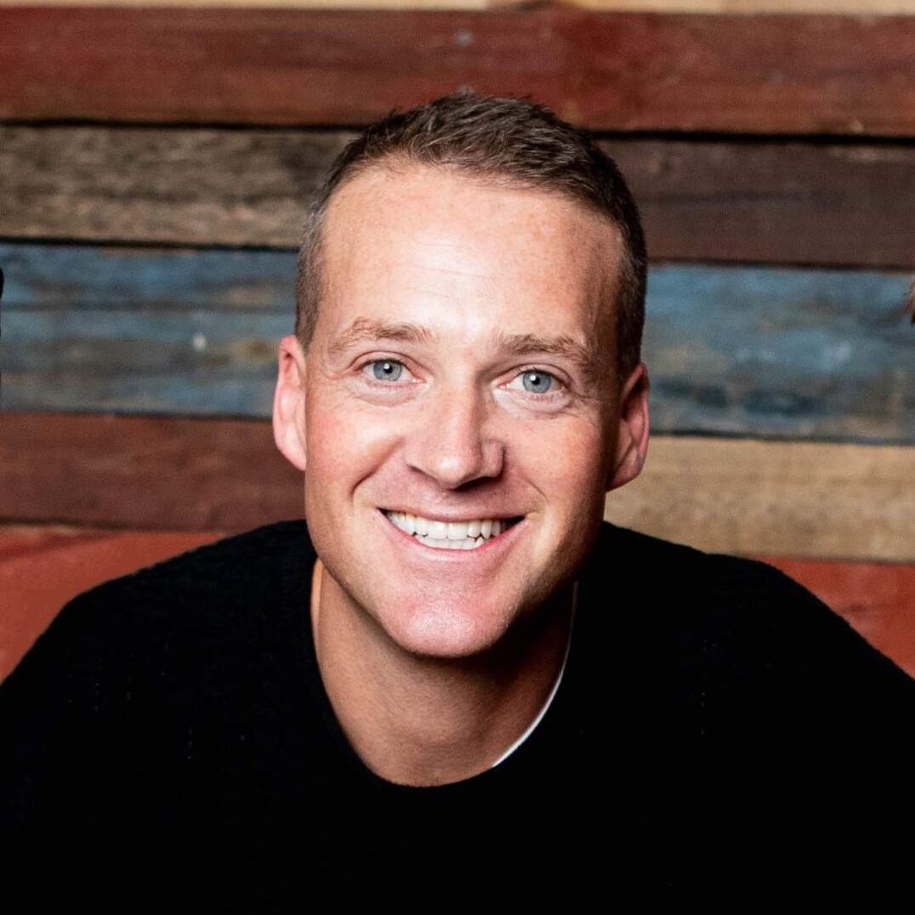
Influencer Strategy
The primary channel for the campaign was LinkedIn, where (usually) everyone wants to
be seen at their best.
Everyone is living their best lives.
But not this time.
Jules Lund
FOUNDER: TRIBE
LINKEDIN: 57K
TWITTER: 51.8K
Notes:
Showcasing our influencer’s honest and real screw ups was a breath of fresh air compared to the usual content on the platform.

Slide 16
Next time,
DocuSign.

Slide 17
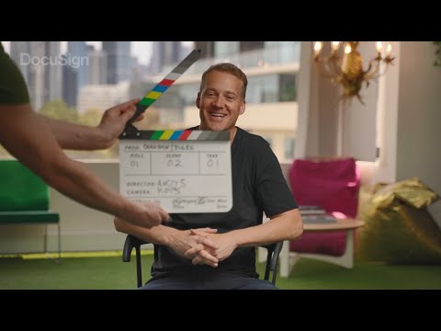
Notes:
and here’s Jules’s video -

Slide 18
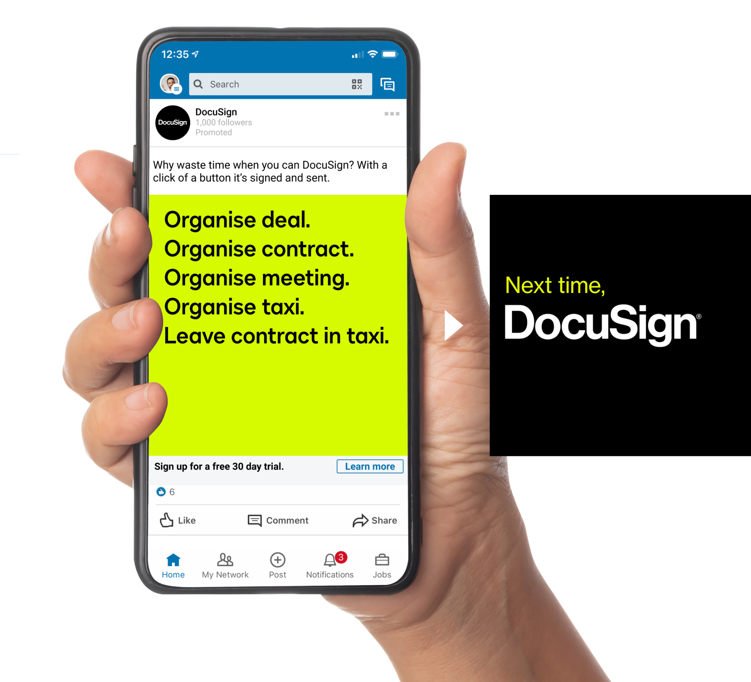
Notes:
Outside of the three influencer videos, we created a series of GIFs that perfectly communicate the Next Time, DocuSign idea. The creative highlights the friction of traditional paper-based processes in snappy, short copy lines - with the solution of course, being… Next time, DocuSign.

Slide 19
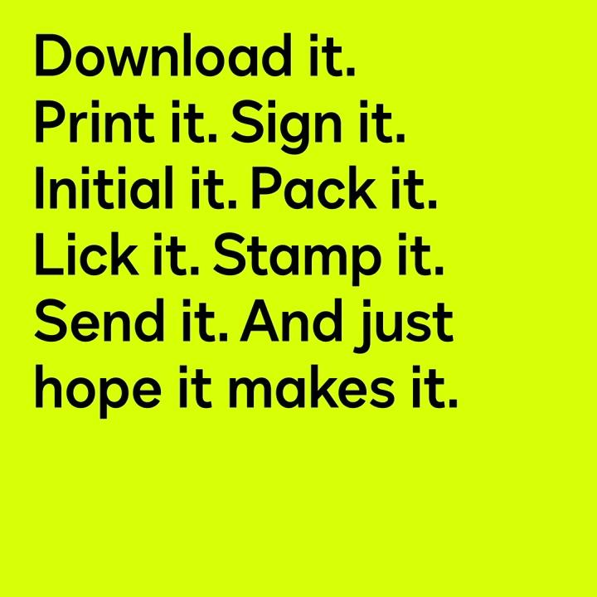
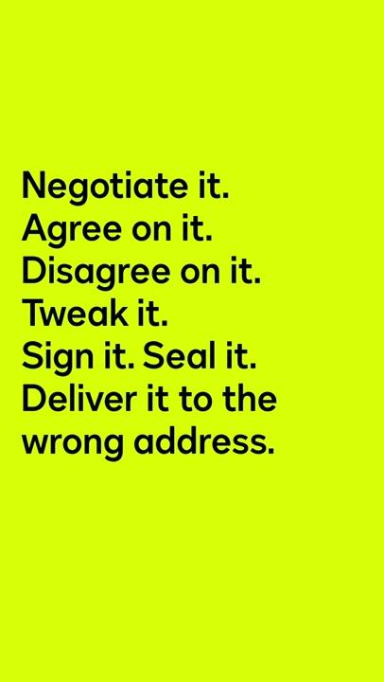
Notes:
This is how it looked when published.

Slide 20
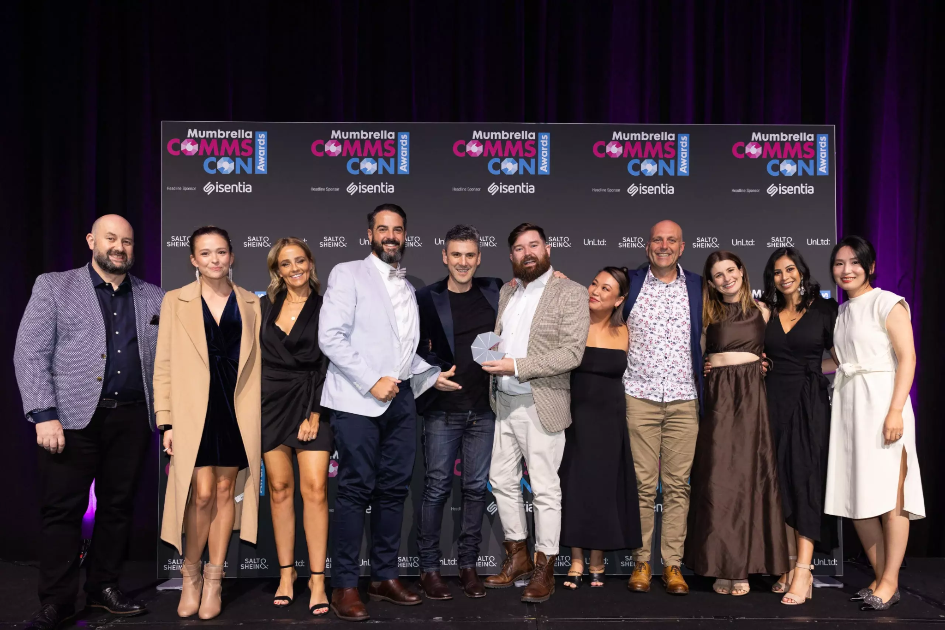
Results: Mumbrella CommsCon awards
DocuSign: ANZ Marketing Team
Andrea Dixon
Agency: HardHat
Dan Monheit
Best B2B Campaign
1st place Xero
Highly commended, DocuSign
Best Influencer Strategy
1st place DocuSign
Highly commended, McDonalds
Notes:
Mumbrella is the top marketing and comms trade publication in Australia. It’s commscon awards showcases the best creative campaigns across the countries and we’re proud to announce that we won best influencer strategy, beating McDonalds - and also received highly commended for best B2B campaign, just behind Xero.

Slide 21
Workshop
This requires participation from
a cross-functional team.

Slide 22
Lower funnel stages require “Mental Availability”
How will you build it?
Performance KPIs
Operational KPIs
Messaging
1
Awareness
Increase awareness of problem and our solution
Impressions/ Views/Reach
Frequency
Brand / ad recall
Brand differentiation
Share of Search
Memorable, branded storytelling
Awareness
Strangers
Familiarity
2
Favorability
Heighten positive perceptions of us and our products
Prospects
Brand Marketing builds mental availability
3
Consideration
Nudge toward trial/ purchase process
Preference in category
Consideration
Customer stories
Leads
Engagement (CTRs/site visits, time spent on site, downloads, subscriptions, contact me, etc.)
Demand Marketing converts via digital & physical availability
4
Intent
Increase likelihood of trial
MQL
SQO
Evaluation
Product messaging, category entry points, direct response
Purchase
Customers
5
Net Promoter Score
Likelihood to evangelize and opt for brand if re-evaluating
Cross- and up-sell

Slide 23
Cross-Functional Team Exercise
01
The messaging at the top of the funnel is all about being memorable and establishing our brand through the use of distinctive assets.
02
Accept that some measurement is always imperfect but we need to strive for a credible barometer so that we can benchmark and anticipate outcomes.
03
Note the stages are sequential. A prospect should have a positive perception of us before they’ll consider taking an action doing a trial.
04
Are you setting clear goals for your upper funnel programs? Do you consider them immeasurable? Are they always the first to be cut?
05
Review all the assets end-to-end with a cross-functional team..
Does your story make sense, when viewed through the eyes of a customer? Are you persuaded by it?
06
Define goals on the worksheet and come to agreement on how you will measure success – then regularly review your progress, the same you do with pipeline reviews.

Slide 24
Worksheet: Align on the WHY of your key areas of marketing investment
What do we want to achieve? | With whom? JTBD Personas | How will we reach them? | When should we expect revenue impact? | Investment % | Acceptable Measurement
Build category & brand awareness | Across all stages & products | Thought Leadership Content Marketing Advertising ($) | >12 months |  | Awareness, Category, Brand Lift #%
Increase favorability & consideration | New logos | Focused Markets: Video, Display, DSP | >12 months |  | F & C Lift #% Share of search
Generate marketable contacts | New logos New use cases at existing customers | Educate & Opt In: Content syndication | > 9 months |  | Database growth of ICP
Generate ICP engagement | New logos Upsell & Expansion | Targeted: LinkedIn, Demandbase | > 9 months |  | Marketing program engagement lift
Capture existing demand | Freemium, Trialists, Buyers | High-Intent Inbound: Paid Search | 0-3-6 months |  | Pipeline creation & close
Capture demand across all stages of the funnel | Across all stages & products | Evergreen Organic: SEO | >12 months If SEO isn’t mature, otherwise ongoing |  | Paid media optimization with organic
Notes:
Sample sheet to be used as a cross-functional exercise.
Document what you have today, and host a discussion on each cell: does each column match reality?
Does each row lead to a subsequent next best action? Does it drive the right behavior?
Can you measure the impact of each, and do you have cross-functional acceptance that the measurement represents success?
If everyone doesn’t BELIEVE this, the friction will show up in the organization.
** If personas aren’t informed by Jobs To Be Done, then you are merely describing types of clouds, in response to the question ‘when will it rain’?

