Slide 1

Signal-based Selling:
How to Leverage Intent Data for The Enterprise
x
RevShoppe
Created for Scale Venture Partners

Slide 2
Agenda
x
01
Total Relevant Market (ICP) + Identify your AIM via Intent
02
Strategies to Identify AIM
03
Activate in System of Action
04
Breakout Sessions!

Slide 3
Total Relevant Market (ICP) + Defining Your Signals
x

Slide 4
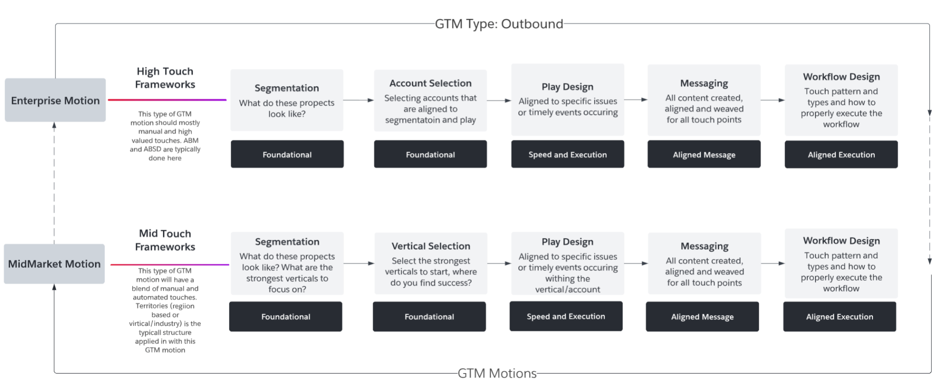
GTM Strategy Types
x

Slide 5
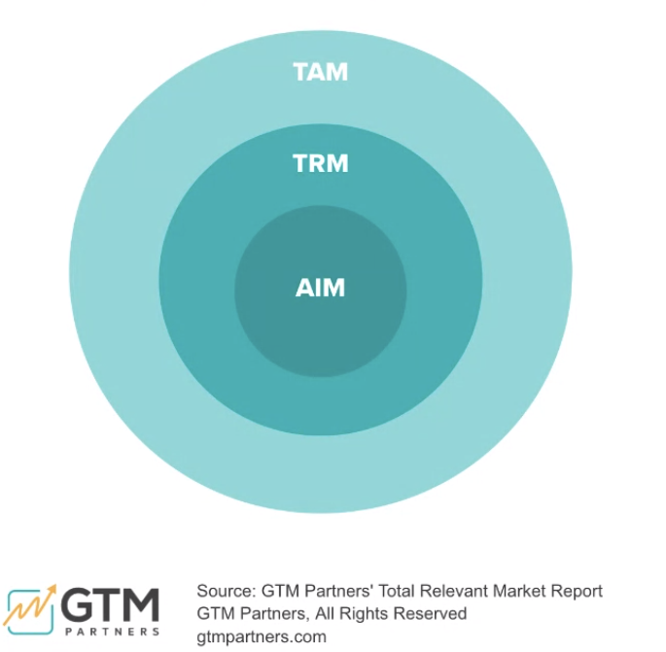
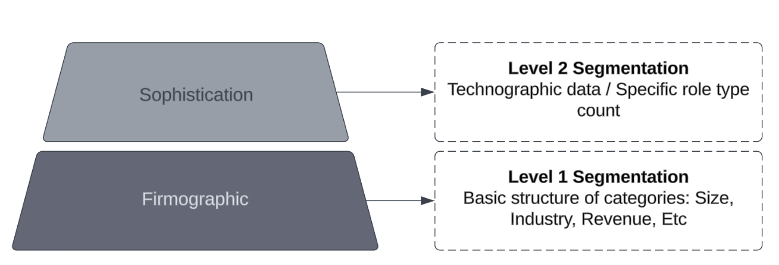
Account Selection: Identifying your TRM (ICP)
x
Define the above for each “bucket” you’re targeting for tiering purposes:
Firmographic: If the problem you solve is slightly different for size of company and industry, you want to consider creating “buckets” of accounts that fall into each category. (These can also become your tiers)
Sophistication: Same applies here - are there specific technologies used by a company that are strong indicators for an ideal prospect? You can use this to tier your accounts. Ex: Using Marketo vs Hubspot? Or using SFDC vs Pipedrive?
Note: You can have different tiers based on this data. For example, your TRM (ICP) for an enterprise account in the finance industry could look different than an enterprise account in the travel and hospitality industry.

Slide 6
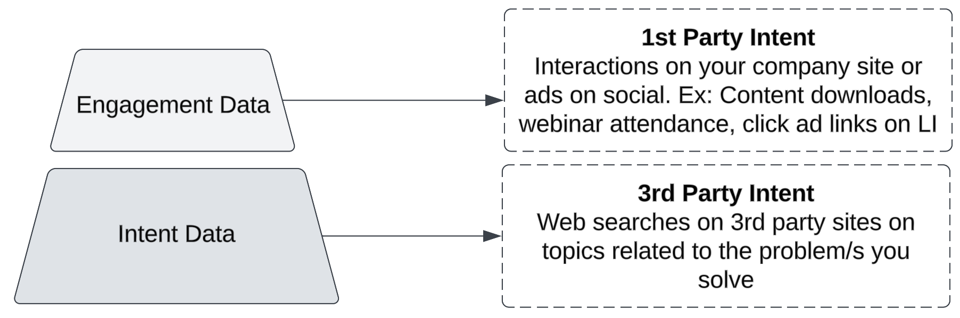
Account Selection: Defining Signals
x
Define your key topics and phrases: Create the list of keywords and phrases that align to your solution, topics of interest based on the problems you solve. What words or phrases, if searched, would be a signal for you that someone is in a potential buying cycle?
Define the engagement level of importance: What engagement channels are most important and have the highest value? Content downloads, LinkedIn ad clicks, demo request? Create scores that align to the importance.
Define fit: Fit refers to the persona. In your model you want to make sure that the correct titles and functions are a part of the buying committee for your prospect account.

Slide 7


Account Model Example - Account Fit Score
x
Model Requirements | Firmographic Data | Technographic data | Role Type Count | Intent Keywords and Phrases | Engagement Types
Model Inputs | Employee Size: 5,000-10,000 Industry: Retail Location: AMER | MA: Marketo CRM: SFDC Cloud Service: AWS | Marketing Role Count: 100+ | Digital Strategy Content Strategy Go To Market | Linkedin Ad Campaign Clicks Content Download Demo Requests Specific Webinar attendance Website page visits
Notes:
Maybe show a visual with intent data providers and web / social activity happening. Being fed into the CRM and pushing out an account that’s an ICP and in market
Account model → fed into 6Sense (personas, technographics, intent and engagement) → surface already in market
Exercise 1) interview top 3 AE in the field - what was their pain point and what were they looking to solve for. What was their point points what’s resonates
Exercise 2) Have 3 SDR use new messaging around what the AE’s are hearing.
Run opportunity report that has closed won report in the last 90 days and look at their MEDDIC/MEDPIC fields and run the same exercise as above
Bonus: Do this 4 times within the year. Create a slack channel and tiger team
For Scoring - you need to consider the

Slide 8
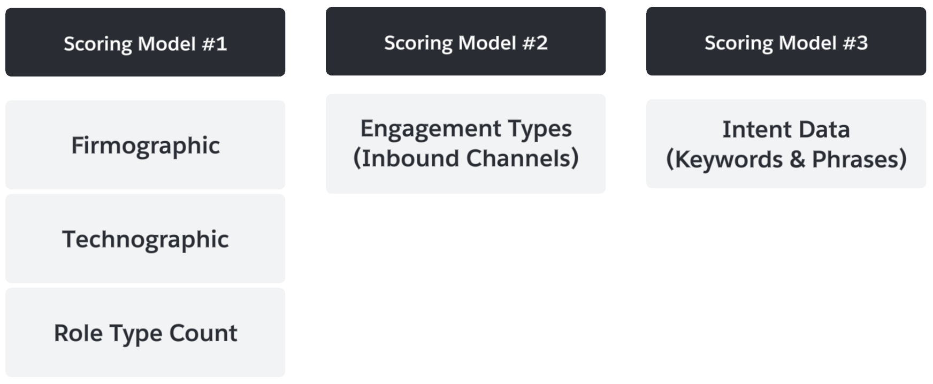
Account Scoring and Models
x
AIM = Already in Market
Or Accounts in Market

Slide 9
Strategies for Identifying Signals (on a Budget)
x

Slide 10

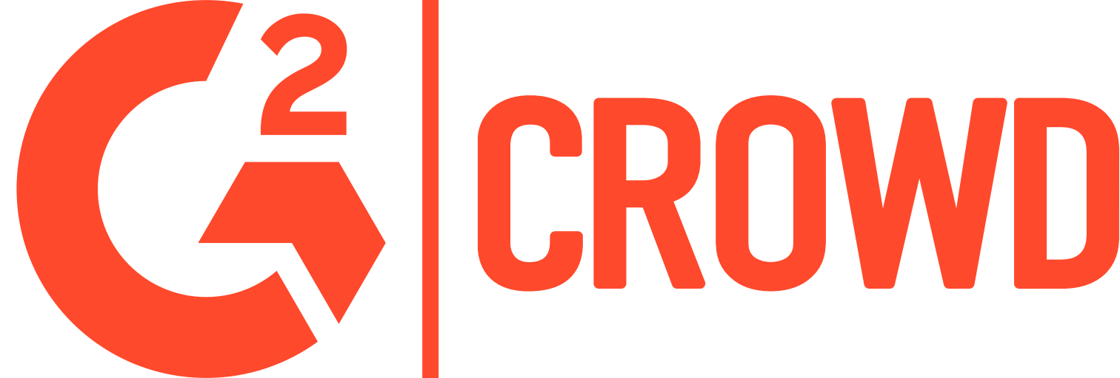
x

Slide 11
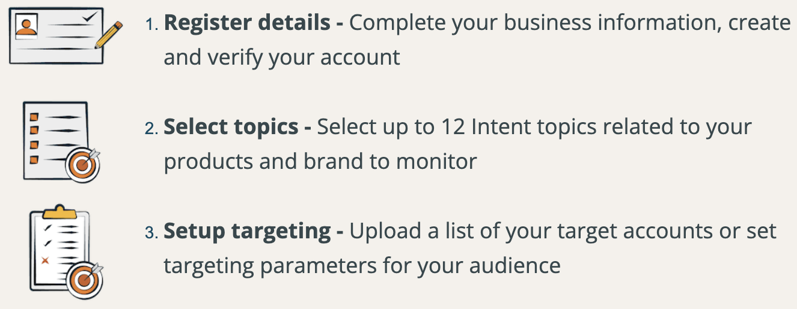
Tools to Identify AIM Accounts
x
Define your key topics and phrases: Create the list of keywords and phrases that align to your solution, topics of interest based on the problems you solve. What words or phrases, if searched, would be a signal for you that someone is in a potential buying cycle?
Option #1 Define a specific list of accounts: If you have a list of accounts you’re responsible for and want or a list you want to solely focus on you can upload them.
Option #2 Define an ICP and see what surfaces: If you’re more interested in surfacing any account that fits within your ICP then you can set those parameters and see what bubbles up during the week

Slide 12
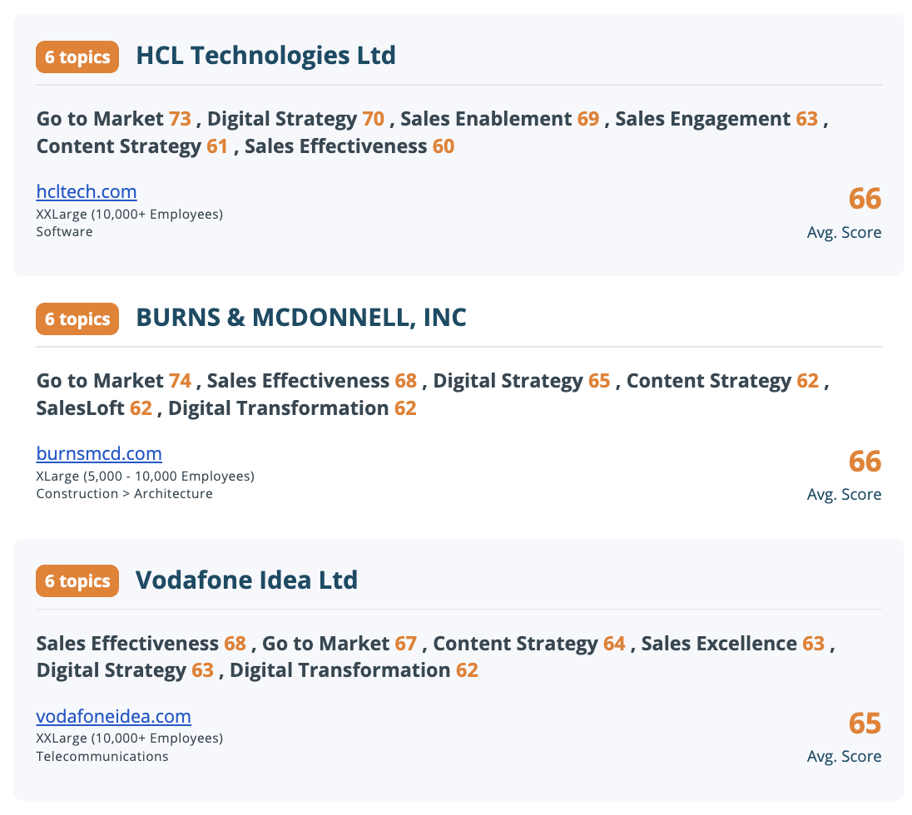
Tools to Identify AIM Accounts
x
How to action
What are the surfaced topics telling you? Take time to think through 3-5 plays that align to 1 topic or a group of topics. How do these singles help define your approach and message to these accounts?
NOTE: If you have a partner ecosystem - leverage them to drive introductions.
Notes:
Look at the signals for each account and what key phrases, words cause them to surface, What plays could you design around this?
Do this for Bombora, G2 LinkedIn - what are 3-5 plays you could create?
How could you use these together?
Design those plays (workflows / sequences) and install them
For each signal - align to the available play

Slide 13
Stepping back – Where do you add value?
…and how do you add value to a prospect?
x
Understand your “Itsy Bitsy Spider”
Context: Setting the scene using the prospect (hero)’s maturity curve
Conflict: The pain – problem landscape (including the consequence) of that pain
Turning Point: Focusing on the solution landscape
Resolution: The consequence of choosing your solution
Notes:
Top of Funnel’s job is to send the right message to the right person at the right time. It’s said that only 3% of the market is actively looking, so timing is probably the hardest part. What can you do to chisel a sculpture out, because right now you’re telling your SDRs to go after anything marble or granite and wanting them to come back with a work of art.
A title is not a comprehensive persona. It’s the starting line, not the finish line.
Segments are not Employee size.
Function maturity and dynamics are a lot different in ENT
A company isn’t a better fit because they have more money.
Concise. SDR reception attention span.
Sam McKenna has a phrase: show me you know me.
How do you know? What can you research? Where do people need help? This dictates the give.
30/60/90 day guide to onboarding a {{persona}} leader
{{IC persona}} Hiring guide
{{peer}} webinar
Level up assessment - {{are you ready to graduate from Sagemaker}}

Slide 14
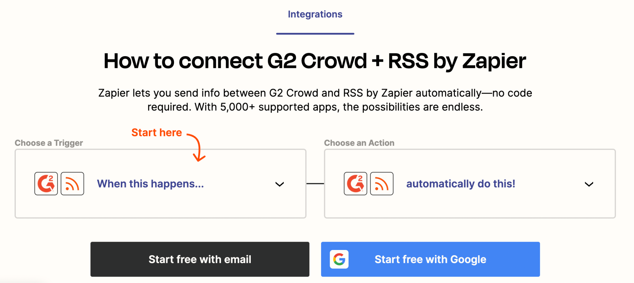
Tools to Identify AIM Accounts - Social Listening
x
Process:
Listen to your product & direct competitors: Create a Zapier integration with Slack to pull down new G2 Crowd reviews in real-time
Research the reviewers connections: Look at the targets bar of “people also looked at”, past companies, and recommendations to look for their 1st degree connections
Leverage the review and relationship: Reach out to person about hosting webinar. Reach out to that person’s visible connections
Notes:
You want to leverage the things that people say about you and your competitors. This may come in the form of NPS scores internally (which often Sales & Business Development never even see), or on public forums like X (formerly Twitter), Reddit, or review sites like G2 Crowd. Going to the promoters’ first degree connections will often yield a much higher hit rate, especially when done in concert with marketing..

Slide 15
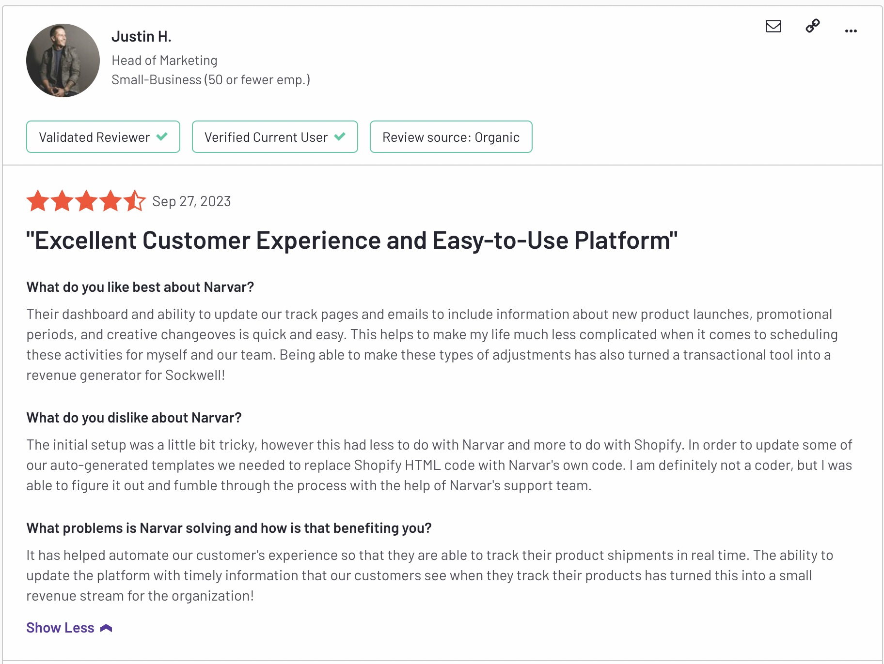
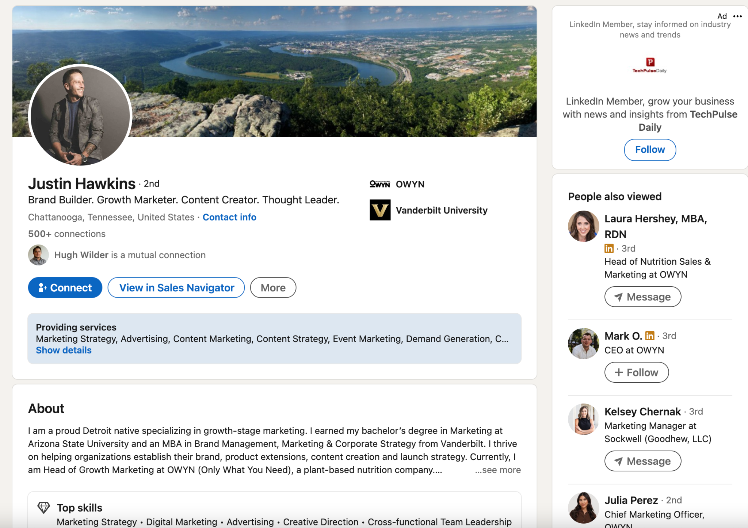
Example - Narvar
x
+
Notes:
Picked out one of Scale’s PortCo’s – this was the top review that came in organically. Thankfully, he mentioned the company name in the review, which made him really easy to find. There’s plenty of language in there to use in outreach as well.

Slide 16
Ingredients for Play Design
x
1. What’s the problem you’re seeing based on the signals?
When you look at the signals, what’s it telling you? What challenges might they be experiencing?
Take time to start mapping what one or a group of signals might indicate. Create 3 - 5 problem statements.
2. How do you solve these problem statements?
From the problem statements you create, can you answer how your offering/s solves this?
Take time to craft how you solve the 3-5 problem statements.
3. Solution Outcomes
When you solve a problem with you offering, what outcome can a buyer expect? What’s the change state that comes with that?
Align your outcome statements to the 3-5 problem statements.

Slide 17

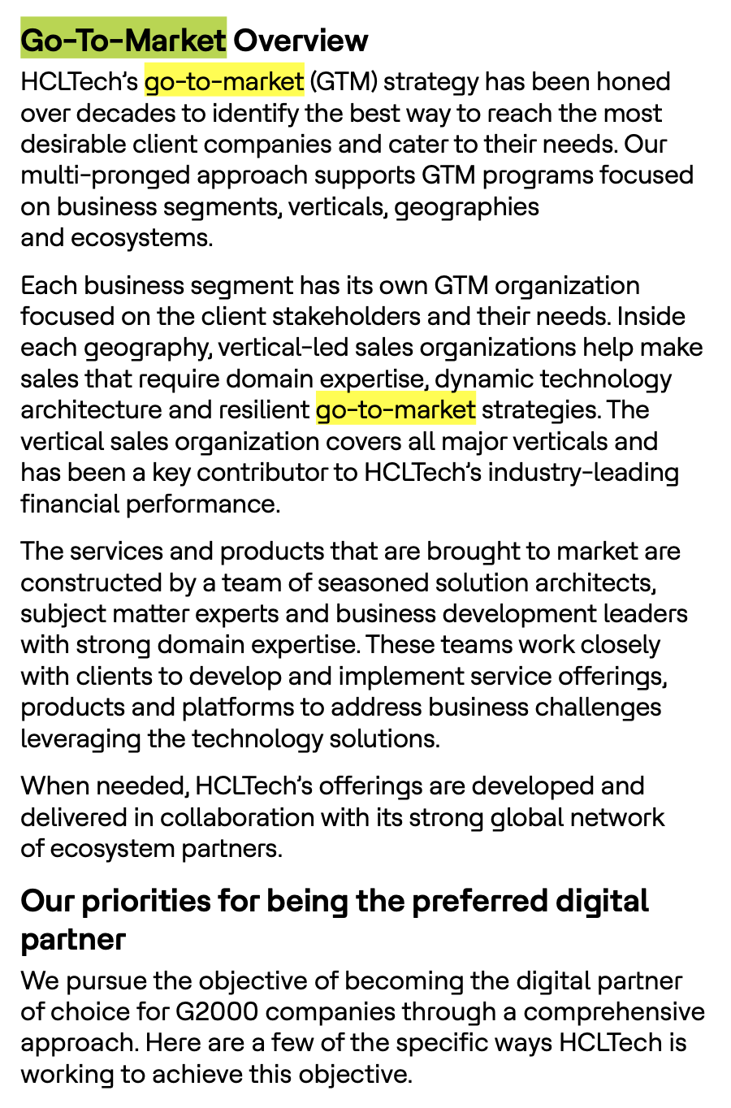
Ingredients for Play Design
x
1. Research 10k | Earnings Call
Search for the keywords within their 10k | earnings call that surfaced. Can you find any further information and data to support the signals? There’s so much rich information you can leverage to support your outreach efforts
2. {{Company}} Name + Surfaced Keywords
You can plug into Google or Bing the company name and the surfaced keywords and phrases to uncover any other articles and resources that can be of value in your play and copy design.

Slide 18
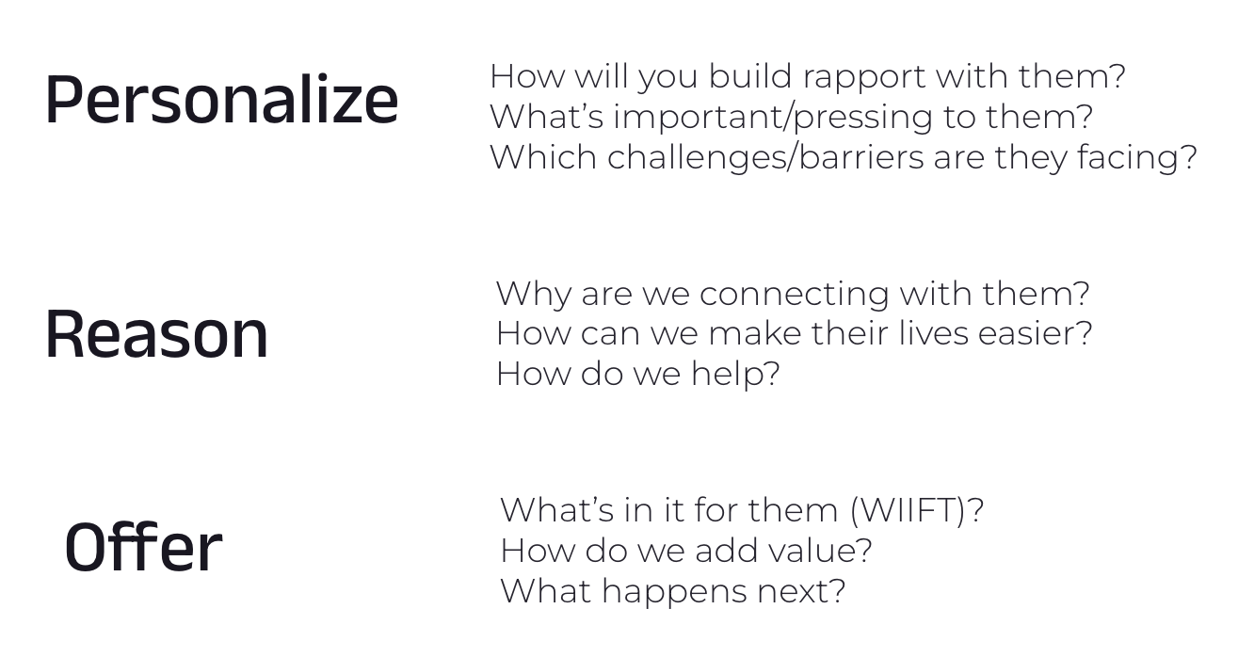
PRO Framework
WIP
x
Process:
Creating Personalization: Use the Bombora, G2, LinkedIn and 10k data to start crafting your personalized why. Why are you reaching out?
Play Design: This should be templatized, based on the signals you’ve identified and built messaging around. How are are you solving their problem?
WIIFT & Your Ask: Align this to the pain you’ve identified via intent signals and problem statements you’ve created.

Slide 19
Actioning your Signal Plays
x

Slide 20
Develop Your Plays Based on Signal
WIP
x
Account Name | Signals Identified | Play Identified | Workflow
Acme #1 | Digital Strategy | DS: Revenue Operating Model | Play #2: Digital Strategy
Acme #2 | Sales Engagement | SE: Workflow Optimization | Play #3: Sales Engagement
Acme #3 | Content Strategy | CS: Content Operating Model | Play #4: Content Strategy

Slide 21




Develop Your Plays Based on Signal
x
Signals
Sales Engagement Platform
Plays
Go to Market
Play #1: Go to Market
Digital Strategy
Play #2: Digital Strategy
Sales Engagement
Play #3: Sales Engagement
Content Strategy
Play #4: Content Strategy

Slide 22
Message Play: Signal Centric Model
x
Identify
Accounts easily identified that fall within the created ICP
Enable
Creates a consistent workflow process for reps to learn and action.
Signal Play Surfaced
Align
Messaging and resources become aligned to the signal/s (emails, call scripts, ads, whitepapers, etc)
Notes:
We approach messaging from a Use Case Centric model. Help to align all aspects of this workflow. From copy design to how the reps execute the workflow.

Slide 23

x
Jason Vargas
Co-Founder | RevShoppe
jason@revshoppe.com
What questions do you have?

