Slide 1

The Power of Outbound:
Strategies for Success
x
RevShoppe
Created for Scale Venture Partners

Slide 2

We help our portfolio build and optimize hyper-growth GTM machines

Slide 3










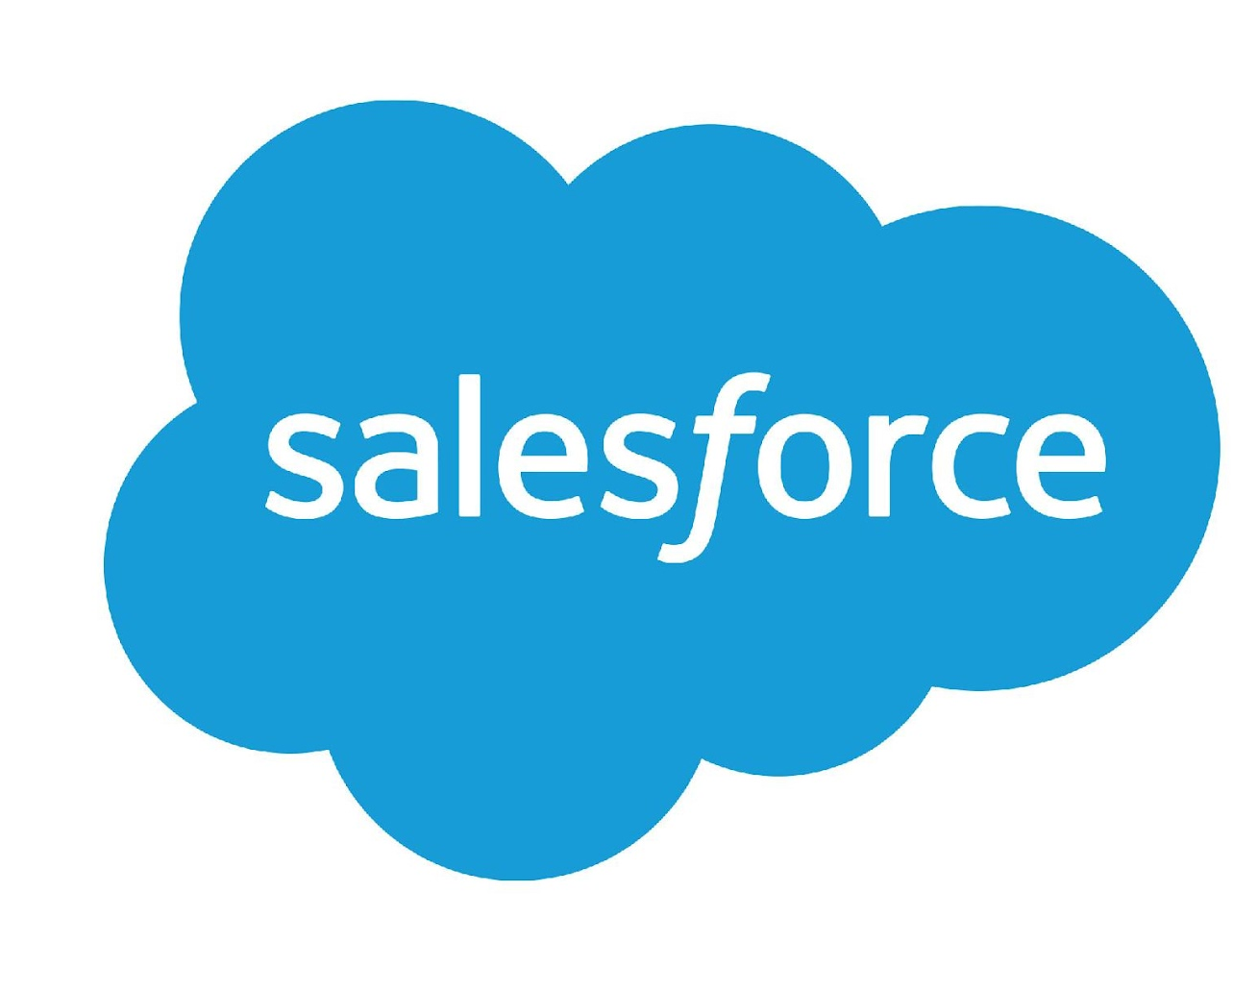



The GTM platform leverages our expert network to provide a suite of offerings
Educational / Networking Events
Advisory
Content
GTM
Network
Experts in sales and marketing across the startup growth lifecycle

Slide 4

Welcome to the Scale SDR Council
A community of SDR professionals from both Scale and our GTM Network. Our objective is to share our knowledge and experience with other members of the Scale portfolio to facilitate idea share for the purpose of education, community and mutual growth.
Events
Quarterly Councils (f2f, virtual)
Monthly webinars
Content
SDR Content Portal featuring tools and frameworks
Community
Digital community coming soon
Peer networking
Advisory
GTM Network and peer connections
EIRs

Slide 5
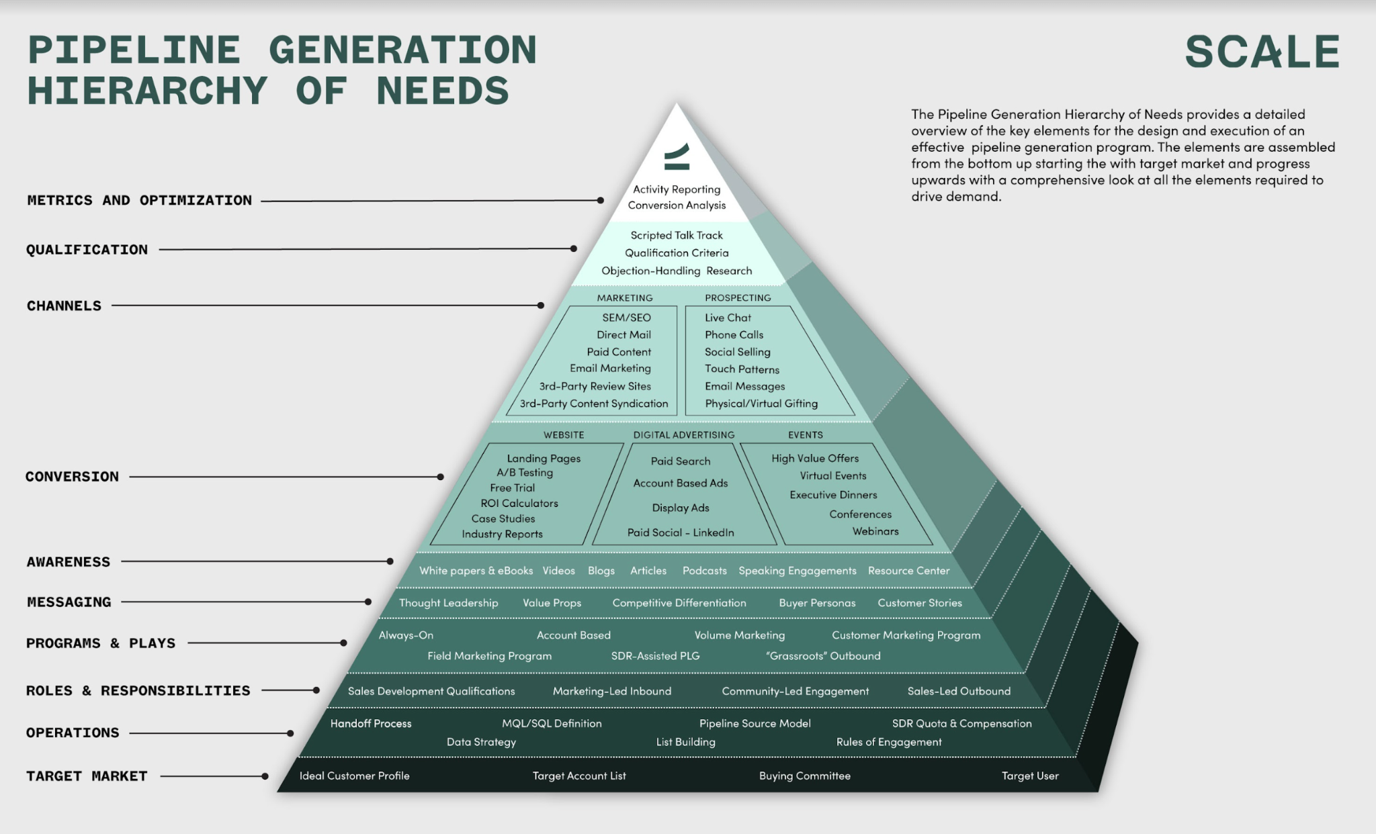
Focus:
*Prospecting
*Qualification
*Metrics
*Optimization

Slide 6
How You Join?
Send request to anisha@scalevp.com
Or – just show up. You will receive invites on a semi-regular basis

Slide 7
Agenda
01
GTM Strategy + Messaging
02
Success Monitoring
03
Workflow Enablement
04
System Operations: Email Deliverability

Slide 8
GTM Strategy + Messaging

Slide 9
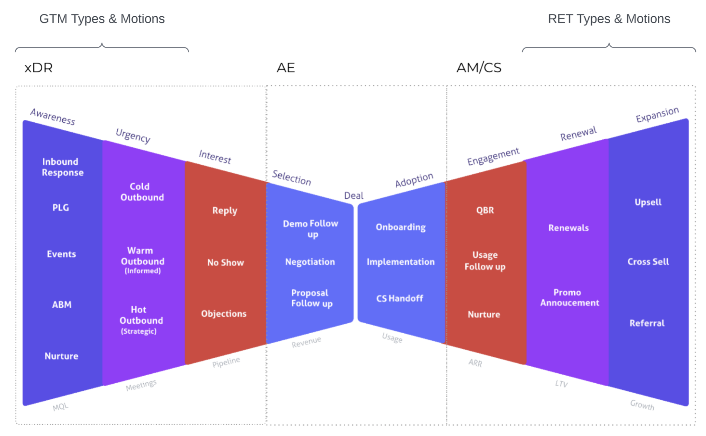

Slide 10
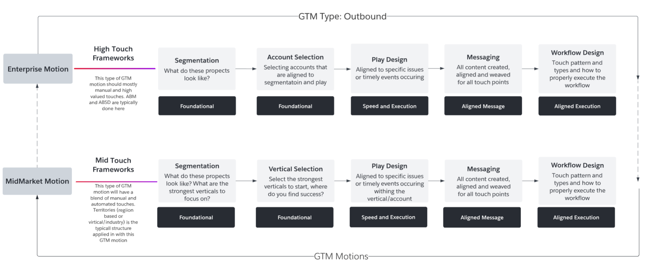
GTM Strategy Types

Slide 11
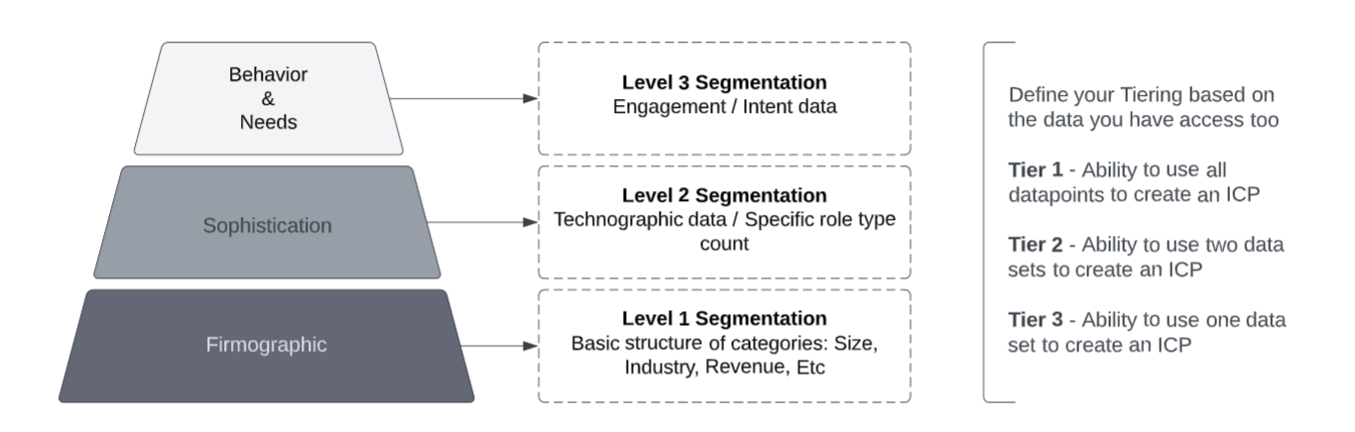
GTM Strategy - Targeting (Account ICP Segmentation)
Firmographic Data What does your customer look like based on -Industry, employee size, revene, etc. How would you rank them?
Sophistication/Technographic Data What tools, platforms and systems do your customers typically use? What’s your prospects title/department and how many people within organization fall into that department? How does this influence your interest in the company?
Behavior & Needs/Intent Data What’s the data telling you about buying patterns and existing needs of your prospects?
Note You can have different ICPs based on GTM motions and industries. Your ICP for an enterprise account in the finance industry could look different than an enterprise account in the travel and hospitality industry.

Slide 12
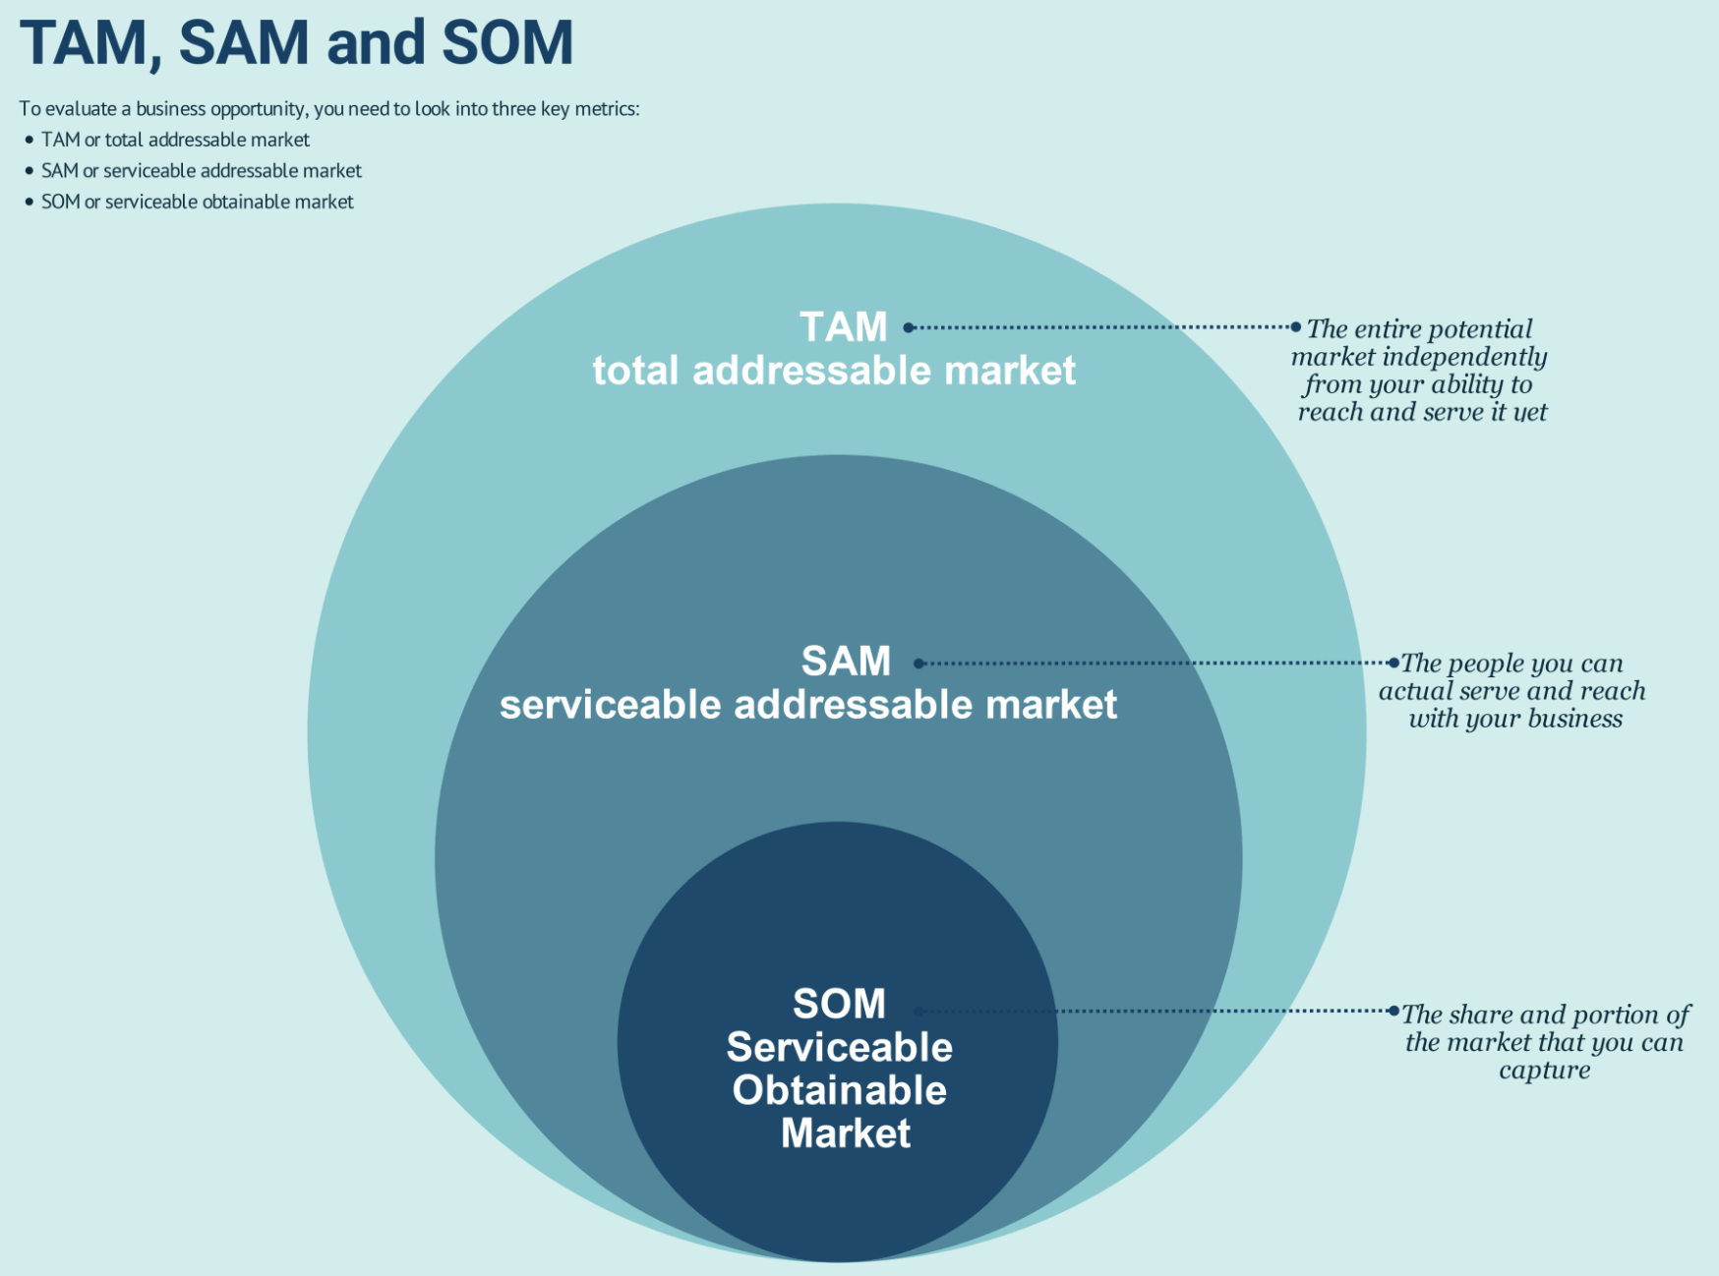
GTM Strategy - Prioritized Pipeline

Slide 13
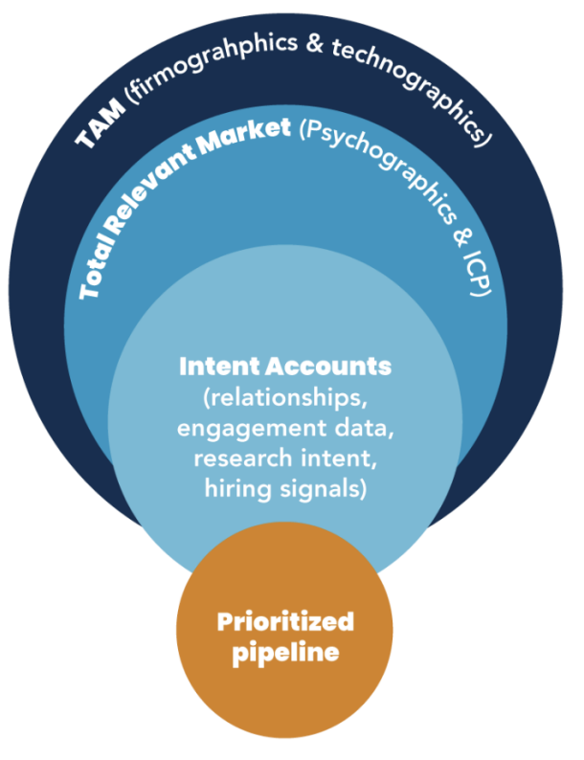
GTM Strategy - Prioritized Pipeline
Notes:
GTM Partners

Slide 14
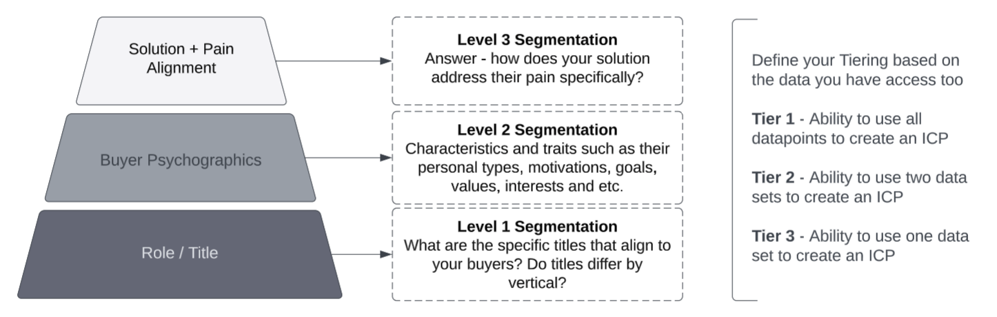
GTM Strategy - Targeting (Personas ICP)
Solution + Pain Alignment Knowing and understanding their motivations and drivers. How does your solution solve these? How do you address and resolve the pain they’re experiencing?
Buyer Psychographics Data What are the traits, characteristics and needs of this buyer that align to the solution you provide?
Role / Title Data Identify the top role types and titles. Understand the nuances / differences between these roles / titles within different verticals / industries. Often times there are difference for titles that are exactly the same.

Slide 15
Messaging: Frameworks
Low Touch
Email Only
Mid Touch
Emails + Calls
High Touch
Manual Multi-Channel
Insights
Little to no insights available
Low seniority (Mgr or below)
Some insights available
Mid seniority (Mgr to Director)
Rich insights available High seniority (Director or above)
General with no room for personalization (PROa pre-built)
Customized with room for personalization in some steps
(Reps to add Personalization in Email 1)
Highly personalized in the most steps
(Reps to add Personalization throughout steps)
Message
Strategy
Drive urgency & get response
Deepen awareness
Schedule meeting
progress opportunity
Conversion
0.3%
1.1%
1.5%
Prospect seniority level and amount of data available determines what messaging framework to use.

Slide 16
Messaging: Value Sets
Step 1 Value set 1 New email
Step 2 Value set 1 Resource (Text)
Step 3 Value set 1 Reply bump
Step 4 Value set 2 New email
Step 5 Value set 2 Resource
Step 6 Value set 2 Reply bump
Step 7 Value set 3 New email
Step 8 Value set 3 Resource
Step 9 Value set 3 Reply bump
The PROa Method should be applied to the first new email in each value set.
Reply bumps and resources may use the PROa method at times, but are generally follow ups and don’t require as much structure.

Slide 17
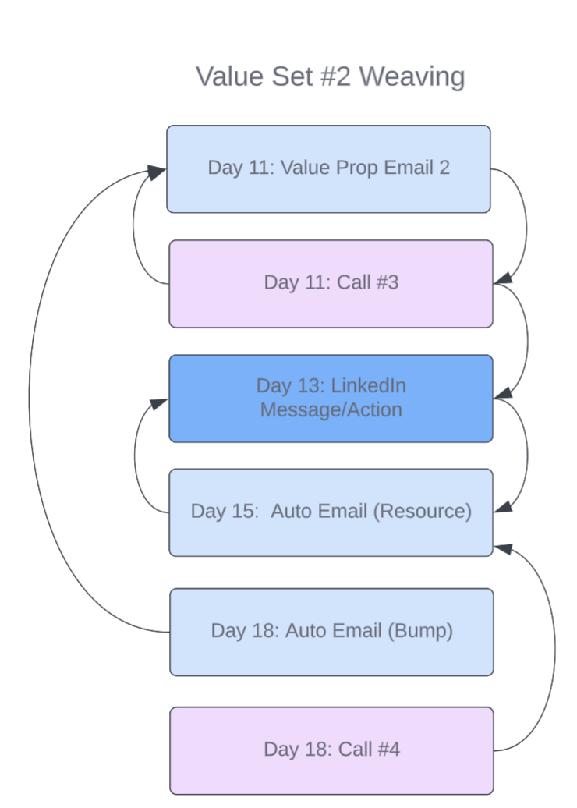
Messaging: Sequence / Cadence Weaving
Day 11 Value Prop 2 Email #4
End of the email will reference that the rep will call the prospect at the end of the day if they don’t hear back from them
Day 11 Call #3
Rep will mention they are follow up on a call as promised in the email. They will also mention a video follow up explaining more (and that they’ll send via LI)
Day 13 LinkedIn Message Video
At the end of the video they will mention an email with a resource they’ll send over in a few days
Day 15 Auto Email #5 (Bump)
Pushes back to previous emails
Day 18 Call #4
Addresses the value proposition and the resources and attempts made to get in contact.

Slide 18
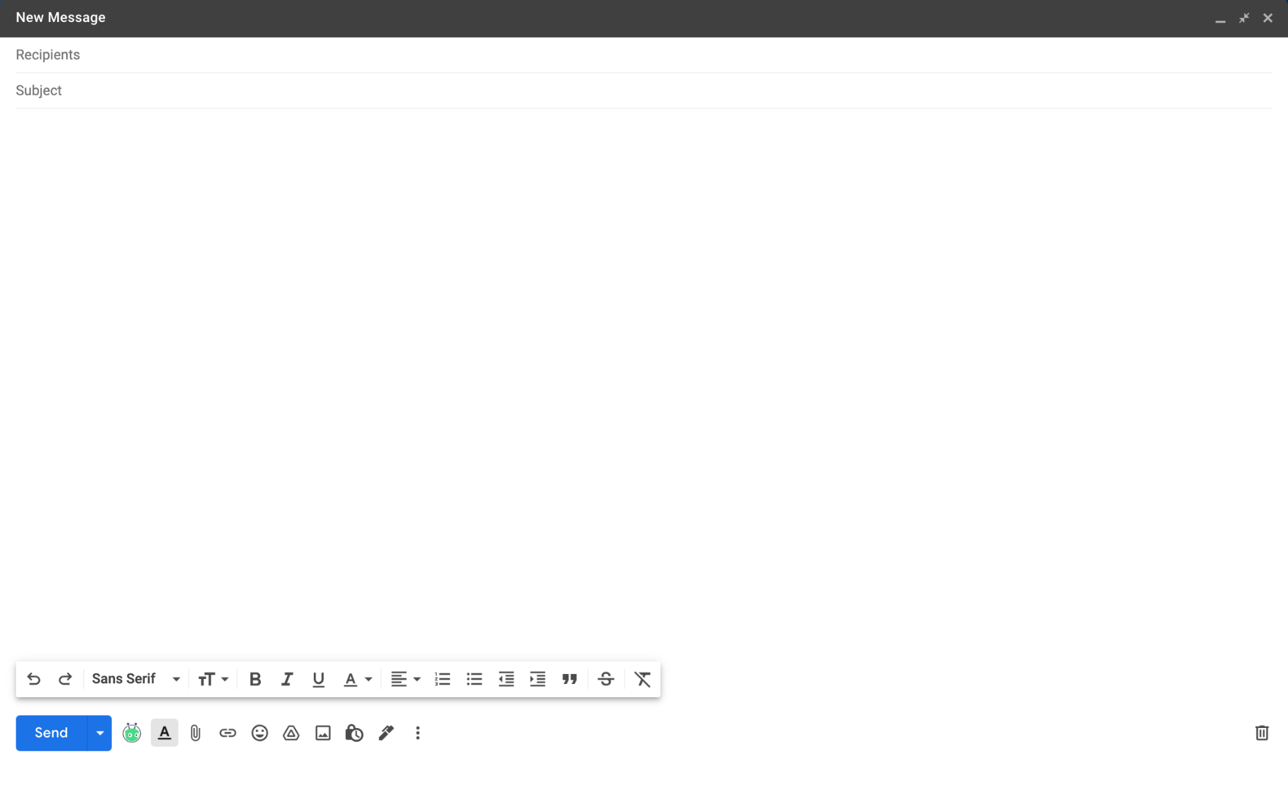
Messaging: PRO(a) Email Methodology
P
Pain or Personalization Relevant challenges or research
Inflation is hitting everyone where it hurts. I noticed you have more open seats than usual as I search for a reservation online. Are you experiencing cancellations?
You might be paying more for tools, like {{! i.e., POS integration }} and a much higher fee for reservations made from your website.
Instead, you could use a table management system with a lower cover fee. And reservations made from your website? Totally free.
What day works over the next week to review your account and discuss maximizing your revenue?
Risk of inaction Why take action now?
R
O
Outcome Solution to their pain
a
Ask One clear ask per email

Slide 19
Core COM
M1
Diagnosis
Prescribe framework
M2-4
Design
Build COM
M5
Validation
Pilot COM
M6
Rollout
Plan to scale
Stakeholder Interviews
Messaging Review COM Readout and Recommendations
COM Workshoppes (2)
COM Build Sessions (15)
Messaging Workshoppe
Messaging Authorship (5)
Enablement Workshoppe
COM Pilot Workshoppe
Pilot Intro Videos
Live Workshops (4)
Pilot Follow up
Weekly Feedback Review
Weekly Performance Report
Office Hours (4)
Pilot Results Readout
COM Expansion Planning
Program Retrospective

Slide 20
Success Monitoring

Slide 21
Success Monitoring and Outcomes
Messaging Performance
 | Meetings | Open Rate | Click Rate | Reply Rate | Bounce Rate | Opt Out Rate
Today | X | X% | X% | X% | X% | X%
Avg Baseline | -- | X% | X% | X% | X% | X%
Behavior Performance
Immediate Actions
Prospects Added
Overdue Tasks
Skipped Steps
Sequence States
Step Bottlenecks
Rep Execution

Slide 22
Workflow Enablement Framework

Slide 23
Enablement Cadence
Micro Training JIT
Knowledge Check
Knowledge Check
Step 1
Awareness
& Excitement
Step 2
Teaser
& Prework
Step 3
Hands on
Workshops
Step 4
Coaching
& Reinforcement
Step 5
Hands on
Workshops
Step 6
Coaching
& Reinforcement
What’s coming/why
What’s in it for you
What to expect
What’s expected
Resources
What you’ll learn
What’s the impact
Prep for change
Get sneak peek
What changed
Why it’s changed
What’s in it for me
Show examples
Live Practice
What Mgrs need
Launch Interactive Resources
Practice what you learned
1:1 Role plays
Mgr Teach backs
Video submissions
Expanded learning outcomes and practice Reinforcement sessions with Mgrs and users
Practice what you learned Demonstrate you apply the changes Celebrate successes
Certify teams

Slide 24
System Operations

Slide 25
How to Avoid Impacting Email Deliverability
Domain Configuration & Authentication CNAME, DMARC, DKIM, SPF
It’s all about the Authentication of your domain and the Reputation of your domain. Need to make sure that these are all set up correctly. You also want to make sure that you’re monitoring this on a regular basis.
Email/Domain Warm Up
Data Validation Has the contact data you’re using been scrubbed and verified? Only use valid data.
Content Relevant and timely content to the correct persona.
No links, no click tracking, no images or HTML in the body of the cold email.
Consider removing unsubscribe language and links, images, HTML and link in signature
Domains health Have a reputable domain name on Gmail and only send 40 emails per day per domain.
Multiple domain names with multiple inboxes
Email/Domain Warm Up - When your domain is showing higher levels of reply rates it’s not flagged as spam.

Slide 26
What to do If You’ve Torched Your Domain
Work towards rebuilding the reputation of your domain
Have you done the work to ensure it’s authentication? (CNAME, DMARC, DKIM, SPF)
How is your Reputation?
Check Domain for IP or Blacklist,
Check your IP address reputation
Pull this domain out of rotation and start to warm it up**
Adf a picture profile on google account
List Quality
Validate your contacts list
Remove fake and bounced email addresses
Content Quality
Don't use complex HTML
Don't use fancy signatures that have link tracking
If you can, avoid cold email opt-out links and language
Testing the Emails
Keep your bounce rate below 5% (ideal <2%)
Remove inactive subscribers from your list (do not keep emailing them)

Slide 27
Next Steps
01
Look at how well is your GTM strategy is aligned to your workflows
02
How well has your team been trained on each GTM workflow
03
Schedule time with me to dig in deeper.

Slide 28

Thank You.
What questions do you have?

Slide 29
Appendix

Slide 30
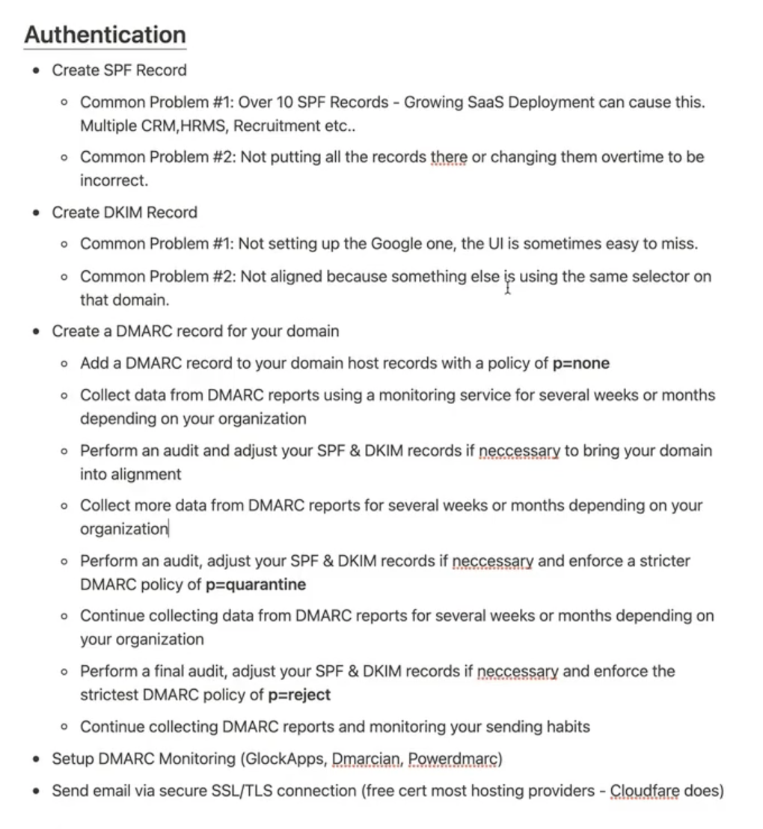
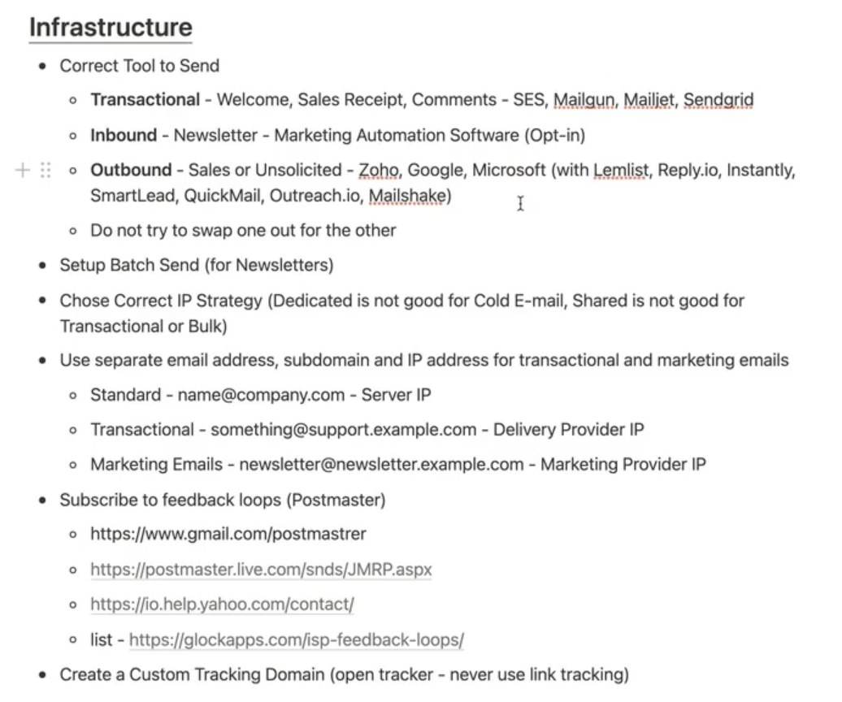
Email Deliverability

Slide 31
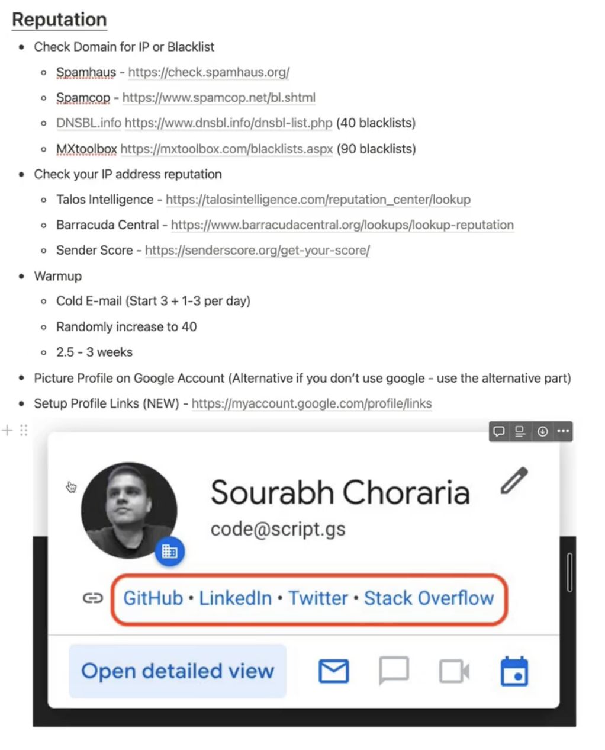
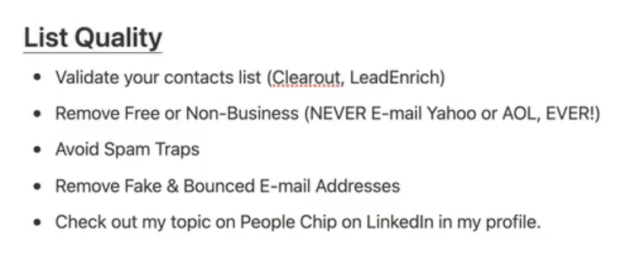
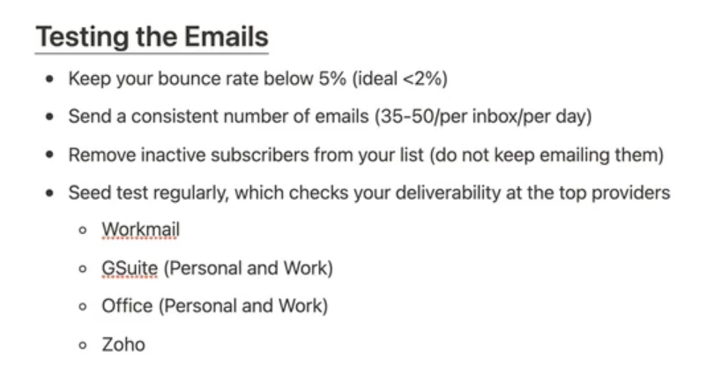
Email Deliverability

Slide 32
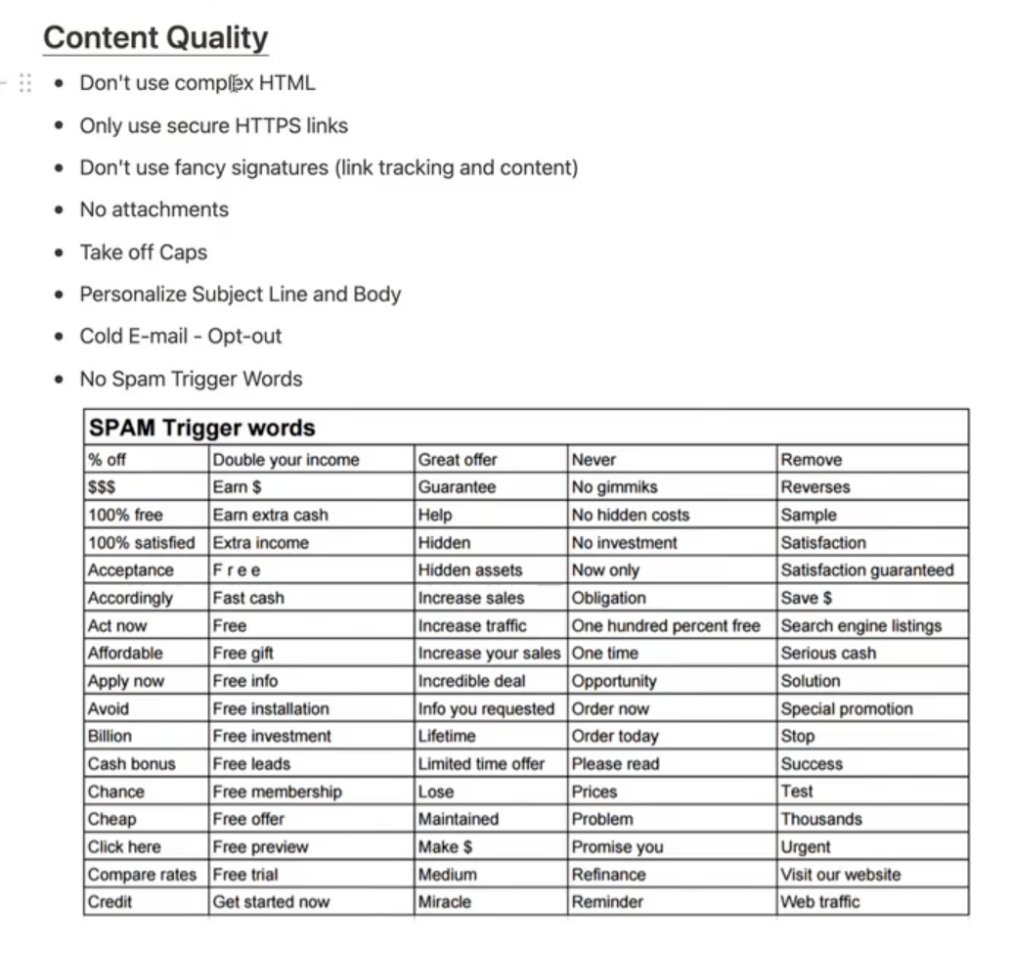
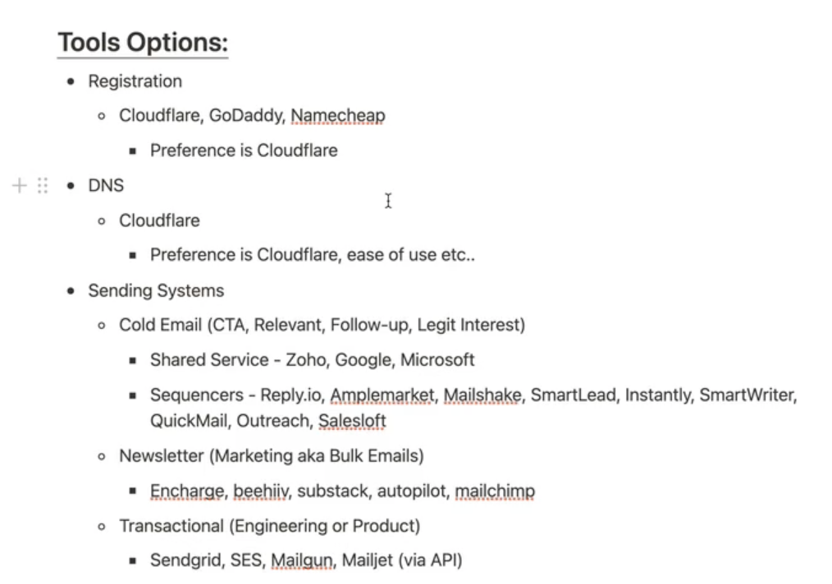
Email Deliverability

