Slide 1
Annual Planning for 2023

Slide 2

What We Were Saying Last Year …
Finally, remember the world can change on a dime. When it does every Board member will promptly forget the “grow at all costs” advice and rediscover cash flow as a constraint. That may not happen in 2022, I have given up macro forecasting as a fool’s errand, but at some point, it will. At that point be sure to have enough cash, which in turn means enough time, to switch to a more balanced growth plan.
- 2022 Annual Planning: Advice for CFOs
It looks like that time is now …

Slide 3

The Venture Board Member Dilemma
We need growth to justify high valuations
But growth costs money and is getting harder
 | PEAK MULTIPLE | TODAY’S MULTIPLE | % DECLINE | CAGR REQUIRED¹
All Public SaaS | 16.1x | 6.2x | 62% | 60%
However …
High-Growth Public SaaS | 81.6x | 19.5x | 76% | 105%
Cut the burn to avoid down round (dubious)
Cut the burn to offset revenue shortfall (hell yes)
Highest-Priced Private SaaS | 100x+² | 20x+ | 80% | 123%
In two years can “grow into the valuation”
This causes the CFO dilemma
¹ Annual Growth Rate required to compound back to breakeven in two years at today’s multiple
² Anecdotal per tomtunguz.com/100x-arr/
Source: Scale Venture Partners

Slide 4
The CFO Dilemma
What you know
What you don’t know
What has happened to valuations
What will happen in the real economy
vs.
What you don’t want
What you do want
To run out of money and look like an idiot
To preserve the upside in the company
vs.

Slide 5
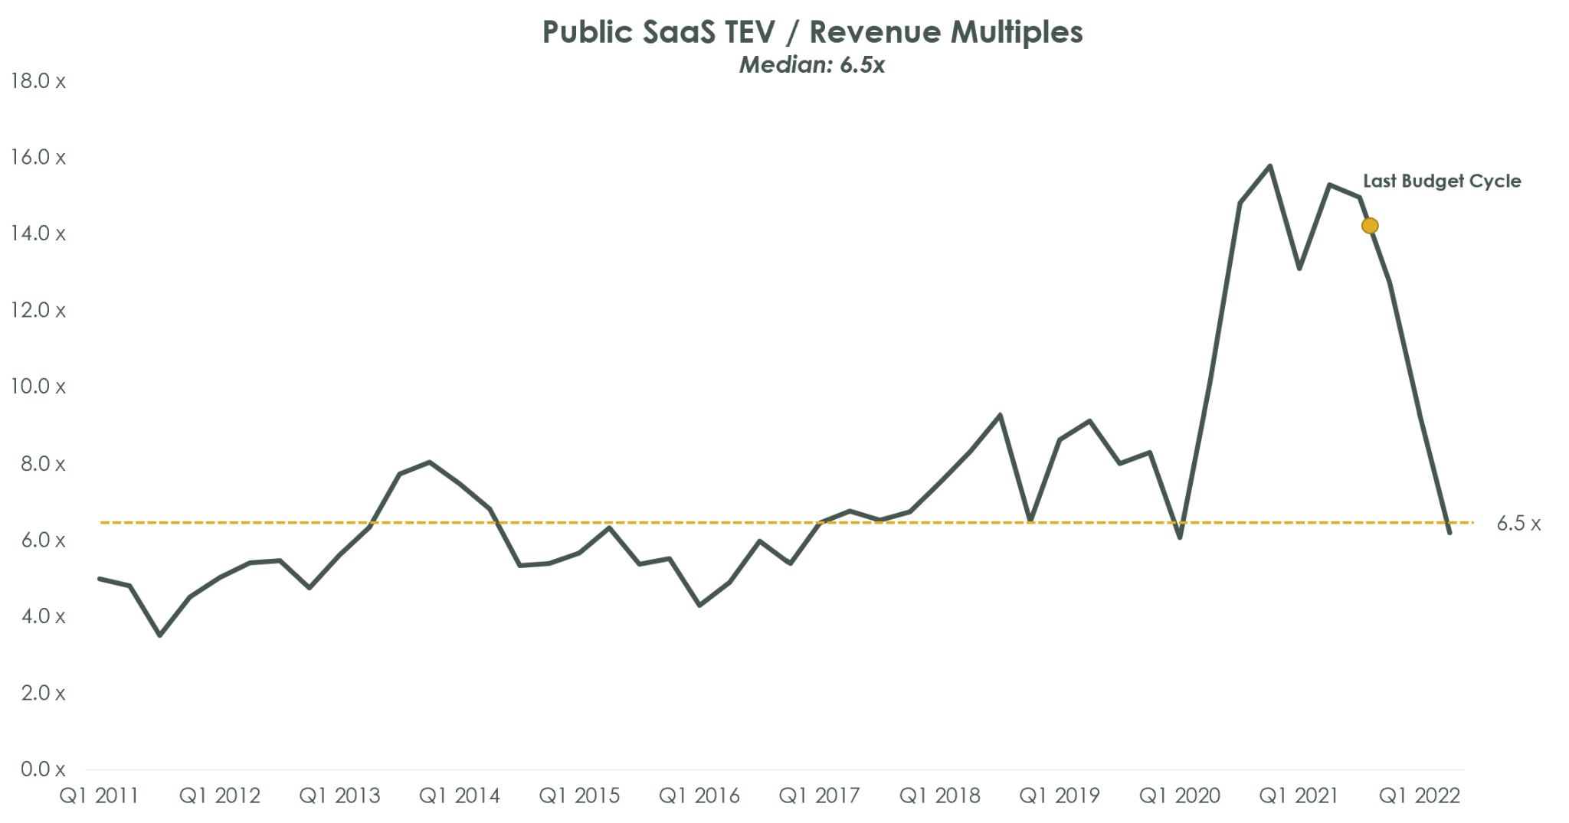
The Valuation Story – Two-Year Mass Delusion Is Over
Data as of 6/30/22 are compiled from publicly reported filings of more than 145 SaaS and cloud computing / service companies listed on United States exchanges starting in Q1 2004. Most companies have recurring revenue business models and gross margin profiles in excess of 70%. Total Enterprise Value (“TEV”) / Revenue multiples are calculated as of the last day of each reported quarter and are determined by dividing (a) the TEV reported by each company by (b) the GAAP revenue multiplied by 4 (to derive an annualized revenue run rate). The all-time median is calculated as the median of all periods of reference.

Slide 6

Real Economy Story: Q3 Slowdown
Q3 saw a portfolio slowdown in growth and attainment approaching (or exceeding) the original Covid Shock
51%
Median ARR Growth Rate continues to slide nearing low watermark of Q220
160%
Top Decile ARR Growth Rate stabilized; Still low compared to previous high
13%
Companies That Achieved Q322 plans; Worse than Covid Shock in Q220
57%
Median Plan Attainment well below historical norms

Slide 7
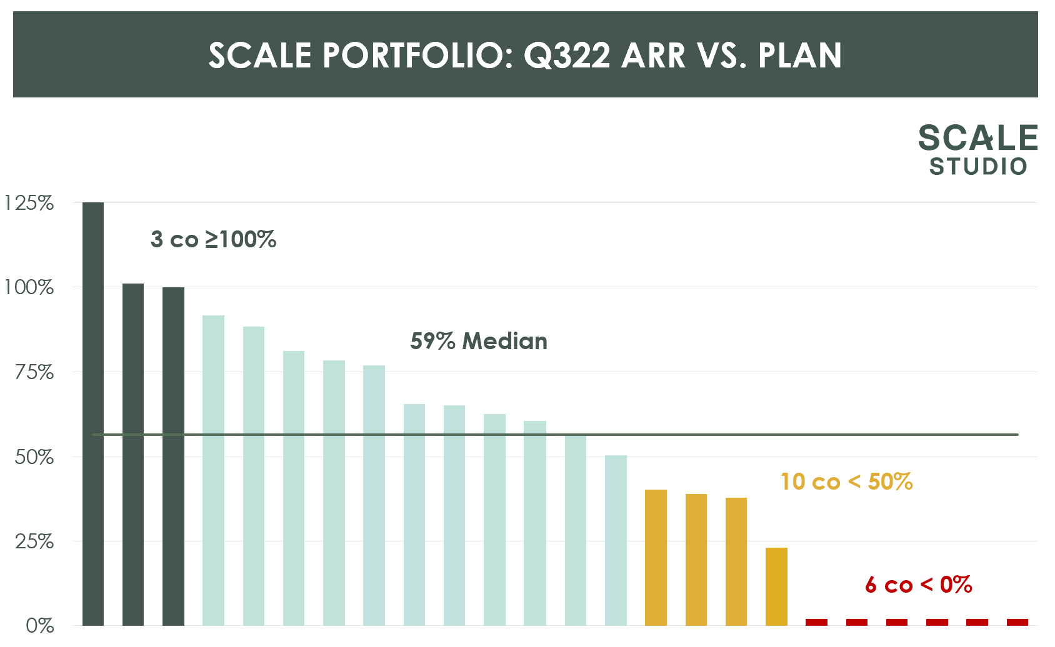
Most Companies Struggled to Make Plan
Performance vs. Q322 Plan
57%
median attainment of Q322 plan
13%
companies overachieving plan
35%
companies above 75% of plan
2023 ANNUAL PLANNING

Slide 8
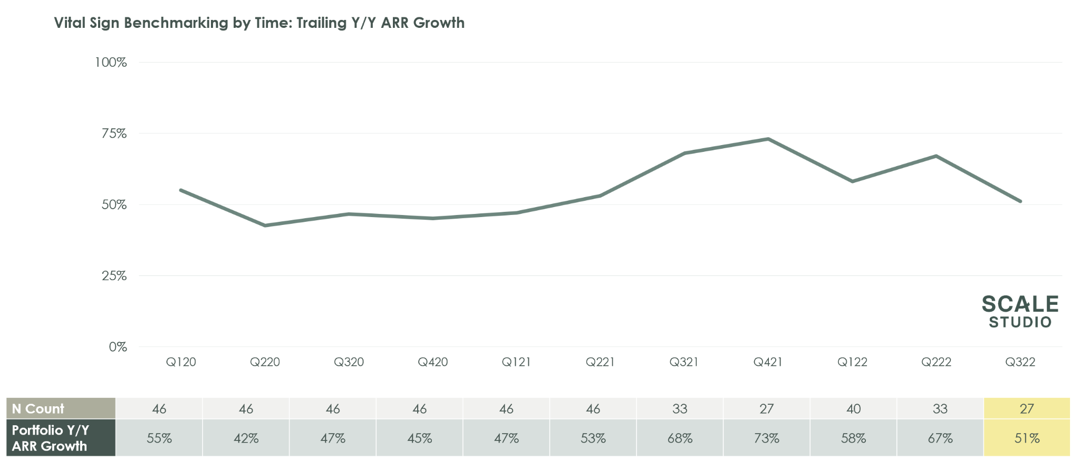
ARR Growth Now Trending Below Pre-Pandemic Levels

Slide 9
Top Performers Exceeded Estimates, but the Median Company Missed Early 2022 Estimates
ENDING ARR GROWTH RATE
By Quartiles |  | 2022 Whisper Numbers |  | 2022 Latest Forecast
90 Percentile |  | 120% |  | 163%
75 Percentile |  | 100% |  | 96%
50 Percentile |  | 80% |  | 51%

Slide 10
Early Estimates for 2023 Feel High
ENDING ARR GROWTH RATE
By Quartiles |  | 2020 |  | 2021 |  | 2022 Latest Forecast |  | 2023 Whisper Number
90 Percentile |  | 120% |  | 261% |  | 163% |  | 143%
75 Percentile |  | 64% |  | 126% |  | 96% |  | 104%
50 Percentile |  | 40% |  | 53% |  | 51% |  | 62%
Historical Actuals
These are time-based benchmarks; size-based benchmarks should also be considered to calibrate performance

Slide 11
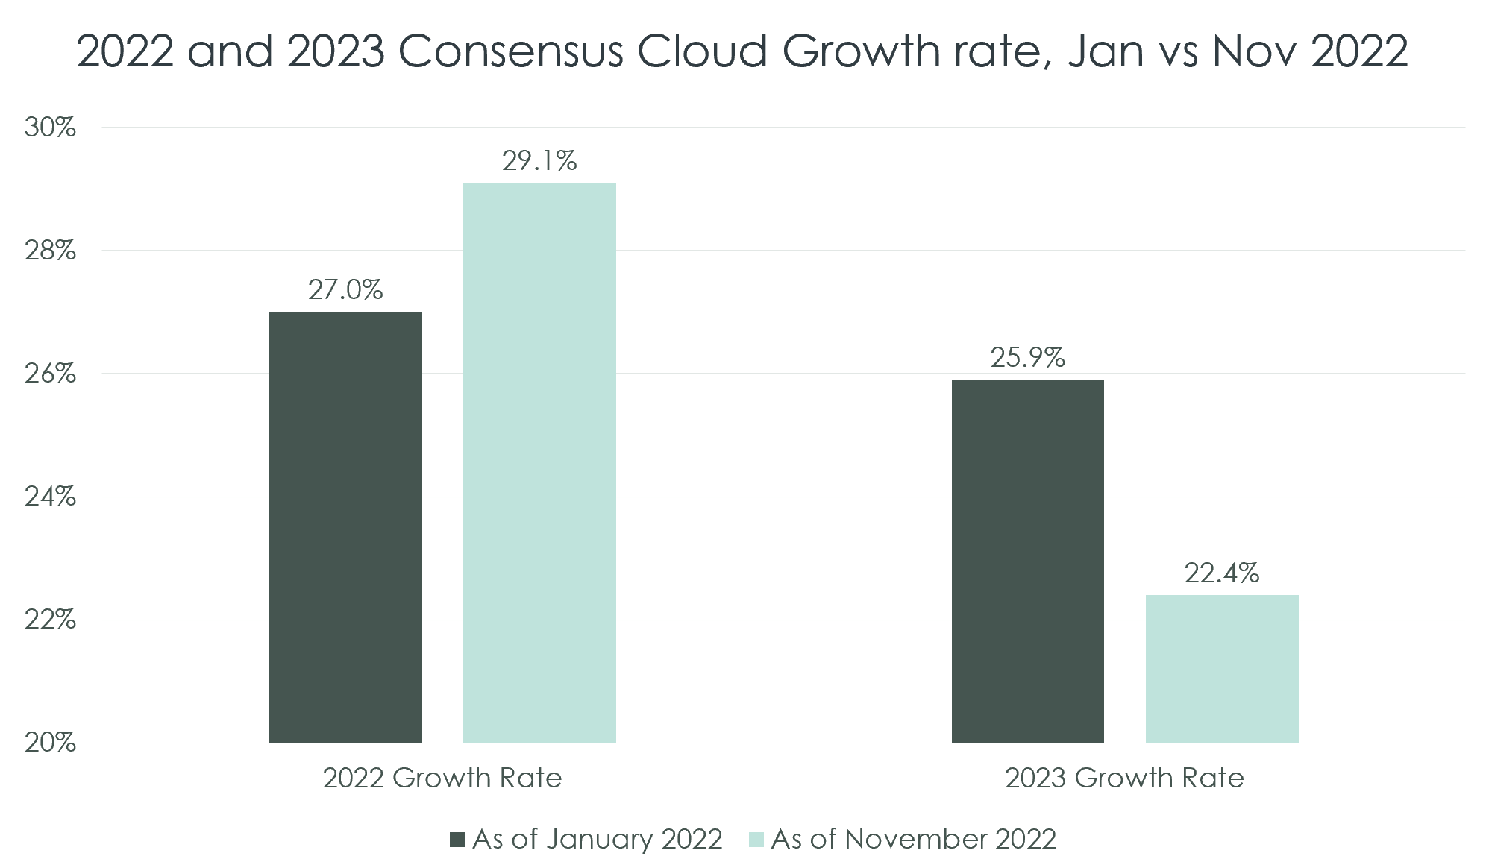
Public Comps Telling Roughly the Same Story
+2.1%
Change in 2022 Growth
-3.5%
Change in 2023 Growth
Source: Bessemer Cloud Index; Capital IQ. Figures represent AVERAGE consensus NTM revenue growth of Bessemer Cloud Index Companies as of 1/3/2022 and 11/7/2022. Axis adjusted for visual impact.

Slide 12
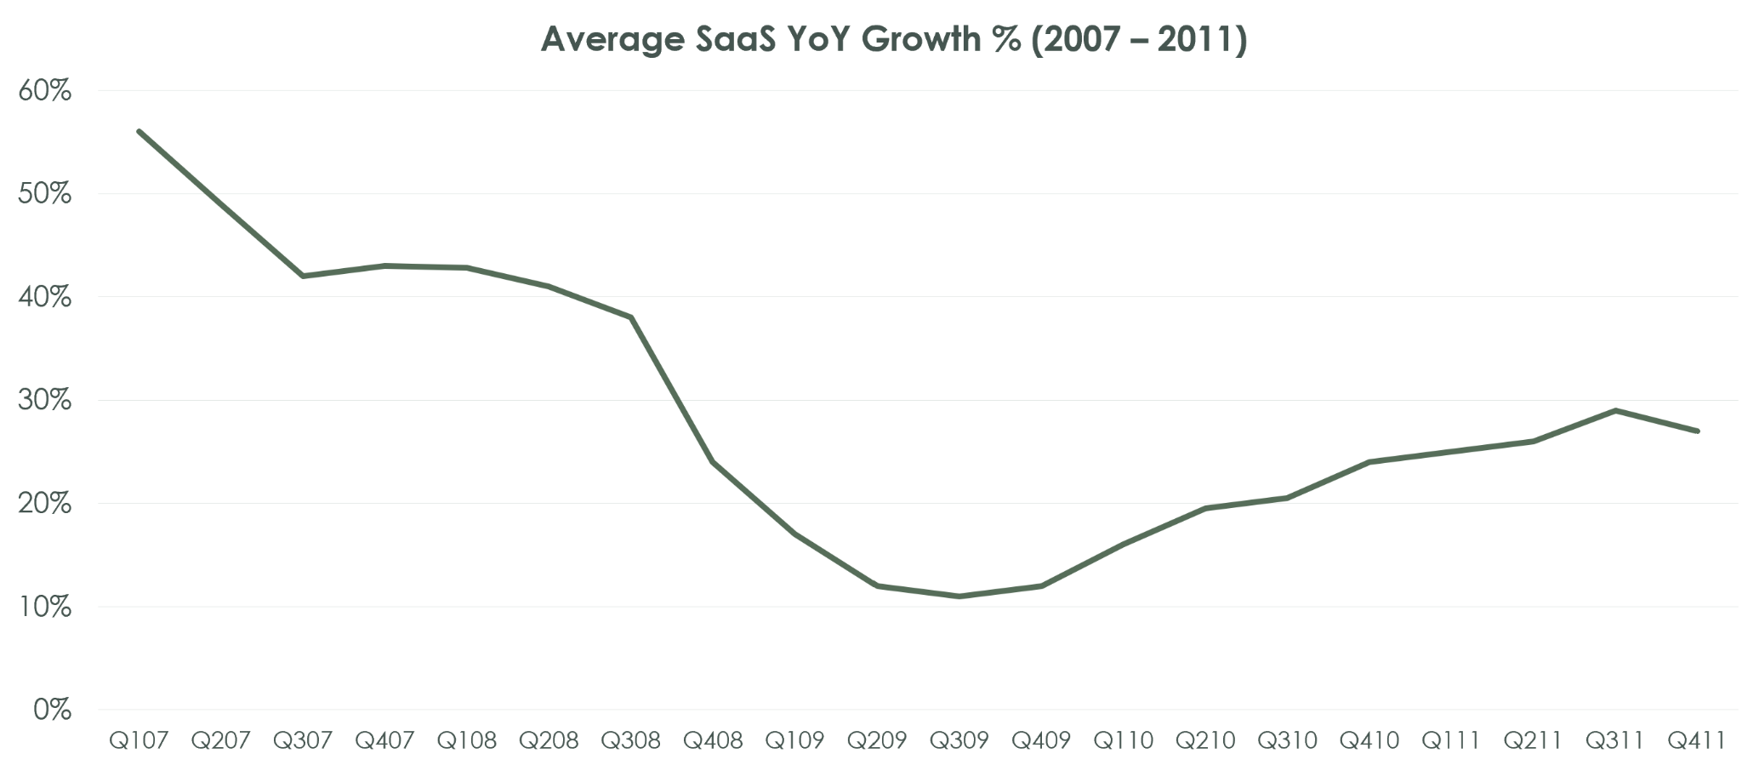
But Slowdown Is Still Nothing Like the Financial Crisis
Source: Clouded Judgement / Jamin Ball

Slide 13
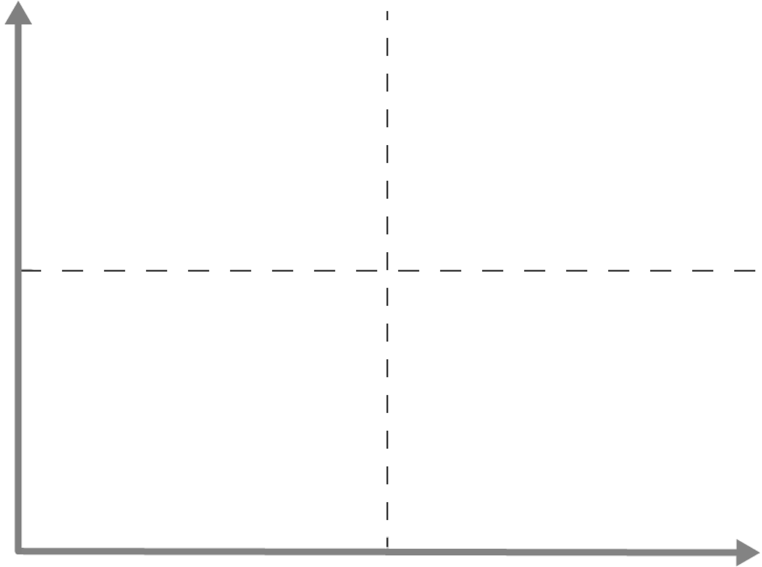
Even in a Recession, It’s Not a One-Size-Fits-All World
High Growth Low Burn Multiple
You can raise capital today if you have to. There is always room at the top.
High Growth High Burn Multiple
Tricky. Venture loves the growth but suddenly fears the burn. Your options depend on how much cash you have. With enough cash (cash equals time) you can work slowly to the right on burn ratio, hopefully without slowing too much on growth. If you don’t have cash, you will have to cut even at the expense of growth. The world has changed and sometimes is not fair.
Low Growth Low Burn
Your growth rate is not compelling for venture. The good news is that you are converging on cashflow breakeven. Companies here can “make it” and sell at attractive normalized valuation multiples. Less “blue bird” upside.
Low Growth High Burn Multiple
Tough place to be. You will not be able to raise new capital easily. You have to cut burn to give yourself max time to change the business or look to sell.
Growth Quartile
90%ile
High Growth
High Burn Multiple
Venture suddenly uncomfortable here
High Growth
Low Burn Multiple
Venture needs You even now
75%ile
50%ile
Low Growth
High Burn Multiple
You need Runway
Low Growth
Low Burn Multiple
You don’t need (much) venture
25%ile
2.4
1.6
0.8
Burn Multiple
Burn multiple moves with company size

Slide 14

Sharing With CFOs How You Are Tracking
Growth Quartile
2021 Actuals
 | 2021 Actuals | 2022 Plan (Reforecast) | 2023 Plan (Estimate)
ARR Band | $10M – $25M | $10M – $25M | $25M – $50M
Beginning ARR | $10.0M | $20.0M | $30.0M
NNARR | $10.0M | $10.0M | $13.0M
Ending ARR | $20.0M | $30.0M | $43.0M
OpInc | ($25.0M) | ($30.0M) | ($20.0M)
Growth Rate | 100% | 50% | 43%
Growth Percentile | Top Quartile | 3rd Quartile | 3rd Quartile
Burn Multiple | 2.5 | 3.0 | 1.5
90%ile
75%ile
50%ile
2022
Reforecast
2023 Estimate
25%ile
2.4
1.6
0.8
Burn Multiple

Slide 15

Budget Planning Process
Forecasting Revenue
Look at Q3. Are you being realistic enough about 2023 ?
A churn explosion is the lurking downside risk
Changing your cost structure
Your cost structure is almost certainly wrong
The choice is a graceful fix over a year or an abrupt fix in a month
Cash
You have to frame financials in the context of upside tradeoffs
If you need money in 2023, that is all the board will talk about

Slide 16
Notes From Successful CFO on Costs
Overview
Line up CEO support, get benchmark data,
Ask yourselves “what would hardcore PE do”
GTM Savings
Stopped hiring reps on “opportunity” instead only when pipe/territory there
Eliminated product overlays, instead trained reps on products
Marketing went all digital
HR
Remote was not a saving, 10% which was spent in travel
Offshoring was saving, ask for every new headcount, can it be offshored
Salary freezes led to some gaming on promotions to get salary increases
Not all managers are capable of change, that is ok
Did not get done and wanted to “real estate”

Slide 17
Board Approval Tips
Remember plan context
Link back to Company objectives, not just financial
Can be OKR process, CEO thoughts, Board-level strategic process
Important: provide non-financial anchor for financials
Show key assumptions and summary results
Pick small number of key metrics that explain your business
Show trends: 2021, 2022, and 2023 by KPI
Show high-level results, bookings, revenue, growth rates, operating income
Discussion will be dominated by cash need
Provide a multi-year plan, don’t leave me hanging in Dec 2023
Multi year plan but with quarterly gates

Slide 18

The New Inevitable Annoying Question
What we were asking last year …
… vs what we’re asking now
Are we growing fast enough?
(Or, could we grow faster with more capital?)
You must be able to say you thought about it already!
You must have a philosophy on growth vs. capital consumption
Today’s philosophy is growth at pretty much all costs
You must know where you rank relative to other companies
Hence our Scale Studio work: know where you stand on “Vital Signs” metrics
Data beats anecdotes
You must know your constraints
They are almost certainly internal or market driven ... not capital
Can we reduce burn by another 10%?
(Or, could we grow the same with less capital?)
You must be able to say you thought about it already!
You must have a philosophy on growth vs. capital consumption
Today’s (new) philosophy is value creation and efficient growth
“Default investable”
You must know where your company benchmarks relative to others
Hence our Scale Studio work: know where you stand on “Vital Signs” metrics and your Growth vs Burn trajectory
Data beats anecdotes
Although annoying, it’s the right question to ask
Capital constraints are #1 now

Slide 19
Backup Flash Report Data by Quarter
By Percentiles |  | NNARR Plan Attainment |  |  |  | Net New ARR Growth |  |  |  | Ending ARR Growth
 |  | Q122 | Q222 | Q322 |  | Q122 | Q222 | Q322 |  | Q122 | Q222 | Q322
90 Percentile |  | 130% | 113% | 98% |  | 425% | 213% | 316% |  | 253% | 151% | 160%
75 Percentile |  | 111% | 101% | 80% |  | 207% | 58% | 71% |  | 117% | 124% | 96%
50 Percentile |  | 93% | 73% | 57% |  | 82% | 1% | (17%) |  | 58% | 60% | 51%
25 Percentile |  | 60% | 54% | 10% |  | (10%) | (45%) | (70%) |  | 27% | 28% | 29%

