Slide 1
SDR Council
Unlocking Signal-Based Selling
March 22, 2024

Slide 2


Today’s SDR Council leaders
Travis Henry
Director of SDR Operations & Enablement
Snowflake
Brendan Short
Founder & Writer
The Signal

Slide 3
Today’s Agenda
Welcome and Introductions (20 min)
Presentation - Unlocking Signal-Based Selling (30 min)
Open Discussion (30 min)
Notes:
Q - what is the tool they use most often / what tool are you most excited about? - favorite piece of technology or app today?

Slide 4
We help our portfolio build and optimize hyper-growth GTM machines

Slide 5

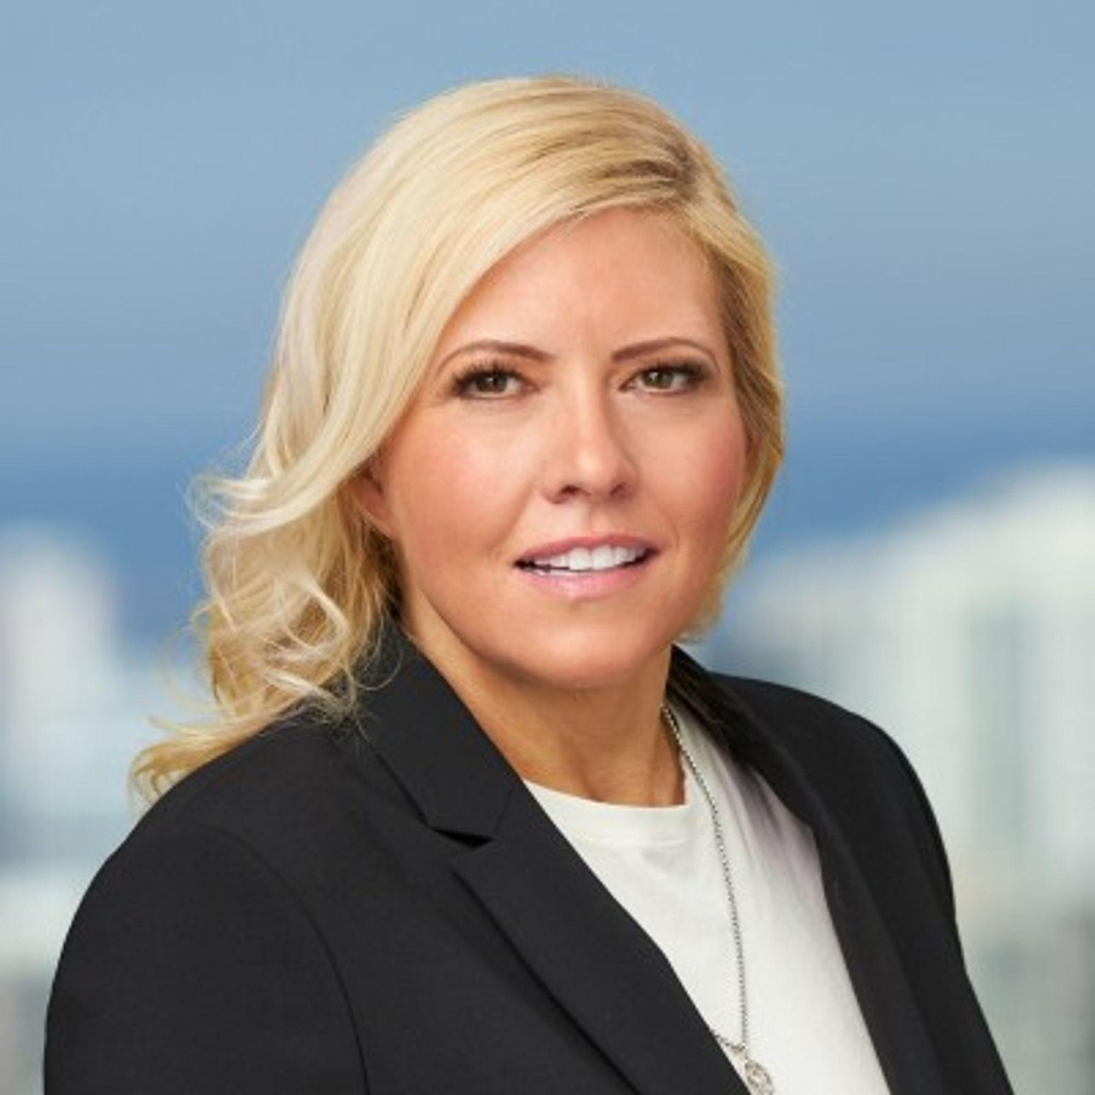
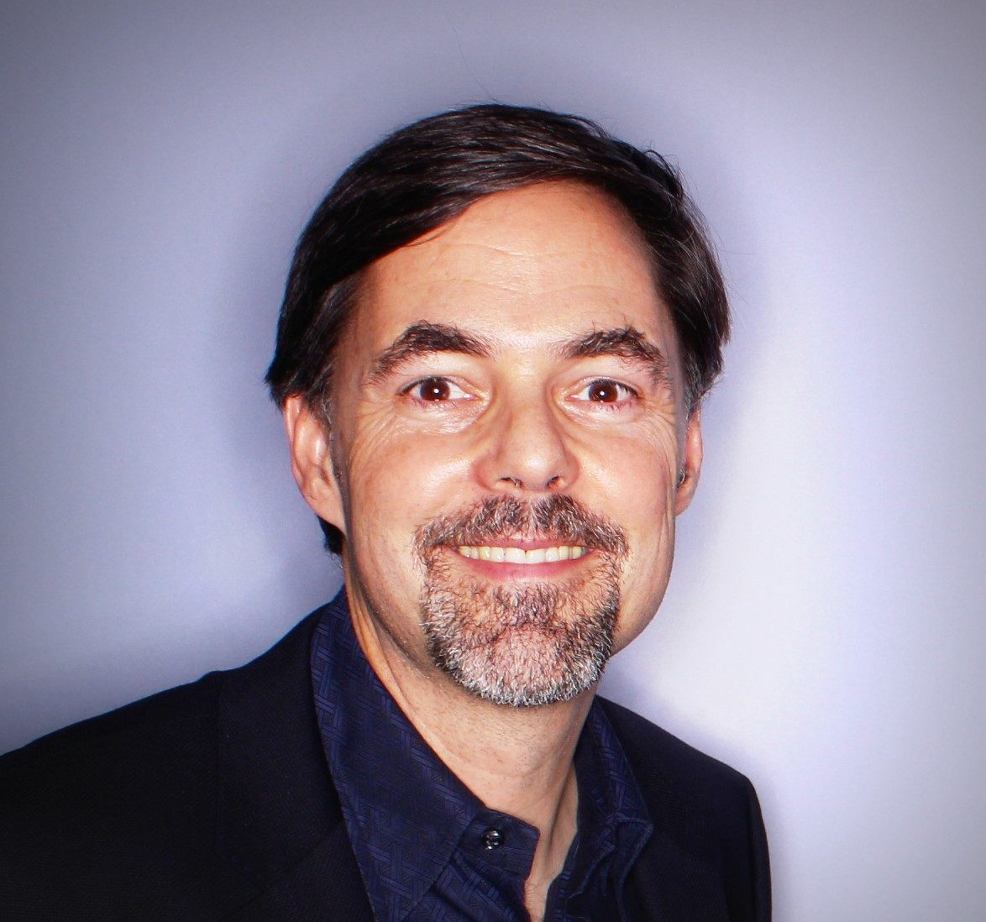

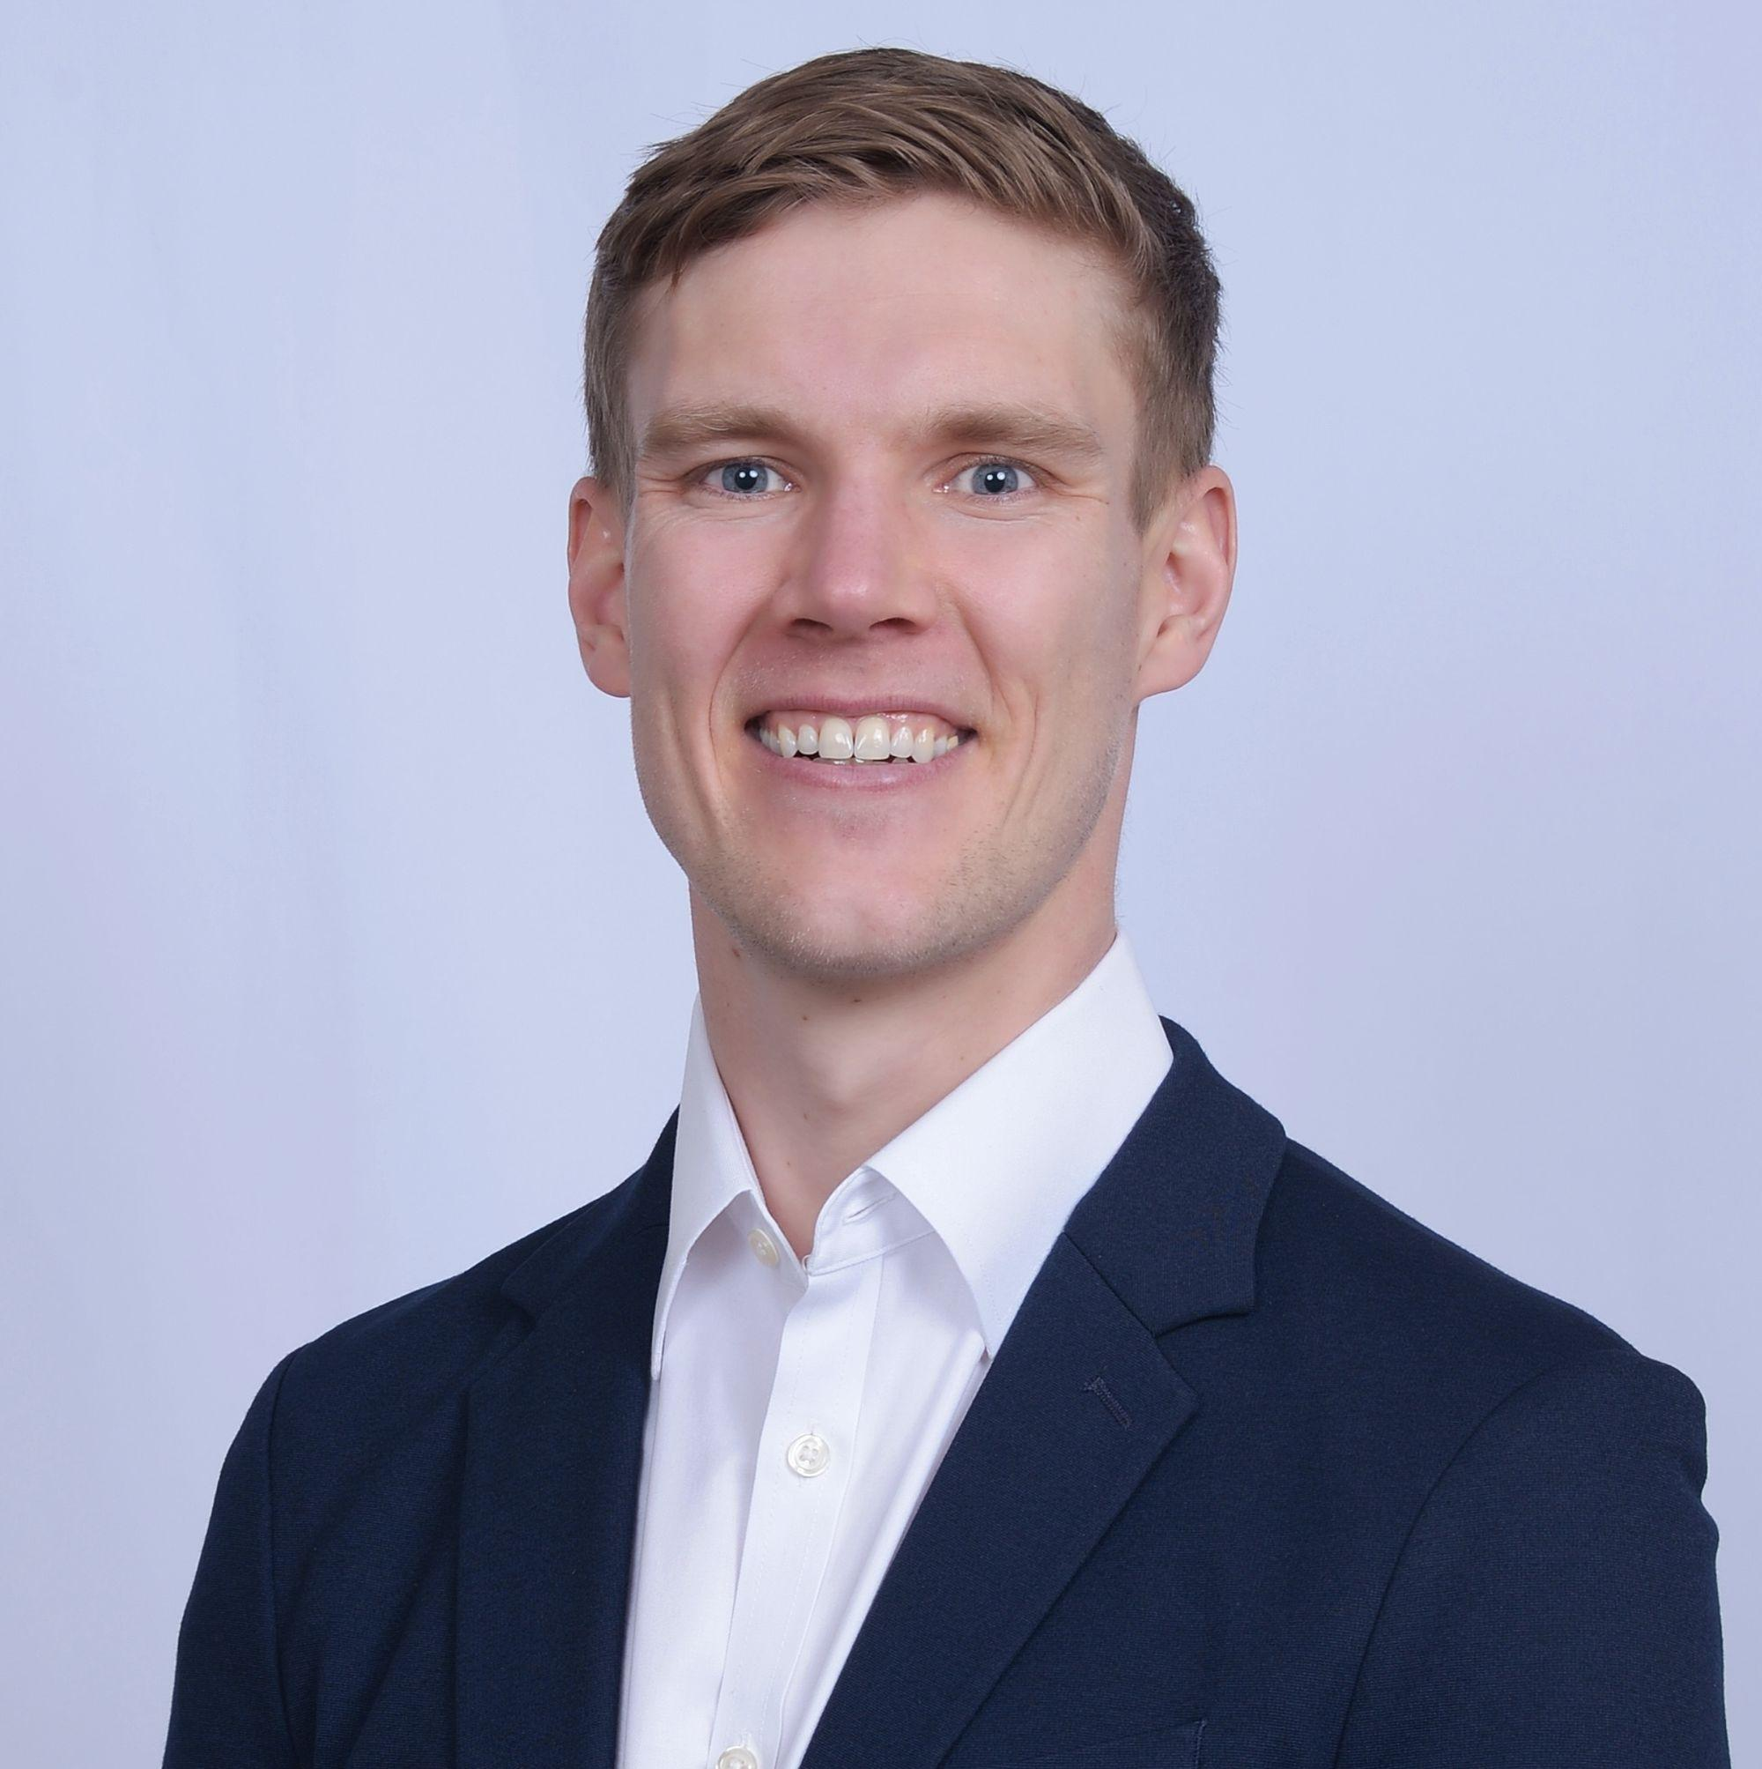





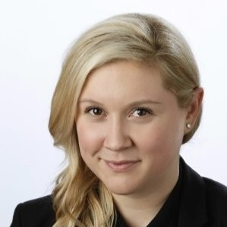

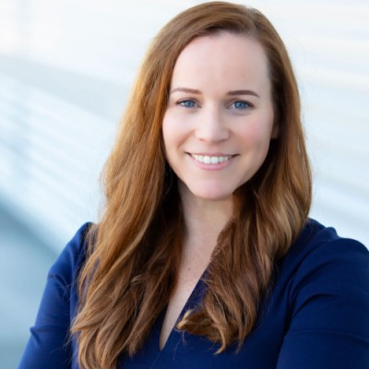
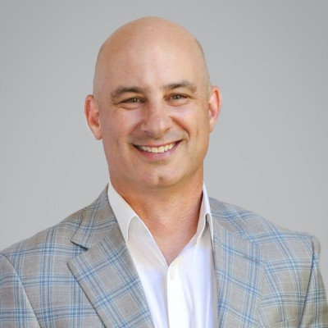




An ecosystem designed to drive GTM excellence
EIRs
Lauren Vaccarello
Maria Pergolino
Zack Urlocker
Brandon O’Sullivan
James Huber
GTM advisors
Katherine Andruha
Anton Lenke
Kristina McMillan
Ralph Barsi
Friends of the program
Third party consultants
Peer community
Portfolio companies
Notes:
Kat, anton, kristina (argyle health), ralph, travis?

Slide 6
Advisory
Content
Community
Been-to-Market Expertise
Step by Step Guides
The Power of Community
Email anisha@scalevp.com with your questions!
Advising our portfolio companies with bespoke GTM consulting
Access it here:
https://community.scalevp.com/c/static/content
Distilling decades of experience into concise GTM playbooks
Check out our online community:
https://community.scalevp.com/home
Connecting our network of EIRs, Exec Advisors and portfolio execs

Slide 7
How We Scaled This
GTM Summit
Thursday, May 30th
The Ritz Carlton
600 Stockton St, San Francisco
Councils
9am - 12pm PT
Pipeline, RevOps, & Product Marketing
Summit:
12pm - 6pm PT With lunch and cocktail hour
Notes:
Summit slide

Slide 8
Introductions
Name
Title
Company
If we could benchmark any metric, tactic, point-of-view, what would be valuable to you?

Slide 9
The Why
Signal-based selling is the modern approach to identifying the segment of your market that is (most likely) ready to have a sales meeting today
TAM
Total Addressable Market
Serviceable Available Market
Serviceable Obtainable Market
Signal Based Market
SAM
SOM
SBM
Notes:
TAM maybe changes once a year, signal-based market changes daily

Slide 10
Types of Signals
Companies
People
Data Sources
1st Party (website, product usage, other interactions)
3rd Party (LinkedIn, B2B databases/tools, 10-Ks)
How to find signals relevant for your business
There is no one-size-fits-all approach
“Do things that don’t scale”…then scale them (with ai and automation)
Notes:
- other interactions might include previous conversations from CRM, engagements with marketing automation emails or webinars, or other ways you’re engaging with your TAM.
- your goal is to identify signal within the noise of all your gtm activities, and external data

Slide 11
Start with your goal
What Play(s) should you run, based on what you’re optimizing for within your go-to-market motion?
Notes:
This is a framework to help choose what to optimize for with your signal-based selling strategy

Slide 12
3 signal-based selling Plays
you can run today
1. Website visitors play
2. Product-led sales (PQLs) play
3. Closed-lost deal play
Notes:
There are hundreds of different Plays you could run — you need to choose the Plays that will have the most impact for your business and its current goals
Let’s walk through each of these examples really quickly

Slide 13
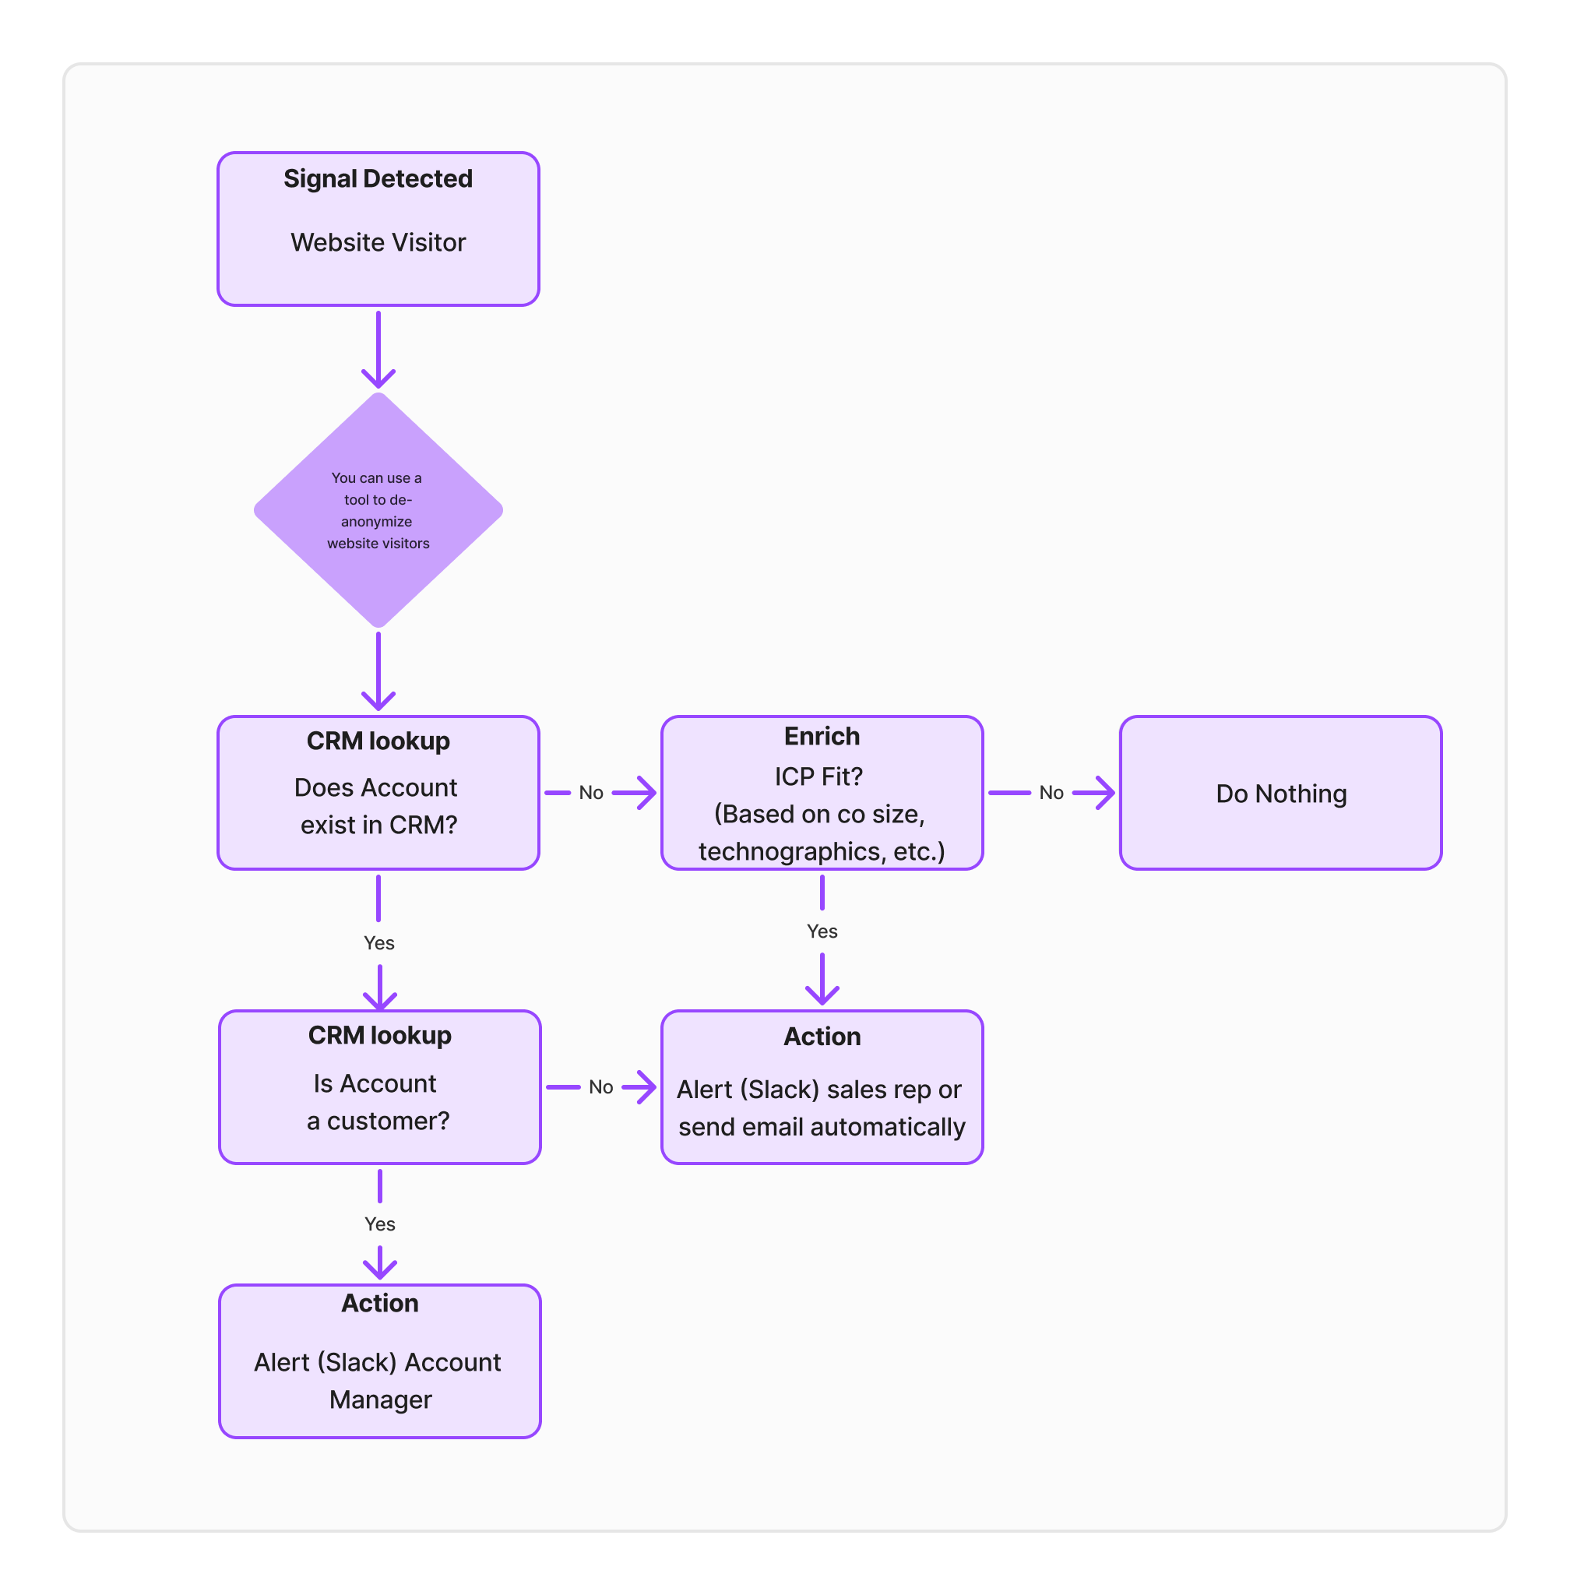
Website Visitor

Slide 14
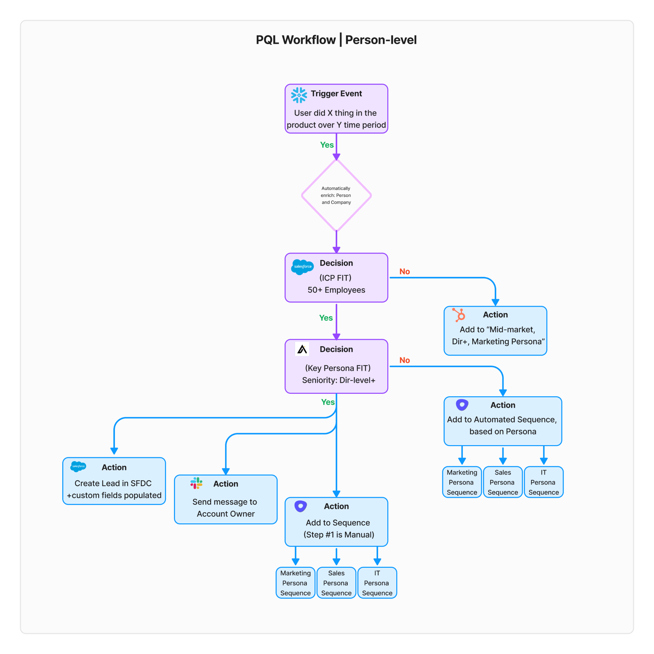
Product qualified lead (PQL)

Slide 15
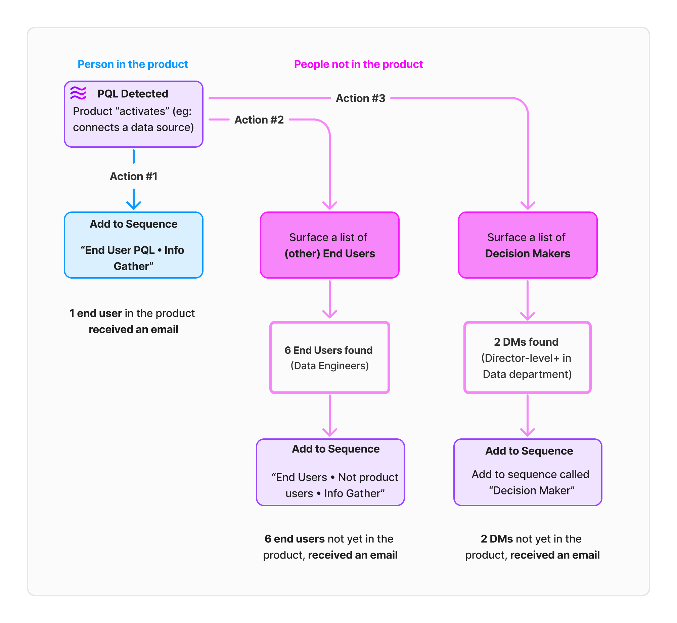
Product-led sales (Outbound account-based sales motion)
Notes:
Typically you’d want to reach out to PQLs (Product Qualified Leads) - or people who are within your ICP and one of your Key Buyer Personas This Play shows a more advanced way of using one signal (PQL) and using that to trigger an outbound ABM motion

Slide 16
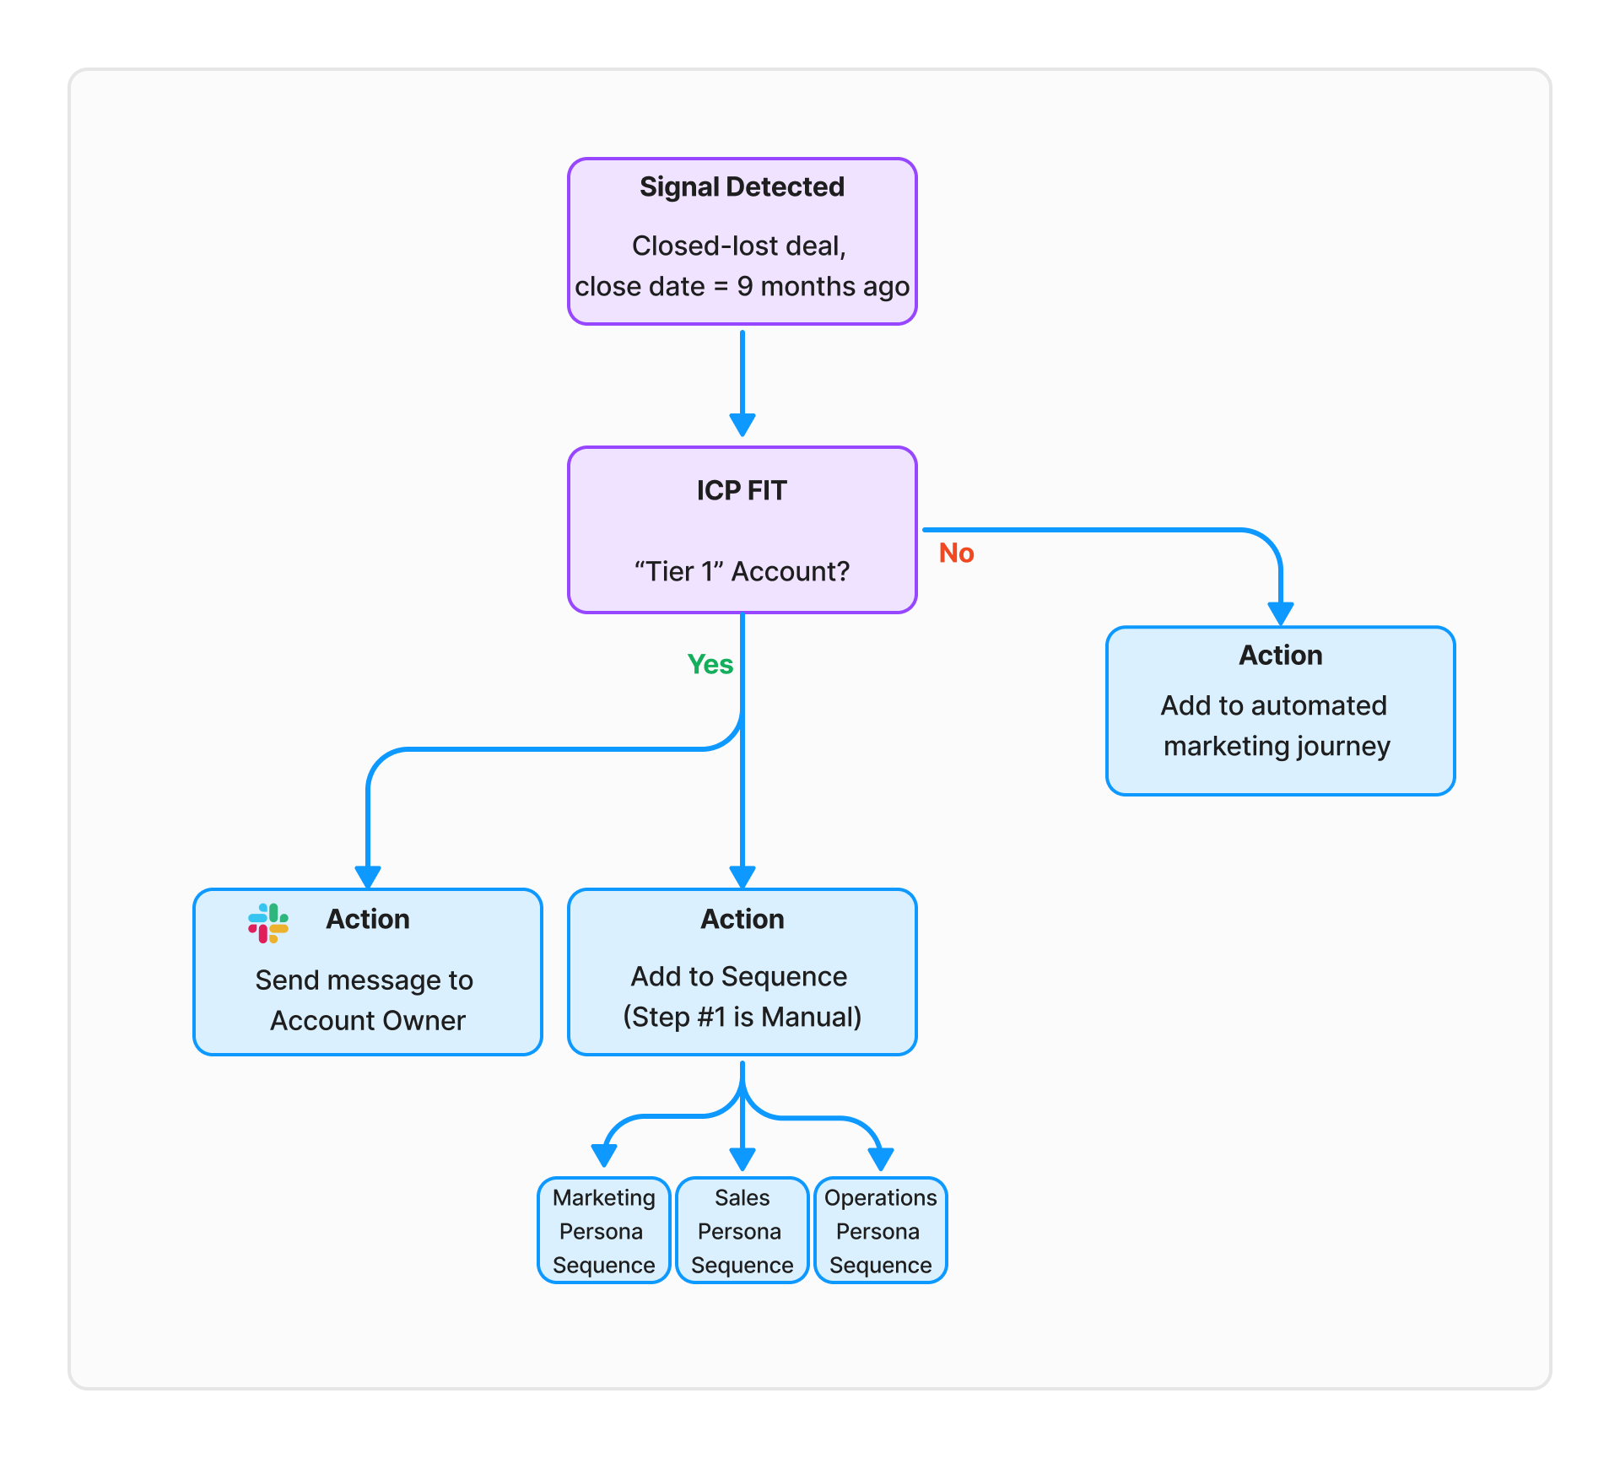
Closed-lost deal
(Resurrect)
Notes:
There are hundreds of different Plays you could run — you need to choose the Plays that will have the most impact for your business and its current goals
Let’s walk through each of these examples really quickly

Slide 17
The future of GTM
RevOps strategic role across all departments
The evolving (but still highly relevant) role of SDRs
The new way of buying—optionality!
Tech and the future of AI/automation

Slide 18
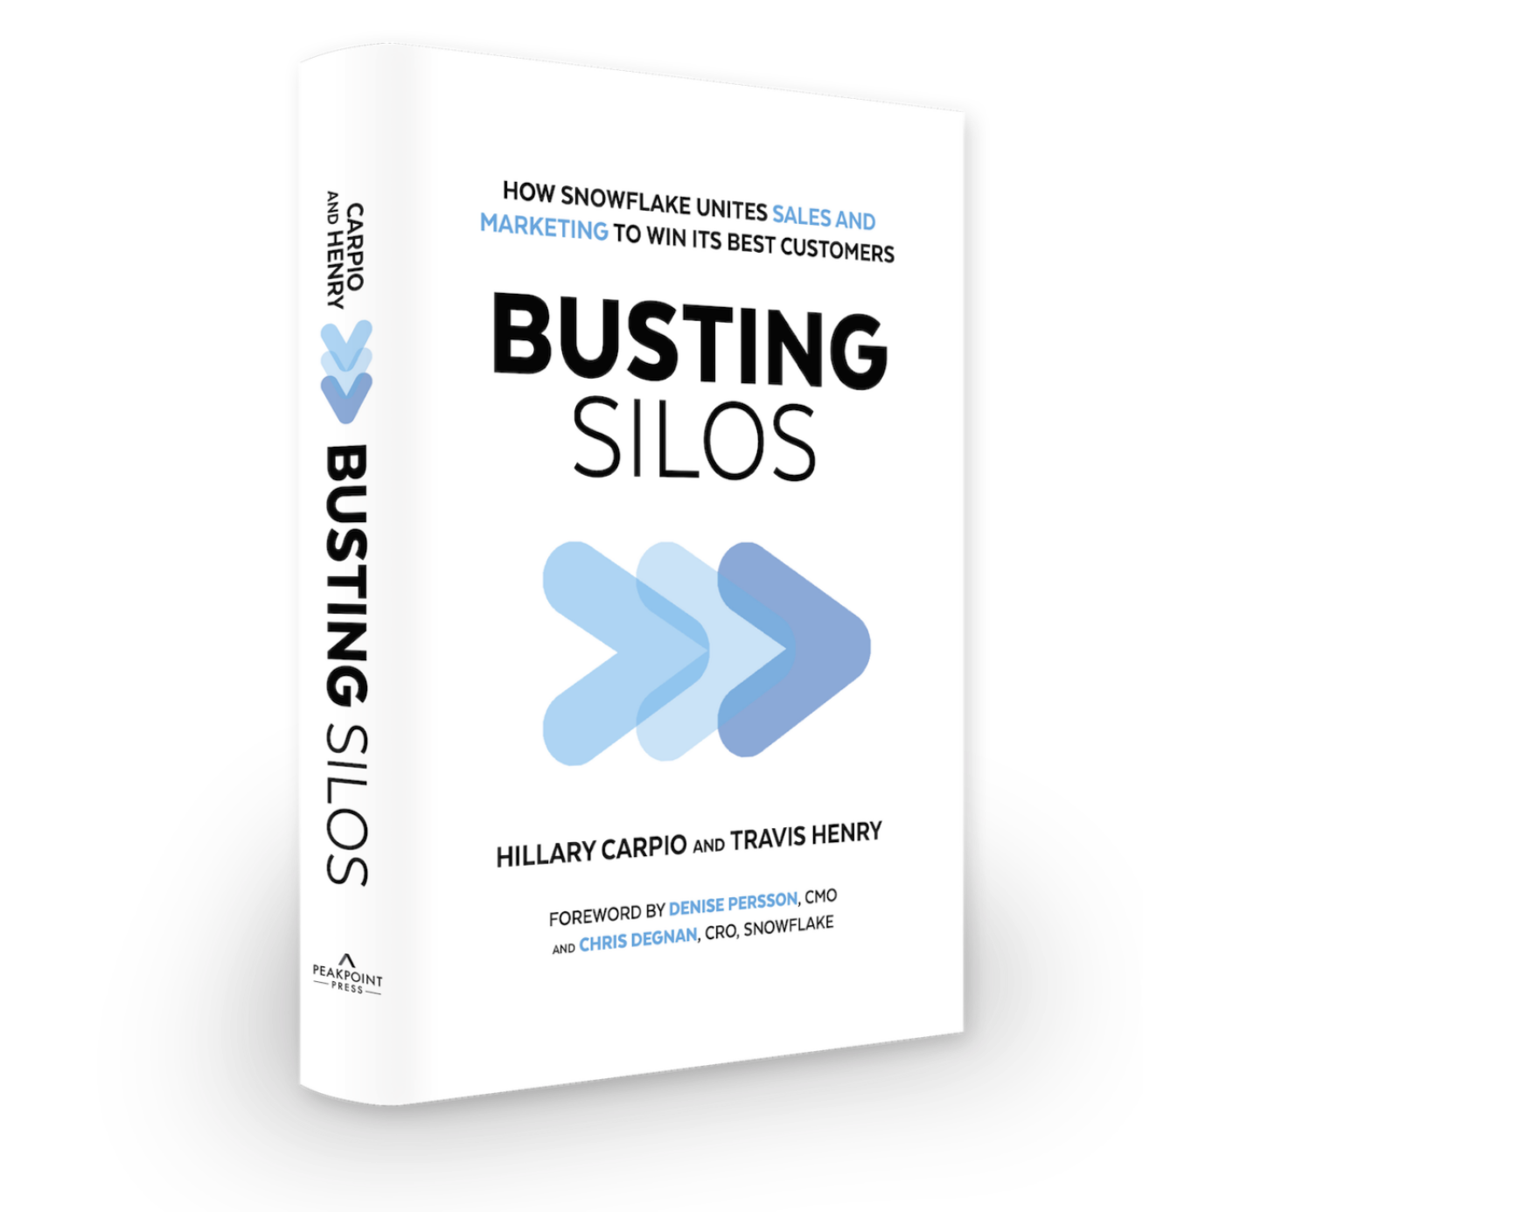
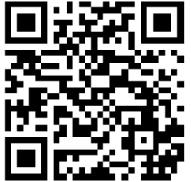
Claim your free copy of Busting Silos!
Notes:
https://www.snowflake.com/busting-silos-claim/

Slide 19
What topics / challenges are top of mind?
menti.com (1469 6563)

Slide 20
Thank
you!

