Slide 1
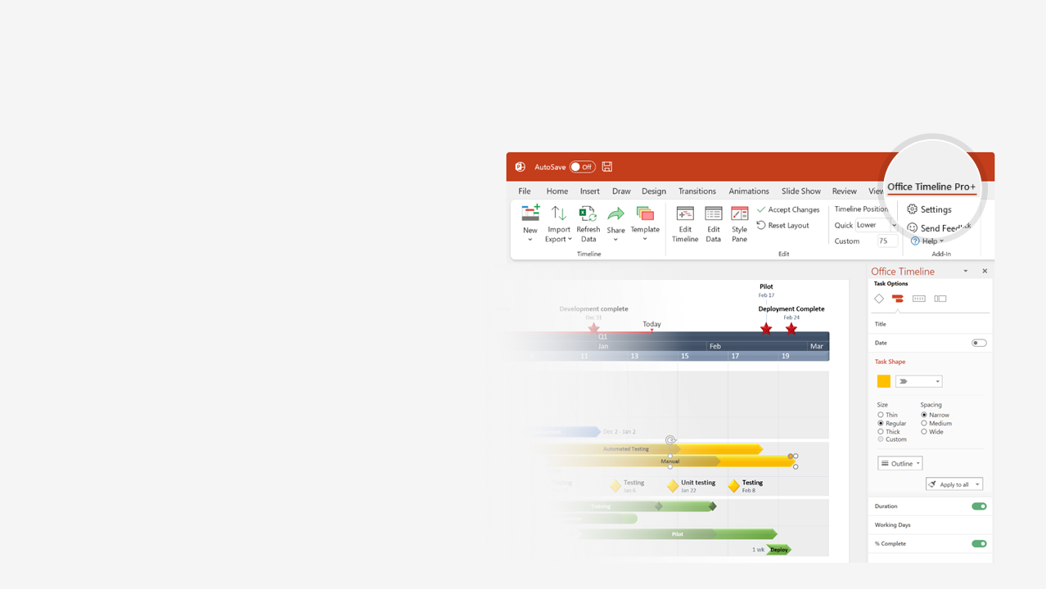

How to update this template in seconds
The Office Timeline add-in for PowerPoint will help you edit it with just a few clicks.
Get your free 14-day trial of Office Timeline here:
https://www.officetimeline.com/14-days-trial
Re-open this template, and create your impressive
PowerPoint visual in 3 easy steps:
1
Click the Edit Data button on the Office Timeline tab.
2
Use the Data and Timeline views to edit swimlanes, milestones and tasks.
3
Click Save to instantly update the template.

Slide 2

Lawyer timeline template
Leak begins
Response base up
13:16
17:47
Declared Code Red
Mop-up and recovery begins
13:22
18:05
Aug 11
13:00
14:00
15:00
16:00
17:00
18:00
4.4 hours
13:22
Sector D Incident Response Time
17:47
13:43
17:07
Vanguard team dispatched
Mitigation equipment sent
13:31
16:52
Response preparations
Mitigation personnel arrive
16:06
Mitigation personnel depart
16:03
Mitigation equipment sent

