Slide 1
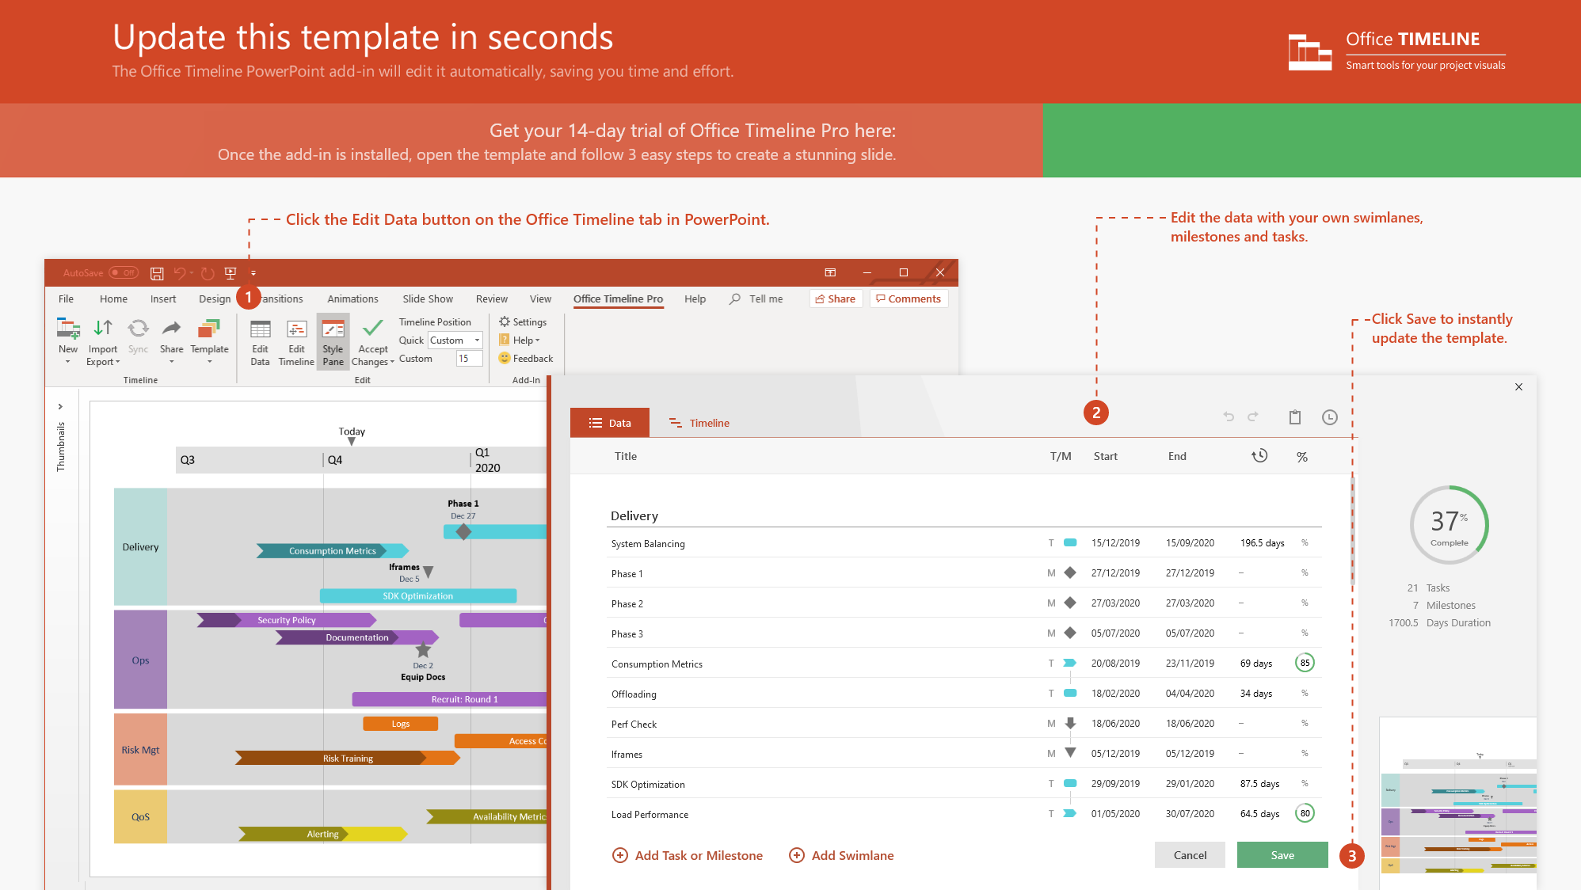
https://www.officetimeline.com/14-days-trial

Slide 2
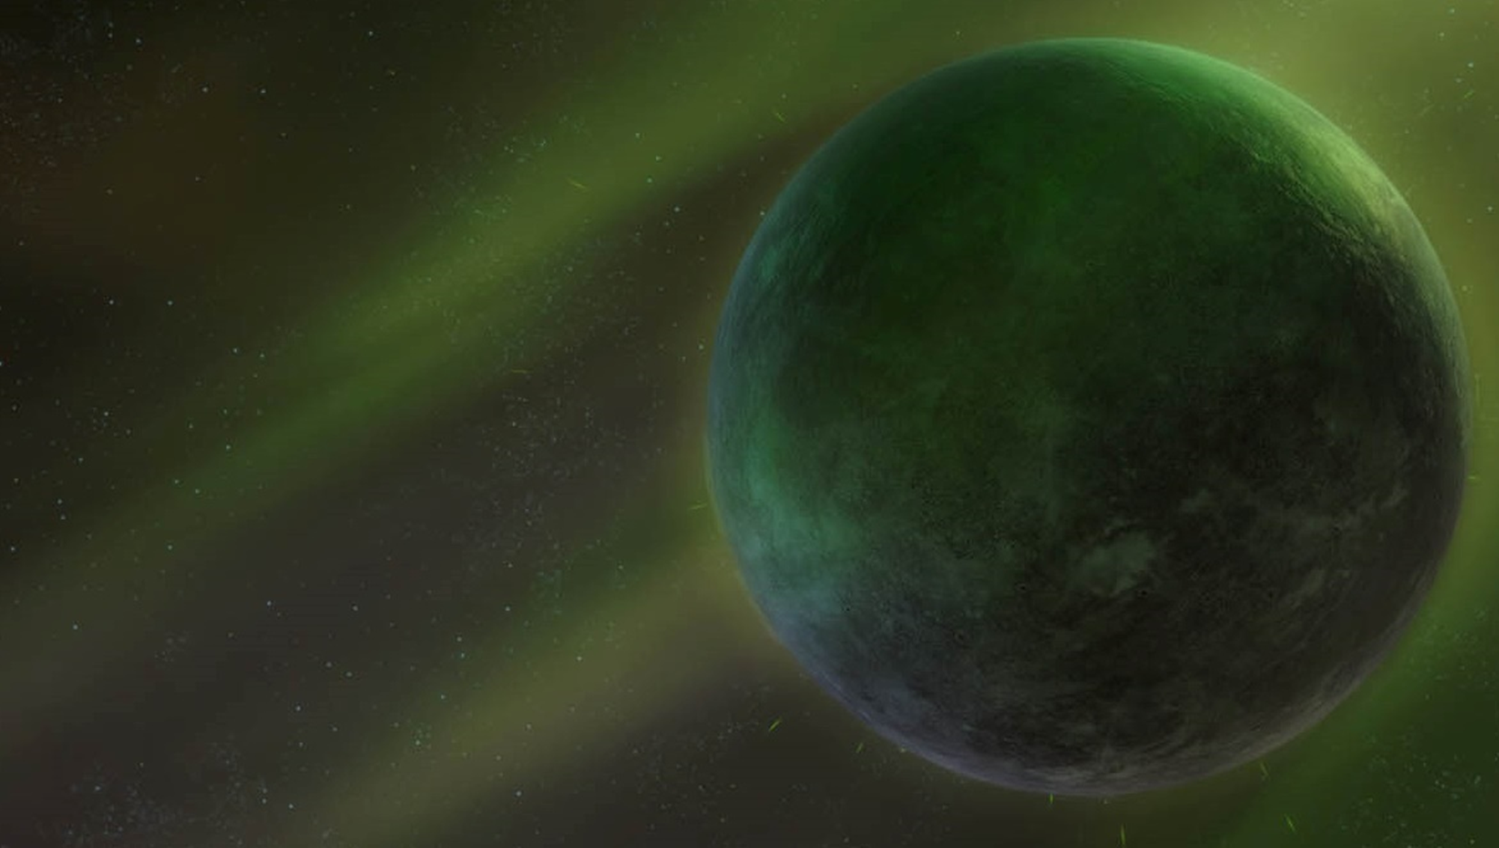







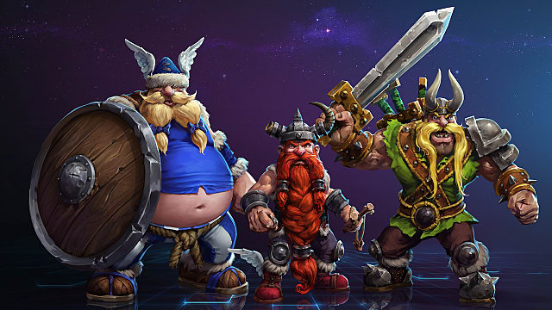


1990
1990
1994
1998
2002
2006
2010
2014
2018
2021
Warcraft: Orcs & Humans
Warcraft III: The Frozen Throne
Jan 1, 1994
Jul 1, 2003
Warcraft
Warcraft II: Beyond the Dark Portal
Warcraft III: Reforged
Apr 30, 1996
Jan 28, 2020
Warcraft II: Tides of Darkness
Warcraft III: Reign of Chaos
Dec 9, 1995
Jul 3, 2002
StarCraft
StarCraft II: Wings of Liberty
StarCraft: Remastered
Apr 1, 1998
Jul 27, 2010
Aug 14, 2017
Starcraft
StarCraft: Brood War
StarCraft II: Legacy of the Void
Nov 30, 1998
Nov 10, 2015
StarCraft II: Heart of the Swarm
Mar 12, 2013
Diablo
Diablo II
Diablo III
Diablo III: Reaper of Souls
Jan 2, 1997
Jan 1, 2000
May 15, 2012
Mar 25, 2014
Diablo
Diablo: Hellfire
Diablo II: Lord of Destruction
Diablo III: Rise of the Necromancer
Nov 25, 1997
Jun 29, 2001
Jun 27, 2017
Diablo III: Ultimate Evil Edition
Aug 19, 2014
The Burning Crusade
Cataclysm
Mists of Pandaria
Legion
Jan 16, 2007
Dec 7, 2010
Sep 25, 2012
Aug 30, 2016
World of Warcraft
World of Warcraft
Wrath of the Lich King
Warlords of Draenor
Nov 23, 2004
Nov 13, 2008
Nov 13, 2014
Battle for Azeroth
Aug 14, 2018
Hearthstone
Mar 11, 2014
Singles
The Lost Vikings
Heroes of the Storm
Jan 1, 1993
Jun 2, 2015
Overwatch
May 23, 2016

