Slide 1
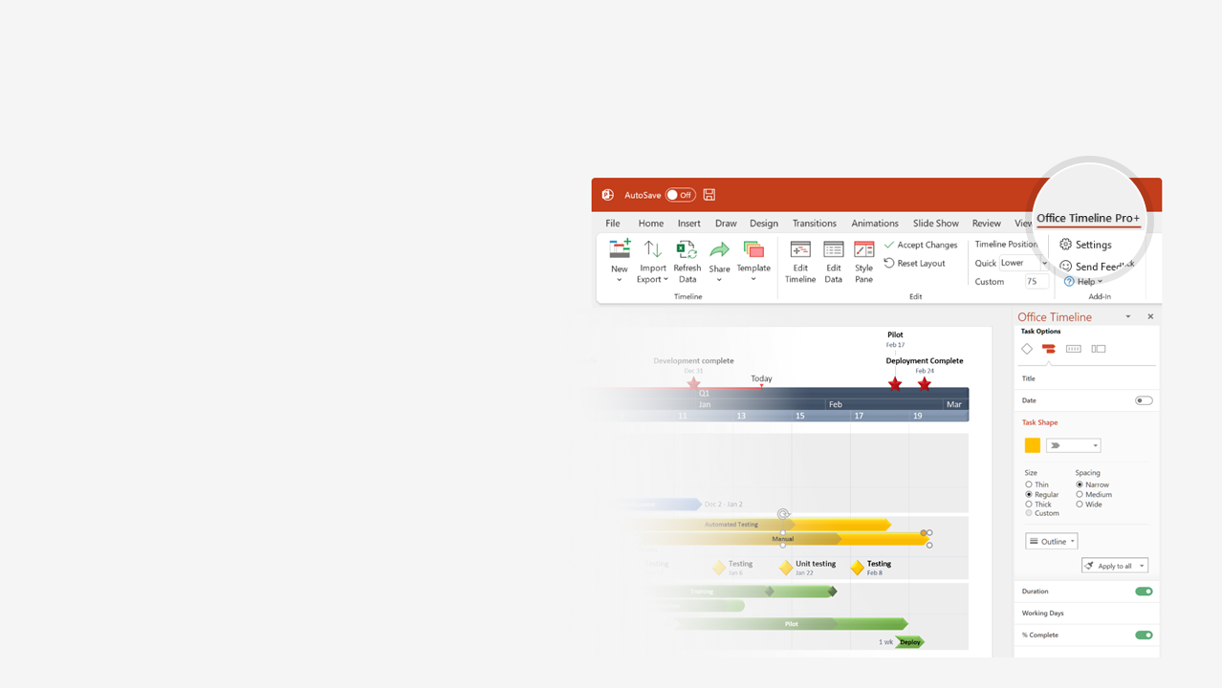

How to update this template in seconds
The Office Timeline add-in for PowerPoint will help you edit it with just a few clicks.
Get your free 14-day trial of Office Timeline here:
https://www.officetimeline.com/14-days-trial
Re-open this template, and create your impressive
PowerPoint visual in 3 easy steps:
1
Click the Edit Data button on the Office Timeline tab.
2
Use the Data and Timeline views to edit swimlanes, milestones and tasks.
3
Click Save to instantly update the template.

Slide 2

Incident response timeline
Average response from detection to remedy
Incident Report
8:09 am
Incident Verified
8:15 am
Response Identified & Dispatched
8:19 am
Response Arrives
8:29 am
Incident Occurs
Incident Cleared
Operations Resume
Health check
Health check
8:00 am
8:40 am
9:15 am
9:38 am
10:00 am
8 am
9 am
Detection
Verification
Response
Remedy
9 mins
10 mins
10 mins
11 mins
Incident Duration Total
Remedy Validation
40 mins
35 mins
Return to Normal Flow
45 mins

