Slide 1
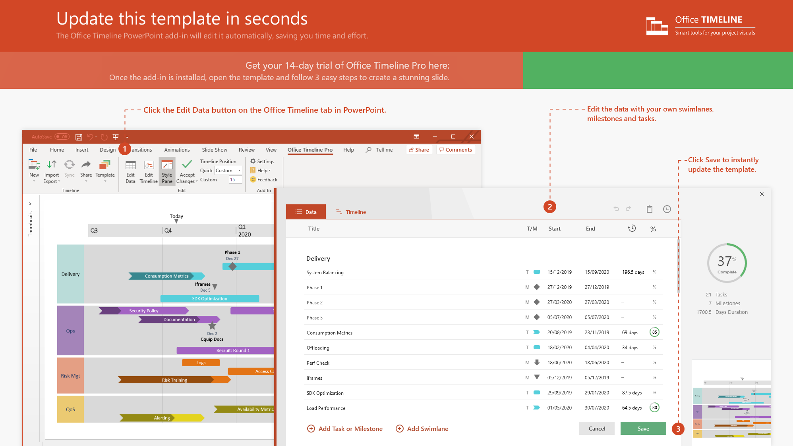
https://www.officetimeline.com/14-days-trial

Slide 2

Initiation
Planning
Execution
Monitoring and Control
Closure
Feb 2
Feb 24
May 21
Jul 29
Oct 25
Feb
Mar
Apr
May
Jun
Jul
Aug
Sep
Oct
Identify Competing Interests
Initiation
Feb 9
Outline Communication Framework
Feb 16
Feb 24
Scope Statement
Apr 7
Mar 10
Work Breakdown Structure
Apr 25
Planning
Mar 15
Gantt Chart
Apr 18
Apr 6
Risk Management Plan
May 19
Apr 14
Communication Plan
May 21
May 21
Eliminate Unnecessary Distractions
Jul 20
Jun 12
Get Underperformers Back on Track
Aug 14
Execution
Jun 16
Manage Morale / Prevent Burnout
Aug 18
Jul 4
Mediate Potential Conflicts
Aug 25
Jul 17
Find Extra Needed Resources
Sep 10
Aug 1
Monitor Critical Path Tasks
Sep 15
Monitoring and Control
Aug 13
Verifying And Controlling Scope
Oct 5
Aug 28
Updating Stakeholders
Oct 13
Aug 29
Planned Costs vs Actual Costs
Oct 20
Sep 5
Optimizing Performance
Oct 17
Release Resources
Oct 26
Closure
Post Mortem Meeting
Oct 28
Communicate Completion
Oct 27

