Slide 1
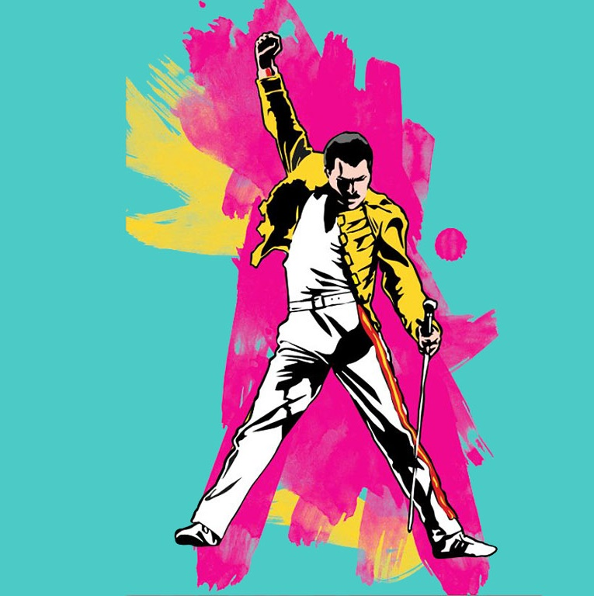
Enrolls at West Thames College
Records unreleased tracks with Michael Jackson
1966
1983
Co-founds Queen with Brian May & Roger Taylor
1st solo album "Mr. Bad Guy"
1970
1985
Meets & befriends Kenny Everett
Dies at the age of 45
1974
Nov 24, 1991
1946
1946
1950
1954
1958
1962
1966
1970
1974
1978
1982
1986
1990
1993
Today
1958
Sep 5, 1946
1971
1988
Farrokh Bulsara is born
He forms band The Hectics
Changes his surname to Mercury
2nd solo album "Barcelona"
1953
1969
1985
Begins taking piano lessons
Meets Mary Austin
Outstanding performance with Queen at Live Aid
1964
1981
Moves with family from Zanzibar to England
Queen Concert with attendance record in Sao Paolo

