Slide 1


How to update this template in seconds
The Office Timeline add-in for PowerPoint will help you edit it with just a few clicks.
Get your free 14-day trial of Office Timeline here:
https://www.officetimeline.com/14-days-trial
Re-open this template, and create your impressive
PowerPoint visual in 3 easy steps:
1
Click the Edit Data button on the Office Timeline tab.
2
Use the Data and Timeline views to edit swimlanes, milestones and tasks.
3
Click Save to instantly update the template.

Slide 2
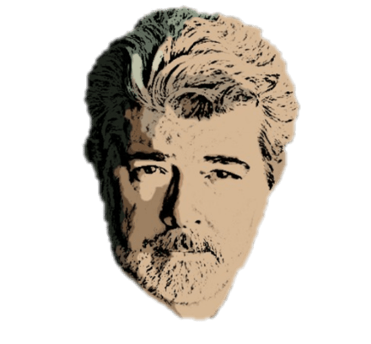

George Lucas timeline
George Lucas is born in Modesto, CA
Founds Lucasfilm
Sells Lucasfilm to Disney
1971
Founds THX Ltd.
2012
80th Birthday
May 14, 1944
Graduates from USC
1983
May 14, 2024
1967
1944
1953
1962
1971
1980
1989
1998
2007
2016
Suffers near-fatal crash
Adopts Amanda
Adopts Katie
Marries Mellody Hobson
Life
1962
1981
1988
2013
Marries Marcia Lou Griffin
Divorces Marcia
Adopts Jett
Daughter Everest is born
1969
1983
1993
2013
Best Foreign Producer (David di Donatello Awards)
CINE Golden Eagle
Festival Trophy – Cannes
1981
1990
2005
Irving G. Thalberg Memorial Award
Lifetime Achievement Award Sci-Fi Magazine
1992
1995
Excellence in Film award - BAFTA
Nikola Tesla Award
Awards
2002
2003
Life Achievement Award – AFI
OFTA Film Award
2005
2018
Filmmaker’s Award
Milestone Award - PGA
2005
2022
Jules Verne Lifetime Achievement Award
Honorary Palme d’Or - Cannes
2006
2024
GL Educational Foundation
Raises $500K for Koret Family House
Charity
1991
2005
Donates $1 million to Martin Luther King memorial
Signs the Giving Pledge
2005
2010

