Slide 1


How to update this template in seconds
The Office Timeline add-in for PowerPoint will help you edit it with just a few clicks.
Get your free 14-day trial of Office Timeline here:
https://www.officetimeline.com/14-days-trial
Re-open this template, and create your impressive
PowerPoint visual in 3 easy steps:
1
Click the Edit Data button on the Office Timeline tab.
2
Use the Data and Timeline views to edit swimlanes, milestones and tasks.
3
Click Save to instantly update the template.

Slide 2
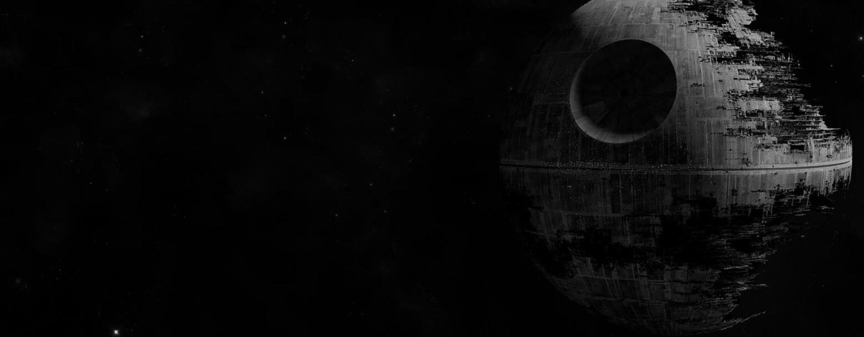

Howard the Duck
George Lucas films timeline
More American Graffiti
1986
Willow
THX 1138
1979
1988
1971
Twice Upon a Time
The Land Before Time
Radioland Murders
Strange Magic
1983
1988
1994
2015
1971
1977
1983
1989
1995
2001
2007
2013
2019
1973
1980
1988
American Graffiti
Kagemusha
Tucker: The Man and His Dream
2012
1986
Red Tails
Labyrinth
1985
Mishima: A Life in Four Chapters
Star Wars
Star Wars:
Return of the Jedi
Star Wars: Episode II – Attack of the Clones
Star Wars:
The Clone Wars
1977
1983
2002
2008
Star Wars
Star Wars:
The Empire Strikes Back
Star Wars: Episode I – The Phantom Menace
Star Wars: Episode III – Revenge of the Sith
1980
1999
2005
Raiders of the Lost Ark
Indiana Jones and the Last Crusade
Indiana Jones and the Dial of Destiny
Indiana
Jones
1981
1989
2023
Indiana Jones and the Temple of Doom
Indiana Jones and the Kingdom of the Crystal Skull
1984
2008

