Slide 1
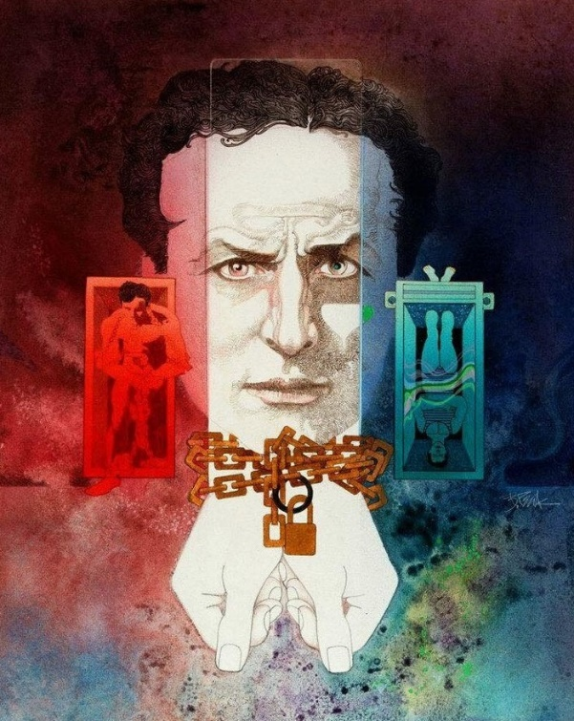


Escapes from master handcuffs (Mirror Challenge)
Changes his name to Harry Houdini
March 21, 1904
March 21, 1891
Introduces Chinese Water Torture Cell Stunt
Erik Weisz (Houdini) is born
Meets manager Martin Beck & gains recognition
March 24, 1874
March 21, 1912
Public debut as a trapeze artist
March 21, 1899
Begins movie career
February 24, 1883
Jumps off a bridge
March 21, 1918
Meets future wife & stage assistant, Beatrice 'Bess' Rahner
March 21, 1907
Dies from complications of appendicitis
Moves to US with his family
Presents Buried Alive Stunt
July 3, 1878
March 21, 1893
March 21, 1915
March 21, 1926
1874
1874
1880
1886
1892
1898
1904
1910
1916
1922
1927
Today
July 21, 1894
March 21, 1908
March 21, 1923
Marries Bess
Performs Milk Can Escape
Becomes president of America's oldest magic company
March 21, 1900
Tours in Europe
August 21, 1912
May 21, 1891
Performs Overboard Box Escape
Begins his magic career, initially focused on card tricks
March 21, 1906
Breaks out of prison
Life events
Notable performances

